Slide 1
Developing a Taxonomy for Pediatric Chaplaincy The Advocate Health Care Model
Rev Paul Nash
Chaplaincy and Spiritual Care Lead
Birmingham Women’s and Children’s hospital NHSFT, England
Director, Centre For Paediatric Spiritual Care
https://bwc.nhs.uk/centre-for-paediatric-spiritual-care
P.Nash@nhs.net

Slide 2
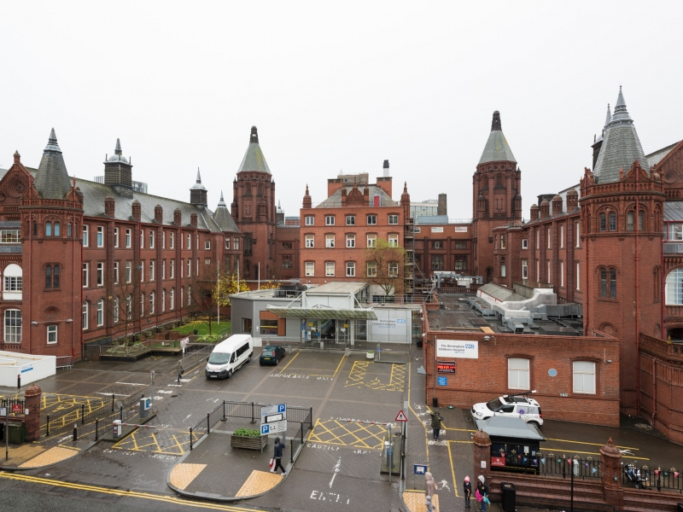
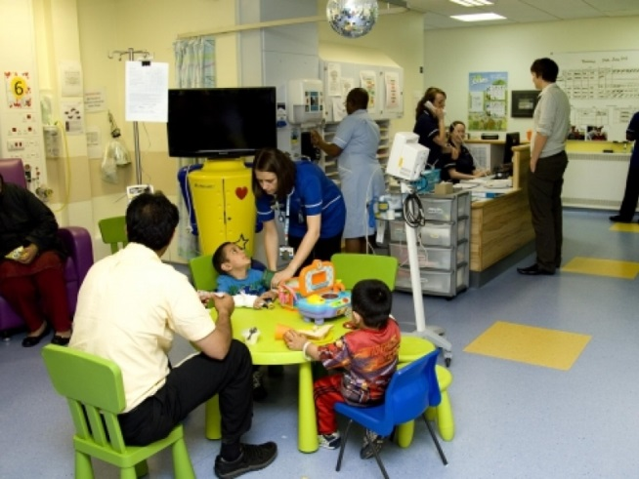
Birmingham Children’s Hospital, UK
370 beds
3,700 staff
Located in the centre of Great Britain’s second city
Birmingham population 2015 - 1.3 million
22% are 0-15 years olds(higher than national average)
Multi-faith, multi-cultural context
Multi faith team of 12 staff and 25 Honorary Chaplains and volunteers - representing 7 major world religions and beliefs

Slide 3
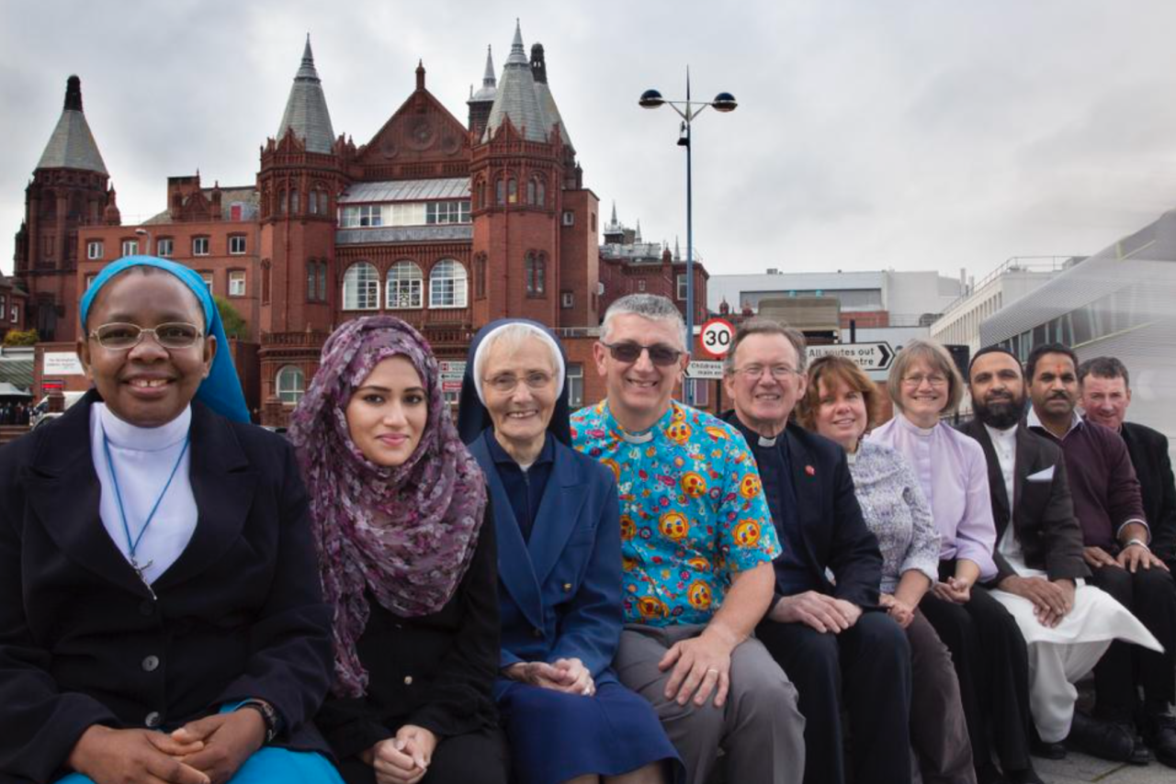
Methodology
Multi faith team
Use existing adult tool
Additions from our research
Basic definitions were given for consistancy
An assessment and recording form was developed to use alongside.
Quantitative data was analysed
Qualitative thematic analysis was
then undertaken on the recording sheets

Slide 4
Sample
N = 80 responses were collected by 12 multi faith team members.
46% female, 44% males, 10% not specified
Age Group | Patients visited | Hospital inpatients over same time period
0-5 | 32.3% | 57.9%
6-10 | 23% | 20%
11-15 | 24.6% | 19.3%
15+ | 1.54% | 2.9%
Not specified | 18.5 % | N/A

Slide 5
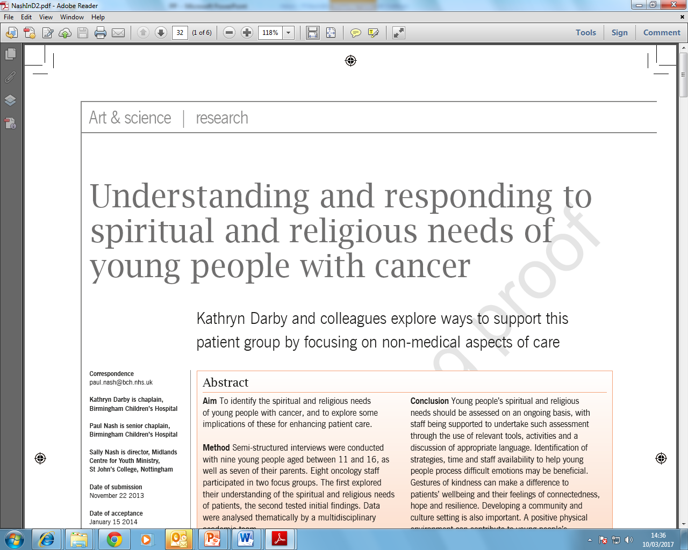
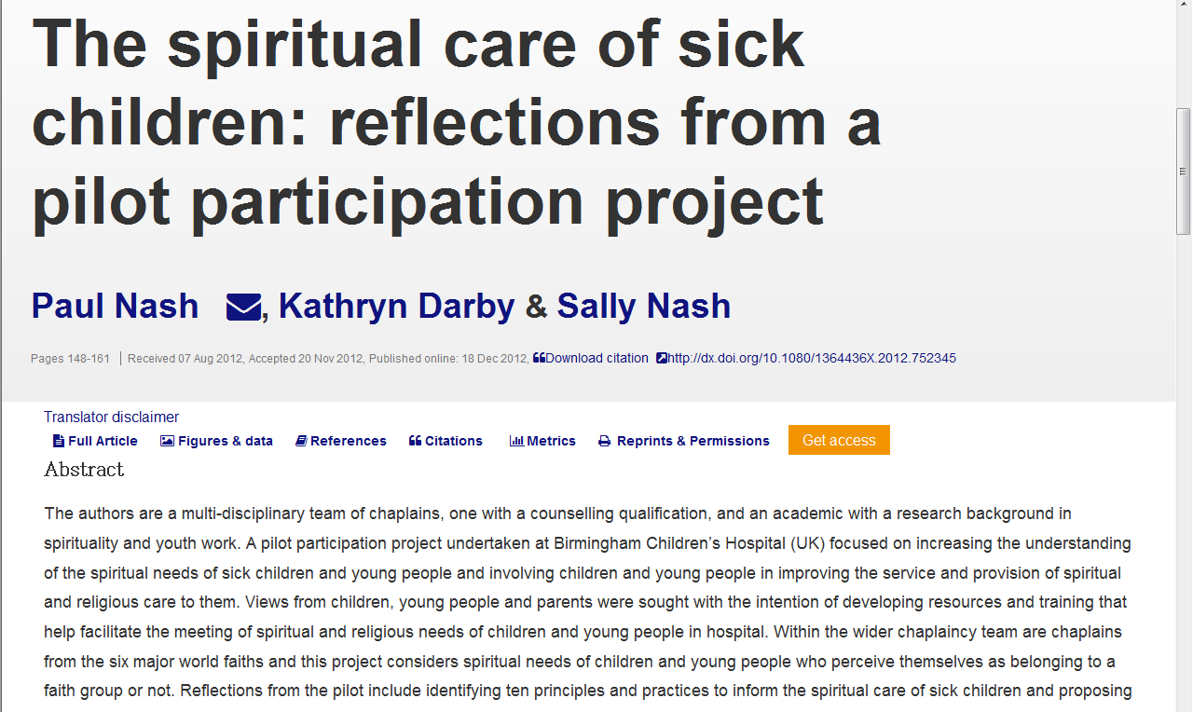
Adopted and amended: What we added and why?

Slide 6
Research used to develop paediatric taxonomy items
Articles:
Nash, P., McSherry, W. (2017). What Is the Distinctiveness of Paediatric Chaplaincy? Findings from a Systematic Review of the Literature. Health and Social Care Chaplaincy, 5(1), DOI: 10.1558/hscc.31816.
Nash, P., & Nash, S. (2015). Reflections on Using Metaphors in Exploring Spiritual and Religious Needs with Young People with Cancer and their Families. Journal for the Study of Spirituality, 5(2), 143-156.
Darby, K., Nash, P., & Nash, S. (2014). Understanding and responding to spiritual and religious needs of young people with cancer. Cancer Nursing Practice 13(2), 32. http://dx.doi.org/10.7748/cnp2014.03.13.2.32.e1059
Darby, K., Nash, P., & Nash, S. (2014). Parents' spiritual and religious needs in young oncology. Cancer Nursing Practice, 13(4), 16. http://dx.doi.org/10.7748/cnp2014.05.13.4.16.e1082
Nash, P., Darby, K., Nash, S. (2012) The spiritual care of sick children: reflections from a pilot participation project, International Journal of Children's Spirituality, 18(2), 148-161.
Books:
Nash, P., Darby, K., Nash, S. (2015). Spiritual care with sick children and young people. London: Jessica Kingsley.
Nash, P., Parkes, M., Hussain, Z. (2015). Multifaith care for sick and dying children and their families: a multidisciplinary guide. London: Jessica Kingsley.

Slide 7
Additions: pre questions
The Taxonomy starts after an assessment tool has been used.
So we asked our team to also record what:
Assessment tools:
How you identify the issues, needs and strengths of the patient
2. Spiritual needs
What religious /spiritual needs you identified
3. Care Plan
What future interventions might be helpful?

Slide 8
Main objectives
1. Ensuring the integrity of the original Advocate tool and research
2. Check it was fit for purpose to serve our pediatric context, without effecting objective 1.
What we added did not change the essesnce of the existing tool, as you can tick as many boxes as are applicable

Slide 9
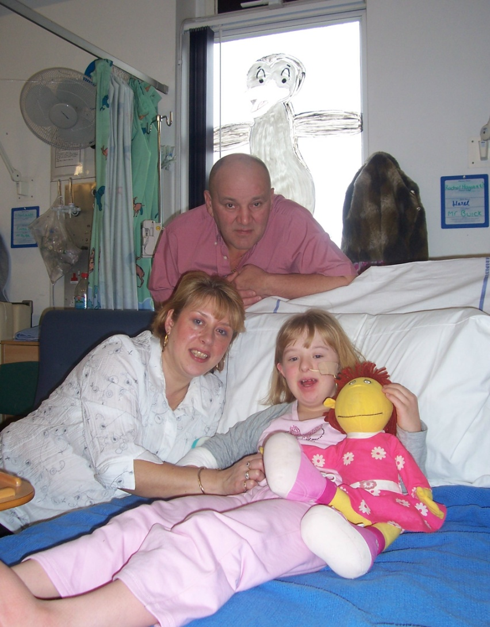
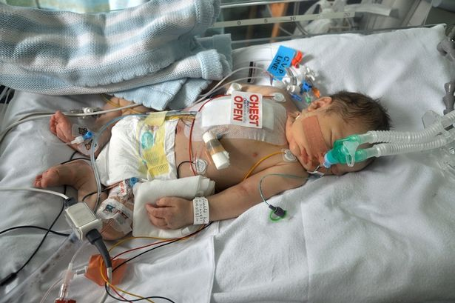
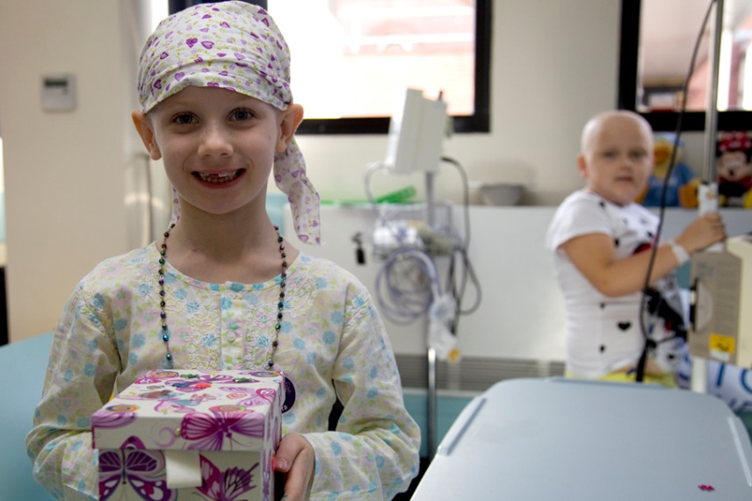
What do think we might have found?
Why?

Slide 10
Overall use of taxonomy
Taxonomy | Venue | List | Chosen
Intended effects | Advocate | 15 | 14
 | BCH | 17 | 18
Method | Advocate | 26 | 24
 | BCH | 5 | 4
Intervention | Advocate | 53 | 44
 | BCH | 10 | 7

Slide 11
Intended effects: Top 12 ( Peds additions in red)
Build relationships of care and support (69, 86%)
Demonstrate care and concern (53, 69%)
Establish rapport and connectedness (53, 66%)
Demonstrate kindness and compassion (50, 63%)
Convey a calming presence (48, 60%)
Feel part of a community (45, 56%)
Lesson someone's feeling of isolation (45, 56%)
Lessen anxiety (43, 53%)
Faith affirmation (41, 51%)
Enhance spiritual wellbeing (39, 49%)
Engender resilience (38, 48%)
Build self esteem (38, 48%)

Slide 12
2. Methods
The most popular response (71%) was offer emotional support.
Only two other options were selected by more than half of the respondents, these were offer support and encourage a sharing of feelings.
The least popular options (10% or under) were: Encourage gratitude, explore quality of life, collaborate with care team member, explore cultural values, educate care team about cultural/religious values, setting boundaries, encourage end of life review, explore values conflict and explore forgiveness.
No respondents selected accompany someone in their spiritual/religious practice outside your faith tradition, explore ethical dilemmas or celebrate religious festival.
Items added by the BCH Chaplaincy department did not receive many responses. The highest (16%) was explore identity and then explore worldview, this may relate to the differences in ages of patients and the stage of life they were at. The lowest was celebrate religious festival with no one selecting this option.

Slide 13
Intervention: Top 6 (Peds additions in red)
Active listening (54, 66%)
Acknowledge current situation 45, 56%)
Pray (34, 43%)
Asked guided questions (33, 41%)
Leave a gift (31, 39%)
Engage in participative spiritual care activity (27, 34%)

Slide 14
Advocate top 10 frequency rated items | BCH top 10 selected items from Advocate list
Active listening | Build relationship of care and support
Provide a pastoral presence | Offer emotional support
Demonstrate care and concern | Demonstrate care and concern
Preserve dignity and respect | Active listening
Remain open to patient’s beliefs | Establish rapport and connectedness
Collaborate with care team member | Convey a calming presence
Demonstrate acceptance | Lessen someone’s feeling of isolation
Establish rapport and connectedness | Acknowledge current situation
Offer emotional support | Lessen anxiety
Build a relationship of care and support | Offer support

Slide 15
Comparison: top responses from all 3 sections
Advocate top 10 frequency rated items from concept mapping | BCH top 10 frequency rated items from BCH list
Active listening | Build relationship of care and support
Provide a pastoral presence | Offer emotional support
Demonstrate caring and concern | Demonstrate care and concern
Preserve dignity and respect | Active listening
Remain open to patient’s beliefs | Establish rapport and connectedness
Collaborate with care team member | Demonstrate kindness and compassion
Demonstrate acceptance | Convey a calming presence
Establish rapport and connectedness | Lessen someone’s feeling of isolation
Provide emotional support | Feel part of a community
Build a relationship of care and support | Acknowledge current situation

Slide 16
Conclusion
Conversations, activities and observations were all helpful resources in identifying spiritual, religious and or pastoral needs in our context.
Building relationships and demonstrating care were the most common purpose (Intended effects)
We achieved this mostly through offering emotional support and encourage sharing of feelings (methods)
Our most frequent activities were active listening and acknowledging current situation (interventions)
There is clearly a strong correlation between the general taxonomy and the revised one for paediatrics (5 the same), but in a different order. Some of the differences were very clear but the differences are important to acknowledge in helping articulate the distinctiveness of each discipline.

Slide 17
Benefits of using the taxonomy
Gave us a common language / consistent understanding
Intentionality / focus
Preparedness / expectation
More consciously competent
More reflective

Slide 18
Way forward
Triangulate key findings of the taxonomy with distinctives of pediatrics SLR and spiritual and religious needs of children in hospital research to help us:
Develop a bespoke paediatric patient and family electronic encounter recording system. This will hopefully lead to a consistency of understanding a common terminology when internally discussing and externally explaining the work of pediatric chaplaincy. The right tool for the job leads to speed and accuracy not expediency.
Shape and influence our: Recruitment criteria - Induction and training – Review - Resources and rituals - Research needs
Differentiate between encounter with the patient or the family More items regarding working with families

Slide 19
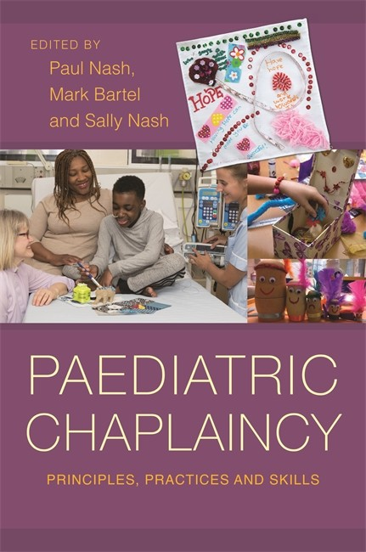
Way forward 2
Track against pre work: demographics, contact method, assessment tool used and spiritual needs identified.
Do alongside 2 PROM’s (Patient Recording Outcome Measures). Compare what patients and families think with what chaplains think happened and why and the effectiveness of the intervention.
Current research to be published this year in USA and UK chaplaincy journals.

Slide 21
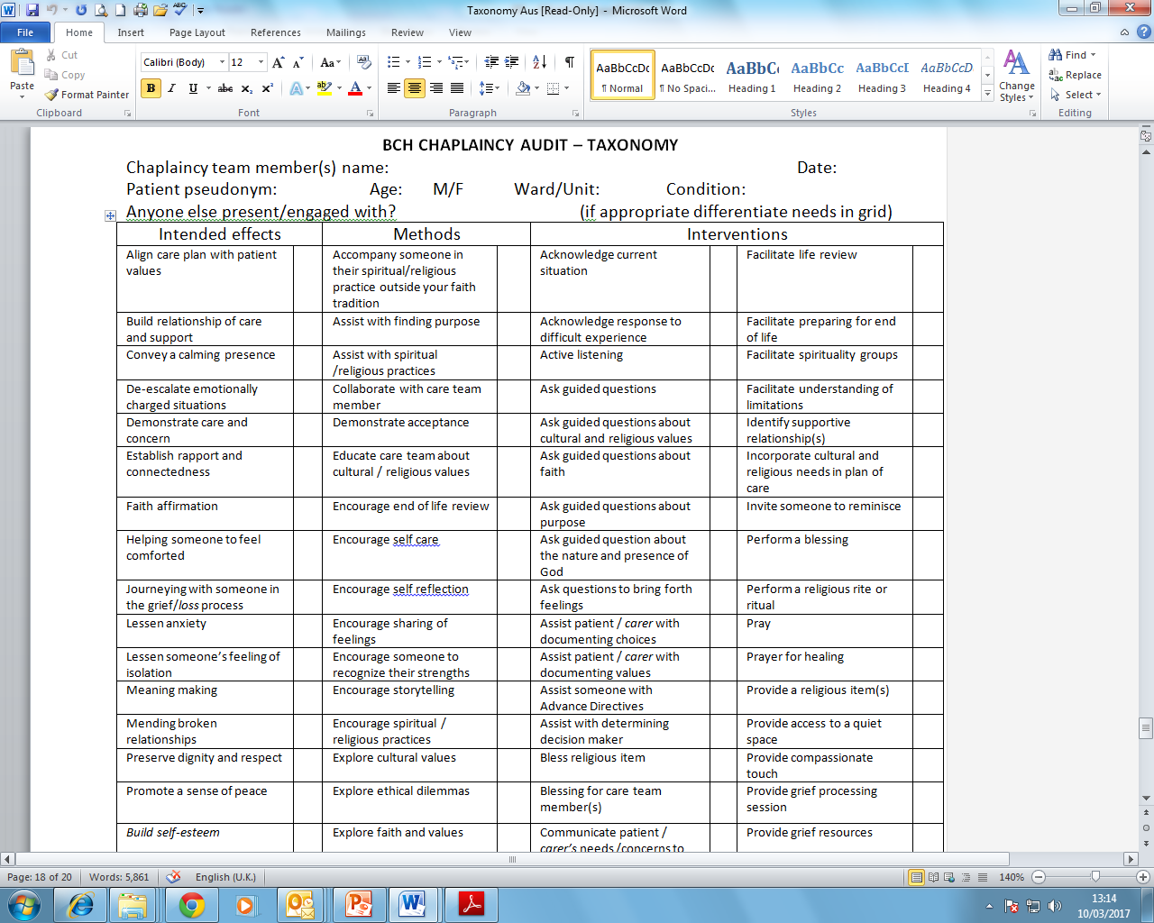

Slide 22
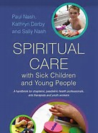
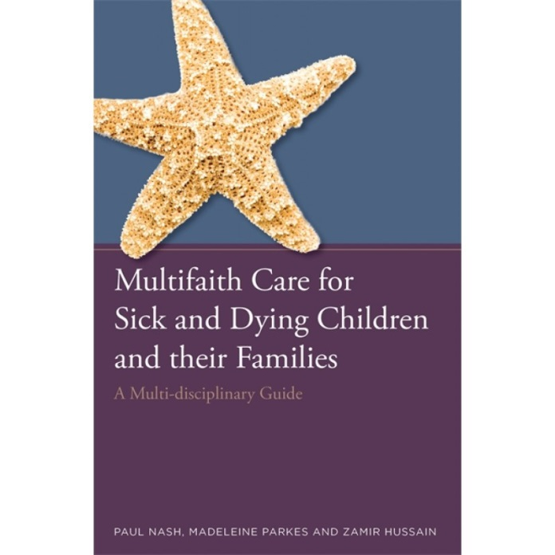
Future needs and thanks
Differentiate between ages, illness, gender, religion / beliefs
Pre work: assessment tools and post tools: care plans
Test efficacy, reliability and patient satisfaction of our spiritual
play activities
Big thank you to
Kevin Massey and Advocate Health Care Chaplaincy team
Patients and families
Jessica Kingsley Publishing:
International Handbook for Pediatric Chaplaincy

Slide 23
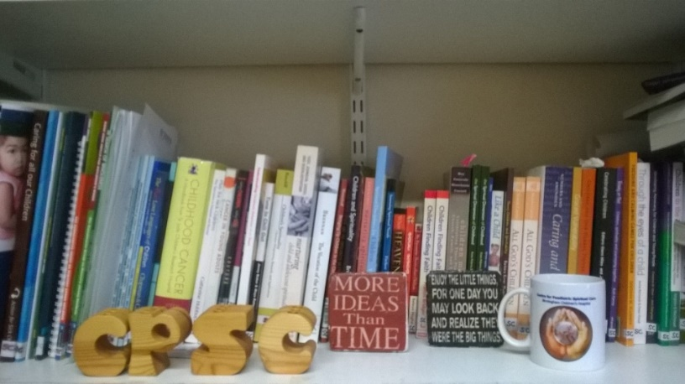
Centre for Paediatric Spiritual Care
MD research, training and resources
Study Centre with 700+ books, articles, dissertations and resources
Web base shared resources and research
Monthly newsletter
https://bwc.nhs.uk/centre-for-paediatric-spiritual-care
P.Nash@nhs.net

