Slide 1
From “What’s Wrong with You” to “What’s Happened to You?”
Reframing Spiritual Care through a Trauma Informed Lens
David Hottinger, M.Div
Manager, Spiritual Care Department
Hennepin Healthcare System
Minneapolis, MN
David.Hottinger@hcmed.org

Slide 2
Hennepin Healthcare System
Minnesota’s premier Level I Adult and Pediatric Trauma Center with many nationally recognized programs and specialties
An essential teaching hospital for doctors who go on to practice throughout the state
A safety net hospital providing care for low-income, the uninsured and vulnerable populations, and…
Beginning the LONG journey to become a Trauma-Informed health care system

Slide 3
2017 Stats
Operating beds..............................................484
Discharges (adults and pediatrics)...........22,050
Births..........................................................1,943
Clinic visits............................................628,037
Emergency Services visits.....................111,912 (includes Urgent Care)
Emergency Medical Services..................81,463 (ambulance runs)
Surgeries..................................................10,683
Poison Information Center contacts.........63,414
Hyperbaric chamber treatments................5,422
Average daily census.....................................333
MVNA-Home health visits........................23,610
Hospice-Average daily census........................53

Slide 4
HHS Journey to Trauma-Informed Care: a Confluence of Factors
Helen Kim, MD and Mother-Baby Program
2016 Community Health Needs Assessment
Creation of a Narrative Medicine Program
Emergence (2016) of a Hospital-Based Violence Intervention Program
Increasing levels of work-place violence alongside heightened staff fears about safety (shooting attack on entrance of Emergency Department in 2014)
Escalating patient, family, staff and community complaints about hospital protocols surrounding the admission of victims of violence
High profile, police-involved shootings and community response
Growing awareness among leadership and staff about institutional racism, implicit bias, racial disparities in health care
System overload: 700 deaths in 2017 (a 20% increase from 2016), massive layoffs, budget woes, sense of institutional crisis

Slide 5
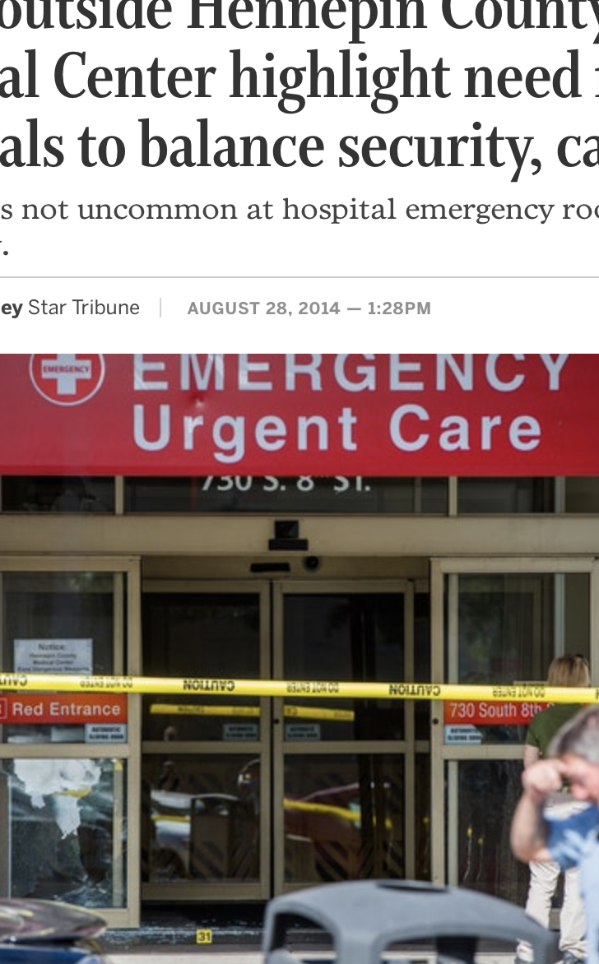
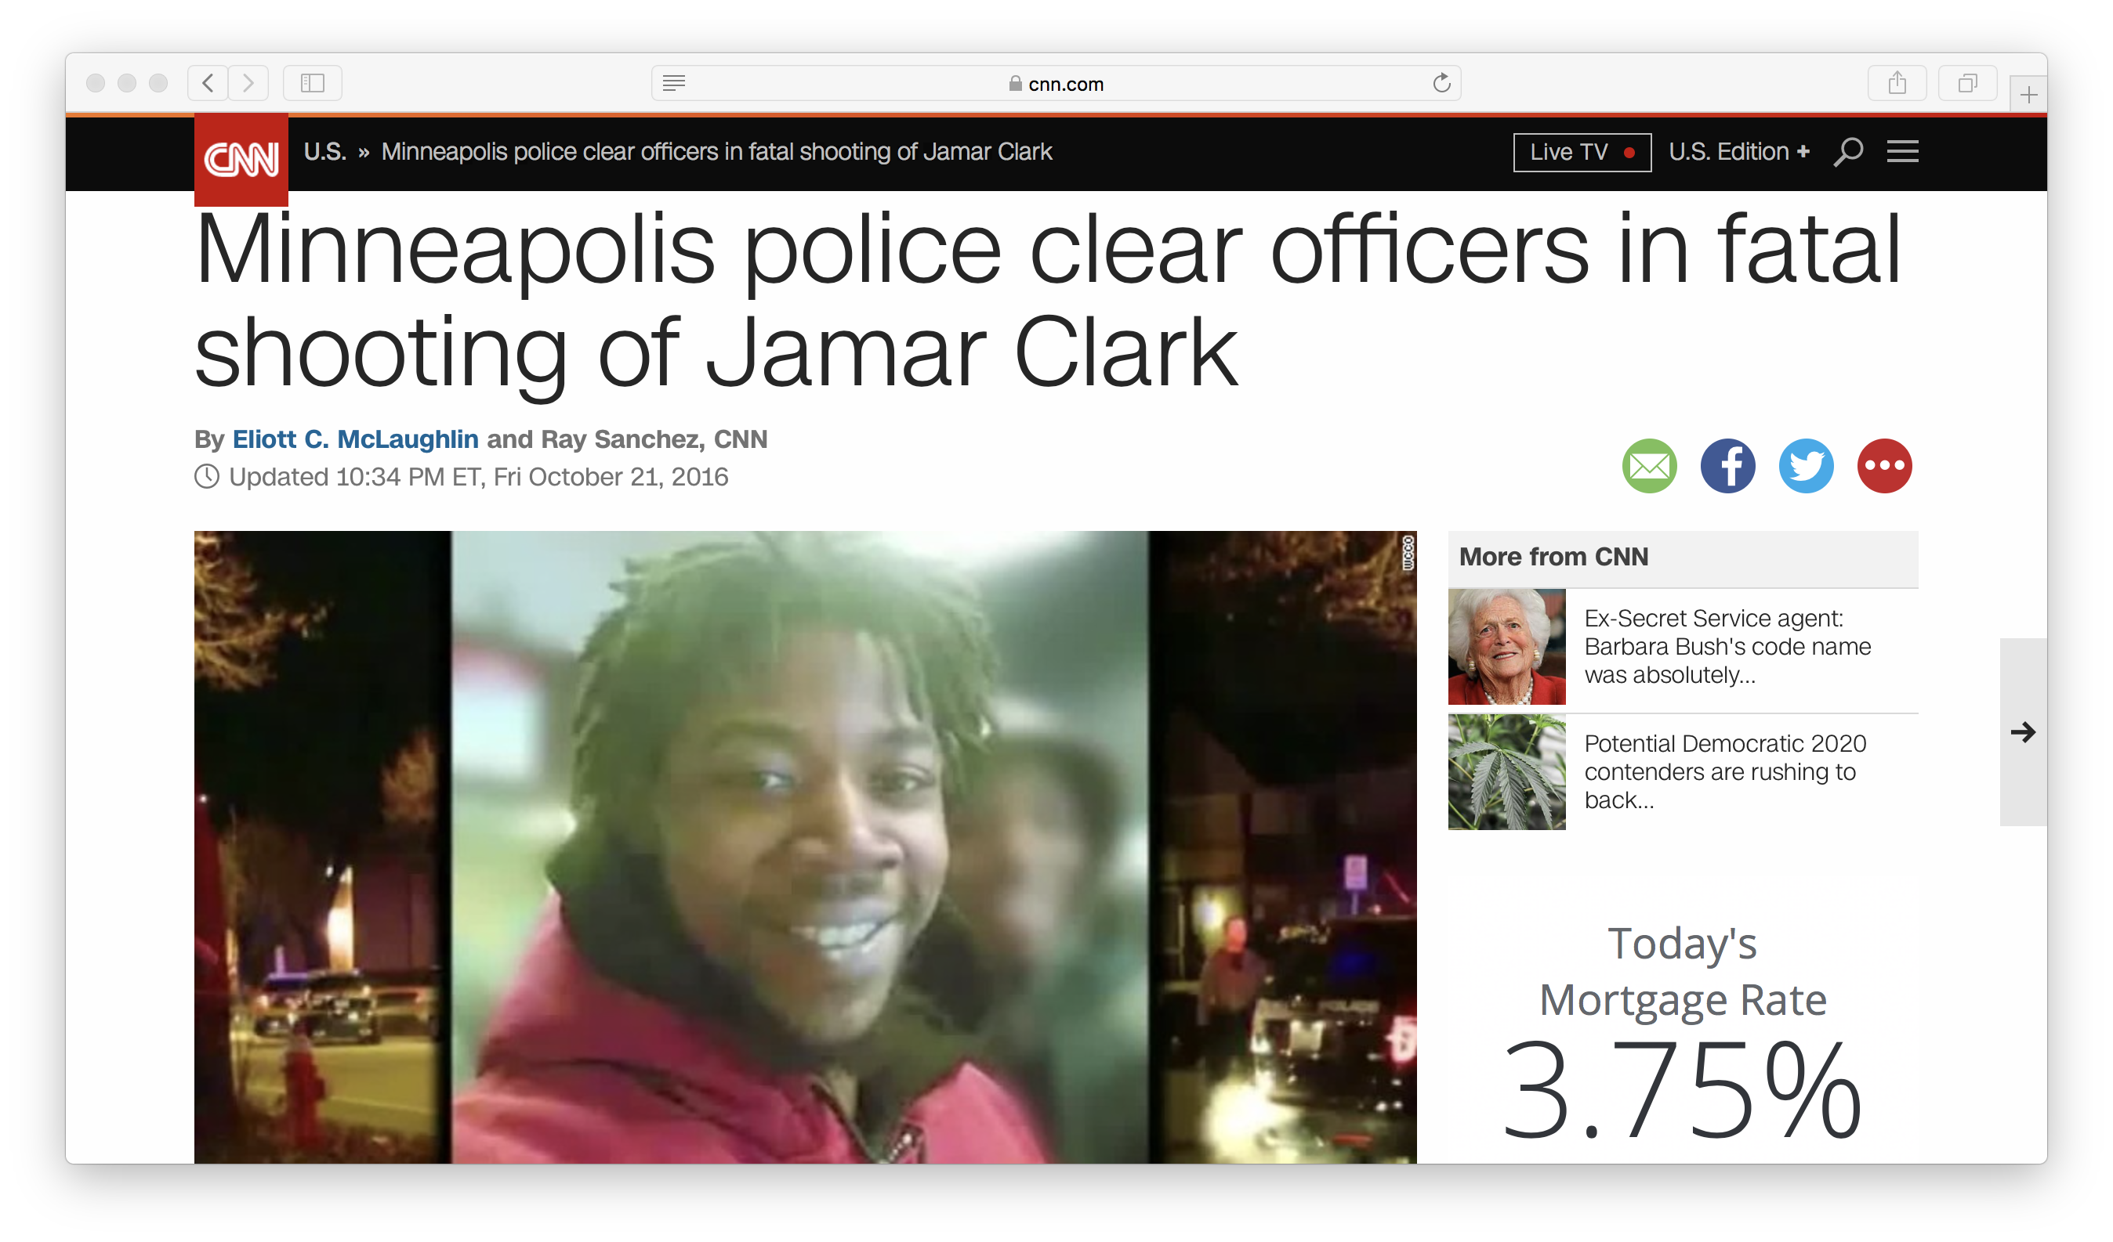
A toxic mix
The understandable mistrust of health care systems by people of color
High rates of burnout, toxic stress, and trauma exposure among health care workers
Minnesota’s abysmal state of racial disparities in health care, housing, education and criminal justice
A sense of “siege” and threat within health care institutions
More patients “acting out” – behavior escalations, violence, verbal abuse, etc.
The imposition of more rules and restrictions to “control the chaos”
Increasing number of patient complaints and decreasing levels of employee engagement/satisfaction
And the cycle continues…

Slide 6
My own journey of discovering Trauma Informed Care
Sense of powerlessness about caring for patients and families who have much deeper emotional, cultural and spiritual wounds than my training prepared me to address
The intersection of my own life trauma with my work with trauma victims
Frustration with individualistic psychological and spiritual care models which fail to address the systemic effects of chronic and historical trauma and racism
Recognition that whole care systems can become trauma-organized : system becomes fundamentally and unconsciously organized around impact of chronic and toxic stress [Sandra Bloom]
Tasked by hospital leadership to co-lead system-wide process-improvement initiative to change the way victims of violence and their loved ones are welcomed
Encountering the work of Sandra Bloom and the Sanctuary Institute - and discovering that key people at HHS were already passionate about TIC

Slide 9
Traumatic Stress
Occurs when a person experiences an event that is overwhelming, usually life-threatening, terrifying, or horrifying in the face of helplessness
(Sandra Bloom)

Slide 10
Toxic Stress
Is associated with prolonged and intense activation of the body’s stress response to such an extent that it can change the way a child’s brain develops, the very architecture of the brain, with problematic long-term consequences. (Sandra Bloom)
Affects how we learn, how we parent, how we react at home and at work, and what we create in our communities. It affects our children, our earning potential, and the very ideas we have about what we’re capable of. What starts out in the wiring of one brain cell to another ultimately affects all of the cells of our society, from our families to our schools to our workplaces to our jails. (Nadine Burke-Harris)

Slide 11
Allostatic Load
The wear-and-tear on the body and brain that can be a result of conditions such as poverty, bigotry, chronic hunger, and lower socio-economic status.
(Sandra Bloom)

Slide 12
SAMHSA Definition of Trauma
“Individual trauma results from an event, series of events, or set of circumstances that is experienced by an individual as physically or emotionally harmful or life threatening and that has lasting adverse effects on the individual’s functioning and mental, physical, social, emotional, or spiritual well-being.”

Slide 13
SAMSHA, 2018

Slide 14
Trauma: physical, emotional, psychological, or spiritual injury in response to a distressing or life-threatening event like an accident, abuse, violence or natural disaster
Acute trauma: a single event that is time-limited (injury accident, pregnancy loss, sudden death of a loved one, assault, divorce, job loss, etc)
Complex trauma: exposure to multiple traumas that are often invasive or interpersonal and have wide-ranging, long-term impact
Historical: occurs in history to a specific group of people causing emotional and mental wounding both during their lives and to the generations that follow
System-induced trauma: when systems designed to help trauma victims inflict trauma or re-retraumatize people (unjust policies, harmful practices, invasive procedures, racial/cultural bias, etc.)
InterGenerational: happens when the effects of trauma are not resolved in one generation. When trauma is ignored and there is no support for dealing with it, the trauma will be passed from one generation to the next.

Slide 15
Complex Trauma
Expectations of harm (from the world and others)
Difficulty forming relationships
Difficulty managing, understanding, and regulating feelings and behavior
Damaged sense of self/fragmented sense of self
Developmental challenges such as:
Problem-solving
Agency
Imagination
Academic and work performance
(Blaustein & Kinniburgh, 2010)

Slide 19
Childhood exposure to abuse, neglect and toxic stress impact adult health and well-being

Slide 20
Adverse Childhood Experiences (ACE) Study
1998 study done with CDC and Kaiser Permanente looking at 17,000 KP enrollees (predominantly white, college educated, employed)
ACE screen: 10 questions about childhood exposure to:
Abuse, maltreatment, neglect
Household dysfunction: living with parent with mental illness or substance abuse, domestic violence, parental incarceration, divorce/separation.
> 60 publications in medical literature since ACE study
The higher the ACE score, the higher the risk for the 7 out 10 leading causes of adult disease and disability
ACE study http://www.cdc.gov/violenceprevention/acestudy/
ACE screen: http://www.acestudy.org/ace_score
Health outcomes and ACEs: http://www.cdc.gov/violenceprevention/acestudy/outcomes.html

Slide 21
What’s my ACE score?
Prior to your eighteenth birthday:
Did a parent or other adult in the household often . . . Swear at you, insult you, put you down, or humiliate you? or Act in a way that made you afraid you might be physically hurt? Yes No If yes enter 1 _____
2. Did a parent or other adult in the household often . . . Push, grab, slap, or throw something at you? or Ever hit you so hard that you had marks or were injured? Yes No If yes enter 1 _____
3. Did an adult or person at least five years older than you ever . . . Touch or fondle you or have you touch their body in a sexual way? or Attempt or actually have oral, anal, or vaginal intercourse with you? Yes No If yes enter 1 _____
4. Did you often feel that . . . No one in your family loved you or thought you were important or special? or Your family didn’t look out for each other, feel close to each other, or support each other? Yes No If yes enter 1 _____
5. Did you often feel that . . . You didn’t have enough to eat, had to wear dirty clothes, and had no one to protect you? or Your parents were too drunk or high to take care of you or take you to the doctor if you needed it? Yes No If yes enter 1 _____
6. Were your parents ever separated or divorced? Yes No If yes enter 1 _____
7. Was your mother or stepmother . . . Often pushed, grabbed, slapped, or had something thrown at her? or Sometimes or often kicked, bitten, hit with a fist, or hit with something hard? or Ever repeatedly hit over at least a few minutes or threatened with a gun or knife? Yes No If yes enter 1 _____
8. Did you live with anyone who was a problem drinker or alcoholic or who used street drugs? Yes No If yes enter 1 _____
9. Was a household member depressed or mentally ill, or did a household member attempt suicide? Yes No If yes enter 1 _____
10. Did a household member go to prison? Yes No If yes enter 1 _____
Now add up your “Yes” answers. This is your ACE Score.
(Nadine Burke-Harris)

Slide 22
Adverse Childhood Experiences (ACE) Study: Major Findings
ACEs are common, and include well-educated, privately insured:
2/3 had at least 1 ACE
1/8 had 4 or more ACEs
ACEs have strong, graded association to major mental and physical health problems in adulthood
Higher ACE score associated with:
Smoking, Teen preg, Alcohol/drug abuse, Mental illness, Suicide, STDs and HIV
Heart disease, Chronic lung disease, Liver Disease, Obesity, Cancer
Compared to people with zero ACEs, people with 6+ ACEs
die 20 years earlier and have 3x rate of heart disease.

Slide 23
Behavioral health
Chronic disease
Notes:
23

Slide 25
Urban ACES Roy Wade, MD, PHD Children’s Hospital of Philadelphia
Witnessing violence (seeing or hearing someone being stabbed, beaten, or shot)
Living in an unsafe community
Experiencing racism
Living in foster care
Experiencing bullying

Slide 26
Historical Trauma
Cumulative and collective. Manifests itself emotionally and psychologically. As a collective phenomenon, those who never even experienced the traumatic stressor, such as children and descendants, can still exhibit signs and symptoms of trauma. May manifest itself as:
Historical Unresolved Grief: Grief as the result of historical trauma that has not been adequately expressed, acknowledged, or otherwise resolved. Examples include Holocaust survivors; lack of acknowledgement of the Armenian genocide and the mass murder of other ethnic groups in World War II.
Disenfranchised Grief: Grief as the result of historical trauma when loss cannot be voiced publicly or that loss is not openly acknowledged by the public. For example, the lack of recognition of the generations of loss of American Indians from colonialism, disease and other factors, and the corresponding lack of recognition of their right to grieve these collective experiences.
Internalized Oppression: As the result of historical trauma, traumatized people may begin to internalize the views of the oppressor and perpetuate a cycle of self-hatred that manifests itself in negative behaviors. Emotions such as anger, hatred, and aggression are self-inflicted, as well as inflicted on members of one’s own group. For example, self- hatred among Blacks/African Americans who act out their aggression on people who look like them.
(SAMSHA GAINS Center for Behavioral Health and Justice Transformation)

Slide 28
Toxic stress response
Can occur when a child experiences strong, frequent, and/ or prolonged adversity—such as physical or emotional abuse, neglect, caregiver substance abuse or mental illness, exposure to violence, and/ or the accumulated burdens of family economic hardship—without adequate adult support. This kind of prolonged activation of the stress-response systems can disrupt the development of brain architecture and other organ systems, and increase the risk for stress-related disease and cognitive impairment, well into the adult years.
- Nadine Burke-Harris, MD

Slide 29
Toward a Trauma-Informed Philadelphia, Sandra Bloom 2016

Slide 30
Trauma-organized individual (Sandra Bloom)
Inability to grieve and anticipate future
Problems with authority
Lack of basic safety/trust
Loss of emotional management
Problems with cognition
Communication problems
Confused sense of fair play

Slide 31
Trauma-organized organizations (Bloom)
Inability to grieve or anticipate future
Problems with authority
Lack of basic safety/trust
Loss of emotional management
Problems with cognition
Communication problems
Injustice, failure to act

Slide 32
Organizational Stress (Bloom)
Hyperarousal
Lack of safety
Loss of emotional management
Communication failure
Organizational alexithymia (inability to feel)
Organizational amnesia
Organizational learning disabilities
Increased bullying
Silencing of dissent
Organizational reenactment
Organizational grief and decline

Slide 33
Parallel processes between trauma-organized people and systems (Bloom)
Clients | Staff | Organization
Feel unsafe | Feel unsafe | Is unsafe
Aggressive | Punitive | Punitive
Helpless | Helpless | Stuck
Hopeless | Hopeless | Missionless
Hyperaroused | Hyperarsoused | Crisis Driven
Fragmented | Fragmented | Fragmented
Overwhelmed | Overwhelmed | Overwhelmed
Confused | Confused | Valueless
Depressed | Demoralized | Directionless

Slide 34
Toward a Trauma-Informed Philadelphia, Sandra Bloom 2016

Slide 35
Toward a Trauma-Informed Philadelphia, Sandra Bloom 2016

Slide 37
A program, organization, or system that is Trauma-Informed (SAMSHA)
Realizes the widespread impact of trauma and understands potential paths for recovery
Recognizes the signs and symptoms of trauma in clients, families, staff, and others involved with the system
Responds by fully integrating knowledge about trauma into policies, procedures, and practices
www.samsha.gov

Slide 38
Trauma-Informed v. Trauma-Specific (SAMSHA)
A trauma-informed approach can be implemented in any type of service setting or organization and is distinct from trauma-specific interventions or treatments that are designed specifically to address the consequences of trauma and to facilitate healing.
Trauma-specific intervention programs generally recognize the following:
The interrelation between trauma and symptoms of trauma such as substance abuse, eating disorders, depression and anxiety.
The survivor's need to be respected, informed, connected, and hopeful regarding their own recovery
The need to work in a collaborative way with survivors, family and friends of the survivor, and other human services agencies in a manner that will empower survivors and consumers

Slide 39
Principles of Trauma-Informed Care (SAMSHA)
Safety
Trustworthiness/Transparency
Collaboration and Mutuality
Empowerment
Voice and choice

Slide 40
“Repairers of the breach” Rev Barber (www.breachrepairers.org)
Reimagining healing with (not for) communities:
Acknowledging the breach between “systems” and communities by naming historical trauma, systemic racism and implicit bias ---- pre-requisite to creating safety
Shifting frames of care from hospitals/clinics to communities
Moving from expert-driven to community-driven/lived experience –driven
Shifting to trauma-informed care

Slide 41
Naming the Why of Trauma-Informed Care (Helen, Kim, MD, HHS Mother Baby Program)
Trauma is pervasive in all socioeconomic, racial/ethnic communities and impacts health and resilience
Childhood trauma can lead to adult chronic illness
Prevention of trauma in children is essential to long term health
Addressing trauma and promoting resilience in adult trauma survivors is essential to addressing their physical and mental health
Creating safety and respect for all staff and patients are paramount to being a healing environment because of how many come to HCMC with too many experiences where safety and respect were not honored.
Organizations and staff can unintentionally be harmful to patients and other staff by being unaware of possible trauma triggers.
Trauma-informed care would not be one more initiative --- it would be a connecting framework and help us tell the story of HHS as a trauma-informed healthcare system versus just a trauma hospital

Slide 42
Parallel Process
Organizations, like people, are vulnerable to stress
As staff, we come to work with our own lived experiences and work with population with high rates of trauma
Trauma-Informed Care has been called “monumental change”
Creating and sustaining a parallel process of healing/safety for patients, family members, staff, the organization as a whole

Slide 43
The power of making connection
“It’s truly amazing what happens when we stop blaming people and instead empathize with them and share with each other the scientific information we have now about how disrupted attachment, exposure to adversity and toxic stress, and trauma and allostatic load affect people, all people. It becomes far easier for us to open up to the possibility that although what has happened wasn’t our fault, it is now our responsibility to prevent further injury and to create the opportunity for our existing injuries to heal.”
(Sandra Bloom)

Slide 44
5 key HHS leadership messages on Trauma Informed Care
1.) We state in our Values that we want to "transform" the health of our community. Person centered, Trauma informed care (TIC) helps us to do that by offering compassionate care for patients, families and staff. This will require awareness and skill building programs for all staff, and it must begin at the top. 2.) We cannot transform the health of our community without first transforming our own organization so staff perceived that they are treated with respect by leaders, and leaders are prepared to help staff engage in self-care to deal with toxic stress. Leaders within our organization need to commit to listening to, hearing and valuing the voices of those who do the work at the frontlines. TIC cannot be fully implemented without self-care. 3.) Historical trauma impacting many of our patients, families and staff is real and while it may be hidden to the naked eye, we must consider it as we create new policies and procedures that support TIC. 4.) We must learn the concepts of ACEs, Persistent Trauma (?), etc., as core concepts and how the systems we have developed can exacerbate these issues and render our attempts to "help others" null and void. 5.) Executive leaders should sponsor workshops for their departments and direct reports that will include exposure to the new play "Complications," and to the training on historical trauma with Sam Simmons, plus additional skill-building training in TIC concepts.

Slide 45
What’s happening in 2018?
Trauma-Informed Care Steering Committee: identify, educate, and deploy champions throughout the system
600 leaders and staff will receive 4 hours of training Historical Trauma in African-American/Native communities
Pilot projects:Trauma-Informed Response to Child Abuse Reporting, TIC Demonstration projects in one clinic and one inpatient unit
Expansion of Next Step Hospital-Based Violence Intervention Program using TIC-principles
Creation of the Center for Family Healing

Slide 46
HHS Commitments to Trauma Informed Care (HHS White Paper on TIC, 2017)
As responsible stewards of an outstanding healthcare resource, we at HHS are committed to healing these inequities, protecting children and families from further harm and to reframing the relationship between ourselves and our communities.
Trauma-informed care will help us to do that. TIC at HHS is about holding adults and children accountable for their behaviors without shaming and blaming them and providing a safe place and time for pondering the experiences that have led to their actions.
TIC involves shifting our focus to the kind of medical practice where the key question is, “What Happened to You?” rather than, “What’s Wrong with You?” The first question recognizes that our patients are people first, and that they have an important story that should inform everything we do with them.
Since our goal is also to engage all patients more effectively in their own care -- thereby improving outcomes and reducing avoidable costs -- our commitment must be to build a TIC health system that is highly informed about the importance of a patient’s story and is prepared to meet the patient’s needs in the most healing way possible.

Slide 47
Building a Trauma Informed Care system at HHS means
Understanding the widespread impact of individual and historical trauma on the physical and mental health of our patient population and staff.
Acknowledging our unique standing in the healthcare community that requires us to “respond with compassion and courage” when facing signs and symptoms of emotional, psychological and spiritual trauma in patients, families and staff.
Building our capacity for integrating trauma knowledge and awareness into policies, procedures and practices.
Activating our determination to resist re-traumatization and educate patients in the possibilities of recovery and building resilience.

Slide 48
HHS Principles of Trauma Informed Care
Safety First: Nothing is more basic to us than the idea that people who turn to HHS for care should experience our organization as a place of physical, emotional, psychological and spiritual safety.
Transparency & Trustworthiness: Patients and families should receive clear, accurate information from us about the efficacy and cost of treatment, who is providing care and how we will provide such care.
Co-Production & Collaboration: We strive to work with patients as co-equals to create desired outcomes based on their knowledge of themselves and our application of evidence-based medicine; plus, we work cross-functionally in the planning and execution of patient care, assuring that patients and practitioners are on the same page at the same time.
Leveraging Patient Power: Understanding that each person brings unique strengths and assets to their care and helping them deploy those strengths in the quest for health and healing; also, approaching every patient as a distinct individual who has the right to direct his or her own treatment.
Two-Generation Lens: Supporting patients as people with vital family roles – parents and caregivers – allows for an upstream approach to the health of children. In TIC, we actively partner with family caregivers to stop the intergenerational transmission of trauma and promote the health and healing of the whole family.
Speaking TIC language: The words we use when talking with people and staff can be either helpful or hurtful. For example, if we say, “I’m going to see the gallbladder in Room 315,” as some providers have done, we may reinforce a sense that the person is a “case” instead of a human being with distinct experiences, feelings and abilities.

Slide 49
By 2019, as HHS views the world through the eyes of our patients, we will see (HHS TIC White Paper, 2017):
A person- and family-centered healthcare system informed and largely controlled by people who trust us to act as good stewards of their health. They will know that TIC means we actively engage them and their communities in solving longstanding racial and socioeconomic disparities in health and wellbeing in Minnesota.
An executive team that champions TIC internally and externally. “Championing” implies that we lead by example, that we set the pace, and that we take the risk of being vulnerable.
Multi-generational approaches to healing based on TIC methodology described herein, which will be definitive of our organization. This approach will make HHS a highly cherished and sought after institution, and the leading national model for integrated, trauma-informed, and two-generation healing.
Personal training and development programs that provide antidotes to toxic stress in our staff and providers. Our employees need integrative health resources for coping with stress and becoming the “confident guides” we want them to be.
Extensive use of narrative medicine, the arts, and integrative health to promote meaningful reflection on both illness and wellness. This means expanding the educational repertoire of interns, residents, medical students and staff to include the humanities.
Staff at every level who evaluate, understand, and acknowledge their own implicit bias, place of privilege, and role in supporting or impeding true healing. This will be difficult work that a TIC framework can help our entire HHS system to navigate.

Slide 50
Mission in 2013
To save and improve lives by strengthening the emotional health and parenting capacity of mothers and families
Mission in 2017
To embrace and strengthen young children, parents, and families through a safe, holistic, trauma-healing community grounded in social justice and lived experience
Clinical Excellence * Teamwork * Innovation

Slide 51
The unique contributions of Spiritual Care to Trauma-Informed Care
Cultivate Safety
Embody Presence
Nurture Story
Witness
Unearth meaning and identify sources of strength

Slide 52
Cultivate Safety
“Safety is the treatment” – Stephen Porges, originator of the Polyvagel theory
Physical Safety
Emotional Safety
Social Safety
Moral Safety
Spiritual Safety

Slide 53
Embody Presence
. . We all need groups of support that are dedicated to just being present to one another . . . whether it’s two people getting together, whether it’s ten people getting together . . . there is a sense in our bodies that we’re really just here for one another and that we can hold whatever it is that arises in that moment. . . . We are meant to be interdependent through our entire lives.”
Bonnie Badenoch

Slide 54
Nurture Story
When violence leads to physical and mental injury, it also engenders a healing response. One aspect of this is the trauma story, whose function is not only to heal the survivor, but also to teach and guide the listener—and by extension, society—in healing and survival.
– Richard F. Mollica M.D., Healing Invisible Wounds

Slide 55
Witness
“ Though compassionate witnessing does not remove the pain of trauma, it reconfigures it by restoring human connection, building strength and hope even in the midst of tragedy.” (Deborah Hunsinger)
4 Quadrants of the Witness (Kaethe Weingarten)
Empowered Disempowered
Aware Unaware
Aware and Empowered is ideal
Empowered and Unaware has most potential for harm/abuse
Unaware and Disempowered: see/hear no evil
Aware and Disempowered: often triggers a stressful empathic response in caregivers (chaplains?)

Slide 56
Unearth meaning and identify sources of strength
Post-traumatic growth
“to hope is to adopt an existential stance. The grounds for hoping do not lie in the facts of reality but rather in the meaning we ascribe to reality. Hence hoping is an active process of making meaning... While hope is founded in our capacity to make sense of suffering, we need more than the power of our reasoning to sustain it… we need more than the head; we need the heart.” – Jon Allen, MD
Viktor Frankl: Man is not destroyed by suffering; he is destroyed by suffering without meaning.”

Slide 57
Putting Trauma-Informed Care into Action: an example from Hennepin Healthcare
From: Security Huddle
To: Patient Transition Conference

Slide 58
Resources
The Sanctuary Model, Dr. Sandra Bloom www.sanctuaryweb.com
National Child Traumatic Stress Network http://www.nctsn.org/resources/topics/creating-trauma-informed-systems
SAMHSA https://www.samhsa.gov/topics/trauma-violence/samhsas-trauma-informed-approach
Adverse Childhood Experiences (ACE) study https://www.cdc.gov/violenceprevention/acestudy/
Bonnie Badenoch, The Heart of Trauma: Healing the Embodied Brain in the Context of Relationships, 2018
Nadine Burke Harris, The Deepest Well: Healing the Long-Term Effects of Childhood Adversity, 2017
Judith Herman, Trauma and Recovery: The Aftermath of Violence – from Political Terrorr to Domestic Abuse, 1992
Stephen Joseph: What Doesn’t Kill Us: The New Psychology of Traumatic Growth, 2013
Bessel van der kolk : The Body Keeps the Score: Brain, Mind and Body in the Healing of Trauma, 2015

