Slide 1
Spiritual Care in the Face of Medical Assistance in Dying – Are the Two Mutually Exclusive?
Présenté par / Presented by:
Roshene Lawson, Clinical Chaplain,
St. Vincent Hospital,
Ottawa, Ontario CANADA

Slide 2
Workshop Objectives
MAiD in Canada – Overview
Challenges facing chaplains since MAiD
Importance of the role of Spiritual Care in the MAiD landscape
How to advocate for spiritual care in MAiD process

Slide 3
MAiD in Canada

Slide 5
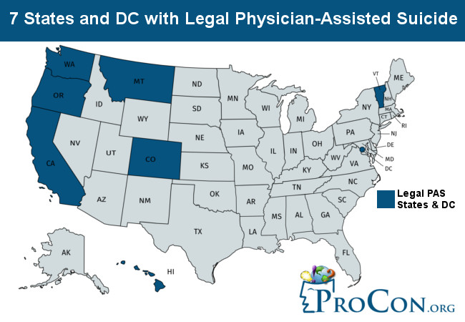

Slide 6
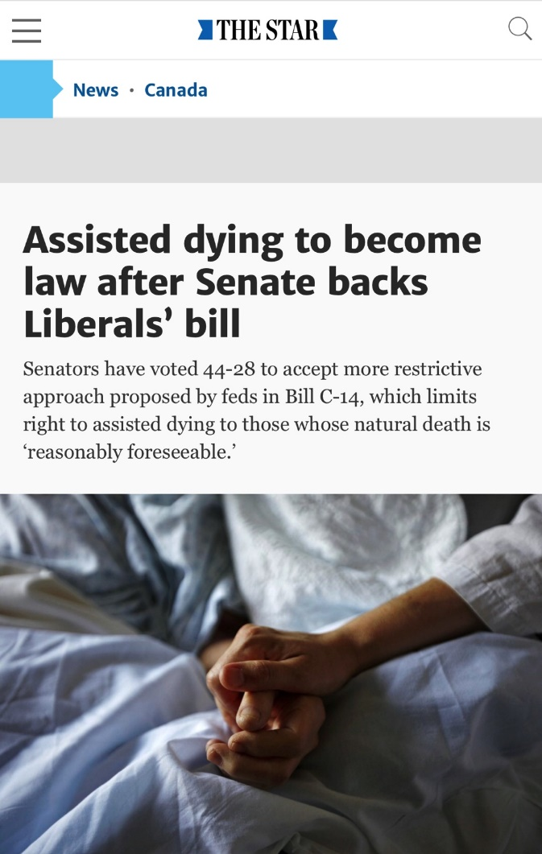
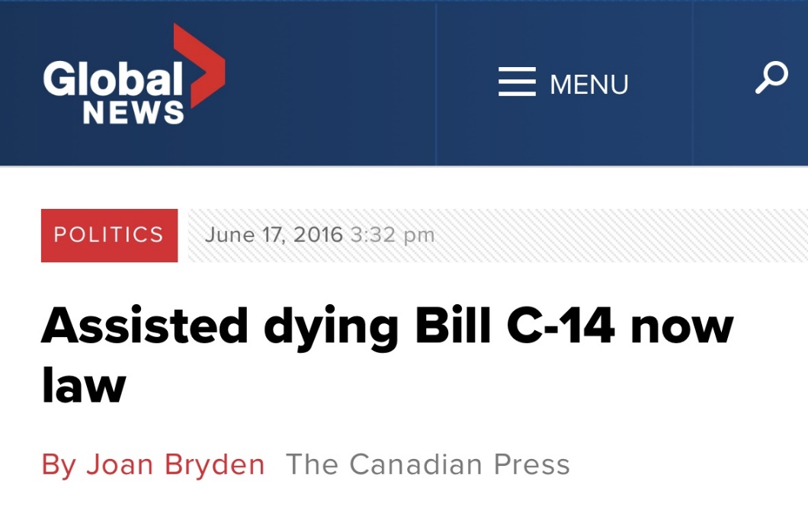
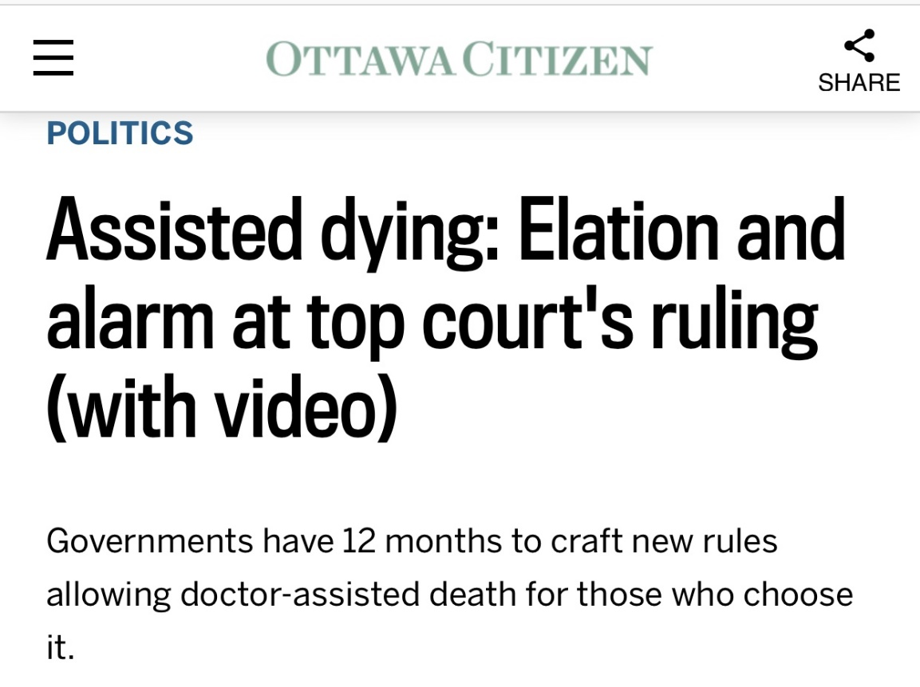
MAiD in Canada
February 6, 2015: Criminal Code prohibition on Physician Assisted Death struck down by Supreme Court. (Carter decision)

Slide 7
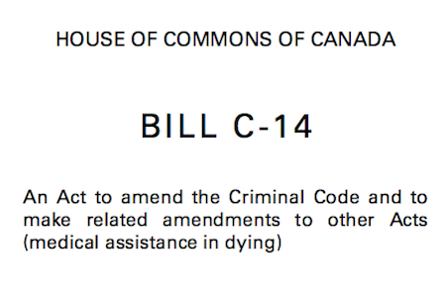
MAiD in Canada

Slide 8
MAiD in Canada
Hospitals and health care providers have the right to conscientious objection. However, physicians must provide a referral (CPSO).

Slide 9
What MAiD Is
“The administering of a substance to a person, at their request, that causes their death.”
Can be clinician administered (MD or NP)
- combo of IV drugs that reliably cause a comfortable death (seconds to minutes)
Or prescribed (by MD or NP) for self administration
- combo of po drugs that are self-administered and reliably cause a comfortable death (minutes to hours)

Slide 10
What MAiD Isn’t
Withdrawal of treatment.
Example: Discontinuation of dialysis, ventilator.
Decision not to use an available treatment.
Example: Not using antibiotics for pneumonia.
Palliative sedation.

Slide 11
Who is eligible for MAiD
Patient must be eligible for health services funded by a government in Canada.
Be a capable adult who is at least 18 years old.
Provide clear, informed consent to medical assistance in dying after having made a voluntary request. This means that patients must be informed of alternative options for care, such as palliative care. Patients may withdraw their request at any time.

Slide 12
Who is eligible for MAiD
Grievous and irremediable medical condition:
serious and incurable illness, disease or disability
advanced state of irreversible decline in capability
experiencing enduring physical or psychological suffering that is intolerable and cannot be relieved under conditions that they consider acceptable
natural death has become reasonably foreseeable

Slide 13
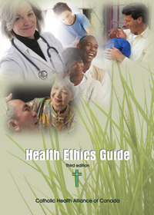
Why Bruyère Continuing Care Does Not Provide MAiD

Slide 14
Challenges facing chaplains post MAiD
Fear of losing religious endorsement
Balancing personal religious beliefs and values vs. being present for a patient requesting MAiD
Having a voice in the MAiD process
Ensuring they follow the beliefs and values of whatever hospital they work in (e.g. Catholic, Jewish or other denominational hospitals)

Slide 15
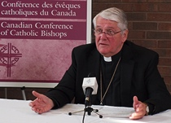
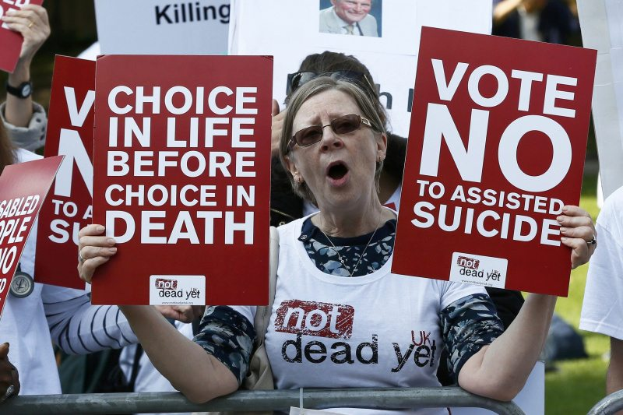
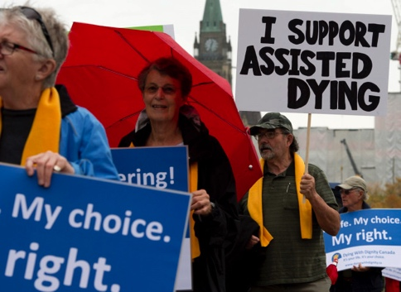
Importance of the Role of Spiritual Care in MAiD

Slide 16
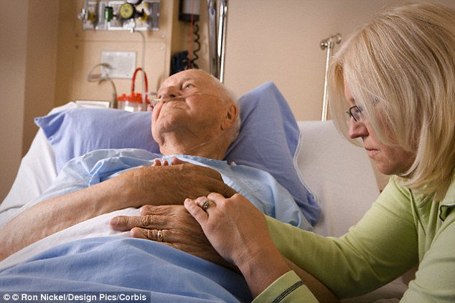
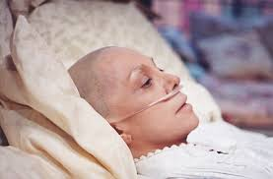
Importance of the Role of Spiritual Care in MAiD

Slide 17
What Do We Do As Chaplains?
We provide presence and a safe space to speak what is being lived.
We advocate for their story to be spoken.
Through a dialogical process we help patients seek understanding of their own story enabling them to make authentic decisions for themselves and find peace there.

Slide 18
Spiritual Crises in MAiD
Existential angst
Fear of suffering
Loss/Grief
Shame
Forgiveness
Closure

Slide 19
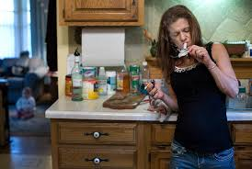
Case Study #1

Slide 20
Case Study #1
Spiritual Crises Presented:
Guilt
Shame
Seeking Forgiveness

Slide 21
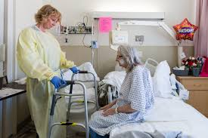
Case Study #2

Slide 22
Case Study #2
Spiritual Crises Presented:
Loss
Grief
Existential crisis – who am I if I can’t do?

Slide 23
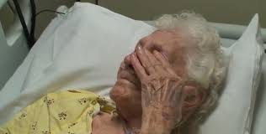
Case Study #3

Slide 24
Case Study #3
Spiritual Crises Presented:
Fear of suffering
Fear of death
Existential Angst – is this pain my life? Can I bear it?

Slide 25
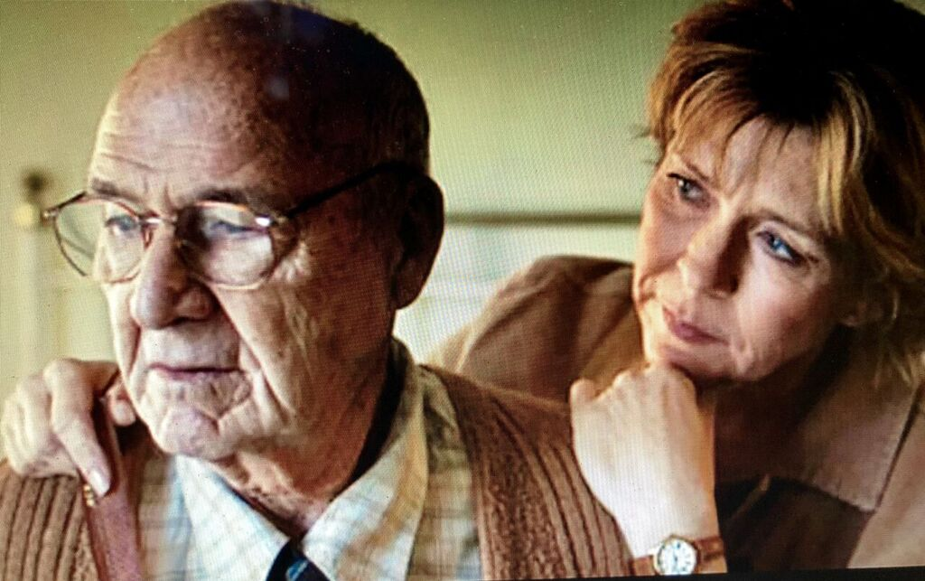
Case Study #4

Slide 26
Case Study #4
Spiritual Crises Presented:
Grief
Loss
Shame
Loneliness

Slide 27
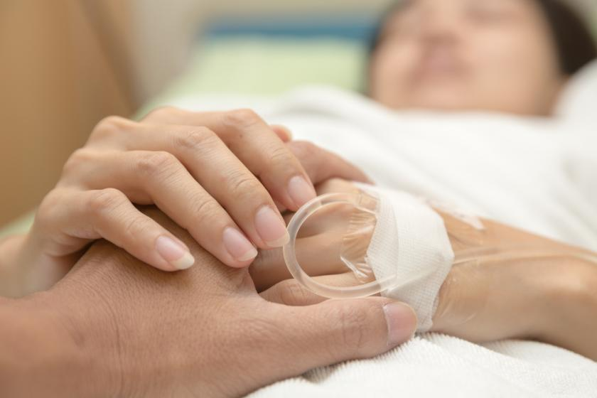
Advocating for Spiritual Care in the MAiD Landscape

Slide 28
Advocating for Spiritual Care in the MAiD Landscape
Educate
Communicate
Take the lead
Withhold judgement
Keep focused on “patient-centred/relationship-centred” care

Slide 30
Questions

