Slide 1
Science fiction as spiritual reflection
Jonna Rachele garvin

Slide 2
The main thing to understand is we are imprisoned in some kind of work of art.
-Terrence mckenna

Slide 3
objectives
Identify the benefit of spiritual reflection
Discuss present-day texts as basis for reflection
Expand spiritual identity for millennials

Slide 4
a narrative and reflective review of one’s lived experiences through cultural lenses and with layered meanings
Spiritual reflection

Slide 5
Spiritual reflection
“All sorrows can be borne if you put them in a story, or tell a story about them.”
Isak Dinesen
Science fiction can give us a frame for experiences beyond reason

Slide 6
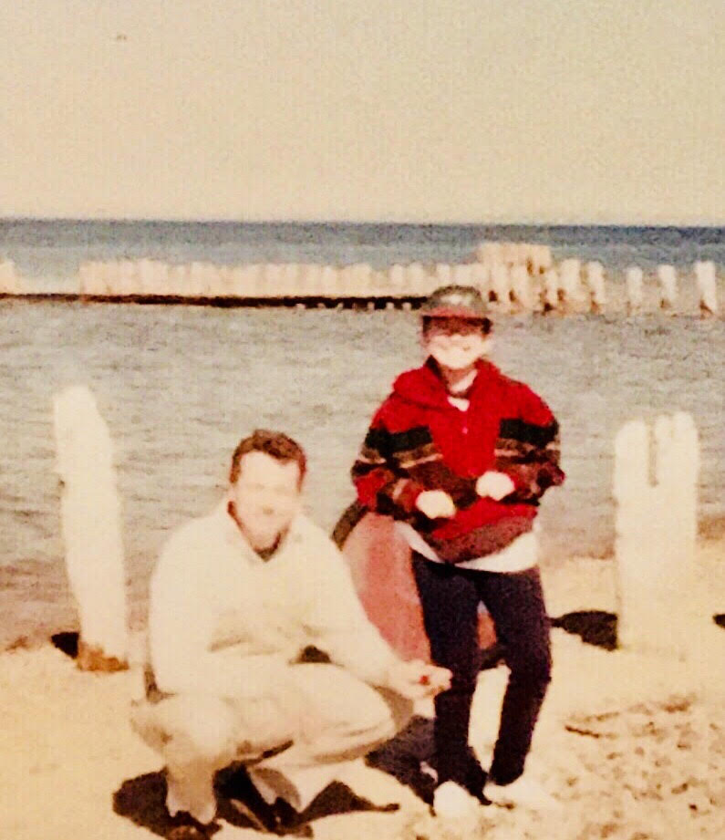
“Yet if (as per Clarke’s law) “any sufficiently advanced technology is indistinguishable from magic,” then might it not also be said that any sufficiently advanced civilization is indistinguishable from divinity?”
- James McGrath, Theology and Science Fiction (2016)

Slide 7
Science fiction
Science fiction is the literature of the human species encountering change, and the literature of ideas and philosophy; it is multi- and interdisciplinary; and at its heart is a community of thinkers and creatives. -Gunn Center for the Study of Science Fiction at the University of Kansas
Narratives which imagine our collective or individual futures as unique, exciting, and challenging by changing some facet of our current understanding of scientific reality in our known universe

Slide 8
My aim, then, is not to show science fiction as a window into the truth of religious practice, but a window into the truth of an individual’s story.
Image Credit: Roar of Our Stars, Retrieved from www.deviantart.net

Slide 9
Meaning-making
Fiction helps with paradox – and science fiction is uniquely placed to help us navigate the unfathomable depths of future, possibility, and hope
Image Credit Vader Crossing the Delaware, retrieved from www.pinterest.com

Slide 10
Changing religious landscape

Slide 11
data

Slide 13
The power of symbol
The extended reach of sacred story

Slide 14
Cultural formation
Image Retrieved from www.nme.com
Image Retrieved from www.warpspeedtononsense.blogspot.ca

Slide 15
Implications for practice
For care receivers
“What stories were most meaningful to you growing up?”
Cues from physical spaces, attire, and conversation
Opportunities to increase agency
For personal reflection
Shared Wisdom, Pamela Cooper-White (2004)
The Power of Myth, Joseph Campbell (1988)

Slide 16
References
Jodie Whittaker Image
Nichelle Nichols Image
Marina Sirtis Image
Vader Crossing Image
Pew Research Data
11th Doctor Image
American Family Data
The Robcast with Josh Radnor
Image retrieved from www.fanpop.com

Slide 17
Fiction is one of the few experiences where loneliness can be both confronted and relieved. Really good fiction… [will] find a way to illuminate the possibilities of being alive and human…
David foster wallace

