Slide 1
2018 Caring for the Human Spirit Conference Advanced Cancer Patients: Understanding their Spiritual Strengths and Distress through Lived experience Saneta Maiko, PhD., BCC., Ann Cottingham, MAR, MA., Alexia M. Torke, MD. MS.
Notes:
Good morning. It so good to have you here today. Ur presentation focuses on understanding the spiritual strengths and distress through lived experiences of adults with advanced cancer

Slide 2
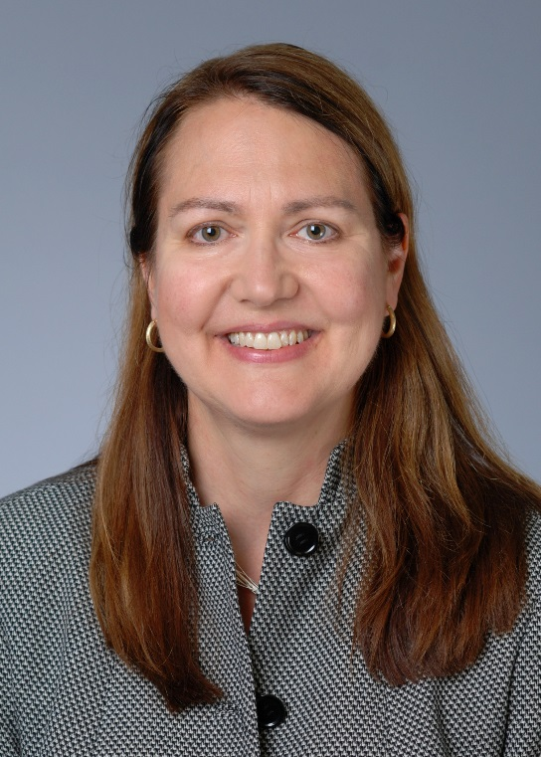
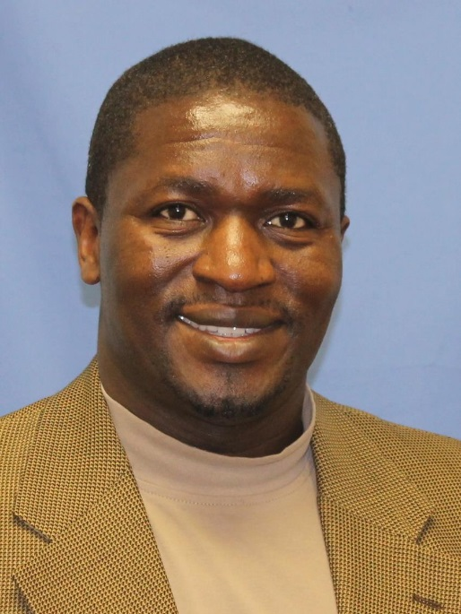
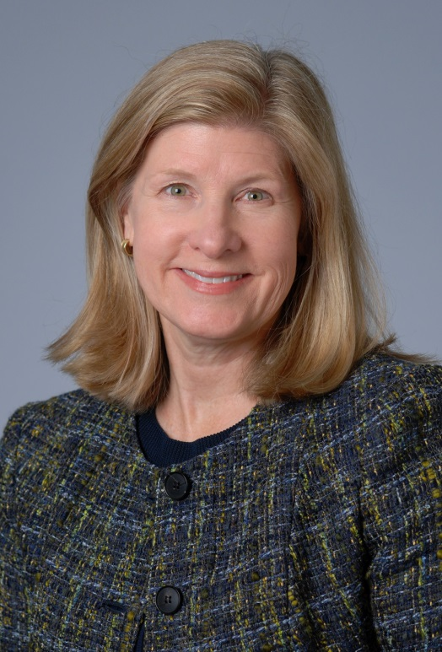
Speakers
Alexia Torke
Saneta Maiko
Ann Cottingham
Notes:
I want to start by acknowledging the speakers today.
Saneta Maiko, PhD, BCC, Indiana University Health, Daniel F. Evans Center for Spiritual and Religious Values in Health Care, Indiana University Center for Aging Research, Regenstrief Institute
Dr. Saneta Maiko is a Board Certified Chaplain and a research chaplain who focuses on the spiritual and religious dimensions of care for adults with advanced cancer and their families. His focus is on the religious and spiritual needs, coping, satisfaction and the impact of spiritual care on spiritual and emotional wellbeing of palliative cancer patients and their families. Dr. Maiko is a John Templeton Research Fellow through the Transforming Chaplaincy Program. He is an ordained elder with the Indiana United Methodist Conference.
Ann Cottingham, MA, MAR, IU School of Medicine, Regenstrief Institute, Daniel F. Evans Center for Spiritual and Religious Values in Health Care
Ann Cottingham is Director of Research in Health Professions Education and Practice with the Regenstrief Institute and Indiana University School of Medicine where she co-directs the ASPIRE Fellowship (Advanced Scholars Program for Internists in Research and Education). Ann is a health services researcher with a focus on spiritual, religious and psychological dimensions of illness and care, the role of community organizations in enhancing health, and health care team communication.
Alexia Torke, MD, IU School of Medicine, IU Center for Aging Research, Daniel F. Evans Center for Spiritual and Religious Values in Healthcare
Dr. Alexia Torke is interested in the ethical and communication aspects of medical decision making. She conducts qualitative and quantitative research on how family members and other surrogates make major medical decisions for patients with impaired cognitive function. Dr. Torke is the Director of the Daniel F. Evans Center for Spiritual and Religious Values in Healthcare, Associate Director of the IU Center for Aging Research and Associate Chief of General Internal Medicine and Geriatrics.

Slide 3
OTHER CO-INVESTIGATORS
Shelley A. Johns, Psy.D., ABPP.
Paul Helft, MD.
Beth Newton Watson, M.Div., BCC
Nasser H. Hanna, MD.
Kianna Montz, MA
Shadia Jalal, MD.
Sarah Rush, BA.
Steven S. Ivy, PhD, M.Div.
Caroline Jackson Lynn, MSN RN CCRC.
SUPPORT
Supported by the Daniel F. Evans Center for Spiritual and Religious Values in Healthcare, Indiana University Health and the Department of Spiritual Care and Chaplaincy Services. The content is solely the responsibility of the authors and does not necessarily represent the official views of the above named organizations. The investigators retained full independence in the conduct of this research.
Notes:
I am so thankful for other co-investigators unable to be here today. Without the support from these co-investigators and several agencies, this project would not have come to fruition.

Slide 4
Workshop Overview
Literature Review: Saneta Maiko
Study Design: Saneta Maiko
Qualitative Analysis: Ann Cottingham
Study Results: Saneta Maiko
Giving and Receiving Mentorship in Research: Alexia A. Torke
Discussion: Ann, Saneta, and Alexia

Slide 5
What Research tell us
Religion and spirituality (R/S) are central to the lives of Americans
Gallup 25 August 2015; Valluripalli ,2012; Phelps, 2009; Puchalski, 2009; Steinhauser, 2006; Pargament,, 2004.
Religious and/or spiritual (R/S) distress impacts up to 50% of cancer patients.
Fitchett, 2004; Tarakeshwar, 2006; Thune-Boyle, 2013
Advanced cancer patients have existential, spiritual and religious distress
Puchalski, 2012; McClain 2003; Breitbart, 2002.
Religion and spirituality are central to coping
Balboni, 2007; Tarakeshwar, 2006; Ferrell, 1995.
Negative coping is associated with poorer health outcomes
King, 2015; Fitchett, 2004; Sherman, 2005, 2009; Parmament, 2000.
Satisfaction and QOL are higher, cost low when spiritual care attended.
Balboni, 2011; Kernohan, 2007; Chochinov, 2005.
R/S beliefs influence communication, decision-making and utilization
Torke, 2014; Peteet,2013; Silvestri, 2003.

Slide 6
So what?
One recent meta-analysis shows no clear predictable findings from literature on what the S/R needs specific to cancer patients are.
Mesquita, et a. 2017
Findings of spiritual distress for cancer populations is imprecise and unpredictable.
Piderman, et al 2015
Without understanding specific S/R distress of cancer patients, it will be difficult studying the spiritual relationships with health outcomes.
Jim, et al. 2015

Slide 7
Study Goals
To ascertain S/R strengths and distress of adults with advanced cancer using qualitative semi-structured interviews.
To identify the preferences of advanced cancer patients regarding spiritual distress, coping and support.

Slide 8
Methods
Subjects
Patients >2 weeks post diagnosis of stage 4 cancer
Patients <12 months estimated survival
Indiana University Simon Cancer Center outpatients
Patients are at least 18 years of age at the time of enrolment
Patients are willing to participate in this study
Data Collection
One-on-one, in-person in-depth interviews
Semi-structured interview guide

Slide 9
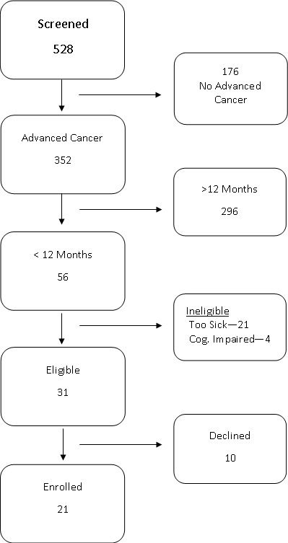
Recruitment chart
Rates: 68% recruitment rate 32% decline rate 38% too sick to participate Reasons for Decline: Pain No time Not interested Conflict with other responsibilities
Notes:
We screened 528 adults with metastatic cancer, 31 were eligible and we enrolled 21. Most patients declined due to pain, time conflict, no interest, too sick and cognitive impairment

Slide 10
Data Analysis
Interviews were audiotaped and transcribed verbatim.
Constant comparative method.
Systematic approach to qualitative data
To identify important new variables
To develop hypotheses and theories for future projects
An average interview time of 27:03 minutes
50:59 minutes longest interview
14:01 minutes shortest interview
A total of 146 pages, 64, 238 words, 1,782 paragraphs and 5,181 lines analyzed.
Notes:
A total of 146 pages was analyzed

Slide 11
Participants (N=21)
Characteristic | Number (Percent)
Age, mean range | 60.9 32-77
Female | 14 (67)
Race African American White | 1 (4.8) 20 (95.2)
Education, mean range | 13.1 12-20
Marital Status | 16 (76)
Income level | 13 (62)

Slide 12
Spiritual and Religious demographics
Spiritual / Spirituality: | Number screened (%)
Religious | 8 (38%)
Both religious and spiritual | 5 (24%)
Spiritual | 4 (19%)
Neither religious or spiritual | 4 (19%)

Slide 13
Qualitative Analysis of Patient Interviews Ann H. Cottingham, MAR, MA

Slide 14
Using numbers to describe everything… “is analogous to describing ‘Hamlet’ as a play with 21 principal characters, a ghost, a group of players, and various numbers of lords, ladies, officers, soldiers, sailors, messengers, and attendants – one of whom is already dead, one of whom dies by drowning, one by poisoned drink, two by poisoned sword, and one by sword and drink!” Inui and Carter, 1985
Notes:
The why, the meaning of events and interactions

Slide 15
Key Qualitative Data Sources
Observations
Focus groups
Open-text surveys
Written records (diaries, etc.)
Conversations
Interviews (unstructured, semi-structure, structured)
Notes:
The deductive researcher works from a theory to hypotheses to data to add to or contradict the theory
The inductive researcher uses participants’ views to build broader themes and generate a theory interconnecting the themes
Appropriate method for this study

Slide 16
Example: Interview Transcript

Slide 17
Steps in the Qualitative Analysis of Cancer Patient Interview Transcripts
Inductive method.
All 21 interviews were independently coded by the primary investigator.
Five investigators reviewed each transcript and identified comments/concepts that stood out for them, related to the general topic, by marking the comment and providing a descriptive label or code.
Notes:
Deductive approach – testing theory/hypothesis – confirmation or disconfirmation of existing theory
Inductive approach – begin with specific observations, find patterns, form hypothesis, then theory - approach with open mind, no pre-conceived notions
From specific observations to broader generalizations and theories

Slide 18
Example: Coding Template #1

Slide 19
Steps in the Qualitative Analysis of Cancer Patient Interview Transcripts
4.Team met regularly to
Discuss the preliminary codes
Revise, add and delete codes
Create a preliminary codebook
5. Investigators then read and coded an additional three interviews using the preliminary codebook and came to agreement on codes

Slide 20
Qualitative Analysis
6. All interviews were then coded using this codebook by two investigators.
7. The two investigators then grouped the codes into themes and subthemes and developed a model to inform eventual development of theory.

Slide 21
Example: Coding Template #2

Slide 22
Final Model

Slide 23
Example: Coding Template #2

Slide 24
Analyzing Student Professionalism Narratives
Review 2-3 narratives and underline what stands out as important for professionalism
Add a descriptive label or code to each underlined statement
What is this statement about?
What stood out for you in this statement?
Find a partner. Discuss what you each underlined and agree on a preliminary set of descriptive labels or codes

Slide 25
Analyzing Student Professionalism Narratives

Slide 26
Analyzing Student Professionalism Narratives
Review 2-3 additional narratives and try to apply the codes to those texts.
Review codes and try to group them into clusters of similar topics.
6. Label those clusters with a theme

Slide 27
Analyzing Student Professionalism Narratives

Slide 28
RESULTS Saneta Maiko, PhD, BCC

Slide 29
Five Themes Emerged
1. Relationships
2. Meaning of life
3. Identity
4. Acceptance
5. Suffering
Notes:
1. Relationships (Family, friends)
: Support, lack of support, abandonment, worries
(God/higher power)
: Support, in charge, abandoned by God, abandoning God
(Faith community)
: Support, separation
2. Meaning of life
:Life as an example, wake up call, why me?
3. Identity
: Maintaining identity, why I am, Losing Identity
4. Acceptance
5. Suffering

Slide 30
Relationships
Family support
My husband is very, very supportive… whether it’s sickness, where it’s a new job, whether it’s buying a car, doesn’t make any difference. My husband has always been my champion.

Slide 31
Relationships
Family abandonment
Being distant from him (son) he doesn’t even know I have cancer, as far as I know. I talked to him after I had my surgery and I had the cancer removed from my esophagus…the only thing he said was what’s wrong dad …The rest of it was about him

Slide 32
Relationships
God in charge
And what do you do and at one point I remember thinking well I don’t know what to do but whatever happens happens. It’s not in my hands. So I thought well I’ll just do whatever God wants and I’ll just leave it up to that. When I did that I didn’t worry any more.

Slide 33
Relationships
Faith community separation
I didn’t get much response from my church at the time. We now attend a different church. So the church that I grew up in and had attended for over 50 years… I thought maybe they would have reached out to me in the fact that I wasn’t there.

Slide 34
Meaning of Life
My life as an example:
Maybe He’s using me to show people what faith can do for a serious thing like this. And that if I let people know how much I truly believe …and then I have good results maybe that would be my way to work for God to show people that if they believe and have faith in Him … that He will get them through awful things like stage four lung cancer…..I feel it’s a miracle.

Slide 35
Meaning of Life
It is a wake up call
It’s like a wake-up call. You go to church and you feel like you do the right thing and all of a sudden it’s a kaboom. This is the real deal. What now?

Slide 36
Acceptance
It is what it is
At first it was kind of scary and then you just accept it. It is what it is and you can’t get yourself down because that’s probably the worst thing you can do. So just do what you’ve got to do and move on.

Slide 37
Suffering
Feeling worthless
I feel sick, tired, worthless, dragging everybody, family crashed, letting family down by being sick

Slide 38
Moving Forward
Feasibility, Acceptability of (SCAI) Framework
Spiritual Care and Intervention (SCAI) Framework
Assessment and intervention targeting the distress of adults with advanced cancer in outpatient setting
To be used proactively
Semi-structured spiritual care intervention
Structured documentation of the intervention content
Structured documentation of the effects of SCAI
Notes:
To test the feasibility, acceptability and preliminary effects of Spiritual Care and Intervention (SCAI) Framework

Slide 39
Giving and receiving mentorship in research
Alexia M. Torke, MD, MS.

Slide 40
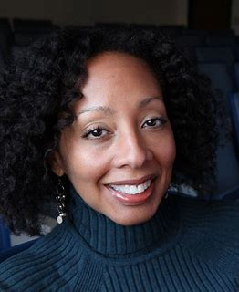
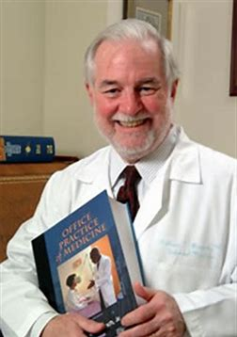
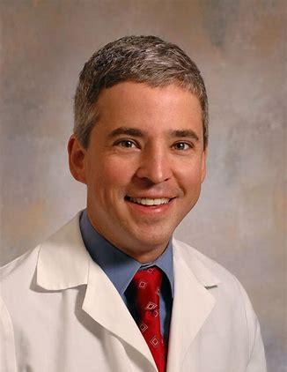
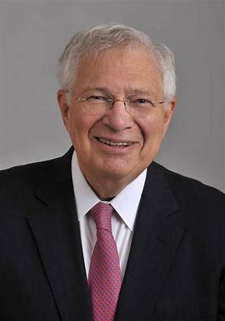
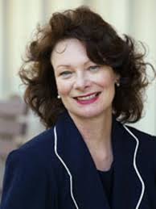
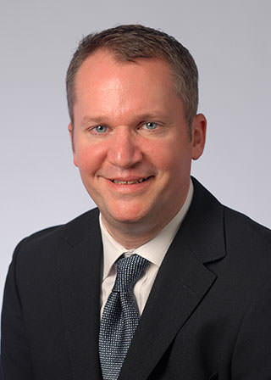
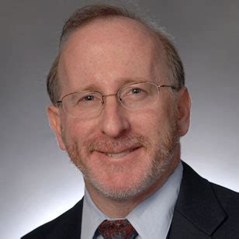
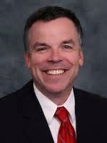
My Mentors
Notes:
Began with a small project (Giselle Corbie Smith) then a line of research (Branch). Didn’t know what I wanted to do and was probably hard to mentor. Clarified my own goals in my fellowship and worked with 2 mentors (Alexander and Sielger) who each provided very different kinds of guidance. So you might need differnet metnors for different things. I came to IU primarily because of Chris Callahan, but then had a team who worked together well and complemented each other.

Slide 41
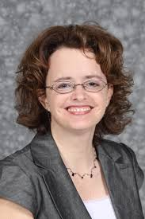
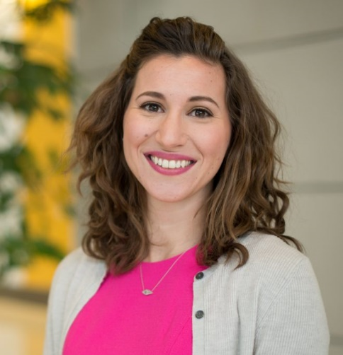
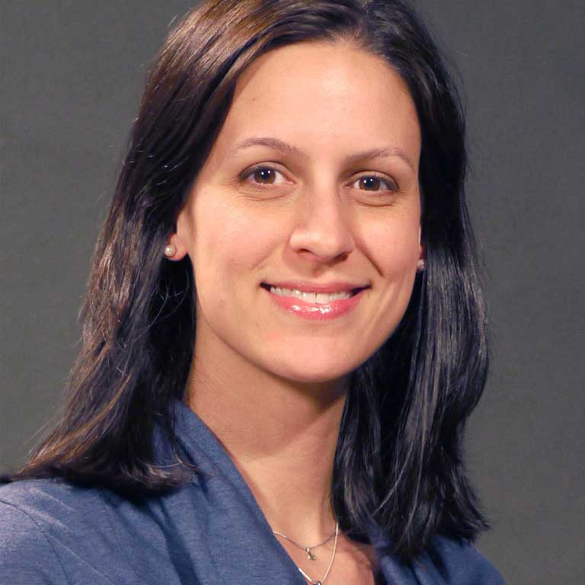
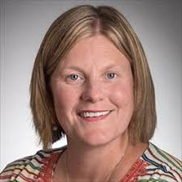
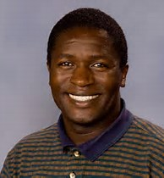
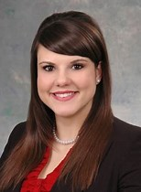
My Mentees

Slide 42
Research Mentorship Principles
Tailor mentoring structure for the mentee
Schedule regular meetings
Establish a clear, written mentoring plan
Provide training and resources for mentors and mentees
Ensure ongoing evaluation
Create a mechanism to reward mentoring
Welch et al

Slide 43
Being a Mentee
Actively seek mentorship
Know (or explore) your own direction
Identify a mentor (or mentors)
Discuss the mentorship relationship
Establish a mentoring plan
Communicate often with your mentor
Schedule meetings
Set goals and meet them

Slide 44
Being a mentor
Make careful decisions about whom you will mentor
Prioritize your mentees’ work
Communicate often
Schedule meetings
Set expectations, goals and benchmarks
Assist with career planning
Provide regular feedback
Be an advocate for your mentee
Praise, love and encourage

Slide 45
Discussion/Questions

