Slide 1
See Change: Health Care Chaplaincy of Tomorrow
April 13th, 2016
Rev. Kevin Massey, BCC Vice President – Mission and Spiritual Care
Advocate Lutheran General Hospital

Slide 2
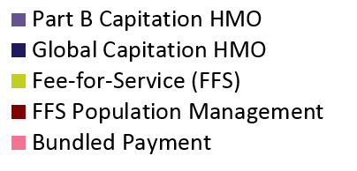
Fee for Service to Value – Shifting Incentives

Slide 3


Slide 4
“It is better to be silent and be there, than to speak and not be there.”

Slide 5
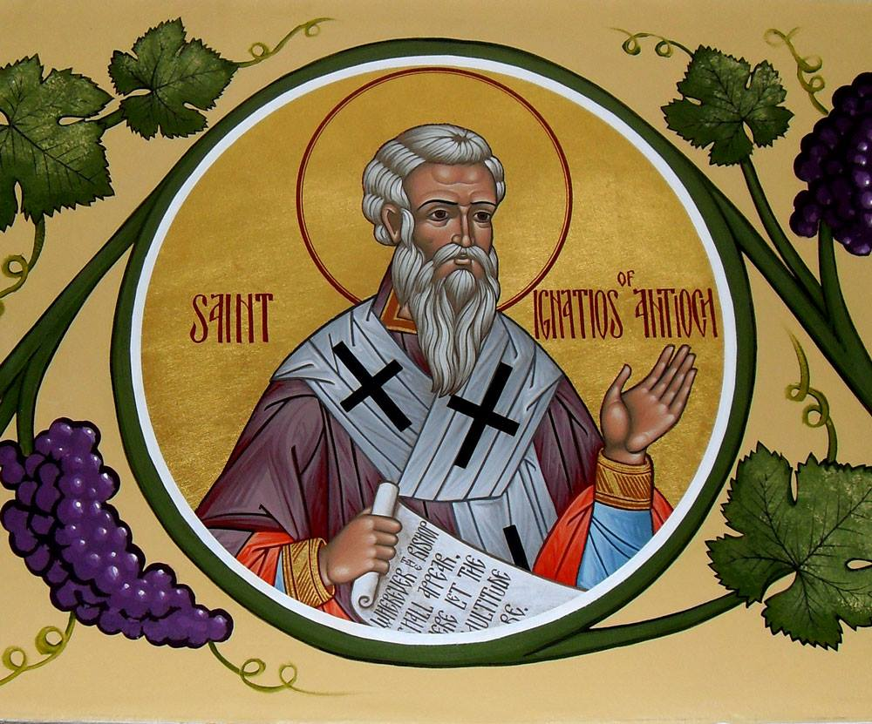
Ignatius of Antioch (35-108 CE)

Slide 6
Dying in America
7 out of 10 Americans say they would prefer to die at home.
Time/CNN Poll (2000)
Only 25 percent of Americans actually die at home.
Centers for Disease Control (2005)

Slide 7


Slide 8
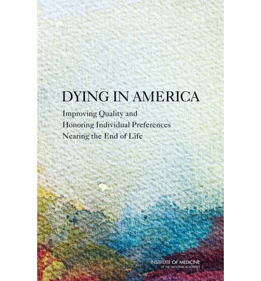

Slide 9


Slide 10
Future Elements for Improving Chaplain formation and Certification
Incorporating the perspective of recipients of care into training and certification
Objective observation of competency in training and certification
Sharing a normative language for our interventions and hoped for outcomes

Slide 11
Future Elements for Improving Chaplain formation and Certification
Incorporating the perspective of recipients of care into training and certification
Objective observation of competency in training and certification
Sharing a normative language for our interventions and hoped for outcomes

Slide 18
“What you remember is significant regardless of whether it is literally what was said or done.”

Slide 19
Future Elements for Improving Chaplain formation and Certification
Incorporating the perspective of recipients of care into training and certification
Objective observation of competency in training and certification
Sharing a normative language for our interventions and hoped for outcomes

Slide 20
Future Elements for Improving Chaplain formation and Certification
Incorporating the perspective of recipients of care into training and certification
Objective observation of competency in training and certification
Sharing a normative language for our interventions and hoped for outcomes

Slide 24
Future Elements for Improving Chaplain formation and Certification
Incorporating the perspective of recipients of care into training and certification
Objective observation of competency in training and certification
Sharing a normative language for our interventions and hoped for outcomes

Slide 25
Future Elements for Improving Chaplain formation and Certification
Incorporating the perspective of recipients of care into training and certification
Objective observation of competency in training and certification
Sharing a normative language for our interventions and hoped for outcomes

Slide 26
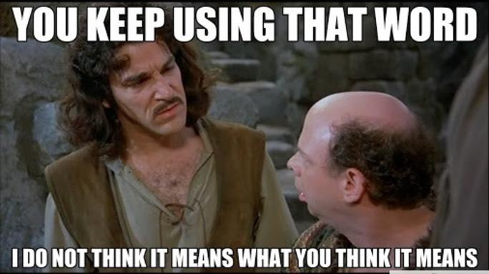
The Need for Standard Chaplaincy Terminology

Slide 28
Advocate Chaplaincy Taxonomy Methods…
Case
Studies
Reliability
Concept Mapping
Experience Sampling
Chaplain
Self-Evaluation
Focus Groups
Retrospective
Chart Review
Literature
Review

Slide 29
Intended Effects | Methods | Interventions
Aligning care plan with patient’s values | Accompany someone in their spiritual/religious practice outside your faith tradition | Acknowledge current situation | Facilitate communication
Build relationship of care and support | Assist with finding purpose | Acknowledge response to difficult experience | Facilitate communication between patient and/or family member and care team
Convey a calming presence | Assist with spiritual/religious practices | Active listening | Facilitate communication between patient/family member(s)
De-escalate emotionally charged situations | Collaborate with care team member | Ask guided questions about cultural and religious values | Facilitate decision making
Demonstrate caring and concern | Demonstrate acceptance | Ask guided questions about faith | Facilitate grief recovery groups
Establish rapport and connectedness | Educate care team about cultural and religious values | Ask guided questions about purpose | Facilitate life review
Faith affirmation | Encourage end of life review | Ask guided questions about the nature and presence of God | Facilitate preparing for end of life
Helping someone feel comforted | Encourage self care | Ask questions to bring forth feelings | Facilitate spirituality groups
Journeying with someone in the grief process | Encourage self reflection | Assist patient with documenting choices | Facilitate understanding of limitations
Lessen anxiety | Encourage sharing of feelings | Assist patient with documenting values | Ask guided questions
Lesson someone’s feelings of isolation | Encourage someone to recognize their strengths | Assist someone with Advance Directives | Identify supportive relationship(s)
Meaning-Making | Encourage story-telling | Assist with determining decision maker | Incorporate cultural and religious needs in plan of care
Mending broken relationships | Encouraging spiritual/religious practices | Assist with identifying strengths | Invite someone to reminisce
Preserve dignity and respect | Explore cultural values | Bless religious item(s) | Perform a blessing
Promote a sense of peace | Explore ethical dilemmas | Blessing for care team member(s) | Perform a religious rite or ritual
 | Explore faith and values | Communicate patient’s needs/concerns to others | Pray
 | Explore nature of God | Conduct a memorial service | Prayer for healing
 | Explore presence of God | Conduct a religious service | Provide a religious item(s)
 | Explore quality of life | Connect someone with their faith community/clergy | Provide access to a quiet place
 | Explore spiritual/religious beliefs | Crisis intervention | Provide compassionate touch
 | Explore values conflict | Discuss concerns | Provide Grief Processing Session
 | Exploring hope | Discuss coping mechanism with someone | Provide grief resources
 | Offer emotional support | Discuss frustrations with someone | Provide hospitality
 | Offer spiritual/religious support | Discuss plan of care | Provide religious music
 | Offer support | Discuss spirituality/religion with someone | Provide sacred reading(s)
 | Setting boundaries | Ethical consultation | Provide spiritual/religious resources
 |  | Explain chaplain role | Respond as chaplain to as defined crisis event
 |  | Facilitate advance care planning | Share words of hope and inspiration
 |  | Facilitate closure | Share written prayer
 |  |  | Silent prayer

Slide 30
Intended Effects
Aligning care plan with patient’s values
Build relationship of care and support
Convey a calming presence
De-escalate emotionally charged situations
Demonstrate caring and concern
Establish rapport and connectedness
Faith affirmation
Helping someone feel comforted
Journeying with someone in the grief process
Lessen anxiety
Lesson someone’s feelings of isolation
Meaning-Making
Mending broken relationships
Preserve dignity and respect
Promote a sense of peace

Slide 31
Pathway of Care
Intended Effect: Aligning care plan with patient’s values
Method: Explore cultural values
Intervention: Ask guided questions about cultural and religious values

Slide 32
Intended Effect: Aligning care plan with patient’s values
Method: Explore cultural values
Intervention: Ask guided questions about cultural and religious values
Intended Effect: Preserve dignity and respect
Method: Explore cultural values
Intervention: Ask guided questions about cultural and religious values

Slide 33
http://www.advocatehealth.com/chaplaincyresearch

Slide 34
Future Elements for Improving Chaplain formation and Certification
Incorporating the perspective of recipients of care into training and certification
Objective observation of competency in training and certification
Sharing a normative language for our interventions and hoped for outcomes

Slide 37

Thank you for caring for the human spirit!

