Slide 1

Towards the integration of spiritual care: a plea for a new art of dying
Carlo Leget PhD
Vice-President of the European Association for Palliative Care

Slide 2
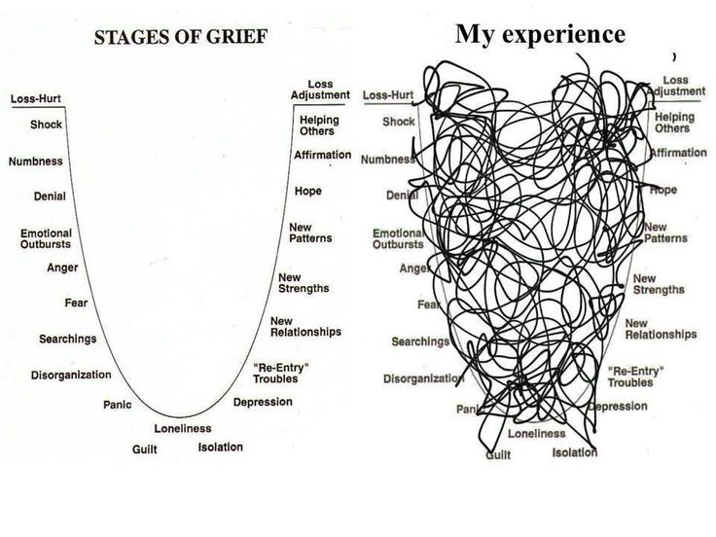

Slide 3
Outline
  Assisted dying and euthanasia: the world in motion
  The case of The Netherlands: what is going on?
  How to understand The Netherlands?
  How can we respond to this situation?
  What could be the role of health care professionals?

Slide 4
1) The world in motion
  1997: Euthanasia Laws Bill of the Parliament of Australia
  1997: Oregon Death with Dignity Act
  Washington (2008), Vermont (2013), California (2015), being debated in New Jersey
  2009: In Montana, a court ruling finding no constitutional objection to assisted suicide has opened the way for similar practices
  2014: Similar court ruling in New Mexico is under appeal

Slide 5
European perspectives on euthanasia
  Since 1942: Swiss law permits assisted suicide
  2001: Termination of Life on Request and Assisted Suicide (Review Procedures) Act in the Netherlands
  2002: Legislation of euthanasia in Belgium with similar regulations to those in the Netherlands
  2009: Luxemburg introduced euthanasia and physician-assisted suicide similar to the criteria in the Netherlands and Belgium
  2015: Commercial provision of physician-assisted suicide similar to Swiss practices prohibited in Germany

Slide 6
2) What is going on in the Netherlands?
Euthanasia
3,8 % of all deaths

Slide 7
Dutch definition, State Committee (1985)
“the intentional termination of the life of a person at his/ her explicit request by someone else than the person concerned”
International
  active or passive
  voluntary or involuntary
  direct or indirect
The Netherlands
  active termination of life
  voluntary request
  direct
  intentional and deliberately

Slide 8
Judicial practice: defence of necessity
  Criminal Law, Article 40:
  Any person who is compelled by force majeure (defence of necessity) to commit an offence shall not be criminally liable
  Conflict of interests:
  Duty to preserve life versus duty to prevent harm
Notes:
8

Slide 9
The new law (since 1 April 2002)
Article 293 of the penal code:
Section 1:
He who intentionally takes the life of another person at the latter’s explicit and earnest request will be punished by a prison sentence with a maximum of twelve years or a fine of up to Dfl. 100,000.

Slide 10
Termination of life on request and assisted suicide act (‘new’ law 2002)
  Addition to the criminal law:
    The action mentioned in section 1 is not punishable, if it has been performed by a physician who has complied with the requirements of carefulness (prudent practice) and who has informed the municipal coroner
  Six requirements of carefulness
Notes:
10

Slide 11
The requirements of carefulness/prudent practice: physicians must
Be convinced that the patient’s request is voluntary and well considered
Be convinced that the patient’s suffering is unbearable and interminable (hopelessness)
Inform the patient about his or her situation and prospects
Come to the joint conclusion that there is no alternative reasonable solution
Notes:
11

Slide 12
Continuation
Consult at least one other physician with no connection to the case, who must then see the patient and state in writing that the attending physician has satisfied the criteria listed in 1 to 4
Exercise due medical care and attention in terminating the patient’s life or assisting in his/her suicide

Slide 13
Current notification procedure
  1998: establishment by ministerial order of five regional review committees, each consisting of a physician, a lawyer and an ethicist
  2002: the regional review committees are legally embodied in the new ‘euthanasia law’
  Doctors report to this committee
  No direct contact of the physician with the legal authorities
  If a doctor has not complied with the legal requirements, the committee refers the case to the legal authorities

Slide 14
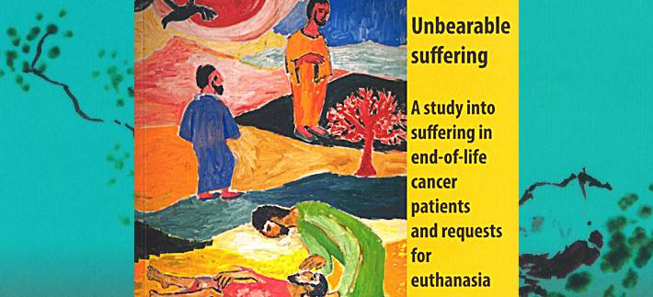
Cees Ruijs: measuring unbearable suffering
  94% of patients with an euthanasia request report unbearable suffering, and 87 % of patients without an euthanasia request do so (n=64)
  Those who ask for euthanasia: euthanasia declaration (77%) and higher education (35%)
  Sources to bear
  suffering: family
  and proxies (69%);
  faith and trust
  in God (40%)

Slide 15
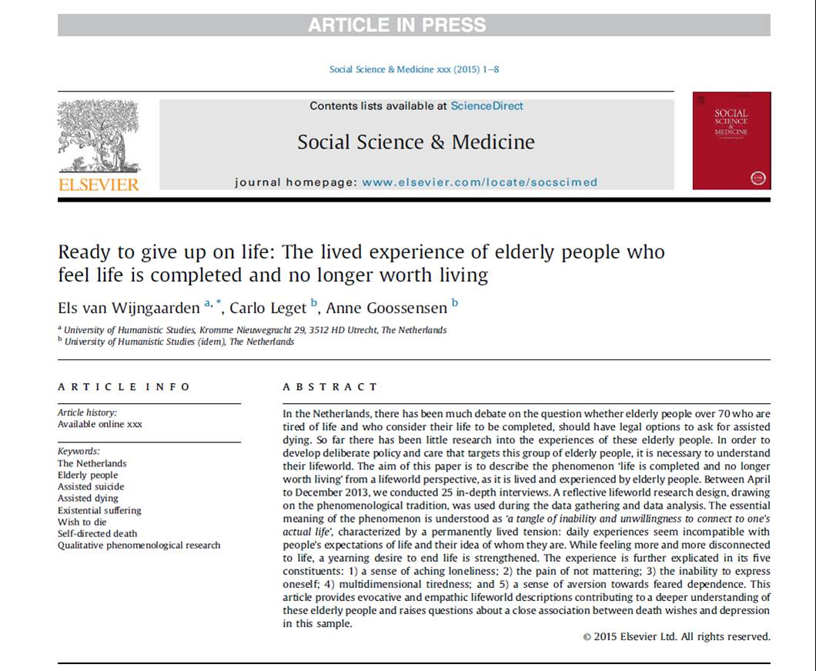
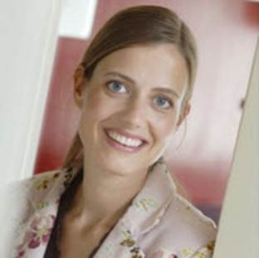
Other developments…

Slide 16
Goals and design
To provide in-depth insight in what it means to feel ‘life is completed and no longer worth living’ as lived and experienced by elderly people who do not suffer from a life-threatening disease or a psychiatric disorder.
To gain a deeper understanding of what it means to live with the firm intention to end life at a self-chosen moment.
A qualitative, phenomenological interview study
25 Dutch mentally competent elderly citizens (70+) who considered their life to be completed; suffered from the prospect to live on; and actually had a reasonable death wish

Slide 17
‘Life is completed and no longer worth living’
Essential meaning of the phenomenon:
‘a tangle of inability and unwillingness to connect to one’s actual life’
A sense of aching loneliness
The pain of not mattering
The inability of express oneself
Multidimensional tiredness
A sense of aversion towards feared dependence

Slide 18
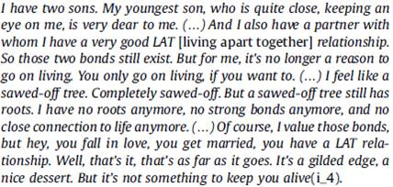
1. A sense of aching loneliness

Slide 19
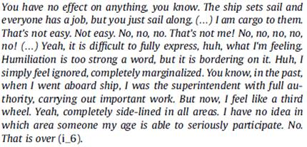
2. The pain of not mattering

Slide 20
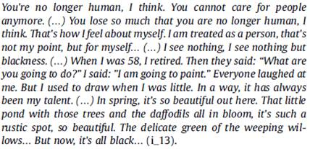
3. The inability to express oneself

Slide 21

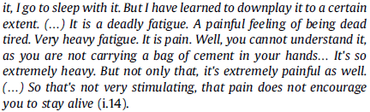
4. Multidimensional feelings of tiredness

Slide 22
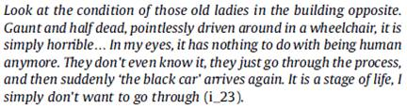
5. A sense of aversion towards feared dependence

Slide 23
Living in between…
Living in-between intending and actually performing a self-chosen death is characterized as a constant feeling of living in a paradoxical position, explicated in the following themes:
1) Detachment and attachment;
2) Rational and non-rational considerations;
3) Taking grip and losing grip;
4) Resisting interference and longing for support;
5) Legitimacy and illegitimacy

Slide 24

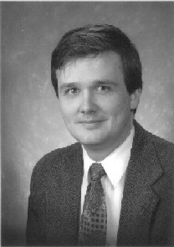
3) How to understand The Netherlands?
Dutch mentality and cultural developments
  Central feature:
  “Let’s talk about it,
  and find a solution”
Prof dr James Kennedy
Notes:
The Dutch approach:

Slide 25

Problems should be negotiated and solved
Getting rid of taboos and guilty feelings
Euthanasia might be inevitable because of modern medical power
Solidarity with suffering people: “What is done out of love, cannot be wrong”
Self-determination and
responsibility:
in dialogue with the GP
Transparancy and control

Slide 26
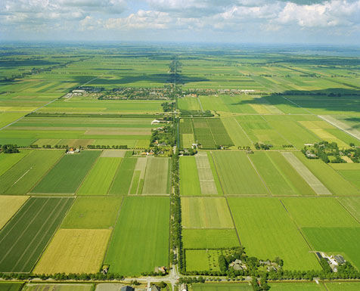
Transparent and controlled landscape
  The Dutch like control (water, drugs, dying, prostitution)
  Best remedy against misuse is transparancy
  Non-moralising debate
  Freedom is not to be supressed but to be regulated

Slide 27
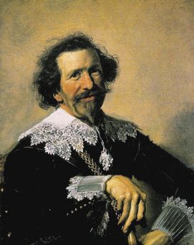
Preachers and merchants
  Calvinism and commerce
  Politics of tolerance
  Secularisation
  Pragmatism
  Polder-model

Slide 28
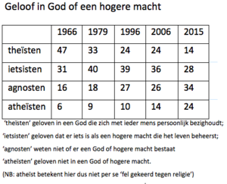

God in the Netherlands
“A large majority of the Dutch (82%) never or almost never visits a church and only 14% of them believes in a personal God. For many Dutch people Christianity has become an unknown or exotic world.”

Slide 29
Larger cultural developments
Neoliberal climate
Medicalisation of dying
Intolerance towards suffering and decline
Strong belief in autonomy of the patient
Crisis of ‘meaning’ and spirituality in healthcare?
Three cultural reasons:

Slide 30
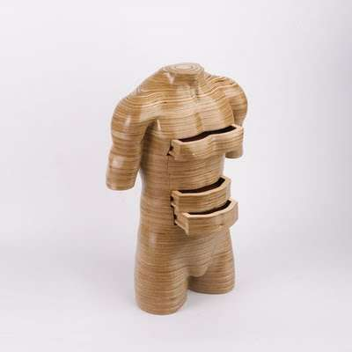
a) Professional: only the functional is meaningful
  Diagnostic reduction
  Reframing en ‘disowning’
  Control in order to treat
  Exclusion of unwanted connotatons

Slide 31
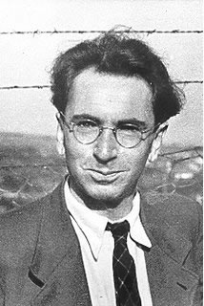
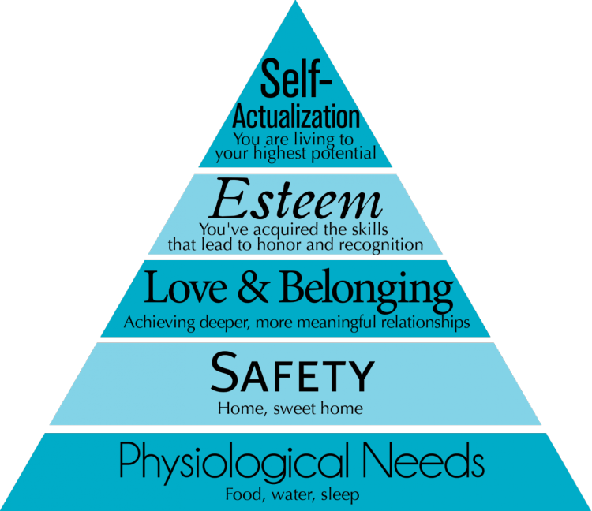
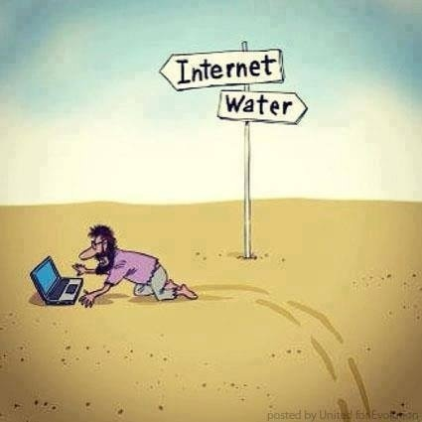
b) Societal: the homo oeconomicus in charge

Slide 32
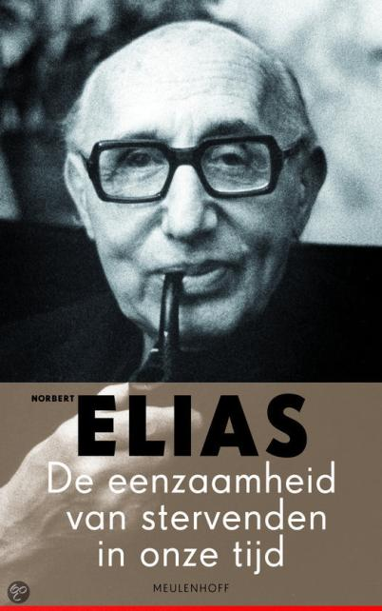
c) Cultural: spirituality is a private affair
Homo clausus
… contains the expectation that each human life should have a meaning for itself alone. If one cannot find that meaning one complains about the meaningless of one’s existence. (…) Meaning is a social category.

Slide 33
4) How can we respond to this situation?
The patient should have access to a new ‘art of dying’, an ars moriendi that helps patient and proxies to deal with their situation
In this new art of dying the influence of the cultural context should be taken into account
This new art of dying should help transforming the cultural context
All health care professionals should assist patients and proxies in this process
This should also transform the professional practice of the health care professionals, and integrate spiritual care

Slide 34
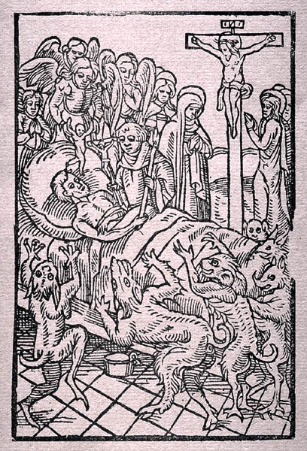

Slide 35
Five choices
Loss of faith
Despair
Impatience
Complacency
Avarice
Faith
Hope
Patience
Humility
Love

Slide 36
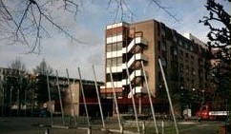
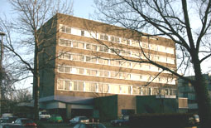
Rotterdam,
two palliative care units
in two nursing homes:
Antonius Binnenweg
Antonius IJsselmonde

Slide 37
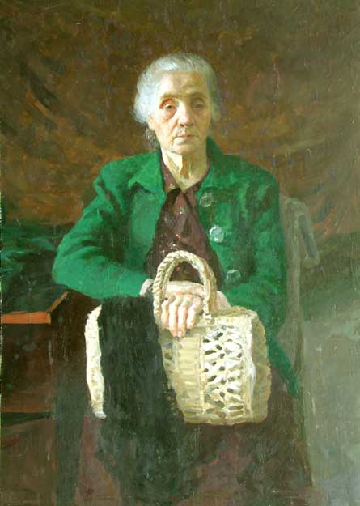
An old lady
‘Space’ in the care-giver
  Listening: with an open mind
  Answering: returning the question ‘opened up’
‘Space’ in the patient
  Experience and emotions
  Opening up new perspectives

Slide 38
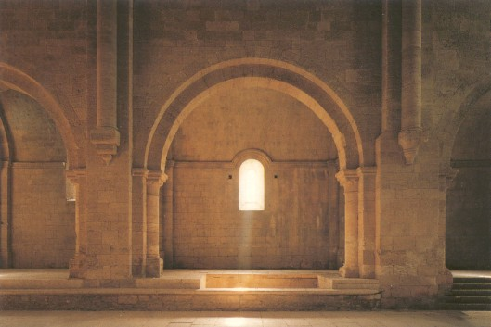
Inner space
(metaphor)
A state of mind
that enables one to be aware
of one’s actual thoughts and feelings
without being overthrown or swept away by them

Slide 39
Inner space
  Simple and easy to recognize (body)
  Formal (≠ inner peace)
  Open to different spiritual traditions
  Process oriented
  Also addressing the caregiver
  At the crossroads of psychology, spirituality, ethics
Opening up and discovering new horizons

Slide 40

Inner space
… of the care-giver
… of the patient
… of the relatives

Slide 41
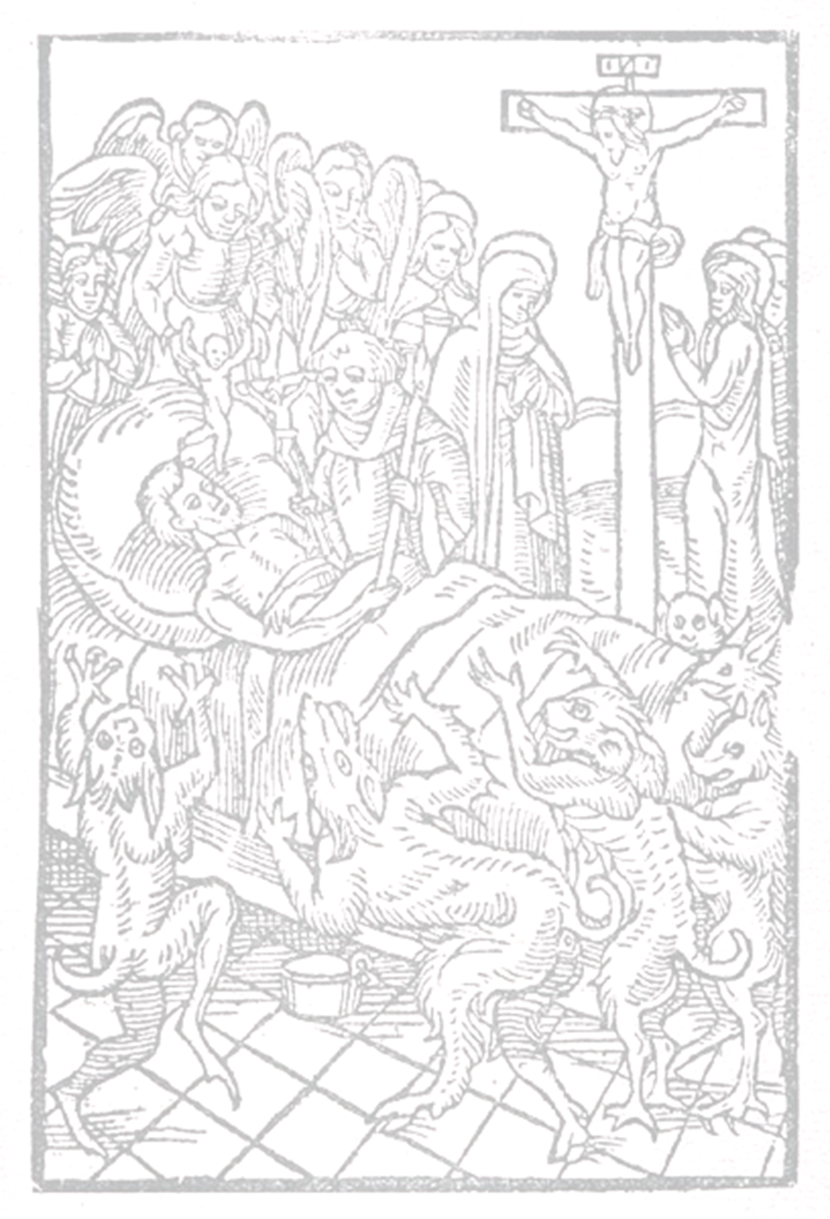
Relations
Guilt
Holding on - letting go
Remembering - forgetting
Inner
space
Doing - undergoing
Knowing - believing
Hope
Oneself - the other
Suffering
Autonomy

Slide 42
1. Autonomy: oneself – the other
3
1
2
P. Ricoeur

Slide 43
1. Autonomy: oneself – the other
Strong sense of I-centered autonomy
Neoliberal climate
Individualism
Less social connections
No respect for authorities (Church, politicians, physicians)
Maximum (negative) freedom of citizens

Slide 44
2. Suffering: doing – undergoing
Activism
Apathy
psycho -
social
spiritual
physical

Slide 45

2. Suffering: doing – undergoing
Activism
Control
Transparency
Medical Specialties
Technological revolution
Low tolerance for suffering
Control over life, control over death

Slide 46
3. Relations: holding on – letting go
possessions position
loved ones
body, image of self

Slide 47
3. Relations: holding on – letting go
No familiarity with decline and dying
Conservation of youth
Conservation of the good things in life
Materialism
Life expectancy: women 82+ years, men 77.5 years
Holding on or throwing away
Problems with loss (letting go)
Replacement instead of repair

Slide 48
4. Guilt: remembering – forgetting
Holding on to the good
(but no fixation)
Letting go of the bad
(but no denial)
feeling guilty
guilt

Slide 49
4. Guilt: remembering – forgetting
Guilt can be dealt with in therapy
Guilt is not ‘healthy’: let go of morality
Functionalism
Pragmatism
Subjectivism: ‘my truth versus your truth’
Happiness as ‘feeling good or being lucky’

Slide 50
5. Hope: knowing – believing
knowing
believing
agnosticism
openness
subjective
no
objective
?
(‘knowing’)

Slide 51
5. Hope: knowing – believing
Disenchantment of the world
Empirical foundation of all knowledge
‘What’s the use of religion?’
Measuring = knowing
Freedom of self-search and expression
Subjectivation of the spiritual
Privatization of belief

Slide 52

How can I say goodbye?
How do I deal with suffering?
How do I look back on my life?
Who am I and what do I really want?
What can I hope for?

Slide 53
5) The role of the health care professional
  Five ways in which the model can be used
  Framework for reflection: patients and families
  Training: all healthcare professionals
  Spiritual history taking: health care professionals with an education in spiritual care
  Spiritual assessment: chaplains
  Communication: patient files and transfer

Slide 54
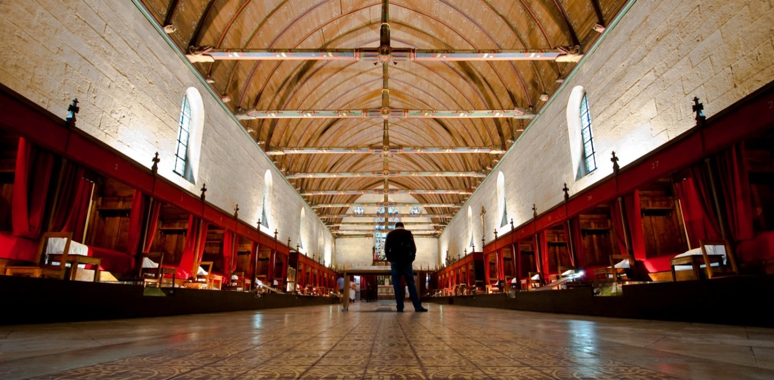
Ars moriendi as a cultural challenge
Leget C (2003) Ruimte om te sterven. Een weg voor zieken, naasten en zorgverleners. Tielt: Lannoo
Leget C (2007) Retrieving the Ars moriendi tradition, Medicine Health, Care and Philosophy 10; 313-319
Leget C (2008) Van levenskunst tot stervenkunst. Over spiritualiteit in de palliatieve zorg. Tielt: Lannoo
Leget C (2016) A new art of dying as a cultural challenge, Studies in Christian Ethics (upcoming)
Thank you

