Slide 1
Spirituality and Medicine: From Asclepius to P-values
Tracy A. Balboni MD, MPH
2016 Caring for the Human Spirit Conference
April 12, 2016

Slide 2
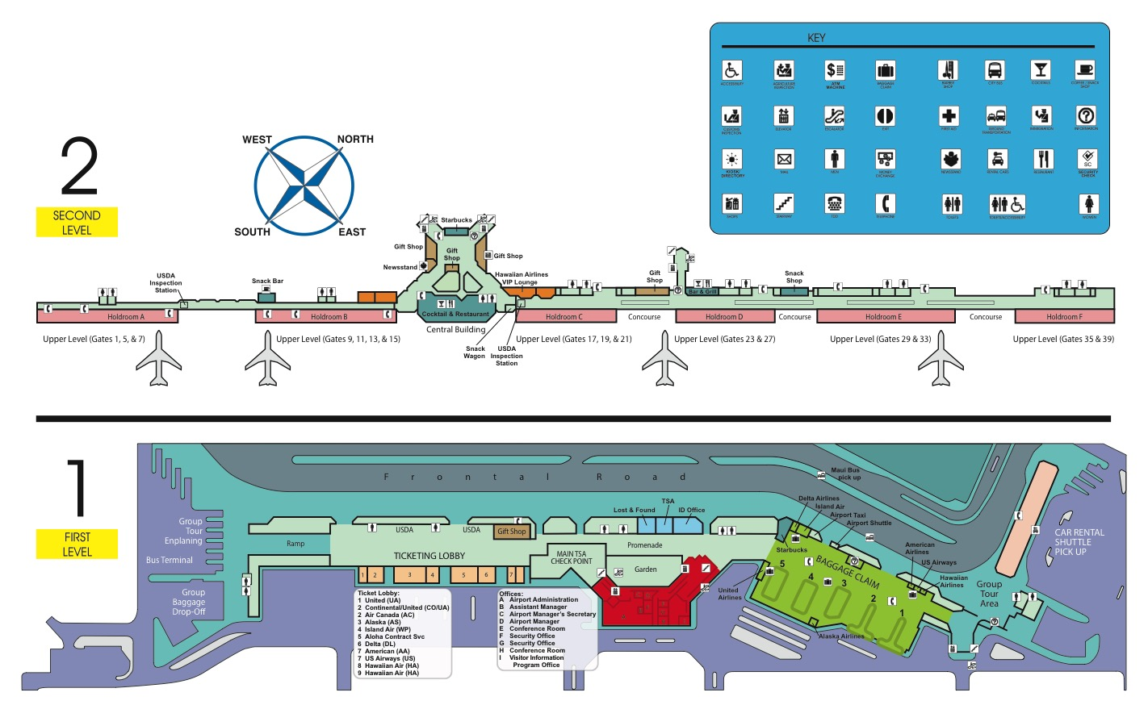

Slide 3
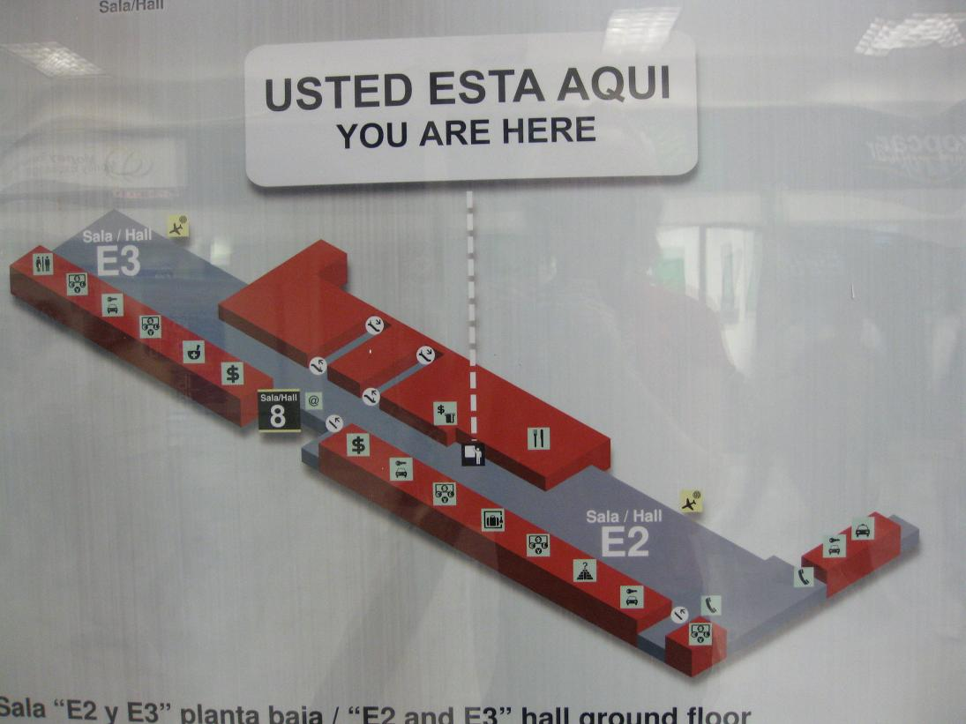

Slide 4
Spirituality and Medicine: From Asclepius to P-values
Historical background to relationship of spirituality and medicine
Implications of this history on patients, practitioners, and institutions
Research (and the p-value) as tool for reintegration of spirituality into the practice of healthcare

Slide 5
Spirituality and Medicine: From Asclepius to P-values
Historical background to relationship of spirituality and medicine
Implications of this history on patients, practitioners, and institutions
Research (and the p-value) as tool for reintegration of spirituality into the practice of healthcare

Slide 6
Spirituality and Medicine: From Asclepius to P-values
Historical background to relationship of spirituality and medicine
Implications of this history on patients, practitioners, and institutions
Research (and the p-value) as a tool for reintegration of spirituality into the practice of healthcare

Slide 7
I. Historical Background: Spirituality and Medicine

Slide 8
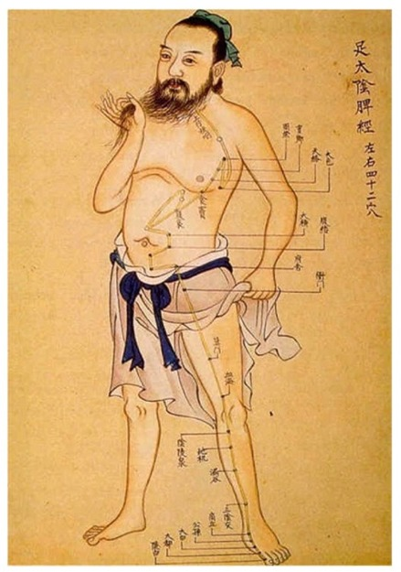
Exceptions: Traditions with Integrated Conceptions of Body and Soul

Slide 9
History of Spirituality and Medicine: Classical Antiquity (~800BC-600AD)

Slide 10
John William Waterhouse. “A Sick Child brought into the Temple of Aesculapius”. 1877

Slide 11
Hippocratic Oath
I swear by Apollo, Asclepius, Hygieia, and Panacea, and I take to witness all the gods, all the goddesses, to keep according to my ability and my judgment, the following Oath and agreement…

Slide 12
Rod of Asclepius
World Health Organization

Slide 13
History of Spirituality and Medicine: The Middle Ages (6th -16th centuries)

Slide 14
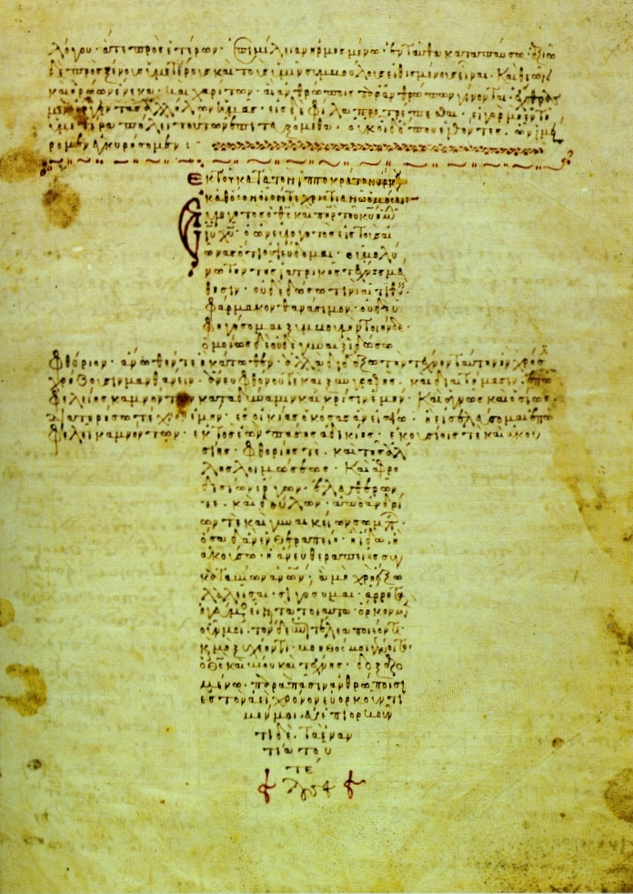
12th Century Byzantine Manuscript

Slide 15
History of Spirituality and Medicine: High Middle Ages and Renaissance (14th-17th centuries)

Slide 16
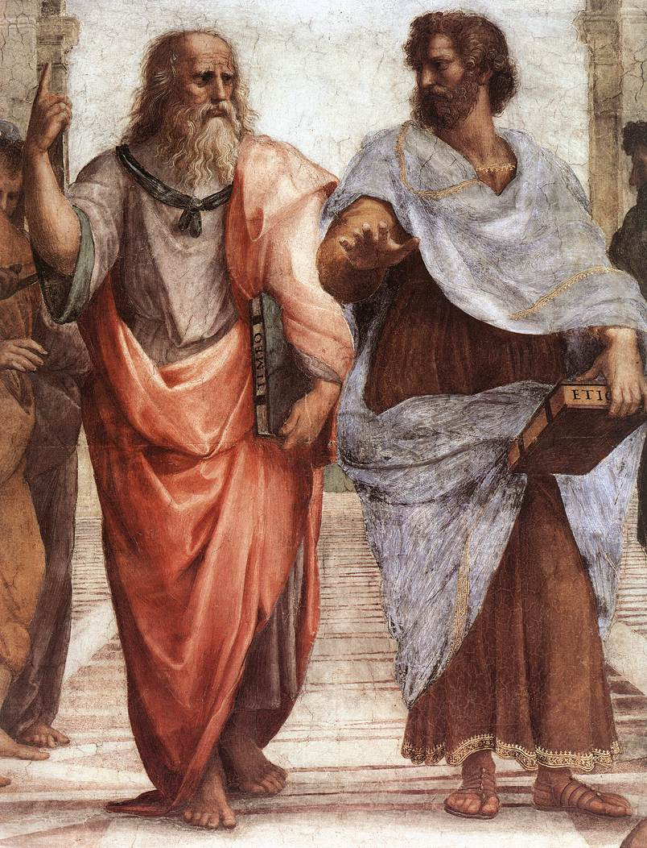
Raphael. The School of Athens. 1509-1510.
Notes:
Give example of

Slide 17
Spirituality and Medicine: Enlightenment to Post-Modernism (18th century-present)

Slide 18
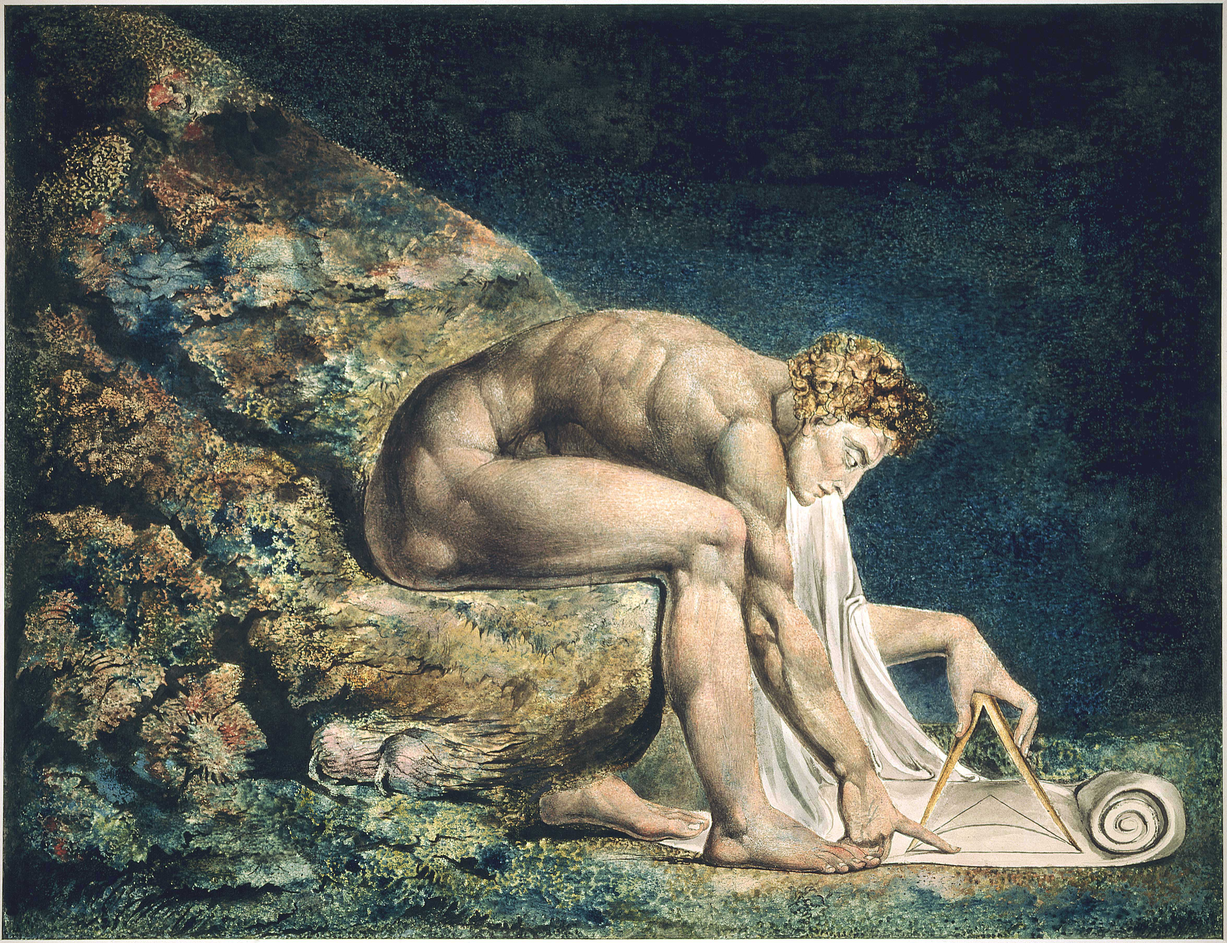
William Blake. Newton. 1795
Notes:
Give example of

Slide 19
II. Implications of Where We Are for Patients, Caregivers, and Medical Institutions

Slide 20
Implications of Where We Are for Our Patients: Kate’s Story

Slide 21
Kate “Every time I walk into this place [Dana-Farber], it feels like all my energy has been sapped out of me. I have to do energy work for days after being here to become myself again… When I walk in, I can almost hear this place telling me that all I am is a body full of tumors that are killing me.”

Slide 22
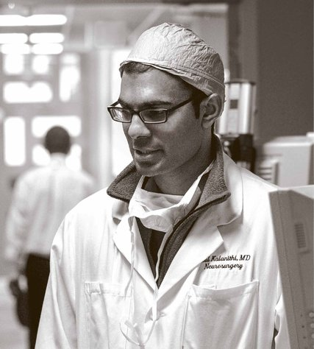
Implications of Where We Are for Medical Caregivers

Slide 23
Implications for Caregivers
“At moments, the weight of it all [suffering and death of his patients] became palpable. It was in the air, the stress and misery. Normally, you breathed it in, without noticing it. But some days, like a humid muggy day, it had a suffocating weight of its own. Some days, this is how it felt when I was in the hospital: trapped in an endless jungle summer, wet with sweat, the rain of tears of the families of the dying pouring down.”

Slide 24
Implications for Medical Institutions
When Too Much is Too Little
R. Sean Morrison, M.D., Diane E. Meier, M.D., and Christine K. Cassel, M.D.

Slide 25
Implications for Medical Institutions
“The experience with this patient is a disturbing illustration of the care received by many terminally ill patients in U.S. hospitals – the site of death for 65 percent of the population. Despite repeated requests that he receive no further diagnostic interventions or life-prolonging treatment and that he be allowed to return home to die, the patient underwent a lung biopsy, three CT studies, daily phlebotomies, and insertion of multiple nasogastric tubes, as well as a gastrostomy tube. He was tied to a bed for 29 days so he would not remove the intravenous lines or feeding tubes, and he spent the last month of his life in the hospital. Recent reports suggest that his case, unfortunately, is not unusual.”

Slide 26
Implications for Medical Institutions
“The culture of modern medicine probably contributed to this patient’s suffering. The dramatic advances in medicine during this century have transformed death from a natural and expected milestone of human existence into an unwanted outcome of disease. Callahan has pointed out that the availability of a technique offering any possibility of prolonging life, no matter how limited, mandates its use, and he argues that this technological imperative appears to inform much of the decision making in the care of terminally ill patients.”

Slide 27
What Might It Look Like to Practice Healthcare with Integrated Body and Soul?
“First, the dying person confessed and then received the sacrament of extreme unction from the cleric who had heard confession and had absolved him. The administration of holy oil occurred on the traditional places of the five senses and the other bodily areas considered to be suffering… Some brethren remained with the dying inmate throughout the day and night, praying and reading from the Scriptures by candlelight. The point of this vigil was to ensure “proper passing”; nobody should be left to die alone. If death became imminent, the whole monastic community was summoned and the monks congregated around the sick on both sides of the bed alternately to pray and sing.”
Risse, Guenther. Mending Bodies, Saving Souls: A History of Hospitals. (Oxford UnivPress 1999): 105.

Slide 28
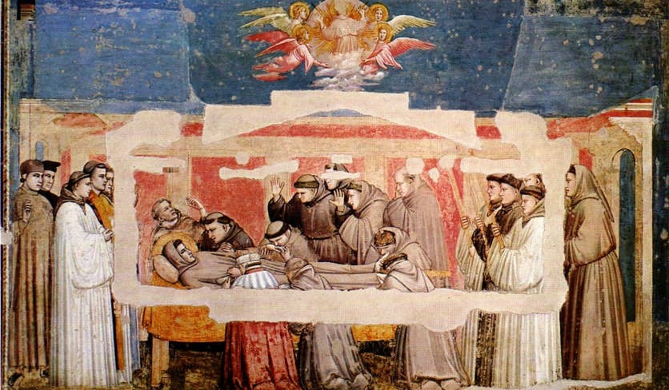
Giotti, Death of St. Francis, c 1320

Slide 29
III. Research as a Tool for Reintegrating Spirituality and Medicine

Slide 30
P-value: The probability that the sample results (e.g., flipping 5 coins in a row heads) are due to chance alone. P<0.05 means there is a less than 5% chance that the finding is due to chance.
When Too Much is Too Little
R. Sean Morrison, M.D., Diane E. Meier, M.D., and Christine K. Cassel, M.D.

Slide 31
Story 1: Patient Spirituality is Important Serious Illness
Coping with Cancer 1 Study (n=343):
“How important is religion to you?”
Balboni et al. Journal of Clinical Oncology, Vol 25, No. 5, 2007.

Slide 32
Story 1: Patient Spirituality in Serious Illness
Religion and Spirituality in Cancer Care Study
75 randomly selected patients receiving palliative RT (RR=73%) in 4 Boston centers
78%: religion and/or spirituality important to advanced cancer experience
Alcorn S et al. “If God wanted me yesterday, I wouldn’t be here today”: Religious and spiritual themes in patients’ experiences of advanced cancer. Journal of Palliative Medicine [in press] 2010.

Slide 33
Qualitatively-grounded religious/spiritual themes in patients’ experiences of advanced cancer, n = 53*
Theme | n (%) | Representative Quote
Coping through R/S | 39 (74) | I don’t know if I will survive this cancer, but without God it is hard to stay sane sometimes. For me, religion and spirituality keeps me going.
R/S practices | 31 (58) | I pray a lot. It helps. You find yourself praying an awful lot. Not for myself, but for those you leave behind. There will be a lot more praying.
R/S beliefs | 28 (53) | It is God’s will, not my will. My job is to do what I can to stay healthy—eat right, think positively, get to appointments on time, and also to do what I can to become healthy again like make sure that I have the best doctors to take care of me. After this, it is up to God.
R/S transformation | 20 (38) | Since I have an incurable disease that will shorten my life, it has made me focus on issues of mortality and sharpened my curiosity on religion/spirituality and what the various traditions have to say about that. I’ve spent a lot of time thinking about those issues, and it has enriched my psychological, intellectual, and spiritual experience of this time.
R/S community | 11 (21) | Well, I depend a lot upon my faith community for support. It’s proven incredibly helpful for me.

Slide 34
Story 2: Patient Spirituality is a Key Component of Patient QOL
Brady et al. Psycho-Oncology 1999
Multi-institutional cross-sectional study of 1610 cancer patients.
R/S (measured by the FACIT-Sp) → independent predictor of QOL
Controlled for physical well-being, emotional well-being, social well-being, disease, demographic variables
Brady et al. A case for including spirituality in quality of life measurement in oncology. Psycho-Oncology. 1999; 8: 417-428.

Slide 35
Story 2: Patient Spirituality and QOL
Steinhauser et al. JAMA 2000
National survey of 1885 seriously ill patients
Importance of 44 attributes of quality of life near death
9 major attributes ranked
Steinhauser et al. Factors Considered Important at the End of Life by Patients, Family, Physicians, and Other Care Providers. Journal of the American Medical Association. 2000; 284(19): 2476-2482.

Slide 36
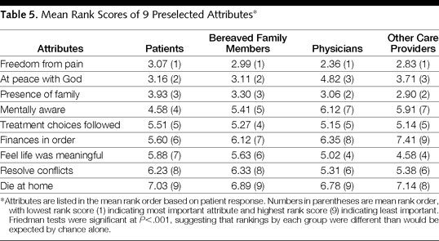
Story 2: Patient Spirituality and QOL
Steinhauser et al. Factors Considered Important at the End of Life by Patien’ts, Family, Physicians, and Other Care Providers. Journal of the American Medical Association. 2000; 284(19): 2476-2482.

Slide 37
Story 3: Patient Spirituality Plays a Key Role in Medical Decision-Making
Silvestri et al. Journal of Clinical Oncology, 2003
100 pts with advanced lung cancer, their caregivers, 257 medical oncologists
Rank 7 factors important to patient in making treatment decisions
Silvestri et al. Importance of Faith on Medical Decisions Regarding Cancer Care. Journal of Clinical Oncology. 2003; 21(7): 1379-1382.

Slide 38
Story 3: Patient Spirituality and Medical Decision-Making
7 factors ranked:
Oncologist’s treatment recommendation
Ability of treatment to cure disease
Side effects
Family doctor’s recommendation
Spouse’s recommendation
Children’s recommendation
Faith in God
#1
#2 for pts/families, #7 MDs

Slide 39
Story 3: Patient Spirituality and Medical Decision-Making
CWC 1 study: Relationship between religious coping and receipt of aggressive medical care at the EOL
Phelps et al JAMA 2009; 301(11): 1143-1147
Notes:
Coping with Cancer Study
Prospective multi-site US study of 345 patients with advanced cancer
Pargament’s brief RCOPE assessed positive religious coping; dichotomized at median to hi or low use of religious coping
Patients followed to death, medical care in last week of life assessed
Primary outcome = intensive life-prolonging care (CPR or mechanical ventilation)

Slide 40
Story 4: Pt Spiritual Support Influences Key Patient End-of-Life Outcomes
Patient’s medical team (e.g., chaplains, doctors, nurses, social workers)
Patient’s community spiritual supporters (e.g., members of a congregation, clergy, etc)

Slide 41
Story 4: Pt Spiritual Support and EOL Outcomes
Multi-site, prospective cohort study of advanced, incurable cancer pts and caregivers, N=343
Purpose: examine psychosocial/ spiritual factors and relationship to EOL and bereavement outcomes

Slide 42
Support of R/S needs by the medical team
Not at all | 143 (42)
To a small extent | 62 (18)
To a moderate extent | 48 (14)
To a large extent | 53 (15)
Completely supported | 37 (11)
Support of R/S needs by religious communities
Not at all | 110 (32)
To a small extent | 43 (13)
To a moderate extent | 43 (13)
To a large extent | 55 (16)
Completely supported | 92 (27)
Pastoral care services | 158 (46)

Slide 43
Medical Team Spiritual Support and
QOL at EOL

Slide 44
Spiritual Support and EOL Medical Care Outcomes
High Spiritual Support from Medical Team (26%)
Greater hospice (OR = 2.99, p=0.003)
Less aggressive interventions (OR = 0.38, p=.04)
Less ICU deaths (OR = 0.23, p=0.03)
Impact of med team spiritual support on EOL care largely seen in high religious coping patients
High Spiritual Support from Religious Communities (43%)
Less hospice (OR = 0.38, p=.03)
Greater aggressive interventions (OR = 2.55, p=.03)
More ICU deaths (OR= 5.73, p=0.004)
Findings stronger among racial/ethnic minority, high religious coping patients
Balboni JCO 2010;
Balboni JAMA Int Med 2013

Slide 45
Story 5: Religious Beliefs about EOL Medical Care are Common and Influence Treatment Preferences
NCI-funded Coping with Cancer 2 Study (PI Prigerson)
Multisite, cohort study of 400 advanced cancer patients examining factors influencing racial/ethnic disparities in EOL medical care
Outcomes: medical care in last 1 month of life, quality of life.

Slide 46
Story 5: Spiritual Beliefs about EOL Medical Care
7 questions assessed religious beliefs/values about EOL medical care seen in the literature (e.g., miracles, sanctity of life)
Response options (5 point): Not at all, a little, somewhat, quite a bit, a great deal

Slide 47
Religious Beliefs about EOL Care
 | Total | Whites | Blacks | Latino
 | n=133 | n=87 | n=29 | n=17
My belief in God relieves me of having to think about EoL medical decisions | 42% | 27% | 82% | 53%
I accept every possible medical treatment because my faith tells me to | 61% | 55% | 79% | 59%
Agreeing to a DNR order is against my religious beliefs | 8% | 1% | 30% | 7%
I am giving up on my faith if I stop treatment | 25% | 19% | 43% | 24%
God can perform a miracle and cure me | 67% | 51% | 96% | 88%
I must endure medical procedures because suffering is God’s testing | 27% | 14% | 66% | 31%
Faith helps me endure suffering from medical treatments | 54% | 44% | 79% | 63%

Slide 48
Story 5: Religious Beliefs about EOL Medical Care and Treatment Preferences
Religious beliefs about end-of-life care predicted greater preference for aggressive EOL care in MVA (AOR=2.49, p=.003)

Slide 49
A Story Unfolding through Research
Spirituality important within illness
Spirituality influences QOL and medical decision-making
Spiritual care source/content appears to influence QOL and medical decision-making/care
Religious beliefs about end-of-life care are common and appear to influence treatment preferences

Slide 50
Summarizing Our Journey from Asclepius to P-values
Spirituality has only more recently been disconnected from the practice of medicine. This separation is the result of particular philosophies governing Western culture.
This separation, and the fixed gaze on the the material, has important implications for our patients, caregivers, and our institutions.
Research/the empiric method is the primary language of medicine. Research is an important tool to help medicine to see beyond its current gaze and to reintegrate spirituality into the practice of medicine.

