Slide 1
The role of the chaplain in Palliative CAre
Malcolm Marler, DMin, BCC
M. Karen Ballard, MCM, RBCC
Sarah Byrne-Martelli, BCc

Slide 2
Guidelines for Excellence
Palliative care inclusive of all people with serious illness, with language specific to the care of neonates, children, and adolescents
Emphasis on community-based resources and providers
More attention to anticipatory, as well as post-death, grief and bereavement (pp. vi-vii)

Slide 3
“A Community Model
for Hospital Chaplaincy
for Persons with Serious Illness”
Malcolm Marler, D.Min., BCC
Sr. Director, Pastoral Care
UAB Hospital, Birmingham, AL
mmarler@uabmc.edu

Slide 4
Palliative Care
available to all persons with “serious illness”
“a health condition that carries a high risk of mortality and either negatively impacts a person’s daily function or quality of life or excessively strains their caregiver.”
Kelley, A.S., & Bollens-Lund, E. (2018). Identifying the population with serious illness: The “denominator” challenge. Journal of Palliative Medicine, 21(S2).

Slide 5
Chaplaincy Without Walls
Strategy is to care for persons in three contexts:
Hospital
Ambulatory Clinics
Community

Slide 6
Community Is Good Medicine
Vision
Every patient with a serious illness has
a loving and supportive community.

Slide 7
Loneliness is Our “Specialty”
“Loneliness is a state of mind characterized by a dissociation between what an individual wants or expects from a relationship, and what that individual experiences in that relationship.”
John Cacioppo, MD, neuroscientist, Univ. of Chicago

Slide 8
Mortality Risk Factor
Loneliness . . . lack of desired meaningful connections
Significant increase risk of cardiovascular disease.¹
Suppresses the functioning of immune system.²
As dangerous as smoking 15 cigarettes per day.³
As dangerous as obesity.⁴
¹ European Society of Cardiology. "Loneliness is bad for the heart." Science Daily, 9 June, 2018.
² NIH News in Health, “Care and Connection: Loneliness Affects All Ages,” August, 2018.
³ WebMD, “Loneliness Rivals Obesity, Smoking as Health Risk,” 4 May, 2018.
⁴ Holt-Lunstad, Julianne. American Psychological Association. 18 October, 2017.

Slide 9
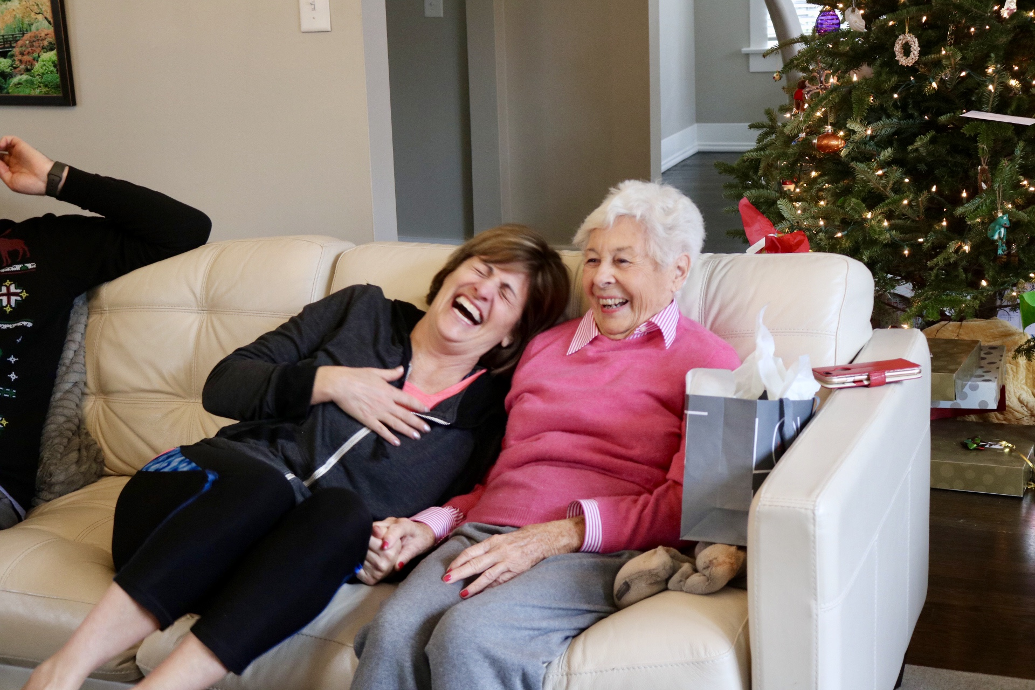
Meaningful Connections Matter
“Strong social relationships can increase the likelihood of survival by as much as 50% relative to individuals whose relationships are weaker.”¹
¹ Holt-Lunstad, Julianne, Smith, Timothy B. , Layton, J. Bradley. “Social Relationships and Mortality Risk: A Meta-analytic Review.” 27, July 2010.

Slide 10
Addressing Loneliness
Hospitals typically address loneliness in health care:
Nurse navigators
Social work
Care Transitions
Case managers
* One employee often follows 25-50 patients

Slide 11
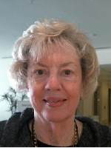
Community Support Team
What if 5-10 persons followed each patient?
“My support team changed my life.”
Transportation to MD appts. monthly
Nutritious meals
Household chores
Regular home visits
Transportation to worship/meetings weekly
Phone calls, handwritten notes
Virginia Lindsey
Notes:
Support Team members provided:
Transportation -17 follow up outpatient visits at UAB;
Provide regular nutritious meals daily;
Assist with household chores;
Visit several times per week;
Transportation to church for worship and meetings weekly;
Regular phone calls;
Personal handwritten notes of encouragement;
No re-admission through January, 2019.

Slide 12
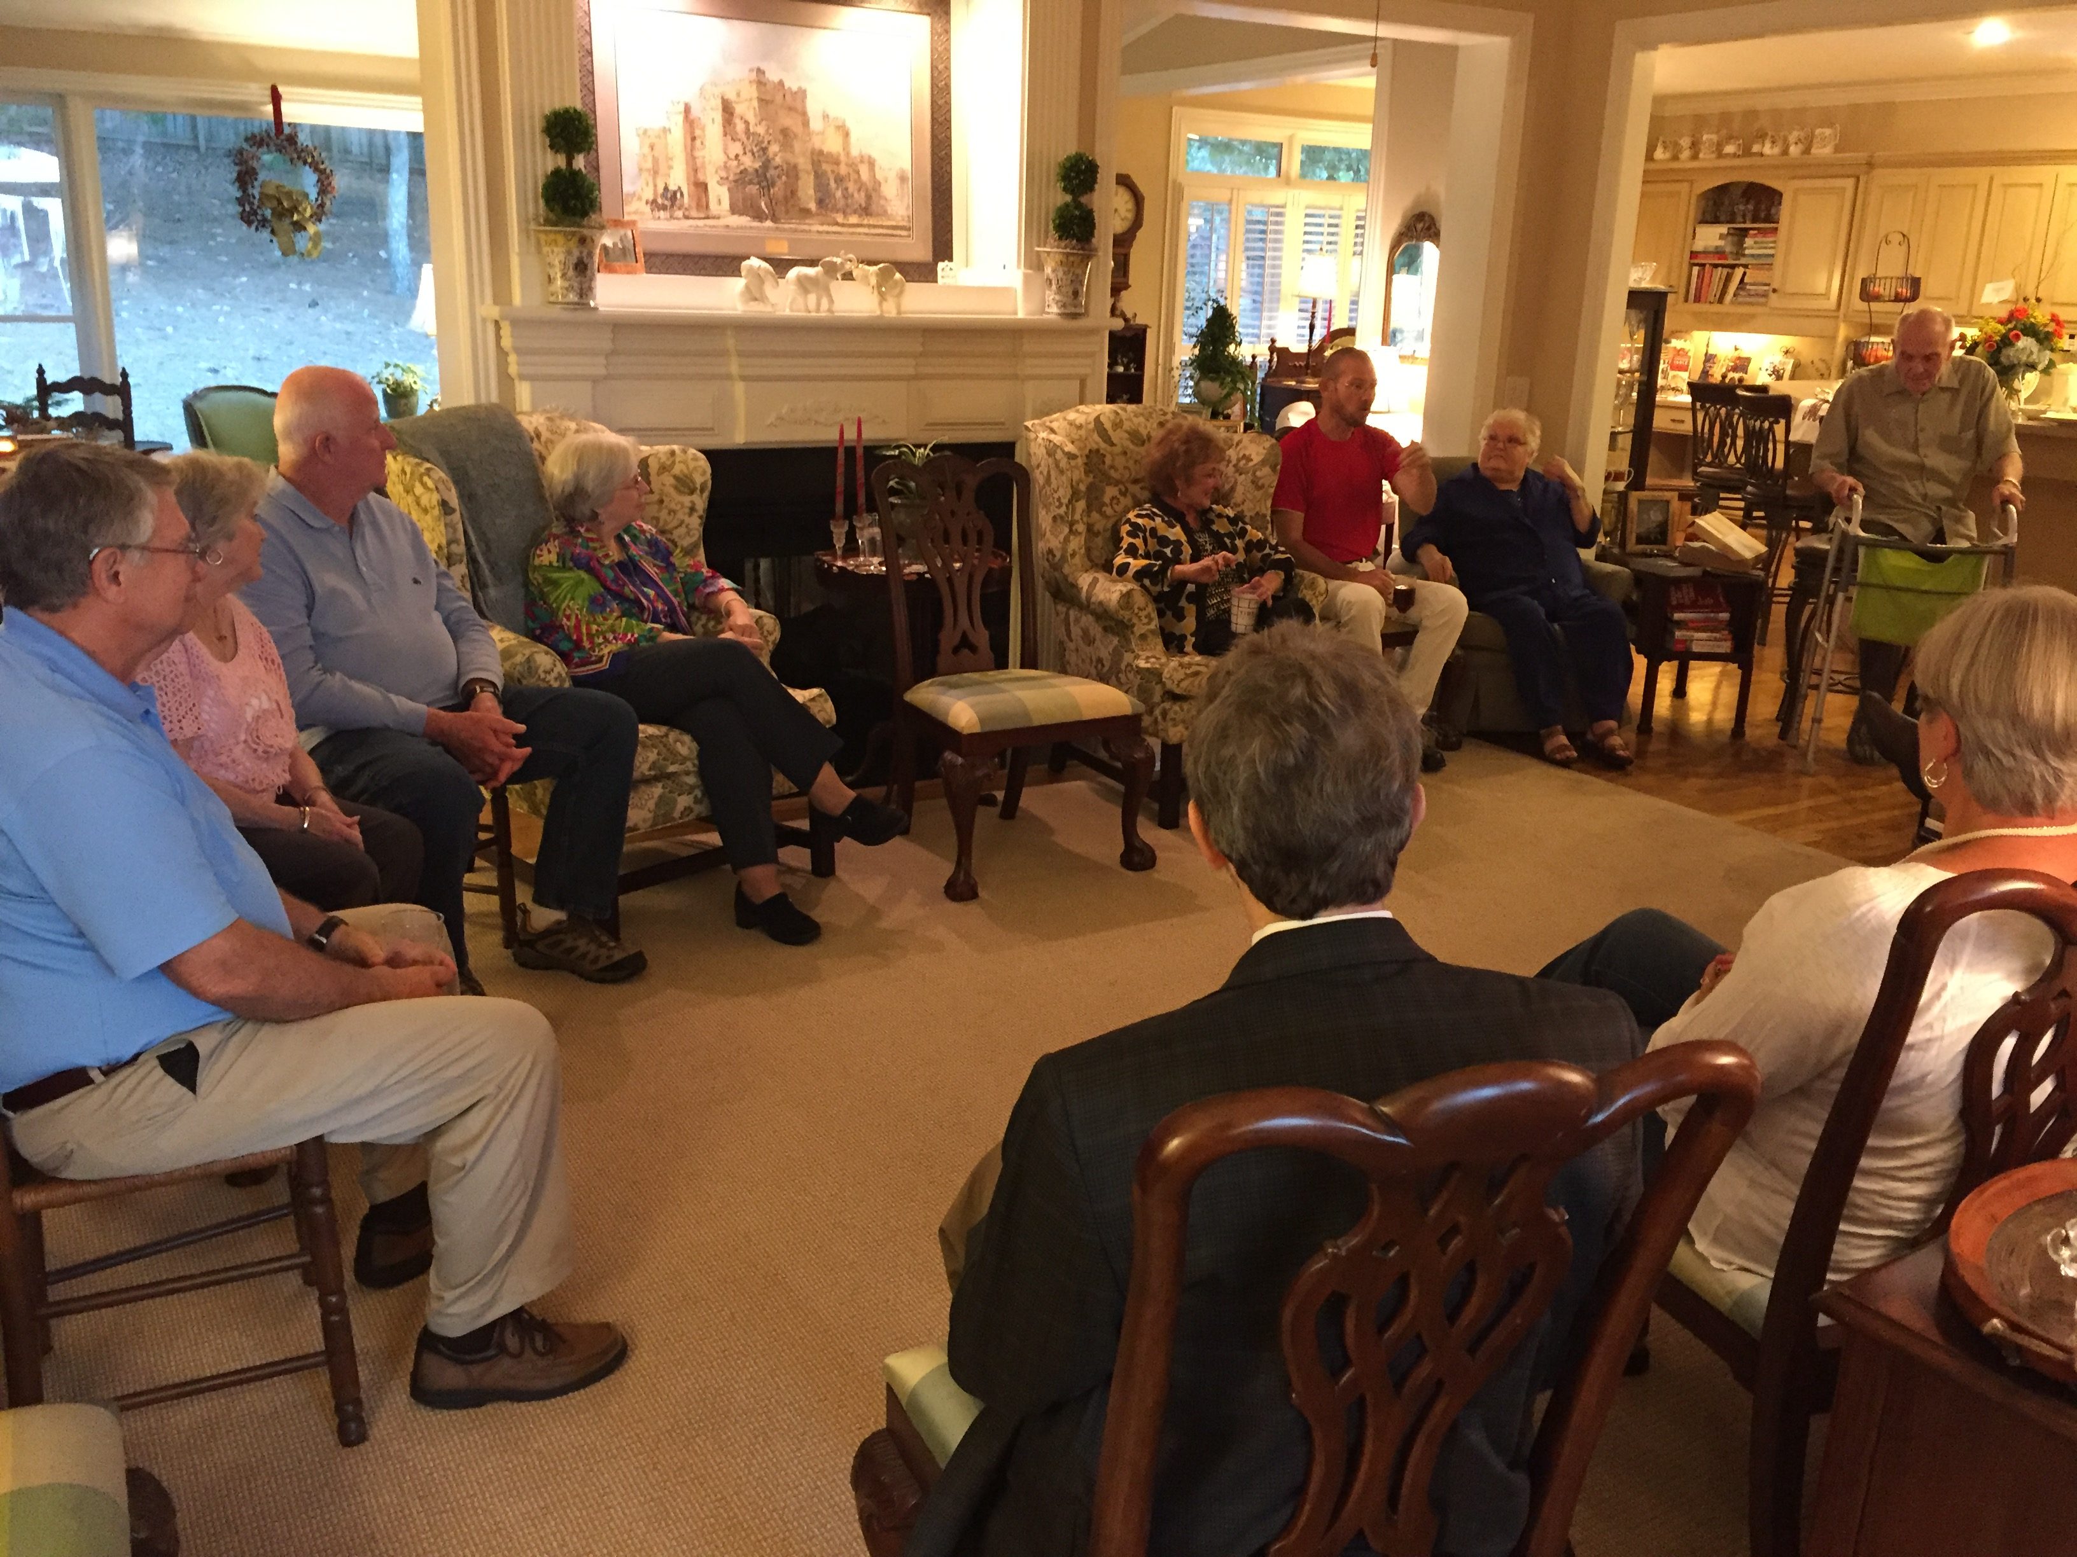
Community Support Team
Volunteers are coordinated
through one trusted friend
to provide practical, emotional,
and spiritual support for a person or family with a serious illness.
Goal is to make it simpler for the patient/family to get what’s needed at the right time and place.
12

Slide 13
What Does a Support Team Do?
Transportation to the doctor, grocery, etc.
Household or yard chores.
Pick up prescriptions.
Cook/deliver meals.
Social outings.
Visit, call, or offer caregivers a break.
Bereavement support for family.
13

Slide 14
What Does a Support Team NOT Do?
The 3-M’s
Money
Giving/loaning money, paying bills, etc.
Medications
Managing medicines
Medical Advice
Taking the place of any healthcare professional
14

Slide 15
Finding Support Team Members
Often, a patient can provide a list
of potential members for their own team.
Has anyone said to you,
“If there is anything I can do, let me know…”
Friends, neighbors, co-workers,
faith community members, affinity groups, etc.
15

Slide 16
Finding Support Team Members
Strategy When There Is No One
Teach and build trust with multiple persons
within a zip code to start teams on their own
so that they can care for persons
they already know, become familiar with model.
Invite them to be a partner with you to start a team for someone who has no one in their zip code.
16

Slide 17
Support Team Best Practices
Do what you love.
When you can.
In a coordinated way.
With a built-in support system.
Set clear boundaries and expectations.
17

Slide 18
Support Team Best Practices
An Open Door (join/leave) to team membership.
Green Bean Casserole rule.
Listen without fixing.
Team Leader delegates, coordinates.
Show by your actions that each person is loved and not alone.
18

Slide 19
Integrating Support Teams in a Hospital System
Unit/Clinic Champion - identifies, consents, refers patient.
Support Team Manager – new team orientation (online).
Community Coach (per diem) - lay person to start team formation within a specific region or zip code.
Data Manager - tracks patients/teams to measure Support Team efficacy (readmission rates, etc.).
Director of Community Engagement/Mission Integration oversees program.
19

Slide 20
Questions/Discussion
Malcolm Marler, D.Min., BCC
Sr. Director, Pastoral Care
UAB Hospital, Birmingham, AL
mmarler@uabmc.edu
205.934.3936
Learn more
www.SupportTeams.org
20

Slide 21
NCP Guidelines: Pediatric Palliative Care
M. Karen Ballard, MCM, RBCC

Slide 22
REFERENCES
Nye, R (2018) “Child Spirituality and Faith Development.” In P. Nash, M. Bartel, S. Nash (eds) Paediatric Chaplaincy Principles, Practices and Skills. London and Philadelphia: Jessica Kingsley Publishers
Ruston, C. and Ballard, M. (2011) “The Other Side of Caring: Caregiver Suffering.” In B. Carter, M. Levetown and S. Friebert (eds) Palliative Care for Infants, Children and Adolescents: A Practical Handbook. Baltimore, MD: The Johns Hopkins University Press

Slide 23
Key Concept
Palliative care is inclusive of all people with serious illness, regardless of setting, diagnosis, prognosis, or age.

Slide 24
Child Spirituality and Faith Development
May run along the same course but can take different paths
Spirituality associated with openness and flexibility
Faith has a more fixed pathway
Distinguishing between the two for a child is very complex
PAEDIATRIC CHAPLAINCY, 2018 Nye, p. 23

Slide 25
Child Spirituality and Faith Development, cont.
Goldman, 1964
Inspired by Piaget’s 3 stages
Age 2-5 Intuitive religious thinking
Age 5-11 Literal religious thinking
Age 11+ Abstract religious thinking
PAEDIATRIC CHAPLAINCY, 2018 Nye, pp. 25-27

Slide 26
Child Spirituality and Faith Development, cont.
Fowler, 1981 & 1987
Draws on Piaget’s intellectual development, Erikson’s psychological development and Kohlberg’s moral development
Stage 0: Infants-3 YO Primal or Undifferentiated Faith
Stage 1: 3-6 YO Intuitive-Projective Faith
Stage 2: 6-12 YO Mythical-Literal Faith
Stage 3: Adolescents Synthetic-Conventional Faith
PAEDIATRIC CHAPLAINCY, 2018 Nye, pp. 26-27

Slide 27
Chaplaincy must consider how best to…
Think imaginatively about the experience of each child
Cultivate a “high-expectations” view of the spirituality of childhood
Ensure that practices live up to the quality and potency of children’s spirituality
PAEDIATRIC CHAPLAINCY Nye, p. 31

Slide 28
Family-Centered Care
Throughout the guidelines, it is noted that the patient identifies their family
Family more obvious in pediatrics but still requires careful assessment of the roles of various individuals
Recommend Krista Gregory’s chapter on family systems in PAEDIATRIC CHAPLAINCY: PRINCIPLES, PRACTICES AND SKILLS, 2018

Slide 29
Plan of care is dictated by patient and family
Team members assess for need
In collaboration with patient and family, the plan of care is determined.
The patient and family is always in the driver’s seat.

Slide 30
What is Pediatric Palliative Care?
A Palette of Care

Slide 31
PT/OT/Speech/allied health
Perinatal staff
Spiritual care
Palliative medicine specialists
Case management
Primary care providers Involved subspecialists
Social Work
Expressive therapy
Volunteers
Child life
Dietitian
School personnel
Bereavement
Nursing (incl. home)
Patient/family: whole canvas

Slide 32
Guidelines of Note
Guideline 6.3.3. When the patient is a child or adolescent the IDT assessment also identifies:
Guideline 8.2.3. Attention is paid to the rights of children and adolescents in decision-making as well as applicable statutes

Slide 33
Guidelines of Note, cont.
Guideline 8.3.7. Patients and families are routinely encouraged to create or update legal and financial documents such as wills, guardianship agreements and custody documents

Slide 34
6.3.3
3.a. The role of the child or adolescent in the family and how culture defines a minor’s status in the family
3.b. Whether parents share information about important matters with their child(ren), including siblings, foster children, and whether these decisions reflect the family’s cultural preferences
3.c. How the parents define being a good parent and how that impacts medical decision making.

Slide 35
6.3.3 cont.
3.d. Whether the family’s culture permits parents to make decisions for their minor or if medical decision-making authority is deferred to religion or culture leaders
3.e. The meaning attributed by the minor and family regarding how and why the illness occurred, childhood suffering and death and how that impacts decision-making.

Slide 36
6.3.3 cont.
3.f. When serious illness is diagnosed in utero (perinatal), the meaning of the pregnancy and childbirth practices are valued in the parent’s culture(s)

Slide 37
8.2.3
When does a minor get to make their own health-care decisions?
Important to know the state statutes

Slide 38
8.2.7
Minors should have the opportunity to create advance care directives and wills
My Wishes, Voicing My Choices, Five Wishes published by Aging with Dignity

Slide 39
Guidelines of Note
Guideline 5.1.10. Led by the chaplain, opportunities are provided to engage staff in self-care and self-reflection regarding their own spirituality.
Guideline 5.1.11. Every member of the IDT is trained in spiritual care and recognizes the importance of the spiritual aspects of care.

Slide 40
Caring for the Team
Reflecting upon the questions of transcendence
Acknowledging the experience of suffering
Transforming suffering by creating meaning
Developing forums for discussion and reflection
Creating an environment of respect for patients, families and caregivers

Slide 41
Caring for the Team, cont.
Fostering respectful communication, decision-making and conflict resolution
Creating mechanisms for acknowledging and processing grief and loss
Developing self-care practices
Cultivating healthy boundaries
PALLIATIVE CARE FOR INFANTS, CHILDREN AND ADOLESCENTS, 2011
Rushton and Ballard, pp. 329-336

Slide 42
NCP Guidelines: Chaplaincy and Bereavement
Sarah Byrne-Martelli, BCC
Division of Palliative Care,
Massachusetts General Hospital

Slide 43
NCP Change in terminology
From:
“Care of the Patient at the End of Life”
To: “Care of the Patient Nearing the End of Life”

Slide 44
“Work your magic?”
Notes:
Guideline on bereavement is expanded, emphasizing the responsibility of all clinicians caring for the seriously ill to ensure bereavement services are offered, even when hospice is not involved in the patient’s care.
We all have the magic now!

Slide 45
Everyone has the magic.
“All clinicians must have the knowledge and skills to talk to patients and families about dying” (p. 49)
Notes:
Guideline on bereavement is expanded, emphasizing the responsibility of all clinicians caring for the seriously ill to ensure bereavement services are offered, even when hospice is not involved in the patient’s care

Slide 46
Domain 7: Assessment and Plan
Develop plan to meet patient and family needs throughout dying process
Cultural and spiritual preferences of the patient and family particularly relevant (7.3.1)
IDT provides anticipatory grief support to the family and caregivers (7.3.8)
Notes:
**before, during, and immediately following the patient’s death

Slide 47
Practice Example D7-A: Large Children’s Hospital
New emphasis on palliative care, especially when caring for children with a higher risk of death…
Develop new protocols for symptom management
Dedicated room for imminently dying infants to provide privacy
Comprehensive bereavement program provides support to grieving family, including follow-up through the first year after death
Notes:
They have these examples for all domains!!
Assessment - symptom management includes all symptoms including phycho-social-spiritual
Private room – for anticipatory grief

Slide 48
Domain 7: Cultural Care of the Body
IDT provides respectful care of the body and support for the family based upon cultural & spiritual practices
Post-death care is in accordance with agency practice, local laws, and state regulations (7.4.3)
Assisting with cultural or spiritual practices, funeral arrangements, and cremation or burial planning (7.4.4)
Notes:
either directly or in collaboration with others
Again these practices are identified BY the patient and family PRIOR

Slide 49
Practice Example D7-D: Hospice expansion
Challenged by spiritual and cultural beliefs of new population
Families request own clergy, decline chaplain involvement
Declining care from opposite gender caregivers
Death at home not culturally acceptable and marks them unfavorably, thus request hospitalization at EOL

Slide 50
Practice Example D7-D: Hospice expansion
Engage cultural representatives from the community to better understand context
Chaplains create interfaith discussion group with community clergy and advisory council
Hospice explores ways to hire male staff to increase its capacity
Hospice contracts with local nursing homes so that patients do not have to die at home
Notes:
Which as we know is not indicated medically, increases costs, sets up inappropriate expectations

Slide 51
Domain 7.5: Bereavement Services
IDT directly provides bereavement services and support for a minimum of 13 months after the death
Process in place outlining specific roles and responsibilities of IDT members in the provision of bereavement services
Identifies one IDT member with bereavement care expertise to help other staff and volunteers utilize evidence based practices (7.5.2)

Slide 52
Bereavement Follow-up at MGH
Signed personal bereavement card
Bereavement letters (6w; 3m; 6m; 9m; 13m)
Fall & Spring Support groups
Holiday Bereavement presentation
Emails and telephone inquiries
1-2 meetings with family; referrals

Slide 53
Domain 7.5: Bereavement Services
Developmental, cultural, and spiritual needs and preferences of the family (7.5.6)
Grieving children are referred to pediatric grief specialists, programs, and camps based on their age and needs (7.5.7)
IDT assesses resiliency, cumulative loss, and grief
Emotional support services are also made available to ancillary team members involved in supporting palliative care patients (7.5.8)
Notes:
These services are in accordance with cultural needs
IDT supports each others

Slide 54
Practice Example D7-E: Community Palliative Care
15% of the patients and families waiting until close to death to access hospice; repeated occurrences of stressful deaths…
Develop rapid response program for late admissions
Better integrate chaplain into the team for pts who are eligible but decline hospice care
Track outcomes, including time spent on hospice care, and family caregiver distress and satisfaction
Debrief short LOS patients for QI

Slide 55
The Takeaway
Concept of Bereavement generalists
Team approach to care
Across continuum of disease process
Ongoing, continuous assessment

Slide 56
The Takeaway for Chaplaincy
Advanced chaplaincy practice within team:
Cultural humility / advocacy
Identifying sources of strength and comfort
Rituals and the body
Research literacy around best practices for bereavement

Slide 57
Key Research Articles
Starting a Pall Care bereavement program in a hospital (Morris 2015)
Bereavement care pathway for Pall Care (Hudson 2018)
Bereaved parents as trained educators (Snaman 2018)
Empowering bereaved parents (Snaman 2018)
Notes:
Bereavement initiative and assessment; adding value to a hospital
Literature review and 10 standards for care
Education from bereaved parents can sig. improve clinician care
Barriers and facilitators to implementation; collaboration w chaplaincy

Slide 58
Key Research Articles
Terminal diagnoses which necessitate more bereavement support (Jones 2010)
Palliative sedation: effect on bereavement? (Bruinsma 2015)
Bereavement assessment models (Rubin 2008)
Notes:
Alzheimer’s, ESRD
No negative affect of family’s experience or wellbeing after death
Concept of continuing bonds
We should be able to look up and find the best models for assessment, bereavement, etc.

Slide 59
Spirituality mediates Grief
Coping with guilt, shame, forgiveness
Reconstruction of identity / sense of self
Reconstruction of the assumptive world
Transcendental connection as a source of strength
Burke, Laurie, and Robert Neimeyer. "The Inventory of Complicated Spiritual Grief: Assessing Spiritual Crisis Following Loss." Religions 7, no. 6 (2016): 67.
Notes:
(Job / Gilgamesh)

Slide 60
Spirituality Facilitates Grief
“Continuing bonds” (Klass et al., 1996)
Mourner’s Kaddish, veneration of elders, 40-day memorials, “Memory Eternal,” family altars…
Doka, Kenneth J. "Spirituality and Religion in the Lives of Elders." Social Isolation of Older Adults: Strategies to Bolster Health and Well-Being (2018): 124.

Slide 61
Community Grief Ritual: MGH “Service of Remembrance and Hope”
“There is no more ridiculous custom than the one that makes you express sympathy once and for all on a given day to a person whose sorrow will endure as long as his life. Such grief, felt in such a way, is always ‘present’; it is never too late to talk about it, never repetitious to mention it again.” – Marcel Proust

Slide 62
Malcolm Marler, DMin, BCC M. Karen Ballard, MCM, RBCC Sarah Byrne-Martelli, BCc
Questions?

