Slide 1
ACTIVITY DISCLOSURES
Participants must review this information prior to start of educational activity
ANCC Accreditation Statement
The Maryland Nurses Association is an accredited approver of continuing nursing education by the American Nurses Credentialing Center’s Commission on Accreditation.
Criteria for Successful Completion
In order to successfully complete this activity and receive full contact-hour credit for this CNE activity, you must:
Attend in person and fill out the evaluation form at the end of the session and hand it in.
Conflicts of Interest
Was a conflict of interest or potential bias found for any activity planners and/or presenters of this educatioal activity?
þNo □Yes
If yes, identify the individuals and the conflict of interest
Commercial Support
Is this activity support □Yes

Slide 2
Faith Community Nurses and Chaplains: Partners in Providing Spiritual Care
Sharon T. Hinton D. Min, MSN, BSN, RN-BC
hintons@churchhealth.org
WWW.WESTBERGINSTITUTE.ORG

Slide 3
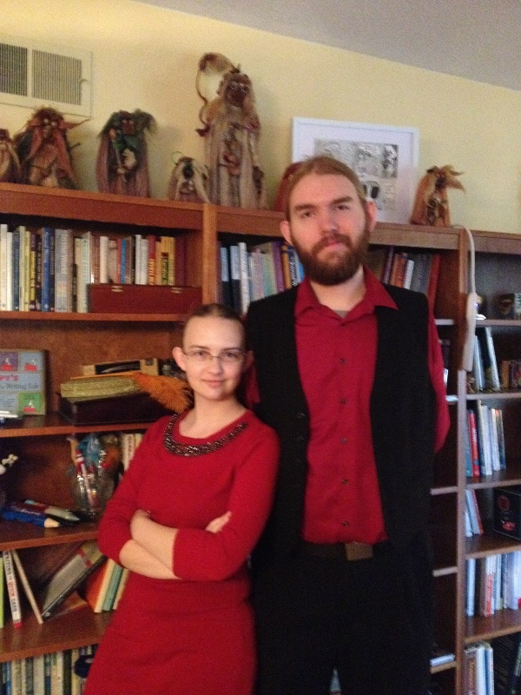
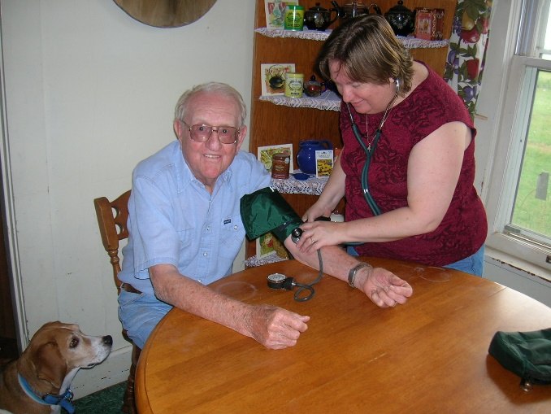
About your presenter…

Slide 4
Introductions
How long have you been a nurse, faith community nurse or chaplain?
Your setting
Where do you see the possibilities for working together between nurses, FCNs and Chaplains in your area of practice?

Slide 5
Spirituality
A dynamic and intrinsic aspect of humanity through which persons seek ultimate meaning, purpose and transcendence, and experience relationship to self, family, others, community, society, nature, and the significant or sacred. Spirituality is expressed through beliefs, values, traditions and practices. (Pulchalski, et al. 2014).
Notes:
Spirituality refers to our inner belief system. It is a delicate ‘spirit-to-spirit’ relationship to oneself, and the God of one’s understanding. Everyone is a spiritual being.

Slide 6
Religion
Like spirituality, religion is also multidimensional.
It is “man-made”
Addresses life, death, and after death concerns
Provides personal as well as social identity
Defines and determines behavioral patterns
Teaches ritual and traditional forms of religious expressions.
Notes:
Religion refers to the externals of our belief system: community worship, prayers, traditions, rites, rituals, etc. Not everyone is religious.

Slide 7
Our focus as FCNs & Chaplains
Spirituality
FCN & Chaplain focused care
Religion

Slide 8
Spiritual, Pastoral and Chaplaincy Care
Spiritual Care: Person-centered care which seeks to help people (re)discover hope, resilience, and inner strength in times of illness, injury, transition, and loss

Slide 9
Spiritual, Pastoral and Chaplaincy Care
Pastoral Care: A focused deliberate intention of caring within a person’s theological context and understanding, utilizing their tradition’s rites and practices

Slide 10
Spiritual, Pastoral and Chaplaincy Care
Chaplaincy Care: Spiritual care for persons of ALL FAITH TRADITIONS AND NONE, providing customized interventions that are sensitive to the unique spiritual, emotional, religious, and cultural needs of persons, identifying and contributing toward a specific positive outcome.
Notes:
Chaplains do not superimpose or proselytize any specific religious or spiritual tradition.

Slide 11
Benefits of Spirituality ACTIVITY
With your partner, list the positive impacts that come to mind related to spirituality, religion, & existential beliefs
Notes:
Research has demonstrated the positive impact of religious, spiritual and existential beliefs, values and practices on humans

Slide 12
Spiritual Well-Being – Spiritual Health
Defined as having a sense of connection and inner strength, comfort, love and peace that individuals derive from their relationship with self, others, nature, and the transcendent.

Slide 13
Spiritual Distress
Nursing: “a state in which the individual is at risk of experiencing a disturbance in his/her system of belief or value that provides strength, hope, and meaning to life.”
HCCN: “impaired ability to experience and integrate meaning and purpose in life through connectedness with self, others, art, music, literature, nature, and/or a power greater than oneself.”

Slide 14
Spiritual Distress, Spiritual Pain
Specific to the individual, so each causative factor must be understood in terms of its personal significance and meaning for that person
In other words, we need to hear people’s stories—their personal life experiences, feelings, and intuition or sense of ‘inner knowing’.

Slide 15
Spiritual Distress Emotional
Restlessness, agitation, anxiety
Denial of illness or of reality of prognosis
Powerlessness or loss of control
Depression/flat affect
Dreams or nightmares
Notes:
Physical signs of spiritual pain and suffering might include emotional, behavioral and verbal cues

Slide 16
Spiritual Distress Behavioral
Refusal to take medications
Refusal with help with activities of daily living
Power struggles with family members/care givers
Frantically seeking advice from everyone
Withdrawal/isolation
Statements about not wanting to be a burden
If active in a religious, spiritual, existential or cultural tradition, refusal to see leaders/members of the community, or stops practices

Slide 17
Spiritual Distress Verbal
• “Why me?” (unfairness)
• “I don’t want to be a burden?” (unworthiness)
• “What’s the point?” (hopelessness)
• “It’s a punishment!” (guilt)
• “No one really understands” (Isolation)
• I’m a coward” (vulnerability)
• “God doesn’t care” (abandonment)
• “But I’ve led a good life” (punishment)
• “Why does God allow suffering?” (confusion)
• “My life’s been wasted” (meaninglessness)

Slide 18
Generalist Spiritual Care
All members of a person’s health care team can learn to screen for spiritual strengths and spiritual distress and incorporate basic spiritual resources and interventions into the patient care plan including supporting the patient’s expression of their needs and beliefs.

Slide 19
Generalist Spiritual Care
Many of the clinical skills that a professional health care provider already possesses—such as good listening, visual observation skills, and a compassionate presence—are essential ingredients of a generalist’s spiritual caregiving.

Slide 20
Generalist Spiritual Care
Ensures that spiritual and religious concerns are identified in every person’s care plan
Identify person’s spiritual and religious resources that can be activated for support
Screen for issues of distress
Address simple issues by incorporating basic spiritual resources and interventions
Provide for specialist care for complex issues

Slide 21
Generalist Spiritual Care Training
Understand one’s own source of meaning and practices of spirituality: meaning and purpose, traditions and practices
Identifying one’s biases or judgments about what others may or may not believe as well as the ways in which they find comfort and strength
Hospitality and respect for all spiritual, religious, existential, and cultural traditions
Emphasis on the person receiving care

Slide 22
Specialist Spiritual Care
Board certified chaplains are uniquely trained to be the spiritual care specialists within health care
Master’s degree, in-depth clinical training, review process for certification including standardized knowledge test and simulated patient encounter

Slide 23
Specialist Spiritual Care
Quality Indicators– including the metrics that indicate quality care is present and evidence-based tools to measure that quality
Scope of Practice – to effectively and reliably produce quality spiritual care and to establish what chaplains need to do to meet those indicators
Professional Code of Ethics

Slide 24
Specialist Spiritual Care
Provide spiritual care to persons of all spiritual, religious and existential traditions as well as those who have none
Complete spiritual assessments to identify a person’s spiritual, religious, existential, cultural and emotional beliefs and values within his or her personal context and narrative
Includes ascertaining a person’s sources of meaning, strength and coping as well as any issues of spiritual pain, suffering or distress.

Slide 25
Specialist Spiritual Care
From the assessment, the chaplain generates a spiritual care plan that describes the issues that have been addressed through his or her interventions and next steps to be taken throughout the patient’s care.
All these elements are documented in the patient medical record and shared with other members of the health care interdisciplinary team.

Slide 26
Specialist Spiritual Care
Board certified chaplains have a wide range of interventions
Combine “doing”, “being”, “practical matters,” and “ultimate concerns” in ways that are unique to their scope of practice
Provide active spiritual and emotional support to other members of the interdisciplinary team, as well as education, coaching and mentoring for generalists to learn how and continue to effectively provide effective spiritual care to patients and families within their scope of practice

Slide 27
Specialist Spiritual Care Challenges
Not every community or health care setting employs a board certified or credentialed chaplain
Some settings employ persons who have not received any training in spiritual care, professional boundaries, or the importance of focusing on the spirituality of the person rather than imposing beliefs upon them

Slide 28
Opportunities for Faith Community Nurses
Effective April 2018, the Spiritual Care Association, an affiliate of HCCN, is offering FCNs affiliated with the Westberg Institute, the following three offerings:
Spiritual Care Generalist Certificate
Credentialed Chaplain (CC)
Board Certified Chaplain (BCC)

Slide 29
To Qualify:
Be an affiliate of the Westberg Institute
Knowledge Sharing Platform
Have completed one of the following:
WI 2014 Foundations of Faith
Community Nursing Course
WI FCN Practice Update Webinar
Notes:
The WI 2014 Foundations of Faith Community Nursing Course
IPNRC Foundations Course AND a complete a current WI FCN Practice Update Webinar
Provide proof of attendance AND content outline of other FCN preparation course for review by the WI FCN Chaplain Committee AND complete a current WI FCN Practice Update Webinar

Slide 30
Spiritual Care Generalist Certificate
Complete the three online self-directed courses in the Spiritual Care Association Learning Center:
What Every Health Care Professional Needs to Know about Spiritual Care
When It’s Time to Say Goodbye: Introduction to Spiritual Care at the End of Life
Talking about What Matters: Advance Directives and Planning
Cost: $199 exclusive to Westberg affiliates only
Timeline to complete: 6 months, Certificate valid for 2 years
Renewal: 4 hours of continuing education CEUs and $49 fee

Slide 31
Spiritual Care Generalist Certificate
An additional credential to add to one’s experience and CV
Ability to work more intentionally with spiritual issues raised by persons and their families
Raises effectiveness of use of spiritual care screening, intervention, and documentation tools
Provides an additional level of care to complement that of community religious leaders
Ensures ability to discuss and complete advance directives documents with persons

Slide 32
Credentialed Chaplain (CC)
Letter from Westberg Institute affirming affiliate is qualified
Official transcript of a Bachelor’s degree from a CHEA accredited (or international equivalent) institution
Complete the online self-directed courses in the Spiritual Care Association Learning Center :
What Every Health Care Professional Needs to Know About Spiritual Care
When It's Time to say Goodbye – Introduction to Spiritual Care at the End of Life
Talking about What Matters: Advanced Directives and Planning
Preparation for Standardized Clinical Knowledge Test for Board Certified and Credentialed Chaplains

Slide 33
Credentialed Chaplain (CC)
Submit employer letter(s) verifying proof of working a minimum of 1,000 hours as a chaplain since completion of clinical training, OR receive a Provisional CC status (which will be automatically transferred to CC status once the work hour requirement is fulfilled – within two years)
Submit three (3) letters of recommendation
Successfully pass the Standardized Patient Exam
Successfully pass SCA’s Standardized Clinical Knowledge Test

Slide 34
Credentialed Chaplain (CC)
Cost: $399 exclusive to Westberg affiliates only
Timeline to complete: up to 10 months
Renewal: 24 hours of continuing education every two years; annual renewal of accountability of ethical conduct; SCA membership ($95) and annual maintenance fees ($150)

Slide 35
Credentialed Chaplain (CC)
An additional credential to add to one’s experience and CV
Provides an additional level of expert care in working alongside community religious leaders
The title of Credentialed Chaplain (CC) attests to your level of competence in the profession, demonstrating the competencies to perform normal chaplaincy tasks in non-complex settings and under the supervision of a Board Certified Chaplain (BCC) in complex settings
Increases professional opportunities to expand work into hospice, long-term care, hospital and other health care settings if desired

Slide 36
Board Certified Chaplain (BCC)
Letter from Westberg Institute affirming affiliate is qualified
Providing official documentation of completion Master’s degree of at least 30 credits from a CHEA accredited (or international equivalent) institution
Complete one unit (400 hours) of clinical training. SCA will offer a tailored CPE program for faith community nurses if there is interest.

Slide 37
Board Certified Chaplain (BCC)
Courses Required (two of these are part of a SCA CPE unit)
What Every Health Care Professional Needs to Know About Spiritual Care
What We Hear and Say: Spiritual Assessment and Documentation
When It's Time to say Goodbye – Introduction to Spiritual Care at the End of Life
Talking about What Matters: Advanced Directives and Planning
More than Listening: Counseling Skills
Preparation for Standardized Clinical Knowledge Test for Board Certified and Credentialed Chaplains

Slide 38
Board Certified Chaplain (BCC)
Submit employer letter(s) verifying proof of working a minimum of 2,000 hours as a chaplain since completion of clinical training, OR receive a Provisional BCC status (which will be automatically transferred to BCC status once the work hour requirement is fulfilled – within two years)
Submit three (3) letters of recommendation
Successfully pass the Standardized Patient Exam
Successfully pass SCA’s Standardized Clinical Knowledge Test
Accountability for Ethical Conduct

Slide 39
Board Certified Chaplain (BCC)
Cost to Participate: $1,299 exclusive to Westberg affiliates only
Timeline to Complete: Up to 12 months
To Renew: 48 hours of continuing education every two years; annual renewal of accountability of ethical conduct; SCA membership ($95) and annual maintenance fees ($150)

Slide 40
Board Certified Chaplain (BCC)
An additional credential to add to one’s experience and CV
Provides an additional level of expert care in working alongside that of community religious leaders
The title of Board Certified Chaplain (BCC) attests to your level of competence in the profession to perform all of the normal tasks within the scope of practice of chaplains in both complex and non-complex settings
Increases professional opportunities to expand work into hospice, long-term care, hospital and other health care settings if desired

Slide 41
Spiritual Care Association Membership
Annual Benefits: $95 Annual Membership Fee
The Chaplain Connection – Online Resource Center & Community
Discounted Price for Online Professional Education Courses
3 Free Spiritual Care Grand Rounds Webinars Annually
Discounted Registration for Annual Caring for the Human Spirit® Conference
Electronic Subscription to Journal of HealthCare Chaplaincy
Subscription to Caring for the Human Spirit® Magazine
Monthly Spiritual Care Updates
Membership Directory
Networking Opportunities
Online Membership Dashboard
A powerful voice for spiritual care advocacy

Slide 42
QUESTIONS???

Slide 43
References
Anandarajah and Hight. Spirituality and Medical Practice: Using the HOPE Questions as a Practical Tool for Spiritual Assessment. 2001.
Daaleman T. A Health Services Framework of Spiritual Care. 2012. J Nurs Manag. 20(8).
Fitchett G and Risk J. Screening for Spiritual Struggle. J Pastoral Care and Counseling. 2009. 63(1-2):4-1-12.
Handzo G. “Generalist plus Specialist Spiritual Care. 2010. Handzo Consulting. Blog Post.
HealthCare Chaplaincy Network. Spiritual Care: What it Means, Why it Matters in Health Care. 2016.
HealthCare Chaplaincy Network. Quality Indicators and Scope of Practice for Chaplains. 2016.
HealthCare Chaplaincy Network. Spiritual Care and Nursing: A Nurse’s Contribution and Practice. 2017.
HealthCare Chaplaincy Network. The Evidence of the Positive Impact of Chaplaincy and Spiritual Care: Summary of Key Findings on the Efficacy of Professional Chaplaincy. 2015.
Monod S, et al. The Spiritual Distress Assessment Tool: An Instrument to Assess Spiritual Distress in Hospitalized Elderly Persons. 2010. BMC Geriatrics. 10:88.
Puchalski C and Ferrell B. Making Health Care Whole. 2010. Templeton Press. ISBN-10: 159947350X.
Puchalski, C, Virani, R., Ferrell, B., Otis-Green, S., Baird, P., et al. Improving the Quality of Spiritual Care as a Dimension of Palliative Care. 2009. Journal of Palliative Medicine, 12(10).
Robinson M, Thiel M, et al. Efficacy of Training Interprofessional Spiritual Care Generalists. 2016. Journal of Palliative Medicine. 19(8).
Ziebarth D. Evolutionary Conceptual Analysis: Faith Community Nursing. J Relig Health. 2014. 53:1817-1835.

