Slide 1
Technology on the Religious and Spiritual Counselling (Tahoor Application)
Anas AlShedokhi
Chairperson,
Religious & Spiritual Counseling Department

Slide 2
Declaration
I have nothing to declare

Slide 3
Objectives
To identify the benefits of using technology in Religious & Spiritual education programs.
To introduce Tahoor Application.

Slide 4
About King Fahad Medical City
1200 beds
Four Hospitals (women, children, rehabilitation, Main)
Four Center of Excellences (Heart, Cancer, neurosciences, metabolic and obesity)
Accredited national and international

Slide 5
About King Fahad Medical City

Slide 7
Religious and Spiritual Counseling Services
RSCS

Slide 9
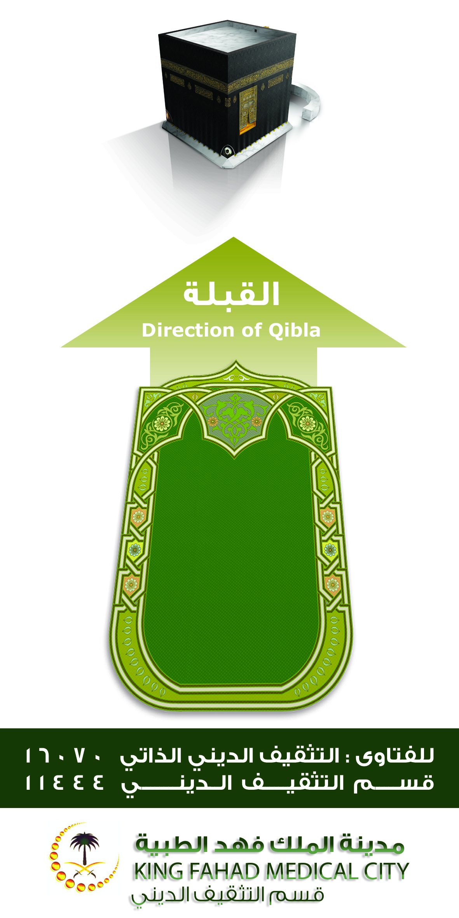
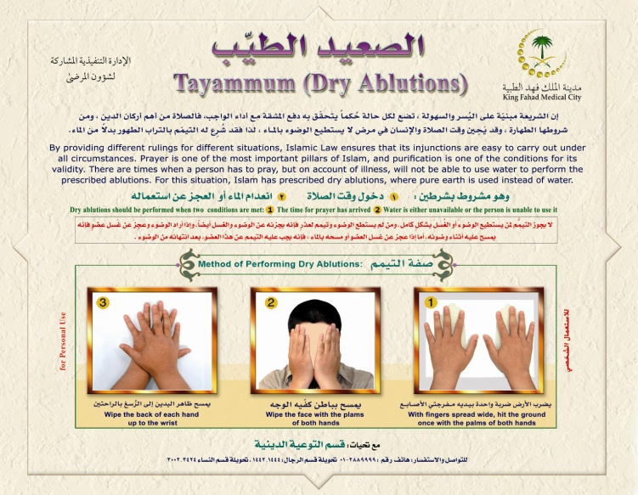

Slide 10
Referral
Contact RSC
Assessment & Management
Documentation

Slide 11
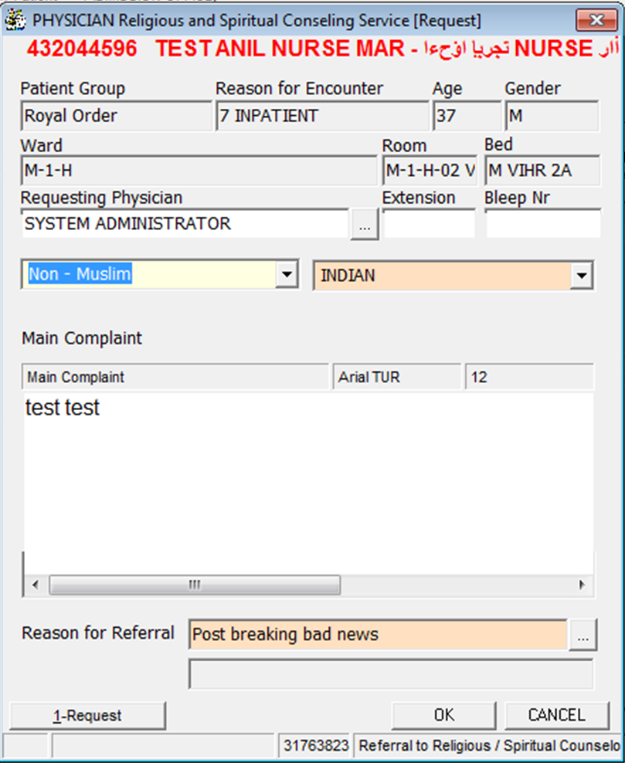
How to refer Patient
Fill in the form
Contact RSC @ 11444
or send email to RSCCounseling@kfmc.med.sa

Slide 13
Patient Services
Patient
Education

Slide 14
Educational Opportunities:
Counseling session through proper dialogue & answering questions
Using educational materials
Guidance to the resources (internal extension, Tahoor application)

Slide 15
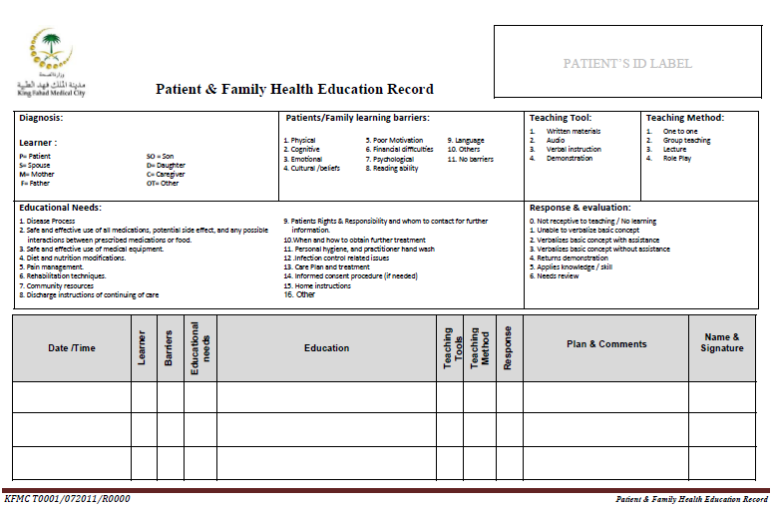

Slide 16
Educational Challenges:
No unified answer
Available for limited time (working hours).
Space.
Time consuming (average 40%)
Any more challenge?

Slide 17
Technology

Slide 18
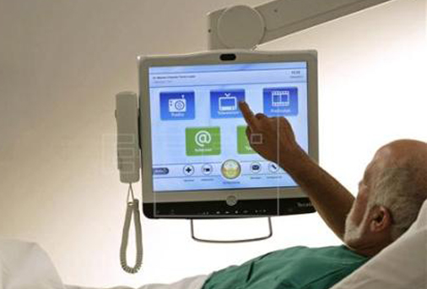
Impact of Technology on Spiritual Education:
More attractive,
Easy delivering the information
Saving time.
Can be use any time.
More population.
Any more impact?

Slide 19
Expected outcome:
Unifying the answer between the counselor
Availability for 24/7
Maintain patient privacy
Enhance accessibility

Slide 20
Religious Self Education (answer machine):
Collecting answers for most frequent questions (74)
Recording all answer (Fatwa)
Grouping the answer according to subject.
Link it with internal phone extension
The experience shared with many hospital now.
Plan to translate it to another language.
Call Now

Slide 21
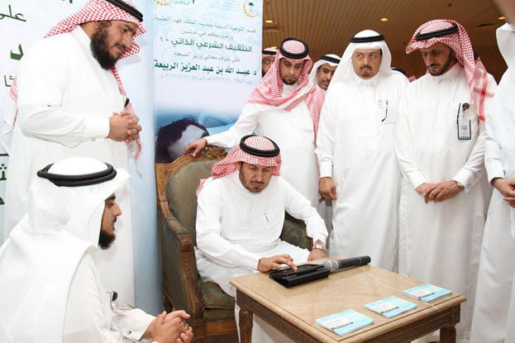
Products
2011

Slide 24
New challenges:
Available for admitted patient
Just Arabic language
Only audio
Phone not available next to all beds

Slide 25
Smart device application

Slide 27
Target population:
Patients and their families
Bilingual
Healthcare providers
International

Slide 28
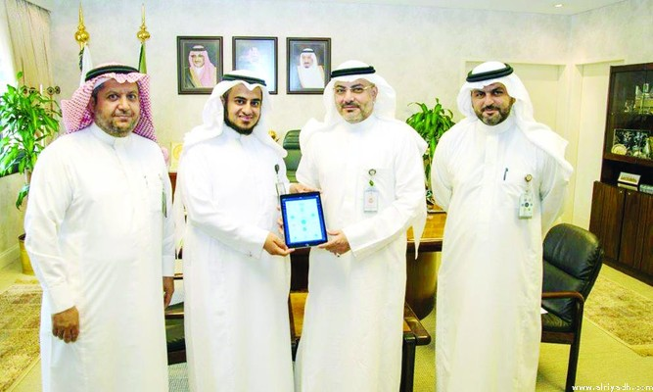
Launched in July 2017

Slide 29
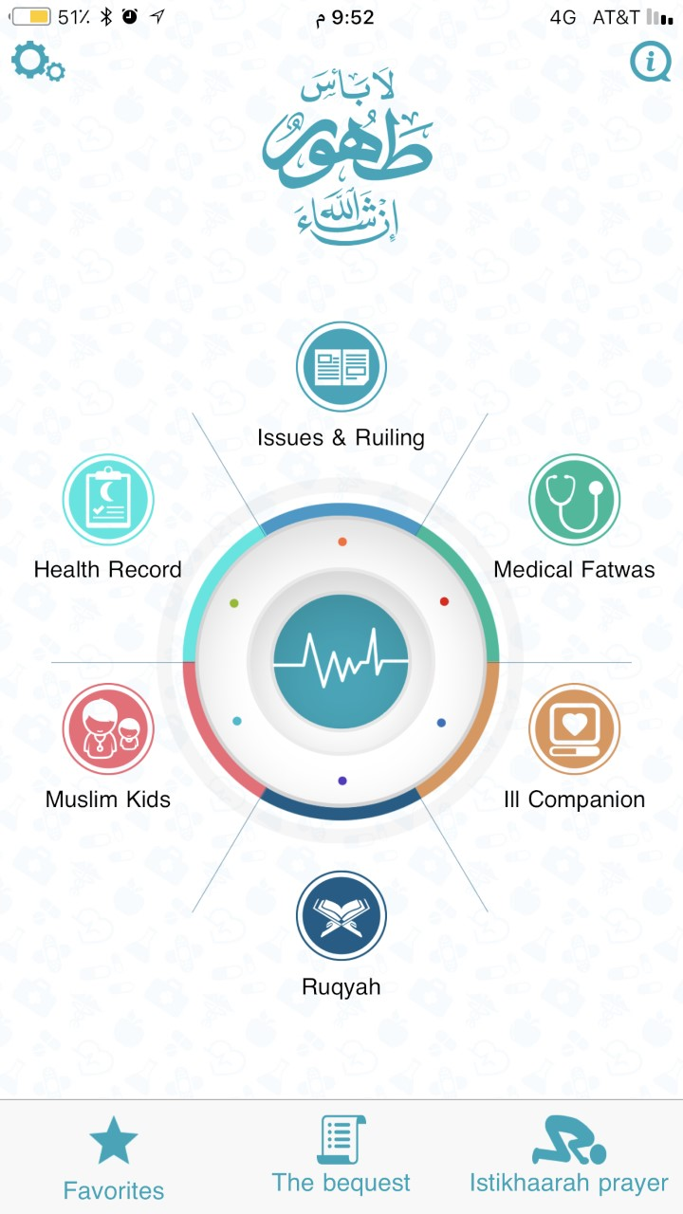
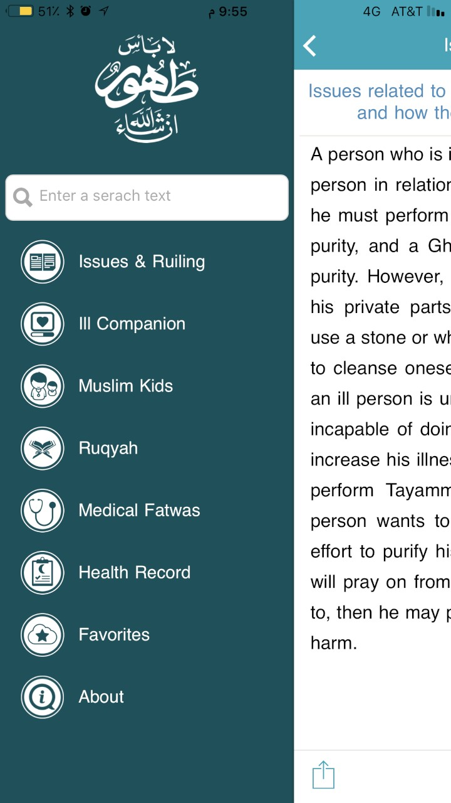

Slide 30
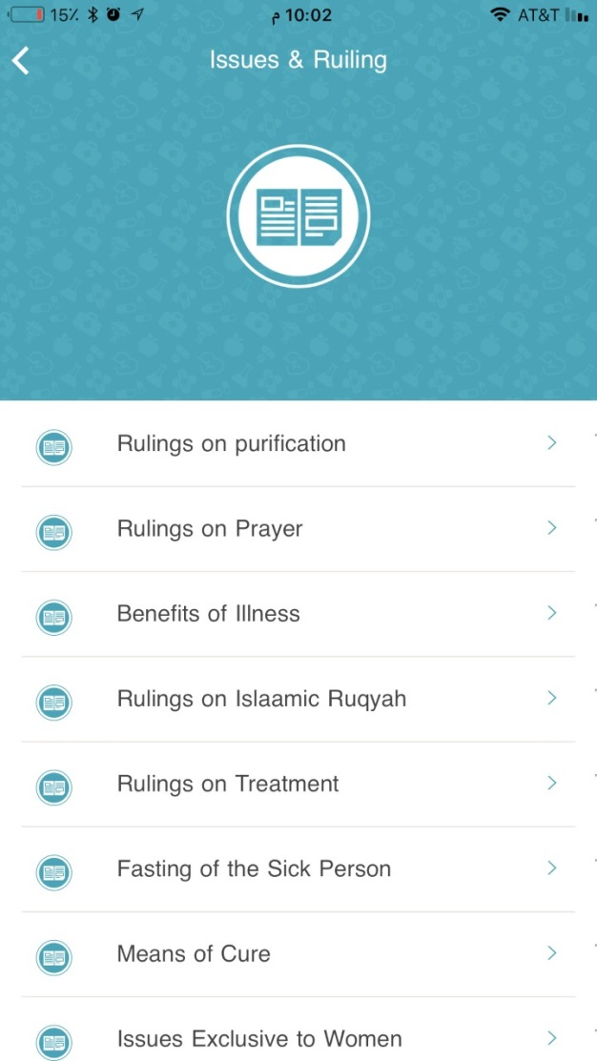
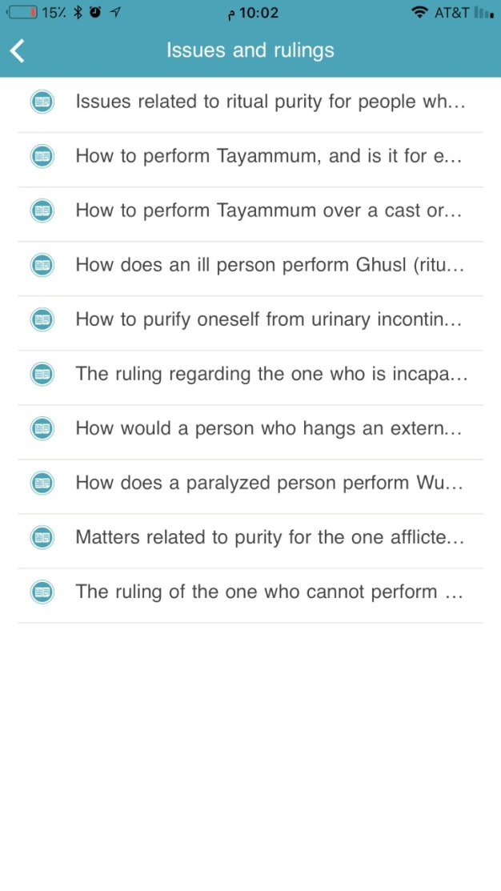
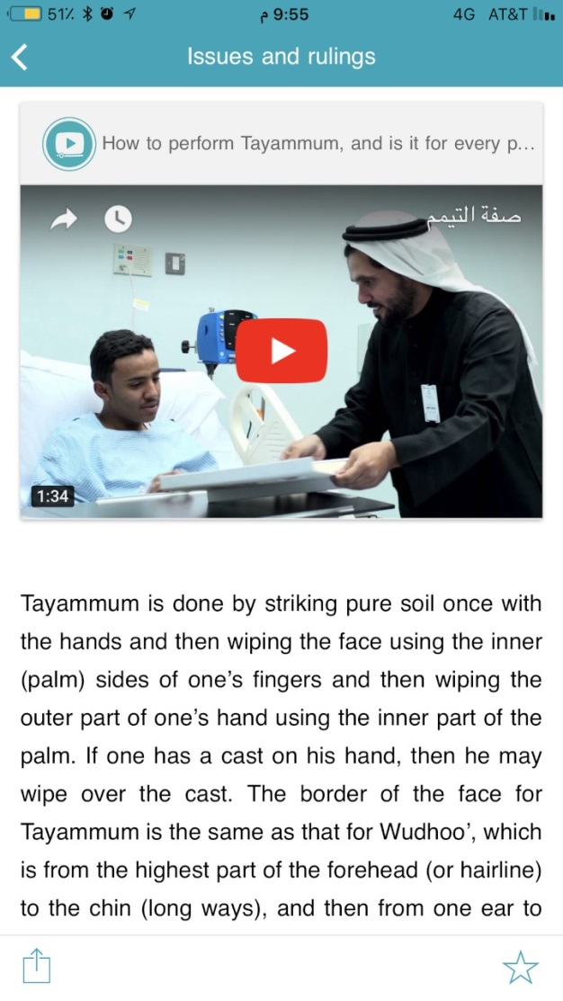

Slide 31
Live Demo

Slide 32
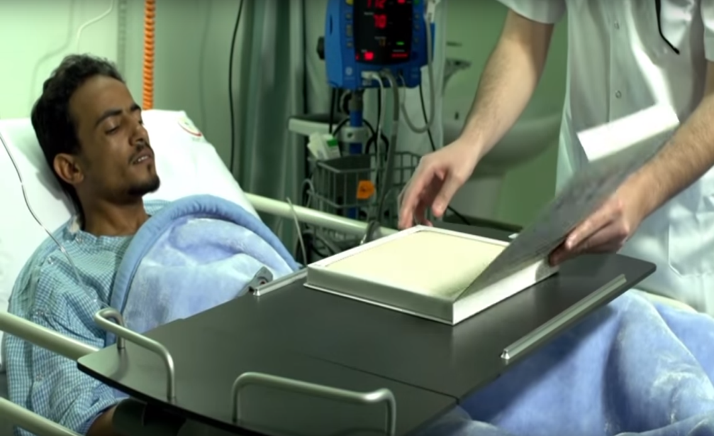

Slide 34
Additional Benefit:
Internal:
Improve patient experience
Allocate more time for counseling/Education.
External:
Enhance KFMC reputation.
Covering more patient worldwide.

Slide 35
Rating:

Slide 36
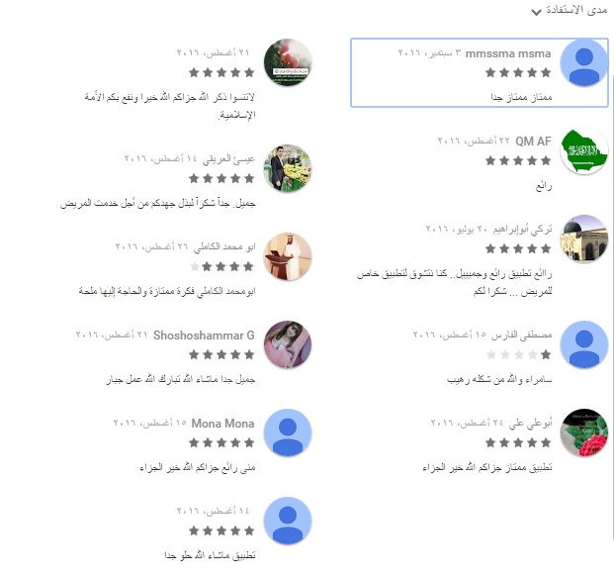
Customer comments:

Slide 37
Thank you
Together we plead for the good and wipe off tears of mournful
Together we draw smiles and light up hope for the confused

Slide 38
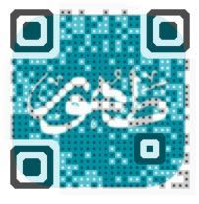
Contact Us:
L Anas AlShedokhi
F anas.s.alshedokhi
M +966 554 45 9652
E aalshedokhi@kfmc.med.sa
E anas9652@hotmail.com

