Slide 1

Dignity, Personhood and Deconstructing Connectedness
Harvey Max Chochinov OC MD PhD FRSC
Canada Research Chair in Palliative Care
Director, Manitoba Palliative Care Research Unit
Distinguished Professor, Department of Psychiatry
University of Manitoba, CancerCare Manitoba

Slide 2
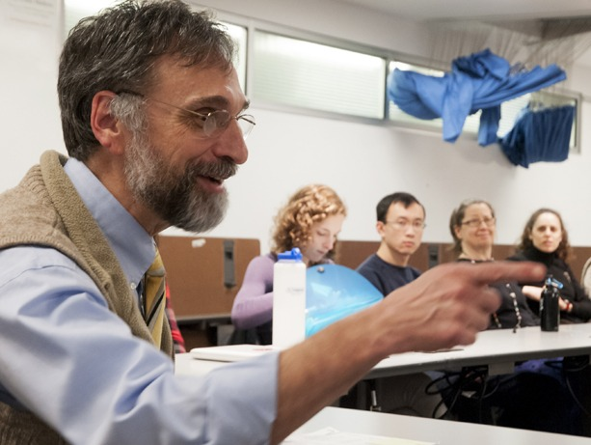
Notes:
As he was approaching his own death, Dr. Stuart Farber, a palliative care physician at the University of Washington, reflected on personhood and what he referred to as his thread.³
“With rare exception, the clinicians who treated me have good hearts, care deeply, but possess little or no knowledge of my thread. My thread is the narrative I use to make sense of my life. It is longitudinal, non-linear, emotional, filled with contradictions, and integrates my life experiences into a coherent whole. It is within the values and meanings of my story that treatment decisions are made. What contributes to meaning and quality is not about living longer but living a life that is consistent with my thread. Without knowing my thread, it is impossible for a clinician to provide respectful care.

Slide 3
Etymology of Witness
Old English witnes "attestation of fact, event, etc., from personal knowledge;" also "one who so testifies;" originally "knowledge, wit," formed from wit (n.) + -ness. Christian use (late 14c.) is as a literal translation of Greek martys

Slide 4
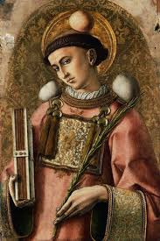

Slide 5
Stability of Will to Live with Pain in an 80 Year-old
Patient with Colorectal Cancer
-- Will to Live
Lancet. 1999;354:816-9.

Slide 6
Stability of Will to Live with Pain in an 80 Year-old
Patient with Colorectal Cancer
---- Pain
Lancet. 1999;354:816-9.

Slide 7


Slide 8

Desire for death (p < 0.0014)
Loss of will to live (p < 0.013)
Depression (p < 0.0084)
Hopelessness (p < 0.020)
Anxiety (p < 0.003)
Chochinov et al. Lancet. 2002;360:2026‐30.
Notes:
8
8

Slide 9
Pain (p < 0.048)
Difficulty with bowel functioning (p < 0.026)
Physical appearance (p < 0.002)
Chochinov et al. Lancet. 2002;360:2026‐30.
Notes:
9
9

Slide 10
Bathing (OR = 8.45 [1.50 to 47.70]; p < 0.016)
Dressing (OR = 2.79 [0.95 - 8.15]; p < 0.061)
Incontinence (OR = 3.47 [1.27 - 9.51]; p < 0.016)
Chochinov et al. Lancet. 2002;360:2026‐30.
Notes:
10
10

Slide 11
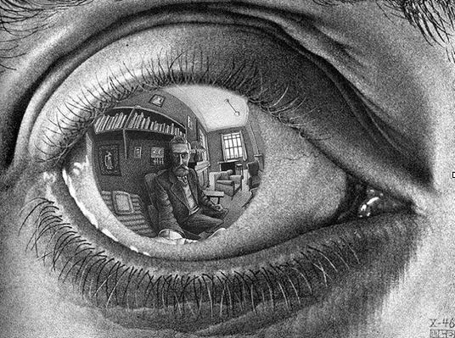
Notes:
11
Seeing some for who they are
Appreciate them for what they are or were
Can’t always enhance attributional dignity; but we can affirm intrinsic dignity

Slide 12
Dignity Model Questions
N=211
# | Variable | % Agree or strongly agree
1 | thinking how life might end | 41.7%
2 | distressing symptoms | 53.1%
3 | uncertainly regarding illness | 59.2%
4 | feeling depressed or anxious | 59.7%
5 | feeling your privacy has been reduced | 65.9%
6 | changes in physical appearance | 66.4%
7 | not being able to accept things the way they are | 71.6%
Chochinov HM, Krisjanson LJ, Hack TF, Hassard T, McClement S, Harlos M. Dignity in the terminally ill: revisited. J Palliat Med. 2006;9:666-72.

Slide 13
Dignity Model Questions
8 | not having a meaning spiritual life | 73.7%
9 | no longer feeling who you were | 74.4%
10 | not being able to mentally fight | 74.5%
11 | not being able to continue with usual routines | 74.9%
12 | feeling life no longer has meaning or purpose | 75.1%
13 | not being able to think clearly | 77.3%
14 | not being able to carry out important roles | 78.5%
15 | tasks of daily living | 79.6%

Slide 14
Dignity Model Questions
17 | not feeling worthwhile or valued | 81.4%
18 | bodily functions | 82.9%
19 | not feeling you made a meaning or lasting contribution | 83.3%
20 | feeling you don't have control over your life | 83.7%
21 | feeling a burden to others | 87.1%
22 | not being treated with respect or understanding | 87.1%

Slide 15


Slide 16
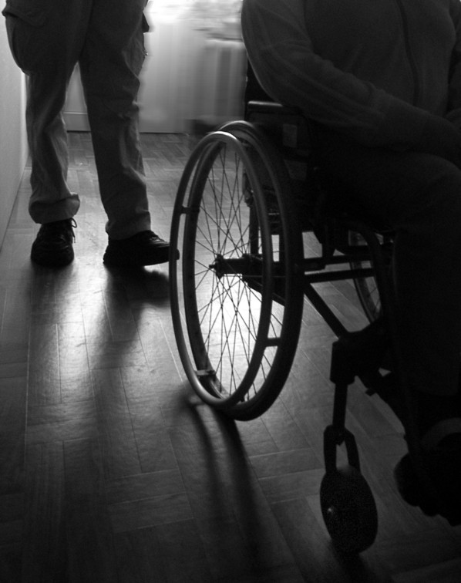
Notes:
16
Might an assumption of poor quality of life in a patient with longstanding disabilities lead to the withholding of life sustaining choices?
The end of this month will mark the 3rd anniversary of my sister Ellen’s death
Born with CP, she was a life long wheelchair user
Several years before she died, respiratory fail
Intensive care/delicate moment when a decision came to discuss if she might need intubation

Slide 17
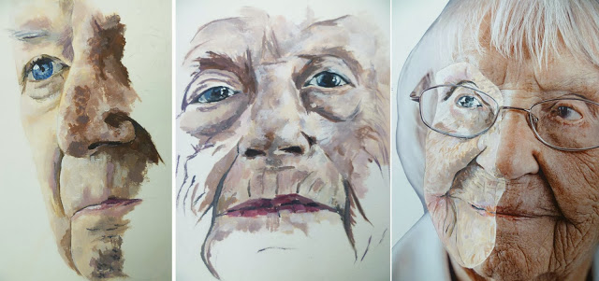
Notes:
Elderspeak e.g. infantilization, intimate nominal references such as honey or good girl; collective pronouns that imply the person cannot act independently

Slide 18
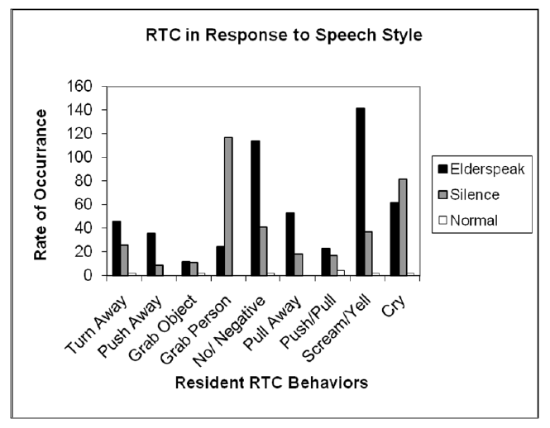
Herman RE, Williams KN. Am J Alzheimers Dis Other Demen. 2009;24:417-23

Slide 19
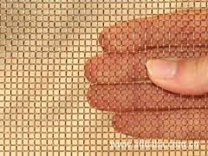

Slide 20
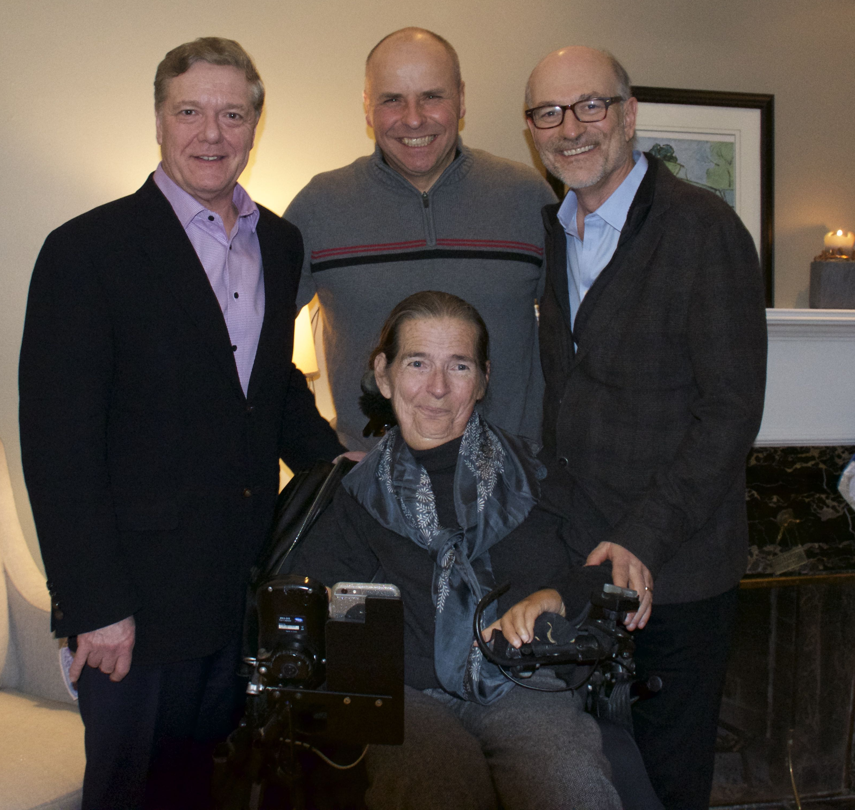
Notes:
Acknowledge the work of the Panel and our Executive Director
This was the educational experience of a lifetime
It was a honour to be chosen and an honour to serve Canada in this way
I hope the Panel Report helps guide the thinking of Parliamentarians as they take their next steps in finding a legislative response to Carter.
Respecting autonomy, it seems, commits us to grapple with vulnerability. And grappling with vulnerability, it seems, calls for us to tease apart the tangled roots of suffering in order to discern between an autonomous claim and a cry of unmet need.

Slide 21
compassion (n.)
mid-14c., from Old French compassion "sympathy, pity" (12c.), from Late Latin compassionem (nominative compassio) "sympathy," noun of state from past participle stem of compati "to feel pity," from com- "together" (see com-) + pati "to suffer" (see passion). “to suffer with”

Slide 22


Slide 23
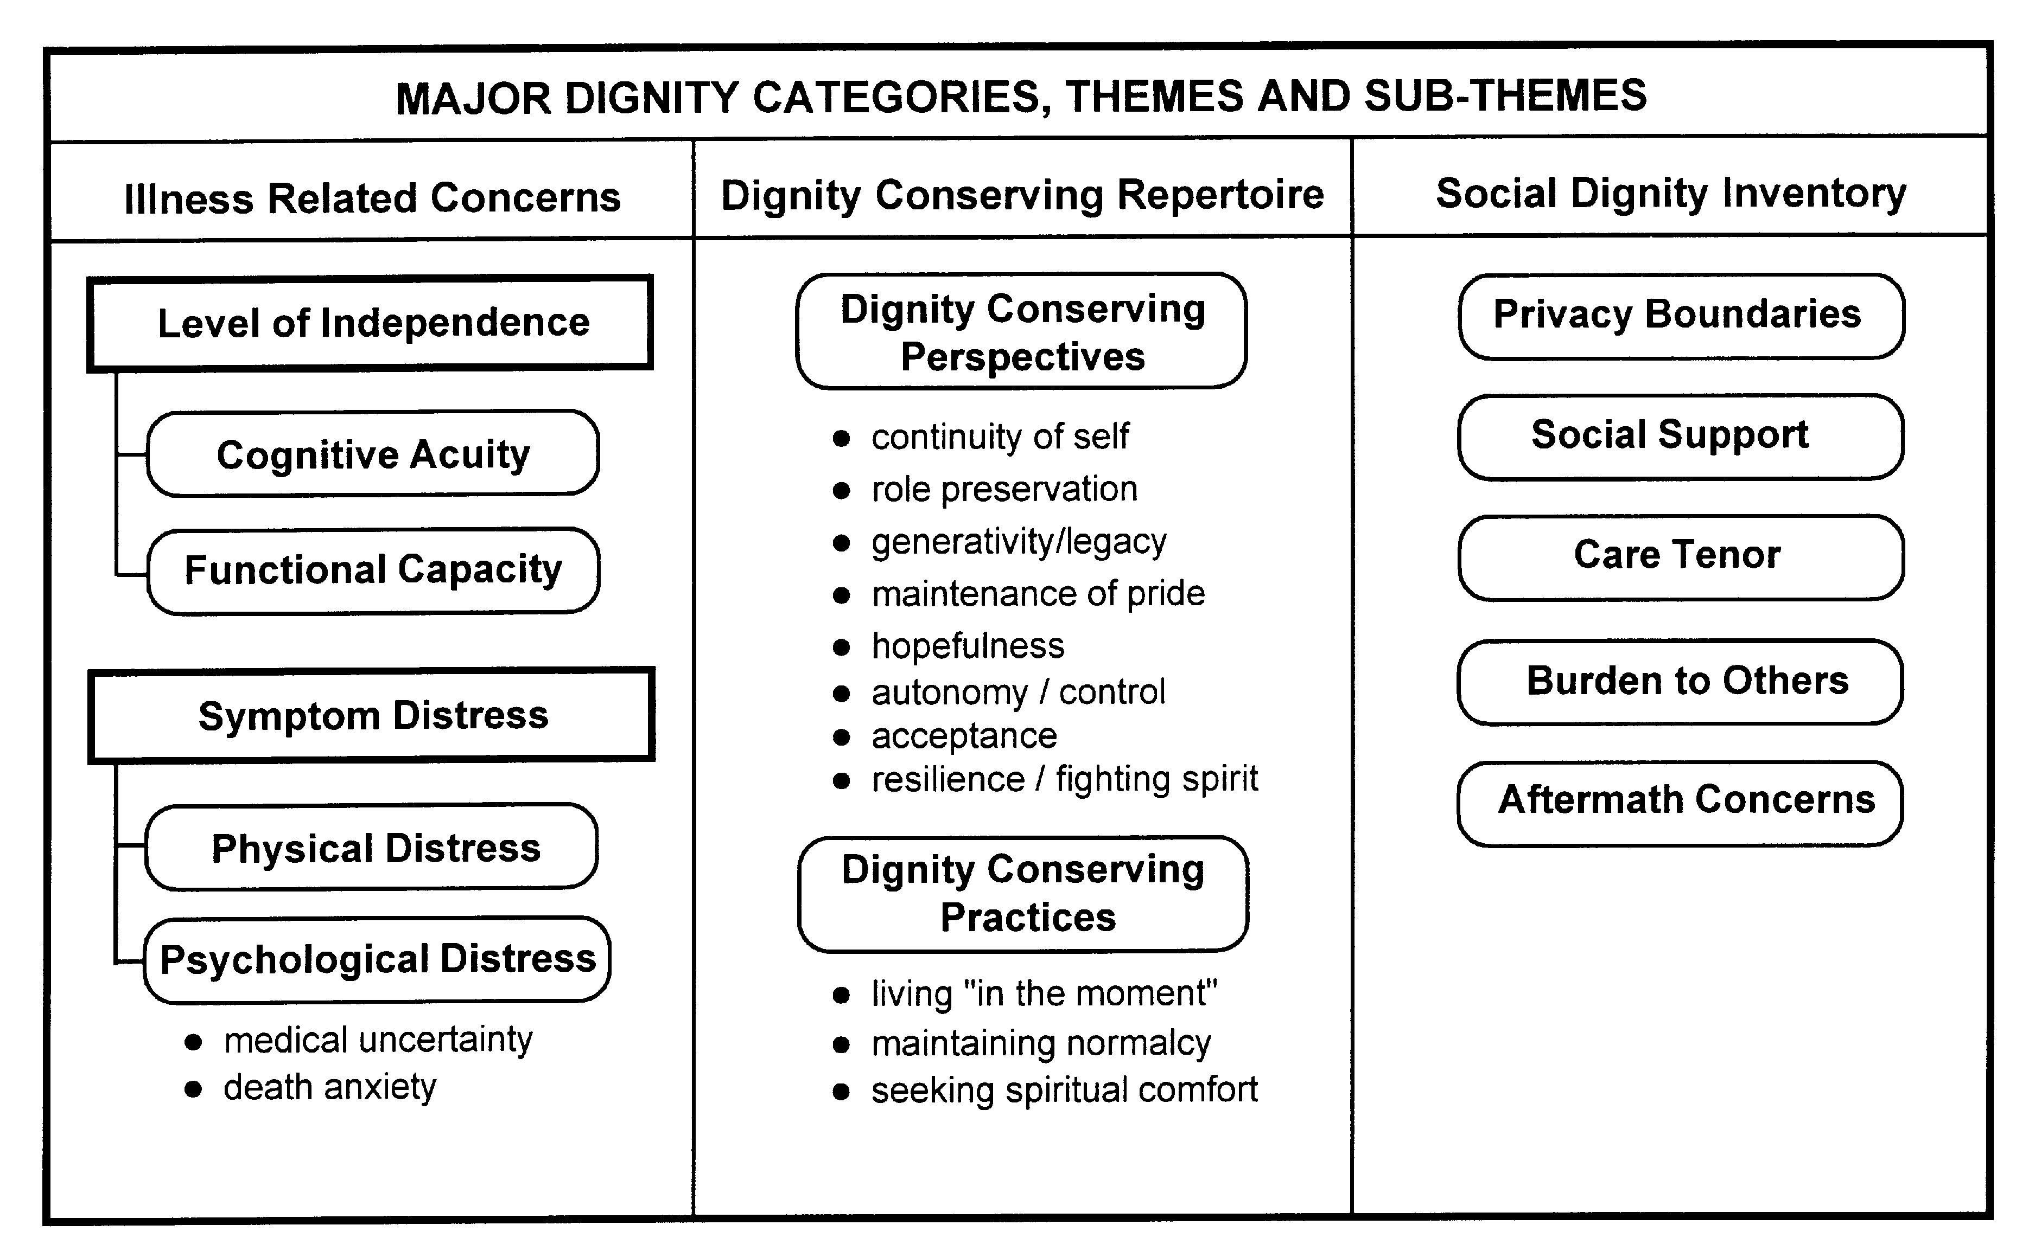
Chochinov et al. Social Science and Medicine 2002

Slide 24

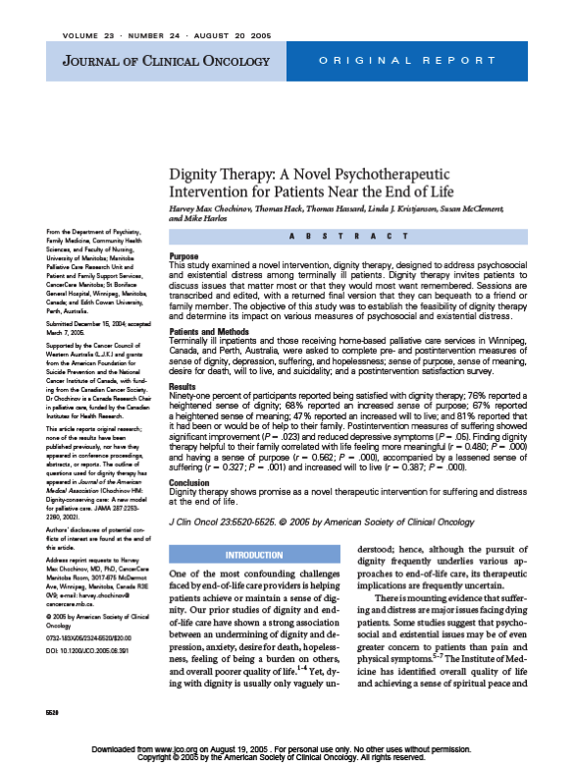

Slide 25
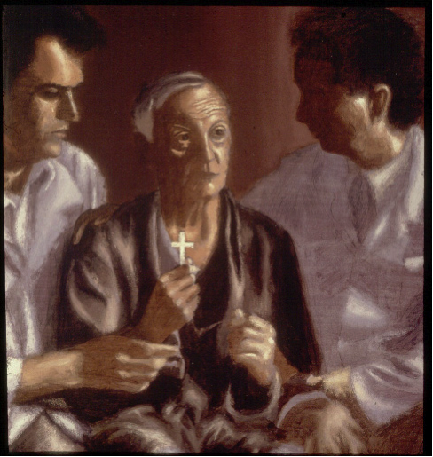

Slide 26
Dignity Therapy Data Overview
17 articles; 12 quantitative studies; establish high satisfaction; high acceptability
Benefits for themselves and their families
Increased sense of meaning and purpose.
Studies with higher base rates of distress indicate lower depression, anxiety; and increased hopefulness

Slide 27


Slide 28
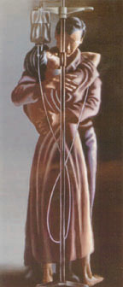
Personhood on the Clinical Radar
“What should I know about you as a person to help me take the best care of you that I can?”
Notes:
28

Slide 29
Patient Dignity Question (PDQ)
Mrs. F. says that because of the residential school, she always had a hard time trusting people. She in fact moved 82 times so as not to let anyone get too close to her. While this has gotten better over time, she still struggles with being able to trust people. She wants to, but it is hard for her. She sometimes worries that she won’t be told the whole truth, or that people will see her as not being deserving of the whole truth. She appreciates people being friendly towards her, but is frightened of authority figures. ‘Authority scares me, but I’m not as bad as I used to be’.
Notes:
29

Slide 30
Patient G: 64-Year-Old Married Woman With Pancreatic Cancer
G. acknowledges that her tough exterior hides a really soft interior. ‘‘I am covering up so they cannot really see me.’’ Sometimes she’s trying to hide the fact that she doesn’t remember things and doesn’t want to appear stupid.. She calls everybody sweetheart, pumpkin, or honeybunch because she has a hard time remembering people’s names. G. says she is scared. She lets everyone believe that she can handle it, that she’s a trooper. She pretends everything is fine but it’s not. It brings her to tears when she thinks about dying. She doesn’t want to die. G. says she wants people to know she has these feelings, that although she tries to hide it, there is a storm brewing inside. She feels that if people know that’s how she really feels then she will not have to put up a front anymore.

Slide 31
PDQ Study Patient and Family Characteristics
Patient completed interview | 66 | 52%
Family completed interview | 61 | 48%
Variable | Years | SD
Patient Age | 73.5 | 12.6
Family Age | 59.4 | 14.1
How long know patient | 49.3 | 13.7
Relationship to Patient | Number | Percentage
Spouse of partner | 27 | 44%
Sibling | 5 | 8%
Adult child | 27 | 44%
Other relative | 2 | 3%
Other | 1 | 2%
Notes:
31

Slide 32
Patient and Family Response to PDQ
Patient/Family Perception | Number of PDQs | Percentage
The PDQ accurate | 121 | 99%
Permission to place on chart | 124 | 97%
Wanted a copy | 95 | 76%
Information Important for HCP | 107 | 93%
Could affect my care | 78 | 81%
Would recommend it for others | 117 | 99%
Notes:
32

Slide 33
Effect of PDQ on Health Care Provider
Effect of PDQ on Health Care Provider | Not Influenced | Neutral | Influenced
Learn something new from PDQ | 24 (8.3%) | 4 (1.4%) | 262 (90%)
Was emotionally affected by PDQ | 40 (13.7%) | 66 (23.0%) | 187 (63.8%)
PDQ influenced attitude | 56 (19.3%) | 73 (25.2%) | 161 (55.5%)
PDQ influenced care | 75 (26.6%) | 82 (29.1%) | 125 (44.3%)
PDQ influence respect | 52 (18.3%) | 96 (33.8%) | 136 (47.9%)
PDQ influenced empathy | 37 (13.2%) | 78 (27.9%) | 165 (58.9%)
PDQ affected connectedness | 29 (10.4%) | 74 (26.5%) | 176 (63.1%)
Notes:
33

Slide 34
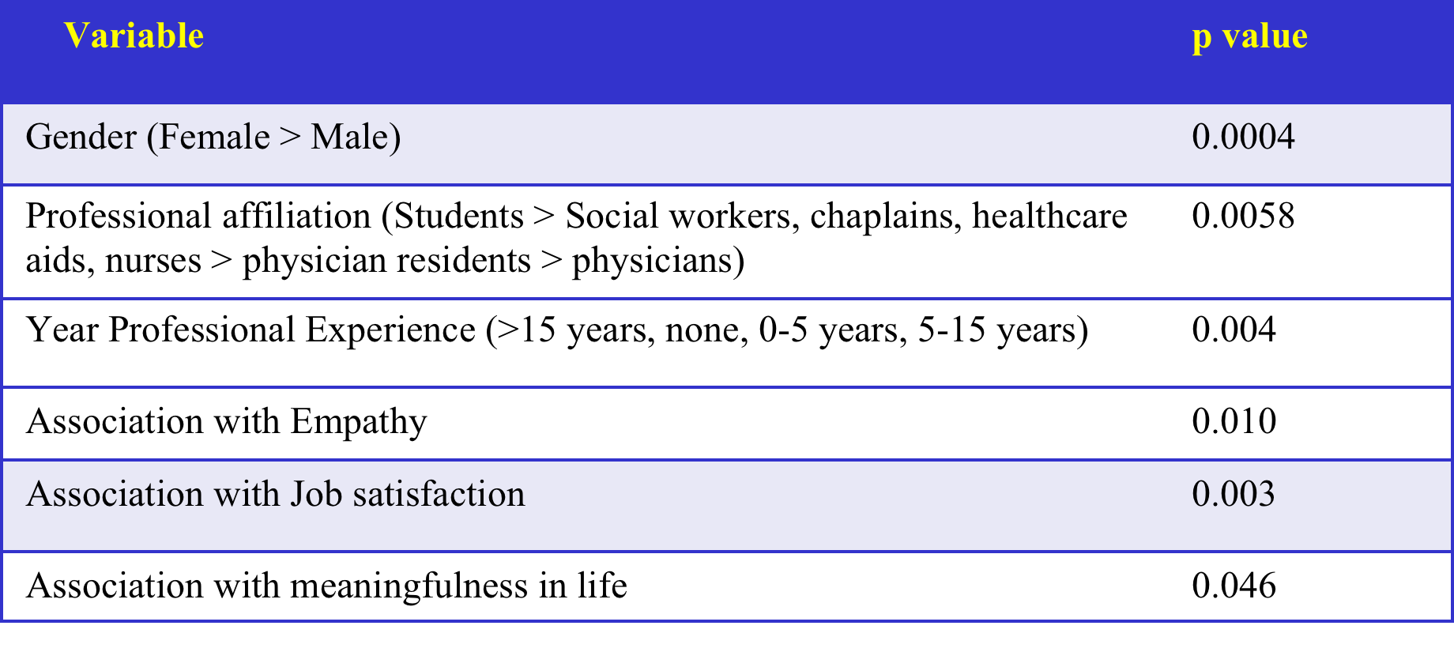
PDQ Response Score (PRS)

Slide 35







Slide 36



Slide 37




Slide 38





Slide 39




Slide 40



Slide 41



Slide 42


Slide 43
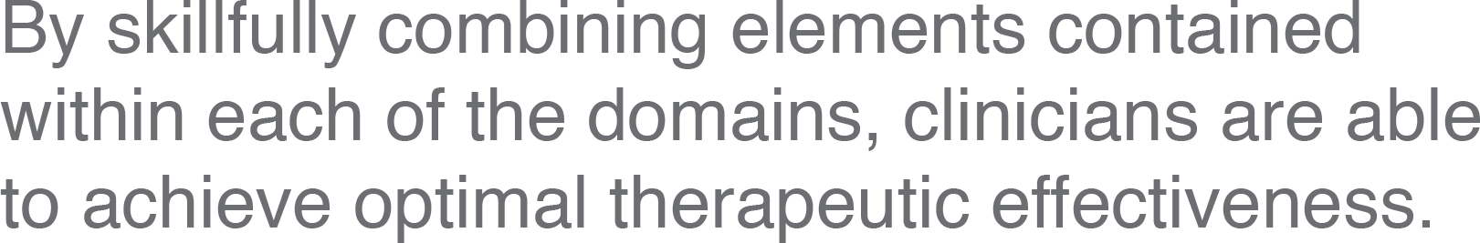

Slide 44
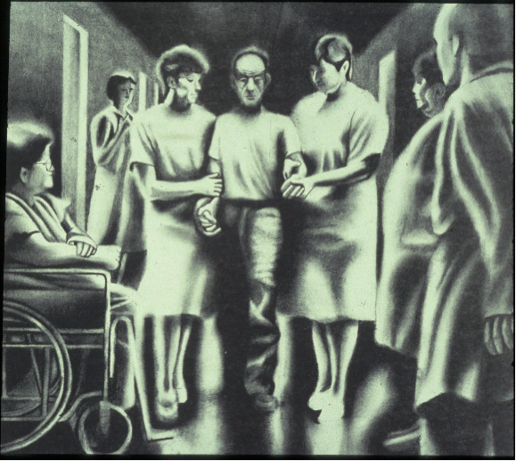
Healthcare
Cognitive/Knowledge
based
Technical/procedural
Healthcaring
Patient and family
satisfaction
Gateway to disclosure
Complaints/litigation
Professional burnout
Notes:
44

Slide 45
Notes:
Healthcare providers have a profound influence on how patients experience illness and on their sense of dignity
Dignity conserving care has an important effect on the experience of patienthood
The A, B, C, and D of dignity conserving careﾑattitude, behaviour, compassion, and dialogueﾑprovide a framework to guide healthcare practitioners towards maintaining patients' dignity
This framework can be applied to teaching, clinical practice, and standards at undergraduate and postgraduate levels and across all medical subspecialties, multidisciplinary teams, and allied health professions

