Slide 1
Balancing Hope in Miracles with Biomedical Decision-Making at
the End of Life
Kelly Arora, PhD
Co-Director, Interprofessional Graduate Certificate & Master of Science in Palliative Care,
Allied Health Professionals

Slide 2
Notes:
U.S. belief in God down, belief in theory of evolution up. (2013). UPI.com. Retrieved from UPI.com website: http://www.upi.com/Health_News/2013/12/22/US-belief-in-God-down-belief-in-theory-of-evolution-up/24081387762886/
Briggs, D. (2012). Belief in miracles on the rise. Huffington Post. Retrieved from HuffingtonPost.com website: http://www.huffingtonpost.com/david-briggs/belief-in-miracles-on-the-rise-in-the-age-of-oprah_b_2039372.html

Slide 3
Portraits of
American Life
Merged Dataset 2006-2012
I have experienced a supernatural miracle, an event that could not have happened without the intervention of God or a spiritual force
Strongly Disagree 20.8%
STRONGLY AGREE 37.7%
Somewhat Disagree 6.3 %
Neutral 21.5%
Somewhat Agree
13.8%
Notes:
http://www.thearda.com/Archive/Files/Analysis/PALS2PAN/PALS2PAN_Var1586_1.asp Portraits of American Life Study

Slide 4
Ethics Consults for Life-sustaining Treatment
Massachusetts General Hospital
2014
95 cases
Chaplains involved in 68.4% of cases
26.3%
“In God’s hands”
18.9%
Hope for miraculous recovery
Bandini, Courtwright, Zollfrank, Robinson & Cadge 2017

Slide 5
Self-aware
Now
Ask
Person guides
Notes:
Khan, F. (2007). Miraculous medical recoveries and the Islamic tradition. Southern Medical Journal, 100(12), 1246-1251.
Cooper et al 2014
Rushton, C The language of miracles: Ethical challenges Pediatric Nursing 1996 Vol. 22, pp. 64-67Orr, R. D. (2007). Responding to patient beliefs in miracles. Southern Medical Journal, 100(12), 1263-1267.

Slide 6
Self-aware
Now
Ask
Person guides
Notes:
Khan, F. (2007). Miraculous medical recoveries and the Islamic tradition. Southern Medical Journal, 100(12), 1246-1251.
Cooper et al 2014
Rushton, C The language of miracles: Ethical challenges Pediatric Nursing 1996 Vol. 22, pp. 64-67Orr, R. D. (2007). Responding to patient beliefs in miracles. Southern Medical Journal, 100(12), 1263-1267.

Slide 7
SPIRITUALITY
Values Beliefs
Relationships
Meanings
Beliefs and principles of ultimate importance
that guide decisions and behavior
CORE VALUES

Slide 8
Impose
Judge
Defend
Pull away

Slide 9
Lived values
& beliefs
Values & beliefs from childhood and youth

Slide 10
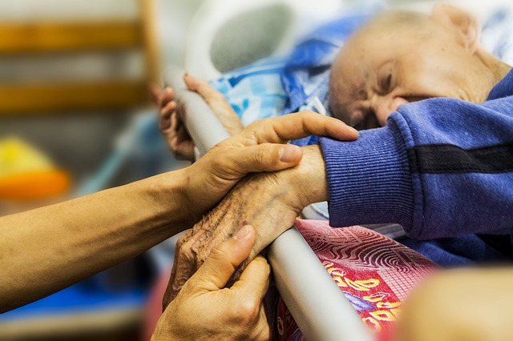
Well-Being
Moral Distress

Slide 11
Lived values
& beliefs
Values & beliefs from childhood and youth

Slide 12
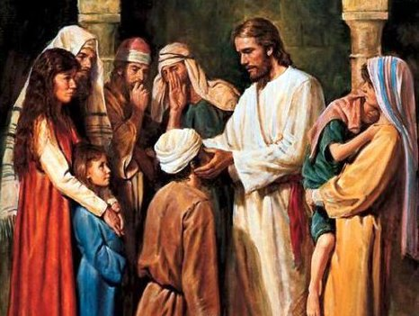
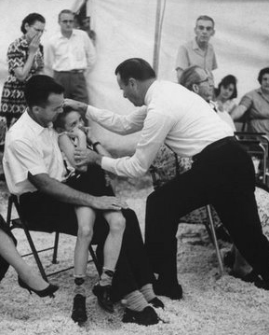
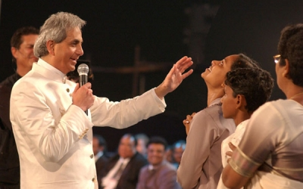
Christianity
Jesus
Benny Hinn
Oral Roberts
Notes:
Image Jesus: http://mydailydevotionorg.blogspot.com/2012/02/your-faith-has-healed-you.html
Oral Roberts image: http://driftglass.blogspot.com/2009/12/rip-oral-roberts.html
Benny Hinn image: http://godinanutshell.com/nutshell-pages/voices-of-honor/benny-hinn.html
Christianity: Pinches, C. (2007). Miracles: A Christian theological overview. Southern Medical Journal, 100(12), 1236-1242.

Slide 13
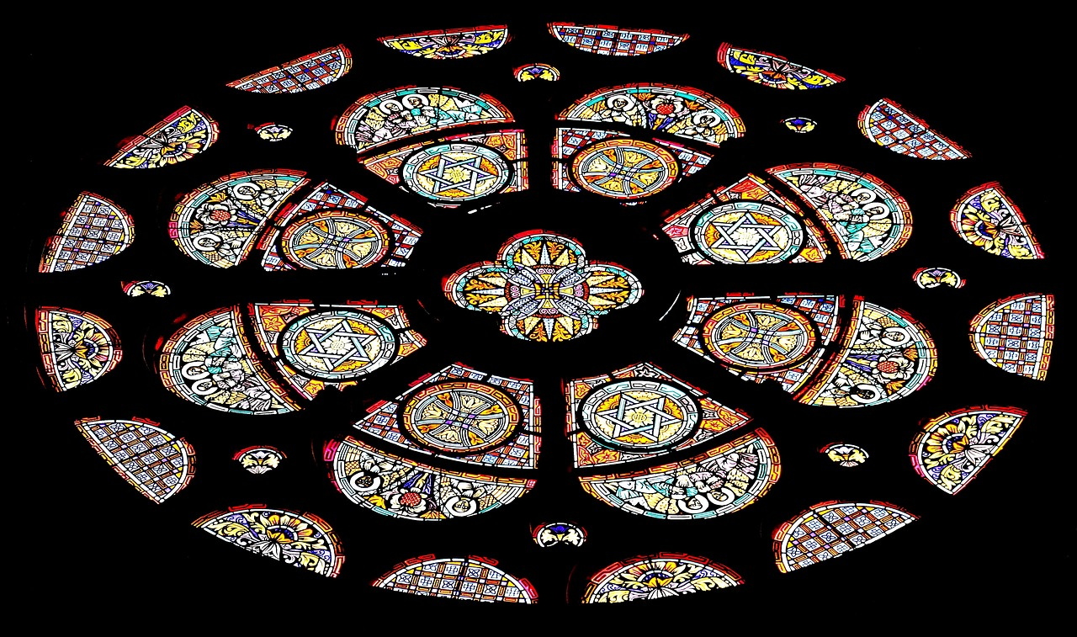
Serious, incurable, or very difficult to treat
Not at a stage to resolve itself
No medications with a bearing on the cure
Complete and permanent
Instantaneous cure (can occur over a few days)
Catholic Church
1735
Lambertini’s Criteria
“Remarkable”
Notes:
https://schott.blogs.nytimes.com/2008/12/05/lambertini-criteria/
2008 CMIL “remarkable” medical vs. ecclesial authority: Dr. Patrick Theillier: "The medical community isn't as sure of itself as it was 20 or 30 years ago… Back then, it was "much more triumphalist, and thought it knew everything."

Slide 14
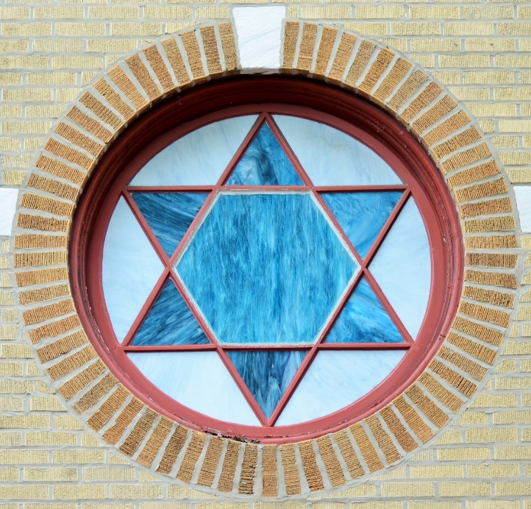
Khan 2007
Everything occurs by Allah’s design and intervention
Judaism
Wonders that
manifest God’s power
Daily miracles
Islam
Mackler 2007
DeLisser 2009
Notes:
Mackler, A. L. (2007). Eye on religion: A Jewish view on miracles of healing. Southern Medical Journal, 100(12), 1252-1254.
Khan, F. (2007). Miraculous medical recoveries and the Islamic tradition. Southern Medical Journal, 100(12), 1246-1251.

Slide 15
Direct appeals to
gods and goddesses for help
Buddhism
Karma
Hinduism
“Supernormal” manifestations of power
Yü 2007
Notes:
http://channel.nationalgeographic.com/the-story-of-god-with-morgan-freeman/articles/what-do-the-worlds-religions-say-about-miracles/
https://www.hinduismtoday.com/modules/smartsection/item.php?itemid=5102
Yü, C. (2007). Eye on religion: Miracles in the Chinese Buddhist Tradition. Southern Medical Journal, 100(12), 1243-1245.
http://channel.nationalgeographic.com/the-story-of-god-with-morgan-freeman/articles/what-do-the-worlds-religions-say-about-miracles/
http://www.patheos.com/blogs/americanbuddhist/2016/05/the-story-of-god-do-buddhists-believe-in-miracles.html
http://www.buddhanet.net/e-learning/dharmadata/fdd63.htm

Slide 16
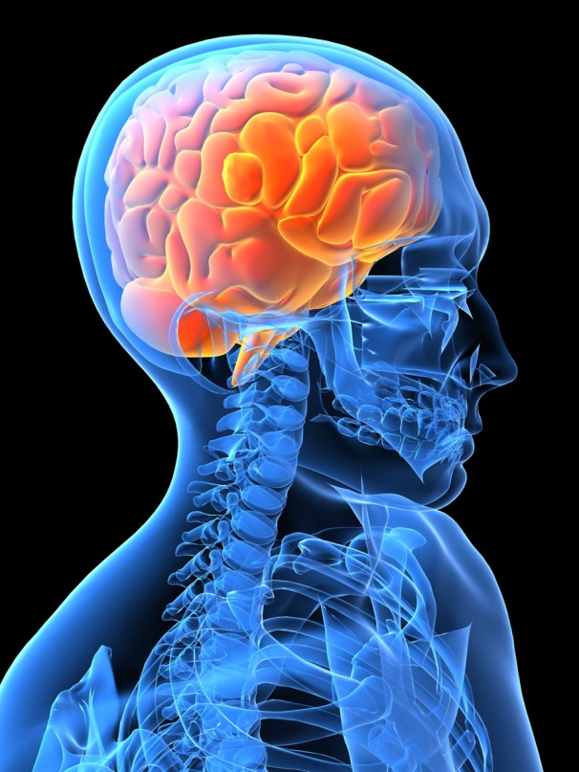
Miracles are
not contrary to nature
or science or history.
They are only contrary
to what we know
(or think we know)
of nature, science, and history.
Attributed to Augustine
Miracles are
not contrary to nature
or science or history.
They are only contrary
to what we know
(or think we know)
of nature, science, and history.
Attributed to Augustine
Notes:
Schoemperlen, p. 298

Slide 17
When you hear “miracle”
in end-of-life care,
what personal and/or
professional values
are at stake for you?

Slide 18
Terminally-ill patients
Clergy Influence at the End of Life
~3/4 say religion is important
1005 Clergy 98% Christian
Balboni 2017
~1/2 receive some EOL spiritual care from clergy
Notes:
Balboni, M. J., Sullivan, A., Enzinger, A. C., Smith, P. T., Mitchell, C., Peteet, J. R., . . . Balboni, T. A. (2017). United States clergy religious values and relationships to end-of-life discussions and care. Journal of Pain and Symptom Management, in press. doi: 10.1016/j.jpainsymman.2016.12.346

Slide 19
High level of spiritual support from healthcare team
Clergy Influence at the End of Life
Aggressive interventions
1005 Clergy 98% Christian
Balboni 2017
Use of hospice care
Notes:
Balboni, M. J., Sullivan, A., Enzinger, A. C., Smith, P. T., Mitchell, C., Peteet, J. R., . . . Balboni, T. A. (2017). United States clergy religious values and relationships to end-of-life discussions and care. Journal of Pain and Symptom Management, in press. doi: 10.1016/j.jpainsymman.2016.12.346

Slide 20
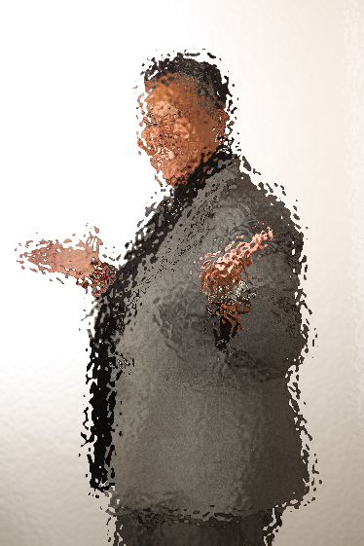
Clergy Values
86% God performs miracles
60% Prayer for physical healing
54% Pursue treatment; life is sacred
27% Redemptive suffering justifies painful
procedures
16% Doctors should “always extend life”
Balboni 2017
Notes:
Balboni, M. J., Sullivan, A., Enzinger, A. C., Smith, P. T., Mitchell, C., Peteet, J. R., . . . Balboni, T. A. (2017). United States clergy religious values and relationships to end-of-life discussions and care. Journal of Pain and Symptom Management, in press. doi: 10.1016/j.jpainsymman.2016.12.346

Slide 21
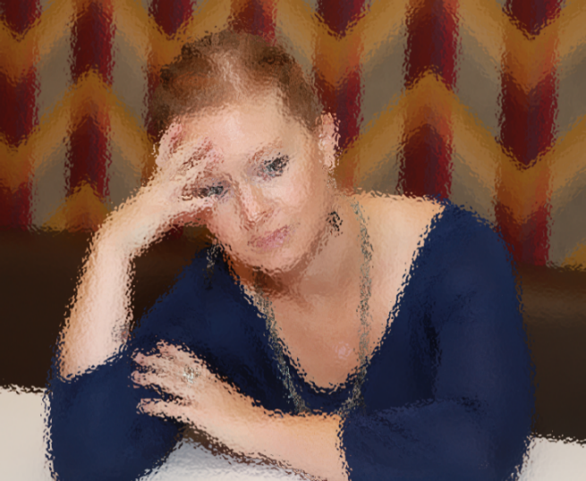
Surrogate Decision-Making
20% Faith in God overrides all other prognostic information
47% consider physician input
2% Rely solely on it
64% Patient’s physical appearance
36% Positive thinking
27% Patient’s character/will to live
179 Surrogates
Boyd et al 2010
Notes:
Boyd, E. A., Lo, B., Evans, L. R., Malvar, G., Apatira, L., Luce, J. M., & White, D. B. (2010). "It's not just what the doctor tells me:" Factors that influence surrogate decision-makers' perceptions of prognosis. Critical Care Medicine, 38(5), 1270-1275. doi: 10.1097/CCM.0b013e3181d8a217

Slide 22
Ethics of “Medical Futility”
Interventions unlikely to produce significant benefits (beneficence) and may do substantial harm (nonmaleficence)
Patient Autonomy
Blackler 2017

Slide 23
Self-aware
Now
Ask
Person guides
Notes:
Khan, F. (2007). Miraculous medical recoveries and the Islamic tradition. Southern Medical Journal, 100(12), 1246-1251.
Cooper et al 2014
Rushton, C The language of miracles: Ethical challenges Pediatric Nursing 1996 Vol. 22, pp. 64-67Orr, R. D. (2007). Responding to patient beliefs in miracles. Southern Medical Journal, 100(12), 1263-1267.

Slide 24
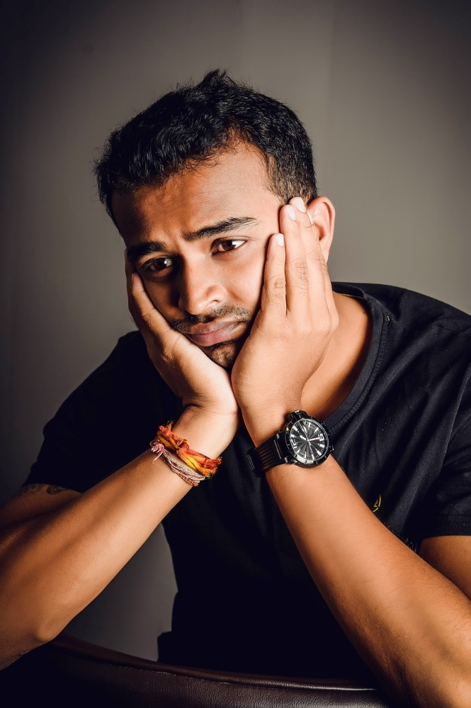
Past
Future
NOW
Notes:
Image: http://artobserved.com/2010/03/ao-on-site-new-york-marina-abramovic-the-artist-is-present-at-moma-march-14-through-may-31-2010/

Slide 25
Self-aware
Now
Ask
Person guides
Notes:
Khan, F. (2007). Miraculous medical recoveries and the Islamic tradition. Southern Medical Journal, 100(12), 1246-1251.
Cooper et al 2014
Rushton, C The language of miracles: Ethical challenges Pediatric Nursing 1996 Vol. 22, pp. 64-67Orr, R. D. (2007). Responding to patient beliefs in miracles. Southern Medical Journal, 100(12), 1263-1267.

Slide 26
I’m familiar with x. What does that mean to you?
Tell me more about ...
Ask:
Open-ended questions
Invite:
“Could you say more about…”
I’d like to know what you mean by ...
I’m not sure. What do you think?

Slide 27
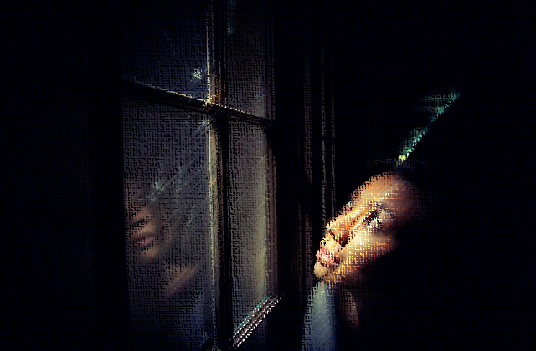
Miracle Talk
Integrated
Hope for divine intervention from religious worldview
Literal appeal
Symbolic request
Expression of faith
Innocuous
Hoped-for outcome without religious connotation
Shaken
Spiritual distress/crisis
Control over providers
Denial
Strategic
Asserting power, avoiding care discussions
Hayward, et al. 2016
Shinall, Stahl & Bibler 2017
Notes:
DeLisser 2009
Polite, B. N., Cipriano-Steffens, T., Hlubocky, F., Dignam, J., Ray, M., Smith, D., . . . Gehlert, S. (2017). An evaluation of psychosocial and religious belief differences in a diverse racial and socioeconomic urban cancer population. Journal of Racial and Ethnic Health Disparities, 4(2), 140-148. doi: 10.1007/s40615-016-0211-6
Hayward, R. D., Krause, N., Ironson, G., & Pargament, K. I. (2016). Externalizing religious health beliefs and health and well-being outcomes. Journal of Behavioral Medicine, 39, 887-895. doi: 10.1007/s10865-016-9761-7
Bandini etal 2017

Slide 28
Asking for “Everything”
I don’t want to give up on life
Don’t leave me
We must explore all options
Every moment matters, even if I suffer
I can’t leave my family
My family won’t let me go
It’s God’s decision when I die
I’m scared of dying
Quill, Arnold & Back 2009

Slide 29
Self-aware
Now
Ask
Person guides
Notes:
Khan, F. (2007). Miraculous medical recoveries and the Islamic tradition. Southern Medical Journal, 100(12), 1246-1251.
Cooper et al 2014
Rushton, C The language of miracles: Ethical challenges Pediatric Nursing 1996 Vol. 22, pp. 64-67Orr, R. D. (2007). Responding to patient beliefs in miracles. Southern Medical Journal, 100(12), 1263-1267.

Slide 31
Notice differences

Slide 32
Silence
Dignity
Peace
Use their language
Justice
Miracle
Meaning
Forgiveness
Independence
God
Nature
Fate
Home
Faith
Integrity
Truth

Slide 33
Which step of SNAP might be most challenging for you? Why?
Self-aware
Now
Ask
Person guides
Notes:
Khan, F. (2007). Miraculous medical recoveries and the Islamic tradition. Southern Medical Journal, 100(12), 1246-1251.
Cooper et al 2014
Rushton, C The language of miracles: Ethical challenges Pediatric Nursing 1996 Vol. 22, pp. 64-67Orr, R. D. (2007). Responding to patient beliefs in miracles. Southern Medical Journal, 100(12), 1263-1267.

Slide 34
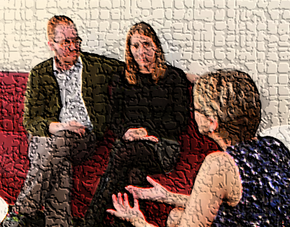
Strategy to Balance
Hope in Miracles with
Biomedical Decision-Making
Notes:
Khan, F. (2007). Miraculous medical recoveries and the Islamic tradition. Southern Medical Journal, 100(12), 1246-1251.
Cooper et al 2014
Rushton, C The language of miracles: Ethical challenges Pediatric Nursing 1996 Vol. 22, pp. 64-67Orr, R. D. (2007). Responding to patient beliefs in miracles. Southern Medical Journal, 100(12), 1263-1267.

Slide 35
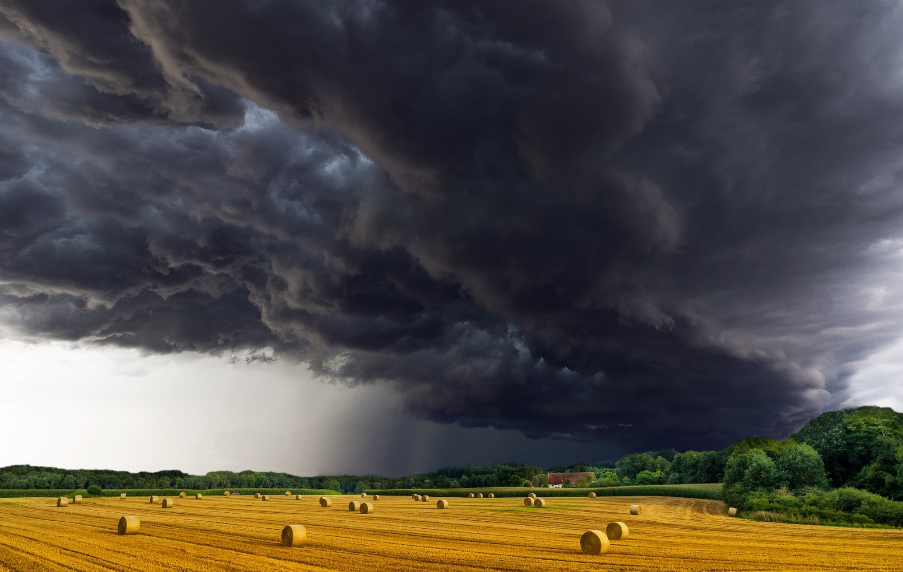
Hope

Slide 36
Hopes
Diverse
Dynamic
Grounded in reality

Slide 37
Breadth of Hopes Feudtner 2009
Finding meaning
Homecoming
Connecting
Pain Relief
Forgiveness

Slide 38
Affirm
their values
and hopes
Meet
them where
they are
Educate on biomedical issues
No matter
what
Cooper, Ferguson, Bodurtha & Smith AMEN 2014

Slide 39
I’m sorry things seem uncertain.
What do you hope for from our team/the care we provide for you?
I/the team also hope for a miracle
I’m sorry the news today isn’t what you wanted to hear.
What hopes do you have for the next week/month/year?
Tell me about your hopes so we can plan your goals of care together.
We’ll be with you regardless of what happens
What we can do is..

Slide 40
Dee
VALUES
WORDS
AREAS TO
EXPLORE
58-year-old woman
Metastatic cancer
Surgery, chemotherapy and radiation
HOPES
Dee has been informed there are no feasible biomedical interventions left. The palliative care team needs to clarify goals of care.

Slide 41
Affirm values and hopes
Meet her where she is
Educate on biomedical issues
No matter what
“I’ve hoped for a miracle since diagnosis. I’ve been praying every day that God would take the cancer away.
VALUES
Self-aware
Now
Ask
Person guides
But no matter how hard I pray, the cancer keeps growing. Other people get cured. Why is God punishing me? I’ve always done the right things. I’ve been faithful.”
WORDS
AREAS TO
EXPLORE
HOPES
Notes:
Shaken example

Slide 42
Miracle Talk
Literal appeal
Symbolic request
Expression of faith
Expression of emotion
Shaken
Spiritual distress/crisis
Control over providers
Denial
Hayward, et al. 2016
Shinall, Stahl & Bibler 2017
Notes:
DeLisser 2009
Polite, B. N., Cipriano-Steffens, T., Hlubocky, F., Dignam, J., Ray, M., Smith, D., . . . Gehlert, S. (2017). An evaluation of psychosocial and religious belief differences in a diverse racial and socioeconomic urban cancer population. Journal of Racial and Ethnic Health Disparities, 4(2), 140-148. doi: 10.1007/s40615-016-0211-6
Hayward, R. D., Krause, N., Ironson, G., & Pargament, K. I. (2016). Externalizing religious health beliefs and health and well-being outcomes. Journal of Behavioral Medicine, 39, 887-895. doi: 10.1007/s10865-016-9761-7
Bandini etal 2017

Slide 43
Affirm values and hopes
Meet her where she is
Educate on biomedical issues
No matter what
“It all bad news now. Hey, maybe I’ll get a miracle cure today! You know, sometimes the universe gives gifts like that – if you believe in it
VALUES
Self-aware
Now
Ask
Person guides
WORDS
and call it to you. If I was stronger, I could have made this a reality by now and put an end to the stress that’s killing me and my family.”
AREAS TO
EXPLORE
HOPES
Notes:
Innocuous example

Slide 44
Miracle Talk
Literal appeal
Symbolic request
Expression of faith
Expression of emotion
Innocuous
Hoped-for outcome without religious connotation
Control over providers
Denial
Hayward, et al. 2016
Shinall, Stahl & Bibler 2017
Notes:
DeLisser 2009
Polite, B. N., Cipriano-Steffens, T., Hlubocky, F., Dignam, J., Ray, M., Smith, D., . . . Gehlert, S. (2017). An evaluation of psychosocial and religious belief differences in a diverse racial and socioeconomic urban cancer population. Journal of Racial and Ethnic Health Disparities, 4(2), 140-148. doi: 10.1007/s40615-016-0211-6
Hayward, R. D., Krause, N., Ironson, G., & Pargament, K. I. (2016). Externalizing religious health beliefs and health and well-being outcomes. Journal of Behavioral Medicine, 39, 887-895. doi: 10.1007/s10865-016-9761-7
Bandini etal 2017

Slide 45
Affirm values and hopes
Meet her where she is
Educate on biomedical issues
No matter what
“I hear you, but of course I still expect a miracle! As a Christian, I know God is in control. If God decides I’ll beat this cancer, I will be healed.
VALUES
Self-aware
Now
Ask
Person guides
WORDS
My church prays for me, and the elders have laid hands on me for healing. I won’t give up on God, and I’m not afraid of suffering more if that’s what God asks of me.”
AREAS TO
EXPLORE
HOPES
Notes:
Integrated example

Slide 46
Miracle Talk
Integrated
Hope for divine intervention from religious worldview
Literal appeal
Symbolic request
Expression of faith
Expression of emotion
Control over providers
Denial
Hayward, et al. 2016
Shinall, Stahl & Bibler 2017
Notes:
DeLisser 2009
Polite, B. N., Cipriano-Steffens, T., Hlubocky, F., Dignam, J., Ray, M., Smith, D., . . . Gehlert, S. (2017). An evaluation of psychosocial and religious belief differences in a diverse racial and socioeconomic urban cancer population. Journal of Racial and Ethnic Health Disparities, 4(2), 140-148. doi: 10.1007/s40615-016-0211-6
Hayward, R. D., Krause, N., Ironson, G., & Pargament, K. I. (2016). Externalizing religious health beliefs and health and well-being outcomes. Journal of Behavioral Medicine, 39, 887-895. doi: 10.1007/s10865-016-9761-7
Bandini etal 2017

Slide 47
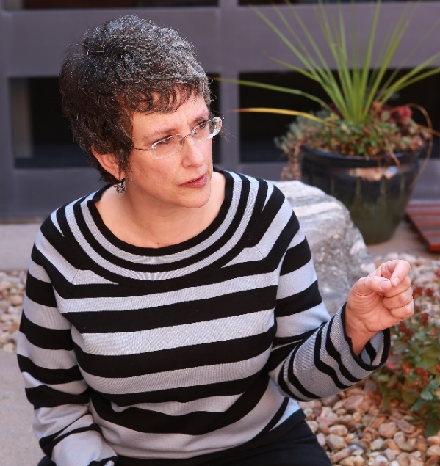
Affirm values and hopes
Meet her where she is
Educate on biomedical issues
No matter what
“I know why you’re here, and I’m not giving up hope for a miracle. You and the rest of the team are
VALUES
Self-aware
Now
Ask
Person guides
not the higher power here. You can’t tell me what can and can’t happen. I know you want me to give up, but I’m holding on for a miracle. You need to focus on doing your job to support me.”
WORDS
AREAS TO
EXPLORE
HOPES
Notes:
Strategic example

Slide 48
Miracle Talk
Literal appeal
Symbolic request
Expression of faith
Expression of emotion
Control over providers
Denial
Strategic
Asserting power, avoiding care discussions
Hayward, et al. 2016
Shinall, Stahl & Bibler 2017
Notes:
DeLisser 2009
Polite, B. N., Cipriano-Steffens, T., Hlubocky, F., Dignam, J., Ray, M., Smith, D., . . . Gehlert, S. (2017). An evaluation of psychosocial and religious belief differences in a diverse racial and socioeconomic urban cancer population. Journal of Racial and Ethnic Health Disparities, 4(2), 140-148. doi: 10.1007/s40615-016-0211-6
Hayward, R. D., Krause, N., Ironson, G., & Pargament, K. I. (2016). Externalizing religious health beliefs and health and well-being outcomes. Journal of Behavioral Medicine, 39, 887-895. doi: 10.1007/s10865-016-9761-7
Bandini etal 2017

Slide 49
Self-aware
Now
Ask
Person guides
Affirm values and hopes
Meet them where they are
Educate on biomedical issues
No matter what

Slide 50
Thank you!
Kelly Arora PhD
Kelly.Arora@UCDenver.edu

