Slide 1
Labyrinth Walks: Meeting Spiritual Needs in a Changing Culture
Libby Conley, MDiv
Noelle Andrew, MDiv, BCC
Caring for the Human Spirit
April 2018
Notes:
Noelle to start
Individual brief introductions

Slide 2
Objectives
Participants will be able to define/describe use of a labyrinth.
Participants will be able to discuss benefits of using a labyrinth in an interfaith setting.
Participants will be able to understand the importance of collaborating to seek out innovative ways to meet spiritual needs

Slide 3
Disclosures
University of Iowa Hospitals and Clinics received a grant. This grant is administered by Calvin College Vital Worship Grants. This grant is for education, training, equipment.
Neither presenter or co-presenter receive any financial gains.
The Spiritual Services Department at UIHC received an internal grant to purchase the labyrinth.

Slide 4
UIHC at a Glance
59,896
Emergency-Trauma Center Visits
36,019
Acute Admissions
226,721
Acute Patient Days of Care
934,073
Clinic Visits
Notes:
13,000 employees, students and volunteers
811 bed hospitals
190 beds at childrens
Level 1 trauma
Only burn unit in the state of Iowa
Extensive behavioral heal unit
Somewhat diverse population
Interpreting services – population
Top 5 non english speaking languages

Slide 5
UIHC at a glance
UI Hospitals and Clinics was the first hospital
in Iowa to be named a Magnet Hospital (2004)
by the American Nurses Credentialing Center
(ANCC) and the first hospital in Iowa to be
re-designated twice (2008 and 2013).
Magnet recognition is the highest award given for
excellence in nursing practice.
At a Magnet hospital, nurses are committed to
maintaining the highest standards of care in
an environment that values quality, safety,
satisfaction, and education.

Slide 6
Spiritual Services Department
Brief History
CPE
Code Blue

Slide 7
Worship history and demographics
Interfaith
Broadcast
Behavioral Health
Mass
Friday Prayers
Religious Preferences
Catholic
None’s/No Preference
Notes:
10 years ago when I started, we offered 4 interfaith worship services every Sunday. Med Psych, behavioral Health – locked unit, and then televised. However one by one, these services ended. This was due to poor attendance, lack of resources and support. Even with the televised services we had no way of knowing if anyone was even watching. When leading worship, Libby would even say if you are watching today, tell your nurse, I would love to come and visit you. Unfortunately, there was little return on investment. Therefore we currently offer 1 Mass on Sunday afternoons and Friday Muslim prayers, which are physician lead. Average Mass attendance continues to be 35. On any given day average Catholic census is 120.
And then of course we have the None’s. Am not sure how you discern what this means in your hospital, but I guess it is safe to say they are open to religion/spirituality, but may not have a denominational/doctrine which strongly guides their beliefs.

Slide 8
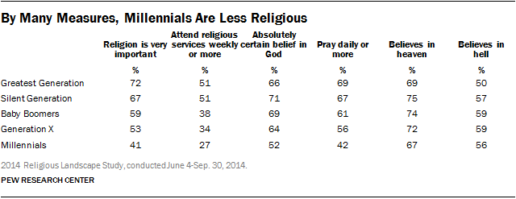
Religious Shift

Slide 9
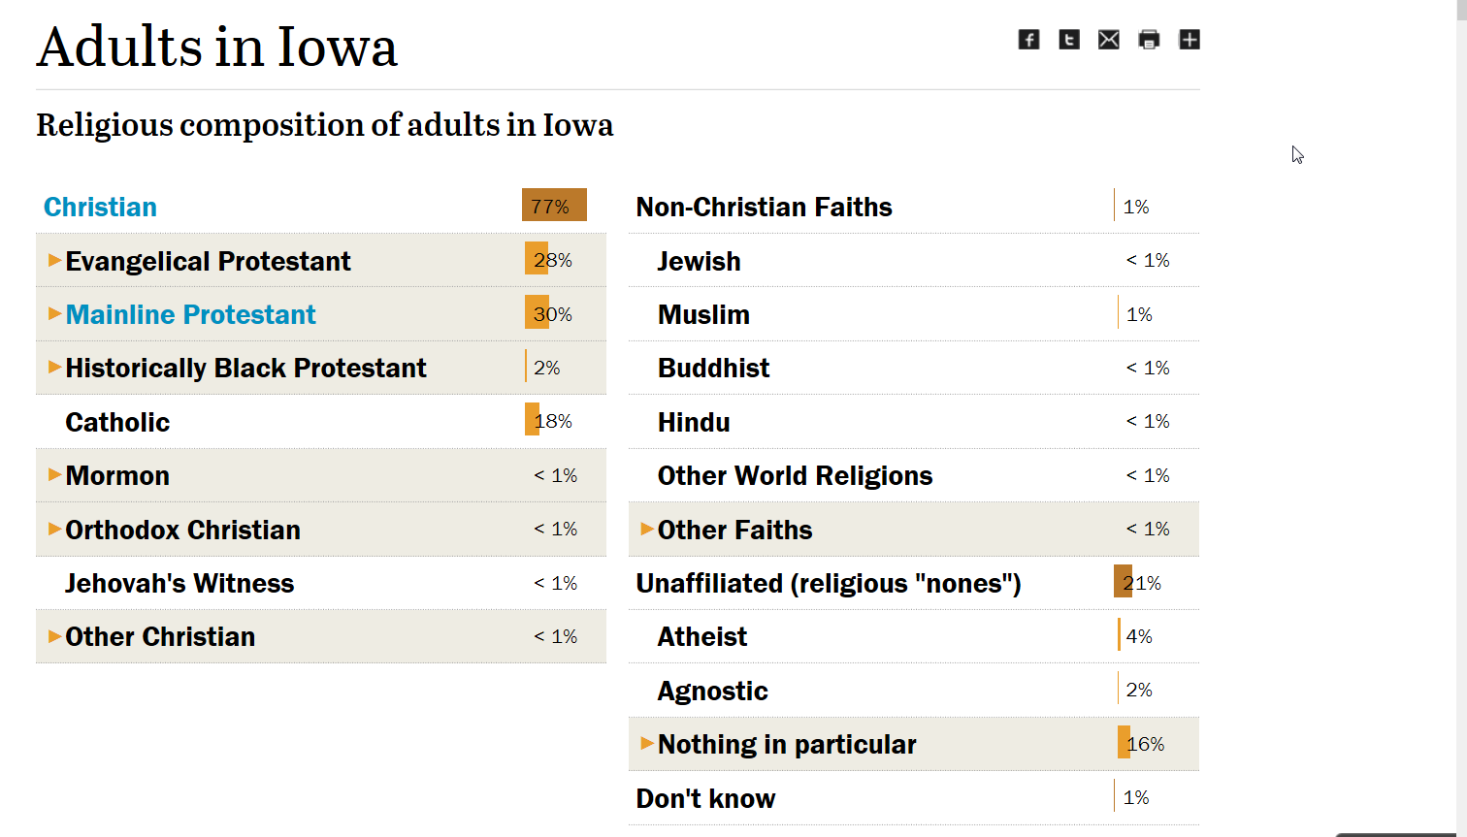
Iowa

Slide 10
Now what? Shift in Culture
Enhanced on line resources/Diversity Calendar
Worship resources in Meditation rooms
Midweek Meditations/Centering Prayer
Labyrinth
Focus on staff support/resilience/coping
COPE team
Notes:
It was not necessarily a proud moment in my career, when as a person of faith, you end 3 out of 4 worship services. Opportunity for change, you consider our hospital culture, chronically, critical ill patients, we needed a shift. Knowing that our patients are critically ill, staying longer, and we really don’t have a sense of what people are desiring.

Slide 11
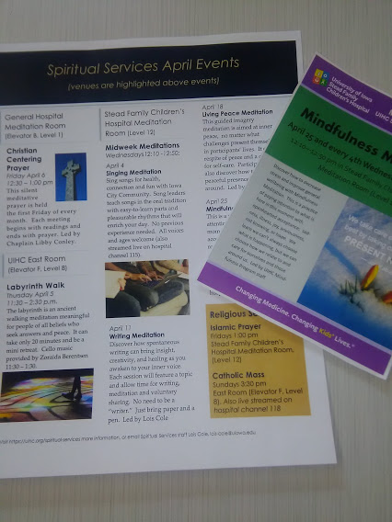
Photo of Monthly Activities

Slide 12
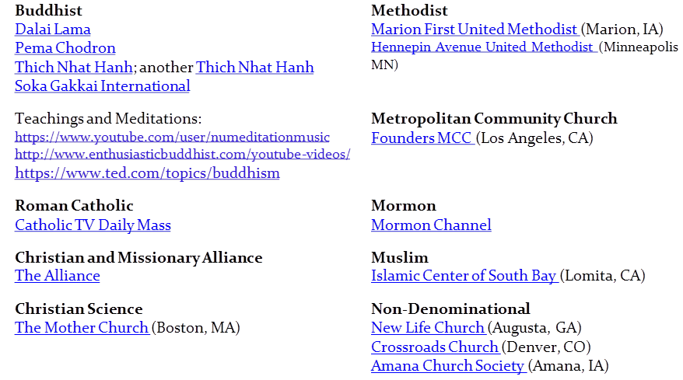
Resources from website
,
Notes:
Streaming
As well as 80 local churches

Slide 13
Next Steps
UIHC Volunteer Services grant to purchase labyrinth 2016, purchased early 2017
22 ft. St Paul/Modified Chartres Canvas
Calvin College Vital Worship Grant 2017 for training, music etc…
Dedicated and started labyrinth walks April 2017
Turning Point Consultants Training August 2017
interdisciplinary including CopeTeam

Slide 14
Collaborative Opportunities
COPE Team
To provide emotional support to staff who have had a work related expereince that might challenge their capacity to cope
Group/individual support
Labyrinth walks

Slide 15
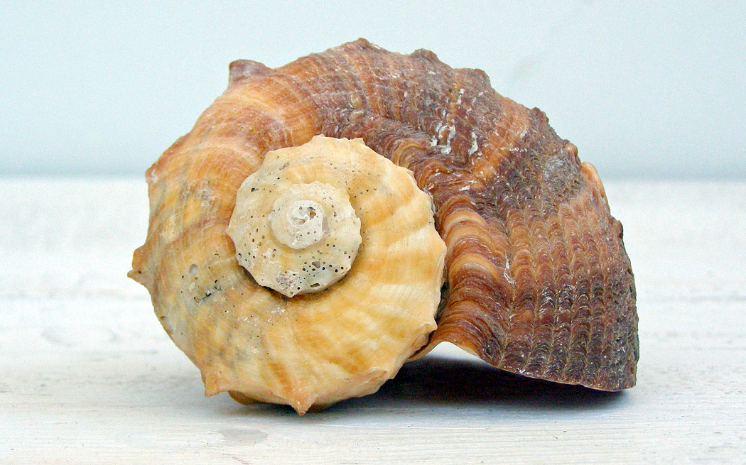
What is a Labyrinth?
Based on spirals found in nature:
fingerprint whorls, cochlea, your hand in a fist, sea shells, ferns unfurling, elephant trunks, ocean waves, tornadoes, hurricanes, Milky Way
A unicursal path, not a maze or puzzle to be solved
Many different configurations
Numbers of circuits vary, 7 is most popular
Notes:
Libby
http://discovermagazine.com/2014/may/3-ask-discover

Slide 16
What is a Labyrinth?
Fingerprint Whorl
Notes:
Libby

Slide 17
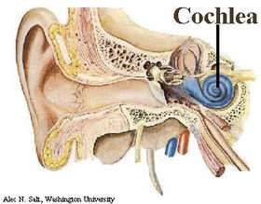
What is a Labyrinth?
Spirals:
outer and inner ear
Notes:
Libby

Slide 18
What is a Labyrinth?
Notes:
Hurricane Irene

Slide 19
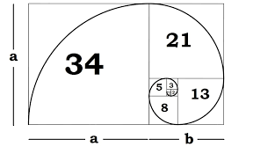
What is a Labyrinth?
Based on the Fibonacci sequence

Slide 20
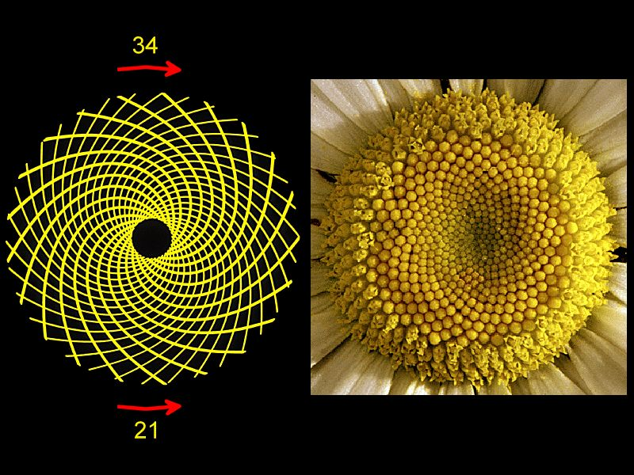
What is a Labyrinth?
More Fibonacci

Slide 21
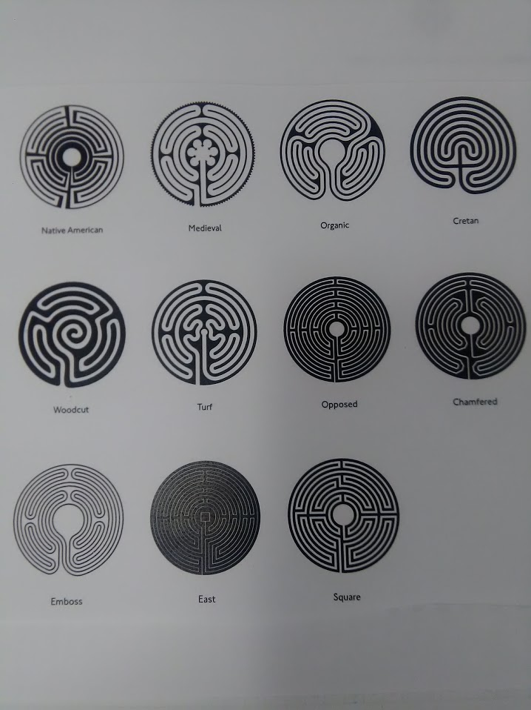
Labyrinth Designs

Slide 22
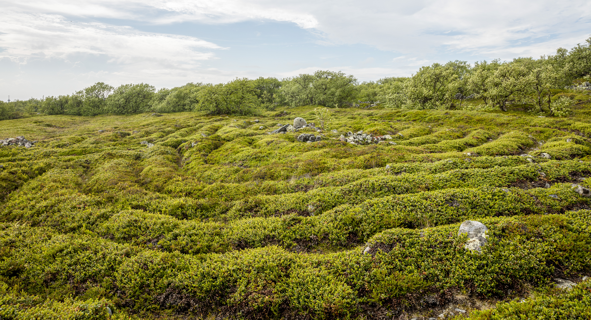
Ancient Labyrinths
Bolshoi Zayatsky Island
2500 years old
Notes:
White Sea Archipelago in Russia
35 stone labyrinths total, 12 on one island
Meaning is unknown- bones are found too

Slide 23
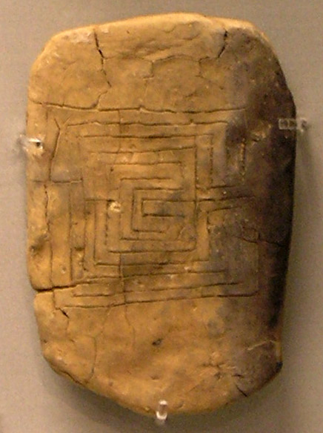
Ancient Labyrinths
Greek clay 1200 years old
Notes:
The same pattern was discovered in India off of an ancient trade route that is 56 feet square.
Estimated to be 2,000 years old. Reverse of a clay tablet from Pylos bearing the motif of the Labyrinth. The tablet, the earliest datable representation of the 7-course classical labyrinth, was recovered from the remains of the Mycenaean palace of Pylos, destroyed by fire ca 1,200 B.C.
In present day India it is still customary to paint labyrinths on walls to progtect a home

Slide 24
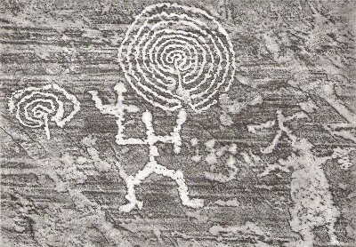
Ancient Labyrinths

Slide 25
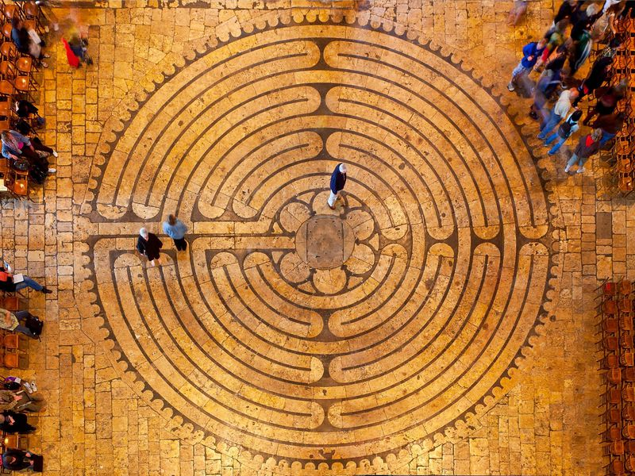
Labyrinths in the Middle Ages
Chartres
Notes:
Chartres is the second Cathedral built on Druid ruins. Middle ages pilgrimage was a way to earn salvation. Two trips to a Cathedral with a relics could equal a trip to the Holy Land. Some pilgrims would walk on their knees.

Slide 26
Chartres in Plan

Slide 27
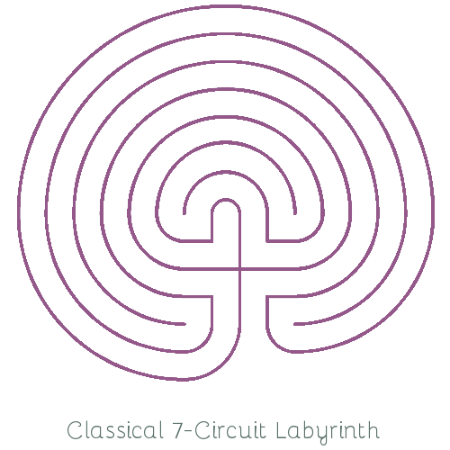
Classical Labyrinth
Notes:
Walking a Sacred Path: Rediscovering the Labyrinth as a Spiritual Tool, has been helpful in suggesting ways to make the labyrinth relevant. Borrowing three steps described in the early Middle Ages, she applies them to the stages of walking the labyrinth. They are: 1. Purgation: Releasing and shedding as we walk towards the center 2. Illumination: Resting in the center to receive inspiration 3. Union: Returning to our lives with a new awareness

Slide 28
Contemporary Renaissance
Rev. Lauren Artress,1990s
Walking a Sacred Path: Rediscovering the Labyrinth as a Spiritual Tool, "The labyrinth is truly a tool for our times. It can help us find our way through the bewildering multiplicity, to the unity of source. The labyrinth is an evocative experience. The labyrinth provides the sacred space where the inner and outer worlds can commune, where the thinking mind and imaginative heart can flow together. It can provide a space to listen to our inner voice of wisdom and come to grips with our role in humankind's next evolutionary step."

Slide 29
My Journey Toward Contemplation
CPE 2002
Spirituality Groups 2005-2010
Coloring Labyrinths
Mandalas
Centering Prayer/Class/Group 2010
Mystic Group/Richard Rohr
University of Iowa Health Care 2015

Slide 30
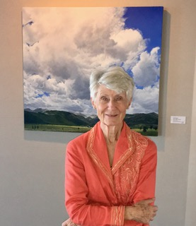
Turning Point Consultants
Zara Renander
Born in India
Raised in England
Raised Children in Montana
Nurse, flight attendant,
Pilgrimage leader
Turning Point Consultant
Notes:
Libby

Slide 31
Turning Point
Ritual
Trauma
Staff wellness
Notes:
Noelle
Ritual – has the ability and power to make meaning/structure in our lives through ceremony, the power to move us from one life stage to another, a vehicle which can be transformative
Our natural fear response is flight, fight, or freeze. The energy from a traumatic response must be released by the body. This energy is stored in our tissues.

Slide 32
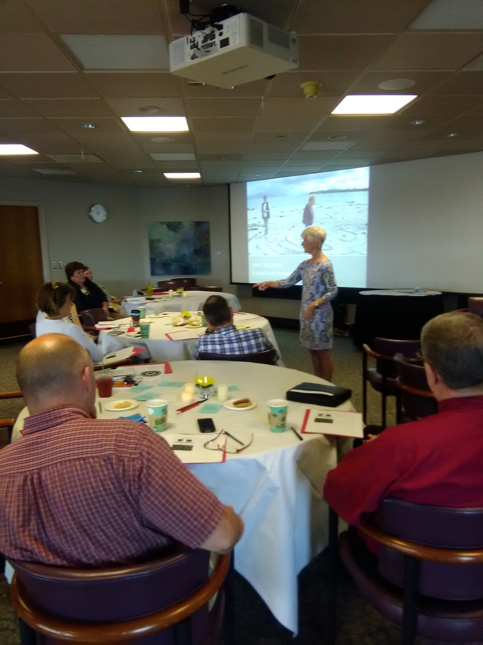
Turning Point

Slide 33
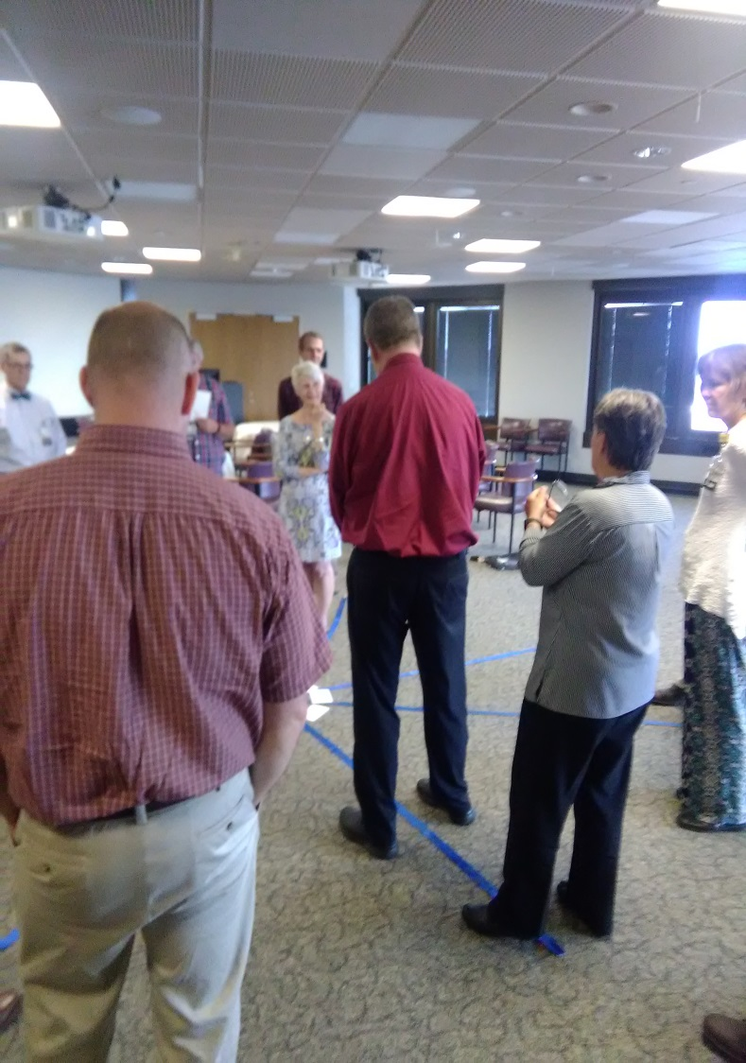
Turning Point
Notes:
Heroes’ journey

Slide 34
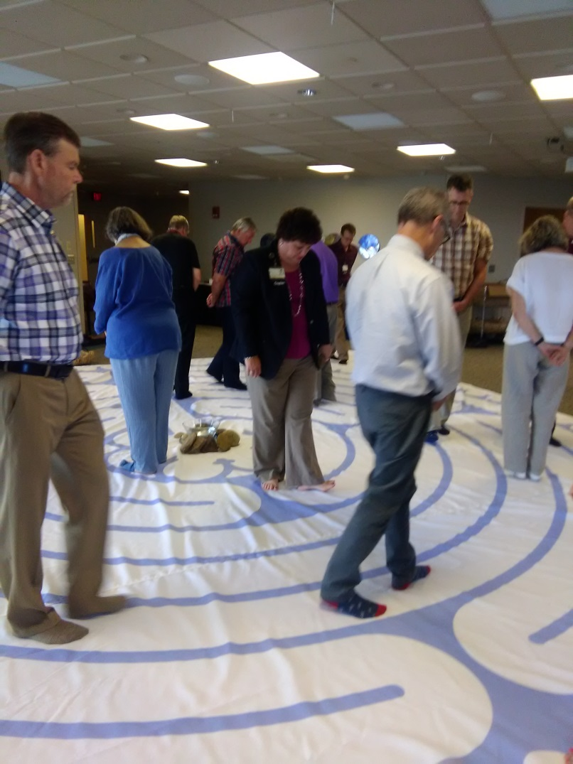
Turning Point

Slide 35
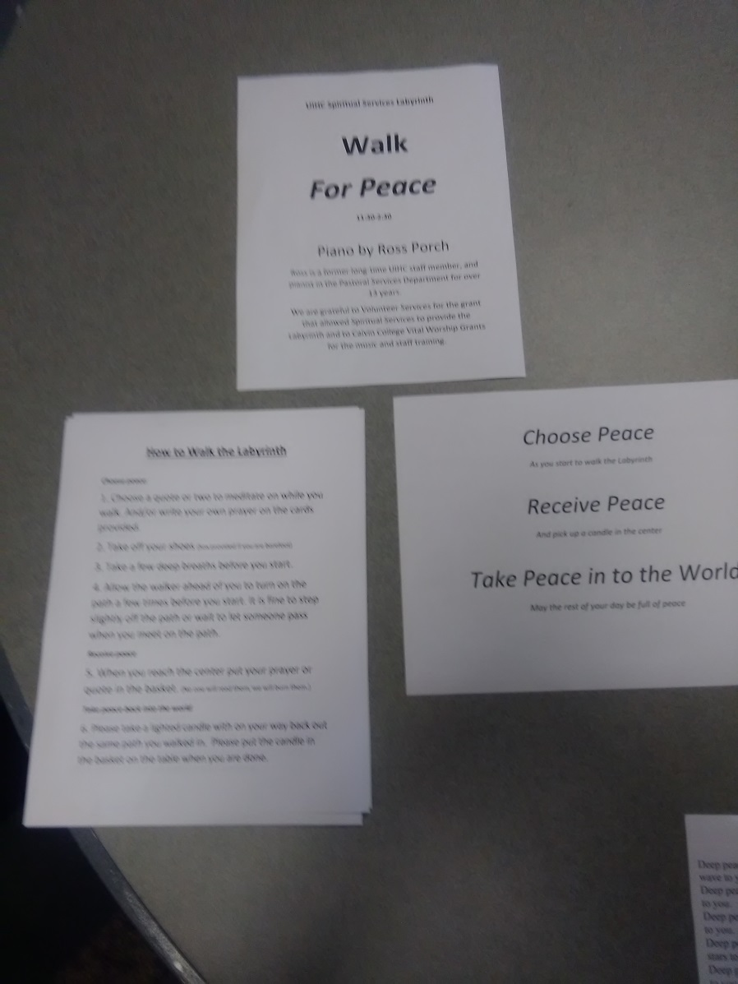
Our walks

Slide 36
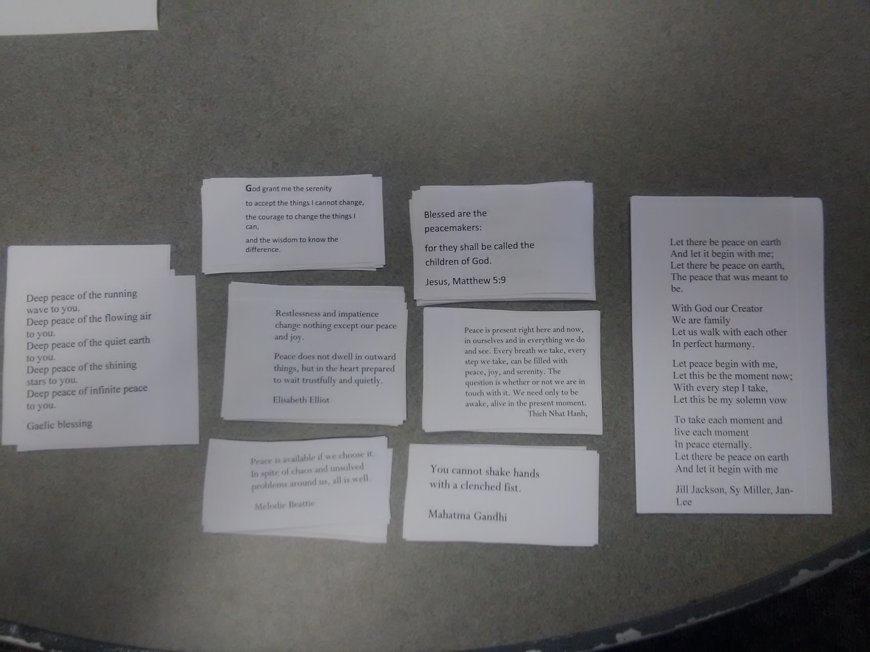
Our Walks

Slide 37
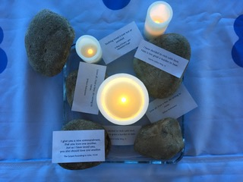

Slide 38
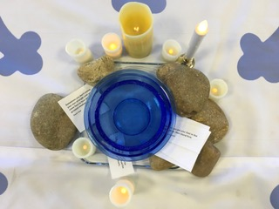
Notes:
Libby
What people bring to the center

Slide 39
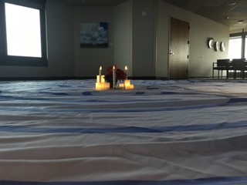

Slide 40
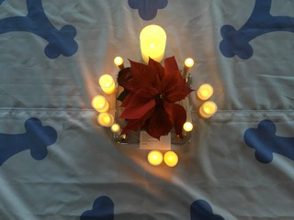

Slide 41
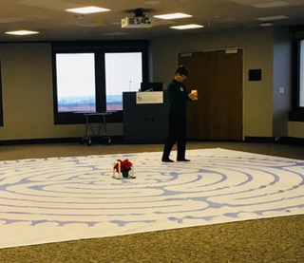
Notes:
Libby
Margalea

Slide 42
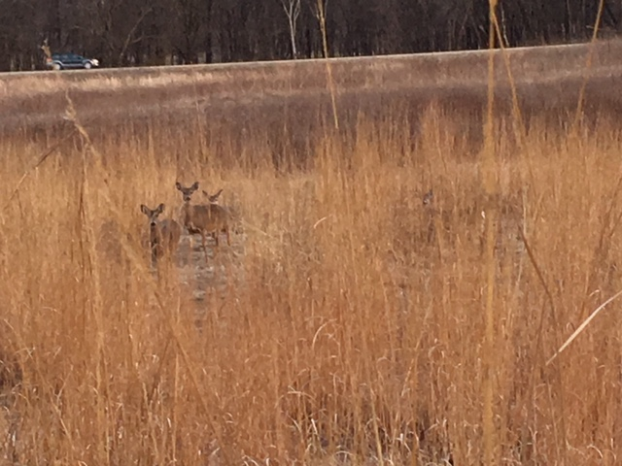
Notes:
Libby
Kelly, quote in locker

Slide 43
Reflections so far…
Paying vendors through the institution via the grant funds is an ongoing challenge.
Communication, advertising, is also a struggle
Small is beautiful
Meaning is deep for those who come, collaborators
Notes:
While it is safe to say everyone loves the concept of the grant, at times it can be very challenging. We were certainly thrilled to receive the grant from Calvin College, it is an external grant from the institution. So, it wasn’t until long after we signed on the dotted line did we learn about the challenges of getting people paid, and that we needed to collaborate with a grant department, of which neither of us knew existed.

Slide 44
Further Reflections
We have found advocates in the system
It takes more than one program for care outside the box.
Is the processing of grief too deep for the workplace?

Slide 45
Future plans
Grant is ending
Staff retreats
Peer to Peer
Burn camp
Memorial Service/Walks

Slide 46
Smaller Labyrinth Meditations
Underground Labyrinth
Lead me down the labyrinth lane
Take me there and back again
Silver train tracks weave your thread
Underground not overhead
Different colours mark the lines
Patterns etched on all our minds
Million journeys brisk and slack
Doors are closing mind the gap!
Lead me down the labyrinth lane
Take me there and back again.
By D’Artagnan Arbuah
Notes:
UK has art in their subways and teaching packets that see labyrinths as art.

Slide 47
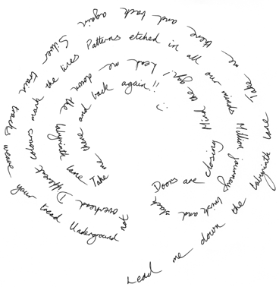
Smaller Labyrinth Meditations
Notes:
You can put the labyrinth pattern underneath a piece of paper to copy a poem or write freely over the pattern

Slide 48
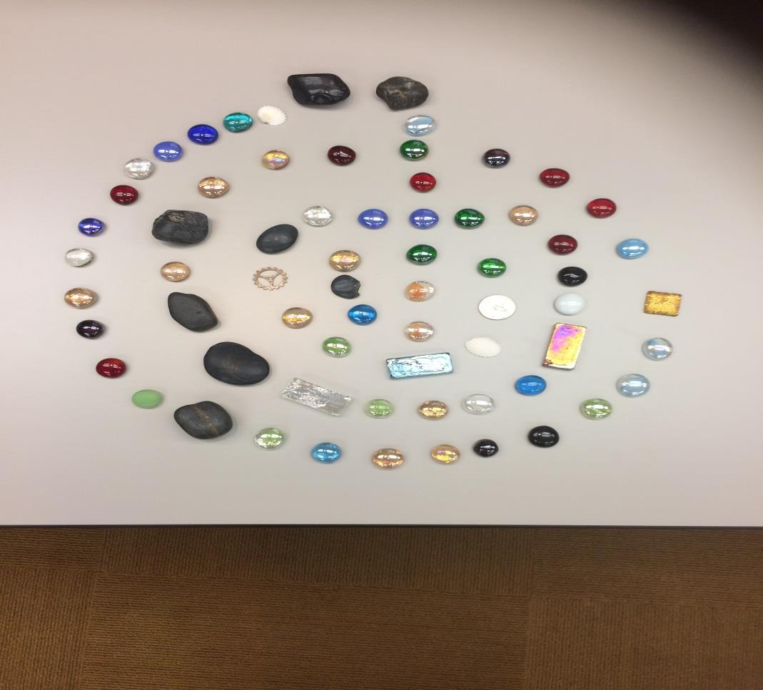
Smaller Labyrinth Meditations
Notes:
Life story for individual or group
Each type of stone is a category and each person adds to the story while placing a stone.
From Turning Point.

Slide 49
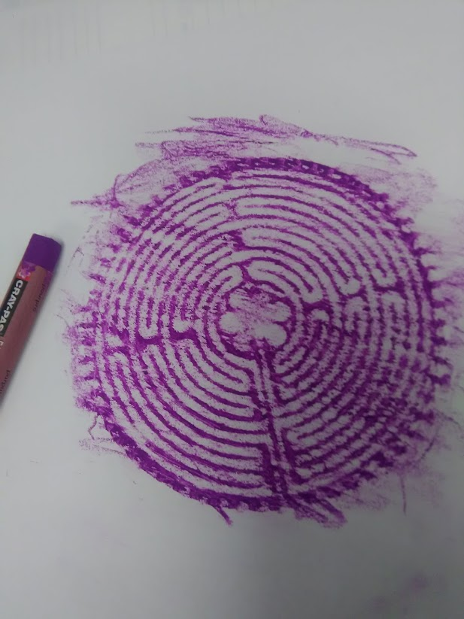
Smaller Labyrinth Meditations
Craypas rubbing

Slide 50
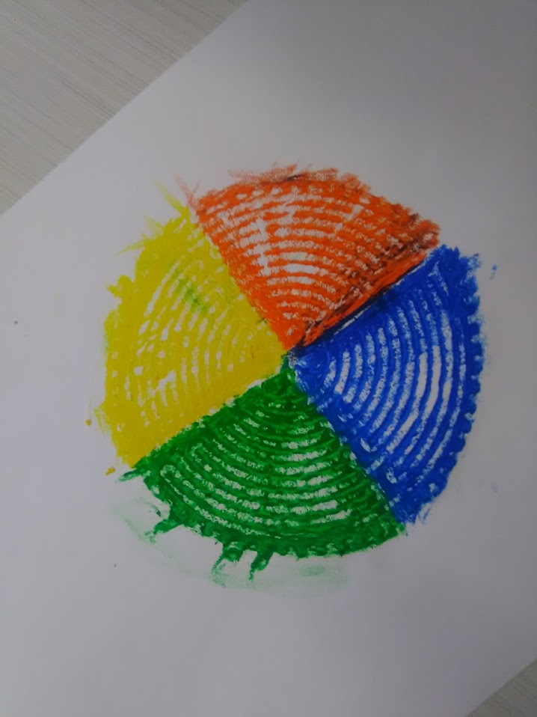
Smaller Labyrinth Meditations
Joel’s

Slide 51
Smaller Labyrinth Meditations
How to draw a labyrinth

Slide 52
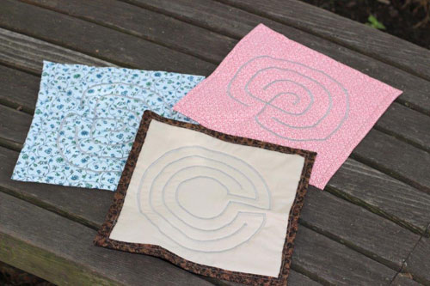
Smaller Labyrinth Meditations
Notes:
ELCA triennial, 5,000

Slide 53
Walking as Meditation
The steps below are adapted from a guided walking meditation led by mindfulness expert Jon Kabat-Zinn.
The components of each step. Walking meditation involves very deliberating thinking about and doing a series of actions that you normally do automatically. Breaking these steps down in your mind may feel awkward, even ridiculous.
a) the lifting of one foot; b) the moving of the foot a bit forward of where you’re standing; c) the placing of the foot on the floor, heal first; d) the shifting of the weight of the body onto the forward leg as the back heel lifts
Focus your attention.
What to do when your mind wanders. No matter how much you try to fix your attention on any of these sensations, your mind will inevitably wander. That’s OK—it’s perfectly natural. Much of our time is spent rushing from place to place, so preoccupied with our next activity that we don’t really notice what we’re doing now. We risk not really experiencing our life as we live it.
Notes:
Evidence That It Works
Grossman, P., Niemann, L., Schmidt, S., & Walach, H. (2004). Mindfulness-based stress reduction and health benefits, A meta-analysis. Journal of Psychosomatic Research, 57(1), 35-43.
A meta-analysis of 20 published studies concluded that the Mindfulness-Based Stress Reduction Program (MBSR), an eight-week training program that includes the walking meditation described above, is effective in improving physical symptoms and psychological well-being among individuals experiencing physical and mental illness (e.g., cancer, heart disease, depression) and among healthy but stressed individuals.
Difficulty: Casual | Frequency: 1x/day | Duration: 10 mins
(7 member ratings)
Why It Works
Walking meditation can help increase awareness both of our internal sensations and our external surroundings, tuning us into experiences that we often miss when we rush on autopilot from place to place. Paying closer attention to the process of walking can also increase our sense of appreciation and enjoyment of our physical bodies. By heightening awareness of mental and physical states, walking meditation—like mindfulness in general—can help us gain a greater sense of control over our thoughts, feelings, and actions, allowing us to respond in more constructive ways when we experience negative thoughts or emotions.
Difficulty: Casual | Frequency: 1x/day | Duration: 10 mins
(7 member ratings)
Sources
Jon Kabat-Zinn, Ph.D., Center for Mindfulness at the University of Massachusetts Medical School
Difficulty: Casual | Frequency: 1x/day | Duration: 10 mins
(7 member ratings)
For More
Difficulty: Casual | Frequency: 1x/day | Duration: 10 mins
(7 member ratings)
By focusing your attention on the sensations of walking, the Walking Meditation can help you cultivate a calmer mind. Are you attuned to the present moment? Take our Mindfulness quiz to find out:
Completion Status

Slide 54
Meditation with Paper Labyrinth
1.Retreat/Release
Ask a question, desire to seek…
Ground yourself, take a few deep breaths
2.Receive/Reunite
As you reach the center, listen deeply. Take some notes. Draw. Write a
prayer, poem or song.
Don’t hurry.
3. Return
Retrace your path slowly with your finger as you prepare to re enter your
current life.
Stay in the moment
Pause at the entrance as you finish your meditation.
Notes:
Metaphor for worship.
Walking a Sacred Path: Rediscovering the Labyrinth as a Spiritual Tool, has been helpful in suggesting ways to make the labyrinth relevant. Borrowing three steps described in the early Middle Ages, she applies them to the stages of walking the labyrinth. They are: 1. Purgation: Releasing and shedding as we walk towards the center 2. Illumination: Resting in the center to receive inspiration 3. Union: Returning to our lives with a new awareness

Slide 55
Some Resources and References
The Wounded Healer Henri J.M. Nouwen
Labyrinths: Journeys of Healing, Stories of Grace by Zara Renander
Exploring the Labyrinth A Guide for Healing and Spiritual Growth by Melissa Gayle West
Journey into Prayer by Kay http://blog.al.com/living-times/2011/11/journey_into_prayer_labyrinths.html
Oldest Labyrinth in the World
http://www.sevensistersmysteryschool.com/docs/The%20Oldest%20Labyrinth%20in%20the%20World.pdf
Millenials Are Less Religious than Older Americans but Just As Spiritual, by Becka A. Alper http://www.pewresearch.org/fact--tank/2015/11/23/millennials-are-less-religious-than-older-americans-but-just-as-spiritual/

Slide 56
Out of the Mystery: Education Pulls Nurses Into Spiritual Screening By Jeremy Hudson, MA, BCC
Veridas website http://www.veriditas.org/?gclid=CNH7nMXNqdECFUQdaQodpt8LoQ
Labyrinth Within the Christian Church Today http://www.ministrymatters.com/all/entry/4329/labyrinths-within-the christian-church-today
How UMC of Boulder applies ministry of the labyrinth in a church and community context http://fumcboulder.org/service-and-community/labyrinth/
Grace Cathedral
https://www.veriditas.org
Labyrinth Finder
https://labyrinthlocator.com

Slide 57
Review of Goals
1. What is a labyrinth?
2. How could you use a labyrinth in an interfaith setting?
3. What new ways can you collaborate with other disciplines and offer innovation in your own ministry context?

Slide 58
Questions???

Slide 59
Contact Information
Libby Conley
elizabeth-conley@iowa.edu
319-353-6928
Noelle Andrew
noelle-andrew@uiowa.edu
319-356-0470

