Slide 1

Family Care
ICU Bereavement Cart project
Combating Post-Intensive Care Syndrome for families when a loved one dies

Slide 2

Objectives
Define a “Good Death”
Define and discuss possible causes for Post Intensive Care Syndrome.
Discuss ways to help families and patients have a “Good Death” in order to avoid development of Post Intensive Care Syndrome
Discuss the Cape Fear Valley Medical Center ICU Bereavement Care Project and its outcomes

Slide 3
Case study
Patient: 86 year old man found down at home by his wife for an unknown amount of time. EMS did CPR and got a pulse. They transported him to the hospital where he coded and was worked on for 20 minutes before the team got a pulse back. He was then stabilized and moved to the ICU.
HCPOA: Spouse of 60 years. 80 year old woman with multiple health issues including diabetes and some cardiac issues.
Other relatives: two sons who live in town, a daughter lives in another state; five grandchildren and two
daughters-in-law
Other support persons: Church of God pastor and other church members
This is not a real case and does not require any special permissions.

Slide 4
Case Study Continued
After the patient arrived in the ICU the nurses began to get him situated and prepared to code him again if necessary. The wife and one of their sons were shown to the waiting room. After an hour in the waiting room the son finally went to the ICU door and asked if they could come back. At this point the doctor came out and talked to them in the hallway asking the wife if his heart stops again would she want them to do CPR again. The wife stated that she wanted everything done that could be done and that she wanted to see her husband.

Slide 5
Case Study Continued
The 80 year old spouse and the son went back into the patient’s room. He was hooked up to the vent and had multiple bags hanging with IVs running into his arms. There were several machines buzzing and numbers on the monitor. There were no chairs in the room and the husband was not responding to her voice. The son got the nurse and asked for a chair for his mother to sit in. She sat next to the bed for the rest of the day. The son could not get her to go anywhere so he asked if he could bring her something to eat and he was told there could not be any outside food.
Over the next few days the wife was asked multiple times if she would “make him a DNR”. She wouldn’t leave her husband’s side except for a few moments when her sons managed to get her to come out of the ICU to eat. She grew increasingly anxious and could be found having laid her head down on his bed and fallen asleep.

Slide 6
Case Study continued
Multiple times her pastor showed up and he was only allowed back if her children left so his visits were short and consisted of a simple prayer for a miracle. The staff appeared to give negative looks and laughed about a “miracle” happening when this man was so sick. The staff started acting frustrated when the woman continued to insist on doing everything and refused to “make him a DNR”.
After two more days the patient coded again. The doctor said, “you need to make him a DNR. We are crushing his ribs and breaking every bone in his body and he is not coming back.” Among sobs the 80 year old woman started nearly falling over and one of her sons caught her.

Slide 7
Case study continued
The son insisted the staff get her a chair and told the staff she hadn’t eaten and began raising his voice with them about how they were treating his mother. The staff called Security to take him out of the ICU and the staff continued to pressure the woman for a DNR so they could stop. Finally her second son told the staff to stop. All the staff left and let the family go back into the room. The patient lay uncovered on the bed and the room was a mess with everything that had been thrown around during the code. After about a half hour the wife was told to sign the form for the morgue and given a tiny strip of paper that had been ripped off of one of a piece of paper with the number for Vital Statistics. Then the whole family left.

Slide 8
What mistakes did the staff make?
What would you change in this case?
Was this a good death?

Slide 9
A Good Death
What would you want your death to look like?
How would you want your family’s experience to be?
Have you experienced a “good death”?

Slide 10
What we are and aren’t talking about
Good Death
A term that reflects individual preferences for how a person wants to die. For many people, factors that constitute a good death include dying at home, with family and friends and without stressful physical symptoms (nausea and vomiting, pain, dyspnea, respiratory tract secretions, pain, and agitation).
Any death that others view as a comforting and 'smooth' transition from a living to nonliving state
AND-Allow for Natural Death
Comfort Care
Not:
Physician assisted suicide, Euthanasia, Brain Death, etc.

Slide 11
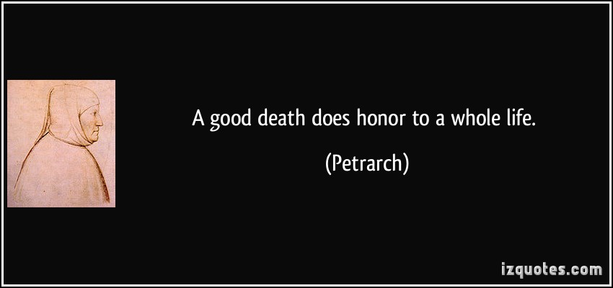
Good Death

Slide 12






1.Steel Magnolias
2.Beaches
3.Tender Mercies
4.Bonneville
5.Terms of Endearment
6.Truly Madly Deeply
7.PS I love you
8.The Notebook
9.One True Thing
10.The Bucket List
11.Rabbit Hole
12.Ghost
13.The Other Woman
14.My Life
15.Philadelphia
16.What Dreams May Come
17.Ponette
18.Delores Claiborne
19.Wuthering Heights
20.Ordinary People
21.Out of Africa
22.Extremely Loud and Incredibly Close
23.Step Mom
24.The Kite Runner
25.Mystic River
26.The Descendants
27.Two Weeks
28.Miss Potter
29.The Lovely Bones
30.The Doctor
31.Alex, the Life of a Child
32.Love Story
33.Patch Adams
34.Up
35.Burning Man
36.The Sweet Hereafter
37.Last Tango in Paris
38.Seven Pounds
39.Dear Zachary: A Letter to a Son About His Father
40.My Sister’s Keeper
41.Sophie’s Choice
42.Catch and Release
43.Moonlight Mile
44.White Oleander
45.Monster’s Ball
46.Things We Lost In the Fire
47.Reign Over Me
48.In the Bedroom
49.To Gillian on Her 37th Birthday
50.The Big Chill
51.About Schmidt
52.Nights in Rodanthe
53.Taking Chance
54.In the Gloaming
55.Wit
56.Message in a Bottle
57.Lorenzo’s Oil
58.We Bought a Zoo
59.Beautiful Boy
60.The Laramie Project
61.Marley and Me
62.The Broken Circle Breakdown
63.August: Osage County
64.The Family Stone
More……………
https://whatsyourgrief.com/64-movies-about-grief-and-loss/

Slide 13



















Slide 14
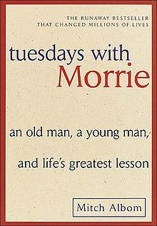



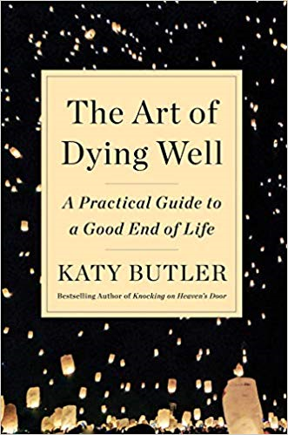



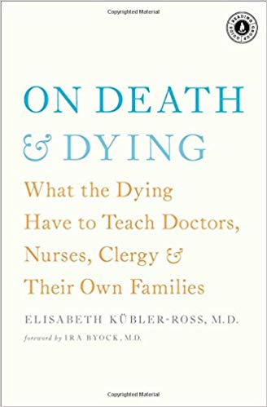

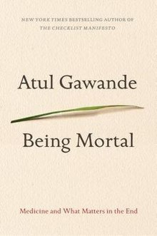
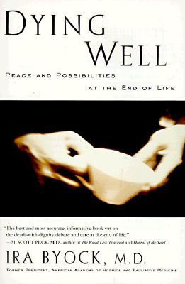

Man’s Search for Meaning
Viktor E. Frankl

Slide 15
We are obsessed with death
But no one wants to talk about it

Slide 16
Excuses for not talking about death
I feel fine so we can think about it tomorrow
I’m young. People don’t die young
I eat healthy and work out so I’m not going to die
My loved ones know what I want
I don’t have time
We don’t talk about death (taboo subject)
If I fill out an Advance Directive I’ll die
Others?

Slide 17
Monetary Effects of not talking about death
Hospital cost at End of Life vs. Hospice
Days prior to death | Hospital cost per day | Hospice cost per day
1-3 | $5,983 | $230.74
4-7 | $638 | $230.74
8-20 | $493 | $190.55
21-40 | $349 | $190.55
41-60 | $267 | $190.55
60-90 | $220 | $190.55
90-130 | $184 | $190.55
130-180 | $156 | $190.55
Duncan, I., Ahmed, T., Dove, H., & Maxwell, T. L. (2019). Medicare Cost at End of Life. American Journal of Hospice and Palliative Medicine®, 1049909119836204.

Slide 18
The effects of not talking about death
Even at varying levels of exposure (e.g., 1 year vs a few months prior), care coordination and palliative supports can lower end-of-life costs and utilization.
Ruiz S, Snyder LP, Giuriceo K, et.al. Innovative Models for High-Risk Patients Use Care Coordination and Palliative Supports to Reduce End-of-life Utilization and Spending. Innov Aging. 2017 Nov 20;1(2):igx021.
Approximately US $205 billion is spent in the United States on patients in the last year of life or 13% of the annual total spending on health care
Aldridge MD, Kelley AS. The myth regarding the high cost of end-of-life care. Am J Public Health. 2015;105:2411–2415

Slide 19
Spiritual Effects of Not Talking about death
Clergy and death: unusual findings
Multiple studies report that significant Spiritual support by local clergy (not clinically trained) led to:
More aggressive care at end of life
Less likely to go into Hospice Care
More likely to die in Intensive Care
Balboni MJ, Sullivan A, Enzinger AC, Smith PT, Mitchell C, Peteet JR, Tulsky JA, VanderWeele T, Balboni TA. : U.S. Clergy Religious Values and Relationships to End-of-Life Discussions and Care J Pain Symptom Manage. 2017 Jun;53(6):999-1009. doi: 10.1016/j.jpainsymman.2016.12.346. Epub 2017 Feb 6. PMID: 28185893
Balboni TA, Vanderwerker LC, Block SD, et al.: Religiousness and spiritual support among advanced cancer patients and associations with end-of-life treatment preferences and quality of life. J Clin Oncol 2007; 25:555-560
Alcorn SR, Balboni MJ, Prigerson HG, et al.
Balboni TA, Phelps AC, Gallivan K, et al. : Religious coping and use of intensive life-prolonging care near death in patients with advanced cancer. JAMA 2009; 301:1140-1147
Phelps AC, Maciejewski PK, Nilsson M, et al. : Religious coping and use of intensive life-prolonging care near death in patients with advanced cancer. JAMA 2009; 301: 1140-1147
Balboni TA, Phelps AC, Gallivan K, et al. : Provision of spiritual support to advanced cancer patients by religious communities and associations with medical care at the end of life. JAMA Intern Med 2013; 173:1109-1117.
Balboni TA, Paulk ME, Balboni MJ, et al. : Provision of spiritual care to patients with advanced cancer: Associations with medical care and quality of life near death. J Clin Oncol 2010; 28: 445-452
Balboni T, Balboni M, Paulk ME, et al.: Support of cancer patients’ spiritual needs and associations with medical care costs at the end of life. Cancer 2011; 117:5383-5391

Slide 20
Clergy reasons for not talking about death
Some clergy reported that due to a theological belief in sanctity of life and miraculous healing they did not believe they should talk about it and chose instead to focus only on what a good life looks like
Some clergy reported being uncomfortable to talk about it
Many clergy did not believe in the idea of a “good” death
A large number of clergy responded that they needed more training
Belief in miracles and hope and fear that the family/patient may lose their faith
LeBaron, V. T., Cooke, A., Resmini, J., Garinther, A., Chow, V., Quiñones, R., ... & Balboni, T. A. (2015). Clergy views on a good versus a poor death: ministry to the terminally ill. Journal of palliative medicine, 18(12), 1000-1007.
Sanders, J. J., Chow, V., Enzinger, A. C., Lam, T. C., Smith, P. T., Quiñones, R., ... & Balboni, T. A. (2017). Seeking and accepting: US clergy theological and moral perspectives informing decision making at the end of life. Journal of palliative medicine, 20(10), 1059-1067

Slide 21

Medical team’s reasons for not talking about death
Fear patient will “lose hope”
Don’t want to “give up”
Don’t know how to bring it up
Don’t know how to talk about it
Fear families/patients might get angry
No time
Center for Medicare and Medicaid Services (CMS) created provider billing options for ACP in January of 2016.
Advance Care Planning: ICN 909289. August 2016 Report from: Center for Medicare and Medicaid Services (CMS), Department of Health and Human Services (HHS), Medicare Learning Network (MLN). www.cms.gov/Outreachand-Education/Medicare-Learning-Network-MLN/MLN Products/Downloads/AdvanceCarePlanningText-Only.PDF.

Slide 22
The effects of not talking about death
Death comes suddenly and unexpectedly
Guilt
Grief intensifies
Questioning
No time to say goodbye
Shock
Others?

Slide 23
Post-intensive care syndrome

Slide 24
Post-Intensive Care Syndrome: What is it?
What is PICS-Family?
PICS-Family is a group of symptoms that may affect family members of people who have recently left the ICU. It is common for family members to feel any or some of the following symptoms:
  Stress
  Sleepiness
  Sadness
  Grief
  Post-traumatic stress disorder
  Anxiety
Pulmonary and Critical Care Medicine
What You Need To Know About Post-Intensive Care Syndrome (PICS)
Patient Education by University of Michigan Health System is licensed under a Creative Commons Attribution-NonCommercial-ShareAlike 3.0 Unported License. Last Revised 10/17/2014
Adapted from: VA “What You Need To Know About PICS”

Slide 25
Pics-f development diagnosable disorders
From symptoms of anxiety to generalized anxiety disorder
From symptoms of depression to major depressive disorder
Panic disorder
Acute stress disorder and PTSD-related symptoms
Complicated grief
Taken from: Schmidt, M., & Azoulay, E. (2012). Having a loved one in the ICU: the forgotten family. Current opinion in critical care, 18(5), 540-547.

Slide 26
PICS-F: Post Intensive Care Syndrome-family
Factors associated with a higher risk for PICS-F signs and symptoms include the patient’s severity of illness, death of the patient, sex of the family member, relationship between the family member and the patient, decision-making by the family member, and the family member’s psychological history. Additionally, avoidant coping after a stressful event has been associated with the development of adverse psychological signs and symptoms and has been predictive of later indications of PTSD in family members of ICU patients.
Petrinec A. Post–Intensive Care Syndrome in Family Decision Makers of Long-term Acute Care Hospital Patients
Am J Crit Care September 2017 vol. 26 no. 5 416-422

Slide 27
Complicated Grief
After a death in the ICU:
6 months: 52% of families present complicated grief symptoms
12 months: 53% of families present complicated grief symptoms
Kentish-Barnes N, Chaize M, Seegers V, Legriel S, Cariou A, Jaber S, et al. Complicated grief after death of a relative in the Intensive Care unit. Eur Respir J. 2015 (5): 1341-52.
People with this condition are caught up in rumination about the circumstances of the death, worry about its consequences, or excessive avoidance of reminders of the loss.
Shear MK. Grief and mourning gone awry: pathway and course of complicated grief. Dialogues Clin Neurosci. 2012 Jun; 14(2): 119–128.

Slide 28
PTSD-Post Traumatic Stress Disorder
Predictors for PTSD development in families
The quality of information and family satisfaction with the information (dissatisfaction with what the information is and dissatisfaction with presentation of information)
The more families feel responsible for the life and death decision-making process of their loved one (feelings of guilt, worry, uncertainty)
Azoulay E, Chevret S, Leleu G, Pochard F, Barboteu M, Adrie C, et al. Risk of post-traumatic stress symptoms in family members of intensive care unit patients. Am J Respir Crit Care Med. 2005; 171(9):987-94.

Slide 29
Changing the culture of the icu

Slide 30
Ways to help the family
Research shows earlier conversations about death lead to better quality of life, better patient/family satisfaction, and a higher likelihood of having a good death.
Establish trust early
Communicate early and often
Provide mental/spiritual evaluation and support
Hold family meetings within the first 72 hours and weekly afterwards
  Update family on pt medical condition and treatment options
  Discuss the pt prognosis and gain understanding of the pt attitude towards death and dying
  Obtain consensus from family about treatment plan
  Establish clinical milestones that indicate success or failure of treatment plan
  Establish the next family conference
Hickman R and Douglas S. Impact of chronic critical illness on the psychological outcomes of family members. AACN Adv Crit Care. 2010; 21(1): 80-91.
Lilly C, De Meo D, Sonna L, Haley K, Massaro A, Wallace R, et al. An intensive communication intervention for the critically ill. American Journal of Medicine 2000;109:469-475

Slide 31
Family conference and bereavement pamphlet
Among ICU patients expected to die within a few days, a proactive family conference and bereavement pamphlet resulted in improvements in family symptoms of depression, anxiety, and post-traumatic stress disorder.
Lautrette A, Darmon M, Megarbane B, Joly LM, Chevret S, Adrie C, Barnoud D, Bleichner G, Bruel C, Choukroun G, et al. A Communication strategy and brochure for relatives of patients dying in the ICU. N Engl J. Med 2007; 356:469=478

Slide 32
Ideas to help the family
Proactive and effective communication strategies
Printed information materials (information pamphlet, brochures)
ICU organization (regular nurse-physician meeting, unit staff level, open visiting hours)
Nurse family care specialist
Family participation in care
Psychological screening
Post-ICU interventions (family debriefing visit, family clinics, posthospital disease management program)
Taken from: Schmidt, M., & Azoulay, E. (2012). Having a loved one in the ICU: the forgotten family. Current opinion in critical care, 18(5), 540-547.

Slide 33
Family-centered critical care
The model of family-centered critical care reflects a philosophy of care that approaches the family as an extension of the critically ill, who also experience the process of care. This model is a departure from the traditional patient-centered care model
The severity of psychological distress among family members of the CCI is likely to interfere with their ability to comprehend vital medical information and formulate informed decisions regarding the patient’s medical care that has commonly guided the delivery of care in the ICU.
Hickman R, Douglas S. Impact of Chronic Critical Illness on the Psychological
Outcomes of Family Members AACN Adv Crit Care. 2010 ; 21(1): 80–91.

Slide 34

Chaplains in Critical care

Slide 35
How clinically trained Chaplains Help
“family members were more likely to be satisfied with their spiritual care if a pastor or spiritual care advisor was involved during the 24 hrs before the patient’s death.”
“families who were more satisfied with their spiritual care were also more satisfied with their total ICU experience.”
Wall, R. J., Engelberg, R. A., Gries, C. J., Glavan, B., & Curtis, J. R. (2007). Spiritual care of families in the intensive care unit. Critical care medicine, 35(4), 1084-1090.
Families show more satisfaction with care in the ICU when spirituality was addressed in care conferences
Gries CJ, Curtis JR, Wall RJ, Engelberg RA. Family member satisfaction with end-of-life decision making in the ICU. Chest. 2008; 133:704-12.
Conversations with families about the patient as an individual, with specific reference to his or her wishes for end-of-life care, may be particularly useful for families. These families report Spiritual care providers questions about the patient helped families make decisions in the ICU
Johnson, J. R., Engelberg, R. A., Nielsen, E. L., Kross, E. K., Smith, N. L., Hanada, J. C., ... & Curtis, J. R. (2014). The association of spiritual care providers’ activities with family members’ satisfaction with care after a death in the ICU. Critical care medicine, 42(9), 1991.

Slide 36
“The Impact of Professional Spiritual Care”
A 2018 joint publication of
ACPE: The Standard for Spiritual Care and Education; Association of Professional Chaplains;
Canadian Association for Spiritual Care; National Association of Catholic Chaplains; Neshama: Association of Jewish Chaplains
What do patients want from chaplains?
In a 2010 survey
    70% of patients wanted at least one visit from a chaplain.
    78% of patients wanted chaplains to remind them of God’s care and presence.
    71% of patients wanted chaplains to offer support to their family and friends.
    69% of patients wanted chaplains to be with them during times of particular anxiety or
uncertainty.
    62% of patients wanted chaplains to pray or read scriptures or sacred texts.
    39% of patients wanted chaplains to counsel them regarding moral or ethical concerns
or decisions
Piderman, K. M., Marek, D. V., Jenkins, S. M., Johnson, M. E., Buryska, J. F., Shanafelt, T. D., Mueller, P. S. (2010). Predicting patients’ expectations of hospital chaplains: A multisite survey. Mayo Clinic Proceedings, 85(1), 1002–1010.

Slide 37
Patient Satisfaction
“A study of nearly 9,000 patients found that chaplaincy visits increase patients’ willingness to recommend the hospital and are more satisfied with their overall care, as measured by both Press Ganey (one of the most widely used patient satisfaction companies) and the Centers for Medicare and Medicaid Services’ survey, Hospital Consumer Assessment of Healthcare Providers and Systems (HCAHPS).*The Press Ganey survey specifically found that patients who have a chaplain visit are significantly more likely to endorse positive responses to questions regarding whether the “staff addressed my emotional needs” and “staff addressed my spiritual needs.””
“Spiritual Care and Physicians: Understanding Spirituality in Medical Practice” HealthCare Chaplaincy, September 2017
*Marin DB, Sharma V, Sosunov E, Egorova N, Goldstein R, Handzo GF. Relationship between chaplain visits and patient satisfaction. J Health Care Chaplain. 2015;21(1):14-24.

Slide 38
SPIRITUAL WELL-BEING
Multidimensional 12-month intervention for palliative care outpatients. “Compared to the control group, patients who received the CCT intervention had improved scores on a measure of spiritual well-being. They also had reductions in shortness of breath, improvements in anxiety and sleep and reduced health care utilization.”
Fitchett G. Recent progress in chaplaincy-related research. Journal of Pastoral Care and Counseling. 2017 Sept; 71(3):163-175.

Slide 39
Spiritual Support
“Those receiving a high level of spiritual support from the medical team were associated with higher rates of hospice use, fewer ICU deaths and fewer aggressive interventions.”
TA Balboni TA, Balboni M, Enzinger AC, et al. Provision of spiritual support to patients with advanced cancer by religious communities and associations with medical care at the end of life. JAMA Intern Med. 2013; 173 (12):1109-1117

Slide 40

Bereavement project
Cape fear valley medical center’s intensive care unit
Family centered care

Slide 41
The team
Cape Fear Valley Foundation funded project
Lead: Dr. Esteban Mery-Fernandez-Critical Care Intensivist
Co-lead: Robin Kivett, RN, BSN, MSN, CHPCN-Palliative Care nurse
Melissa Asycue, RN-Found literature and resources needed
Sue Halstead, NA-maintains the cart and makes family follow up calls
Dr. Peggy Kirk, RN, BSN, MSN, PhD- Logo;Provided stencils and embroidery for materials
Dr. Beth Langley, RN, BSN, MSN, PhD-nursing administration
Felicia McGarry, RN, BSN-Patient Care Manager for Intensive Care Units
Chaplain Melanie Swofford, MDiv, BCC-Critical Care Chaplain
Demetria Ward, RN-Nurse on Med/surg floor developed Purple dove

Slide 42
Fayetteville, nc
County seat of Cumberland County
Home of Fort Bragg
6th largest city in North Carolina
Population of 204,759 as of 2016
Located in the Sandhills on the Cape Fear River in the Coastal Plains of North Carolina
Largest metropolitan area in Southeast North Carolina
Located right off of Interstate highway 95

Slide 43
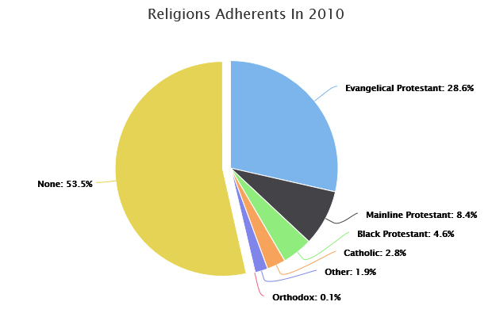
http://www.city-data.com/city/Fayetteville-North-Carolina.html

Slide 44
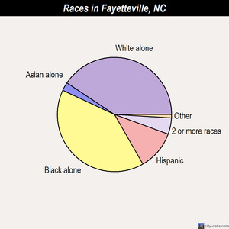
Fayetteville statistics: race layout
  86,560 42.3% Black alone
  77,785 38.0% White alone
  23,953 11.7% Hispanic
  8,825 4.3% Two or more races
  4,98 2.4% Asian alone
  1,869 0.9% American Indian alone
  336 0.2% Native Hawaiian and Other Pacific Islander alone
  467 0.2% Other race alone
http://www.city-data.com/city/Fayetteville-North-Carolina.html

Slide 45
Cape Fear Valley
Cape Fear Valley is a 950-bed, 8-hospital regional health system, the 8th largest in North Carolina, with more than 1 million inpatient and outpatients annually. A private not-for-profit organization with 7,000 employees and 850 physicians
Cape Fear Valley Medical Center (Houses the busiest ED in the state and in the top 20 of the nation)
Highsmith-Rainey Specialty Hospital
Cape Fear Valley Rehabilitation Center
Behavioral Health Care
Bladen County Hospital
Hoke Hospital
Health Pavilion North
Health Pavilion Hoke Harnett Health

Slide 46
Initial findings
Families do not like to leave the bedside of their loved one who is in the ICU
Outside food is not allowed in the ICU so families who would not leave at all would not be able to eat
Loved ones were sitting at the bedside for hours with nothing to drink
Some loved ones wouldn’t or couldn’t go home
Often family members would forget to take medicines
There was a coffee pot in the waiting room that was never stocked and no other snack or drink machines the families could access without leaving the floor
Clergy and Spiritual leaders were sometimes hours away and unable to offer support
Lots of interruptions from staff taking blood and doing unnecessary hourly testing
Staff going into the room as they normally would without realizing the patient was dying and showing the proper respect for the situation.

Slide 47
Symbol for the project

Slide 48
Steps Taken
Created End of Life Care Policy
Created Comfort Care Order Set
Began family follow up calls
Bereavement Tray
Purple Dove
Comfort Care Brochure
ICU information Brochure
Comfort Care Cart
Extensive Education about
Most recent addition to improving family care: Coping with Loss Brochure

Slide 49
ICU brochure
“Patients are admitted to the Intensive Care Unit (ICU) to receive specialized care due to a life threatening illness. We recognize that this is a difficult time for our patients and their families. This booklet is designed to tell you what to expect during an ICU stay, answer many of your questions, and make this difficult time a little easier for you.”

Slide 50
Comfort care policy: Procedural Guidelines
1. Acknowledge the patient’s right for end of life care.
2. Consider the patient and family members as the unit of care. Maintain dignity, respect and
sensitivity at all times.
3. Assess patient’s needs. Inform patient and family about the options for care. Plan
interventions based on the wishes of the patient and family. Consider their preferences
regarding nutritional needs, pain management, and alternative therapies.
4. Review Advance Directive documents and Code Status
5. Assess the patient’s comfort/pain level. The patient’s subjective report of comfort and pain is accepted, interventions are implemented, and comfort/pain is reassessed after interventions to determine if goals have been achieved.
6. Provide individualized, holistic, and culturally sensitive care throughout the end of life
process. Refer to the Diversity Reference on Info-Web.
7. Offer a Bereavement Tray to the family
8. Place comfort measures/end of life signage (purple dove) outside the patient’s room.

Slide 51
Comfort care order set

Slide 52
Comfort care brochure
“Even with aggressive, intensive care and the use of life-sustaining medications and equipment, patients may not recover. The illness may not be able to be cured. The goal of comfort-focused or end-of-life care is to prevent suffering. If the family or patient chooses comfort care, all life-sustaining treatments will be discontinued. Stopping curative treatment does not mean discontinuing all care; instead, nursing and medical care change to focus on providing comfort to the patient and family, relieving suffering, and ensuring respect for the patient’s wishes”

Slide 53
Bereavement Tray
Fruit
Water
Soda
Cookies
Protein bars
Potato chips
Etc.
Bereavement tray is put together by food services
Ordered when a patient is made comfort care
Part of the comfort care order set

Slide 54
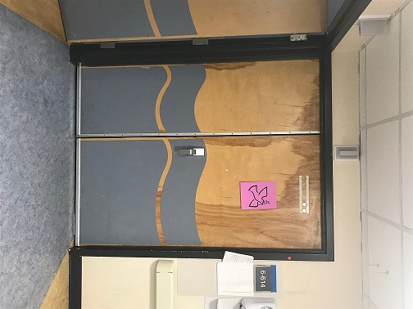

Purple Dove: sign to alert staff
Developed by staff nurse on med/surg floor in response to an observed need for notice to staff that comfort care had been ordered (added privacy and cues staff to ask a nurse about anything they need to do or not do)

Slide 55
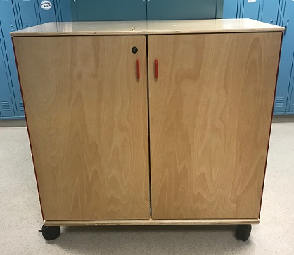
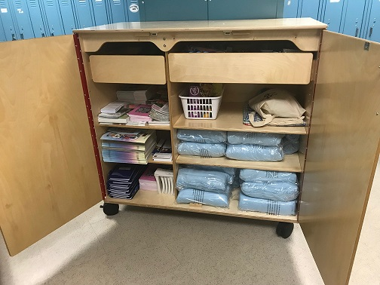
Bereavement cart

Slide 56
Items in cart
Comfort items:
Blankets
Special bags with symbol
Soap/body wash
Shampoo
Deodorant
Combs
Brushes
Chapstick
Antibiotic hand gel
Wipes
Lotion
Kleenex
Toothbrush kits
Shaving cream/razors
Hair ties
mouthwash
Literature, etc.
Pens
Journals
Crayons
Coloring books
Care notes (English and Spanish)
Sesame street grief books for children
Comfort care brochures
ICU booklets
Food items:
Coffee
Sprite
Ginger ale
Juice
Candy (sugar free and regular)
Crackers
Snacks
Protein bars

Slide 57
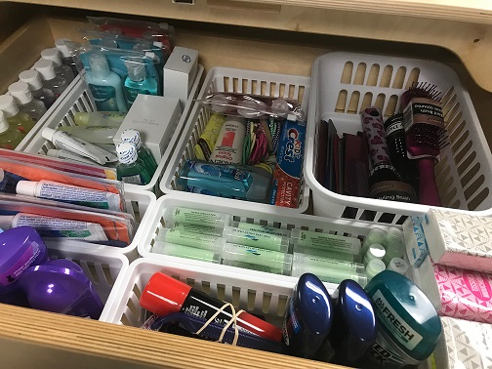
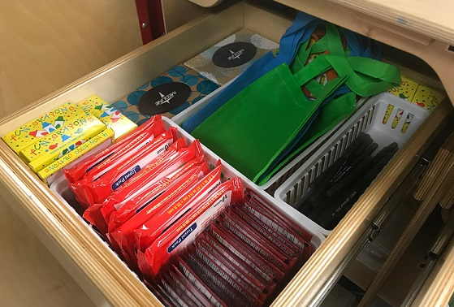
Inside

Slide 58


Liturature

Slide 59
Coping with loss brochure: outside
Idea came from Pediatric ED
Patient Care Manager: Stacie Koonce
Utilized
  Pastoral Care
  Vital Statistics
  Adult ED Patient Care Manager
  Patient Relations
  Marketing

Slide 60

Brochure
Inside

Slide 61
Family survey
Was your experience in the ICU?…positive or negative
Were you treated with dignity and respect?...yes or no
Did the staff honor and support your family’s wishes, spiritual beliefs, and valued traditions?…yes or no
Did you feel comforted by the staff?...yes or no
Did the staff keep you informed about your husband/wife’s status, including any changes in condition?...yes or no
Was everyone on the same page when sharing information about your husband/wife?...yes or no
Did you hear any comments from staff that you thought were inappropriate?...yes or no
Were you involved in making decisions about husband/wife’s care?...yes or no
Did you feel rushed in any decisions you were asked to make about his/her care?...yes or no
Do you feel your voice was heard when making those decisions?...yes or no
Were you supported in dealing with any feelings of being afraid, worried or sad?...yes or no
Were you comfortable with the amount of time you were allowed to stay with your loved one after his/her passing?...yes or no
If you were giving our ICU staff a grade…A, B, or C

Slide 62
Follow up calls:
Overall negative vs positive responses

Slide 63
Comments: negative experiences
Felt rushed at times
Doctor spoke in the hall instead of privately
The doctor wouldn’t listen and kept telling her that she was making her mother suffer
Nurse kept talking to us about her in front of her. We thought she should have talked to us outside of the room
Only problem was not being able to get the information since I was not the HCPOA, but my dad was confused and couldn’t share the info
Everything was great except the donor services kept calling.
The nurses were kind but the doctor kept talking in the room in front of the patient
Felt pressured to make my brother a DNR and when I decided to reverse the decision because I knew my brother wouldn’t want that, the doctor seemed to get really upset with me
It was difficult to get information. My daughter always had to hunt down the doctor for us to find out what was going on

Slide 64
Comments: positive experiences
It was a difficult time, but everyone treated them kindly
Didn’t feel she could make the decisions she had to without the doctors kind and caring guidance
This was my second son who died and my other one is in Texas. I just need someone to talk to. Thank you for calling.
They were so nice how they provided snacks and drinks for us
Multiple comments about how they appreciated the phone call and having the opportunity to talk to someone.

Slide 65
Comments: positive experiences
The family member was now raising her grandson who was the son of the patient after their passing. They could not have asked for any better care for the patient. Everyone that they dealt with was awesome, they were called every time there was a condition change and there was no one with the patient. They were not rushed at all and allowed to stay with the patient as long as they wanted after their passing.

Slide 66
Comments: positive experiences
I could not imagine that the employees could make the experience easier. Everyone was extremely helpful and understanding. If every family was treated like I was, I could not imagine any complaints from anyone. It is a very difficult time for anyone to endure, so perhaps some people are very emotional and take a very necessary conversation and explanation for the doctor as rude. Of course, no one wants to hear the dreaded news of no possibility of recovering. But these are things that adults have to deal with if they have a loved one who is suffering. I almost tossed this survey in the trash before filling it out because I know writing about this would probably make me cry and it just did. But it’s ok because I do not want what your employees helped me through go unnoticed. Thank you.

Slide 67
Websites that can help
www.dyingmatters.org – encouraging conversations about dying and advance planning
https://theconversationproject.org/ - The Conversation Project is dedicated to helping people talk about their wishes for end-of-life care.
https://agingwithdignity.org/ - Aging with Dignity
https://fivewishes.org/ - Five Wishes

Slide 68
Our words and ears can serve as mental and spiritual CPR, breathing life into others’ hopes and calm into fearful hearts

Slide 69
References
Balboni TA, Balboni M, Enzinger AC, et al. Provision of Spiritual Support to Patients with Advanced Cancer by Religious Communities and Associations with Medical Care at the End of Life. JAMA Intern Med. 2013; 173 (12):1109-1117
Cadge Wendy, Paging God: Religion in the Halls of Medicine. The University of Chicago Press: Chicago, 2012.
Coble, Richard. The Chaplain’s Presence and Medical Power: Rethinking Loss in the Hospital System. Lexington Books: Lantham, 2018.
Field Guide: Religious Literacy Primer for Crises, Disasters, and Public Health Emergencies (2014) National Disaster Interfaith Network and Center for Religion and Civic Culture, Crcc.usc.edu
Fitchett G. Recent Progress in Chaplaincy-Related Research. Journal of Pastoral Care and Counseling. 2017 Sept; 71(3):163-175.
Fitchett G, Risk JL. Screening for spiritual struggle. J Pastoral Care Counsel. 2009; 63(1):1-12.
Gawande, Atul, author. Being Mortal : Medicine and What Matters in the End. New York: Metropolitan Books, Henry Holt and Company, 2014.
HealthCare Chaplaincy Network; Spiritual Care Association. Spiritual Care and Nursing: A Nurse’s Contribution and Practice. Mar 2017.
HealthCare Chaplaincy Network “Spiritual Care and Physicians: Understanding Spirituality in Medical Practice.” 2017.

Slide 70
References Continued
Impact of Professional Spiritual Care (2018) Joint Publication of ACPE, APC, CASC, NACC, NAJC.
Joint Commission, “Part 1. Body, Mind, Spirit: Hospital Chaplains contribute to Patient Satisfaction and Well-Being” The Source, January 2018, vol. 16, issue 1.
Joint Commission, “Part 2. Body, Mind, Spirit: Hospital Chaplains contribute to Patient Satisfaction and Well-Being” The Source, February, 2018, vol. 16, issue 2.
Marin DB, Sharma V, Sosunov E, Egorova N, Goldstein R, Handzo GF. Relationship Between Chaplain Visits and Patient Satisfaction. J Health Care Chaplain. 2015;21(1):14-24.
Matlins, Stuart and Magida, Arthur (editors) How to Be A Perfect Stranger (6th Edition): The Essential Religious Etiquette Handbook 6th Edition, Skylight Paths Publishing: Woodstock, VT 2015.
National Consensus Project for Quality Palliative Care (2013). Clinical Practice Guidelines for Quality Palliative Care. 3rd edition. www.nationalconsensusproject.org
Piderman, K. M., Marek, D. V., Jenkins, S. M., Johnson, M. E., Buryska, J. F., Shanafelt, T. D., Mueller, P. S. (2010). Predicting Patients’ Expectations of Hospital Chaplains: A Multisite Survey. Mayo Clinic Proceedings, 85(1), 1002–1010
Puchalski, C, Romer AL. Taking a Spiritual History Allows Clinicians to Understand Patients more fully. J Palliat Med. 2000:3(1):129-137

Slide 71
References Continued
Puchalski C, Ferrell B. Making Health Care Whole: Integrating Spirituality into Patient Care. Templeton Press: 2010.
Remen R, Kitchen Table Wisdom: Stories that Heal, Penguin Publishing Grou: 2006
Sulmasy, Daniel. The Kennedy Institute for Ethics: Georgetown University. Est. 1971.
Sulmasy D. “Spirituality, Religion and Clinical Care”. Chest 2009;135;1634-1642.
Williams JA, Meltzer D, Arora V, Chung G, &Curlin FA (2011). Attention to inpatients’ religious and spiritual concerns: predictors and Association with Patient Satisfaction. Journal of general internal medicine PMID: 21720904
Wintz S, Handzo G. HealthCare Chaplaincy Network, Handbook of Patient’s Spiritual and Cultural Values for Health Care Professionals 2014.

