Slide 1
Staying Fresh – The Art of Personal/Profession Revival
Rev. James A. Kraft, MTh.
Director, Advance Care Planning & Collaborative Care

Slide 2
Disclaimers:
Conflict of Interest
No conflict to report
Off Label Use
Off-label use of any products will not be discussed
Commercial Support
There is no commercial support for this program

Slide 3
Learning Objectives
Identify the causes of burn-out or compassion fatigue
Through self-assessment, identify personal level of fatigue
Discover interventions that will prevent and or recover from compassion fatigue or burnout

Slide 4
From Star Struck to Curmudgeon

Slide 5
Top Five Signs You Might Be Heading Towards Compassion Fatigue. If…
5. You consider a 40 hour week a vacation.
4. You wake up to discover your house is on fire, but go back to sleep because you just don't care.
3. You don't set your alarm anymore because you know your pager will go off before your alarm does.
2. Your friends call to ask how you've been, and you immediately scream, "Stop asking me all these questions!"
1. You're so tired, you now answer the phone with "Go to Hell."

Slide 6
What is Compassion Fatigue???
Often described as “burnout”, compassion fatigue also known as secondary traumatic stress (STS) is a condition characterized by a gradual lessening of compassion over time.
Compassion fatigue is a holistic depletion, meaning a person is physically, emotionally, and spiritually depleted, while still trying to provide care to patients in emotional and physical distress.
Common in healthcare professions, particularly those who work closely with the chronically and terminally ill such as those in palliative and hospice care or advance care planning may find it difficult to continue doing their jobs for an extended number of years. Those with a better ability to empathize and be compassionate are at a higher risk of developing compassion fatigue.
Compassion Fatigue Awareness Project ©

Slide 7
Effects of Compassion Fatigue/Burnout
Burnout
Work related
Unmet Goals
Stress
Organizational Effect
Low quality of care,
Disengaged employees
High turnover rates
Compassion Fatigue
Personal/Relational
Powerless to relieve suffering
Failure
Personal Effect
Guilt
Frustration
Feeling of being depleted
Study.com

Slide 8
Signs of Compassion Fatigue
Excessive blaming
Bottled up emotions
Isolation from others
Receives unusual amount of complaints from others
Voices excessive complaints about administrative functions
Substance abuse used to mask feelings
Compulsive behaviors such as overspending, overeating, gambling, sexual addictions
Poor self-care (i.e., hygiene, appearance)
Legal problems, indebtedness
Reoccurrence of nightmares and flashbacks to traumatic event
Chronic physical ailments such as gastrointestinal problems and recurrent colds
Apathy, sad, no longer finds activities pleasurable
Difficulty concentrating
Mentally and physically tired
Preoccupied
In denial about problems
Compassion Fatigue Awareness Project ©

Slide 9
Self Check
By Jayson DeMersFounder and CEO, AudienceBloom@jaysondemers
1. Perpetual exhaustion
Do you feel like you can never get enough sleep? Do you wake up exhausted every day? Do you feel perpetually tired and at the end of your resources, both emotionally and physically? These can be symptoms of a health problem, but also commonly accompany personal and professional burnout.
2. Unhealthy lifestyle choices
People who are suffering from burnout often don't have the energy or drive to make healthy lifestyle choices. They may eat too much (or too little), choose unhealthy foods or stop exercising. Research also suggests they are more likely to use and abuse alcohol as a way to escape their anxious or depressive feelings.
3. Inability to stop thinking about work
It's normal to think about work in your free time. But if these thoughts are accompanied by feelings of dread, or if they start to interfere with your day-to-day activities, it may be a sign you're on the path to burnout.
4. Stress-related health problems
People suffering from burnout often experience health issues commonly associated with depression and anxiety. These can include gastrointestinal problems, back pain, frequent headaches and low energy levels.
5. Difficulty sleeping
Occasional insomnia is common, but the frequent inability to fall or stay asleep--particularly if accompanied by thoughts of work--can signal burnout. There is also some evidence that insomnia may predict the onset of burnout; meaning if you're struggling with sleep, it's important to work towards good sleep hygiene sooner rather than later.

Slide 10
Self Check
6. Loss of enjoyment in daily activities
Another symptom commonly associated with depression as well as burnout is a loss of enjoyment in daily activities. While you may have enjoyed your work in the past, you may now feel apathetic or even fearful about it. You may also find you no longer feel satisfied with your personal life, and that activities you once enjoyed no longer hold any appeal to you.
7. Increased irritability at work or home
If you're feeling out of control, it's easy to take these feelings out on those around you. You may be so overwhelmed by your own issues and exhaustion that minor annoyances lead to intense feelings of anger and irritability.
8. Persistent cynicism at work
Workplace cynicism may be characterized by frequent isolation, frustration and pessimism while at work. You may be distrustful of your boss and colleagues, and may be wary or suspicious of their motivations.
9. Frequently missing work
Research has shown that people suffering from burnout are more likely to be chronically late for or absent from work. You may find yourself looking for excuses to miss work, or may lack the motivation to show up on time.
10. Poor job performance
Whereas you once excelled at your job, you may find yourself performing poorly and relying on those around you to pick up the slack. Research into chronic job burnout and daily functioning suggests that an individual's burnout may actually impact the performance of the workplace as a whole: "Individual performance is compromised because burned-out workers need to invest extra time and effort in performing their job. Additionally, collective performance may suffer because healthy employees spend time in helping their sick colleagues, at risk of also damaging their own health."

Slide 11
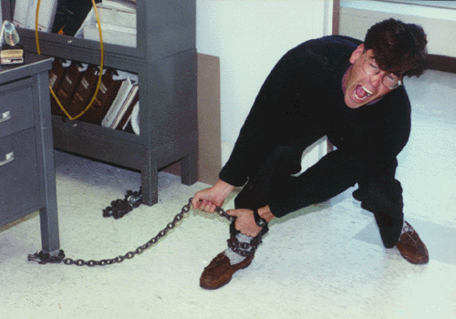
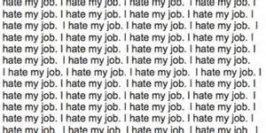
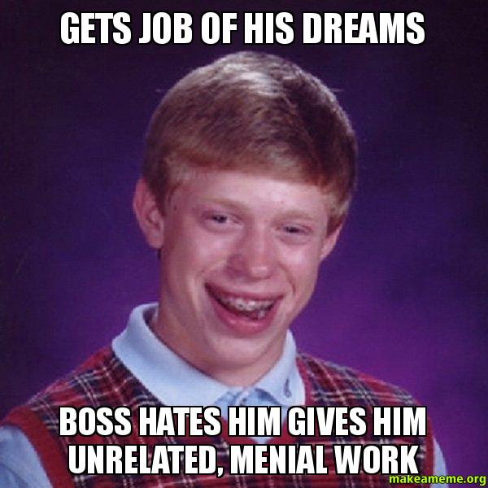
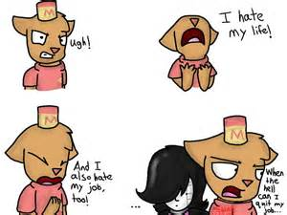

Slide 12
Three R’s to Revival (OK, Four)
Remember Return Refresh Reframe

Slide 13
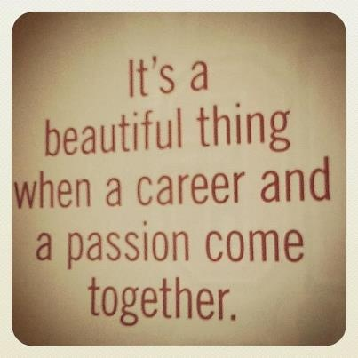
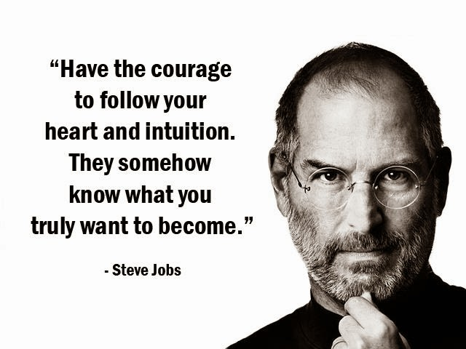
Remember

Slide 14
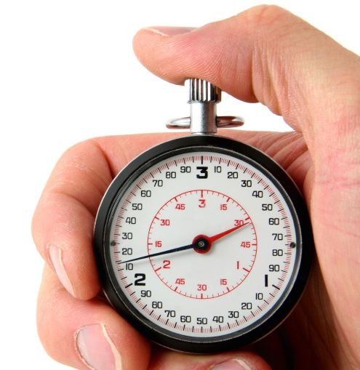
Exercise
In groups of 3, share how you entered into your work.
Did your calling find you, or did you find your calling?
You have 15 minutes

Slide 15
Where R U Working From???
Calling
Occupation
Job
Which best describes your perception right now????

Slide 16
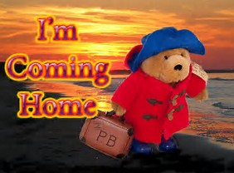
Return

Slide 17
Do the Things You Did At First
What was your attitude like?
What activities supported those attitudes?
Who were you connecting with?
Support & encouragement
What were you doing that enabled you to grow?

Slide 18
Rose

Slide 19
Who Is Your Rose?
In groups of 3, share a story about a person or family that touch you in profound way. Why was that?
You have 15 minutes

Slide 20
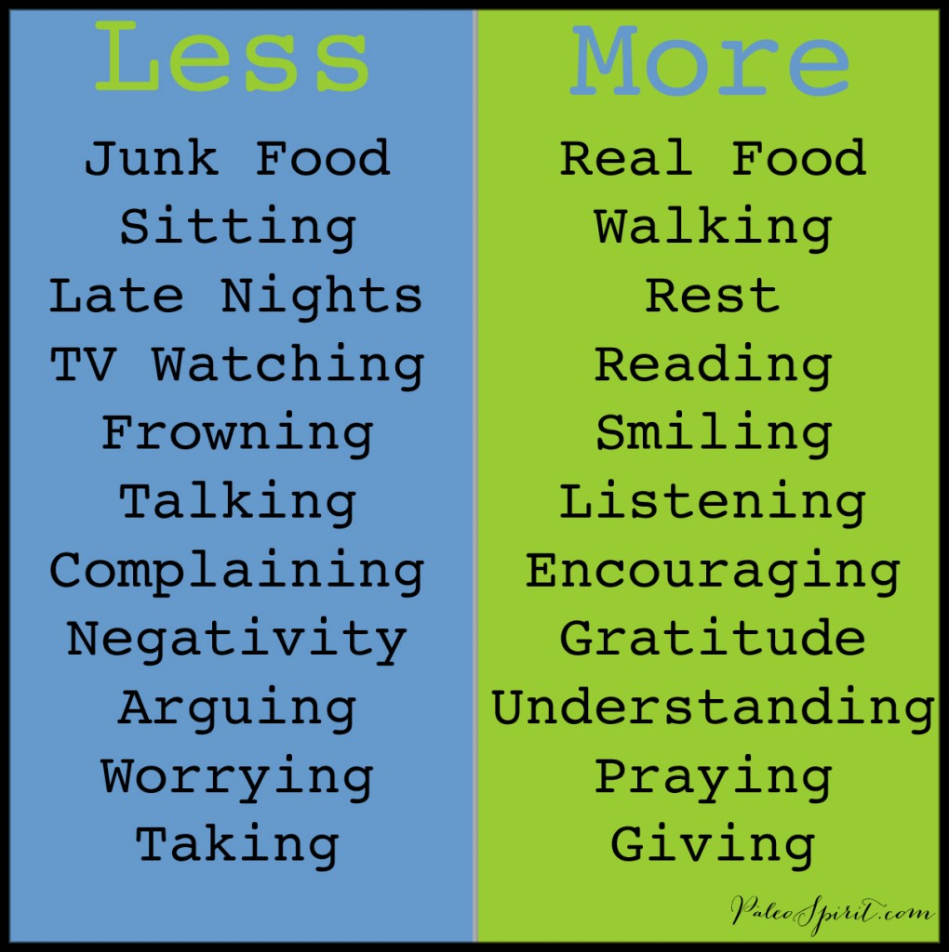
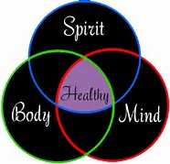
Refresh

Slide 21
Re-Frame
“You can learn more from the lows than the highs. The highs are great but the lows make you really look at things in a different way and want to improve. Every player will have both in their careers and I have, but what you get is that experience which is so important to perform at your best.” – Wayne Rooney
“We must think differently, look at things in a different way. Peace requires a world of new concepts, new definitions”…Yatzik Rabin

Slide 22
What’s Your Why?

Slide 23
WHAT’S YOUR WHY (YOUR PURPOSE)?
Your WHY is what sets you apart from everyone else.
WHY did you get out of bed this morning?
WHY does this connect you to others?
Your WHY = Your CALLING
Your WHY statement should be:
Simple and clear
Actionable
Focused on how you’ll contribute to others
Expressed in affirmative language that resonates with you

Slide 24
WHAT’S Your WHY (YOUR PURPOSE)?
To________________, so that ________________.
To________________, so that ________________.
“To inspire people to do the things that inspire them so that, together, we can change our world.”-Simon Sinek’s WHY
“To organize the playing field so that others can hit home runs.”- Consultant
What’s Your Why?
___________________________________________________________________________________________________________________________________________________________________________________________________________________________________________________________________________________________________________________________________________________________________________________________________________________________________________________________________________________________________________________________________________________________________________________________________________________________________________________
This Photo by Unknown Author is licensed under CC BY-NC

