Slide 1
Quantitative-based Spiritual Care
Creating A Palliative Care Spiritual Care Community: Introducing the Religious Comfort Index (RCI)
Dr. Jack D. Giddens, DMIN, BCC, CTP
Director, RCI Health Metrics, LLC
Professor of Philosophy (Religion), University of West Florida
May 2019
Copyright © RCI Health Metrics, LLC, Inc., 2019, ALL RIGHTS RESERVED
This presentation is sponsored by and is the sole property of RCI Health Metrics, LLC and is not affiliated, sponsored-by
or in any way associated with any other organization

Slide 2
What is Palliative Spiritual Care?
First, what is palliative care? Care that focuses on relieving the patient from suffering (distress) at any stage of illness
What is palliative spiritual care? Spiritual care that focuses on treating the patient’s EXPERIENCE of suffering
What is a palliative spiritual care community? A community of chaplains/spiritual care practitioners who focus on treating the patient’s SUFFERING as key to their practice

Slide 3
Why Focus on Suffering?
1) It provides chaplains with a CLINICAL HEALTH SPECIALTY that transcends religion-spirituality
2) It focuses on PATIENT EXPERIENCE which is what health institutions/healthcare is now focused on
3) It focuses on addressing the most intense/acute NEED(S) of the patient
4) It provides context for addressing PATIENT SPIRITUAL-RELIGIOUS ISSUES which are best elicited indirectly
5) It makes the chaplain NECESSARY instead of merely HELPFUL to the clinical team

Slide 4
Difference between a Palliative Spiritual Care Community and Traditional Spiritual Care
1) PSC community is more strategic, focused, and effective overall in providing patient spiritual care
2) PSC community is more unified and collaborative as a staff in providing patient spiritual care
3) PSC community has a greater impact on the overall health institutional environment
4) PSC community develops a higher level of spiritual care skill than a traditional one
5) PSC community realizes greater opportunity for professional development than a traditional one

Slide 5
What Is the Religious Comfort Index (RCI)?
1) A platform for conducting palliative spiritual care
2) A measurement of patient suffering and coping
3) A methodology for addressing patient satisfaction
4) A process for accessing suffering and coping levels
5) An accounting system for performance results
6) A quantification of patient coping/suffering level
7) A health statistic indicating patient suffering level

Slide 6
What Is the RCI?: Phenomenologically
The RCI is an approach to practicing spiritual care that focuses on facilitating and measuring the RESULTS chaplains achieve in providing palliative patient spiritual care

Slide 7
Need For A Results-Oriented Approach?
1) Healthcare chaplaincy (like research, and like charting) is perceived as HELPFUL, but not NECESSARY—chaplains can do their jobs without research and clinicians can treat patients without chaplain charting. We may be helpful, but we’re not yet perceived as necessary to the healthcare milieu
2) Healthcare chaplaincy has not yet demonstrated a DIRECT connection to either clinical patient care or institutional healthcare performance. We remain vulnerable and disempowered as professionals and as a profession.

Slide 8
What is the RCI?: Philosophically
1) The RCI is philosophically consistent with the three new emphases of healthcare: patient satisfaction (experience), health outcomes, and cost containment
2) The RCI is philosophically consistent with the new palliative care direction of healthcare reflected in the National Consensus Project for Quality Palliative Care (2002): focus on wholistic and preventive interventional care across the spectrum of care
3) The RCI is outcomes/dynamic v. descriptive/static; this reflects shift in spiritual care from identity-focused to health results-focused

Slide 9
What is the RCI: Initial Results
1) HCAHPS scores were 15.5% higher for patients treated using the RCI platform than patients who were not based on evaluation of 9-month period (127 completed RCI test cases for quarter compared to previous and subsequent quarters when RCI not used on selected patient population)
2) Current results reveal consistent performance with pervious use results although not testing for estimated HCAHPS impact

Slide 10
Invention and Development
Co-invention finalized in 2011 by Dr. Jack D. Giddens, DMIN, board certified chaplain, transpersonal psychotherapist, and professor of philosophy (religion) at the University of West Florida, and Dr. Harold G. Koenig, MD, Psychiatrist, Professor and Director of the Duke University Medical School Center for Spirituality, Theology and Health while Dr. Giddens was a John Templeton summer fellow at the Center
Dr. Koenig is the world’s leading spirituality/medicine integration researcher (53 books/755 published articles)
Developed over the past 8 years through use in hospitals

Slide 11
Feedback from Directors and Chaplains
Chaplaincy Directors and Chaplains report the following feedback from current RCI use:
1. Greater breadth and depth of spiritual care—
overall higher quality patient spiritual care
2. Greater departmental unity, collaboration, and
strategic functioning among chaplains
3. Greater interest in professional development
and clinical professionalism among chaplains
4. Consistency and alignment with clinical pastoral
education (CPE) training
5. Ease of implementation and use with increased
ability to prioritize patient needs and visits

Slide 12
Current Use and Future Goals
1) Current trial use by two large hospitals
2) Negotiating agreement for use by a 5-hospital system
3) Goal is to reach hospitals, hospices, nursing home/ALF/SNF, urgent care centers, and other health care systems and organizations
4) Seeking to make the RCI the suffering health statistic
5) Transformation: bring spiritual care (chaplaincy) into the value v. volume, palliative-oriented, ACA healthcare world

Slide 13
What Is the RCI By How It Works?
1) A chaplain receives an admit and makes a Pretest visit
2) After completing the Pretest visit the chaplain’s results are sent to a database administrator signaling need for an intervention
3) The interventionist chaplain completes an intervention and the results are sent signaling need for a Posttest visit
4) A chaplain completes a posttest visit and the results are sent to the data administrator
5) The data administrator compiles the results for weekly, monthly, quarterly, yearly reports to the director
6) Chaplains may alternate the visits, or, one chaplain can do all three visits

Slide 14
What is the RCI by How It Works
1) Can also be used as a stand-alone assessment tool—no absolute need for separation of Pretest, Intervention, and Posttest visits
2) Can be integrated into the EMR so physicians, nurses, and others can see the statistic and use it as part of care plans
3) Can be used to integrate spiritual care into the mainstream of patient care and as central to care plans
4) Can be used in all health settings: hospital, hospice, ALF, SNF, Urgent Care Centers, home care, etc.

Slide 15
Data and Results
1) Weekly, monthly, quarterly, and yearly results compiled
2) Summary departmental and individual chaplain performance results compiled; industry-results compiled
3) Departments and chaplains can assess how much they’re “moving the needle” from Pretest to Posttest in transitioning a patient from relative suffering to satisfaction and which can be correlated with HCAHPS scores
4) Trends can be discovered that reveal professional development needs and opportunities
5) Overall departmental performance can be assessed,
compared and contrasted across health system facilities

Slide 16
Sample Report: Weekly
RCI
Health Metrics, LLC
www.rcihealthmetricsllc.org
jdgiddens@aol.com
850-207-0848
______________________________________________________________________________
___________________________________HEALTHCARE
Department of Pastoral Services
WEEKLY RCI REPORT
Submitted Monday, March 18, 2019
Dates for Information Included in this Report: 3/1/19-3/15/19
I. Summary
This initial Weekly RCI Report covers RCI results from the initial two-week period from Friday, 3/1/19 through Friday, 3/15/19. The rationale for including two weeks for this initial report was to allow enough data for providing a report. Over the period, there were 13 Pretests and 3 Posttests completed. As explained below, the initial results are highly positive.
II. Results
Following are key results from the period:
1. The summary average RCI score for the department was .89+, which is .59+ standard deviations above the estimated norm of .30. This number reflects high success in testing and intervention.
2. The average RCI Posttest score was 1.75+, which is .75+ above the goal of 1.0 on the Posttest. This indicates that the average patient transitioned successfully from relative suffering to satisfaction.
3. Overall, these results suggest success in helping transition a patient from relative suffering to satisfaction.
III. Discussion
1. The .89+ average change from Pretest to Posttest (1.75-.84+) indicates successful testing and interventions by chaplains. This is based on only three completed test cases, however. It is questionable whether this level of change can be sustained over a long time period.
2. The 1.75+ average Posttest score indicates high coping behavior after initial testing. This indicates that patients have increased their S-R coping from Pretest to Posttest.
3. Given the data aggregation concept, there is no opportunity to assess individual chaplain performance. Only overall departmental performance assessment is obtainable.
4. These results are not yet correlated to institutional HCAHPS performance.
5. These results do not address individual chaplain performance on interventions.
IV. Recommendations
1. Pretests: Focus more attention on the Mental Health domain suffering issues on the Pretest.
2. Interventions: Focus more on addressing Mental Health domain suffering issues during interventions.
3. Posttests: no recommendations at this time.

Slide 17
Sample Report: Weekly
4. Overall: provide more emphasis on the Mental Health domain throughout all visits.
V. RCI Scores – Analysis
PH/Pre EH/Pre MH/Pre Pretest
.68 .61 1.21 .84
PH/Pos EH/Pos MH/Pos Posttest RCI
1.58 1.83 1.83 1.75 .89
As indicated above, the average RCI score for the period was .89. This indicates that the average change from Pretest to Posttest was .89+ standard deviations. The anticipated average standard deviation for a department is estimated at .30. The department achieved .59+ standard deviations above the estimated norm.
VI. Pretest Scores – Analysis
PH/Pre EH/Pre MH/Pre Pretest
.68 .61 1.21 .84
As indicated above, the average RCI Pretest score was .84. The average Pretest scores for physical and emotional domain issues were similar (.68, .61), however, the average Pretest score for the mental health domain was 1.21. This latter score is significant compared to the previous two. This indicated that patients experienced greater suffering per religious-spiritual coping in physical and emotional health issues, but lesser on mental health issues.
VII. Posttest Scores - Analysis
PH/Pre EH/Pre MH/Pre Pretest
1.58 1.83 1.83 1.75
As indicated above, the average RCI Posttest score was 1.75. The average Posttest scores for the Emotional and Mental Health domains was similar (equal), however, the average Posttest score for the Physical Health domain was 1.58. This score is significant compared to the other two. This indicated that change from Pretest to Posttest was greater for Emotional and Mental Health, but less so for Physical Health.
VIII. Domain Scores – Analysis
PH/RCI EH/RCI MH/RCI
.90/.89 (1.01) 1.22/.89 (1.37) .62/.89 (.69)
As indicated, the greatest change from Pretest to Posttest occurred in the Emotional Health domain, and the least in the Mental Health domain. The Mental Health domain score is significant compared to the other two scores. This may suggest emphasizing the Mental Health domain from Pretest to Posttest is important.

Slide 18
What Is the RCI?: Domains
There are 3 health domains that make up the RCI:
1) Physical – the patient’s physical health
2) Mental – the patient’s mental health
3) Emotional – the patient’s emotional health
* Designation of these three based on a 3,700+ patient case study conducted from 2007-2010

Slide 19
What is the RCI?: Prompts
There are two prompts within the three domains that address the patient’s health relevant to the domain:
Physical: 1) How much are you suffering because of condition 1 at this time (event)?; 2) How much are you suffering because of condition 2 at this time (process)?
Mental: 1) How much are you suffering because of fears at this time (event)?; 2) How much are you suffering because of anxieties at this time (process)
Emotional: 1) How much are you suffering because of feelings about your caregivers at this time (event)? How much are you suffering because of feelings about your overall care at this time (process)?

Slide 20
What Is the RCI?: Prompts
There is one prompt within each of the domains—the third prompt—that addresses the patient’s coping level relevant to the domain:
How much do spiritual or religious beliefs or practices help you cope with these?

Slide 21
Scoring-Domains
The third prompt within each domain is divided by the average of the first two prompts within the domain to determine the patient’s relative coping/suffering level relevant to the domain. This is expressed by the following equation with PSu=patient suffering, RSC=religious or spiritual coping, and P1=Prompt one and P2=Prompt 2:
PSu=RSC/(P1+P2)/2

Slide 22
Scoring: Overall
1) The RCI Score for each domain PSu=RSC/(P1+P2)/2
is averaged to arrive at the RCI score for the patient.
2) The Pretest RCI score is subtracted from the Posttest RCI Score to assess the change in patient suffering/satisfaction from Pretest to Posttest: PosT – PreT = RCI score
3) Each patient domain score can be assessed individually for each patient
4) Trends in Pretest and Posttest scoring can be assessed
5) Overall departmental and chaplain performance can be assessed by domain and by total scores

Slide 23
The App
1) The RCI is on an app a chaplain can use on their smart phone
2) The app is easy to score and sends the results automatically
3) The chaplain conducts the assessment AFTER the patient visit
4) The app automatically compiles the summary data
5) No charting necessary! Scoring the app takes about 2 minutes

Slide 24
What the App Looks Like
Screen Shot of the App

Slide 25
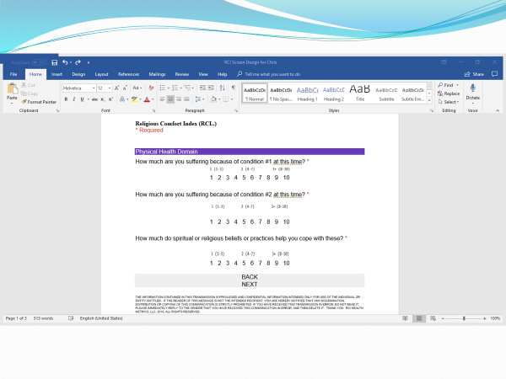

Slide 26
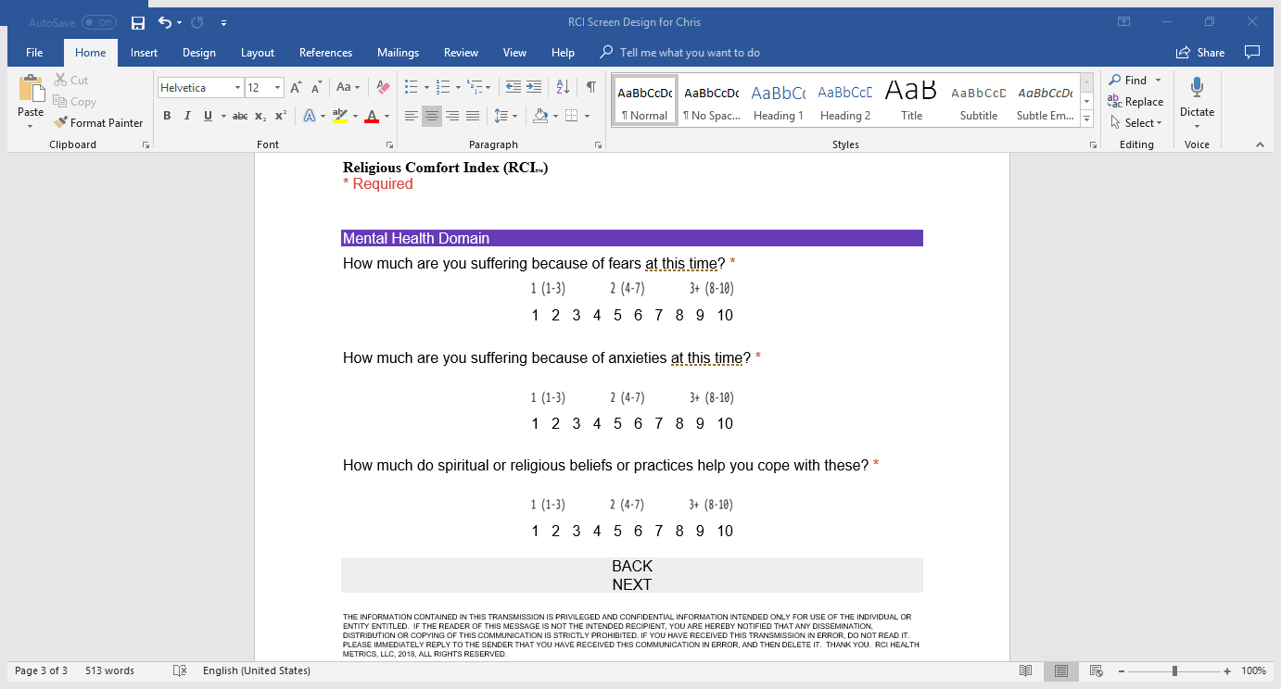

Slide 27
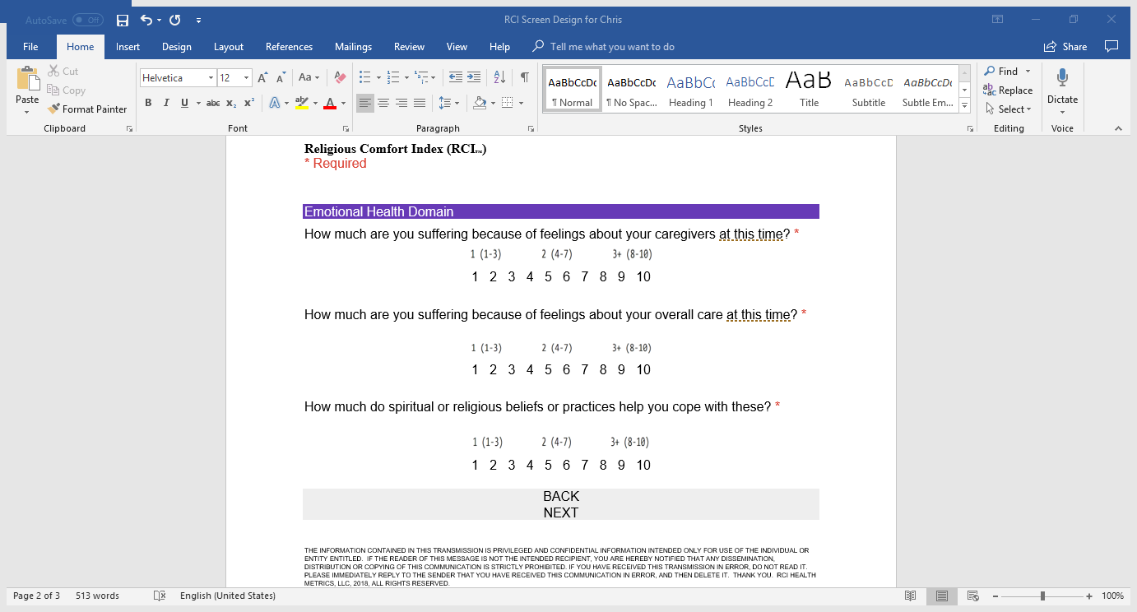

Slide 28
What Is the RCI?: Tests
1) Patients receive a Pretest and a Posttest visit
2) Tests typically take 10-15 minutes
3) Chaplains may, but are not required to use the prompts; they only need to get answers to them
4) Tests make use of both didactic (direct/instructive) and rhetorical (indirect/expressive) communication
5) Scoring is up to the chaplain’s perception and interpretation of what the patient is saying

Slide 29
What Is the RCI?: Interventions
1) Interventionist reviews the Pretest scoring
2) Interventionist devises an intervention
3) Interventionist makes 1-3 intervention visits
4) Interventionist pri0ritizes domain scores
5) Interventions typically take 15-20 minutes

Slide 30
How to Score a Test Visit
Score the first two questions within each domain (suffering level) and the third question within each domain (coping level) on a 1-10 scale
0 is not a valid score; for patients who report no issues, record a 1 (for the fact that they’re in the hospital!)
For each 1-10 rating, distinguish between an issue, and a supporting point to an issue
Use either an Inductive or Deductive approach to scoring, or better yet, an Abductive approach

Slide 31
How to Score a Test Visit
For every third supporting point, increase the number of issues by 1
- Example: 1 issue and three supporting points is 2 issues; another three supporting points raises the
number of issues to 3, etc.
- Patients may express 2 issues, and no
supporting points; score these as 2 issues, etc.
*** The Key is to distinguish between an issue, and a supporting point to an issue***

Slide 32
Calculating the Score: Chart
Issues | Supporting Point(s) | Score
0 | 0 | 1
1 | 1-2 | 1
1 | 3 | 2
2 | 1-2 | 2
2 | 3 | 3
3 | 1-2 | 3
3 | 3 | 4
4 | 1-2 | 4
4 | 3 | 5
5 | 1-2 | 5
5 | 3 | 6
6 | 1-2 | 6
6 | 3 | 7
7 | 1-2 | 7
7 | 3 | 8
8 | 1-2 | 8
8 | 3 | 9
9 | 1-2 | 9
9 | 3 | 10

Slide 33
What Is the RCI?: Scoring
An RCI score of .25, for example, indicates that coping to suffering is 25%, or that the patient’s coping level is less than (1/4) of the patient’s suffering level
RCI scores of < 1 are considered low—the suffering level for the patient is significant
The goal is 1.0 or >, which means the patient’s coping level is greater than the patient’s suffering level
RCI scores < 1 indicate the patient is in a state of dissatisfaction (suffering); RCI scores = to or > 1 indicate the patient is in a state of satisfaction (lack of suffering)

Slide 34
A Word About Scoring
Most patients will not score 1.0 or greater
The average patient improvement from Pretest to Posttest is approximately 3-4 standard deviations
The goal for each intervention is to achieve a 3-standard deviation change (1/domain) from Pretest to Posttest
- Example: If the patient scores .25 on the Pretest,
the goal is for the patient to score .55 on the
Posttest: although the ultimate goal is always for every patient to achieve 1.0+ on the posttest

Slide 35
Results from Current Use (6 months)
Total Pretests Completed: 148
Total RCI’s Completed: 44 (29%)
RCI Score Total Completed cases: 2.05
RCI Score Removing Outliers (39 cases): .34
RCI Score for Suffering Patients Only (32 cases): .27
Goal (.30)

Slide 36
A Word About Communication Style
Didactic v. Rhetorical – some people communicate directly and explicitly by explaining; other people communicate indirectly and by action by expressing
Didactic: “My chest hurts right here and I feel like I’m having a heart attack”
Rhetorical: “Can I get this shirt off because it’s getting too tight and it’s too hot in here”
Challenge: to comprehend what a patient is communicating, whether didactically or rhetorically, or to some degree both
David: rhetorical communicator (Psalms)
Solomon: didactic communicator (Proverbs)

Slide 37
RCI Skills
1) Non-Verbal Message – communicate the non-verbal message that you are there for more than a mere social interaction; no “popcorn” visit; pull up a chair and take your time
2) Pace, Mood & Tone – the pace should be slow, the mood should be sublime, and the tone should be solemn; don’t forget that they’re a patient in a hospital; manage the mood toward the sublime
3) Listen, listen, listen – the key skill is listening; listen (and perceive) on many different levels; great listening is more difficult than great speaking; great listening is great leadership
4) Timing – it is imperative to use the prompts at the right time; the timing is more important than the style of communication or the words used
5) Mental Noting – develop the skill of counting up the number of patient issues in your head while listening to the patient and while you continue to demonstrate sympathetic, interactive dialogue. This is hard to do but is a great skill to develop

Slide 38
Where Does the Data Go?
1) The data goes directly into a database that automatically compiles both individual and summary departmental data
2) The Director of Pastoral Services receives a weekly, monthly, quarterly, and yearly report showing how well the department is performing individually and collectively
3) The monthly data is correlated with the institution’s quarterly HCAHPS scoring to determine either the correlative or causative relationship between departmental performance and institutional scoring based on which concept the institution decides on
4) The quarterly and yearly department data can be correlated to institutional and VBP results to determine the dollar value the department is ensuring for the institution
5) RCI Health Metrics, LLC provides the data aggregation, reporting, and consulting

Slide 39
Database
1) Controls for total results, total results minus outliers, and total results for suffering patients only
2) Controls for both departmental and individual chaplain patient and domain results for pretests, interventions, and posttests
3) Controls for patient age and diagnosis

Slide 40
Conclusions
The RCI platform is an approach to spiritual care that facilitates and measures the results chaplains achieve in providing patient spiritual care from a palliative care approach
The RCI has demonstrated significantly positive change in overall increases in quality spiritual care
The RCI is available on an easy-to-use smart phone app that automatically generates statistical data for performance assessment
The RCI gets pastoral care staffs “on the same page” in providing unity, collaboration, accountability, professionalism, and overall strategic functioning
The RCI is consistent with the new consumer-oriented, results-oriented, value over volume approach to healthcare

Slide 41
Potential Next Steps
1) Institutional presentation and discussion
2) Discussion about trial period use
3) Discussion about facility or system-wide implementation, training, and consulting services

Slide 42
Thank you for your attention!

