Slide 1

Spiritual Care for the “None”
Curated by Joshua berg
With material from
Joshua Berg, Greta Christina, Chaplain Ben iten, Jason torpy

Slide 2
What is Nonbelief?
GOD
Notes:
It may get uncomfortable.
How many atheists does it take to screw in a lightbulb? You won’t need a lightbulb when you are burning in the fires of eternal damnation!

Slide 3
Atheism and Humanism
Atheism is a lack of belief in gods. Atheism is not a philosophy of life and does not attempt to answer any other question about what a person believes. It is also not anti-religion. It is simply a rejection of the assertion that there are gods.
Humanism is what we do believe. It is a progressive philosophy of life that, without supernaturalism, affirms our ability and responsibility to lead ethical lives of personal fulfillment that aspire to the greater good of humanity. (HMIII)
Notes:
Some pointed but functional distinctions: Nontheist means not a believer in gods. Naturalistic means no supernatural either, i.e. science-based reality. Atheist just means ‘not a believer’ (not anti-religious) but tends to offend believers. Agnostic also serves primarily to make believers feel better. Humanism is what we do believe.

Slide 4
Some ”None” Beliefs
Humanity and Life
Nature, Science, and Reason
Negative Beliefs
The human spirit
Human relationships are important
Respect for the individual, humanity
Cooperation, kindness, & compassion
Ethical and humane behavior
Find meaning in life
Personal fulfillment
Perspective and place in a natural world; ultimate concern
Connection to and reverence for nature and the environment
Deference to reason & science
Critical thought - It’s OK to say “I don’t know” until we can know.
You CAN be "good without god”
This is the ONLY life we know we have
Ethical Benchmarks – evolution, philosophy, humanist documents
Choosing ethical action – reason, intuition, experience, efficacy
Religion is/can be harmful
Religious people are delusional or brainwashed
The world would be better without religion
Most of the conflict in the world is the result of religion
Notes:
Diversity is not a challenge to manage, but a strength to leverage. “If you talk to a man in a language he understands, that goes to his head. If you talk to him in his language, that goes to his heart.” -- Nelson Mandela
“The view of reality disclosed through the natural sciences evokes for me feelings of awe incomparably greater than anything religious or mystical writings of any tradition can inspire.” - Stephen Batchelor
Negative beliefs are important to understand, right or wrong, we have to understand the mindset of the patient as best possible and attempt to validate them without compromising our own beliefs and values. It is all about perspective and knowing the patient’s perspective can facilitate spiritual treatment.

Slide 5
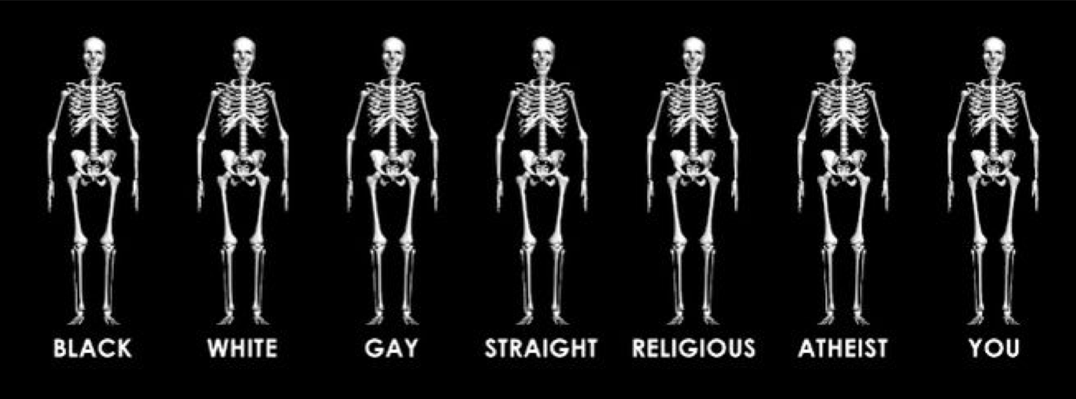
Who are the Nones?

Slide 6




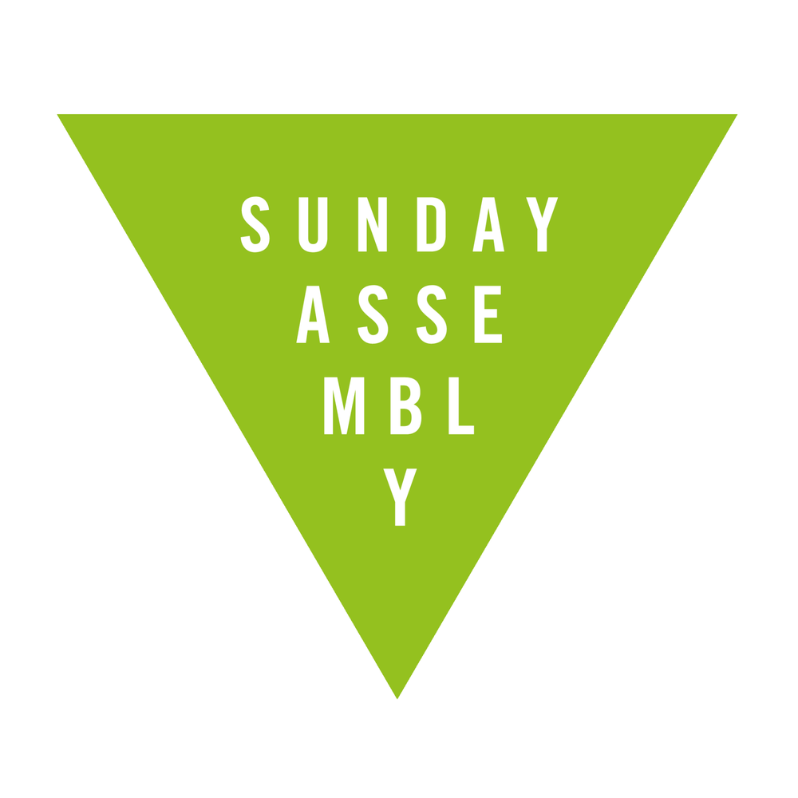



Some other “Nones”
LABELS AND GROUPS
Agnostics
American Ethical Union
American Humanist Association
Atheists United
Freethinkers
Center for Inquiry
Foundation Beyond Belief
Military Associations of Atheists and Freethinkers
Naturalists (also Religious Naturalists)
Nontheists
Secular Student alliance
Sunday Assembly
Secular Humanistic Jews
Undeclared/uncommitted
Unitarian Universalist Humanists
Buddhists, Taoists, ….
Notes:
Just a quick note about the Military Association of Atheists & Freethinkers. MAAF (rhymes with math) is essentially a military ministry for humanists, atheists in foxholes, and other nontheists. We provide to chaplains the resources they need to best serve our constituency. Unfortunately much of our service is directly to service members and on their behalf in the form of advocacy. This is because military chaplains are in the vast majority and at the highest levels entirely hostile to the nontheistic perspective. This is unfortunate and makes me that much more appreciative of your welcoming me here today.

Slide 7
They Could be Anybody
The hospital census does NOT tell the whole story
Family, friends, visitors
There are degrees of belief
"God" means different things to different people
Notes:
"God" means different things to different people. -- According to writer and literary and cultural critic, Maria Popova, some words have been vacated of meaning from overuse or misuse. It also depends on perspective, what the word means to the speaker vs. how it’s received.

Slide 8
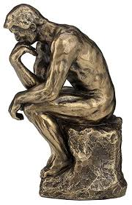
Finding Meaning

Slide 9
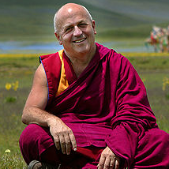
The Good without God
LIFE
JOY
This is the one life/moment we have
Relationships and intimacy
Loving-kindness
Self: satisfaction & pride
Connection to the environment
Happiness is “connecting with durable well-being even in the midst of the negative.” – Sam Harris
"Happiness does not depend on what you have or who you are. It solely relies on what you think.”
– Matthieu Ricard
There is no path to happiness. Happiness is the path.
-Buddhism

Slide 10
Coping without God
DEATH
PAIN
There is nothing after death
Death is a part of life
Genes, ideas, and positive energy live on
Loss is necessary for life and change
Death is necessary to treasure what we have.
Death is motivating
Permanence ≠ value and meaning
We won, so why complain we didn’t win more?
After death is the same as before birth.
Suffering is unavoidable
Without pain, there is no pleasure
We are not being punished
Learning and teaching opportunity
Hurt increases strength
Deciding to end pain is an option
Notes:
You Want a Physicist to Speak at Your Funeral
by NPR commentator Aaron Freeman
You want a physicist to speak at your funeral. You want the physicist to talk to your grieving family about the conservation of energy, so they will understand that your energy has not died. You want the physicist to remind your sobbing mother about the first law of thermodynamics; that no energy gets created in the universe, and none is destroyed. You want your mother to know that all your energy, every vibration, every BTU of heat, every wave of every particle that was her beloved child remains with her in this world. You want the physicist to tell your weeping father that amid energies of the cosmos, you gave as good as you got.
And at one point you'd hope that the physicist would step down from the pulpit and walk to your brokenhearted spouse there in the pew and tell him/her that all the photons that ever bounced off your face, all the particles whose paths were interrupted by your smile, by the touch of your hair, hundreds of trillions of particles, have raced off like children, their ways forever changed by you. And as your widow rocks in the arms of a loving family, may the physicist let him/her know that all the photons that bounced from you were gathered in the particle detectors that are her/his eyes, that those photons created within her/him constellations of electromagnetically charged neurons whose energy will go on forever.
And the physicist will remind the congregation of how much of all our energy is given off as heat. There may be a few fanning themselves with their programs as he says it. And he will tell them that the warmth that flowed through you in life is still here, still part of all that we are, even as we who mourn continue the heat of our own lives.
And you'll want the physicist to explain to those who loved you that they need not have faith; indeed, they should not have faith. Let them know that they can measure, that scientists have measured precisely the conservation of energy and found it accurate, verifiable and consistent across space and time. You can hope your family will examine the evidence and satisfy themselves that the science is sound and that they'll be comforted to know your energy's still around. According to the law of the conservation of energy, not a bit of you is gone; you're just less orderly.
There is nothing after death. Our existence is purely corporeal.
Acceptance: Death is a part of life, and we cannot predict when we will died, so accept its inevitably and move on.
No anxiety from questioning what will happen.
No anxiety about punishment, reward
Avoid the pain of unnecessary, aggressive medical care.
Prepared for death
No bandaids, no cognitive dissonance
No deceit
Face grief
Family can deal with death.
Don’t put someone in a position of making a terrible choice, agree with what you don’t believe, or defend your belief. You wouldn’t tell a Jew that their loved one was with Jesus. Why would you tell non-believer, their loved one was in heaven?
The lie of atheists in foxholes. It is religion that is usually questioned as we die, not atheistic conviction. Would you tell a Muslim that they will reject their belief system when they die and turn to Jesus?
Comforting thoughts
The positive energy you put into the world is passed on, even if the specifics of your deeds or body are eventually forgotten.
Your genes or your ideas will also live on.
Loss, including death, is necessary for life and change to be possible.
Death is necessary to focus our lives and make us treasure the people and experiences we have.
Death is a deadline, which motivates us to do something valuable with the time we have.
Death is unpredictable, which motivates us to make the most of each moment.
Things don’t have to be permanent to be valuable and meaningful. Your life will always have existed. The end of life doesn’t negate or eradicate the time you were alive.
Death is a natural, physical process that connects us intimately with nature and the universe.
We were each astronomically lucky to have been born, so complaining that our lives aren’t infinite it like winning the lottery, winning a million dollars, and complaining that we didn’t get a hundred million.
We didn’t exist for billions of years, and that was not a painful or bad experience so, being dead won't be any different than not having been born.
“Atheism offers us the comfort of knowing that we can shape our own lives, and don’t have to rest our fate in the hands of a god whose ways can at best be described as “mysterious.” It offers the comfort of not having to wonder what we did wrong, or why we’re being punished or tested, every time something bad happens. It offers the comfort of experiencing the world as shaped by a stable and potentially comprehensible set of physical laws, rather than by the capricious whim of a creator who is theoretically loving but in practice is moody, short-tempered, and wildly unpredictable. It offers the comfort of being intimately connected to the rest of the universe, rather than somehow set apart from it. It offers the comfort of being able to make our own moral judgements, based on our own instincts and experiences, rather than trying to reconcile the outdated and self-contradictory teaching of a centuries-old religious text -- or trying to second-guess the wishes of an invisible and imprecise deity. And it offers the comfort of being able to see the world as it is, to the best of our abilities, without having to ignore or rationalize every experience that contradicts our faith.” -- Greta Christina

Slide 11
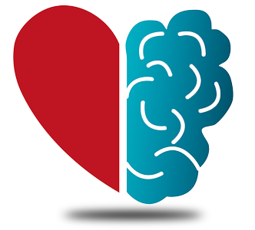
Clinical Practice

Slide 12
Through the Threshold
BEFORE ENTERING THE ROOM
Relationships with and education of the IDT (Inter-Disciplinary Team)
Relationships with the other chaplains
Check/explore your own biases
Plan possible responses but go in without preconception and open to hearing your heart
Use your resources
Many paths to truth. Their truth is theirs.
Be prepared for anger, fear, and even hatred
Don't enter if you feel you can't, don't push interaction, and know if you should leave
Notes:
Through the Threshold
Relationships with and education of the IDT
“The chaplain is here to pray with you”
“Do you need a chaplain (what do they do)”
Relationship with other chaplains
respect
Don’t question their belief unless it’s an honest, respectable exchange
Check/explore your own biases - “A religion charged with bringing God’s truth to the world faces the question of how to deal with people who refuse to accept it.” Is the value of religious faith equal to the value of peace in a secular society?

Slide 13
What Can I Say?
STATEMENTS THAT CAN BE DISTRESSING
CONSIDER INSTEAD
Can I pray for you?/I'm praying for you
Have a blessed day
They will be with god
They will be with their [loved one(s)]
God bless you
Jesus would have...
The bible says that...
Only god knows
It's up to god
Can I offer some words of encouragement?
Have a peaceful day
They will remain in your heart and the heart of all those they touched
May you have a full recovery
I wish you peace and happiness
An appropriate quote or a joke
Stay strong
Notes:
It’s not about what we feel is right or wrong.
We are not out in public where things are different. We are tasked with calming and reassuring people so even if we believe saying “have a blessed day” or the like is harmless, they may not.

Slide 14
What Can I Do?
THE PRACTICAL AND CLINICAL
presence, companionship, witness, respect, deference
sincerity
laughter
mindfulness
stretching and relaxation exercises
Finding vs. making meaning
Helping others – social service
Call a humanist
distraction
Music, art, poetry
learn their language. listen and repeat.
PRR (Peaceful, Rational, Real)
confront and accept pain
Milestones and celebrations
Education
Provide informational resources
Notes:
Secular PRR (Peaceful, Rational, Real) - UU
Shine! by Mary Edes - Like the cosmic dust following after a great Perseid meteor, we are the living remnants of time and all that has come to pass in its wake—briefly shining lights on the way to eternity. We are only visible to the naked eye for an instant. Take this moment to shine like the stardust you are. May the light of our time on earth shine to bless the world and each other. Shine. Shine. Shine.

Slide 15
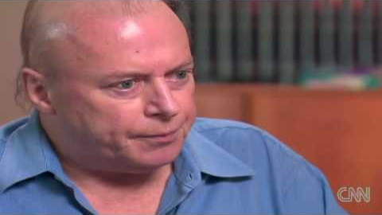
Let’s Treat an Atheist
Christopher Hitchens, God And Cancer.

Slide 16
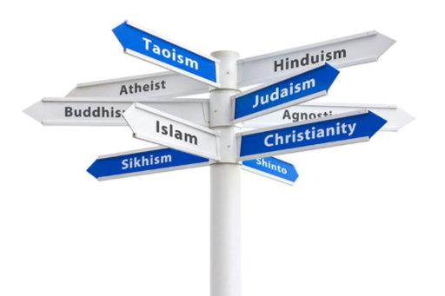
Changing the Culture

Slide 17
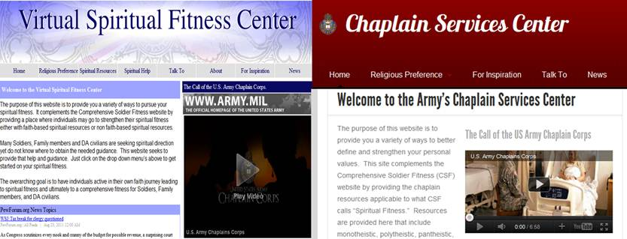

Materials We Provide
A chaplain visited.
We are sorry we missed you.
If you need the services
of the spiritual care
department, please ask a nurse.
Well wishes.
God bless you.
Ignorance and disparagement of humanists
Hundreds of evangelical Christian links
Direct phone number to Focus on the Family
Months of delays with no action
MAAF-generated replacement
Equal treatment of all beliefs and philosophies
Improved content for all perspectives
Sectarian services retained, but only under sectarian areas

Slide 18
CPE and Spiritual Care Reform
Chaplaincy must be reformed to include the full scope of belief, rather than just theistic belief
Chaplains must work to educate colleagues, patients, and the greater public
A belief in god(s) is not a unifying factor
Theological – not just theos anymore
Provide resources for all
Can you explain the diversity of belief in your care?
Do you invite minority identification (eg., “atheist/humanist”)?
Try asking this. “Do you have a religious preference that you’d like to list?” alternatively, ”What can our spiritual care team do for you?”
Do you have open ended questions (e.g., “what can the chaplains do for you?”)?
Do you have a “catalog” card with various services showing your support for diversity?
Do you have diversity events scheduled just in case (and to demonstrate you commtiment)?

Slide 19
Online Resources
Humanism and Its Aspirations (The Humanist Manifesto III)
American Humanist Association
AHA Center for Education
The Humanist Society
GriefBeyondBelief.org
AHA Center for Humanist Education
African-American Humanists
American Atheists
American Ethical Union
American Humanist Association
The Black Humanist Alliance
The LGBTQ Humanist Alliance
Center For Inquiry
Council for Secular Humanism
Foundation Beyond Belief
Unitarian Universalist Humanist Association
International Humanist & Ethical Union
Military Association of Atheists & Freethinkers
Secular Coalition for America
Secular Student Alliance
Society for Humanistic Judaism
International Institute for Secular Humanistic Judaism
Humanists UK
United Coalition of Reason
The Humanist Hub
The National Home Funeral Alliance
Meadville Lombard Humanist Special Collection

Slide 20
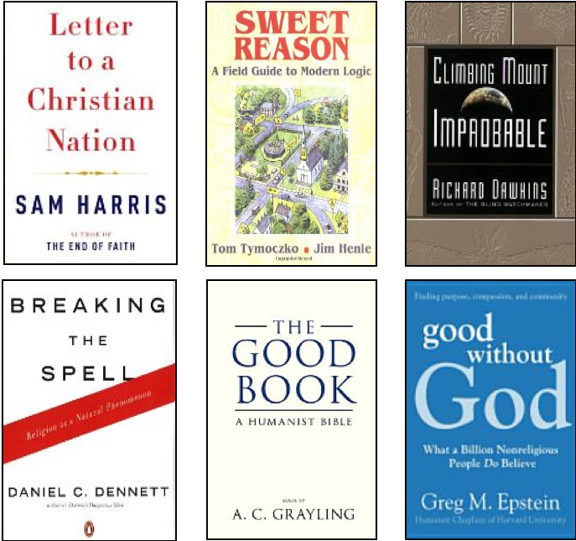
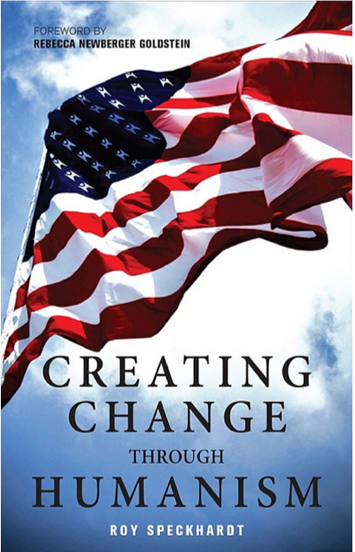
Print Resources
The Little Book of Atheist Spirituality, Andre Compte-Sponville
Waking Up: A Guide to Spirituality Without Religion, Sam Harris
Comforting Thoughts About Death That Have Nothing to Do with God, Greta Christina
Mortality, Christopher Hitchens
Judaism in a Secular Age, edited by Kogel and Katz
Confessions of a Buddhist Atheist by Stephen Batchelor
Happiness: A Guide to Developing Life's Most Important Skill by Matthieu Ricard
The Humanist Ceremonies Handbook: Writing and Performing Humanist Weddings, Memorials, And Other Life-cycle Ceremonies by Autumn Reinhardt-Simpson

