Slide 1
Engaging the Religious Aspects of End of Life Care Chaplain Rebekah Wagner, MA, BCC, APBCC Manager of Spiritual Services

Slide 2
No conflicts of interest to disclose.

Slide 3
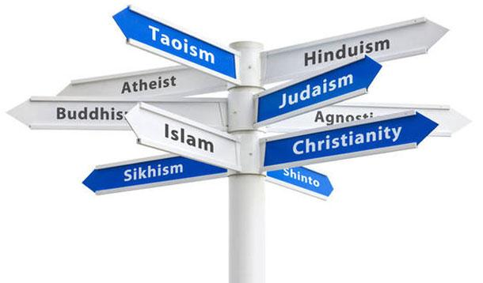

Slide 5
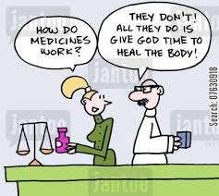

Slide 7
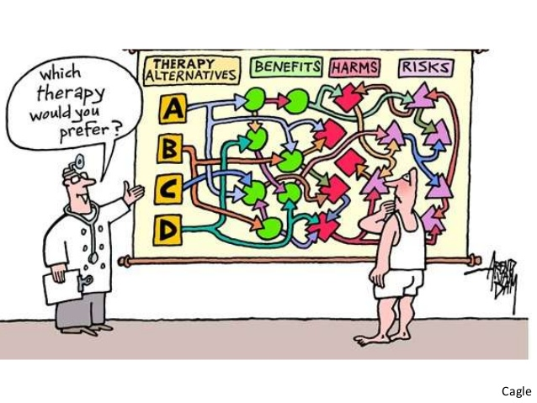

Slide 10
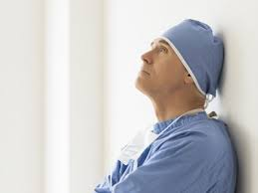

Slide 11
Why Health Care Professionals other than Chaplains Need to Address Spirituality
There are many reasons why health care professionals need to assess and address the religious and spiritual needs of patients and cannot leave this entirely up to chaplains and other clergy. The patient is a unique person with physical, psychological, social and spiritual needs that must be addressed if health care is to be maximized and the whole person treated.
–Harold Koenig, MD
(Bolded text by presenter)

Slide 12
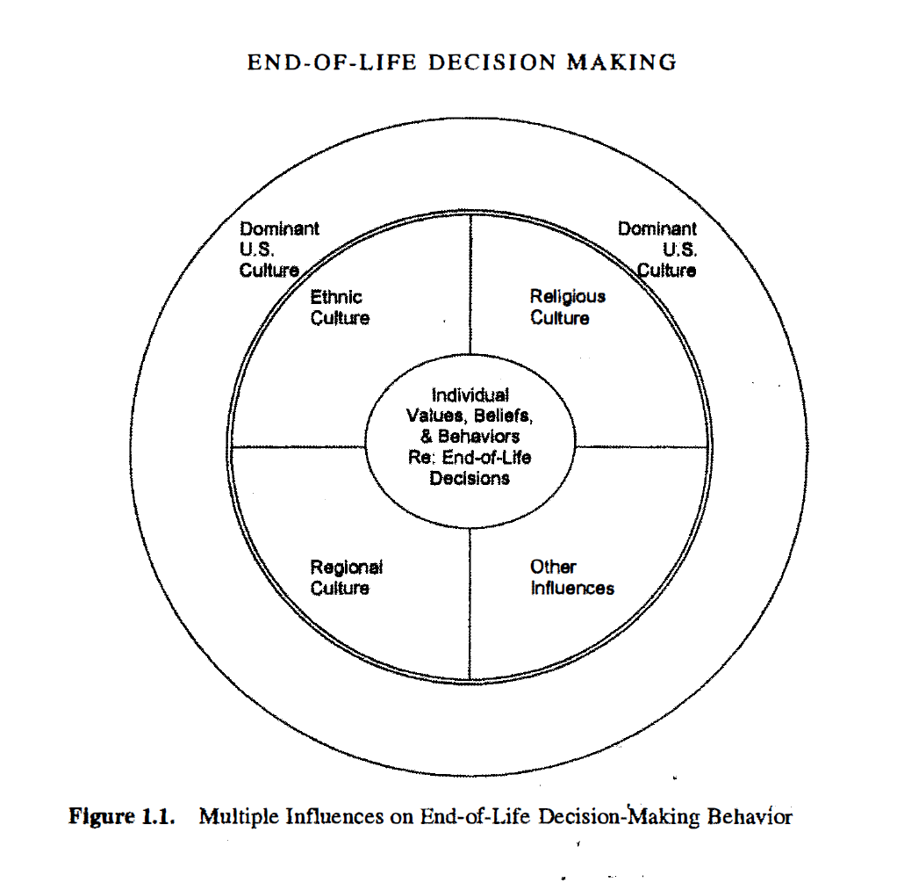
Graphic found in: Cultural Issues in End-Of-Life Decision Making, p. 6

Slide 13
Religious Aspects of Serious Illness and Facing Death
These beliefs influence how patients and families respond to illness and how they regard death and dying.
Often religious beliefs become more important to people as they face death
Humans in general hunger for rituals at times of transition
What we do can impact not only a person’s body but also their soul

Slide 14
Illness and Death Tend to Bring Up Spiritual and Religious Questions
Why me?
Do I still have worth when I can’t do the things I used to do?
Do I need forgiveness for something I have done?
Is there anything undone or are there relationships that are yet to be reconciled?
Who will be with me as I go through this?

Slide 15
Yet research shows…
Patient’s desire to be asked about their spiritual needs exceeds the practice of being asked
Patients often experience spiritual distress at end of life, yet they are often not screened for spiritual distress or seen by a chaplain
Patients and family members who bring up spiritual or religious issues in family meetings are not feeling heard
Most doctors and nurses do not feel comfortable addressing spiritual or religious needs
(Koenig)

Slide 16
Religion is the Oldest Form of Medicine
Now, in western culture, we separate the body and soul/spirit
In Eastern culture and medicine, integration of body and spirit remain.
(in Christian, Muslim and Jewish religions)patients often see the medical system and medical professionals as an extension of God’s healing power
So…it is a complicated mix of old and new beliefs that don’t always make sense to health care professionals

Slide 17
Palliative Care sets the bar for interdisciplinary collaboration!
Some leaders in health care reform, including Shirley Otis-Green,
advocate that all care should be based on palliative care guidelines. Palliative care=best medical practice

Slide 18
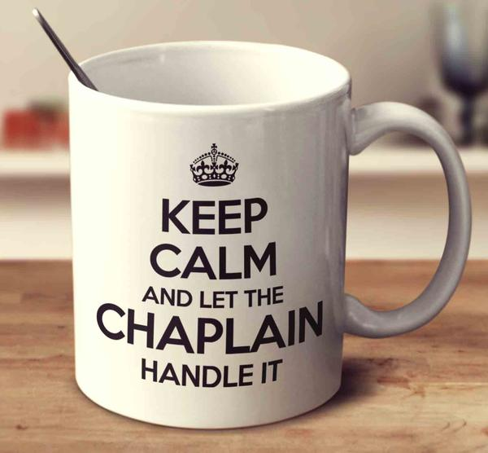
Ok, so we just refer chaplains more often…
Why this simple solution won’t work

Slide 19
Why Don’t Patients Ask for a Chaplain More Often? (Or Say No When You Ask if They Want to See a Chaplain)
I’m not religious
I’m not dying’
I have my own…
(Pastor/Rabbi/Imam/Monk)
I’m doing fine, why do you think I need to talk to someone?

Slide 20
Why Health Care Professionals Don’t Want to Talk about Religion?
That’s not my area. That’s what chaplains are for.
That is a private subject. I don’t want to offend someone.
What if they want to pray with me?
I don’t want them to ask about my religious preferences.

Slide 21
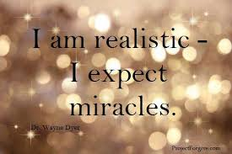
“Keep all the life support going. We’re waiting for a miracle”
This can mean a variety of things…
“I believe that everything is possible with God so the physicians prognosis doesn’t mean anything to me.

Slide 22
The Theology Behind many of These Demands for Care often are Very Complicated
Is this truly what the community believes or their individual interpretation?
Has this been an important part of their lives or is this an example of “foxhole” religion?
What exactly do they mean? How do they understand what they are asking for?

Slide 23
“Keep all the life support going. We’re waiting for a miracle”
“I hope that you’re wrong and I refuse to give up or think negatively.”
“I’m not willing to (or just can’t) receive this information.”
“I’m angry about the medical care so why would I believe you. I have to fight to get all the care I deserve/need.”

Slide 24
Public/Health Care Worker Divide
When asked if “miracles still occur today as in ancient times?” 79% of the 35,000+ people asked said “yes.” This data was not predicated on a certain religion or even whether they were religious.
The only group whose answers differed significantly were Jehovah’s Witnesses. Only 30% agreed.
(2007 survey by Pew Forum of Religion and Public Life)

Slide 25
Differences in Religiosity of Health Care Professionals versus Patients/Families
One study found that 50% of the public believes that a miracle could save a patient even when physicians say there is no hope (Jacobs et al. 2008)
Cancer patients and families rank faith in God as second most important factor in medical decision making after physician recommendations

Slide 26
In comparison…
Of nearly 1000 trauma professionals surveyed by Jacobs and Burns in 2008, only 20% believe in miracles.

Slide 27
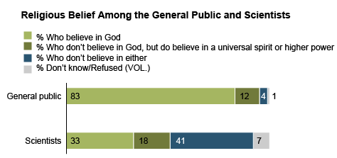
Differences in religiosity of health care professionals versus patients/families
91% of patients reported faith in God versus 64% of physicians. (Maugans & Wadland, 1991)

Slide 28
All Religious Coping is not the same…
Research shows that people with negative religious coping…
have 19-28% increased mortality
Poor outcomes for BMT
Overall poorer quality of life and end of life outcomes

Slide 29
R-COPE
The Brief RCOPE is a 14-item measure of religious coping with major life stressors. As the most commonly used measure of religious coping in the literature, it has helped contribute to the growth of knowledge about the roles religion serves in the process of dealing with crisis, trauma, and transition
(Pargament, Feuille & Budzy 2011)

Slide 30
Religious Coping (+)
Looked for a stronger relationship with God
Sought God’s love and care
Sought help from God in letting go of my anger
Tried to put my plans into actions together with God
Tried to see how God might be trying to strengthen me in this situation
Asked forgiveness for my sins
Focused on religion to stop worrying about my problems
(Paragament brief R-COPE)

Slide 31
Religious Coping (-)
Wondered whether God had abandoned me
Felt punished by God for my lack of devotion
Wondered what I did for God to punish me
Questioned God’s love for me
Wondered whether my church had abandoned me
Decided the devil made this happen
Questioned the power of God
(Pargament brief R-COPE)

Slide 32
Medical Decisions Most Affected by Religious Beliefs
Use of advanced directive
DNR
Approach to artificial nutrition
Advance life support

Slide 33
Why Engage in This if it is so Complicated?
Increased patient satisfaction
Less adversarial relationships
More satisfaction of health care professionals in dealing with difficult situations
Most patients want to be asked about their spiritual or religious needs.

Slide 34
Why it is so complicated…
“Every life is different from any that has gone before it, and so is every death. The uniqueness of each of us extends even to the way we die.” (Nuland, 1994)
“Individual personalities, experiences and situations often have more influence on behavior and choice than does native culture or religion.” (Hallenbeck, 1996)
(Cultural Issues in End of Life Decision Making, Ed. Braun et al. p. 64 &321)

Slide 35
“Every person is …
Like all others,
Like some others,
Like no other.”
Kluckhohn & Murray 1953

Slide 36
Did you hear about the time when the Priest, the Rabbi and the Pastor went fishing…
Sounds like one of those typical jokes
These jokes are so funny because they play on stereotypes that everyone understands. But when you’re one of the characters, it is easy to be offended that you are being portrayed in a certain way that might or might not fit you.

Slide 37
Concept of Cultural Humility
Will serve us better than cultural competence.
Cultural competence infers that we can master the topic
Instead we need to come to the patient and family curious to know more about how they feel and how cultural and religious beliefs are influencing them personally
Notes:
Uncertainty is a part of medical practice. How do we manage our insecurity about uncertainty. Are we willing to be vulnerable with our patients and admit we don’t know something?

Slide 38
So if the Point is Don’t Assume You Know Anything…
What am I going to talk about today?
In order to be respectful and to spot potential issues, it is helpful to have a basic understanding of what might be a concern and then be able to check it out for accuracy.

Slide 39
And use your resources- Chaplain as Spiritual Specialist
Whether in an outpatient or an inpatient setting, the chaplain should be fully integrated into the healthcare team. As I indicated before, the chaplain or pastoral counselor is at the core of the spiritual care team because he or she is the only person fully trained to address spiritual needs. Consequently, the chaplain should be actively involved in hospital rounds and in discussions involving patients in the clinic

Slide 40
Chaplain Visits Desired versus Patients that saw a Chaplain (Need for Spiritual Generalists)
In a survey of 1591 patients at the Mayo Clinic, researchers found that 70% of hospitalized patients wanted to see a chaplain, but only 43% were visited by a chaplain, which is over double the national rate, which is about 20%. The proportion of OUTPATIENTS seen by a chaplain or pastoral counselor is probably in the single digits
Piderman KM, Marek DV, Jenkins SM, et al. Predicting Patients’ Expectations of Hospital Chaplains: A Multisite Survey. Mayo Clinic Proceedings. 2010;85(11):1002-1010. doi:10.4065/mcp.2010.0168.

Slide 41
So between the resistance to seeing a chaplain, and limited chaplain resources…
We need your help!
And the patients and families want to engage in respectful dialogue about how their beliefs influence their choices at end of life
“ Patients and families who feel that they have had a chance to share their stories, concerns, and hopes will be more likely to trust the practitioners and to feel comfortable with the advice and guidance offered.”
(Cultural Issues in End-of-Life Decision Making, p. 310)

Slide 42
A few overview slides about the most common religions
This is true for the Midwest region.
If you are from out of this region, your mix of religions encountered may be different
Even the major religions have regional nuances.
Again, when in doubt, ask, be curious!

Slide 43
Caucasian Christian (Mainline Protestant)
Trust that they will go to heaven after death
Often want prayer during illness and especially at the time of death for final ritual
Value quality of life, autonomy

Slide 44
Take-aways
Religion, even when important, is less likely to be primary driver of end of life decisions
Least likely to invoke miracle language or primary religious influence on medical decision making
Individual(s) make decision rather than group

Slide 45
Evangelical Christians (esp. African American)
Religion plays a greater role than for mainline protestants
Prayer as primary way to cope with stress
Believe in faith healing
Have trust issues with medical establishment-less likely to have HCPOA, DNR or Hospice
Aggressive end of life care may be reflection of trust issues, test of faith or allowing for God’s miracle to occur
Quality of life is not a primary value

Slide 46
Take-aways
Need high level of patient-doctor communication
Tend to make decisions as a group- need to allow time for this to occur
Perceived pressure to change treatment preferences often results in communication breakdown

Slide 47
Hispanic Christians (predominantly Catholic)
Many different subgroups-difficult to generalize
Some general principles are emphasis on family rather than individual (familioso)
Respect for hierarchy (jerarquisimo)
Need to develop trust over time (personalismo)
Belief that spirits, good and bad, influence health (espirito)
Emphasis on present (presentisimo)

Slide 48
Hispanic Christians cont.
Acceptance of death as a part of life (Dia de los Muertos)
But least likely to have DNR
Likely to want aggressive end of life care
Low use of Hospice
Against Autopsy (understanding that the body needs to be whole for reunion with God)

Slide 49
Roman Catholic
Believe that there is an afterlife and that they will meet their creator for a time of judgment
Place high importance on Sacraments-especially anointing, confession and communion at end of life
Pray for their loved one through the intercession of the saints
Many ask for Priest advice on whether forgoing or withdrawing life support or nutrition is allowed or is considered Euthanasia

Slide 50
Take-aways
Issues are likely to revolve around forgoing or with-holding nutrition/hydration and ventilator
Sacramental care is very important, schedule extubations etc. around Priest
Concerned with being right with God at time of death

Slide 51
Jewish
Pikuah Nefesh (saving life) is highest value
Death is seen as a part of life but our duty is to embrace life until the end
Dying person should never be left alone
Likely want Rabbi to advise them on medical treatment (particularly Orthodox or Conservative)

Slide 52
Take-aways
Often surrounded by and advised by community
Life is considered sacred, quality of life does not enter consideration
Death can be allowed but never hastened
Decisions likely to involve Rabbi

Slide 53
Muslim
Different sects and ethnicities influence views
Believe that everything, including illness and death come from Allah (God)
Focus in life is in living a life worthy of meeting Allah in the next life
Part of the religious practice is to pray daily prayers so that they are ready for death at any time
Gender issues- will prefer same sex caregivers
All forms of treatment are considered voluntary
Suicide though is forbidden so can not choose death, just can allow death

Slide 54
Take-aways
Assign same sex health care professionals whenever possible
Provide for modesty and privacy
Allow for prayer and fasting as able
If patient/family feel something is forbidden by faith, ask about that rather than challenge it
Allow Imam to visit and advise
Allow for death rituals and do not allow non-Muslim to touch dead body without gloves.

Slide 55
Jehovah’s Witness
Believe that they will “sleep” until God resurrects them from the dead then some will go to Heaven and others to a paradise on Earth
Prefer only to pray with people from their religion
Medical treatments with whole blood products prohibited (some fractions of blood products allowed)

Slide 56
Take-aways
Tend to not talk about religion with others not in their community unless about medical treatments that are allowed or not
Allow for Elders in the church to visit and minister to them for spiritual/religious support
Most hospitals have Jehovah’s Witness liaison committee and volunteers to visit their patients

Slide 57
Hindu
Illness is seen as a disruption of homeostasis.
Believe in re-incarnation-soul moves to another body until achievement of Nirvana
Healthcare decisions made by eldest son
End of life rituals can include tying of a thread around the neck and wrist of the dying patient, sprinkling with water from the Ganges or placing a basil leaf on the tongue.
Sacred threads or other Holy objects should not be removed from the body after death.
Body is cremated as they believe that burning releases the spirit

Slide 58
Take-aways
May refuse medication as they want to be alert and may feel that suffering may help their spiritual growth
There is a notion of good death, how to die and a bad death is greatly feared. Good karma leads to good birth and bad karma to bad rebirth.
Because death is viewed as a transition rather than a final conclusion, Hindu attitudes on end-of-life care options may radically differ from perspectives shaped by the Western tradition of bioethics

Slide 59
Buddhism
All existences are mutually related and mutually dependent
Interwoven reality- no one event has a single cause
Suffering comes from clinging to false beliefs such as “life continues forever.”
Karma- deeds committed in the present life have influence on the next life
Object to brain death criterion, only stopping of the heart is considered death
Because life is transient, should not resist death with aggressive measures

Slide 60
Take-aways
Decision on end of life usually made by family consensus as we live interdependent not independent lives
Do not allow autopsy or organ donation or accept organ donation as our bodies are not ours to give away nor should we take another life to save ours

Slide 61
Research indicates that only about 10% of physicians conduct a spiritual assessment. Why is this so?

Slide 62
So What is the Role of a Spiritual Generalist
So, what is a reasonable expectation for how a health care professionals could address religious/spiritual needs?
1. Conduct a basic spiritual screening regarding coping,
2. Document patients’ responses in the EMR
3. Alert the spiritual care team if spiritual needs are identified, and…
4. Follow-up to ensure that spiritual needs are met

Slide 63
Basic screening questions
My favorite: “People often find spirituality or religion helpful when dealing with serious illness. Is this true for you?”
If yes, Would you please tell me more about that. How might your beliefs affect your medical care?
If no, “What does help you maintain hope in the midst of difficult times? Are there ways this might affect your medical care that I should be aware of?”

Slide 64
Examples
I am a Christian and I believe that God is going to heal me from this illness. I don’t want to talk about anything that might be negative.
I like to be in nature. Being inside makes me feel restless and anxious. Do you think we could arrange for me to get outside?

Slide 65
VALUE model family meetings
Value and appreciate family comments
Acknowledge / address emotions
Listen actively
Understand the patient as person
Elicit family questions
Lautrette A, et al. N Engl J Med 2007; 356:469-478. http://depts.washington.edu/eolcare/instruments/index.html

Slide 66
LEARN model of family meetings
L-Listen to the patient’s perspective
E-Explain and share one’s perspective
A-Acknowledge difference and similarities between the two perspectives
R-Recommend treatment
N-Negotiate mutually agreed upon plan
Berlin, EA, Fowkes, WC. A teaching framework for cross-cultural health care.
West J Med. 1983:139.

Slide 67
AMEN

Slide 68
So how do we know when we are successful?
A successful outcome, according to the AMEN protocol's developers, is one where the clinician joins with and is actively engaging with the patient or family, allowing ongoing conversation in an atmosphere of openness and collaboration

Slide 69
Case study 1
55 y.o. AA male with C5-6 quadriplegia secondary to a traumatic fall 5 years ago. Now has stage 4 decubiti with staph, respiratory failure, end stage kidney and heart failure. Patient/family are Pentecostal Christians and refuse to talk about any limits to care.
How might you handle this?

Slide 70
Case Study 2
Patient is a 65 y.o. Asian female who is Buddhist. Pt. has stage 4 endometrial cancer that has spread to multiple boney sites. Patient appears to be in pain but refuses all pain medications other than tylenol.
How might you address this?

Slide 71
What Questions Do You Have?

Slide 72
Contact Information
Chaplain Rebekah Wagner, MA, BCC
Froedtert Hospital
Spiritual Services Department
9200 W Wisconsin Ave
Milwaukee, WI 53226
414-805-4660
Rebekah.wagner@Froedtert.com

Slide 73
References
Balboni, T., Balboni, M., Paulk, M., Phelps, A., Wright, A., Peteet, J., Block, S., Lathan, C., VanderWeele, T. and Prigerson, H. (2011). Support of cancer patients' spiritual needs and associations with medical care costs at the end of life. Cancer, 117(23), pp.5383-5391.
Balboni, T., Fitchett, G., Handzo, G., Johnson, K., Koenig, H., Pargament, K., Puchalski, C., Sinclair, S., Taylor, E. and Steinhauser, K. (2017). State of the Science of Spirituality and Palliative Care Research Part II: Screening, Assessment, and Interventions. Journal of Pain and Symptom Management, 54(3), pp.441-453.
Braun, K. (2010). Cultural issues in end-of-life decision making. Thousand Oaks, Calif: Sage Publications.
Cooper, R., Ferguson, A., Bodurtha, J. and Smith, T. (2014). AMEN in Challenging Conversations: Bridging the Gaps Between Faith, Hope, and Medicine. Journal of Oncology Practice, 10(4), pp.e191-e195.

Slide 74
References
Edwards, A., Pang, N., Shiu, V. and Chan, C. (2010). Review: The understanding of spirituality and the potential role of spiritual care in end-of-life and palliative care: a meta-study of qualitative research. Palliative Medicine, 24(8), pp.753-770
Handzo, G. and Koenig, H. (2004). Spiritual Care: Whose Job Is It Anyway?. Southern Medical Journal, 97(12), pp.1242-1244.
Heilig, S. (1994). CQ Interview with Sherwin Nuland on How We Die. Cambridge Quarterly of Healthcare Ethics, 3(04), p.624.
Jeuland, J., Fitchett, G., Schulman-Green, D. and Kapo, J. (2017). Chaplains Working in Palliative Care: Who They Are and What They Do. Journal of Palliative Medicine, 20(5), pp.502-508.

Slide 75
References
Koenig, H. (2008). Medicine, religion, and health. West Conshohocken, Pa.: Templeton Foundation Press
Koenig, H., Perno, K., Erkanli, A. and Hamilton, T. (2017). Effects of a 12-Month Educational Intervention on Clinicians’ Attitudes/Practices Regarding the Screening Spiritual History. Southern Medical Journal, 110(6), pp.412-418.
Koenig, H., Perno, K. and Hamilton, T. (2017). Integrating Spirituality Into Outpatient Practice in the Adventist Health System. Southern Medical Journal, 110(1), pp.1-7.
Koenig, H., Perno, K. and Hamilton, T. (2017). The spiritual history in outpatient practice: attitudes and practices of health professionals in the Adventist Health System. BMC Medical Education, 17(1).
The medical manual for religio-cultural competence. (2009). Tanenbaum Center for Interreligious Understanding.

Slide 76
References
Otis-Green, S., Ferrell, B., Borneman, T., Puchalski, C., Uman, G. and Garcia, A. (2012). Integrating Spiritual Care within Palliative Care: An Overview of Nine Demonstration Projects. Journal of Palliative Medicine, 15(2), pp.154-162.
Pargament, K., Feuille, M. and Burdzy, D. (2011). The Brief RCOPE: Current Psychometric Status of a Short Measure of Religious Coping. Religions, 2(4), pp.51-76
Puchalski, C., Ferrell, B., Virani, R., Otis-Green, S., Baird, P., Bull, J., Chochinov, H., Handzo, G., Nelson-Becker, H., Prince-Paul, M., Pugliese, K. and Sulmasy, D. (2009). Improving the Quality of Spiritual Care as a Dimension of Palliative Care: The Report of the Consensus Conference. Journal of Palliative Medicine, 12(10), pp.885-904.
Schmidt R. The Role of Chaplaincy in Caring for the Seriously Ill #347. The Role of Chaplaincy in Caring for the Seriously Ill #347. 2018;21(3):2018 21:3, 389-390 .
Widera, E., Rosenfeld, K., Fromme, E., Sulmasy, D. and Arnold, R. (2011). Approaching Patients and Family Members Who Hope for a Miracle. Journal of Pain and Symptom Management, 42(1), pp.119-125.

