Slide 1
Blending humanistic and economic outcomes to make the case for spiritual care
J. Brian Cassel, PhD
Palliative Care Research Director
Associate Professor of Medicine
Virginia Commonwealth University
Brian.Cassel@VCUhealth.org

Slide 2
Objectives
Discover relevance of economic outcomes
Integrate economic, clinical and spiritual outcomes
Translate evidence from health services research into strategic planning
Tensions and paradoxes
Outcomes of inter-disciplinary team and uni-disciplinary role
Required but seemingly optional role of chaplains
Efficiency without industrialization or commodification
Standardization in context of continual change and evolution

Slide 3
Outline
Value of chaplains in healthcare
Broad range of patient-centered services
Brief history of ACP, hospice, palliative care
Evaluation model and diverse outcomes
Examples of financial outcomes in palliative care
Principles of making the business case
Evaluation (measurement) practices
Requirements and realities

Slide 4
1. The tremendous value of chaplains
Willing, able to take the time needed for listening
Preserving dignity; supporting expressions of forgiveness, gratitude, love; promoting wisdom; reducing distress; helping with coping, grieving, capturing legacy
Providing team-based, personalized, precision medicine!
Bridging gaps – science and religion; hopes and fears; alienation; incoherence
Supporting healthcare teams – hospice, palliative care, trauma, pediatric oncology, transplant, ICUs
Re-affirming the need for non-industrial models of quality
Community engagement – overcoming distrust, denial, misconceptions

Slide 5
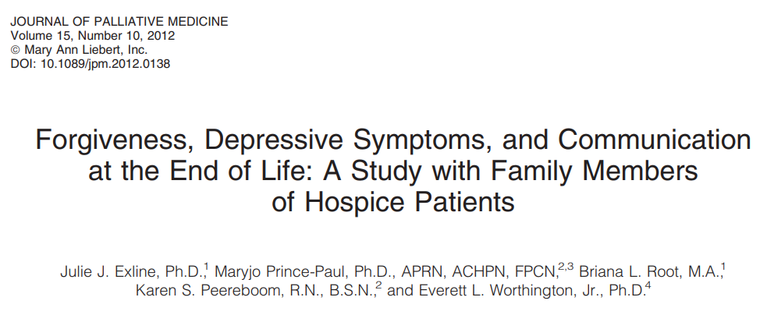
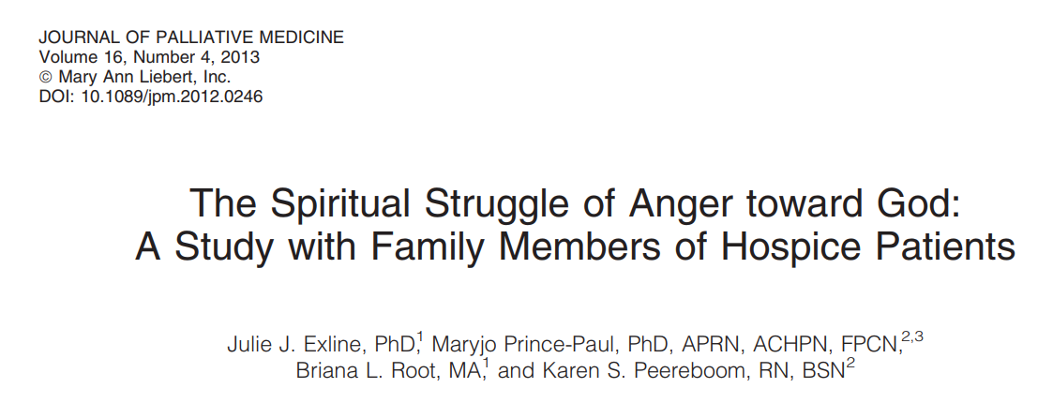
Slide 5

Slide 6

Current and former VCU Health System palliative care chaplains at a community engagement event in Richmond VA about advance care planning. Jason Callahan (foreground), Tim Ford (background).
https://honoringchoices-va.org/events/ambassador-2/

Slide 7
Case example: Interdisciplinary Teamwork
A 43 year old Mexican immigrant was found to have extensive, metastatic lung cancer. He had been given two types of chemotherapy regimens, neither of which was effective in keeping the cancer at bay. He lived in Richmond with his wife. His three children lived in a small village just outside of Mexico City, with his brother and other members of his family.
He had severe bone pain secondary to cancer invading his left front ribcage. He was told of his prognosis, which was poor, by his oncologist. The oncologist planned to try a third type of chemotherapy, that had a 10-15% chance of shrinking the cancer.
The Palliative Care nurse, physician, and chaplain had 2 extensive discussions by translator telephone, first with the patient, and then with the patient and his wife. They elicited from the patient that his family was the most important thing in his life. He wanted to see them again. There would probably not be any chance for more chemotherapy in the Mexican village where he lived.

Slide 8
Frank discussion with the patient and his wife confirmed for them that using another chemotherapy regimen could weaken him and hasten his death, as well as prevent him from returning home. The chaplain confirmed that the patient valued seeing his family again above anything else, including extending his life. The chaplain also learned that it was extremely important to the patient to die at home and to be buried in his village.
The patient was initially unable to travel because of weakness and rib pain. Over the course of the next several days, the team optimized and simplified his oral pain regimen, and arranged for a short but intensive course of radiation to the ribs. The physical and occupational therapists assisted him with walking and strengthening exercises, and energy conservation so that he could endure the long trip to Mexico City. They were also able to secure a walker for him to take with him on the plane. The social worker assisted his wife in obtaining tickets and papers to travel home, and made the necessary phone calls to the family so that they could meet the patient at the airport.
Volunteers contacted a local Hispanic group who were able to povide further financial as well as psychological and translational support. One of the members drove the family to the airport and in fact, traveled to Mexico with them.

Slide 9
2. Patient-centered care / services
Nutritional counseling
Survivorship
Navigators
Psycho-social, mental health services
Caregiver and family supports
Pastoral care / chaplaincy
Other patient-centered efforts:
Medical-legal partnerships
Advanced care planning / POLST paradigm / Serious illness conversations
Palliative care
Hospice
Integrative health
Commonalities: Patient-centered, family-oriented. Not purely biomedical. Often seen as “nice”. Much more than amenities. Some require complex interventions or system change. Not adequately reimbursed if at all. How do you make the case?

Slide 10
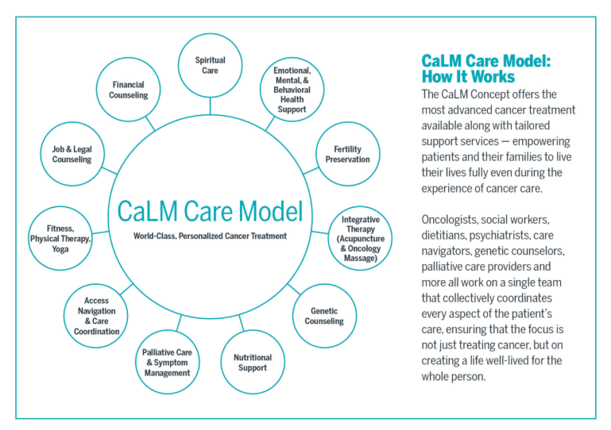
Super awesome. How will we sustain funding for all of that?
https://www.livestrong.org/livestrong-cancer-institutes
https://uthealthaustin.org/clinics/cancer/calm-concept

Slide 11
Palliative care field: useful template
Complex intervention (clinical, educational, cultural)
Bio-psycho-social-spiritual domains
Inter-disciplinary team a core tenet
Insufficient reimbursement in fee-for-service context
Goes against tide of medical culture
  Holistic rather than reductionistic
  Death seen as natural event, not as medical failure
  Shared decision-making, not “doctor knows best”
Misconceptions abound
Positive outcomes, but are they compelling enough to get sustained funding?

Slide 12
3. Brief history

Slide 13
Milestones in Advance Care Planning, Hospice, & Palliative Care 1967-2017

Slide 14
Hospice: From innovations to CMS benefit
1967 First hospice (Saunders in UK)
1965
1974 First hospice in US (Wald in CT)
1978 Nat’l Hospice Organization founded
1975
1979 HCFA hospice demonstration projects
8-12 years
1983 Hospice accreditation standards
1985
1982 Medicare Hospice Benefit created
1986 Medicare Hospice Benefit made permanent
1995
1993 Hospice RN certification
2005
2006 ABMS HPM subspecialty created
2010 ACA allows concurrent hospice for children
2015

Slide 15
Advance care planning:
From legal cases to innovations to payment
1965
1969 Kübler-Ross “On death & dying”
1976 Quinlan case (US Supreme Court)
1975
1985
1990 Cruzan case (Supreme Court); Patient Self-Determination Act
1993 Respecting Choices and Oregon POLST
1995
23 years
1995 Last Acts campaign
2004 National POLST standards
2005
2005 Schiavo case
2015
2016 CMS begins paying providers for ACP

Slide 16
Palliative Care milestones (1975-2006)
Year | Milestone | Category
1975 | Dr. Balfour Mount establishes first palliative medicine program, Montreal Canada | Innovation
1986 | Journal of Pain and Symptom Management begins publishing | Dissemination
1987 | Palliative Medicine (journal) begins publishing | Dissemination
1988 | Dr. Walsh establishes comprehensive program in the US at the Cleveland Clinic | Innovation
1988 | Academy of Hospice Physicians (now AAHPM) founded | Professionalization
1988 | Palliative medicine recognized as subspecialty in the United Kingdom | Professionalization
1993 | Oxford Textbook of Palliative Medicine published | Professionalization
1994 | Cleveland Clinic opens first acute palliative care unit | Innovation
1996 | RWJF “Promoting Excellence in EOL Care” begins ($15 million, 22 projects) | Innovation
1999 | Center to Advance Palliative Care founded at Mt Sinai / Icahn School of Medicine | Dissemination
2001 | Oxford textbook of palliative nursing published | Professionalization
2004 | Wall Street Journal story on palliative care’s positive financial effects | Attention
2004 | First national conference on Pediatric Palliative Care, NHPCO | Dissemination
2004 | National Consensus Project publishes first guidelines for palliative care | Standardization
2006 | National Palliative Care Research Center (NPRCRC) established | Innovation
Professionalization – education and certification for healthcare providers by discipline
Innovation – new clinical models, demonstration projects, research studies
Dissemination – widespread sharing of innovations and guidance for implementation; technical assistance

Slide 17
Palliative Care milestones (2008-2017)
Year | Milestone | Category
2008 | First ABMS-recognized HPM board-certifying exam for physicians | Professionalization
2008 | ACGME approves fellowship program requirements for physicians | Professionalization
2008 | Morrison, PCLC centers publish 8-hospital PC-cost savings study | Innovation
2009 | NASW begins certification program for social work, CHP-SW | Professionalization
2010 | NEJM article from Temel RCT: early PC improved QOL, increased survival | Dissemination
2010 | PC Research Cooperative Group established (funded by NIH/NINR) | Innovation
2011 | Oxford Textbook of Palliative Social Work published | Professionalization
2011 | Joint Commission Advanced Certification in PC begins for US hospitals | Standardization
2012 | California State University founds CSU Palliative Care Institute | Dissemination
2013 | CAPC launches community-based palliative care initiative | Dissemination
2013 | Chaplaincy certification in palliative care from APC / BCCI | Professionalization
2013 | Dr. Frist founds Aspire health, a health-IT driven home-based PC company | Innovation
2014 | PallOnc: AAHPM, ASCO sponsor “palliative care in oncology” symposium | Dissemination
2014 | World Health Organization global resolution on PC access (WHA67.19) | Codification
2016 | AAHPM/HPNA publish “Measuring What Matters” recommendations | Standardization
2018 | California mandate (access to CBPC for Medicaid managed care) begins | Codification
Standardization – consensus statements, guidelines and accreditation criteria for programs
Codification – policies and laws regulating what can (or not) be done, and what will be paid for
Slide 17

Slide 18
Rapid, sustained adoption of palliative care
Cassel JB, Bowman B, Rogers M, Spragens LH, Meier DE and the Palliative Care Leadership Centers. Palliative Care Leadership Centers are key to the diffusion of palliative care innovation. Health Affairs 2018 37(2), 231-239

Slide 19
Palliative Care: From innovations to…
1965
1975
1975 First palliative care program, Canada
1985
1986-1988 First journals, palliative medicine textbook
1988 First comprehensive program US
18 years
1995
1994 First palliative care unit in hospital
30+ years
2006 ABMS HPM subspecialty created
2004 NCP Guidelines
2005
2011 TJC accreditation begins
2008 ACGME HPM Fellowships
2015
2014: Calif Medicaid PC mandate

Slide 20
Achieving widespread adoption without a “palliative care benefit” or payment from CMS
Hundreds of innovations (RWJF, OSI, CHCF, Cambia, local)
Professionalization (ABMS, CHPN, A/CHP-SW, BCC-PCHAC, CPSP…)
Standardization (NCP, TJC, CAPC, CAIC…)
Increasingly rigorous research
  Journals: JPM, JPSM, PM, JAMA, NEJM…
  Funders: ACS, NIH, PCORI…
  Resources: NPCRC, PCRC…
Diverse positive outcomes demonstrated locally and nationally and translated into clinical & business case
  Hospitals subsidize inpatient services
  Health plans (Medicare Advantage plans, Medicaid managed care plans, ACOs, etc.) are now creating contracts for non-hospital services

Slide 21
4. The Specialist Palliative Care Evaluation Model
Evaluate SPC Delivery
Design and Deliver SPC
Who: Referring providers, IDT & patient characteristics
When: Timing of PC relative to other events
Where: Locations, settings
How: Expertise, techniques, time spent; costs
How much: Frequency, duration, intensity, breadth; costs
How well: Standards met? Gaps in quality? Sustainable?
Patient-centered, family-oriented
IDT: bio-psycho-social-spiritual needs
Assess and manage symptoms
Elicit goals and evaluate options
Excellent communication, navigation
Evaluate SPC Outcomes
Evaluate impact on your patients
Biological, psychological, social, spiritual needs addressed?
Pain, other symptoms, distress are prevented and reduced?
Subsequent care is effective, goal-concordant, not burdensome?
Patient experience is positive?
Patient
Evaluate impact on families & referring providers
Family – less confused, less distress; positive experience?
Nurses, doctors – appreciate specialist help, less distress?
Social
Institutional
Evaluate impact on payers, systems, sponsors
Shift and reduce costs?
Improve institutional quality & performance metrics?
Adapted from Cassel, Palliat Med 2013 27(2) 103-104.
Notes:
Purposefully does not use “structure” and “process jargon”
Co-created by and first presented with Kathleen Kerr at University of Illinois at Chicago, “nuts and bolts” conference, 2007
This incorporates Triple Aim (not Quadruple Aim! Read Derek Feeley (IHI) and others on this. IHI endorses the value of process goals such as readiness, equity, and joy in work, without moving those into the realm of outcomes.)

Slide 22
Diverse outcomes
Program / population | Positive effects | Source
PC in primary care clinic for adv CHF, COPD, cancer | Dyspnea, anxiety, spiritual well-being, sleep quality, satisfaction with care | Rabow: Arch IM 2004, JPSM 2003
Outpatient PC for adv NSC lung cancer | Survival, quality of life, depressive symptoms | Temel NEJM 2010 / JPM 2016
Home-based PC for home-bound Ca, CHF, COPD | Satisfaction, more at-home deaths, fewer ED visits and hospitalizations | Brumley JAGS 2007
Home-based PC for all conditions (cancer, CV, respiratory, etc.) | Anxiety, appetite, dyspnea, well-being, depression, nausea; hospice use; lower healthcare costs | Kerr JPM 2014, JPSM 2014
Home-based PC for MSSP (ACO) beneficiaries | Increased hospice enrollment & length; less hospital use & lower costs | Lustbader JPM 2017
Home-based PC for MA; CHF, Cancer, COPD, dementia | Less hospital use and lower healthcare costs; patient experience high | Cassel JAGS 2016
Psycho-educ telehealth for adv cancer & care-givers | Patient survival, caregiver depression | Bakitas & Dionne-Odom JCO 2015
Notes:
Includes 2 clinic-based, 4 home-based, and 1 tele
If you’re designing & implementing a clinic-based service, it makes sense to look at the clinic-based papers for descriptions of staffing, timing, frequency of encounters, duration of services etc.
Look at the details of what was measured and how. Not just what effects were achieved – but also what effects were null (not shown here) – some have quite a few non-effects.

Slide 23
Primary outcome: clinical impact on patient
Modified MSAS
Khatcheressian J, Cassel JB, Lyckholm L, Coyne P, Hagenmueller A, Smith TJ. Improving palliative and supportive care in cancer patients. Oncology (Williston Park). 2005 Sep;19(10):1365-76; discussion 1377-8, 1381-2, 1384 passim. PMID: 16285228
Notes:
Cassel / Kerr slides

Slide 24
Patient / family experience
Sharp “Transitions” home-based palliative care program
Cassel et al. JAGS 2016; 64(11): 2288–2295.
Notes:
Part of the Triple Aim of healthcare. Included as an outcome in the SPC Measurement Model.

Slide 25
5a. Economic studies of Hospital-based palliative care

Slide 26
PCLCs 8-hospital study
7 PCLC hospitals + Mt Sinai = mix of academic and community hospitals
Adult hospitalizations 2002-2004, all diseases and conditions
Day-by-day cost analysis for palliative care consult patients and usual-care patients
Propensity score used to construct usual-care group
Return-on-investment estimated
Data re-analyzed in meta-analysis published 2018
Morrison, Penrod, Cassel et al. (2008). Cost savings associated with US hospital palliative care consultation programs. Archives of Internal Medicine 168 (16), 1783-1790.

Slide 27
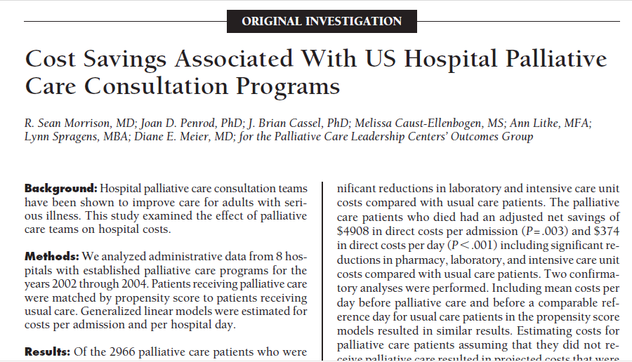
Morrison, Penrod, Cassel et al. (2008). Cost savings associated with US hospital palliative care consultation programs. Archives of Internal Medicine 168 (16), 1783-1790.

Slide 28
Day-by-day costs in relation to palliative care involvement
Usual Care
PC consult day 10-11
PC consult day 12-13
Morrison, Penrod, Cassel et al. (2008). Cost savings associated with US hospital palliative care consultation programs. Archives of Internal Medicine 168 (16), 1783-1790.

Slide 29
Palliative care recipients’ costs per day
Direct cost per day | Survivors | Decedents
48 hours before pall care | $843 | $1,163
48 hours after pall care | $605 | $589
Difference | $238 (28%) | $574 (49%)
Morrison, Penrod, Cassel et al. (2008). Cost savings associated with US hospital palliative care consultation programs. Archives of Internal Medicine 168 (16), 1783-1790.

Slide 30
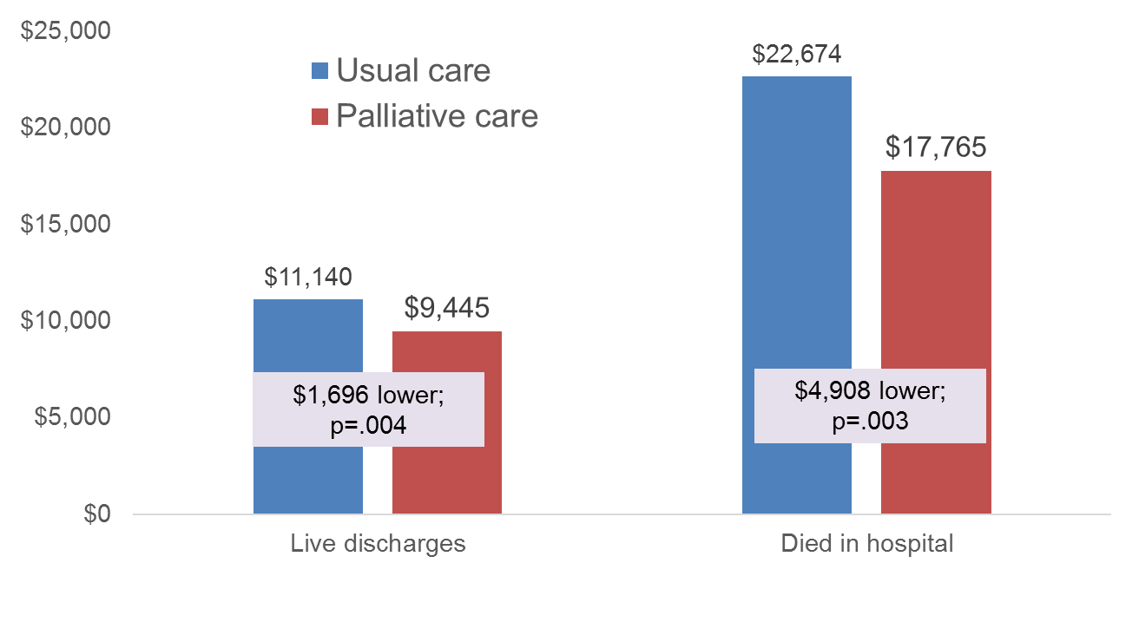
Direct costs per case reduced
Morrison, Penrod, Cassel et al. (2008). Cost savings associated with US hospital palliative care consultation programs. Archives of Internal Medicine 168 (16), 1783-1790.

Slide 31
Positive return-on-investment
  Palliative care team seeing 500 patients per year
  $418,000 personnel costs for palliative IDT
  $240,000 revenue generated by IDT providers
  $178,000 hospital subsidy required for IDT
  $508,800 costs saved for 300 live discharges
  $981,600 costs saved for 200 deaths
  $1,490,400 hospital costs saved minus $178,000 invested
  $1,312,400 positive financial impact (assumes all cases were paid at some kind of fixed rate such as per diem or per case)
  7:1 return-on-investment for the hospital (net impact [$1.3 million] divided by investment [$178,000])
Morrison, Penrod, Cassel et al. (2008). Cost savings associated with US hospital palliative care consultation programs. Archives of Internal Medicine 168 (16), 1783-1790.

Slide 32
“Palliative Care For Cancer” Study
NCI funded R01, five sites (DE Meier, PI)
Cancer patients hospitalized 2007-2011
3,096 cancer patients enrolled at admission, then observed prospectively
Naturally occurring palliative care referrals
Propensity-based matching with 30+ variables to lasso comparison group
Economics papers published 2015-2017
Site | Total N | PC N (Row %) | Control N
Mount Sinai | 614 | 68 (11.1%) | 546
Medical College of Wisconsin | 313 | 44 (14.1%) | 269
Mount Carmel | 204 | 58 (28.4%) | 146
University of Pittsburgh | 1182 | 161 (13.6%) | 1021
Virginia Commonwealth | 783 | 263 (33.6%) | 520
Total | 3096 | 594 (19.2%) | 2502

Slide 33
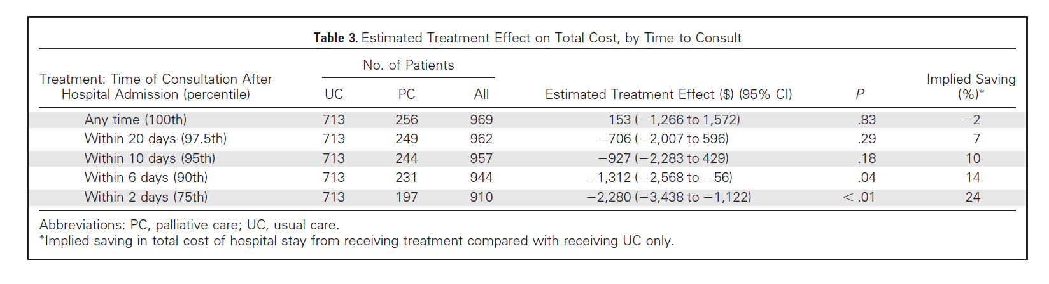
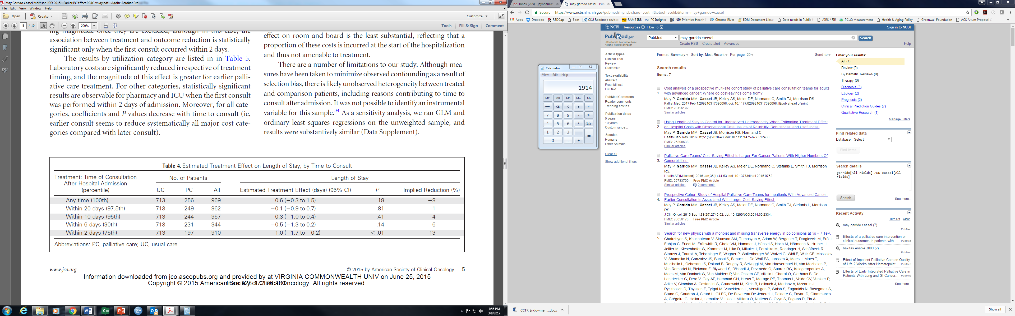
Consult early in stay reduces length and cost of stay
Palliative care consult within 2 days of admit: 24% lower cost (p<.01) and 13% shorter LOS (p<.01)
May P, Garrido MM, Cassel JB, et al. Prospective cohort study of hospital palliative care teams for inpatients with advanced cancer: earlier consultation is associated with larger cost-saving effect. J Clin Oncol. 2015 Sep 1;33(25):2745-52.

Slide 34
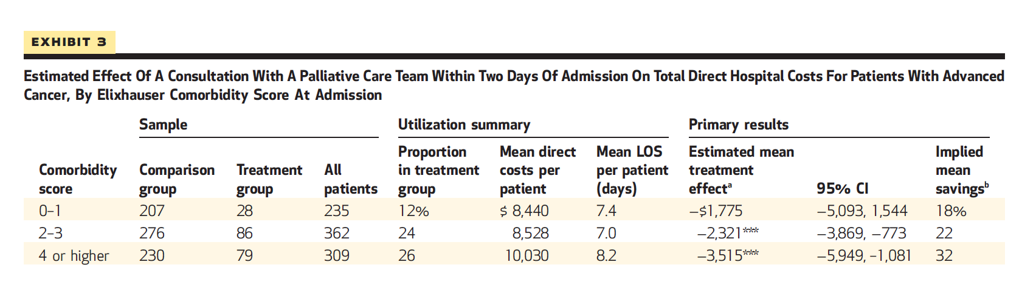
Greater impact on patients with more comorbidities
For those with 2-3 comorbidities, PC cost savings of $2,321 (or 22%). For those with 4+ comorbidities, PC cost savings of $3,515 (32%).
May P, Garrido MM, Cassel JB, et al. Palliative care teams' cost-saving effect is larger for cancer patients with higher numbers of comorbidities. Health Aff (Millwood). 2016 Jan 1;35(1):44-53.

Slide 35

Impact on cost: shorter LOS and reduced cost per day
Lower hospital costs per stay are realized by lower intensity and reduced LOS. The reduced LOS is associated with 63% of the overall cost-saving estimate.
May P, Garrido MM, Cassel JB, et al. Cost analysis of a prospective multi-site cohort study of palliative care consultation teams for adults with advanced cancer: where do cost-savings come from? Palliative Medicine 2017 Apr;31(4):378-386.

Slide 36
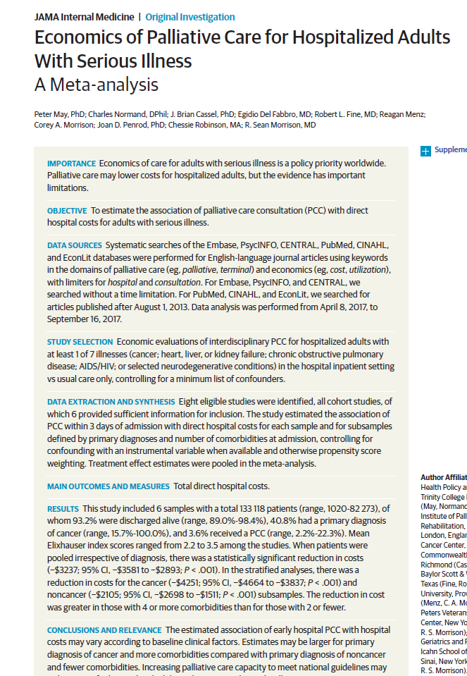

Slide 37
Meta-analysis study
Incorporates data from 6 studies:
  PCLC / Mt Sinai study (8 sites) (Morrison 2008)
  Veterans Administration study (5 sites) (Penrod 2010)
  Medicaid patients in NYS (4 sites) (Morrison 2011)
  Palliative Care For Cancer (prospective) (5 sites) (May 2015)
  Baylor / Scott & White study (5 sites) (McCarthy 2015)
  VCU study (1 site) (May 2017)
10 community hospitals, 5 Veterans, 11 academic
Re-analyzes data from each study using latest methods at 2015 $.
Pooled analysis of 133,118 admissions (4,726 had PC) from 2001-2015
Consult within 3 days of admit defined as the intervention observed
May P, Normand C, Cassel JB, Del Fabbro E, Fine RL, Menz R, Morrison CA, Penrod JD, Robinson C, Morrison RS. Economics of palliative care for hospitalized adults: a meta-analysis. JAMA Intern Med. 2018 Jun 1;178(6):820-829. doi: 10.1001/jamainternmed.2018.0750.

Slide 38
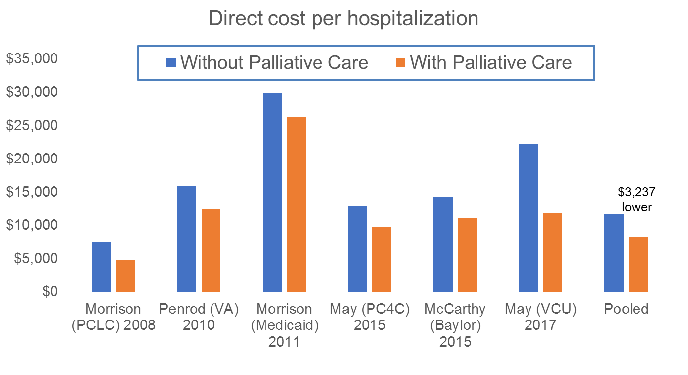
Cost per stay $3,237 lower with PC
May P, Normand C, Cassel JB, Del Fabbro E, Fine RL, Menz R, Morrison CA, Penrod JD, Robinson C, Morrison RS. Economics of palliative care for hospitalized adults: a meta-analysis. JAMA Intern Med. 2018 Jun 1;178(6):820-829. doi: 10.1001/jamainternmed.2018.0750.

Slide 39
Indirect financial contributions of hospital PC
Payers are increasingly linking various factors to reimbursement including patient experience, 30-day mortality, and 30-day re-admissions.
Re-admissions.
  A quasi-experiment (Adelson 2017) found a significant reduction in re-admissions (reduced from 35% to 18%) when palliative care was involved proactively in the hospital stay for solid tumor cancer patients.
  A retrospective study (May 2019) found a reduction in re-admission (26% with usual care, 19% with palliative care), while accounting for mortality.
Adelson K, Paris J, Horton JR, et al. Standardized Criteria for Palliative Care Consultation on a Solid Tumor Oncology Service Reduces Downstream Health Care Use. J Oncol Pract. 2017 May;13(5):e431-e440.
May P, Garrido MM, Del Fabbro E, et al. Evaluating Hospital Readmissions for Persons With Serious and Complex Illness: A Competing Risks Approach. Med Care Res Rev. 2019 doi: 10.1177/1077558718823919.

Slide 40
5b. Economic studies of
Home- and clinic-based palliative care

Slide 41
Key RCTs of CBPC measuring cost impact
Brumley (2007) compared palliative home care (n=145 for average of 196 days) to usual home care (n=152 for average of 242 days) for home-bound patients with COPD, CHF, or cancer. PC patients had greater satisfaction, were more likely to die at home, and had lower healthcare costs (net difference of $7,552 per patient) due to fewer ED visits and hospitalizations.
Higginson (2009) compared fast-tracked PC (n=25) to PC delivered after a delay of 3 months (n=21) for patients with severe multiple sclerosis. PC was delivered in both home and community settings. PC patients’ caregivers had lower ratings of burden, and lower total costs of care (net difference of £1,789 per patient) after 12 weeks; included costs of healthcare and caregiving.
Greer & Temel (2016) compared early outpatient PC (n=68) and usual care (70) patients who had non-small cell lung cancer diagnosed at advanced stage, enrolled 2006-2009 and died by 2013. No significant differences in total costs of care nor in final 30 days of life (e.g., $2,527 lower costs in final 30 days of life for PC group was not statistically significant) (secondary analysis, under-powered).

Slide 42
RCT: Palliative Care at Home
Mean cost of care
Usual care: $20,222
Home PC: $12,670
Brumley, Enguidanos et al, Increased Satisfaction with Care and Lower Costs: Results of a Randomized Trial of In-Home Palliative Care. J Am Geriatr Soc. 2007 Jul;55(7):993-1000
Slide 42

Slide 43
“Home Connections”: Symptoms & costs controlled
“Home Connections” (Buffalo NY)
Mean ESAS item scores ( y-axis) as a function of the week of enrollment (x-axis) within groups categorized by the score at enrollment: good scores (0-2) on onset are represented by the gray line and moderate (4-6) and/or poor (7-10) scores at onset are represented by a black solid line (n=428).
Kerr, Donohue, Tangeman et al. [Cost outcomes] JPM 2014 Dec;17(12):1328-35.
Kerr, Tangeman, Rudra et al. [Clinical outcomes] JPSM. 2014 Nov;48(5):883-92.
Slide 43

Slide 44
Mean healthcare costs per patient per month
178 Transitions pts enrolled for at least six months prior to death and 515 matched comparison patients. Does not include hospice or Transitions program costs.
Cassel JB, Kerr KM, McClish DK, Skoro N, Johnson S, Wanke C, Hoefer D. Impact of a home-based palliative care program on healthcare utilization and costs. Journal of the American Geriatrics Society 2016 November; 64(11): 2288–2295.

Slide 45
Medicaid CBPC pilot
Partnership Health Plan – Medicaid beneficiary pilot
N=51 pilot patients with >=90 days PHC Medi-Cal coverage prior to pilot enrollment, and enrolled for 90+ days. Program costs tallied as maximum PMPM global, quality, and outcome payments. Excludes start-up costs. http://www.partnershiphp.org/Providers/Quality/Documents/Strategic%20Initiatives%202017/PHC%20Palliative%20Care%20Program%20Summary_3_23_17.pdf
Slide 45
Notes:
Payer / sponsor perspective. Pre-post comparison is good design because you don’t need comparison group and because you (usually) have plenty of “post” time to measure effects (not too close to death). This is also inclusive of what the payer paid the providers (not providers costs per se).

Slide 46
UCSF Symptom Management Service
297 cancer patients, 204 with Late-PC: first PC within 90 days of death
93 with Early-PC: first PC >90 days preceding death
*NQF measures
Scibetta C, Kerr K, Mcguire J, Rabow MW. The Costs of Waiting: Implications of the Timing of Palliative Care Consultation among a Cohort of Decedents at a Comprehensive Cancer Center. J Palliat Med. 2016 Jan;19(1):69-75.
Slide 46

Slide 47
MD Anderson
366 cancer patients, 246 with Late-PC: first PC within 90 days of death
120 with Early-PC: first PC >90 days preceding death
Hui D et al., Impact of timing and setting of palliative care referral on quality of end-of-life care in cancer patients. Cancer. 2014 Jun 1;120(11):1743-9.
Slide 47

Slide 48
Virginia Commonwealth
433 pairs solids, 50 pairs hemes
Cassel et al., MASCC 2017.
Slide 48

Slide 49
6. The principles of the business case for PC
1. Palliative care reduces suffering and distress
2. Hospital utilization spikes at EOL
3. EOL hospitalizations result in poor financial outcomes…
4. … and value-based metrics such as 30-day re-admissions
5. Community-based PC can help avoid some hospitalizations
6. Inpatient PC can make hospitalizations less costly
7. Clinical revenue insufficient for PC teams
8. Hospitals see positive “return on investment” with inpatient PC
9. Payers, at-risk providers (ACOs) recoup investment in CBPC
10. Evaluation of outcomes can be done by all
Data + Alignment
Data + Relationships
Cassel, Kerr, Kalman & Smith. The Business Case for Palliative Care: Translating Research Into Program Development in the U.S. J Pain Symptom Manage. 2015 Dec;50(6):741-9.

Slide 50
Dr. Donald Berwick on sustained solutions
“Healthcare’s disintegration is not yet every man for himself, but it is every discipline for itself, every guild for itself. As a result, we tend to assume today that one guild’s solution cannot be another’s. We assume that either we will preserve quality or cut costs; that patients will get what they ask for or that science will prevail; that managers will run the show or that doctors will be in control; that the bottom line is financial or moral.
“No comprehensive solution is possible if it fails to make sense to any of the key stakeholders. At least four parts of our crew [health system] need to share in the solution—a common answer—or the crew will fall apart. Whatever "escape fire" [revolutionary innovation] we create has to make sense in the world of science and professionalism, in the world of the patient and family, in the world of the business and finance of health care, and in the world of the good, kind people who do the work of caring.
“I think the toughest part of this may be in terms of the business and financing of care. There is a tendency to assume that financial success—e.g., thriving organizations—and great care are mutually exclusive. However, we will not make progress unless and until these goals become aligned with each other.”
http://www.commonwealthfund.org/usr_doc/berwick_escapefire_563.pdf

Slide 51
Translating outcomes into hospital finances
Intermediate outcome |  | Ultimate financial outcomes
Improved patient experience | → | HCAHPS scores → VBP score → reimbursement HCAHPS scores → Star ratings → volume
Reduced length of stay per admit | → | More capacity → other admissions → new revenue Greater profitability *
Avoid (make unnecessary) some hospitalizations | → | Capacity → other admissions → replace revenue Avoid re-admission penalty → protect revenue Avoid 30-day mortality → VBP score → reimbursement Re-admissions & mortality → Star ratings → volume ACO and BPCI-A performance
Survival, safety, quality | → | Avoid 30-day mortality → VBP score → reimbursement Reputation → referrals Managed care contracting → reimbursement Patient, family, community, staff loyalty
Reduce overall cost per patient over time | → | Achieved shared savings in ACO BPCI-A performance
* When reimbursement held constant (MS-DRGs, per diem)
You can do similar mapping with interests of other types of funding partners (e.g., payers)

Slide 52
7. Chaplains and program evaluation

Slide 53
Where are IDTs and chaplains in outcomes?
Some economic studies do describe IDT staffing
Large-scale health services research studies using claims data can’t easily discern specialist palliative care encounters, much less specific staff involved
Several ways to approach this in research
  What immediate and longer term effects do spiritual care interventions have on patients, caregivers, healthcare teams, utilization, costs? (Balboni Cancer. 2011 Dec 1; 117(23): 5383–91)
  What are the outcomes of palliative care programs with complete vs. incomplete teams?
  Social-political goals versus scientific goals: What if your research shows that spiritual care is “nice” but doesn’t translate into lower costs, higher revenue, other outcomes that sponsor-funders want?
The imperative for involving chaplains in program evaluation
Notes:
Balboni study:
Prospective, multi-site study of 339 advanced cancer patients accrued September 2002–August 2007 from an outpatient setting and followed until death. Spiritual care was measured by patients' reports that the healthcare team supported their religious/spiritual needs. EOL costs in the last week were compared among patients reporting their spiritual needs were inadequately supported versus those well-supported. Analyses adjusted for confounders (e.g., EOL discussions).
Results
Patients reporting their R/S needs were inadequately-supported by clinic staff were less likely to receive a week or more of hospice (54% vs. 72.8%; p=.01) and more likely to die in an ICU (5.1% vs. 1.0%, p=.03). Among minorities and high religious coping patients, those reporting poorly supported R/S needs received more ICU care (11.3% vs. 1.2%, p=.03 and 13.1% vs. 1.6%, p=.02, respectively), less hospice (43.% vs. 75.3% ≥ a week of hospice, p=.01 and 45.3% vs. 73.1%, p=.007, respectively) and had increased ICU deaths (11.2% vs. 1.2%, p=.03 and 7.7% vs. 0.6%, p=.009, respectively). EOL costs were higher when patients reported their spiritual needs were inadequately supported ($4947 vs. $2833, p=.03), particularly among minorities ($6533 vs. $2276, p=.02) and high religious copers ($6344 vs. $2431, p=.005).

Slide 54
Reminder: Framework for evaluation
Evaluate SPC Delivery
Design and Deliver SPC
Who: Referring providers, IDT & patient characteristics
When: Timing of PC relative to other events
Where: Locations, settings
How: Expertise, techniques, time spent; costs
How much: Frequency, duration, intensity, breadth; costs
How well: Standards met? Gaps in quality? Sustainable?
Patient-centered, family-oriented
IDT: bio-psycho-social-spiritual needs
Assess and manage symptoms
Elicit goals and evaluate options
Excellent communication, navigation
Evaluate SPC Outcomes
Evaluate impact on your patients
Biological, psychological, social, spiritual needs addressed?
Pain, other symptoms, distress are prevented and reduced?
Subsequent care is effective, goal-concordant, not burdensome?
Patient experience is positive?
Patient
Evaluate impact on families & referring providers
Family – less confused, less distress; positive experience?
Nurses, doctors – appreciate specialist help, less distress?
Social
Institutional
Evaluate impact on payers, systems, sponsors
Shift and reduce costs?
Improve institutional quality & performance metrics?
Slide 54
Adapted from Cassel, Palliat Med 2013 27(2) 103-104.
Notes:
Purposefully does not use “structure” and “process jargon”
Co-created by and first presented with Kathleen Kerr at University of Illinois at Chicago, “nuts and bolts” conference, 2007
This incorporates Triple Aim (not Quadruple Aim! Read Derek Feeley (IHI) and others on this. IHI endorses the value of process goals such as readiness, equity, and joy in work, without moving those into the realm of outcomes.)

Slide 55
Not just “measurement” or “all good here”
Measure / acquire data, analyze *
Findings
Insights
Comprehensive assessment of patients at time of enrollment; analyze for patterns semi-annually
Our dual-eligible patients have 2 more co-morbidities than other patients we serve!?
Uh-oh, we might be under-serving some of our more complex patients.
Let’s increase services to that population for 6 months and re-assess.
Assess and record patient/family experience; analyze quarterly
Our dual-eligible patients and families have lower scores on experience & satisfaction!?
Acquire data about patients’ health care utilization in the 6 months following enrollment; analyze
Our dual-eligible patients are still using the ED and hospital frequently even with our service!?
* Slice & dice by patient characteristics to look for differences
Slide 55

Slide 56
GPCQA/QDACT Measuring What Matters Report 4/15/14 - 5/30/16
Measure | Timing | %
Palliative care and hospice patients receive a comprehensive assessment (physical, psychological, social, spiritual & functional) soon after admission | First Visit | 28.6%
 | Within 3 Visits | 34.4%
Seriously ill palliative care and hospice patients are screened for pain, shortness of breath, nausea and constipation during the admission visit | First Visit | 82.9%
 | Within 3 Visits | 86.0%
Seriously ill palliative care and hospice patients who screen positive for at least moderate pain receive treatment (medication or other) within 24 hrs | First Visit | 94.4%
 | Within 3 Visits | 94.9%
Patients with advanced or life ­threatening illness are screened for sob and, if positive to at least a moderate degree, have a plan to manage it | First Visit | 89.8%
 | Within 3 Visits | 91.2%
Seriously ill palliative care and hospice patients have a documented discussion regarding emotional needs | First Visit | 86.2%
 | Within 3 Visits | 88.2%
Hospice patients have a documented discussion of spiritual concerns or preference not to discuss them | First Visit | 33.7%
 | Within 3 Visits | 39.3%
Seriously ill palliative care and hospice patients have documentation of the surrogate decision-­maker's name and contact information (or absence ) | First Visit | 91.5%
 | Within 3 Visits | 93.6%
Seriously ill palliative care and hospice patients have documentation of their preferences for life­ sustaining treatments | First Visit | 93.0%
 | Within 3 Visits | 95.4%
Vulnerable elders with documented preferences to withhold or withdraw life­ sustaining treatments have their preferences followed | First Visit | 94.7%
 | Within 3 Visits | 96.7%
GPCQA alliance sites only. Courtesy of Arif Kamal.
Slide 56
Notes:
Excludes Non-Alliance Sites

Slide 57
The importance of qualitative data
When in doubt, remember the measurement serenity prayer:
  God, grant me the serenity to accept qualitative information for things I cannot quantify,
  courage (and data) to quantify the outcomes that I can,
  and wisdom to know the difference.
With apologies to Reinhold Niebuhr
Slide 57

Slide 58
3-year evaluation plan that includes chaplains
Hypothetical PC program…
Year 3: Refine, scale-up
Operational stuff
  Who, what, where, how much…
  Costs and income of program
Process measures
  Add assessment of opioid risks (CAGE, UDS, PMP)
  Earlier referrals triggered?
  How is staff experience?
  Any inequities related to key demographics?
Outcomes
  Multiple symptoms controlled
  Pt + bereaved family + referring provider experiences
  Payer partner comparison of CBPC to usual care beneficiaries including hospital and hospice use
3+ additional vignettes
Year 2: Refine and begin contract(s)
Operational stuff
  Who, what, where, how much…
  Cost per patient per month
Process measures
  Full bio-psycho-social-spiritual needs assessed
  POLST where appropriate?
Outcomes
  Pain control
  Patient experience
  Hospitalizations avoided
3+ additional vignettes
Year 1: Pilot program
Operational stuff
  Who, what, where, how much…
Process measures
  Symptoms, distress assessed
  Proactive follow-up calls
Outcomes
  Patient experience
3+ compelling vignettes
Measurement process becomes more efficient, automated
Slide 58

Slide 59
8. Requirements and realities

Slide 60
Chaplains required in palliative care?
Nat’l Quality Forum preferred practices – core element
The Joint Commission – required for advanced certification
Center to Advance Palliative Care – “must have”
Calif Advanced Illness Collaborative – considered part of core IDT
Blue Shield Calif – ditto
Anthem Q-HIP – ditto
Calif SB1004 (Medicaid mandate) – chaplains encouraged but not reimbursed (62% of plans require spiritual care capability)
Am College of Surgeons Commission on Cancer standards:
  requires process for screening patients for distress; lists spiritual distress
  requires access to palliative care; chaplains among others on multi-d team

Slide 61
References for those
Calif Medicaid mandate “SB1004”: https://www.dhcs.ca.gov/formsandpubs/Documents/MMCDAPLsandPolicyLetters/APL2018/APL18-020.pdf
Calif Adv Illness Collaborative (CAIC standards): https://coalitionccc.org/public-policy/california-advanced-illness-collaborative-caic/
National Quality Forum: http://www.qualityforum.org/Publications/2006/12/A_National_Framework_and_Preferred_Practices_for_Palliative_and_Hospice_Care_Quality.aspx
Individual and program-level certification: https://www.capc.org/jobs/palliative-care-certification/
Center to Advance Palliative Care Registry data: https://registry.capc.org/metrics-resources/
Blue Shield California: https://www.blueshieldca.com
Am College of Surgeons Commission on Cancer: https://www.facs.org/quality-programs/cancer/coc/standards

Slide 62
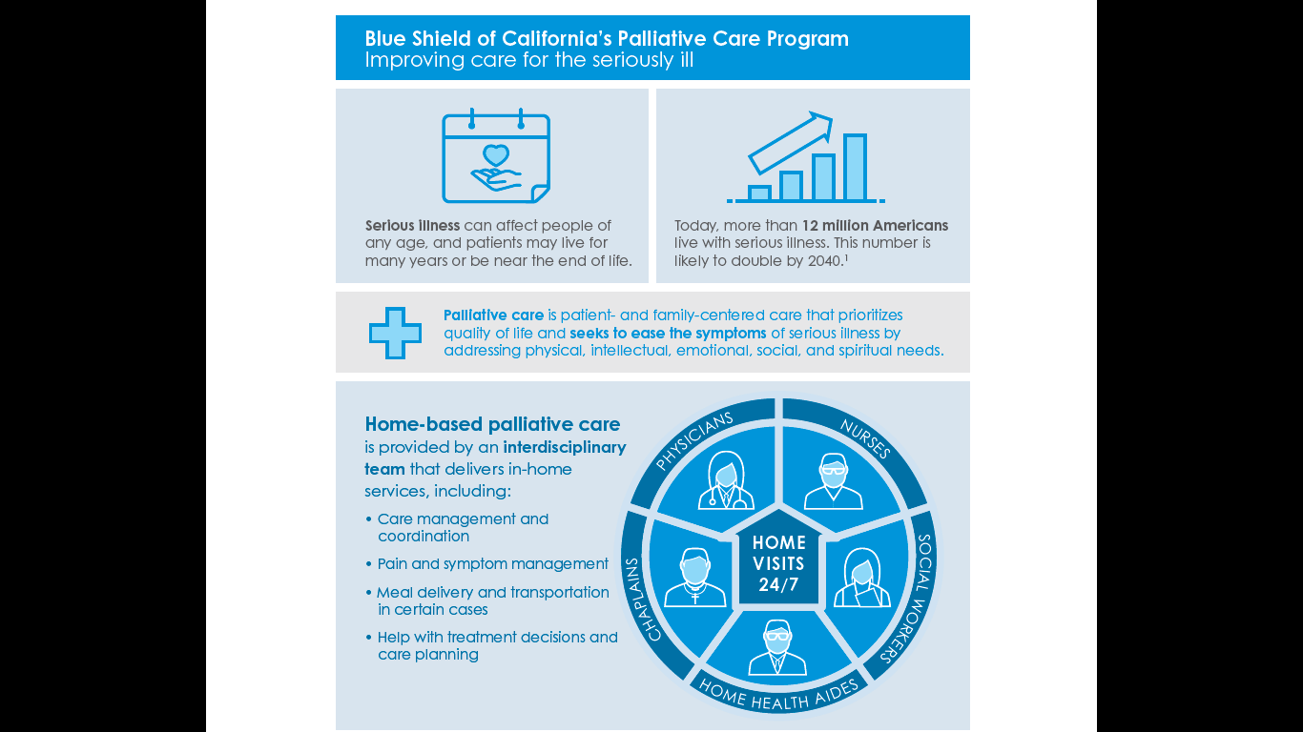
https://www.blueshieldca.com/bsca/bsc/public/common/PortalComponents/member/StreamDocumentServlet?fileName=BSCA_palliative-care-infographic.pdf

Slide 63
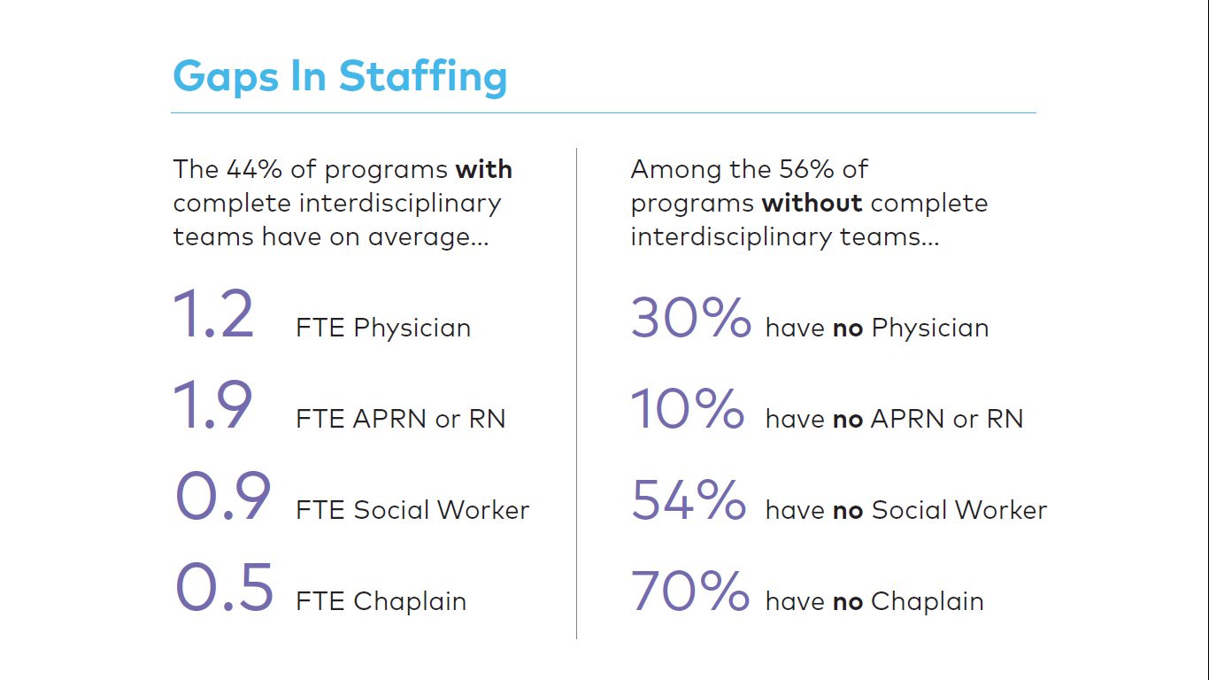
Palliative care program staffing (2015)
https://registry.capc.org/wp-content/uploads/2017/02/How-We-Work-Trends-and-Insights-in-Hospital-Palliative-Care-2009-2015.pdf

Slide 64
Staff composition (clinical FTEs) among “complete” teams
CAPC research department custom analysis. 2017 National Registry data.

Slide 65
IMHO

Slide 66
Take it to the next level: Community engagement
Allan Kellehear “Compassionate communities: end-of-life care as everyone’s responsibility” https://academic.oup.com/qjmed/article/106/12/1071/1633982 4 minutes: https://www.youtube.com/watch?v=oJmqKjzTZpo
Bonnie Tompkins “Compassionate Communities in Canada: it is everyone’s responsibility” http://apm.amegroups.com/article/view/19240/19356
Workplaces, schools, faith communities, civic government, public spaces…

Slide 67
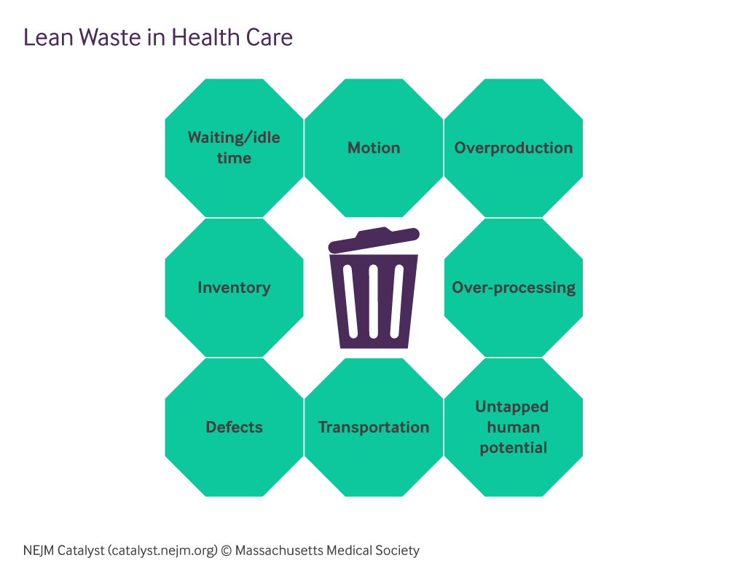
Resist and leverage the assembly line culture
https://catalyst.nejm.org/what-is-lean-healthcare/

Slide 68
All set!
Evaluate and describe your value within and beyond palliative care and hospice
Emulate strategies used in palliative care field to acquire sustained funding and widespread adoption
Align patient-centered outcomes with the business interests of funding partners
In your spare time, transform the culture of healthcare and US society to be humanized rather than industrialized

