Slide 1


The Spiritual Care Profession:
Mandated or Obsolete?
Spiritual Health
Association
2019 Caring for the Human Spirit Conference
Myrtle Beach, South Carolina
Cheryl Holmes, CEO, Spiritual Health Association

Slide 2
Notes:
Every morning in our office, whoever is available, stops what they’re doing and gathers in our meeting room. A candle is lit and placed in the middle of the table and someone chooses a reading from the many books of poetry, and sacred texts we have – or sometimes someone will bring something that seems pertinent to what may be happening at the time. At the end of the reading the singing bowl chimes calling us to a time of silence……and then we are brought out of our silence as the singing bowl sings. – and we go on with our day.

Slide 3


Australian Indigenous Spirituality
Spiritual Health Association
Notes:
Source: https://www.creativespirits.info/aboriginalculture/spirituality#ixzz5DqIcCvLj
If I was delivering this presentation anywhere in Australia, I would begin by acknowledging the traditional custodians of the land on which we are meeting and I would pay my respects to their elders past, present and emerging. I gather that this is not a common undertaking in the USA? For me in the Australian context, this acknowledgment gives recognition to the importance of knowing where we have come from, of attempting to get hold of the truth of who we are, of what has shaped us, of our brokenness and fragility, of what might be needed for us to be the best version of ourselves and what it might take to unite us. These are pertinent questions and begin to frame something of what we might begin to explore together today in this conversation about the spiritual care profession.

Slide 4
Ursula Le Guin quote
“My job is to keep the meaning completely embodied in the work itself, and therefore alive and capable of change…
…leaving around her words that area of silence, that empty space, in which other and further truths and perceptions can form in other minds.”
Spiritual Health Association

Slide 5
Outline of presentation
The Australian Context
  Religion & Spirituality
  Healthcare in Australia
  Spiritual Care in Australia
Challenges
Emerging Opportunities
Mandated or Obsolete?

Slide 6
Spiritual Health Association
Notes:
Australian population 25 million

Slide 7
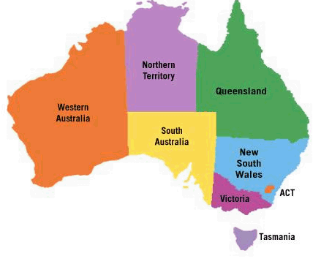
Spiritual Health Association
Notes:
Australia has 6 states and 2 territories.

Slide 8
The changing Australian census
      1996 2006 2011 2016
Anglican 22% 18.7% 17.1% 13.3%
Catholic 27% 25.8% 25.3% 22.6%
Other Christian 21.9% 19.3% 18.8% 16.3%
Other religions 3.5% 5.6% 7.2% 8.2%
No religion 16.6% 18.7% 22.3% 30.1%
Spiritual Health Association

Slide 9
Health Care in Australia
Organisation – National, State/Territory, Local
Role of the Australian Government
Public Hospitals
Person-centred Care
Quality and safety
Spiritual Health Association
Notes:
Healthcare is funded and administered by several layers of Government and supported by private health insurance arrangements.

Slide 10
Health Care in Australia
Patient-centred care that incorporates concern for the patient’s beliefs and values has been identified by the Australian Commission on Safety and Quality in Health Care as a key component for safe and high quality care
Australian Commission on Safety and Quality in Health Care. (2011). Patient-centred care: Improving quality and safety through partnerships with patients and consumers. Sydney: ACSQHC.

Slide 11
Health Care in Australia
Providing for the cultural, spiritual and psychosocial needs of patients, and their families and carers is as important as meeting their physical needs.
Australian Commission on Quality and Safety in Health Care National Consensus Statement: essential elements for safe and high-quality end-of-life care 2015

Slide 12
Health Care in Australia
Standard 1
Initial and ongoing assessment incorporates the person’s physical, psychological, cultural, social and spiritual experiences and needs.
The National Palliative Care Standards (5th Edition)

Slide 13
Health Care in Australia
Multidisciplinary team including medical practitioners, nurses and allied health professionals, most of whom will have specialist qualifications, extensive experience and
skills in palliative care. Medical practitioners and senior nurses may provide consultative services. An extensive range of allied health disciplines will be available including occupational therapy, physiotherapy, speech therapy, social workers, psychologists, pharmacists, grief and bereavement counsellors, art and music therapists, spiritual care and pastoral care workers. Personal care workers who provide support in the person’s home or other residential care home.
The National Palliative Care Standards (5th Edition)

Slide 14
Spiritual Care in Australia
Spiritual Care Australia
Spiritual Health Association
National Survey
National Consensus Conference
Victorian State-wide Survey
Spiritual Health Association

Slide 15
Spiritual Care Australia
Spiritual Care Australia is the professional association of practitioners in spiritual care, pastoral care and chaplaincy.
Spiritual Care Australia seeks to unify, consolidate, support, promote and encourage the development of spiritual care within contemporary multi-faith, multi-cultural Australia.

Slide 16

Spiritual Care Australia – Standards 2014

Slide 17
Spiritual Health Association
VISION
A sustainable organisation that advances the availability and essential contribution of spiritual care to every person in every healthcare setting.
MISSION
Enabling the provision of quality spiritual care as an integral part of all health services.
Spiritual Health Association

Slide 18
Publications of Spiritual Health
Capability Framework for Spiritual Care Practitioners in Health Services 2016
Spiritual Care in Victorian Health Services: Towards Best Practice Framework 2016
Spiritual Care in Medical Records: A guide to Reporting and Documenting Spiritual Care in Health Services 2019
Spiritual Health Association

Slide 19
The National Survey
499 respondents (477 useable surveys)
Gender: Female 70.63% Male 29.15%
Active religious affiliation: Yes 71.33% No 28.67%
System: Public 58.60% Private 26.24% Other 15.16%
Areas of work: Spiritual care 53.66%
            Management 20.40%
            Allied Health 18.63%
            Nursing 14.63%

Slide 20
The National Survey
State or Territory [n=446]
Answer Choice Responses n (%)
NSW 74 (16.59)
Queensland 37 (8.3)
WA 25 (5.61)
SA 79 (17.71)
Victoria 174 (39.01)
NT 12 (2.69)
Tasmania 20 (4.48)
ACT 25 (5.61)

Slide 21
The National Survey
INTRODUCTORY STATEMENTS | AGREE %
Spiritual care positively affects wellbeing | 96.86
Spiritual care positively affects health outcomes | 93.29
Spiritual care positively affects patient experience | 95.8

Slide 22

The National Survey
POLICY ISSUE STATEMENT | AGREE %
All patients should be offered the opportunity to have a discussion of their religious/spiritual concerns. | 95.81
Patient’s values and beliefs should be integrated into care plans. | 93.29
Spiritual care quality measures should be included as part of the hospital’s quality of care reporting. | 85.32
All health professionals should receive training about spiritual care. | 87
Representatives of local faith communities should not be recognised as part of the hospital’s spiritual care team. | 52.41 (Pooled disagree & strongly disagree)

Slide 23
The National Survey
All patients should have an assessment of their spiritual needs. | 75.05
Information gathered from assessments of spiritual needs should be included in the patient’s overall care plan. | 87.63
Families should be given the opportunity to discuss spiritual issues with health professionals. | 92.03
Hospitals should provide a dedicated space for meditation, prayer, ritual or reflection. | 94.34
There should be a paid professional spiritual / pastoral care workforce in hospitals. | 88.68

Slide 24
The National Survey
POLICY OBJECTIVE | DESIRABLE % | FEASIBLE %
Spiritual care is incorporated at all levels of the health system in Australia | 90.48 | 74.68
Spiritual care is included in the education and training of all health professionals | 89.18 | 81.82
Spiritual care workers are recognised as health professionals | 76.84 | 71.64
Professional spiritual care workers are included as members of multidisciplinary teams | 88.96 | 83.98
Research is conducted on the contribution of spiritual care to quality of care. | 91.56 | 87.01
Research is conducted on the effectiveness of spiritual care. | 91.78 | 84.20

Slide 25
National Survey – Final Comments
Spiritual care must be provided in the faith of the patient not just as one religion to cover all as we see currently.
I think it is an essential part of the patient and family experience and should be offered to all.
Hospitals that include spiritual wellbeing as part of the multi-disciplinary team have shown that people accessing the service feel more satisfied with the service.
There needs to be a growing recognition that spiritual care training is needed in acute hospital settings. Also a new model needs to be developed as many people are not religious but are looking to still make meaning, find hope and make sense of what is going on.

Slide 26
National Survey - summary
A national policy agenda will require:
Governance and policy structures that clearly define spiritual care and articulate its place within organisational structures and policy frameworks.
Clear role delineations and scope of practice for spiritual care provision.
Collaboration between education providers, spiritual care professional bodies and policy makers
National standards of practice and accreditation processes for spiritual care providers to ensure best practice spiritual care delivery.
Holmes C. Stakeholder views on the role of spiritual care in Australian hospitals: An exploratory study. Health Policy (2018). https://doi.org/10.1016/j.healthpol.2018.02.003

Slide 27
The National Consensus Conference 2017
Enhancing Quality & Safety: Spiritual Care in Health
Aims
Participants to develop a national strategy for spiritual care in three identified domains:
1. A nationally consistent governance framework to ensure quality and safety in spiritual care services
2. Viable and sustainable spiritual care models
3. Quality education and training

Slide 28
The National Consensus Conference
68 Participants
Representatives from:
State Governments
Universities
National peak bodies
State peak bodies
Health Service Executives
Spiritual care practitioners and educators

Slide 29
National Consensus Conference - Outcomes
Principles for design and delivery of spiritual care services
Spiritual care is integrated and coordinated across all levels of the health system in Australia.
Spiritual care is available for all people
Spiritual care is provided by a credentialled and accountable workforce
Spiritual care is a shared responsibility
Research is conducted on the contribution, value and effectiveness of spiritual care.
Notes:
Very close to the Policy Objectives from the survey

Slide 30
National Consensus Conference - Outcomes
Policy Statements
There is a paid professional spiritual/pastoral care workforce in hospitals.
All patients have an assessment of their spiritual needs.
Information gathered from assessments of spiritual needs is included in the patient’s overall care plan.
All health professionals receive training about spiritual care.
All patients are offered the opportunity to have a discussion of their religious/spiritual concerns

Slide 31
National Consensus Conference - Outcomes
Policy Statements
Patient’s values and beliefs are integrated into care plans.
Spiritual care quality measures are included as part of the hospital’s quality of care reporting.
Families are given the opportunity to discuss spiritual issues with health professionals.
Faith communities are recognised as partners in the provision of spiritual care.
Hospitals provide a dedicated space for meditation, prayer, ritual or reflection.

Slide 32

National Consensus Conference - Outcomes
Spiritual Health Association

Slide 33
Victorian State-wide Survey
2008 & 2019 comparison
2008 Survey
47 public hospitals
2019 Survey
45 hospitals
- 40 public (88%) and 5 private (12%) hospitals.

Slide 34
Victorian State-wide Survey
2008 & 2019 comparison
Spiritual Care Coordinators
2008
23 hospitals employed a Coordinator (49%)
2019
25 hospitals employed a Coordinator (56%)

Slide 35
Victorian State-wide Survey 2008 & 2019 comparison
Changing profile of practitioners
Faith affiliation 2008 | N (%) 2008 | Faith Affiliation 2019 | N (%) 2019
Catholic | 36 (39) | Catholic | 20 (25)
Anglican | 21 (23) | Baptist | 11 (14)
Uniting Church | 11 (12) | Not religious | 9 (11)
Baptist | 8 (9) | Uniting Church | 8 (10)
Other | 6 (7) | Anglican | 7 (9)
Church of Christ | 2 (2) | Buddhist | 6 (7)
Lutheran | 2 (2) | Church of Christ | 4 (5)
Not declared | 2 (2) | Other | 3 (4)
Jewish | 1 (1) | Pentecostal | 3 (4)
Presbyterian | 1 (1) | Presbyterian | 3 (4)
Buddhist | 1 (1) | Salvation Army | 3 (4)
Unitarian | 1 (1) | Jewish | 2 (2)
 |  | Greek Orthodox | 1 (1)
Total | 92 (100) | Total | 80 (100)

Slide 36
Victorian State-wide Survey 2008 & 2019 comparison
Spiritual care activities 2008 compared with 2019
(2008 data shown in red)
Types of Spiritual Care activities to Patients/Families | Hospital paid staff | Faith community paid staff | CPE interns | Students
One-to-one | 24 (56) 24 (69) | 18 (45) 14 (42) | 6 (15) 7 (25) | 3 (9) 2 (8)
Groups | 16 (37) 14 (40) | 12 (30) 6 (18) | 4 (10) 3 (11) | 1 (3) 0
Routine visits | 14 (33) 17 (49) | 6 (15) 10 (30) | 4 (10) 5 (18) | 2 (6) 1 (4)
Assigned to specific wards | 13 (30) 17 (49) | 4 (10) 8 (24) | 7 (18) 11 (39) | 3 (9) 3 (12)
Referral only | 6 (14) 6 (17) | 3 (8) 8 (24) | 1 (3) 1 (4) | 0 0
Faith based visits | 3 (7) 9 (26) | 20 (50) 13 (39) | 0 0 | 1 (3) 1 (4)

Slide 37
Victorian State-wide Survey 2008 & 2019 comparison
Coding systems used
Both surveys asked about the use of the Spiritual Care Intervention Codes (called Pastoral Care in 2008) to record visits.
In 2008 five of the responding hospitals reported using the codes (11%).
In 2019 nineteen of the responding hospitals reported using the codes (44%).

Slide 38
SPIRITUAL INTERVENTION CODES
Australian Classifications of Health Interventions
ICD-10-AM/ACHI/ACS Tenth Edition
Effective 1 July, 2017:
96186-00
Spiritual assessment
Initial and subsequent assessment of wellbeing issues, needs and resources of a client. Elements of this intervention may include an informal explanatory dialogue to screen for
immediate spiritual needs including religious and pastoral
issues, the use of a formal instrument or assessment tool. This intervention can often lead to other interventions.
96087-00
Spiritual counselling, guidance or education
An expression of spiritual care that includes a facilitative
in-depth review of a person’s life journey, personal or familial counsel, ethical consultation, mental health support, end of life care and guidance in matters of beliefs, traditions, values and practices.
Notes:
Following a national revision by the Australian Consortium for Classification Development, changes were made to the ICD10-AM/ACHI/ACS codes that spiritual care practitioners use for documenting in patient medical records within their health service. Language moved from Pastoral Intervention Codes.
These changes took effect from 1 July 2017 and are part of the Tenth Edition Updates by the Australian Consortium for Health Classification

Slide 39
Spiritual Intervention Codes (cont.)
96187-00
Spiritual support
The provision of support to individuals or groups including establishing relationship hearing the person(s)
narrative, and enabling conversation in which spiritual wellbeing and healing may be nurtured, emotional support and advocacy, companioning of person(s) confronted with profound human issues of death,
dying, loss, meaning and aloneness. It is predominantly a ministry of presence and emotional support.
96240-00
Spiritual ritual
All ritual activities, both formal and informal, including such activities as public and private worship, private prayer and devotion, anointing, blessing and naming, dedications, sacraments, rites, meditation, weddings and relationship ceremonies, funerals, memorial services, seasonal and occasional services.
Generalised Allied Health intervention
95550-12
Allied health intervention, spiritual care
Notes:
Note the Allied Health intervention, spiritual care

Slide 40
Victorian State-wide Survey 2008 & 2019 comparison
What do volunteers do?
Types of Spiritual Care activities to Patients/Families | 2008 | 2019
One-to-one | 18 (44) | 19 (51)
Groups | 4 (10) | 9 (24)
Routine visits (Called ‘universal’ in 2008) | 5 (12) | 11 (30)
Assigned to specific wards | 8 (20) | 11 (30)
On-call service (Called 24 hour service in 2008) | 0 | 6 (16)
Referral only | 4 (10) | 5 (14)
Faith based visits (Called ‘denominational’ in 2008) | 13 (32) | 20 (54)

Slide 41
Victorian State-wide Survey 2008 & 2019 comparison
Selection of volunteers
Selection Criteria | 2008 N=27 (%) | 2019 N=29 (%)
Letter of good standing from faith community | 22 (82) | 20 (71)
Police Check | 24 (89) | 27 (96)
Personal life experience | 17 (63) | 20 (71)
Spiritual care experience (Called ‘pastoral’ in 2008) | 14 (52) | 20 (71)
Minimum 1 unit of CPE | 7 (26) | 7 (25)
Working with children check | 9 (34) | 21 (75)

Slide 42
Victorian State-wide Survey 2008 & 2019 comparison
Resources available to volunteers
Resources | 2008 | 2019
Support/supervision | 21 (81) | 22 (81)
Training/education | 17 (65) | 18 (67)
Position description/Roles and responsibilities document | 16 (62) | 18 (67)
Volunteer handbook | 17 (65) | 18 (67)
Spiritual care volunteer standards (Called ‘pastoral’ in 2008) | 11 (42) | 9 (33)
Evaluation material | 8 (31) | 12 (45)

Slide 43
Challenges
Defining spiritual care
Who is responsible for spiritual care?
Best practice
Certification of practitioners
Education pathways
Professional tensions

Slide 44
Defining Spiritual Care
Spiritual care is the provision of assessment, counselling, support and ritual in matters of a person’s beliefs, traditions, values and practices enabling the person to access their own spiritual resources.
Notes:
Our 2018 definition is a clinical definition – it is made up of the language of the ICD-10 codes and the language from the Puchalski definition of spirituality. It makes sense of what we do when speaking with our colleagues-other health professionals, and it also occurs to me that it makes a good definition for research – can clearly measure against this what was done, why it was done and the outcome.
I believe we also need a consumer definition. Lucy Selman’s 2017 article – Patients’ and caregivers’ needs, experiences, preferences' and research priorities in spiritual care: A focus group study across nine countries published in the Journal of Palliative Medicine provides some possibilities for such a definition. Patients talked about spiritual care as:
Providing a safe space
Listening
Counselling
Providing existential support and human connection at a difficult time
People often talk about spiritual care as presence. I’m not sure how helpful that is unless we are able to unpack and specify what that means – I think it needs to be intentional, otherwise the spiritual care practitioner may just be taking up space. So, how do we define spiritual care and for whom?

Slide 45

Who is responsible for spiritual care?
Notes:
It feels like we have been trying to answer this question for a long time. We are all aware of the historical role of the churches and of the faith communities. That role has been traced by Wendy Cadge here in the USA, Christopher Swift in UK and Fiona Timmins in Ireland. Does the responsibility for spiritual care still lie with the churches and religious traditions?
What about the health services themselves? What about our Governments?
Who pays for spiritual care? Where does accountability lie? Is there, or should there be a shared responsibility? Is that possible? Does how we define spiritual care and how we practice it influence the answers to this question?

Slide 46
Best Practice
Notes:
Best Practice Spiritual Care
A practitioners story – stars over the Murray river.
What does best practice spiritual care look like? Is it expressed in this story?
Who provides best practice spiritual care? Are we working towards a model of paid professional spiritual care practitioners integrated as part of the multi-disciplinary teams within our hospitals and health services? That’s certainly what I’m working towards. It seems though, that we are not yet clear about who we are, this ‘spiritual care profession’. Some of the literature talks about chaplains as religious leaders – is that what the spiritual care profession is? Are we religious leaders? Steve Nolan from the UK (Lifting the Lid on Chaplaincy) has raised a question about whether chaplains are agents of the Church? He then suggests perhaps chaplains are activists for the Kingdom. This language is problematic for me and in the Australian context with growing numbers of practitioners from diverse backgrounds, including non-religious, making up the spiritual care profession, a Christian paradigm can no longer frame the way we define the profession.
What then of the role of volunteers? What messages are we giving if we have volunteer models where volunteers are doing the same roles as the paid workforce? Maybe that’s not happening in your contexts, but we still have places where there is no clear scope of practice for volunteers, where facilities are desperate for resources and so bring in more volunteers. How can anyone effectively supervise large numbers of volunteers? What is best practice spiritual care?

Slide 47
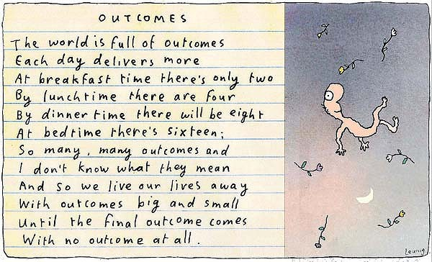
Notes:
Talking about outcomes in our field is still problematic. Aren’t we putting at risk the very essence of what we offer? And are we talking about outcomes or process – is it the results of what we do or what we do that needs to be the focus? Which is most important? I don’t think they’re in competition to be honest. But patient reported outcomes and patient reported experiences are certainly on the agenda in health care in Australia. I think there’s been a nervousness in spiritual care about this language – we’re the people without an agenda, or so the story still goes for some people I speak with. It relates a little to the issue of presence mentioned earlier. If we’re just going to be present, and we have no agenda then I’m not sure we should be in the room at all. Having said this, I am always brought back to something essential and humbling by Michael Leunig: an Australian author, poet and prophet.

Slide 48
Certification
Notes:
we have a problem in Australia as we have no certification process, unlike you in the US who have a few to choose from. I’m not sure which is the biggest challenge! Our challenge is to get clear about both the requirements and the process for certification. To this end – we’re doing a project!

Slide 49
CERTIFICATION FOR SPIRITUAL CARE PRACTITIONERS IN HEALTH
Notes:
We have partnered with SCA on a project. A lit review and a mapping report has been completed by a project worker with recommendations for requirements and processes. The mapping compared various health professions and spiritual care in a number of countries. A consultation is currently underway on the requirements and processes for certification. Requirements do not include faith endorsement – in response to the increasing numbers of non-religious practitioners and belief that our workforce in spiritual care needs to reflect the diversity of the communities in which we live and work. The process recommendations include applicants undertaking a knowledge test and completing a reflective practice exercise. But in order to have a knowledge test we have to have some agreement on the body of knowledge needed for spiritual care.

Slide 50
Notes:
Education pathways – the results of the surveys in both 2008 and 2019 demonstrate that practitioners have come into the work via multiple pathways. I am not so sure that is a problem, and in fact I believe it adds to the richness of the profession. It does raise an important question. What will be our core - our defining education path? Nurses, social workers defined pathway. I wonder whether CPE could be our defining pathway? But CPE (in Australia, can’t talk for anywhere else) needs to get their act together – inconsistency. We need evaluations of the program and evidence of the outcomes – what does CPE contribute to the development of a skilled practitioner? What else is needed to deliver a skilled practitioner? If theology is no longer the body of knowledge (and I don’t believe it is) – what is? And in this whole context, how do we begin to think about formation?

Slide 51
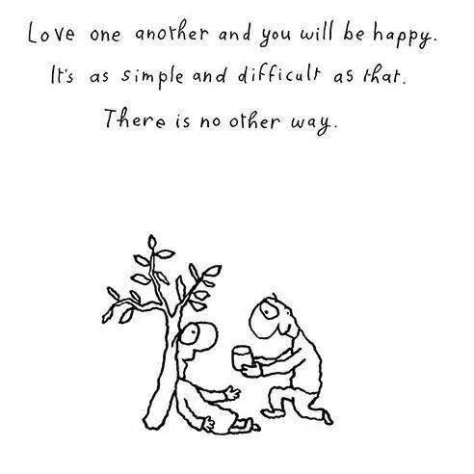
Notes:
To be authentic and to have integrity we need to practice together what we say we believe in and value. This cannot just be about a service to those others ‘out there’ in need. This has to be a lived reality in our offices, it has to be lived in our teams working in health services and it has to be lived in our peak bodies and associations. If we cannot create the safe spaces with each other, if we cannot listen deeply to each other, if we cannot be openhearted and generous with each other, we lack authenticity and integrity. We have to embody our beliefs and values. It’s as simple and difficult as that. There is no other way.

Slide 52
Emerging Opportunities
Person-centred care
Spiritual care is everyone’s responsibility
The voice of the person receiving care

Slide 53
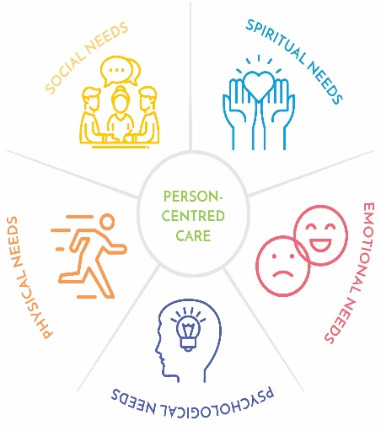
When spiritual needs are recognised and responded to as an integral part of person-centred care an essential contribution is made to people’s health and wellbeing.
Notes:
Person-centred care model: When spiritual needs are recognised and responded to as an integral part of person-centred care an essential contribution is made to people’s health and wellbeing.

Slide 54
Spiritual Care is everyone’s business
All Care Providers
Spiritual Care Practitioners
Faith Representatives Chaplains
The service/system
The Person
Notes:
The Guidelines are based on a model that assumes everyone is responsible for spiritual care – it is part of providing person-centred care.
(Explain model)
The Person – the one who is receiving care is at the centre of care. Any response is based on the needs of the person.
Faith Representatives or Chaplains – a few people will want care specific to their religious needs. The faith representatives/Chaplains provide faith specific care as directed by the person and in response to their needs. This includes religious rituals and ceremonies.
Spiritual Care Practitioners – some people will want spiritual care that is responsive to their spiritual needs. Spiritual Care Practitioners provide assessment, counselling, support and ritual in matters of a person’s beliefs, traditions, values and practices enabling the person to access their own spiritual resources.
All Health Care Providers – many people will want their spiritual needs recognised and responded to as part of person-centred care. All health care providers are able to provide spiritual support and refer as required.
The health service/system ­ - all people will want an environment that fosters holistic care where all people are respected and valued.

Slide 55
I ran a large accounting business.
I love medieval architecture.
I like talking about soccer.
I once met Roy Orbison.
I don’t like talking about politics.
I like a neat whiskey in the evening.
I use my iPhone every day.
I believe in respecting others.
I think a lot about the future of the world.
I believe happiness is a gift.
I believe in the after life.
See me.
Know me.
Notes:
Meaningful Ageing Australia campaign – See me. Know me. This is about engaging seniors and their families as they think about the move into an aged care facility – does the aged care facility take spiritual needs seriously? That is demonstrated by having regard for the whole person, by an organisation that sees beyond the surface and gets to know who you are – know what gives you purpose, know what you believe and know what connects you to life. This campaign uses the voice of the person, the story to highlight spiritual needs.

Slide 56
I sewed clothes for princes and princesses in my home country.
I had five children.
I once walked for two days to get to a wedding.
I like it when all my children and grandchildren visit together.
I survived cancer.
I love going to the market every week.
I believe my ancestors are looking after me.
I cry about losing my sister every anniversary.
I believe compassion is the most important quality we can possess.
See me.
Know me.

Slide 57

The Message Tree
Be vulnerable.
    Be honest.
    Do the classes that scare you the most.
    Cath scared me the most but
    was also the one who helped me the most.
    She taught me a sense of belonging and
    I rediscovered my values.
Notes:
Here is another example of capturing the voice of the person at the centre of care. The Message Tree: This was a message left on the message tree by a patient as part of the Safe Wards Program in a Victorian hospital psychiatric unit. “Cath” is the spiritual care practitioner who facilitates groups on the ward. The voice of the person receiving care is powerful.

Slide 58
Dean Yates
https://www.reuters.com/investigates/special-report/witness-yates-injury/
Notes:
In health care there is a strong emphasis on patient experience and the voice of ‘consumers’ those receiving care. This is an opportunity, because in the end the strongest voice for spiritual care will come from those who receive the best care we are able to provide. And they will receive the best care because we know what quality spiritual care is and we know how to provide it. They might become our strongest champions and allies and we certainly have not tapped into their voices, using their words enough.

Slide 59
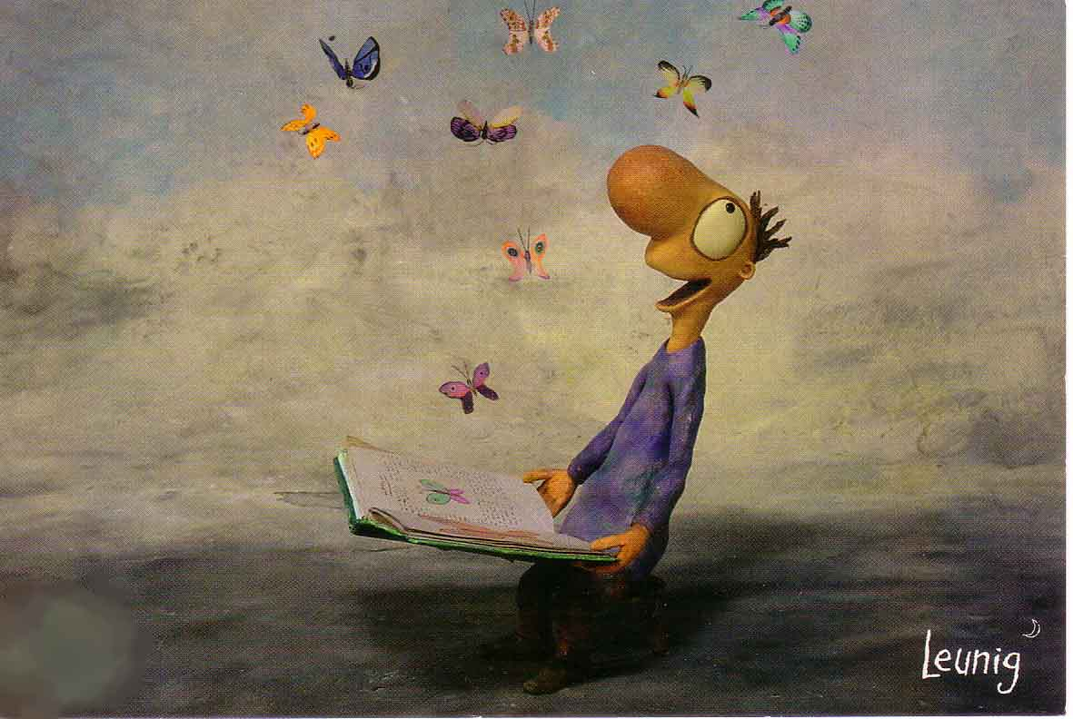
Enabling the person’s story to be heard
Notes:
In closing I return to the beginning – The spiritual care profession: Mandated or obsolete?
One of the changes which I believe has to take place in chaplaincy today is the development of a philosophy of change that meets the current rapid rate of change that is experienced in the secular society, so that we don’t waste energy trying to prop up what we have. It is not a matter of change and settle down. It means that before one change has passed we are already into the next. If this is not happening then we are becoming obsolete. If too much energy is spent on defending what we have, then there will be none left for future developments. I try and stay with the idea that energy is better spent on development rather than defence.
These words were presented by Charles Bailey, Director for Anglican Chaplaincy, in a seminar in 1983, that’s 36 years ago. There has been a lot of change since then and chaplaincy has had to be responsive to that change. I believe there is a growing mandate for spiritual care, for attending to the spiritual needs of people. However, I think there are some unanswered questions for the spiritual care profession. Not least of these comes back to the question of identity. Are we religious leaders? Are we agents of the Church or activists for the Kingdom as Steve Nolan asks? Are we something else again? Are we perhaps, activists for the spirit – that impulse alive in every human person towards transcendence? If we are ‘activists for the spirit’ then the primary focus must be on the person and we find ourselves in the place where spiritual care is most at home – in person-centred care. In the ordinary everyday lives of ordinary people – like us.
When we enable people to voice their ordinary, and yet extraordinarily individual and sacred stories, in each of those moments the spiritual care profession is validated.

Slide 60
Spiritual Health
Association
ceo@spiritualhealth.org.au
www.spiritualhealthvictoria.org.au
3/25 Gipps Street
COLLINGWOOD, VICTORIA 3066
AUSTRALIA
P (+6103) 8415 1144
office@spiritualhealth.org.au

