Slide 1

National Consensus Project Clinical Practice Guidelines - Impact on Care for the Spirit
Betty R. Ferrell, PhD, CHPN, FAAN, FPCN
Professor and Director
Nursing Research and Education
City of Hope National Medical Center
Duarte, California

Slide 2
Objectives
Define palliative care.
Explain how the 4th edition of the National Consensus Project’s Clinical Practice Guidelines for Quality Palliative Care (NCP Guidelines) was developed.
Describe the eight domains of the NCP Guidelines and what’s new in the 4th edition.
Identify the importance of spirituality in all domains of quality care.

Slide 3
What is Palliative Care?

Slide 4
Palliative Care Definition
Interdisciplinary care delivery system designed for patients, their families and caregivers
Beneficial at any stage of a serious illness
Anticipates, prevents, and manages physical, psychological, social, and spiritual suffering to optimize quality of life
Delivered in any care setting through the collaboration of many types of care providers
Improves quality of life for both the patient and the family through early integration into the care plan
- National Consensus Project for Quality Palliative Care

Slide 5

Key Concepts
Person-and family-centered approach to care
Inclusive of all people living with serious illness, regardless of setting, diagnosis, age or prognosis
A responsibility of all clinicians and disciplines caring for people living with serious illness

Slide 6

Serious Illness
A health condition that carries a high risk of mortality and either negatively impacts a person’s daily function or quality of life or excessively strains their caregiver.*
*Kelley, AS, Bollens-Lund, E. Identifying the population with serious illness: the “denominator” challenge. Journal of Palliative Medicine. Volume: 21 Issue S2: March 1, 2018.

Slide 7
Guidelines Background & Process

Slide 8
Why Clinical Practice Guidelines?
Guidelines improve care and safety for patients and families:
  Defines structures and processes of care
  Sets expectations for providers
  Guides clinical decision making
  Promotes standardization
  Creates a foundation for accountability
Guidelines provide the essential elements for standards, policies and best practices

Slide 9


National Consensus Project for Quality Palliative Care (NCP)
Began in 2001 to define and improve the delivery of palliative care
Stakeholder involvement expanded over the last decade
Three prior editions of the NCP Guidelines published: 2004, 2009, 2013
National Coalition for Hospice and Palliative Care serves as organization home of NCP

Slide 10
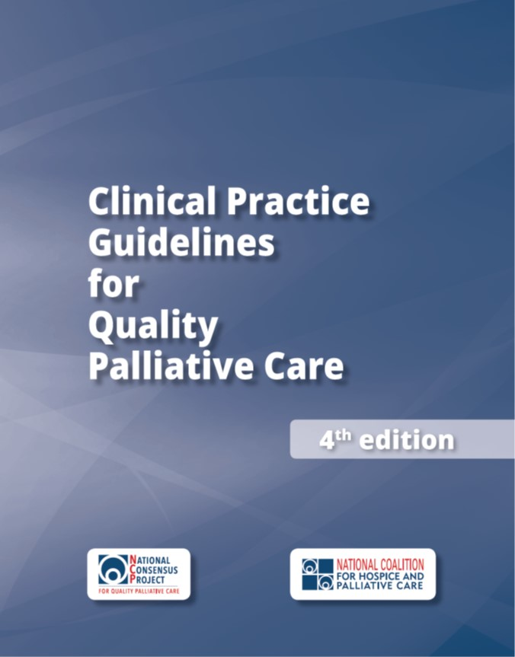
The 4th edition
For all people with serious illness, regardless of setting, diagnosis, prognosis, or age
Funded by the Gordon and Betty Moore Foundation
Published by the National Coalition for Hospice and Palliative Care
NCP leadership consisted of 16 national organizations

Slide 11















NCP Leadership Organizations
National Pediatric Hospice and Palliative Care Collaborative

Slide 12
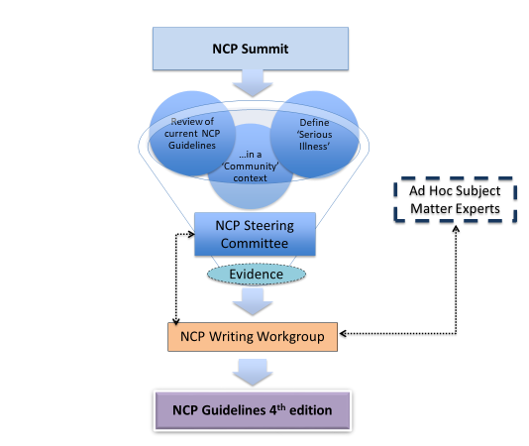
National Consensus Project Process (2017-18)
Development:
  Steering Committee and Writing Workgroup formed
  NCP Strategic Directions Stakeholder Summit held
  Writing > reviews > revisions > approvals > consensus achieved
Systematic review of research evidence:
  Completed by the RAND Evidence-based Practice Center
Endorsements:
  Received from more than 80 national organizations
Publication: October 31, 2018

Slide 13
4th edition: Domains & Content

Slide 14
Domains of Palliative Care
Domain 1: Structure and Processes of Care
Domain 2: Physical Aspects of Care
Domain 3: Psychological and Psychiatric Aspects of Care
Domain 4: Social Aspects of Care
Domain 5: Spiritual, Religious, and Existential Aspects of Care
Domain 6: Cultural Aspects of Care
Domain 7: Care of the Patient Nearing the End of Life
Domain 8: Ethical and Legal Aspects of Care

Slide 15

Key Themes: the 6 C’s
Each domain addresses:
  Comprehensive assessment
  Care coordination
  Care transitions
  Caregiver needs
  Communication
  Cultural inclusion

Slide 16

Domain 1: Structure and Processes of Care
Principles and practices can be integrated into any health care setting
Delivered by all clinicians and supported by palliative care specialists who are part of an interdisciplinary team (IDT)
Begins with a comprehensive assessment and emphasizes:
  Patient and family engagement
  Communication
  Care coordination
  Continuity of care across health care settings

Slide 17

Domain 2: Physical Aspects of Care
Begins with understanding patient goals in the context of physical, functional, emotional, and spiritual
Focuses on relieving symptoms and improving or maintaining functional status and quality of life
Emphasizes symptom management that encompasses pharmacological, non-pharmacological, interventional, behavioral, and complementary treatments
Is accomplished through collaboration between all professionals involved in the patients’ care across all care settings

Slide 18

Domain 3: Psychological and Psychiatric Aspects of Care
IDT addresses psychological and psychiatric aspects of care in the context of serious illness
IDT conducts comprehensive developmentally and culturally sensitive mental status screenings
Social worker facilitates mental health assessment and treatment in all care settings
IDT communicates to the patient and family the implications of psychological and psychiatric aspects of care

Slide 19

Domain 4: Social Aspects of Care
Addresses environmental and social factors that affect patients and their families
Social determinants of health have a strong influence on care outcomes
IDT partners with the patient and family to identify strengths and address needs
Social worker is essential to the IDT

Slide 20

Domain 5: Spiritual, Religious, and Existential Aspects of Care
Spirituality is recognized as a fundamental aspect of palliative care
Dynamic aspect through which individuals seek meaning, purpose, and transcendence, and experience relationships
Expressed through beliefs, values, traditions, and practices
IDT serves in a manner that respects
  all spiritual beliefs and practices, and
  when patients and families decline to discuss their beliefs or accept support

Slide 21
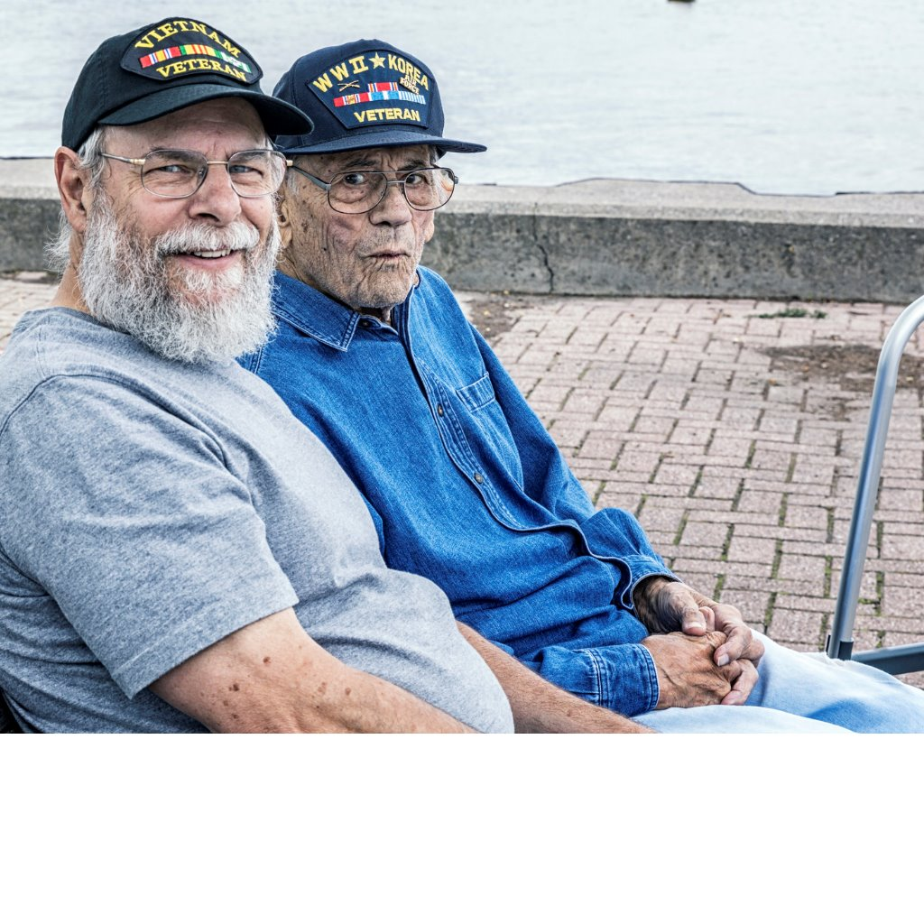
Domain 6: Cultural Aspects of Care
First step is assessing and respecting values, beliefs and traditions
Care plans incorporate culturally sensitive resources and strategies
Respectful acknowledgment and culturally sensitive support for grieving practices is provided
IDT members continually expand awareness of their own biases and perceptions

Slide 22
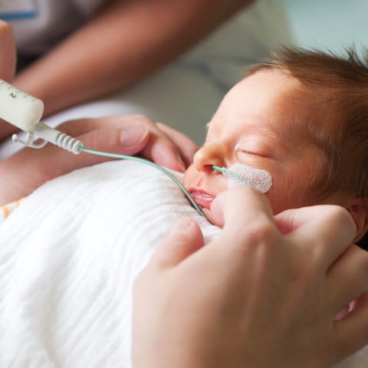
Domain 7: Care of the Patient Nearing the End of Life
Highlights care provided to patients and their families near the end of life,
Particular emphasis on the days leading up to and just after the death of the patient.
Comprehensive assessment and management of physical, social, spiritual, psychological, and cultural aspects of care are critically important near death
IDT provides developmentally appropriate education to patient, family and others

Slide 23

Domain 7: Care of the Patient Nearing the End of Life (continued)
Interdisciplinary model of hospice care is recognized as the best care for patients nearing the end of life
Early access to hospice support should be facilitated whenever possible to optimize care outcomes
Palliative care teams, hospice providers and other healthcare organizations must work together to find solutions for all patients and families in their final months of life

Slide 24
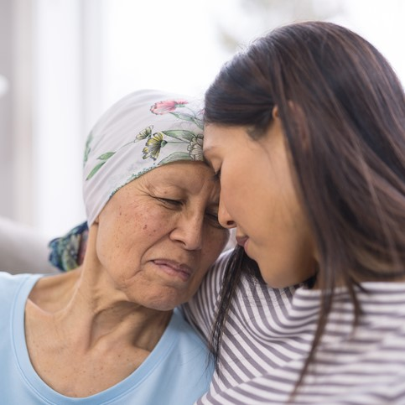
Domain 8: Ethical and Legal Aspects of Care
IDT applies ethical principles to the care of patients with serious illness, including honoring patient preferences, and decisions made by surrogates
Surrogates’ obligations are to represent the patient’s preferences or best interests
Familiarity with local and state laws is needed relating to:
  Advance care planning
  Decisions regarding life-sustaining treatments
  Evolving treatments with legal ramifications (eg, medical marijuana)

Slide 25
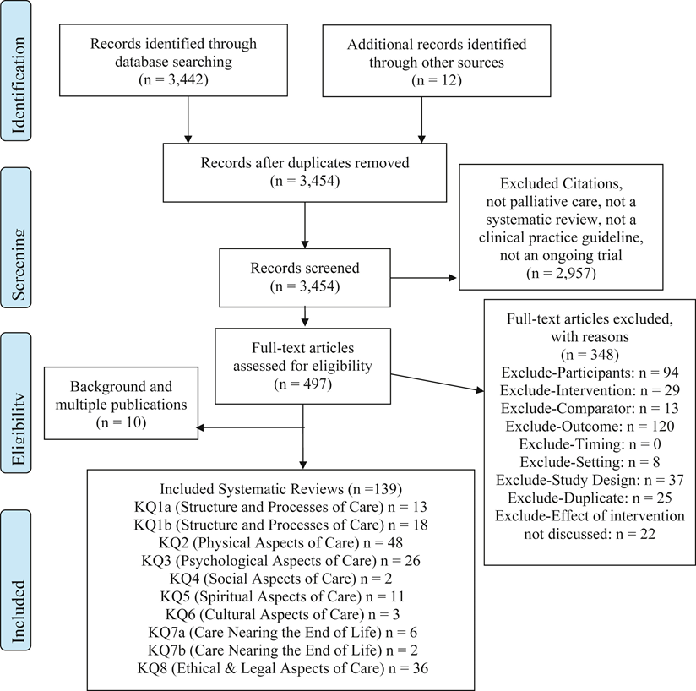
Systematic Review of Research Evidence
Conducted by Rand Evidence-based Practice Center with Technical Expert Panel (TEP)
Complete findings available, Journal of Pain and Symptom Management
  https://www.jpsmjournal.com/article/S0885-3924(18)30468-8/fulltext
Funded by:
  Gordon and Betty Moore Foundation
  Gary and Mary West Foundation
  The John A. Hartford Foundation
  Stupski Foundation

Slide 26
Key Messages
Spirituality should be an element of each domain of quality care
Spirituality is one of 8 essential domains

Slide 27
Key Messages
If you are not providing excellent spiritual care you are not providing excellent palliative care.

Slide 28
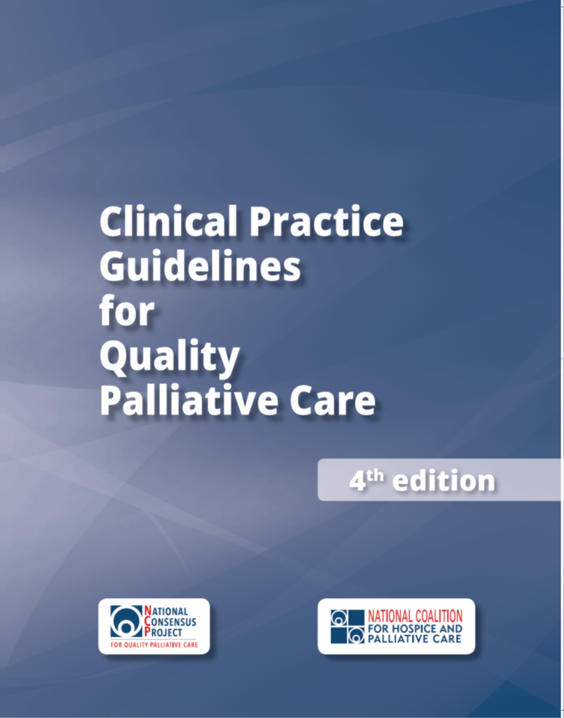
Read the Guidelines
Available at:
www.nationalcoalitionhpc.org/ncp
PDF
E-PUB
ONLINE
PURCHASE

Slide 29
Implement the Guidelines
Share the NCP Guidelines with your team and colleagues
Assess strengths, gaps and opportunities in your practice setting to apply the NCP Guidelines
Develop a plan to improve care for your patients with serious illness and their families/caregivers
Begin with easily attainable goals, and plan to grow and scale
Celebrate achievements

Slide 30

For More Information
Visit: www.nationalcoalitionhpc.org/ncp
Follow: @coalitionhpc (#NCPGuidelines)
Contact: info@nationalcoalitionhpc.org

