Slide 1
Advancing Spiritual Care through Palliative Care Globally: Opportunities and Challenges
Dr. Kathleen M. Foley
May 20,2019

Slide 2
Spirituality and the United Nations
“Unless there is spiritual renaissance, the world will know no peace.”
Dag Hammarskjold

Slide 3
Spirituality and the United Nations
“This says to us that our world is geographically one. Now, we are faced with making it spiritually one. Through our scientific genius we have made of the world a neighborhood; now through moral and spiritual genius, we must make it a brotherhood.”
Dr. Martin Luther King

Slide 4
Spirituality and the United Nations
“We pray, therefore, we are.”
“At the heart, we are dealing with universal values.”
“To be merciful, to be tolerant, to love thy neighbor, there is no mystery here. Such values are deeply ingrained in the human spirit itself. It is little wonder that the same values animate the Charter of the United Nations, and lie at the root of our search for world peace.”
Kofi Annan

Slide 5
UN NGO Committee on Spirituality, Values and Global Concerns
Evolving Vision Statement
The NGO Committee on Spirituality, Values, and Global Concerns (NY) envisions a global culture of peace based on justice, solidarity, inclusiveness, shared responsibility, harmony, cooperation, compassion, love, wisdom, goodwill and reverence for the sacredness of all life through active peaceful engagement.
Infused with a foundation of spirituality and values which are universal in nature, transcending the boundaries of religion, ethnicity, gender and geography, the Committee is resolved to help bring about a culture in which we, the peoples of the world, can address together our common global concerns in a positive, holistic and transforming way and live together in peace with one another, thus realizing the core objectives and universal principles stated in the United Nations Charter and the Universal Declaration of Human Rights.

Slide 6
2002 WHO Definition of Palliative Care
"Palliative care is an approach which improves quality of life of patients and their families facing life-threatening illness, through the prevention and relief of suffering by means of early identification and impeccable assessment and treatment of pain and other problems, physical, psychosocial and spiritual"

Slide 7
Palliative Care as a Public Health Issue
affects all people
need for better information on end-of-life care
potential to prevent suffering
potential to prevent disease

Slide 8
Palliative Care as a Prevention Model
prevents needless suffering
provides peer education
provides patient centered care
incorporates self-management programs

Slide 9
WHO resolution on access to palliative care
Talha Khan Burki
Lancet Oncology. Vol 15;2014.
On Jan 23, WHO's Executive Board introduced a resolution urging member states to integrate palliative care services into their health-care systems. They described provision of such care as an “ethical responsibility”, and added that, when needed, palliative care is “fundamental” to improve quality of life, wellbeing, comfort, and human dignity. In May, the resolution will be presented to the World Health Assembly, but ratification should be a formality.

Slide 10
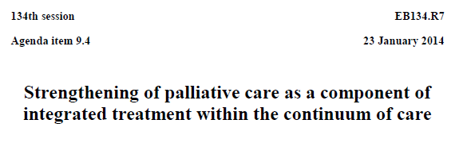
World Health Organization Resolution 2014

Slide 11
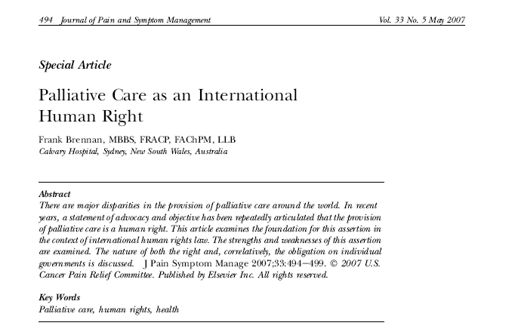

Slide 12
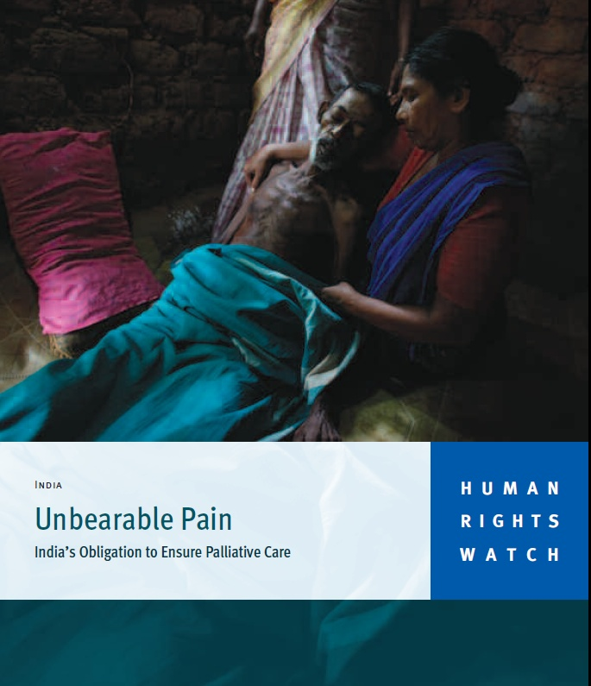
http://www.hrw.org/sites/default/files/reports/health1009webwcover.pdf

Slide 14
The need - a global perspective
57 million deaths
>1 million deaths/week
>800,000 unrelieved pain
~25 million need
palliative care
Families (at least 2 each)
Notes:
Total deaths worldwide annually 54 Million
Estimated people dying in a given year needing palliative care - 33 M
In addition many need palliative care prior to the year they die
Family members also need palliative care
Estimate of 100 million people who would benefit from basic palliative care annually

Slide 15
WHO Public Health Model
Policy
Ou t c o m e s
C o n t e x t
Drug Availability
Education
Implementation

Slide 16
The continuum of palliative care
Life Closure
Therapies to modify disease (curative, restorative intent)
Actively Dying
Diagnosis
6m
Death
Therapies to relieve suffering, improve quality of life
Bereavement Care
Notes:
Slide Note
This chart shows the integration of palliative care early in the disease process.
Examples:
Mitigate side effects of treatment.
Provide medications to treat other conditions that impact quality of lie—fatigue, dementia, neuropathy, depression.
Advance care planning.
Building a trusting relationship with patient, family, friends.

Slide 17
New Initiatives in Global Palliative Care
Religions of the World Declarations on Palliative Care for Children and the Elderly
The PAL-LIFE Project supported by Pope Francis and the Pontifical Academy of Life
New Defintion of Palliative Care by IAHPC
The Lancet Commission Report on Pain and Palliative Care
The Lancet Commission Report on Palliative Care in Oncology

Slide 18
The Maruzza Foundation and Pontifical Academy of Life Collaboration
Sponsored two workshops each resulting in a specific charter to call attention to he need to advance palliative care for children and older persons
Signed by representatives of all the leading religions in the world, palliative care specialists, human rights experts as well as patients and families

Slide 19
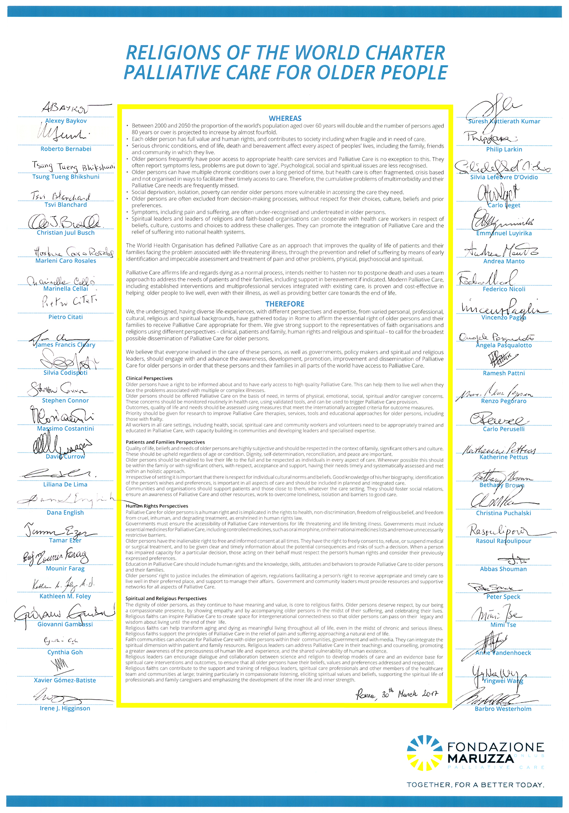

Slide 20
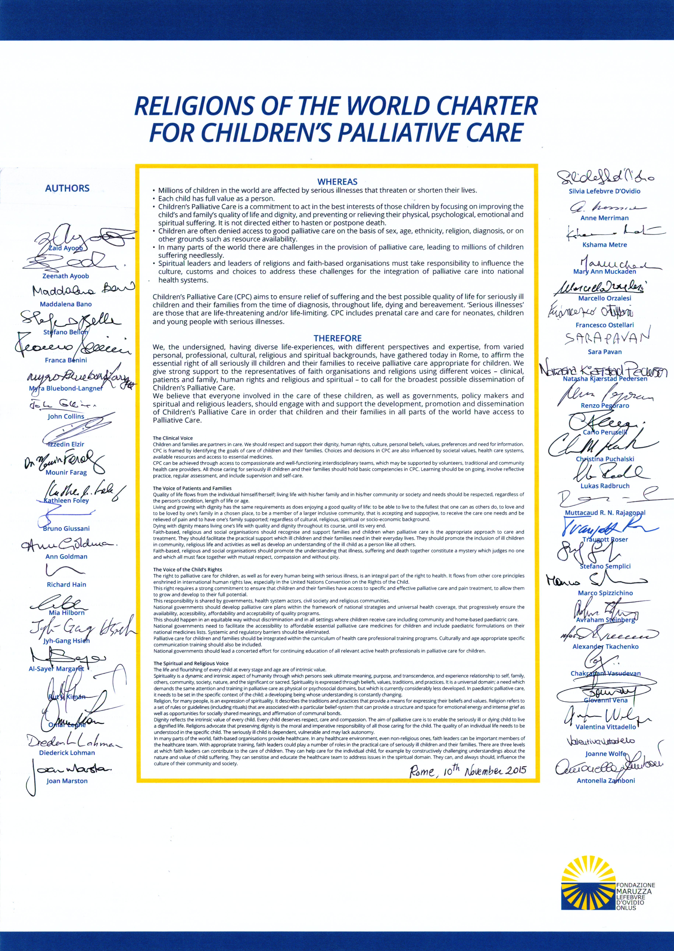

Slide 21
The PAL-LIFE PROJECT
An International Advisory Working Group on Diffusion and Development of Palliative Care in the World of the Pontifical Academy
Its aim is to stimulate the social and cultural attention of the reality of palliative care and promote cooperation to realize concrete projects

Slide 22
Pope Francis definition of palliative care
“It is the experience of the truly human attitude of taking care of one another especially those who suffer. It is a testimony that the human person is always precious even if marked by illness and old age. Indeed the person under any circumstances is an asset to him/her and to others and is loved by God.”

Slide 23
The PAL-Life Project
PAL-LIFE Strategy:
Host international meetings 2017,2018
Publish a White Paper on Global PC advocacy
Support regional events ,seminars and study commissions
https://doi.org/10.1089/jpm.2017.0237

Slide 24
PAL-LIFE Report
White Paper for Global Palliative Care Advocacy : Recommendations from a PAL-LIFE
Advisory Group of the PAL ,Vatican City.
Journal of Palliative Medicine 21,10 2019

Slide 25
13 Major Recommendations
Recommendation 11:
To Spiritual Care Professionals :
Religious institutions and spiritual care groups should work to include spiritual care –including ongoing assessment of spiritual distress and spiritual well being- integrated into guidelines of care and as a component of routine palliative care provision

Slide 26
New Palliative Care Definition
Palliative Care is the active holistic care of individuals across all ages with serious health related suffering due to severe illness and especially those near the end of life. It aims to improve quality of life of patients ,their families and their caregivers.
IAHPC https://hospicecare.com

Slide 27
New Palliative Care Definition
Palliative Care includes prevention, early identification, comprehensive assessment and management of physical issues, including pain and other distressing symptoms ,psychological a distress, spiritual distress and social needs. Whenever possible these interventions must b e evidence based.
IAHPC consensus definition https://hospicecare.com

Slide 28
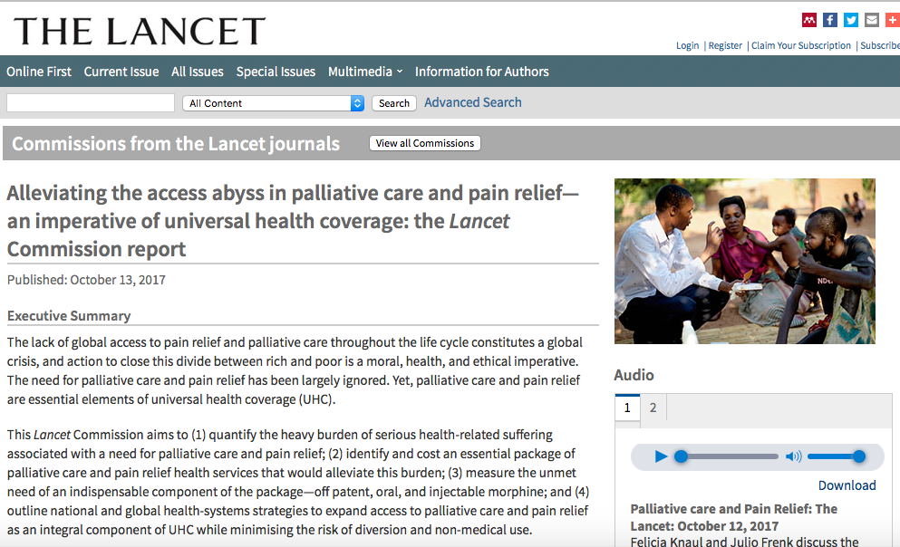
Overview of Lancet Commission and Report
Health Systems and Global Health
+
Palliative Care Specialists
“…a landmark report…”
Richard Horton, Editor-in-Chief, The Lancet.
Chair, co-chair
33 commissioners
61 co-authors from over 25 countries
Led by the
University of Miami in
collaboration with
Harvard University

Slide 29
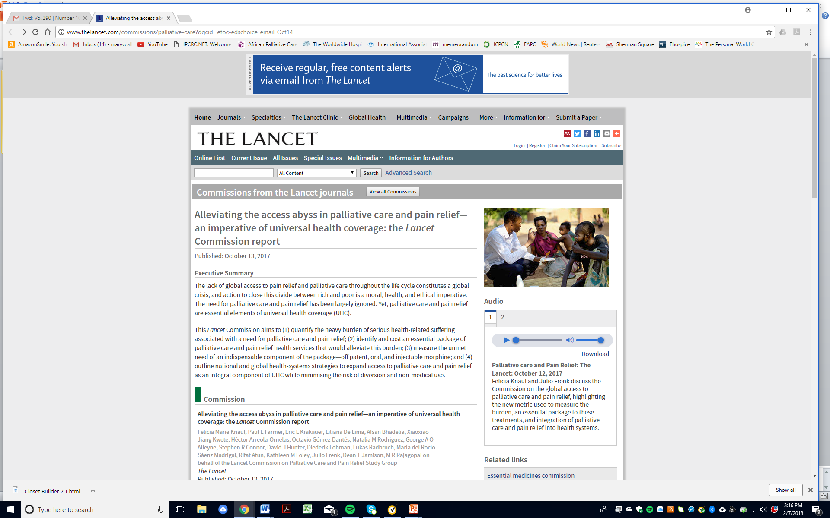

Slide 30
Lancet Commission Report on Pain and Palliative Care
Describes a new conceptual framework for costing serious health related suffering
Provides a method to estimate countries’ need for palliative care
Defines a basic minimum package of palliative care services
Calls for palliative care to be included in Universal Health Coverage
Calls for equity in access to essential medicines for pain and palliative care

Slide 31
5 Key Messages
Alleviation of the burden of serious health-related suffering from life-threatening or life-limiting conditions and at end-of-life is a global health and equity imperative.
Universal access to an affordable Essential Package of palliative care can alleviate much of the burden of SHS.
LMICs can improve the welfare of poor people at modest cost by publicly financing the Essential Package of palliative care and through full integration into Universal Health Coverage.
International and balanced collective action is essential to achieving universal coverage of palliative care and pain relief by facilitating effective access to essential medicines, while implementing measures to prevent non-medical use.
Better evidence and priority setting tools must be generated to adequately measure the global need for palliative care, implement policies and programs, and monitor progress towards alleviating the burden of pain and other SHS

Slide 32
The Lancet Call-to-Action:
“... Measures of suffering have been absent, and so the need for palliative care and pain relief services has been easy to miss. That excuse no longer holds. The scale of human suffering is massive… The Commission has uncovered an appalling oversight in global health.
It is time for that oversight to be remedied.”
Dr. Richard Horton, Editor-in-Chief of The Lancet,
in his editorial
“A milestone for palliative care and pain relief”

Slide 33
Global burden of serious health-related suffering (SHS) - 2015
Health conditions (20): people (decedent and non-decedent) who experienced SHS
Atherosclerosis
Cerebrovascular disease
Chronic ischemic heart disease
Congenital malformation
Degenerative CNS disease
Dementia
Hemorrhagic fevers
HIV disease
Inflammatory CNS disease
Injury
Leukemia
Liver disease
Low birth weight, premature birth, birth trauma
Lung disease
Malignant neoplasm
Malnutrition
Musculoskeletal disorder
Non-ischemic heart disease
Renal failure
Tuberculosis
Symptoms (15): physical (11) and psychological (4); days with SHS
Anxiety
Bleeding
Confusion, delirium
Constipation
Dementia
Depressed mood
Diarrhea
Dry mouth
Fatigue
Itching
Nausea, vomiting
Pain (mild)
Pain (moderate to severe)
Shortness of breath
Weakness
Wounds

Slide 34
Global burden of serious health-related suffering (SHS) - 2015
Health conditions (20): people who experienced SHS
Symptoms, physical (11) and psychological (4): days with SHS

Slide 35
Measuring SHS: Symptom: Pain, by health condition
HIV
MSD
Pain
Malignant neoplasm
(except leukemia)
Injury
Cerebrovascular
diseases

Slide 36
Measuring SHS: symptoms of dementia
Physical
Symptoms
MS pain
Mild pain
Dyspnea
Dementia
Fatigue
Weakness
Health condition: Dementia
Constipation
Confusion/delirium
nausea
diarrhea
Dry mouth
Itchiness
Wounds
Depression
Bleeding
Anxiety
Psychological
Symptoms

Slide 37
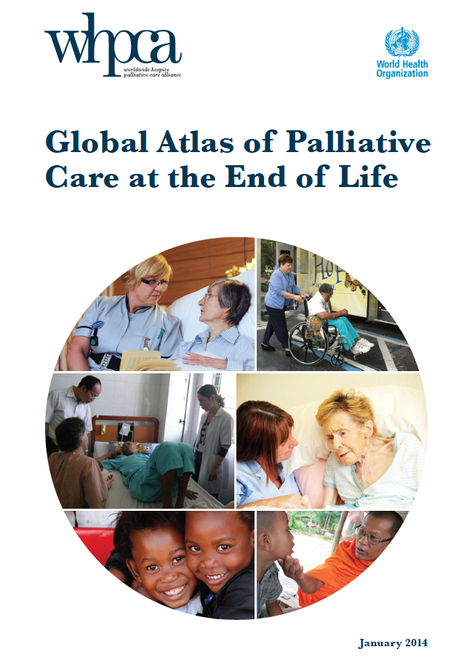
Global Need for Palliative Care
Global Atlas of Palliative Care at the End of Life
Lancet Commission Report on Palliative Care & Pain Relief

Slide 38
Global Need for Palliative Care
Global Atlas
Lancet Commission Report
20.4 million at EOL
40 million total need
1M children
18 major Dz groups
Pain as surrogate for PC
25.6 million at EOL
61.1 million total need
5.3M children
20 major Dz group
Inclusion of Injury
Suffering as surrogate
15 types
http://www.who.int/cancer/publications/palliative-care-atlas/en/
www.thelancet.com/commissions/palliative-care

Slide 39
Global burden of serious health-related suffering (SHS) in 2015
25.5 millon deaths
45% of the 56.2 millon deaths worldwide
And…
at least 35.5 million people experienced SHS (non-decedents)
5.3 million children with SHS
99% are in LMICs
61.1 million people worldwide suffered
> 6 billion days of suffering (up to 21 billion days)
80% in LMICs

Slide 40
Mexico: The burden of SHS (2015)
≃ 470,000 people per year
230,000 deaths
37% of the total
240,000 patients
150 million days
Cancer, HIV/AIDS, injuries, dementia, liver and lung diseases

Slide 41
SHS Burden in Latin America (2015)
≃ 3.3 million people
 | People with SHS (Thousands) | % of total deaths | Days of suffering (millions)
Colombia | 245 | 44 | 85
Guatemala | 71 | 36 | 20
Mexico | 453 | 37 | 150
Panama | 25 | 44 | 9
Peru | 160 | 42 | 55
Uruguay | 35 | 49 | 14
Latin America | 3,278 | 43 | 1,142
Cancer, HIV, Wounds, Dementia, Liver disease, Lung disease

Slide 42
Intervention: Essential Package
Medicine
Amitriptyline
Bisacodyl (Senna)
Dexamethasone
Diazepam
Diphenhydramine (chlorpheniramine, cyclizine, or dimenhydrinate, oral and injectable)
Fluconazole
Fluoxetine or other SSRI (sertraline and citalopram)
Furosamide
Hyoscine Butylbromide
Haloperidol
Ibuprofen (naproxen, diclofenac, or meloxicam)
Lactulose (sorbitol or polyethylene glycol)
Loperamide
Metoclopramide
Metronidazole
Morphine
Naloxone Parenteral
Omeprazole oral
Ondasetron
Paracetamol oral
Petroleum jelly
Medical Equipment
Pressure Reducing Mattress
Nasogastric drainage or feeding tube
Urinary catheters
Opioid lock box
Flashlight with rechargeable battery
Adult diapers/ Cotton and Plastic
Oxygen
Human Resources
Doctors (Specialty and General)
Nurses (Specialty and General)
Social Workers and Counsellors
Psychiatrist, psychologist or counsellor
Physical Therapist
Pharmacist
Community Health Workers
Clinical Support Staff
Non Clinical Support Staff
Aligned with Sustainable Development Goals (SDGs): Should be made universally accessible by 2030

Slide 43
Essential Package: cost per person with SHS Rwanda, Vietnam and Mexico by medicine prices (US$ current value, 2015)
 | Rwanda |  |  | Vietnam |  |  | Mexico
 | Reported Price | Intl Prices |  | Reported Price | Intl Prices |  | Reported Price | Intl Prices
 |  | Lowest | Highest |  | Lowest | Highest |  | Lowest | Highest
Medicines | 52 | 18 | 78 | 27 | 23 | 96 | 122 | 28 | 119
Morphine (oral or injectable) | 20 | 8 | 50 | 14 | 12 | 76 | 90 | 14 | 84
Equipment | 31 |  |  | 5 |  |  | 31
Palliative care team (HR) | 121 |  |  | 78 |  |  | 584
Total | 219 | 182 | 248 | 119 | 115 | 194 | 796 | 694 | 793
% public health expenditure⁴ | 8.8 | 7.3 | 9.9 | 1.0 | 1.0 | 1.7 | 1.0 | 0.8 | 1.0
For LIMCS: =~3% of the
DCP3 Essential UHC package

Slide 44
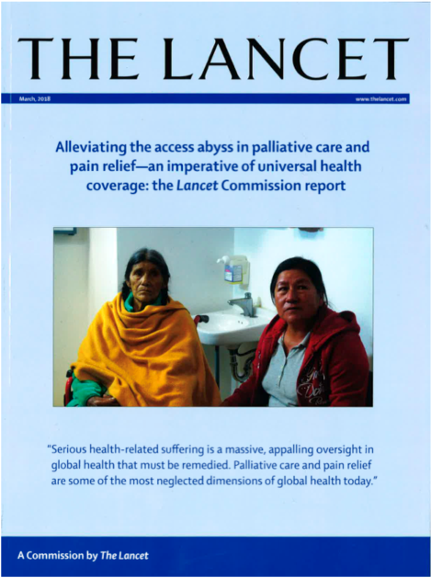
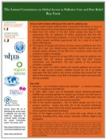
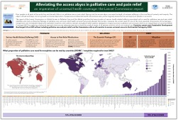
Advocacy Tool-kit and Background Resources
Lancet Commission Publication:
thelancet.com/commissions/palliative-care
Executive Summary and Full report
Commentaries
Podcast
Advocacy Toolkit:
www.miami.edu/lancet --> background resources
Data Appendix
Fact sheets
Country data sheet
Video presentation
Wall map

Slide 45
Implementation Working Group
Anchored by the International Association for Hospice and Palliative Care, in collaboration with global, regional and national regional palliative care networks and associations, and working with the University of Miami
CARIPALCA
Asociación de Cuidados Paliativos del Caribe

Slide 46
Developing a Consensus on Spiritual Dimensions in Healthcare
2004- National Consensus Project developed 8 required domains of care including spiritual, religious, and existential issues
2009 -Improving Quality Spiritual Care as a Domain of Palliative Care developed a consensus definition of spirituality ,literature based categories of spiritual care and recommendations for improving spiritual care in palliative settings

Slide 47
Developing a Consensus on Spiritual Dimensions in Healthcare
2012 - National Consensus Conference on Creating Compassionate Systems of Care developed strategies in research, education and clinical practice and recommendations for incorporation into healthcare settings
2013 -Improving the Spiritual Dimensions of Whole Person Care engaged 41 international leaders to develop an international definition, proposed standards and a strategy for developing a global consensus .

Slide 48
National Consensus Project for Quality Palliative Care 2019
Clinical Practice Guidelines for Quality Palliative Care, 4th edition
Calls for Improved Access to Spiritual Care

Slide 49
Opportunities to Advance Spiritual Care in Healthcare
Spiritual concerns are a component of the WHO definition of palliative care and included in the proposed WHO resolution
Increasing international consensus on a definition of spiritual care and specific recommendations
Growing research agenda and peer- reviewed literature and development of a chaplaincy taxonomy
Closely aligned to a human rights approach with a focus on human dignity

Slide 50
Challenges to Advance Spiritual Care in Healthcare
Palliative care is a new field of medicine with a small workforce
Prevalent concerns that spirituality is not the domain of healthcare providers
Increasing secularism that disparages spirituality discourse
Lack of robust models to assess service costs for UHC inclusion.

