Slide 1
Raising Our Voices for Quality Spiritual Care
Engaging Policy-makers:
May 20, 2019
M. Todd Tuten, Senior Advisor
Akin Gump Strauss Hauer & Feld LLP

Slide 2
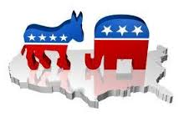
Political
Landscape

Slide 3
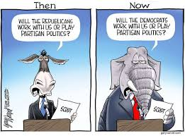
Limited Opportunities for Bipartisanship

Slide 4
Congress voted on 116 bills in the first 100 days, but only 13 became law
Number of bills by final status
“
They’ve been busy here in the first part of the Congress sending us things that have — shall I say — no potential in the Senate. And I understand that there's a new majority. They want to lay out, you know, how they feel about things.”
– Senate Majority Leader Mitch McConnell (R-KY)
“
From passing the #ForThePeopleAct to introducing to make affordable health care available to 13 million people, @HouseDemocrats have put the issues facing American families at the heart of our first #100DaysForThePeople – and there’s only more to come.”
– Speaker of the House Nancy Pelosi (D-CA-12), on twitter
Source: National Journal

Slide 5
The Senate has focused on confirming nominees and has not taken up a number of House bills for a vote
Senate confirmations of nominees in the first 100 days of each Congress
The Senate voted 51-48 on a rule change in April to speed up confirmations of sub-Cabinet level nominees and district court judges
Previous rules required at least 30 hours of debate after cloture was invoked for nominees, and the recent vote to change the rules reduces the post-cloture debate time to two hours
Only two Republican senators voted against the rules change – Sen. Susan Collins (R-ME) and Sen. Mike Lee (R-UT)
Senate Majority Leader Mitch McConnell (R-KY) has stated that his biggest priority in the Senate is to confirm as many of President Trump’s federal judicial nominees as possible
Source: National Journal

Slide 6

Effective
Advocacy

Slide 7
Your Voice Matters
Members respond to grassroots advocacy
Campaigning is constant distraction
Successful elections require money and votes
“Constituent” = “voter”
Most policy-makers actually want to be helpful
Often rely on expertise beyond their own
Many competing interests – don’t cede the playing field

Slide 8
Help Us Help You
Understand the legislative and regulatory processes
Build grassroots support
Deliver promised information and assistance
Pursue legislative and regulatory opportunities
Timing is everything – Calendar drives the agenda

Slide 9
“Who’s Who” in Congress
Party and Committee Leaders
Committee and Caucus Members
Staffers
  Personal staffers often young but play key role
  Committee staffers have expertise, strong influence
  Frequent turn-over as staffers move up/out
Congressional Support Agencies
  Congressional Budget Office (CBO)
  Government Accountability Office (GAO)
  Medicare Payment Advisory Commission (MedPAC)
  Medicaid and CHIP Payment and Access Commission (MACPAC)

Slide 10
The Target Audience
Legislators are “jacks of all trades”
  Focus on committee assignments
  Agendas driven by personal values, experience
Many competing priorities
  Busy legislative calendar
  Floor votes and committee meetings
  Deluge of appointment requests
  Non-stop campaign fundraising

Slide 11
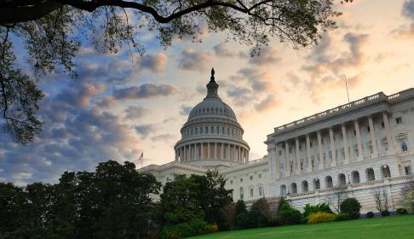
Influencing
Policy-making

Slide 12
Increasing Recognition of Spiritual Care’s Value
American Medical Association
  “RESOLVED, That our American Medical Association support inquiry into, as well as discussion and consideration of, individual patient spirituality as an important component of health …; and be it further RESOLVED, That our AMA encourage expanded patient access to spiritual care services and resources beyond trained healthcare professionals.” (AMA House of Delegates Resolution: 004, I-16, November 2016)
World Health Organization
  “Acknowledging that palliative care is an ethical responsibility of health systems, and that it is the ethical duty of health care professionals to alleviate pain and suffering, whether physical, psychosocial or spiritual ...” (WHA 67.19, Agenda item 15.5, 24 May 2014)
Centers for Medicare and Medicaid Services (CMS)
  “Spiritual advisors play an important role in helping many patients and families achieve their end-of-life goals …” (Hospice Conditions of Participation Final Rule, 73 Fed. Reg. 32088, 32112, June 5, 2008)

Slide 13
Congressional Outreach
Advocate increased awareness of the importance of spiritual care
Build relationships with key policy-makers in Congress, including Committee leaders
Educate Members of Congress and staff on the “value proposition” of spiritual care in the health care setting
Support passage of legislation pending in Congress to expand access to quality spiritual care
  Emphasize the need to include chaplains and spiritual care professionals as members of the integrated care teams serving patients, including individuals in need of palliative care and individuals with chronic illnesses and their caregivers
  Highlight the role of chaplains and spiritual care professionals in supporting advance care planning for Medicare beneficiaries

Slide 14
Legislative Advocacy
H.R. 647, the Palliative Care and Hospice Education and Training Act (PCHETA) – Introduced by Congressmen Eliot Engel (D-NY) and Tom Reed (R-NY)
  Seeks to increase awareness and access to palliative care and hospice, including access to spiritual care professionals
  Strengthens training for physicians and other disciplines on palliative care and hospice teams, including chaplains
  Increases palliative care research and provides incentives to practice and study palliative care and hospice
  Supported by more than 140 bipartisan cosponsors in Congress
S. 1135, the Protect Our Heroes Act of 2019 – Introduced by Senator Dan Sullivan (R-AK)
  Highlights the contributions of law enforcement officers, first responders and public safety officials who risk their lives every day to serve and protect local communities
  Increases penalties for assault or killing of a public safety officer
  Includes chaplains in the definition of public safety officers

Slide 15
Agency Advocacy
Medicare covers voluntary Advance Care Planning (ACP) under the Physician Fee Schedule and the Hospital Outpatient Prospective Payment System
Voluntary ACP involves discussion about the care that beneficiaries would want to receive if they became unable to speak for themselves:
  including the explanation and discussion of advance directives and completion of such forms,
  when performed by the physician or other qualified health professional, and
  face-to-face with the patient, family member(s), and/or surrogate
Medicare pays for ACP as either:
  A separate Part B service when it is medically necessary, or
  An optional element of a beneficiary’s “Annual Wellness” Visit
Voluntary ACP services may only be billed by physicians, designated non-physician practitioners (NPPs) and hospitals

Slide 16
Agency Advocacy (cont’d)
CMS Center for Medicare and Medicaid Innovation has broad authority and funding to test new payment and delivery system reform models
CMS has announced new value-based care initiatives to improve primary care
Primary Care First Payment Model Option:
Provides new, higher payments for advanced primary care practices that are willing to assume financial risk and improve care for complex, chronically ill patients
Primary Care First – High-need Populations Payment Model Option:
Encourages advanced primary care practices, including those whose clinicians typically provide hospice or palliative care services, to take responsibility for high-need, seriously ill beneficiaries who currently lack a primary care practitioner and effective care coordination
CMS will seek additional public input through a Request for Information

Slide 17

Looking
Ahead

Slide 18
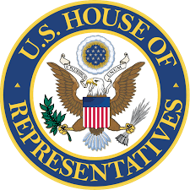
Early 2020 Election Predictions – House
Current House of Representatives:
235 Democrats
197 Republicans
“Roll Call Election 2020” Forecast:
227 Projected House Democrats
11 Toss-up Races
197 Projected House Republicans

Slide 19

Early 2020 Election Predictions – Senate
Current Senate:
47 Democrats and Democratic-leaning Independents
53 Republicans
“Roll Call Election 2020” Forecast:
46 Projected Senate Democrats
2 Toss-up races
52 Projected Senate Republicans
Source: Roll Call

Slide 20

Early 2020 Election Predictions – White House
?

