Slide 1
Caring Choices
Advance Care Planning
For Family Residents
And Across a Health System

Slide 2
Project Team
Mike Johnston, MA, MDiv, DMin
Director of Spiritual Care
AnMed Health
Valerie Johnston, PhD, FACHE
Assistant Professor
Anderson University
Amanda Davis, MD
Melody Franks, MD
Nata Young, MD
Hiliary Weill, MD

Slide 3
Session Objectives
Our Hope: Participants will be equipped to expand the role and practice of chaplaincy in advance care planning within a health system and in the broader healthcare community.
Describe a collaborative, inter-disciplinary model for training family practice residents in ACP.
Identify strategies for an integrated, system-wide approach to ACP.
Consider opportunities for community-based collaborations to expand ACP.
Develop an evaluation plan to document ACP program outcomes.

Slide 4
What is Advance Care Planning?
“Advance care planning is about planning for the ‘what ifs’ that may occur across the entire lifespan.” — Joanne Lynn, MD
Two overriding goals:
establishing a surrogate decision-maker, which is a legal activity; and
expressing your values, treatment goals and wishes, which is a communications task .
Notes:
ACP is a process for you to think about, record and discuss your wishes as you consider health care at different stages of your life. It is about your voice being heard and your choices being honored.

Slide 5
Why Advance Care Planning?
Understanding possible, future healthcare choices
Thinking about choices in light of what is important to the patient
Making decisions outside of crisis.
Talking about decisions with loved ones and physicians
Putting plans in writing
Notes:
We hope to address each of these with you today…. Understanding choices, thinking about choices, talking about choices, putting it in writing.
ACP is about giving your family the gift of conversation and making a plan so that they know what you want…so that you write the last chapter.
If you do not have a plan for care and treatment, neither your healthcare provider nor your family will know your wishes.
This could result in…
Uncertainty
Disagreement
Stress
Anxiety
Delay
Regret
…among your loved ones.
Brief stories of family agreement , disagreement.

Slide 6
Some Facts
60% of people say it is extremely important that their family is not burdened by tough decisions about care ¹
56% have not communicated their wishes
Source: ¹ California Healthcare Foundation, 2012
² Journal of Hospital Medicine, 2013
³ Kaiser Family Foundation, 2015
⁴ The Conversation Project, 2013

Slide 7
Some Facts
75% of people prefer to die at home ²
37% die in the location of their choice
Source: ¹ California Healthcare Foundation, 2012
² Journal of Hospital Medicine, 2013
³ Kaiser Family Foundation, 2015
⁴ The Conversation Project, 2013

Slide 8
Some Facts
90% of people say it is important to talk to their loved ones about end of life care ⁴
27% have actually done so.
Source: ¹ California Healthcare Foundation, 2012
² Journal of Hospital Medicine, 2013
³ Kaiser Family Foundation, 2015
⁴ The Conversation Project, 2013

Slide 9
Some Facts
89% of people say that doctors should discuss end-of-life care with patients ³
17% report having done so.
Source: ¹ California Healthcare Foundation, 2012
² Journal of Hospital Medicine, 2013
³ Kaiser Family Foundation, 2015
⁴ The Conversation Project, 2013

Slide 10
Some Facts
82% of people say it is important to put their wishes in writing ¹
23% have done so
Source: ¹ California Healthcare Foundation, 2012
² Journal of Hospital Medicine, 2013
³ Kaiser Family Foundation, 2015
⁴ The Conversation Project, 2013

Slide 11
Barriers to ACP
System
People
Resources
Continuity of Care
Cultural Barriers
Education/Resources
Priorities
“Do everything” Medical Culture
The Unknown
Faith/Religion
#’s focused
Faith/Religion
Cultural Barriers
No Advanced Care Plan
What to say??
Continuity of Care
Medical School
Patient
How to say it??
Residency
Reimbursement
CME
Family
Communication
Time
Education
Notes:
Will Animate Once Finalized
System:
Continuity of care – inpatient to outpatient
Priorities – ex) presentation is 430 on a Monday, less focus on prevention, poor reimbursement rates
“Do everything” – medical legal, etc
#’s focused – 30 day readmission rates, length of stay
Patient: The unknown – patient expectations vs Reality
Communication: The how – how to even have or start the conversation?
Time: reimbursement $86 outpatient vs $61 inpatient

Slide 12
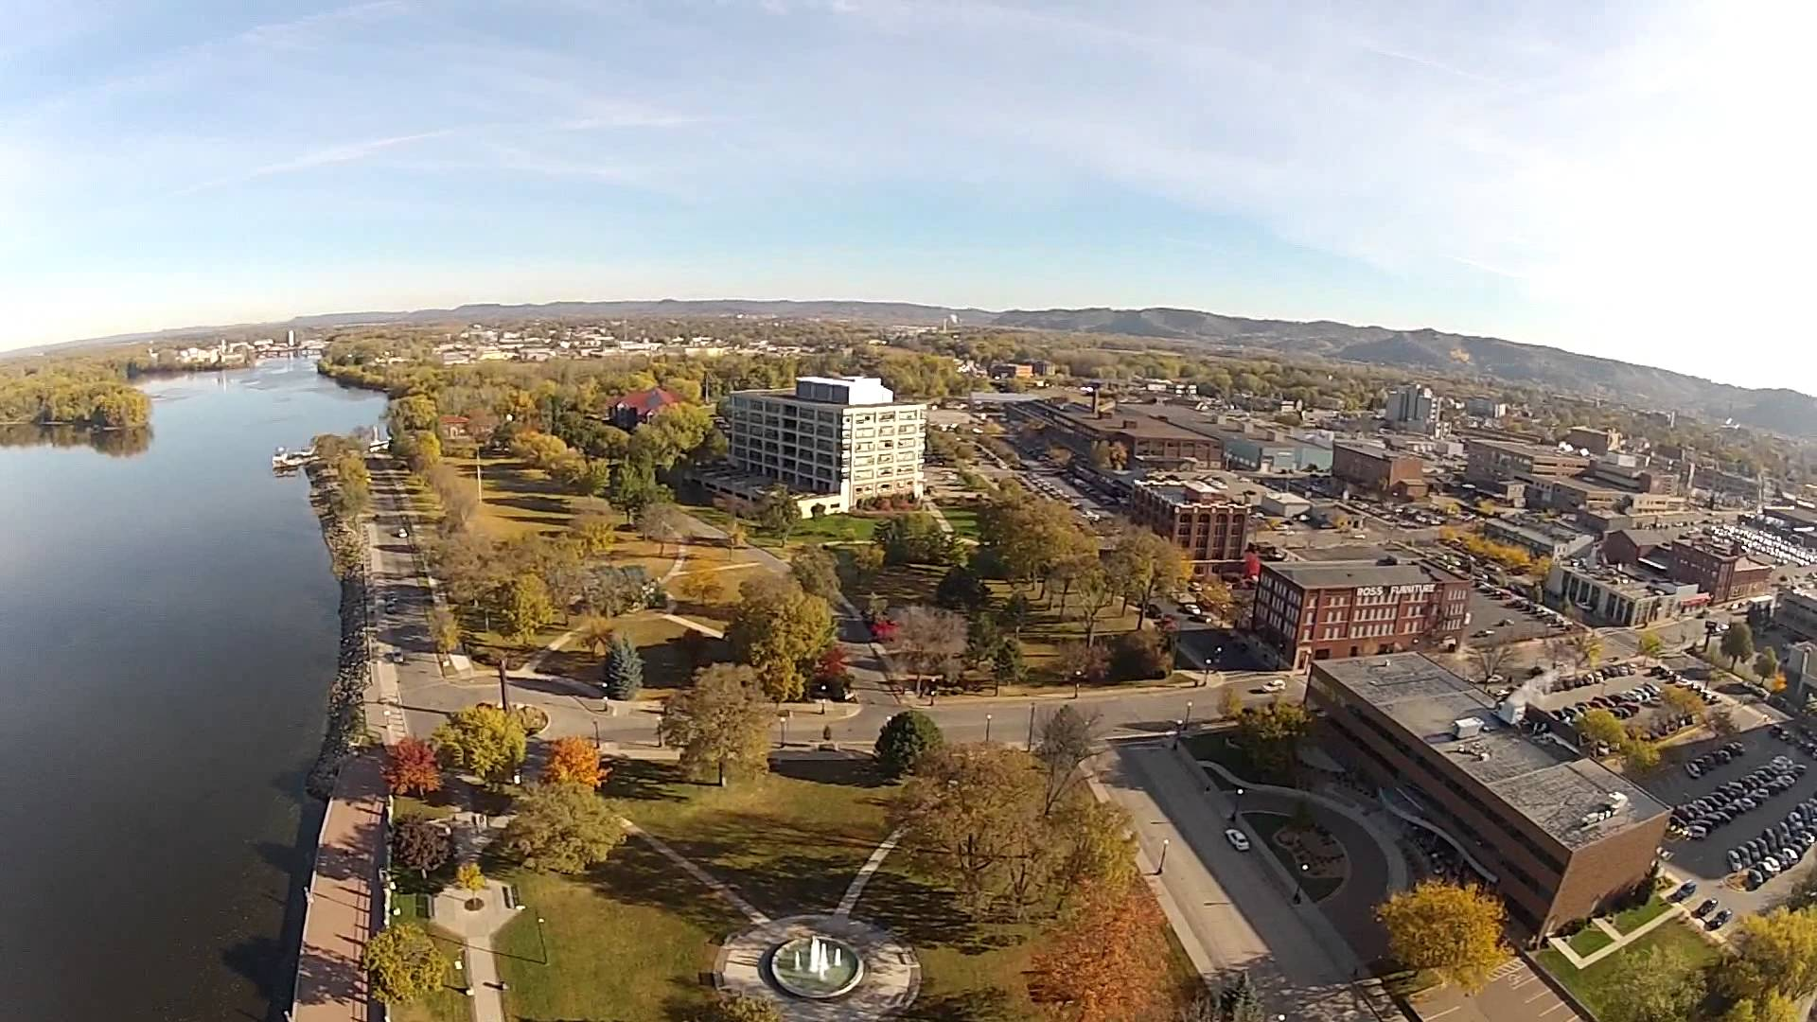
ANDERSON, SC
Plentiful hospice resources
Palliative/Supportive care in the inpatient setting
Frequent conversations in inpatient setting regarding EOL wishes
Support for expanding EOL conversations into ambulatory setting
LA CROSSE, WI
Respecting Choices initiative
Over 90% of pts had AD in place at time of death compared to national average of 20%
In last 6 months of life, patients spent on average 50% fewer days in the hospital and 83% less time in ICU as compared to national averages
Less than $60,000 Medicare dollars spent in last 2 years of life as compared to over $80,000 nationally

Slide 13
It’s a conversation
What brings joy and meaning?
Values: What Matters to the patient?
Physical, Intellectual, Emotional, Spiritual, Social
Choosing a healthcare agent
Medical care at the end-of-life
Treatment goals
Preferences
Closure
At death, After death

Slide 14
Medical Care at the End-of-Life
Treatment Goals
Aggressive
Intermediate
Palliative
Comfort
Life-sustaining Treatments
Cardiopulmonary Resuscitation
Mechanical Ventilation
Mechanical Nutrition / Hydration
Dialysis
Antibiotics
Quality
Quantity
Quantity
Quality

Slide 15
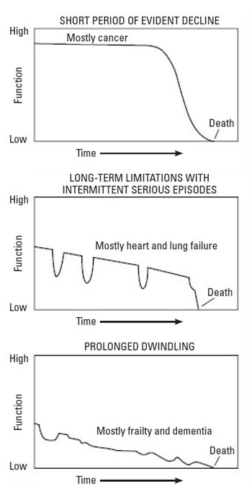
Situations to Consider
Healthy, with no chronic illness or problems
Unexpected Advanced Illness or Injury
Chronic Conditions
Terminal Illness
Dementia and Alzheimer’s Disease
Notes:
RC model – begin conversation over 18 – what do you want if unexpected happens
Important to revisit as one gets older – chronic conditions – what do they understand about their disease process, what is the matter
Terminal/Life-Threatening – What matter’s as disease trajectory becomes unmanageable
What is acceptable quality of life – whole notion of “BURDEN”

Slide 16
Family Practice Residency
Expanding within the Health System
Expanding into the Community
Incorporating Statewide Initiatives
From …
What’s the Matter?
To …
What Matters?

Slide 17
ACP in Family Practice Residency
Didactic opportunities
Advanced care planning clinic
Noon conferences
Being Mortal. Video discussion.
Extreme Measures. Book discussion.
Extremis. Netflix documentary.
2 half days per month
45 min sessions with chaplain and resident
Held in conference room at Family Practice Residency Office
Discuss goals of care, code status and assigning healthcare POA
Assist in completing paperwork
Follow-up visit with PCP within 1-2 months
Snapshots

Slide 18
Average:
Before: 2.6 After: 4.5

Slide 19
Danielle
Notes:
Why do you think Residents level of comfortable decreased after ‘training’

Slide 20
Expanding within the Health System
Family Practice Offices
Specialty Office Practices
Skilled Nursing Facilities
Home Health
Dr. Franks

Slide 21
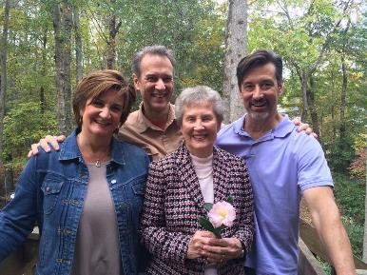
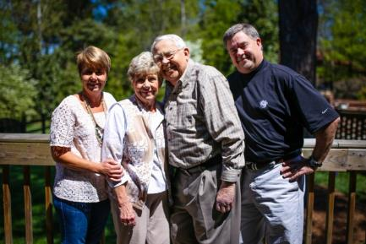
Expanding into the Community
Awareness
It’s Your Story
Faith Communities

Slide 22
Incorporating State Initiatives
POST
ACP Initiative came out of SC-CSI
RC and The Conversation Project
Serious Illness Conversations
Grant Proposal
Collaborative with multiple state entities – Alzheimers, Hospice/Palliative Care, Bar Association, etc.
Mike

Slide 23
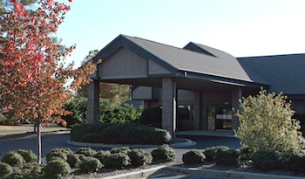
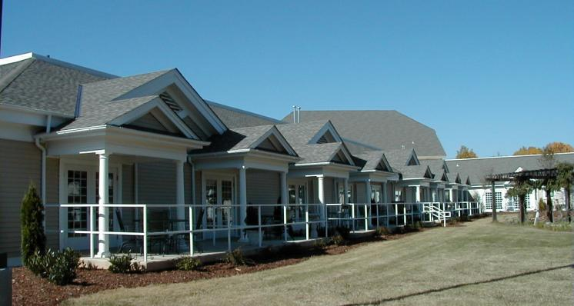
SC Statewide POST Initiative
FM Residency Program ACP Clinic and Educational Initiative
Advance Care Planning Clinics at AnMed Health Outpatient Primary Care Clinics
Inpatient Care
Educational Outreach - Skilled Nursing Facilities and Churches in Anderson County
Outpatient Hospice Care Teams

Slide 24
Key Components to an ACP Initiative
Physician champion
Shared advocacy
Senior Leadership support
Role model communication for providers
Patient family / support persons part of the conversation
Adequate time for discussions
Non-urgent setting, prior to time when end of life is near
ACP as an ongoing conversation, not a one-time form

Slide 25
Source: The Dartmouth Atlas of Health Care, 2014
Notes:
Impact of Community Based Approach – Gundersen Lutheran Health in LaCrosse, WI

Slide 26
Source: The Dartmouth Atlas of Health Care, 2014

Slide 27
Source: The Dartmouth Atlas of Health Care, 2014

Slide 28
AnMed Health: Accomplishments since June 2016
Expanded from 4 PCP offices to all 11 owned practices
Expanded to 3 Specialty practices including Oncology, Pulmonology, and Cardiology
Average 70 patient conversations in the PCP each month with 99% rate of document completion
Assumed primary responsibility for ACP in the hospital
Documents completed and scanned into EMR
Document patient wishes in the ACP notes
Completed 20 POST forms for patients

Slide 29
ACP Program Evaluation: Measuring What Matters
AD expressed and accessible
Percent of patients with an AD document
Percent where AD document can be located in medical record
Percent where wishes were followed
Similar set for ICU patients
Hospital Utilization
Hospital Days and ICU Days
Last 2 years of life
Last 6 months of life
Percent of patients with more than one hospitalization in the last 30 days of life
Percent of patients with more than one emergency department visit in the last 30 days of life
Notes:
Gundersen:
Before they began their ACP initiative, 15% had an AD document.
National average at that time less than 10%.
After the Community Initiative began in 1986
Based on 1998 data – 85% had a document
96% of those who had document was found in Pt Medical Record
Based on 2008 data – 90% had a document
99% in Pt Medical Record & wishes were followed
NQF:
Measure Description:
Percentage of patients with chart documentation of preferences for life sustaining treatments.
Numerator Statement:
Patients whose medical record includes documentation of life sustaining preferences
Denominator Statement:
Seriously ill patients enrolled in hospice OR receiving specialty palliative care in an acute hospital setting.
Measure Description:
Proportion of patients who died (from cancer) with more than one emergency department visit in the last 30 days of life
Numerator Statement:
Patients who died (from cancer) and had at least one emergency department visit in the last 30 days of life
Denominator Statement:
Patients who died (from cancer)
Measure Description:
Percentage of patients who died (from cancer) with more than one hospitalization in the last 30 days of life
Numerator Statement:
Patients who died (from cancer) and had >1 hospitalization in the last 30 days of life
Denominator Statement:
Patients who died (from) cancer.
Can stratify by primary diagnosis / advanced illnesses (e.g. cancer, cardiac, etc.)

Slide 30
References
Respecting choices ™ (http://www.gundersenhealth.org/respecting-choices/)
The Dartmouth Atlas for Healthcare. Care of chronic illness in the last two years of life. (www.darthouthatlas.org)
The Conversation Project (http://theconversationproject.org)
Advance Care Planning, Preferences for Care at the End of Life, Research in Action, Issue 12; Barbara L. Kass-Bartelemes and Ronda Hughes.
Burstin, H. & Johnson, K. (2017) Next-generation quality measurement to support improvement in advanced illness and end-of-life care. Journal of the American Society on Aging. 41(1): 86-93.

Slide 31
Thank You

