Slide 1
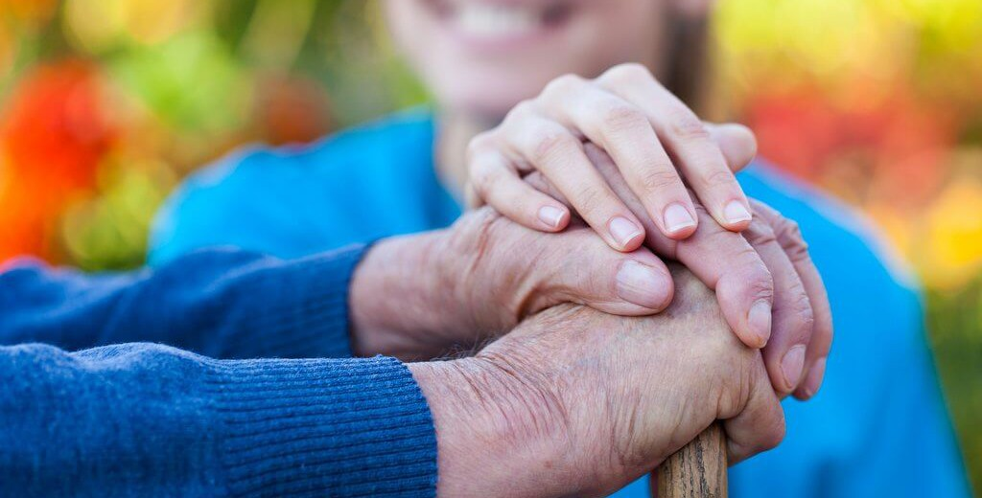

Burnout to Bliss:
Cultivating Joyfulness for
Self-Care

Slide 2
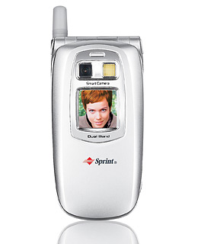

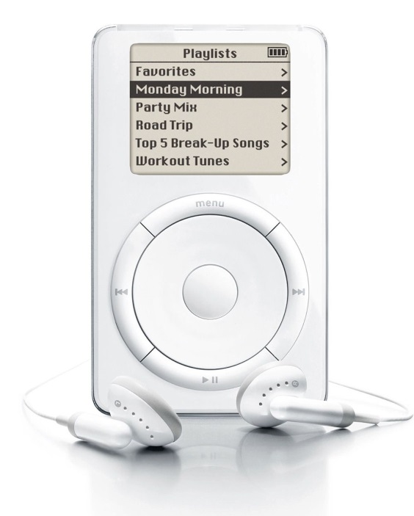






2002

Slide 3
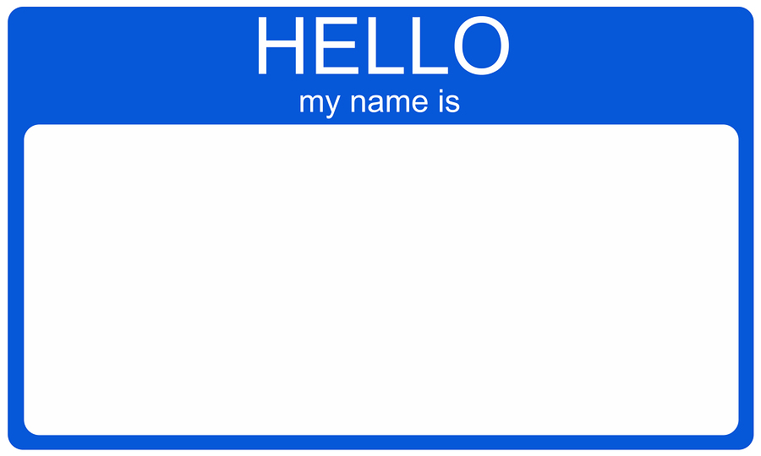
Caregiver

Slide 4
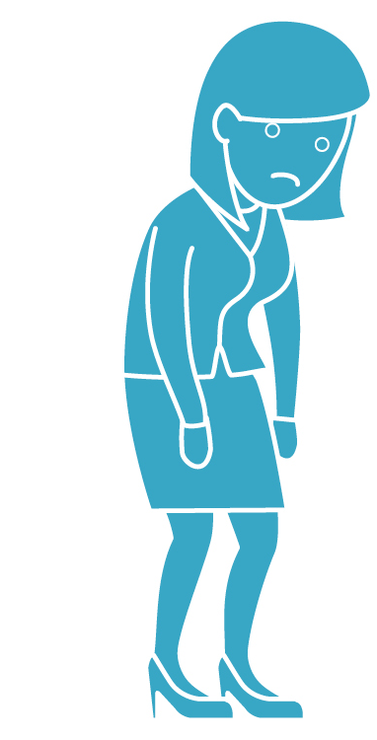

Slide 5
“Once upon a time, there was a very busy girl with a tired yet hopeful soul. Then one day her soul asked her to stop… and just breathe. And so she did and the girl and her soul lived happily ever after.”
~ Maggine Lindley

Slide 6

Synonyms
Exhaustion
Fatigue
Frazzle
Weariness
Sluggish
Antonyms
Refreshed
Rejuvenated
Revitalized
Energy
Drive
Liveliness
Vivaciousness

Slide 7


Slide 8


Slide 9
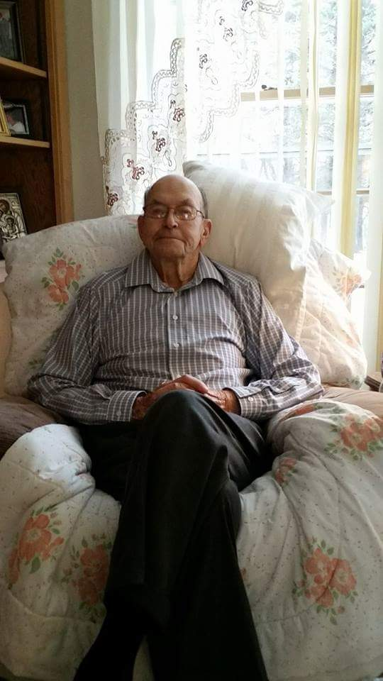
Be a Joy Refueler as we care for others

Slide 10
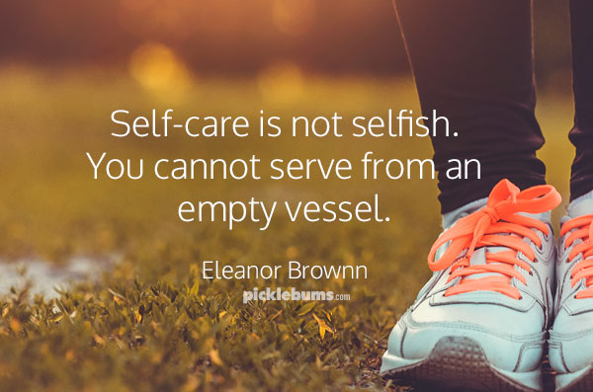

Slide 11

Joy is a choice not a circumstance.

Slide 12

Your Personal Self-Care Plan to

Slide 13

What steals our joy?

Slide 14
Cynicism
Comparison
Complaining
Classifying

Slide 15


Slide 16

How can we refuel our joy?

Slide 17
4 Joy Habits to Cultivate
+
Gratitude

Slide 18
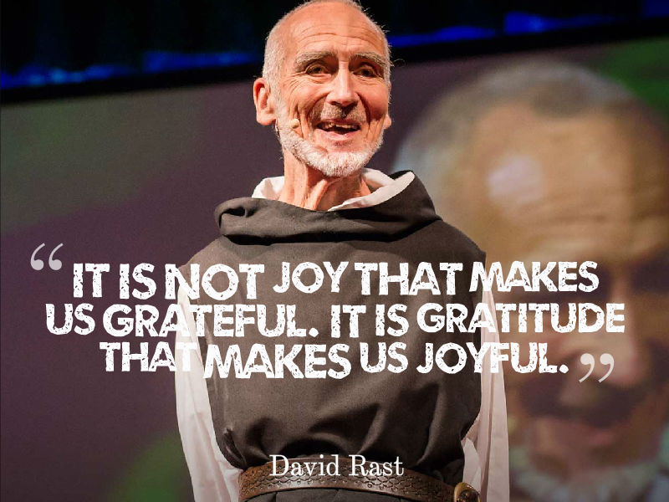

Slide 19

“Give thanks in all circumstances; for this is God's will for you.”
1 Thessalonian's 5:18, NIV

Slide 20

Put on Your Gratitude Glasses

Slide 21

3 Good Things
Notes:
3 Good things

Slide 22
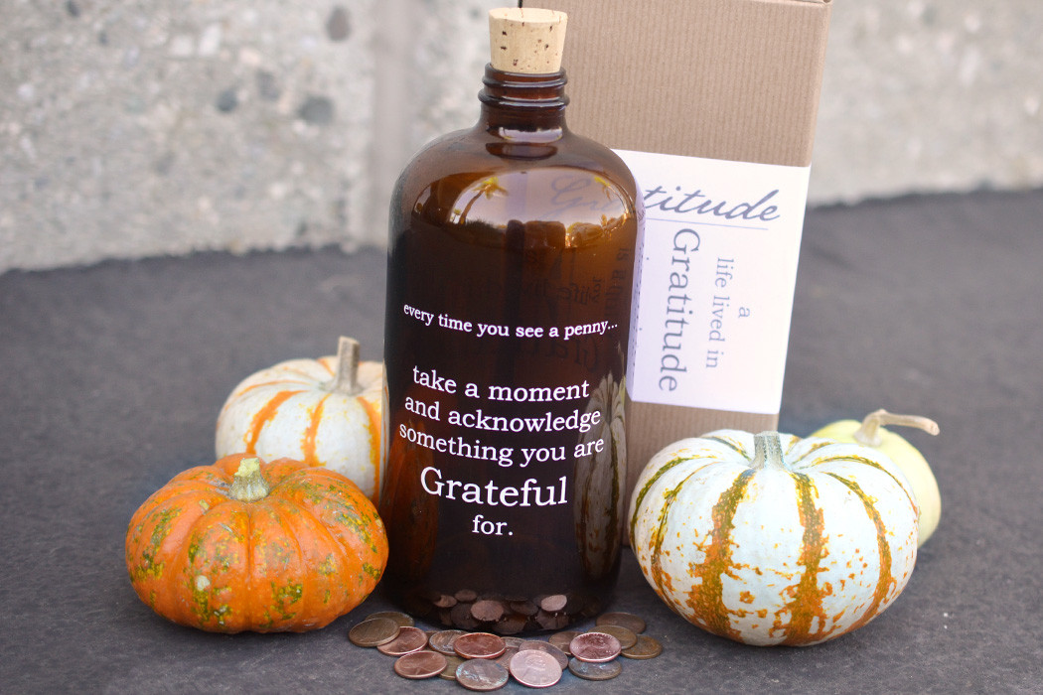
Gratitude Jar

Slide 23

Gratitude Handwashing

Slide 24

Gratitude Letters

Slide 25
4 Joy Habits to Cultivate
+
Gratitude
Grace

Slide 26
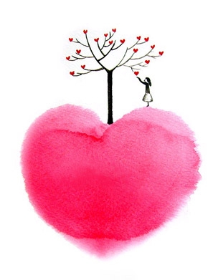
Grace is about extending compassion, kindness or forgiveness to someone who doesn’t deserve it and can never earn it. Grace is rooted in LOVE.

Slide 27
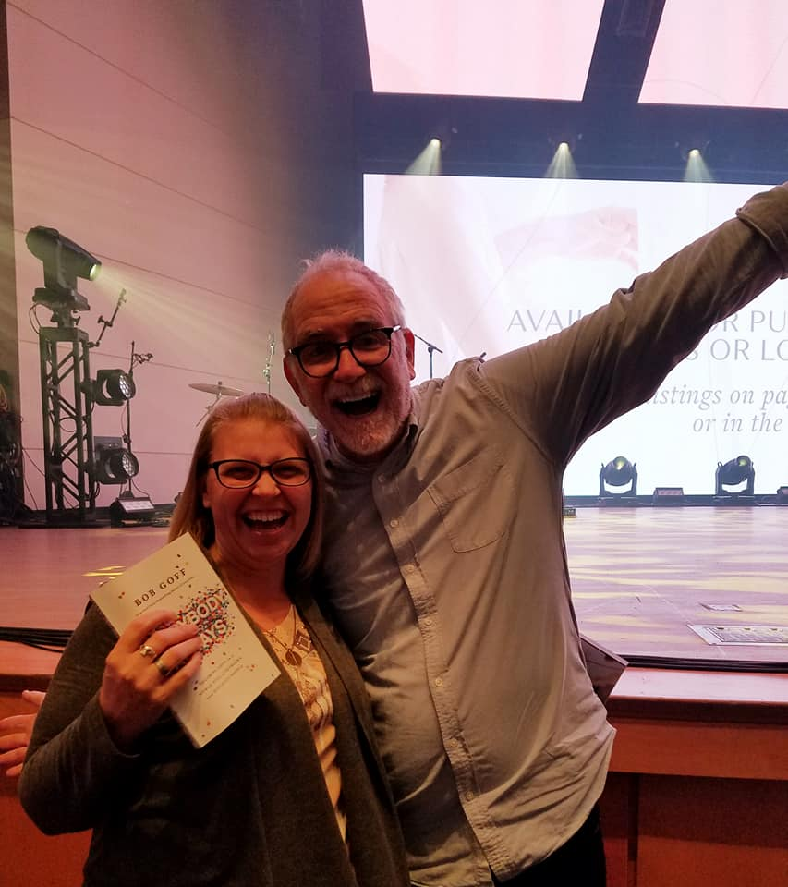
“Love doesn’t just keep thinking about it or keep planning for it. Simply put: love does.”
Notes:
Love does- Bob Goff

Slide 28
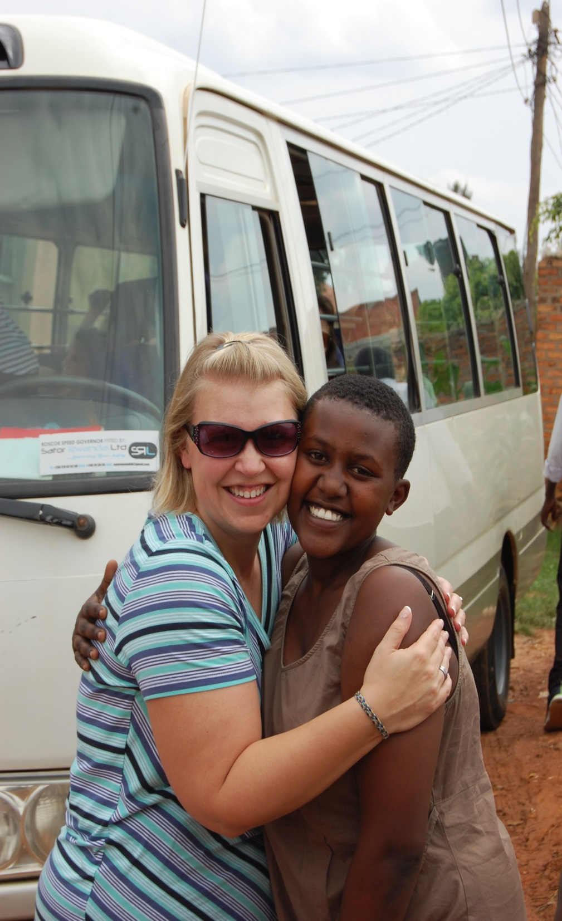

Come and see grace in action

Slide 29

How can you intentionally show love and grace to someone today?

Slide 30

4 Joy Habits to Cultivate
+
Gratitude
Grace
Gifts

Slide 31

You have super powers!

Slide 32
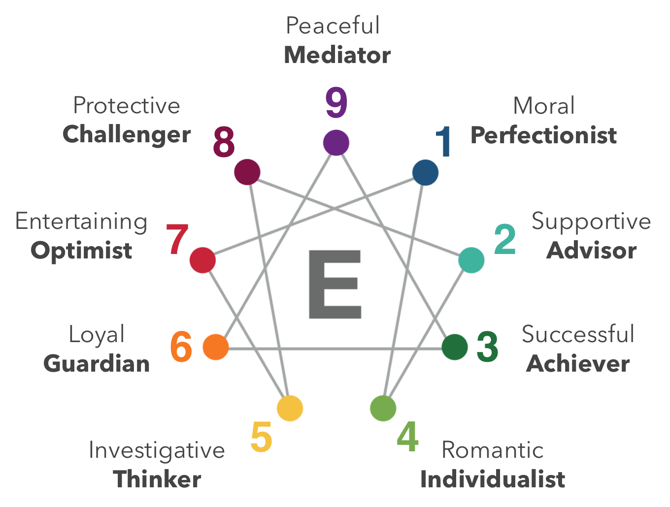

Slide 33

4 Joy Habits to Cultivate
+
Gratitude
Grace
Gifts
Giddy

Slide 34
A joyful heart is good medicine, but a crushed spirit dries up the bones.
Proverbs 17:22, ESV

Slide 35

What is on your joy list?

Slide 36

Celebrate Your Accomplishments

Slide 37

Celebrate You

Slide 38
Your Personal Self-Care Plan to

Slide 39

Joy Self-Care Experiment
For 28 days straight:
Write down 3 things that you are grateful for.
Ask yourself “How can I show love and grace to myself and others today?”
Ask yourself “How can I contribute my gifts to my job, my family, my community and to the world?”
Do one thing on your joy list this week & celebrate your accomplishments.

Slide 40


DawnSpeaks @joyrefueler JoyRefueler DawnMKaiser JoyRefueler
dawn@dawnkaiser.com
www.dawnkaiser.com

Slide 41


Slide 42
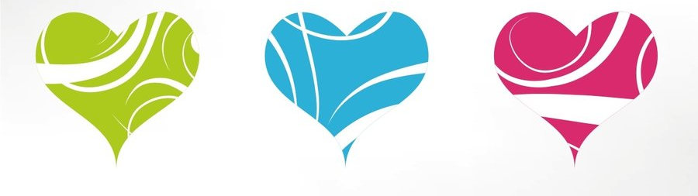
You have the opportunity to heal the mind, soul, heart and body of your patients, their families and yourselves. People you meet and serve may forget your name, but they will never forget how you made them feel.
Today be a Joy Refueler!

Slide 43


