Slide 1
“Spirituality in Mental Illness: Drawing from the Field of Psychology Towards Developing Evidence Based Interventions in Pastoral Care”
Presented by Chaplain Michael Sibley, M.Div., BCC, LPC

Slide 2
Psalm 103:14-
“For God knows how we are formed, God remembers that we are only dust.”

Slide 3
Objectives-
1.) To develop a basic awareness of the overlaps between the fields of Theology, Psychology, Psychiatry, and Neurology.
2.) To develop a basic understanding of the neurophysiological impact of trauma on the brain and the impact of trauma and emotional strain on the meaning making process.
3.) To offer an introduction into literature related to the neurophysiological impact of spiritual practices and psychological interventions on the brain.
4.) To begin to conceptualize pastoral interventions as psychological interventions that manifest not only in behavioral change, but also in biological changes within the brain itself.
5.) To encourage future research and thought related to the impacts of spiritual practices and pastoral interventions on our psychological and neurophysiological growth.

Slide 4
Case Study Example
Jack is a 28 year old man of German origin. He works as an accountant. He has come to you on the recommendation of his mother. Jack has mixed feelings about seeking professional help, as he finds it hard to communicate his feelings. Jack’s major problem seems to be depression. He has an ongoing feeling of dread and an exaggerated fear of being judged by others, resulting in him being withdrawn and depressed. He is uncomfortable interacting with others and prefers to stay at home. This has resulted in work related difficulties, and he is contemplating quitting his job. Jack has been depressed for many years and has no close friends. His relationship with his parents has deteriorated, and he experiences a growing resentment towards his father. This makes him even more depressed, and at times he feels that he cannot see a point in being around. He tends to become philosophical about life and often abuses alcohol to try to manage the distress. He plays online video games for very long periods, resulting in irregular sleep and eating patterns. Jack has no history of drug abuse and is not taking medication at this stage. He is very skeptical about drugs in general. His general practitioner considered anti depression therapy but decided to refer to you instead.

Slide 5
Theology-
In the case study, Jack has moments where he struggles with finding meaning and purpose in his life. While there is no specific mentioning of Jack’s faith background or interests in spirituality, he is clearly struggling with issues related to meaning and purpose. When engaging Jack from a spiritual perspective, one would need to assess what his spiritual resources are and work to assist him to recognize them and engage them towards his well being.

Slide 6
Psychology-
The psychologist would be concerned about Jack’s emotional symptoms. The psychologist may conduct testing to rule out any deficits. In therapy, the psychologist may engage Jack in a course of Cognitive Behavioral Therapy (CBT) to assist him in recognizing and targeting faulty core beliefs about himself leading to the challenging behavior. They may also discuss through the course of therapy the impact of these core beliefs on supportive relationships and ways to improve those relationships. They would also work to improve Jack’s capacity for positive coping.

Slide 7
Psychiatry-
The psychiatrist would be concerned about Jack’s symptoms. Jack meets the DSM 5 characteristics of depression as well demonstrating some avoidant (Cluster C) characteristics with his tendency towards isolation and his apparent social phobia. The psychiatrist would also be concerned with his substance abuse.
The psychiatrist would probably recommend medication in the form of a SSRI. SSRI’s such as Zoloft also have the label of treating social anxiety. The psychiatrist would also probably recommend working with a therapist to improve family relationships and to further treatment related to the alcohol abuse.

Slide 8
Neurology-
Neurology would be considered about Jack’s overall brain structure and its physical health. The Neurologist may be able to see signs of a physical injury to the brain in his symptomology.

Slide 9
What is the Interplay Between the Disciplines?
All growth, development, and meaning making processes engage the brain on some level. Each discipline provides a separate and unique perspective describing similar phenomenon from varying perspectives. Each of these perspectives have something to offer one another in the conceptualization of mental illness, emotional dysregulation, and the development of effective interventions.

Slide 10
Spirituality as an Inherently Psychological Process-
The mechanism that we have to process our experiences in life is the brain. It is organic and has it’s share of weakness, yet it also has enormous capabilities greater than that of any computer.

Slide 11
Hemispherical Engagement-
Right Brain vs. Left-
Right Hemisphere- Creativity, Imagination, Intuition, Insight, Left sided body control.
Left Hemisphere- Analytic though, logic, language, reasoning, Right sided body control.
Despite being held as a common belief by many, the most current research shows that “hemispherical dominance” is not true to how the brain functions. People are not truly “right brained” or “left brained.” Both hemispheres, connected by the Corpus Callosum are very similar in structure and have redundancies built in.

Slide 12
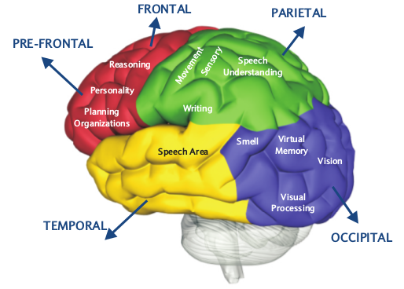
The Seat of Personality-
Research shows that the most distinctive area of the brain as applies to the personality of an individual is the frontoparietal network which serves as the high traffic communication betweent he parietal and frontal lobes of the brain.
This area of the brain is the newest from an evolutionary perspective.
Damage to these areas of the brain can caused marked personality shifts. The damage can be physical in nature, such as trauma or a stroke, or it can be biological in nature with the development of Alzheimer’s and Dementia.

Slide 13
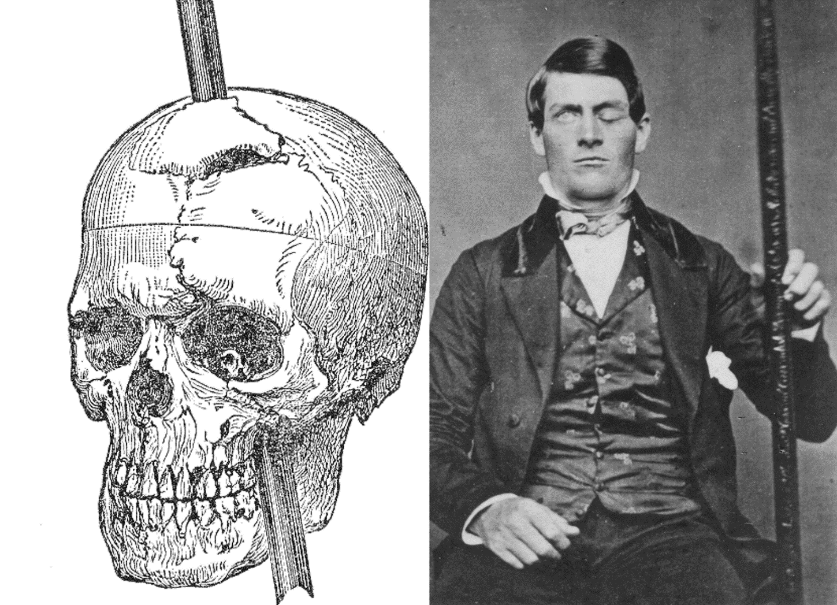
Personality Changes and Brain Injury-

Slide 14
The Vertical Brain Structure-
For today’s discussion and for psychological and pastoral interventions, the vertical brain structure is of greater importance than the hemispherical structure.
This is particularly true when looking at individuals with trauma histories or PTSD.

Slide 15
The Neurophysiological Impact of Trauma on the Brain
In the 1960’s, American physician and neuroscientist Paul Maclean formulated a model describing the evolution of the brain and the impact of this evolution on human behavior.
Maclean saw the brain as having evolved in three distinctive steps:
1.) “The Reptilian Complex”- Basal Ganglia
2.) “The Paleomammilian Complex”- The Limbic System
3.) “The Neomammilian Complex”- Neocortex
While Maclean’s work is an oversimplification, for our purposes today, it will suffice.

Slide 16
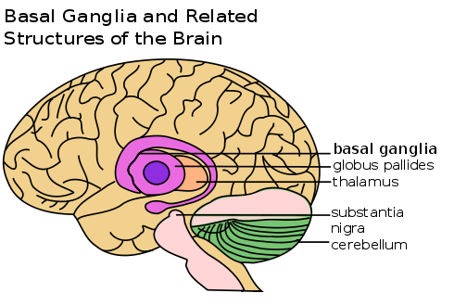
Basal Ganglia- “The Reptillian/Survival Brain”
This part of the brain is responsible for voluntary muscle movements, procedural learning, and routine behaviors.
Functions related to the Basal Ganglia are related to aspects necessary for survival.

Slide 17
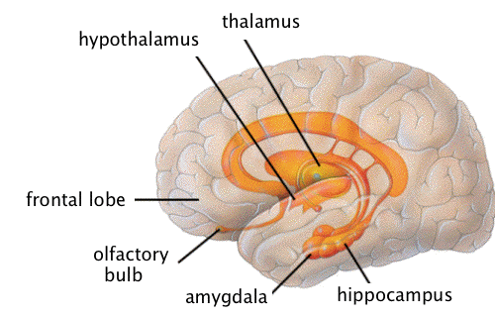
The Limbic System-”The Emotional Brain”
The Limbic system is the part of the brain involved with our emotions and our fight or flight response. The emotions are used to determine behavior based on past experience.
The Amygdala, our fight or flight “switch” is part of the Limbic System.

Slide 18
How the Limbic System Works…
When the body receives a stimulus the limbic system has a corresponding emotional reaction leading to one of the following behaviors:
Move towards a stimulus (pleasure)
Move away from a stimulus (pain)
Ignore the stimulus altogether (neutral)

Slide 19
The Neocortex- “The Thinking Brain”
The Neocortex is responsible for higher order brain function including sensory perception, cognition, generation of motor commands, special reasoning, and language.
The Neocortex is also the part of the brain involved with emotional regulation and the regulation of the Limbic system.

Slide 20
Neuroplasticity
The brain has the ability to reorganize itself by forming new neural connections through life. This allows the brain to compensate for injury. Neuroplasticity is an evolutionary function that enables us to adapt to the world around us in a variety of circumstances. Like all other evolutionary functions, it can have both positive and negative functions depending on the context. Neuroplasticity is the source of both positive change and negative activity/habits.
For the purpose of this presentation, we will focus on changes to the brain caused by environmental factors and therapeutic intervention.

Slide 21
Trauma and the Brain
When people experience trauma, in particular long periods of prolonged trauma, the limbic system becomes overactive and the neural pathways between the limbic system and the neocortex are not well developed.
This can create a dynamic where a person has an over active “fight or flight” response and difficulty self regulating their emotions.

Slide 22

“Stop It!”

Slide 23
Trauma and the Brain
Trauma is an example of external or environmental factors creating a physical change within the brain.
These changes initially are self protective in nature, but can turn maladaptive as the individual exits the set of circumstances in which they were created.
The physical change in the brain due to trauma is what makes it particularly difficult for a person to simply “stop” their behavior.

Slide 24
Three Fundamental Means of Intervention
1.) “Top Down Interventions”- “Talk Therapy” and Thought Based Activities
2.) Taking Medication to shut down inappropriate “alarm” reactions
3.) “Bottom Up Interventions”- allowing the body have experiences that deeply and viscerally contradict the negative feelings that an individual may be experiencing.
While there is a debate about which of these is the best, most literature supports a combination of two or more of these interventions.

Slide 25
Medication
A myriad of psychiatric medications exist. All of these affect change on the brain through varying mechanisms towards the alleviation of psychiatric symptoms. The most common medications used are:
Antidepressants- Examples would include: Cymbalta, Paxil, Celexa, Lexapro, Zoloft, Prozac, and Effexor.
Anxiolytics- Examples would include: Xanax, Buspar, Klonopin, Valium, Ativan, and Some SSRI’s.
Antipsychotics-Examples would include Haldol, Zyprexa, Invega, Geodon, Clozaril, and Thorazine.
Mood Stabilizers- Examples would include Abilify, Risperdal, Seroquel, Depakote, and Lamictal.

Slide 26
Medication
Medication affects different areas of the brain in different ways depending on individual and their illness. It is a requirement for some people who may have more serious and chronic mental illnesses that may include psychotic features or have other debilitating symptoms.
Some conditions, such as mood disorder or depression can often be effectively dealt with through talk therapy with similar symptom abatement being reported by both groups of participants.

Slide 27
“Top Down” Interventions
Cognitive Behavioral Therapy (CBT)
Dialectic Behavioral Therapy (DBT)
Psychodynamic Therapies
Acceptance and Commitment Therapy

Slide 28

“Top Down Interventions”

Slide 29
“Top Down” Interventions
These interventions engage the Neocortex to build neuropathways to increase one’s ability to emotionally self regulate. Often, many of the pastoral interventions that chaplains utilize engage the same principles as these therapeutic modalities. Examples include:
1.) Pastoral Reflection and active listing.
2.) Assisting an individual in wrestling with existential questions.
3.) Meaning making and the processing of grief.

Slide 30
“Top Down” Interventions
Often, the individuals that the chaplain or counselor is working with is experiencing an active limbic response to their circumstances. By engaging in “Top Down” type interventions, the chaplain is assisting the individual in looking at their circumstances in new ways and assisting in their increased ability to emotionally regulate by increasing the neural activity between the limbic regions of the brain and the neocortex.
While chaplains tend to lean towards “top down” interventions, they are not appropriate for everyone. In some cases it is better to engage (at least initially) in “bottom up” interventions.

Slide 31
“Bottom Up” Interventions
These types of interventions engage us at a level that requires little thought. They engage our parasympathetic nervous system to restore the body to a state of calm.
Mindfulness Exercises
Breathing Exercises
Sensory Engagement
Environmental Manipulation

Slide 32

Breathing Exercises…How not to do it…

Slide 33
“Bottom Up” Interventions
“Bottom Up” Interventions are useful to assist in centering a person who may be overwhelmed to the degree that other interventions cannot be administered.
They are also effective in individuals who may be intellectually compromised and unable to fully engage in “top down” type therapies.
“Bottom Up” Interventions can often be used in conjunction with “Top Down” Interventions to de-escalate a person in order to engage in other therapeutic activities.

Slide 34
Utilizing “Top Down” and “Bottom Up” Interventions together…
For individuals who may be tremendously anxious, encouraging breathing exercises or acting to manipulate the environment may serve to relax them to the degree that they are able to participate in “talk type” therapies and pastoral interventions.

Slide 35
So, What exactly is going on during
Spiritual practices?
Some research has suggested that religious experience is a cognitive process mediated by a pre-established neural circuit, involving dorsolateral, prefrontal, dorsomedial, frontal, and medial parietal cortex with experiences taking on a religious meaning when the experience is identified as being consistent with their individual religious structure. (Mohandas, 2008.)
There is, however, no “God Spot” in the brain. Spirituality is an advanced process engaging multiple parts of the brain simultaneously and changing based upon spiritual practice.

Slide 36
Frequency of Engagement
While a chaplain may only interact with a patient once, the substance of the encounter can serve to facilitate the beginning of a process within an individual facilitating an increase in neural pathways.

Slide 37
Your Brain on Prayer…
In the Judeo Christian tradition, the scans of an individual look much like the scans of someone having a conversation with another person.
In Buddhist meditation, the part of the brain involved with visualization is engaged.
For those identifying as Atheist, the researchers did not see the same frontal lobe activity observed in religious people. This suggests that meaning plays a role in the processing of religious activity.

Slide 38

Meditation

Slide 39
Your Brain on Meditation…
Imaging reveals that the process of meditation activates the prefrontal cortex bilaterally, but more so on the right as well as activating the cingulate gyrus.
Guided meditation however, shows a decrease in frontal activity when compared to internally generated meditation.
That being said, the prefrontal and cingulate activation can be identified as being related to the volitional nature in internally generated meditation. Medial prefrontal cortex along with posterior cingulate activation is involved with self reflective thought and having insight into one’s own experiences and perception of self in light of a divine being.

Slide 40
Your Brain on Meditation…
People often describe a sense of timelessness, spacelessness, and self transcendence related to meditative practices.
The source of these sensations is the slow down in activity in the Parietal lobe. The Parietal lobe is associated with our sense of differentiation between ourselves and others or other objects.
Curiously, damage to the Parietal lobes can cause distortions about one’s body even leading a person to disassociate from parts of their body.

Slide 41
Faith Development and the Brain…
“I got beyond my ego self, I got beyond the subjective and objective nature of the world; and then got to see the universe, and experience the universe in a very, very different kind of way.”(Quote from one of Newberg’s research participants.)
Which stage of Fowler’s stages of faith does this sound like?

Slide 42
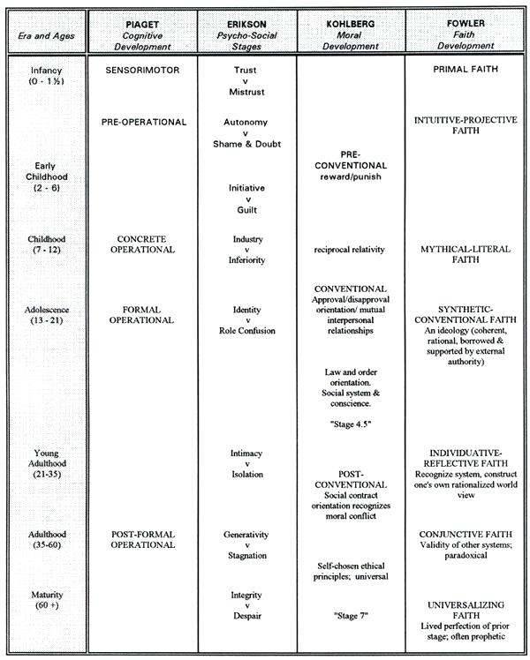
Psycho-Social Stages and Faith Development

Slide 43
Fowler’s Stages of Faith and the Brain…
In order to continue through the stages of faith as presented by Fowler, it is necessary to be able to move past concrete thought to the more advanced thought process of abstract thought.
Said another way, one of the necessities of growing spiritually is to increase neural pathways within multiple areas of the brain. In essence, spiritual growth facilitates biological change within the brain.

Slide 44
Are we “doing” religion wrong?
The current paradigm for religion in the Western world lends itself to continuing an individual in concrete thought. A focus on the literal content of something alone does not allow for a two way dialogue.
This two way dialogue is absolutely necessary to develop a faith and sense of spirituality that is personal and integrated.
It is through the two way dialogue that integration happens. The Neurophysiological equivalent of integration is an increase in neural pathways.

Slide 45
So, I have this new information…Now what?
At their core, spiritual interventions are processed through our psychological processes. By understanding the interplay between psychology, neurology, and theology, it becomes possible to engage the evidence based practices from other disciplines to formulate effective pastoral interventions allowing for effective pastoral interventions even with a lack of directly pastoral evidence based practice.

Slide 46
Challenges for the Future…
The challenges for the future will be to develop an evidence base that supports not only pastoral care and counseling, but also is congruent with the evidence base of the other related and overlapping disciplines.
All of this evidence supports the notion that science is not at odds with religion and spirituality, but rather that they can support one another in moving individuals towards healing and wholeness.

Slide 47
Resources
A., Van der Kolk Bessel. The Body Keeps the Score: Brain, Mind, and Body in the Healing of Trauma. Penguin Books, 2015.
Dahlitz, Matthew, and Geoff Hall. The Psychotherapist's Essential Guide to the Brain. Dahlitz Media, 2017.
DeMyer, William. Neuroanatomy. Williams & Wilkins, 1998.
Dingfelder, S. “In Brief: CBT May Stabilize Over-Activity in Higher-Order Brain Areas.” PsycEXTRA Dataset, doi:10.1037/e362742004-006.
Fowler, James W. Stages of Faith the Psychology of Human Development and the Quest for Meaning. Harper, 1995.
Mohandas, E. “Neurobiology of Spirituality.” Mens Sana Monographs, vol. 6, no. 1, 2008, p. 63., doi:10.4103/0973-1229.33001.
Newberg, Andrew B. Neurotheology: How Science Can Enlighten Us about Spirituality. Columbia University Press, 2018.
Newberg, A.b, and J Iversen. “The Neural Basis of the Complex Mental Task of Meditation: Neurotransmitter and Neurochemical Considerations.” Medical Hypotheses, vol. 61, no. 2, 2003, pp. 282–291., doi:10.1016/s0306-9877(03)00175-0.
“Integrating Two Theoretical Approaches.” The Neuropsychotherapist - The Neuroscience of Psychotherapy, 11 Mar. 2017, www.neuropsychotherapist.com/integrating-two-theoretical-approaches/.
“The Neuroscience of Talking Therapies.” The Neuropsychotherapist - The Neuroscience of Psychotherapy, 11 Mar. 2017, www.neuropsychotherapist.com/the-neuroscience-of-talking-therapies/.

Slide 48
Resources
Beck, Judith S. Cognitive Therapy: Basics and Beyond. Guilford Press, 2011.
Bingaman, Kirk A. Power of Neuroplasticity for Pastoral and Spiritual Care. Lexington Books, 2016.
Blumberg, Lynne. “What Happens to the Brain During Spiritual Experiences?” The Atlantic, Atlantic Media Company, 5 June 2014, www.theatlantic.com/health/archive/2014/06/what-happens-to-brains-during-spiritual-experiences/361882/.
Kapogiannis, Dimitrios, et al. Proceedings of the National Academy of Sciences of the United States of America, National Academy of Sciences, 24 Mar. 2009, www.ncbi.nlm.nih.gov/pmc/articles/PMC2660736/.
Salzman, C. Daniel, and Stefano Fusi. “Emotion, Cognition, and Mental State Representation in Amygdala and Prefrontal Cortex.” Annual Review of Neuroscience, vol. 33, no. 1, 2010, pp. 173–202., doi:10.1146/annurev.neuro.051508.135256.
“Harnessing Neuroplasticity: 9 Key Brain Regions Upgraded Through Meditation.” EOC Institute, eocinstitute.org/meditation/10-key-brain-regions-upgraded-with-meditation-2/.
www.bing.com/cr?IG=DB73D3D18A4D44C2A4AFC94968356CE9&CID=0196D6418BD7635515E5DDAA8A7862A3&rd=1&h=onJhF8VmV7M5Wkefl__XVBZuQ4SIaU9vhc7brag3Jl4&v=1&r=http%3a%2f%2fwww.thoughtsfromatherapist.com%2f2017%2f06%2f01%2fbottom-interventions-support-regulation%2f&p=DevEx.LB.1,5532.1.
“The AI-Therapy Blog.” AI-Therapy | Causes of Social Anxiety, www.ai-therapy.com/blog/cbt-chan
ges-your-brain/.

Slide 49
Questions, Comments, Discussion…

