Slide 1
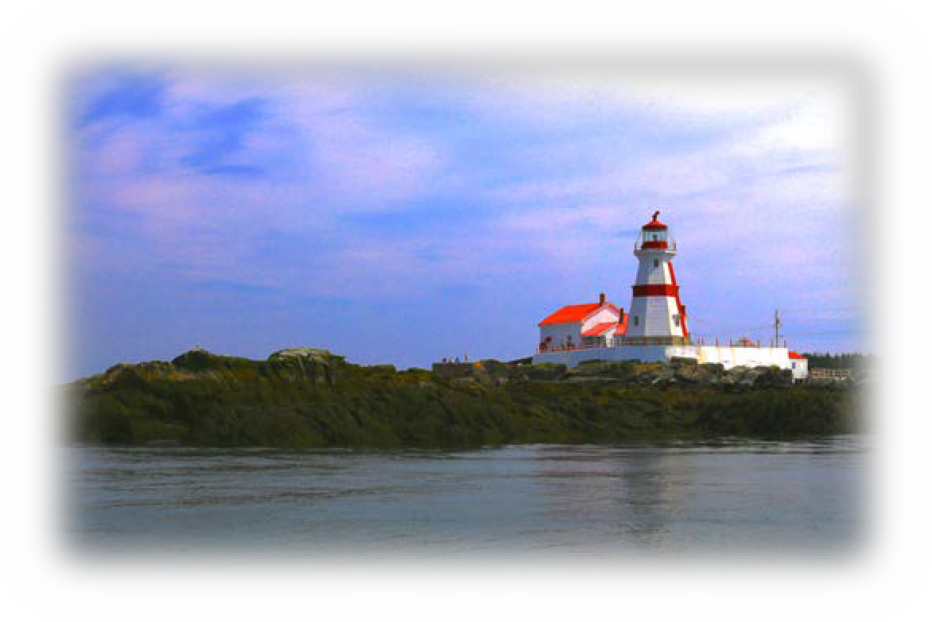
Workplace Chaplaincy:
Seafarer Missions
Chaplains to the Invisible Industry of Shipping
By
Rev. David Reid MA AFNI
Chaplain serving with the Seamen’s Church Institute of South Jersey and Philadelphia.

Slide 2
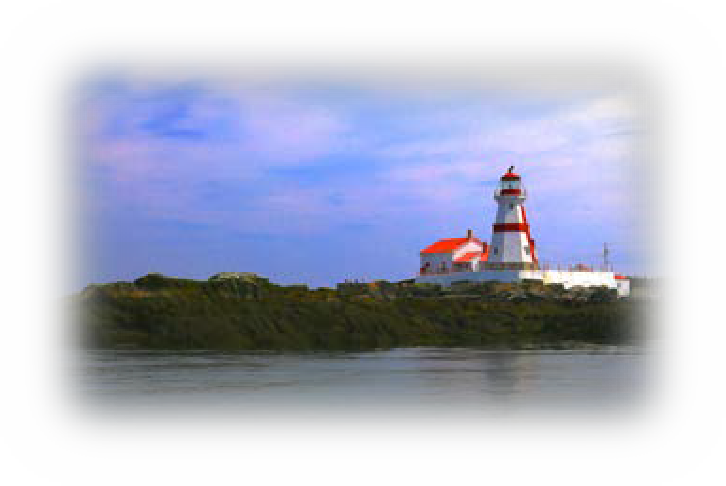
Today’s workshop –
Questions that we will cover:
What is the global Shipping Industry?
Who are the seafarers that keep shipping on the move?
What are seafarer missions and how did they evolve?
How is port chaplaincy relevant in the 21st century.
2

Slide 3
Who am I?
Joined my first merchant ship fifty years ago on November 15, 1968.
Served on both British and Canadian ships to the rank of Chief Officer (second in command).
Spent the past 40+ years as a senior executive, running shipping companies, port operations and strategic supply chains.
5 years ago, I made the decision to chart a fresh course and attended seminary – that in turn led me to an MA In Interfaith Action at Claremont Lincoln University.
Today, I donate my time to serve veterans in hospice and the seafarer mission based at the Navy Yard in Philadelphia.
3

Slide 4
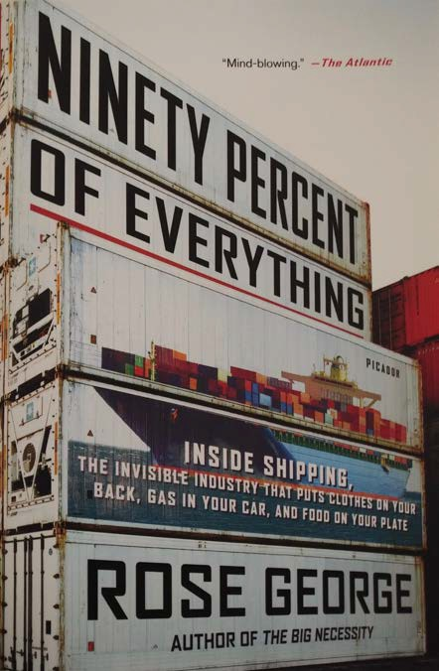
What is the Global Shipping Industry?
British author Rose George described it in her book ”Ninety Percent Of Everything” this way:
“The invisible Industry that puts Clothes on your back, Gas in your car, and Food on your Plate.”
There are over 50 thousand merchant ships involved in International trade.
4

Slide 5
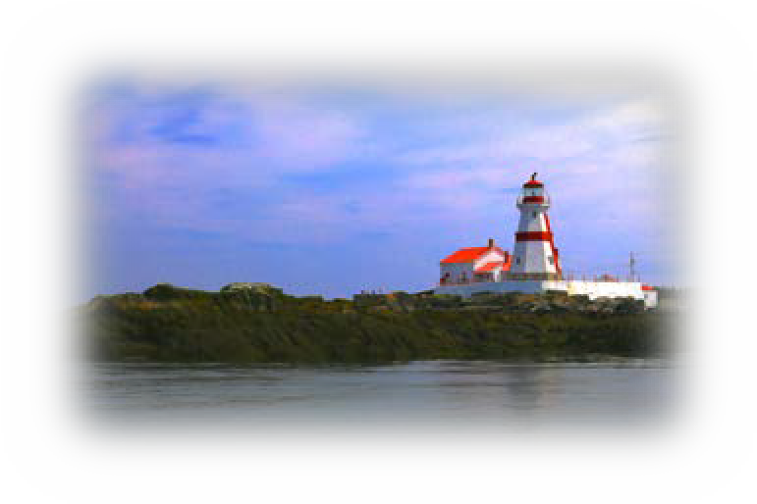
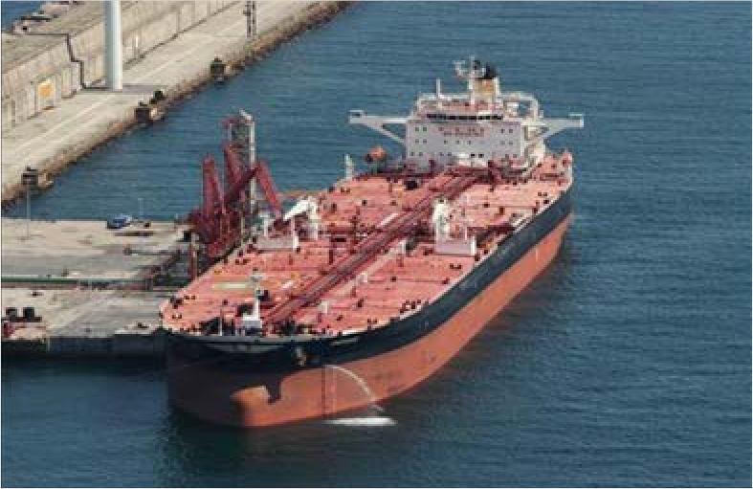
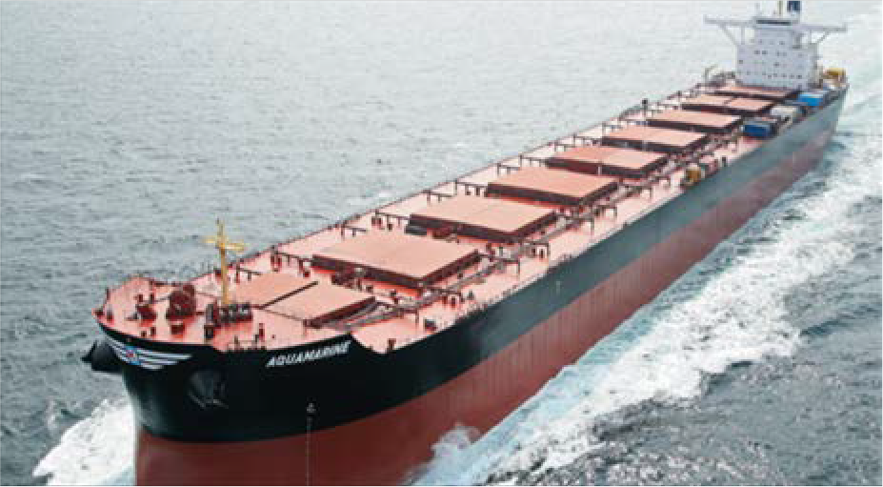
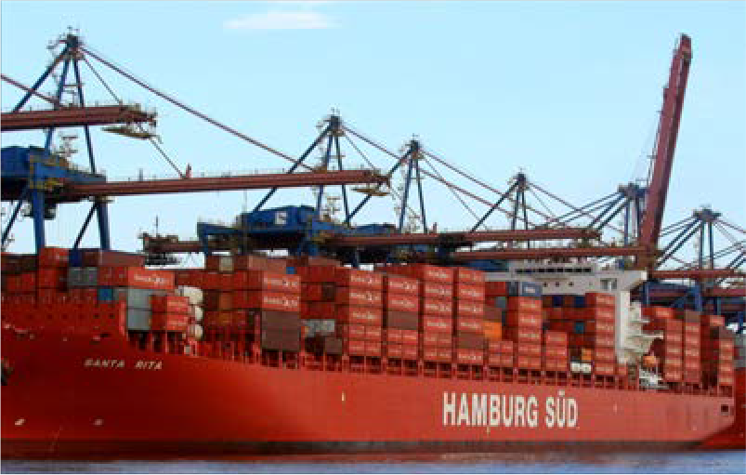
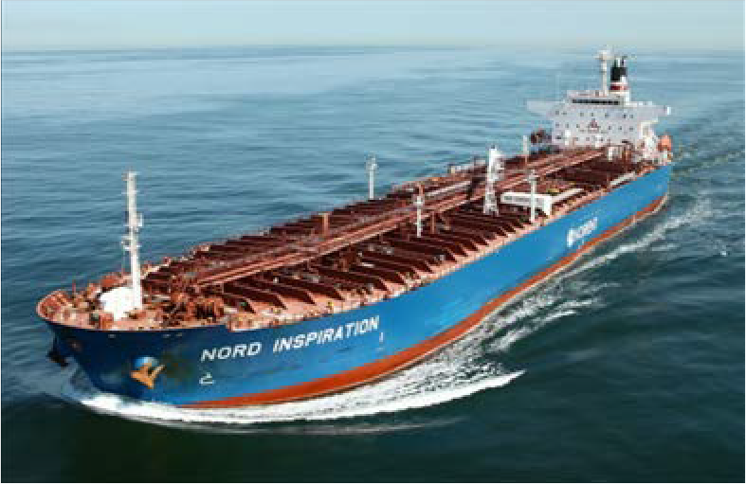
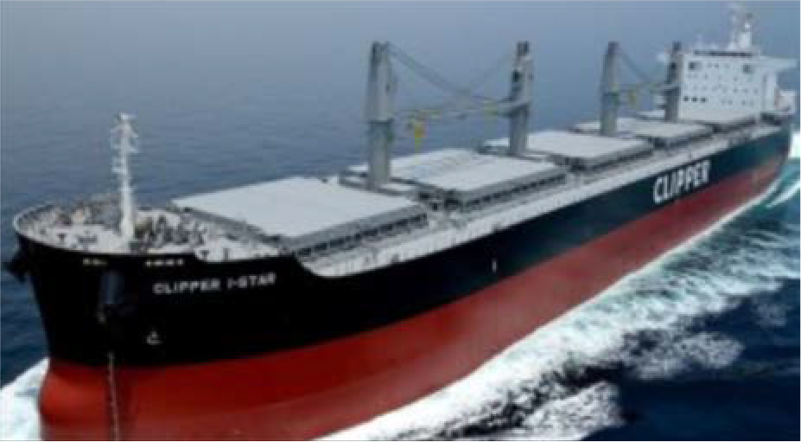
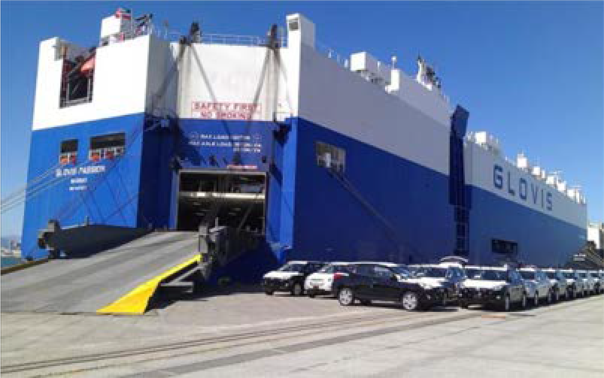
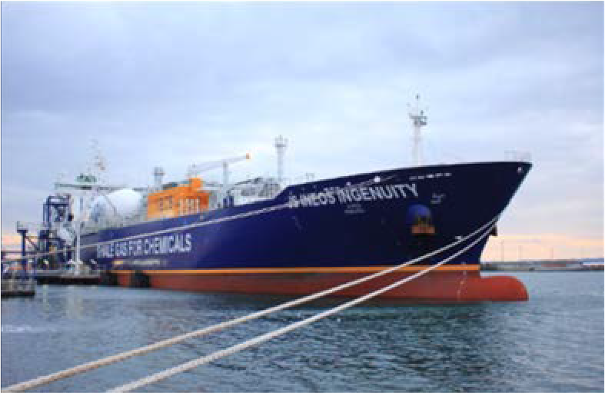
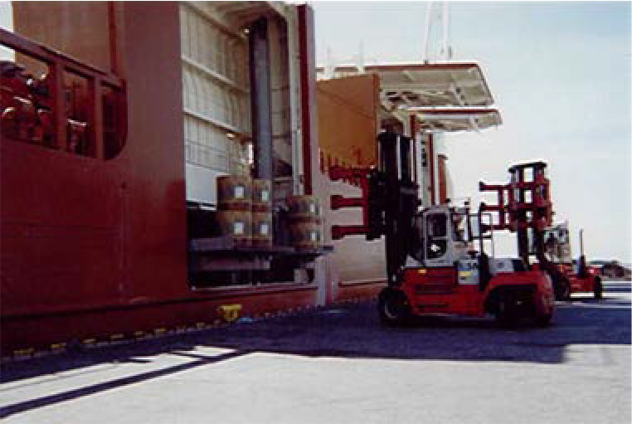
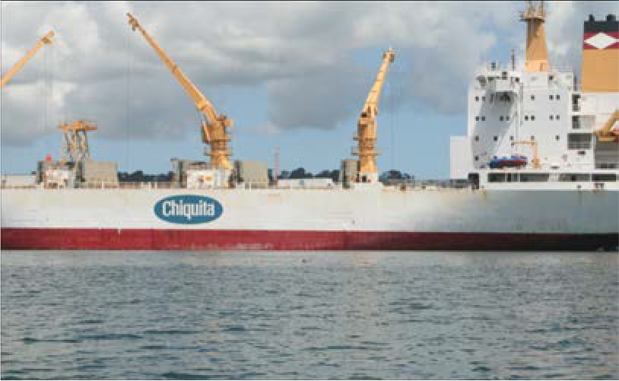
Types of Ship – the basics
u Tankers
u Bulk Carriers
u Container/Auto/Reefer
Crude Oil
Panamax
Container
Product
Supra/Handymax
Auto/PCC
LNG/LPG
Sideloader
Reefer
5

Slide 6
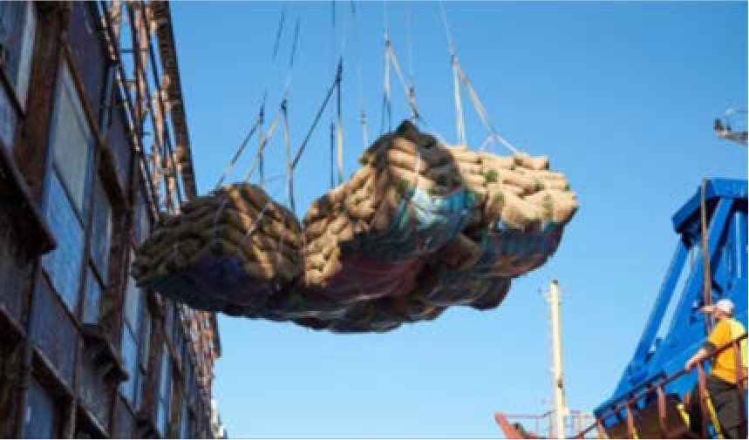
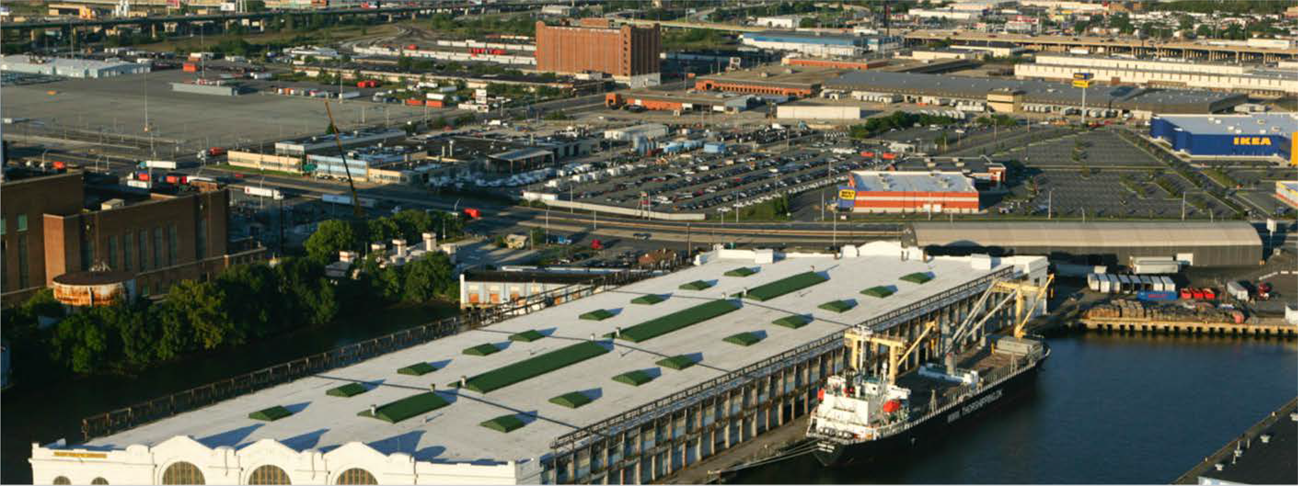
What happens in Port? (Chocolate)
Cocoa Beans in burlap sacks arrive from West Africa to the port of Philadelphia destined to supply the Hershey chocolate factory.
6

Slide 7
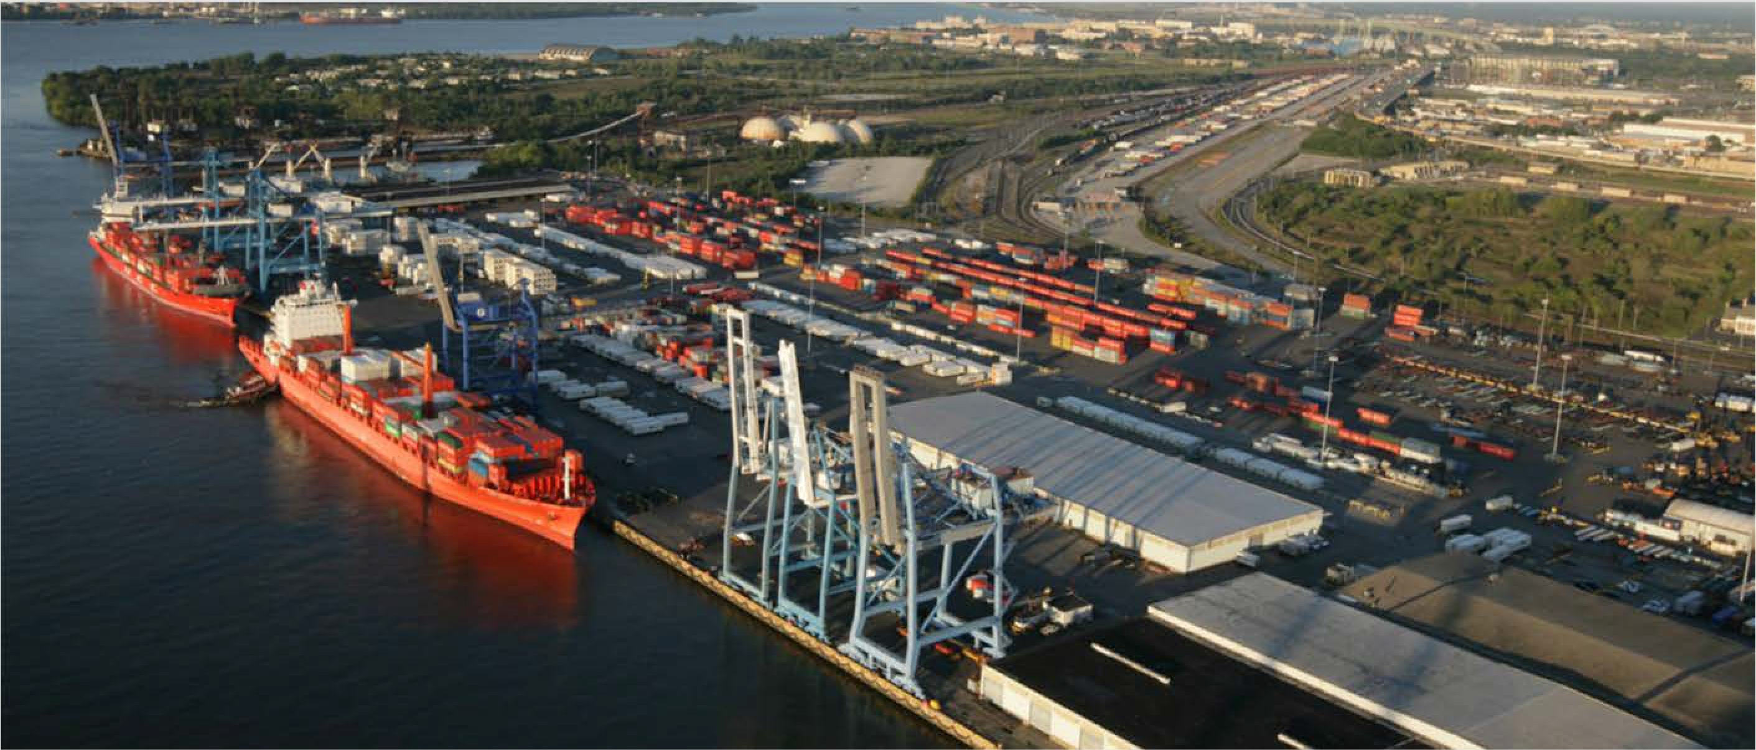
What happens in Port? (Mangoes)
Containers arrive with consumer goods from Europe and Asia. Refrigerated containers bring Mangoes and other fruit from Brazil. These ships are in port for less than 24 hours.
7

Slide 8
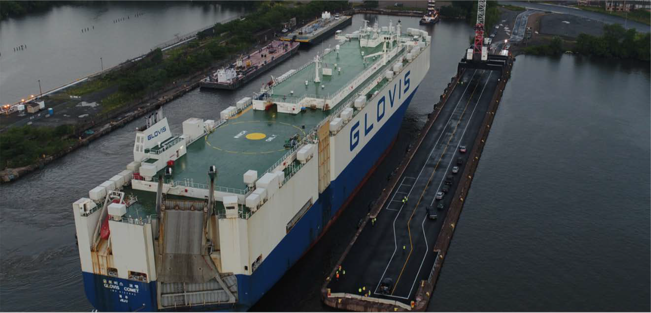
What happens in Port? (Cars)
Car Carriers arrive with thousands of brand new cars from Korea and Japan that are driven off the ship. Damaged US cars are loaded and shipped to West Africa for recycling repair.
8

Slide 9
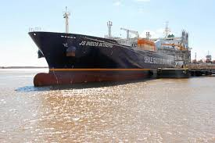
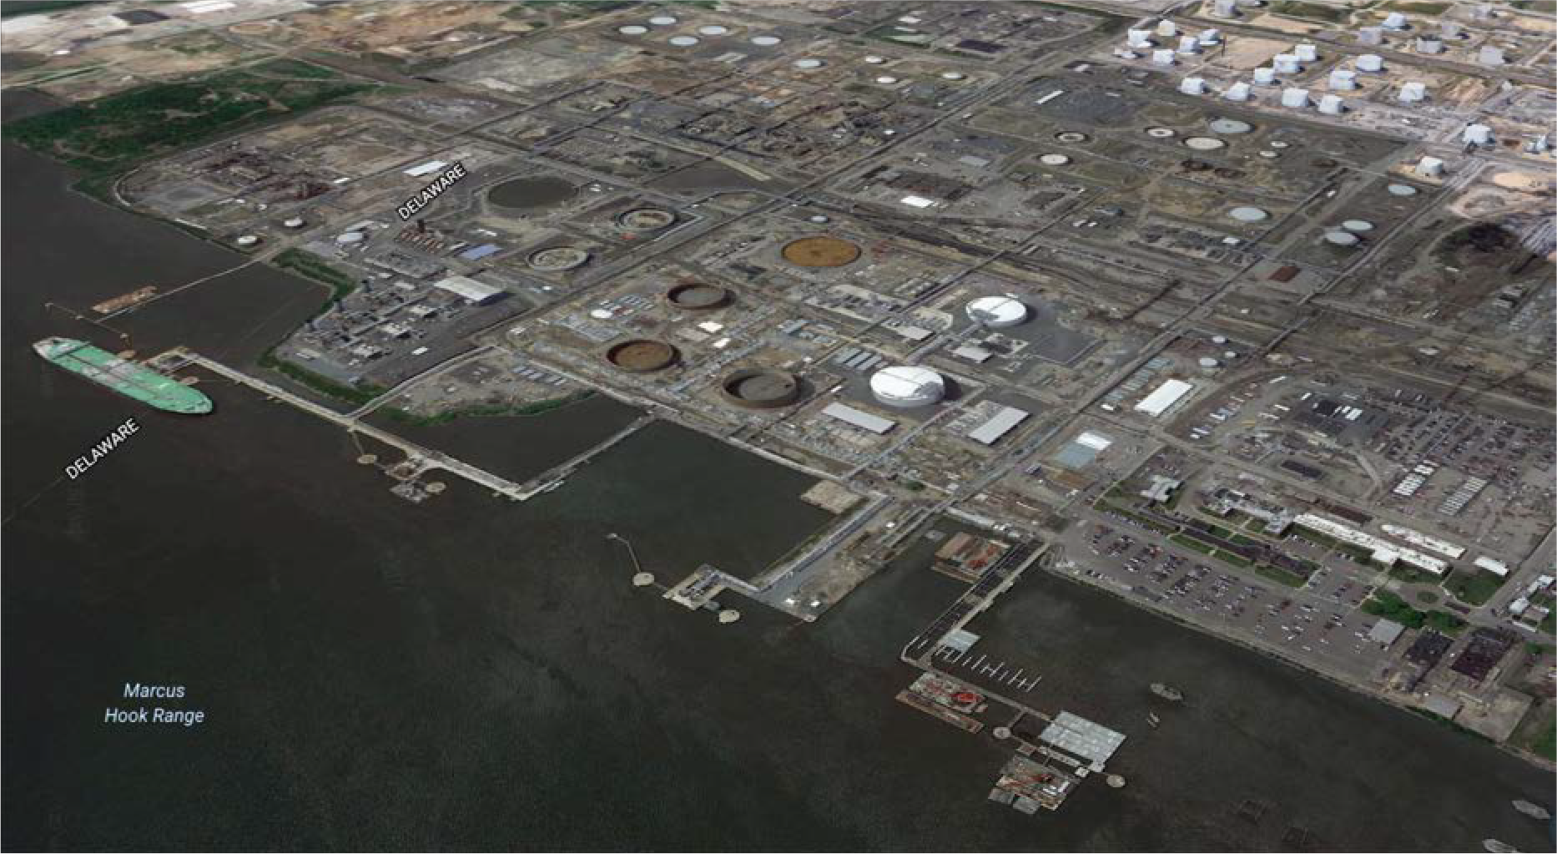
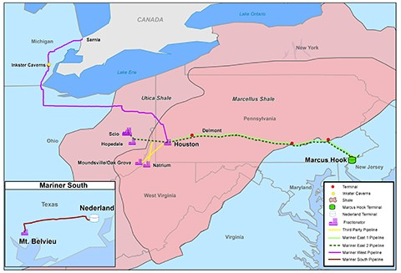
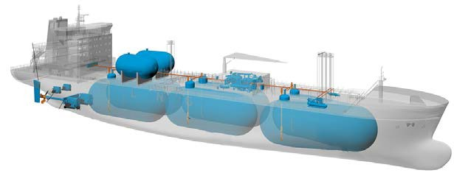
What happens in Port? (Natural Gas)
Liquefied Natural Gas Carriers load chilled Ethane as a liquid for export to Europe, the ethane
Is a byproduct of the Shale Gas revolution and is a component of Natural Gas, Ethane is a feedstock for the plastics industry.
9

Slide 10
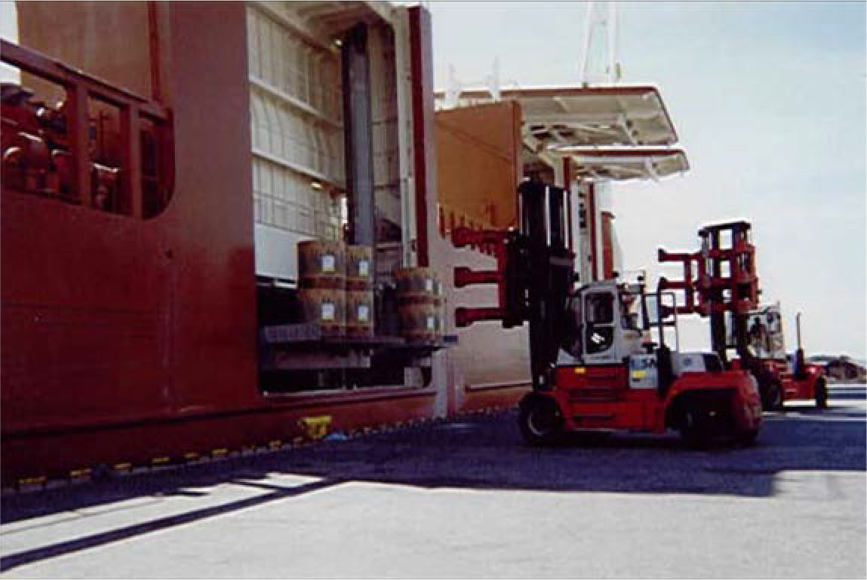
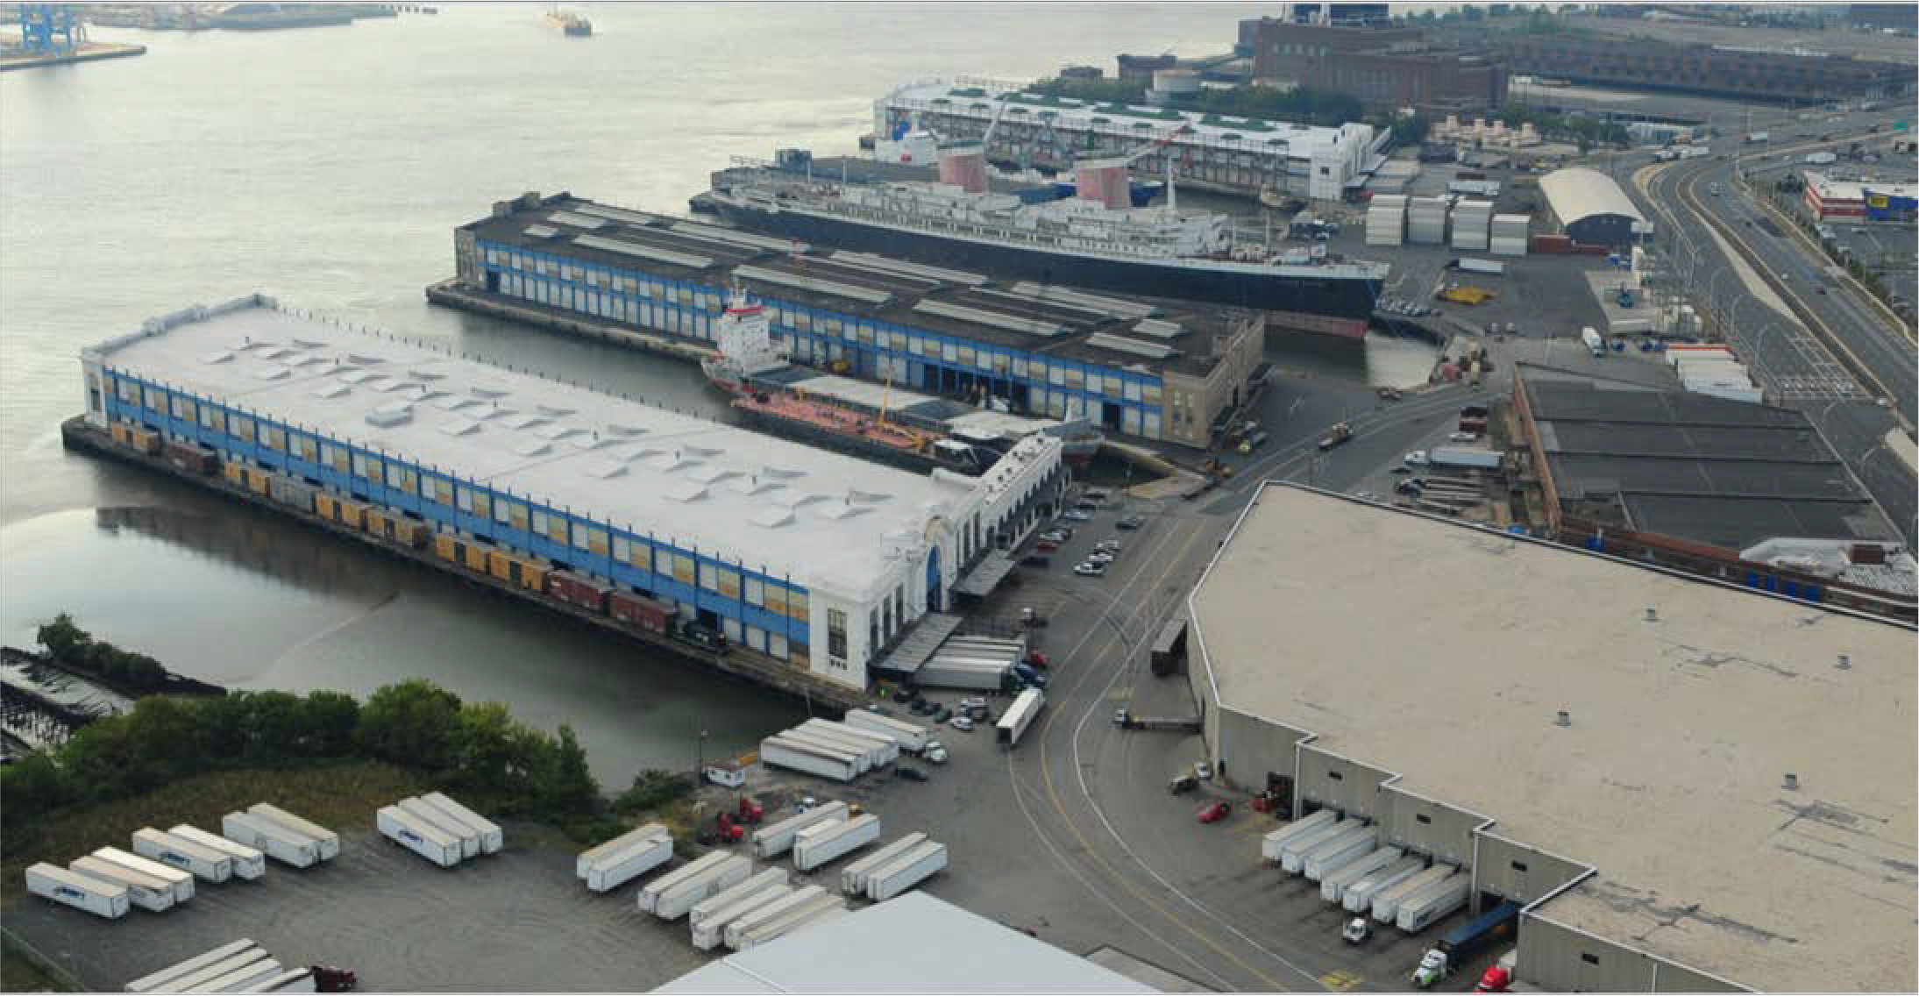
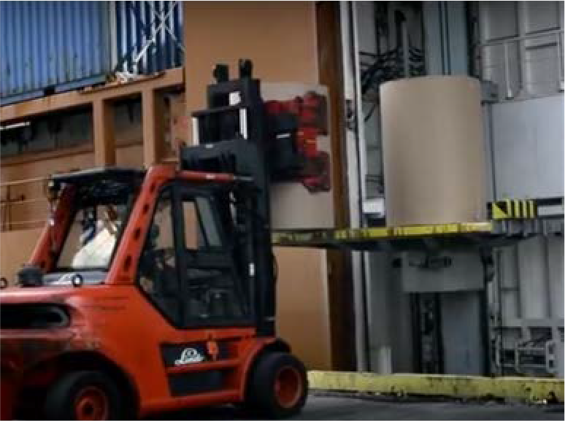
What happens in Port? (Newspaper)
Rolls of Paper for printing Newspapers and Magazines arrives from Canada, and Scandinavia
Carried on special ships that allow these large rolls to be passed through a side door into the dock warehouse.
10

Slide 11
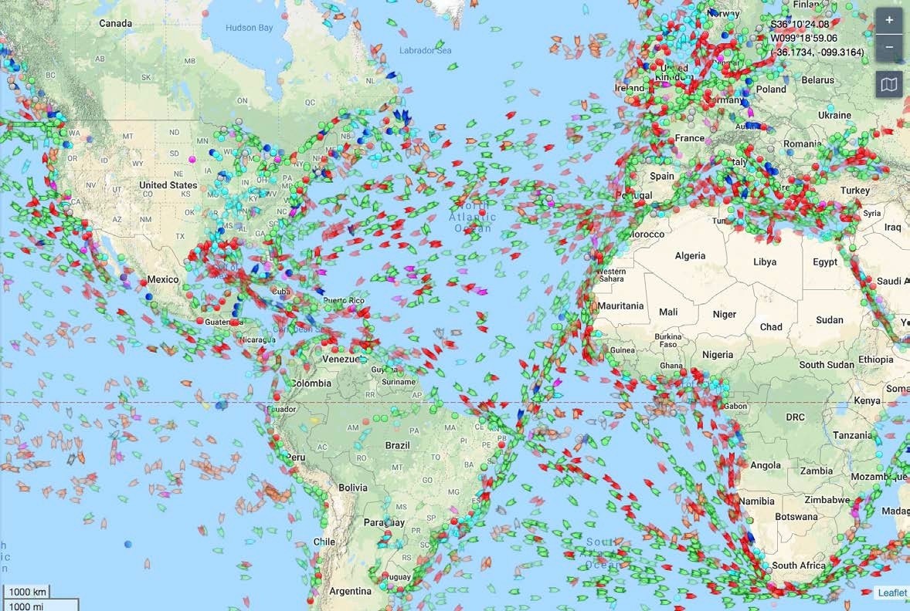
Where are the ships?
After 9/11 the US mandated that all ships be fitted with an automated identification system similar to civil aircraft.
Today, the world of shipping is under constant monitoring.
Source: marinetraffic.com
11

Slide 12
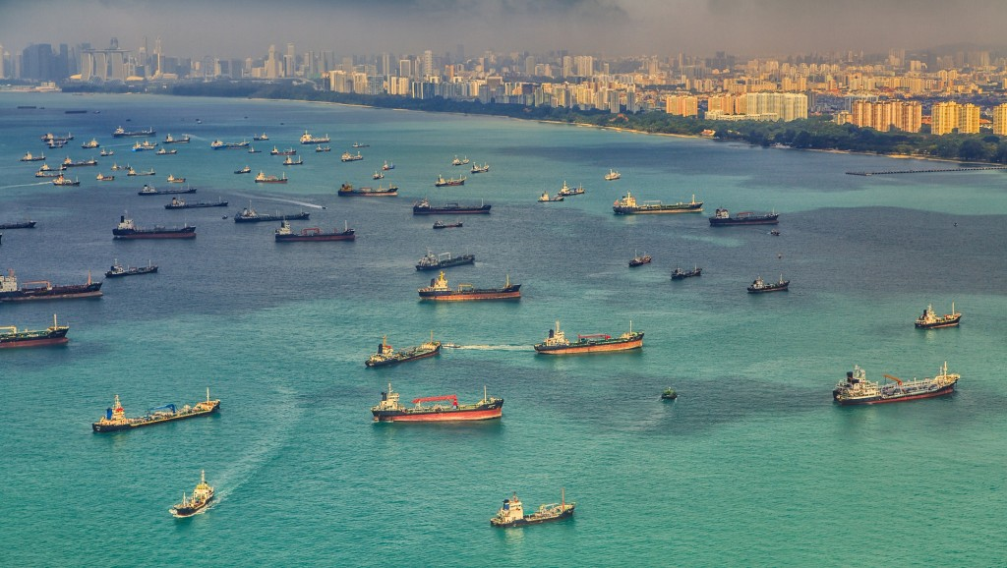
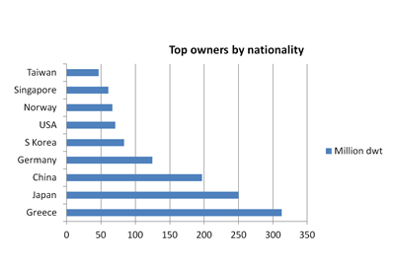
Who owns the ships?
Greece and Japan are the two leading maritime nations with China in 3rd place.
However, today China is the leading builder of merchant ships.
Slides and photo from Marinetraffic.com
12

Slide 13
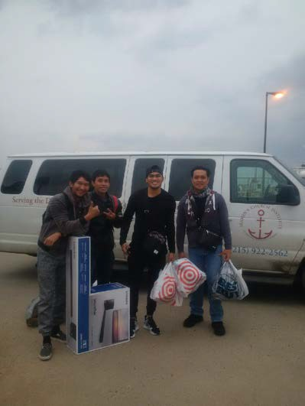
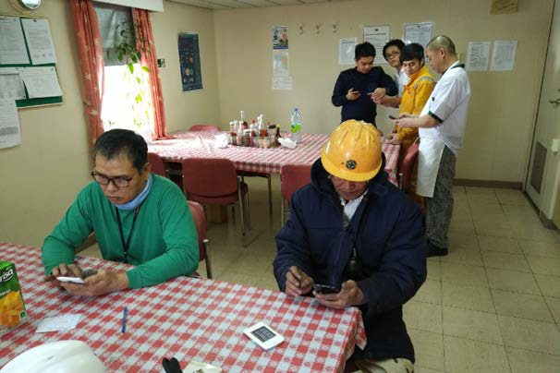
Who are the seafarers that keep shipping on the move?
1.5 million people make up the seafarer workforce manning 50,000 ships, at any given time there are approximately two thirds at sea and one third on leave.
50% are officers either navigators or engineers.
50% are ratings serving in all departments.

Slide 14
Who is onboard and how are they organized?
Ships have a hierarchal command structure with the Master (Captain) in charge.
There are three groups that report to the Master: Deck, engine and catering
department.
Deck department represents the navigating officers and the deck ratings responsible for cargo operations.
Engine department has the engineering officers and engine ratings responsible for propulsion, power and systems.
Catering department consists of the Cook and an assistant responsible for onboard catering.
The Master has risen to command through the deck department.
There is no doctor, nurse, paramedic or other EMS onboard. The second
officer is in charge of first aid.
All of the crew are responsible for emergency services which includes firefighting onboard.

Slide 15
What is the size of the crew?
Today, a crew can range from 16 to 27 people, the number will vary depending on the type and size of ship and whether officers with special skills are required. A typical average crew size is about 22.
Ships operate 24/7/365, so many crew members work 7 days a week on rotating shifts that typically are 4 hours on duty and eight hours off. However, on some vessels due to their workload, they work six hours on and six hours off. (84-hour work weeks)
Contracts vary, typically senior officers have 4 month contracts with 4 months paid leave often two people will alternate with each other. Ratings have 9 to 12 month contracts with 1 to 2 months of leave and work from a pool of seafarers who will join the next available opening.

Slide 16
Where do seafarers come from?
The effect of the changes in ship registry pursued by ship owners competing for cargo on a global stage has led to a shift in seafarer demographics.
This has seen the steady demise of the European seafarer and the rise of the Asian seafarer.
Top Five nations for seafarers: China
Philippines Russia
Ukraine India

Slide 17
What about Nationality and language?
Seafaring uses English as its common language and has done so for for over a hundred years. All seafarers speak English as either a primary or a second language.
Nationality is not important in seafaring, the important issue is being qualified and having the experience to do the job. Very common to find as many as nine nationalities within a crew of 22.
Some of the Nationals we see today were once unified and have new nationality as a result of recent political changes. For example the Soviet Union had a large fleet and an extensive network of maritime academies prior to 1991. Today, we see seafarers of those former Soviet Republics. Further back, prior to 1948, we have the former colonies of the British Empire.

Slide 18
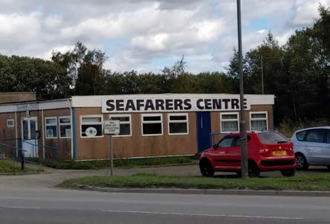
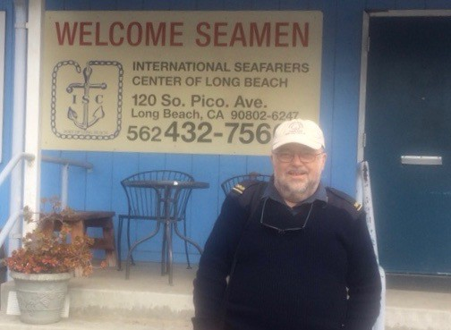
What are seafarer missions and how did they evolve?
The story of seafarer missions begins with the Rev John Ashley in 1835 who founded the Bristol Mission to Seamen. At that time the largest merchant fleet in the world sailed under the British flag and this is the reason why many of the 430 operating seafarer missions trace their roots back to the Anglican church.
Catholic and Lutheran missions were established to serve seafarers from other European nations.
Today most operate jointly to better manage limited resources.
Mission to Seamen: Grangemouth, Scotland
Seafarer Center: Long Beach, California.

Slide 19
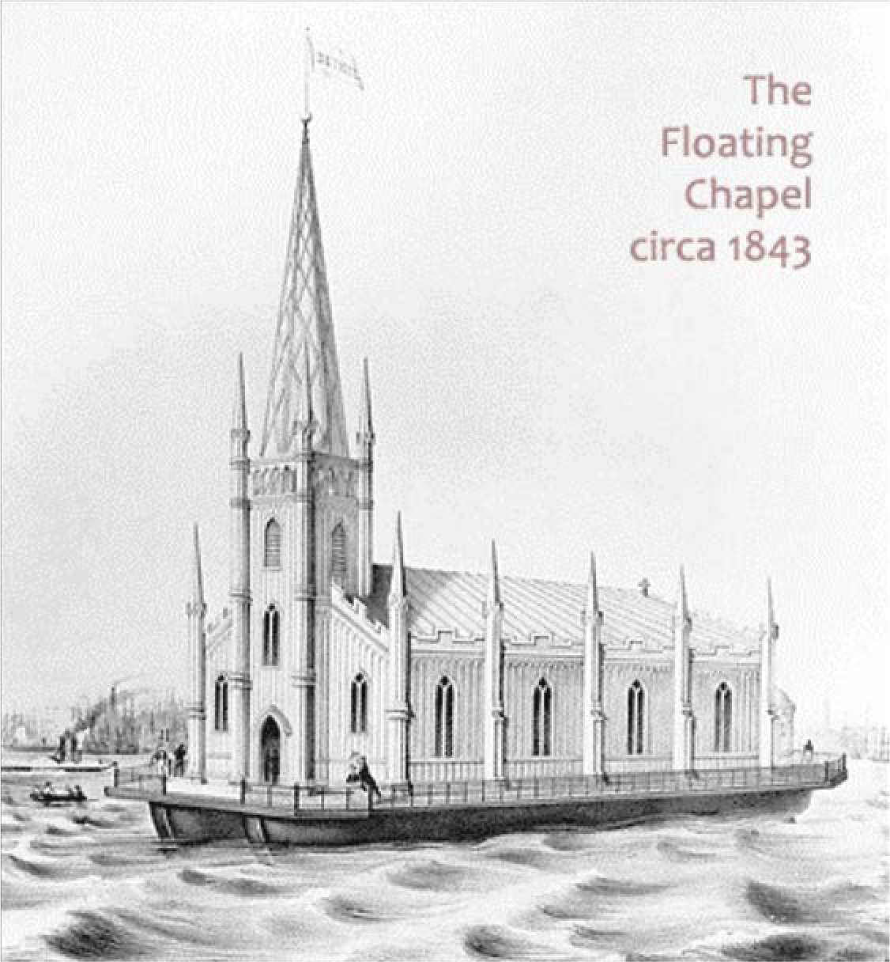
Seafarer Missions – Two Centuries
History of Seafarer’s Welfare:
Earliest period: Protection & Evangelism
Mid 19th to mid 20th century: Advocacy & Hospitality
Mid 20th to 21st: Recreation & Community
Current: Communication, Transport, & Welcome (Presence)
Seamen’s Church Institute – Philadelphia 1843 and its floating chapel.

Slide 20
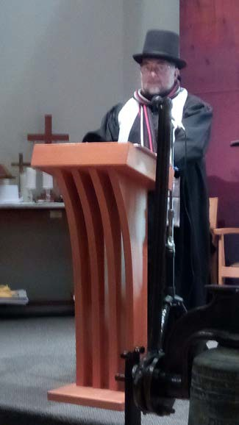
In Philadelphia – it began in 1843
SCI began in 1843, the same year that Charles Dickens published, “A Christmas Carol.”
In the 21st century we now have a new paradigm, the seafarer of today incorporates a mix of Christian, Islamic and the eastern religions of Buddhism, Hinduism, Confucianism and the secular.
This shift means that the seafarer mission of the 21st century requires an interfaith approach in order to serve proactively without prejudice.
Christmas service at the SCI Chapel in 2017, A service that Incorporated A Christmas carol Into the liturgy. Ebenezer Scrooge Speaks.

Slide 21
Seafarer’s Bill of Rights – MLC 2006
Known as “MLC, 2006” it came into force on 20 August 2013 – effectively binding in international law.
MLC 2006 sets out in one place seafarers' rights to decent conditions of work on almost every aspect of their working and living conditions including, among
others, minimum age, employment agreements, hours of work or rest, payment of wages, paid annual leave, repatriation at the end of contract, onboard medical care, the use of licensed private recruitment and placement services, accommodation, food and catering, health and safety protection and accident prevention and seafarers’ complaint handling.

Slide 22
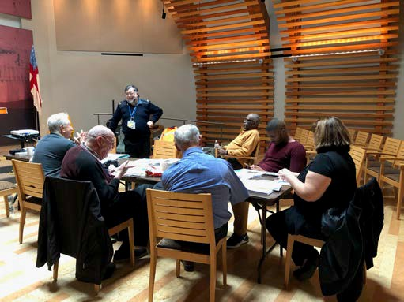
How is port chaplaincy relevant in the 21st Century?
Port Chaplains are mindful of the emotional and spiritual welfare of seafarers. We are there to be a presence, to observe and to listen. We are focused on the holistic wellbeing of all seafarers without regard to faith or no faith.
In the 21st century we make a difference. One Russian Captain told me that we enable his crew to catch a few hours ashore and that was very important for their mental health. He said: “You really make a difference.”
Leading the Volunteer training for ship visitors

Slide 23
What does a seafarer mission do?
An essential component of SCI’s work is visiting the seafarers onboard the ships that call within the port terminals of Philadelphia and South Jersey. This involves visiting thirty port terminals some 40 miles apart on both sides of the Delaware River.
We visit ships as a key component of our work to care for the merchant seafarer and to monitor their welfare consistent with MLC 2006.
We provide both communication tools and transport.
We provide a “ministry of presence” to all seafarers that is both proactive and without prejudice.

Slide 24
How is the work funded?
From the outset in the early 19th century they have always been voluntary societies.
Early support came from the Anglican, Church of England.
Today they are supported by contributions from shipowners supplemented by fund raising programs within the port community plus donations from local churches and philanthropic donors.
The support varies from port to port and some are almost 100% volunteer driven while others are able to support a paid staff.
International groups like the ITF, NAMMA others provide grants.

Slide 25
What are the challenges?
Since 9/11, Port security around the world has become very strict, with all ports now secure areas with limited access.
At many port terminals the seafarer mission bus is the only way seafarers gain shore leave.
Seafarer Stress and Mental Health is a global concern.
MLC 2006 guidelines recommend Port Welfare facilities and committees.
Seafarer missions – chaplains and trained ship visitors are on the front line of seafarer wellbeing.

Slide 26
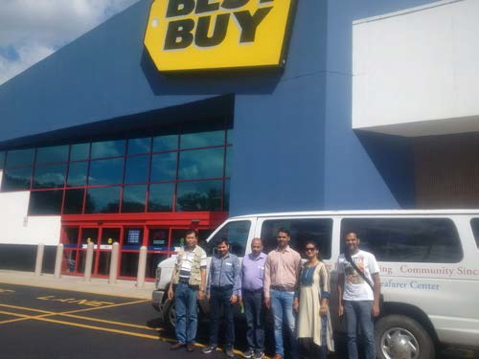
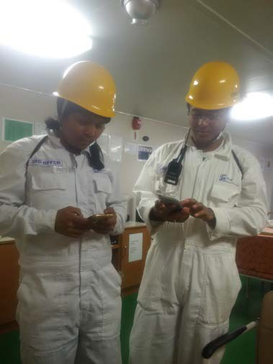
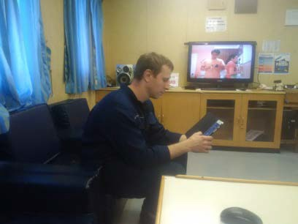
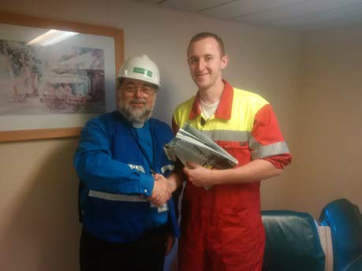
Internet, Transport and Presence.
Taking a group shopping at Best Buy.
Two Myanmar seafarers connect to social media using the WiFi Hostspots.
Russian engineer on Skype to his wife.
Being there to listen.

Slide 27
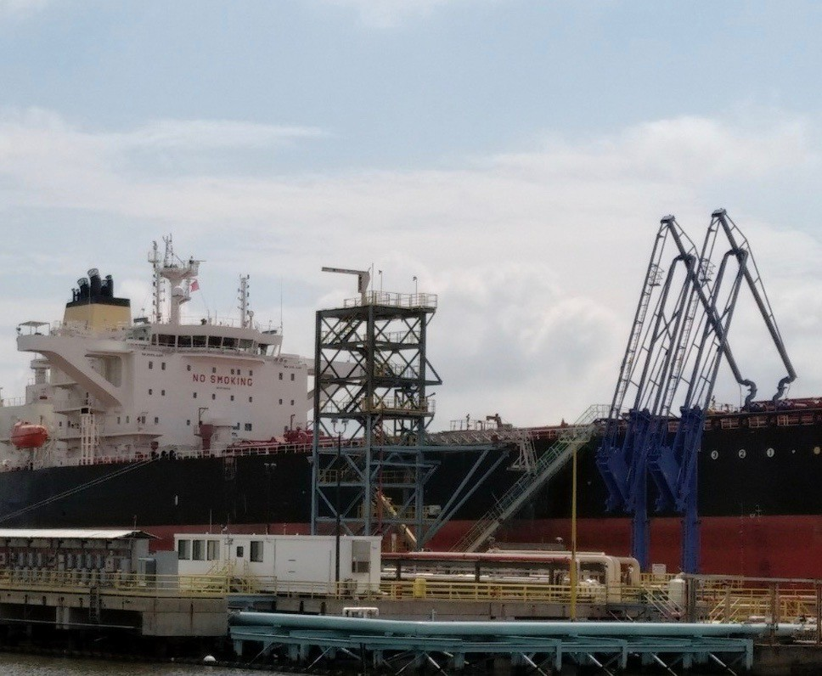
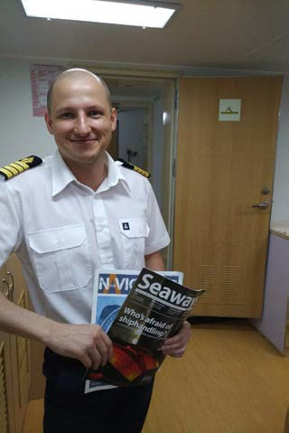
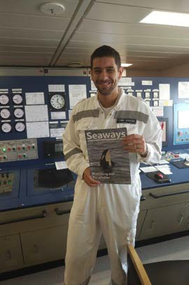
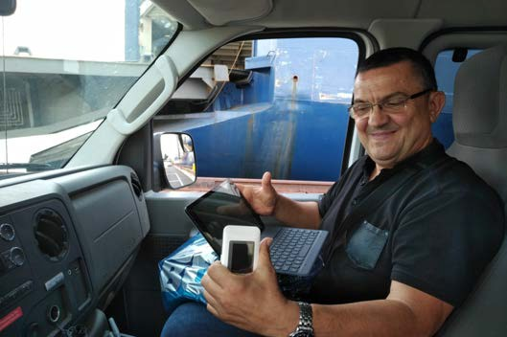
Internet, Transport and Presence.
Delivering professional
magazines to a Russian Captain and a Greek Chief Officer
Often a steep climb on the gangway
WiFi in the van – Ukrainian Captain connects with his family.

Slide 28
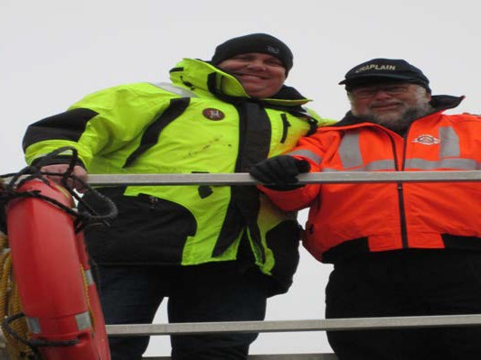
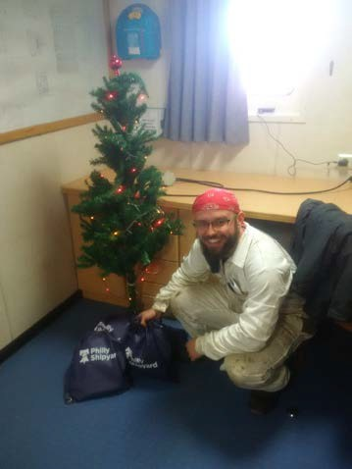
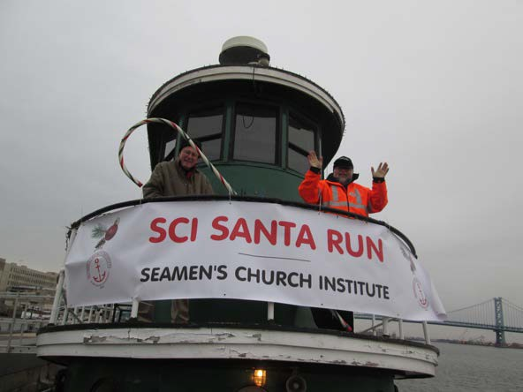
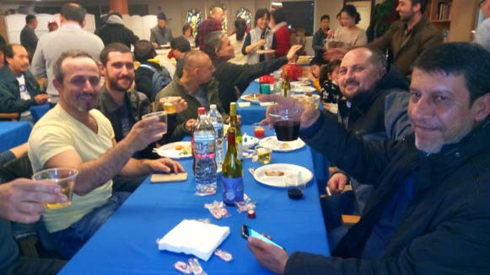
Special activities?
Delivering over 2000 “ditty” bags over the holiday season.
A small Christmas tree onboard with a “ditty” Bag for every seafarer.
Seafarer service and fellowship

Slide 29
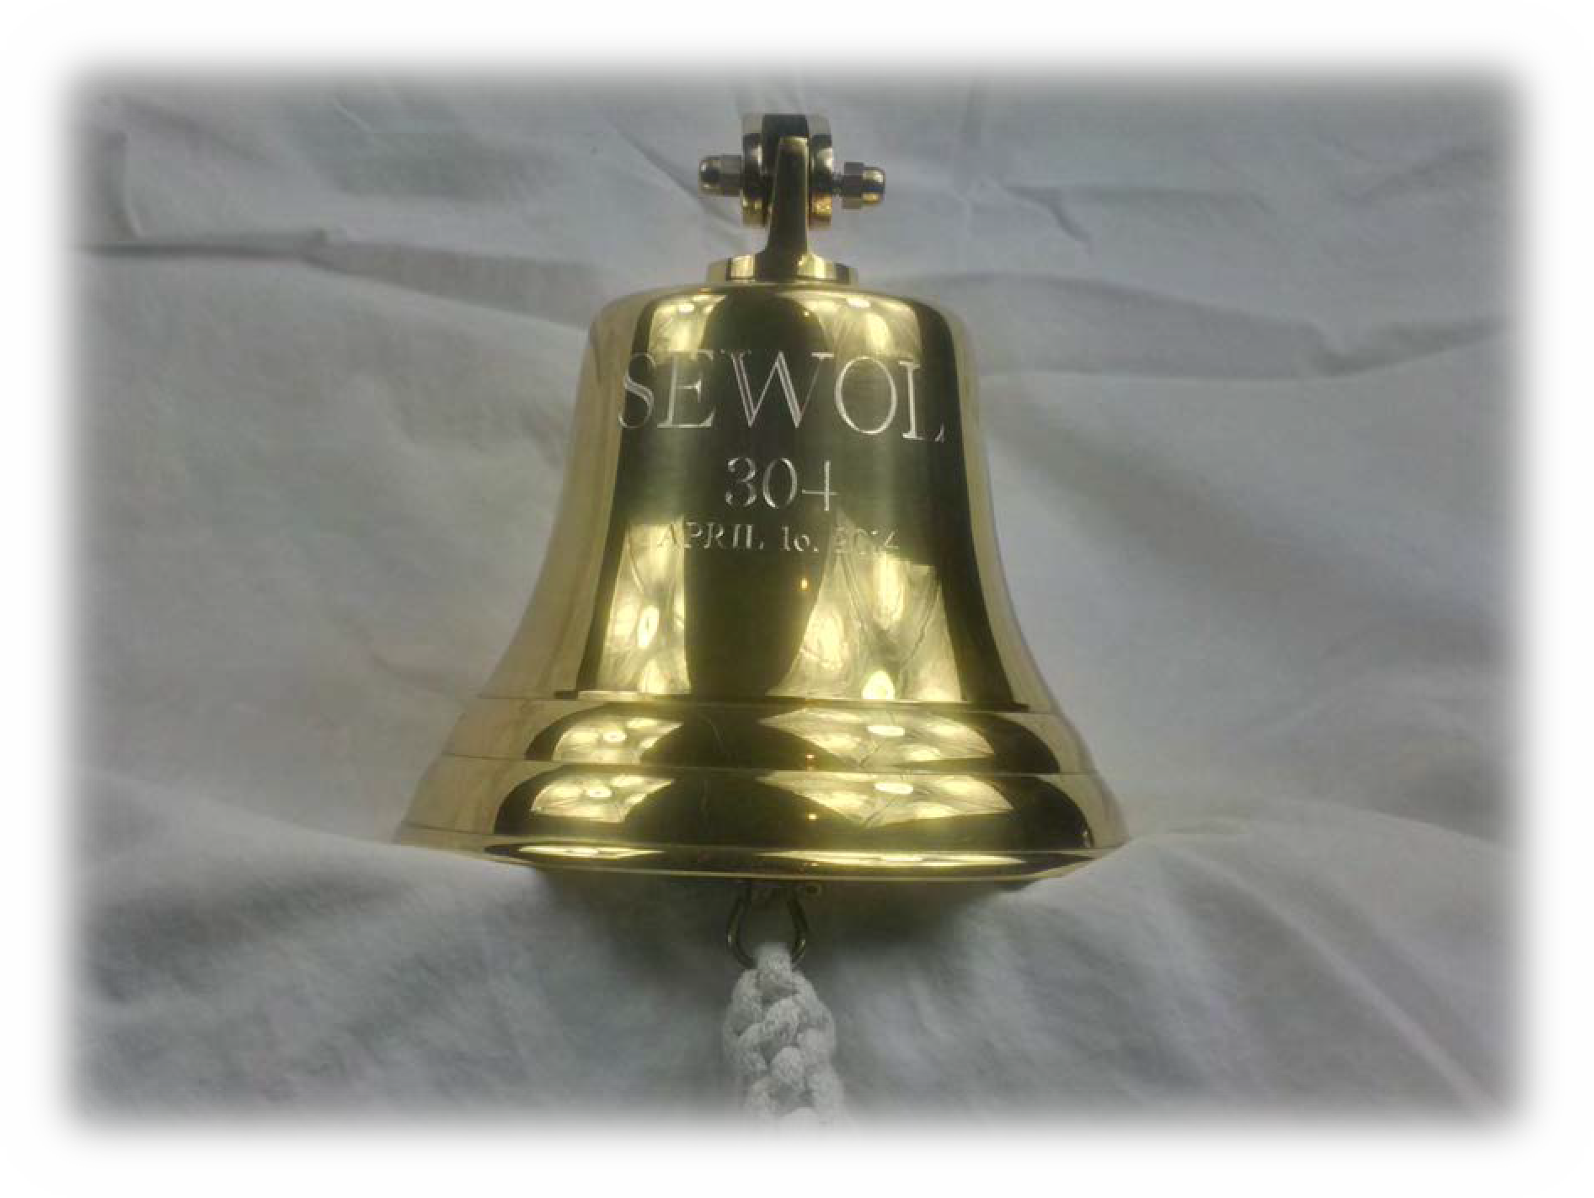
Special moments
A memorial service for the Korean-American community To mark the 3rd anniversary of the loss of 304 onboard the Korean Ferry ”SEWOL” on April 16th, 2014.
This included 250 High school students
29

Slide 30
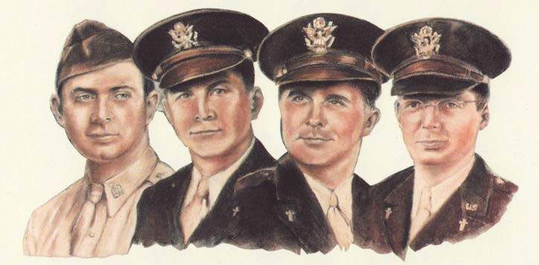
Chapel of 4 Chaplains
“Unity Without Uniformity”
On Feb 3rd, 1943 a troopship called the Dorchester was sunk by a German U boat in the North Atlantic on its way to a US base in Greenland. 902 were onboard, 672 died.
The four Army chaplains gave their lifejackets to the younger men and as the Dorchester sank
they were seen arm in arm in prayer. They were a Rabbi, a Catholic Priest, a Methodist, and a Dutch
Reformed minister.
Their sacrifice led to the founding of The Four Chaplains Memorial Foundation and they now confer a Legion of Honor award to recognize ordinary people who do extraordinary things. About 400 people each year are recognized
around the world. They are based at the Navy yard in Philadelphia.
30

Slide 31
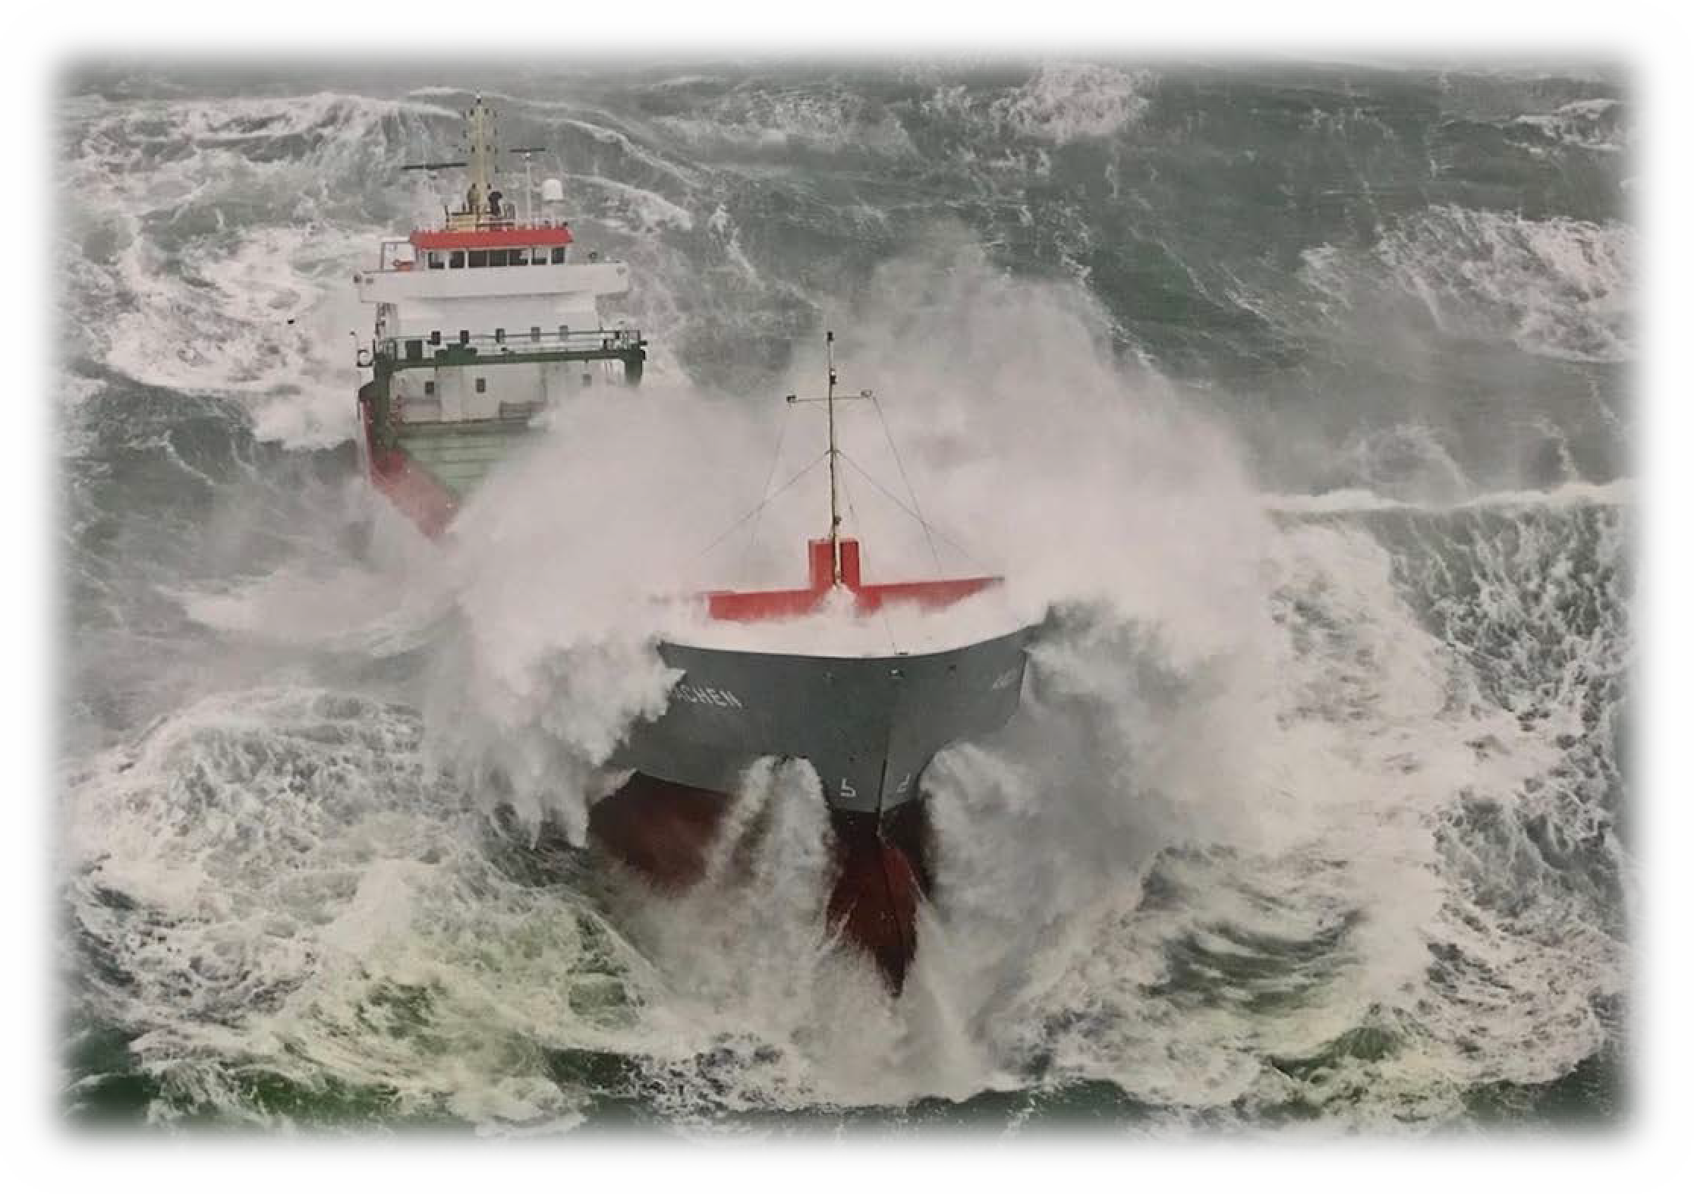
Next time that you buy a Hershey chocolate bar, read a magazine, or go shopping. Remember that the invisible industry of shipping made this possible and when there is a storm – remember the seafarers who are at sea… Thank you.
31

Slide 32
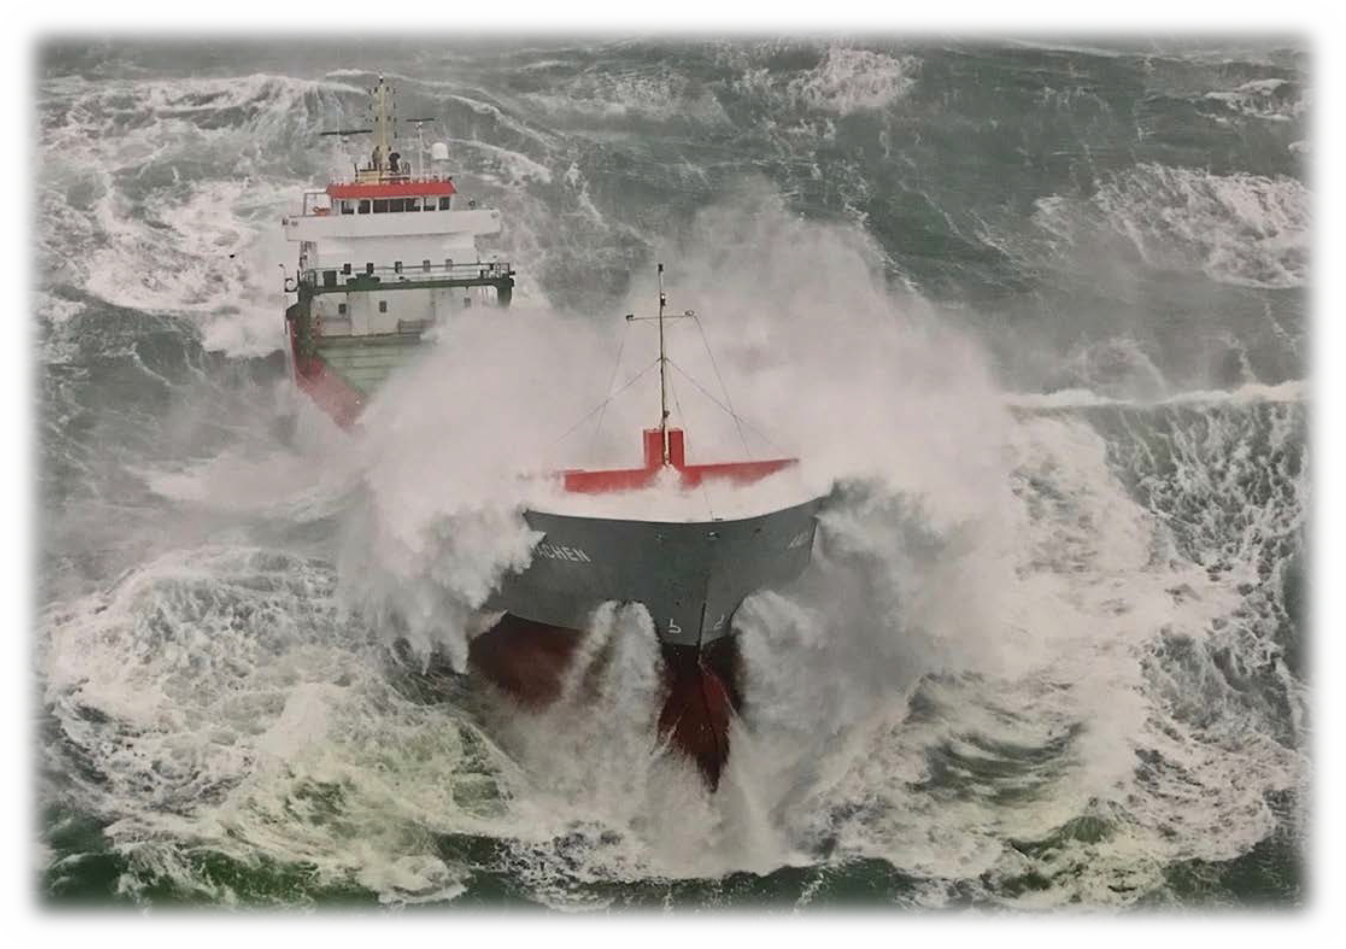
Q and A
32

