Slide 1
Suicide Prevention in Veteran and Service Member Populations
Chaplain Gretchen Hulse, M.Div., M.S., BCC, NCC, LPC
Chaplain, VA Pittsburgh Healthcare System
Pittsburgh, PA
Ryan Parker, M.Div., BCC-PTSD, ACPE
Chaplain / ACPE Certified Educator
Durham, NC
Jason A. Nieuwsma, PhD
Associate Director, VA Mental Health and Chaplaincy
Associate Professor, Duke University Medical Center
Durham, NC
Notes:
Monday, May 29, 2019, 4:00 PM - 5:30 PM
Workshop Title:
Suicide Prevention in Veteran and Service Member Populations
Authors:
Gretchen Hulse, MDiv;¹ Ryan Parker, MDiv,² Jen Wortmann, PhD,³ Keith Meador, MD, ThM, MPH,³ & Jason A. Nieuwsma, PhD³
Pittsburgh VA Medical Center
Durham VA Medical Center
VA Mental Health and Chaplaincy
Educational Objectives:
By the end of this training, each learner will be able to:
Demonstrate use of the Hybrid Model of Crisis Intervention (aka. Psychological First Aid) to de-escalate a Veteran.
Initiate processes to develop chaplain teams within integrated healthcare systems that are equipped to address suicidality.
Describe how to apply evidence-based psychotherapeutic principles in the care of persons with suicidal thoughts.
Abstract:
Suicide rates have been steadily increasing in the U.S. population at large during the 21st century (Curtin et al., 2016), with a particularly troubling increase among Veteran and Service member populations (VA Suicide Prevention Program, 2016). Chaplains can play an important role in preventing suicide among this population (Kopacz et al., 2016, 2017), but suicide prevention training among chaplains has frequently been lacking. This workshop will feature three presenters from the Department of Veterans Affairs (VA) discussing different ongoing efforts at VA medical centers and across the VA system to more effectively engage chaplains in suicide prevention. Chaplain Gretchen Hulse will describe a project that consists of a simulated training to help prepare chaplains with the knowledge, skills, and abilities necessary to provide effective crisis intervention when engaging with a crisis involving potential lethality. Chaplain Ryan Parker will describe the development and implementation of a Chaplain-Suicide Prevention Team, including reception of this team across the medical center, processes for referrals, and communication about patients with interdisciplinary team members. Finally, Dr. Jason Nieuwsma will cover suicide prevention findings from a VA system-wide chaplain training program, highlighting ways that evidence-based psychotherapeutic practices are being used by chaplains to address suicidality among veterans. Lessons for chaplains and other healthcare providers working in different contexts will be discussed, and time for interaction will be provided.
Curtin, S.C., Warner, M., & Hedegaard, H. (April 2016). Increase in suicide in the United States, 1999-2014. NCHS Data Brief No. 241.
Kopacz, M.S., Kane, C.P., Pigeon, W.R., & Nieuwsma, J.A. (2017). Chaplaincy Encounters Following a Suicide Attempt. Journal of Health Care Chaplaincy, 23, 167-173.
Kopacz, M.S., Nieuwsma, J.A., Jackson, G.L., Rhodes, J.E., Cantrell, W.C., Bates, M.J., & Meador, K.G. (2016). Chaplains’ engagement with suicidality among their service users: Findings from the VA/DoD Integrated Mental Health Strategy. Suicide and Life-Threatening Behavior, 46, 206-212.
VA Suicide Prevention Program (July 2016). Facts about Veteran Suicide. Access at: https://www.va.gov/opa/publications/factsheets/suicide_prevention_factsheet_new_va_stats_070616_1400.pdf

Slide 2
Objectives
Demonstrate use of the Hybrid Model of Crisis Intervention (aka. Psychological First Aid) to de-escalate a Veteran.
Initiate processes to develop chaplain teams within integrated healthcare systems that are equipped to address suicidality.
Describe how to apply evidence-based psychotherapeutic principles in the care of persons with suicidal thoughts.

Slide 3
Outline
Upstream suicide prevention and intersections for utilization of evidence-based practices
  Jason Nieuwsma
Simulation training to improve pastoral care interventions for suicidality
  Gretchen Hulse
Integrating suicide prevention and chaplaincy via standardized referral protocols
  Ryan Parker
Notes:
Good morning Jason/Gretchen!
I’ve been thinking about the proposal we submitted, the Learning Objectives outlined, and recent similar presentations I’ve given on this topic.
We have 90 minutes for the presentation (4:00PM-5:30PM,) so roughly 30 minutes each.
I’d like us to have a Q&A “pause” built in after each of us present.
That might look like 25 minutes of material and 5 minutes of discussion/conversation.
(Jason and I each presented at the Society for Military Psychology on 4/4/19 and had 25 minutes each, so I think that’s doable here.)
I’d like to propose the following order of presenters: Jason, Gretchen, Ryan.
I think this works because Jason’s “upstream interventions” research sets the stage for illustrating how Chaplains can use evidence-based practices to provide missing elements of care.
Gretchen’s training is an emerging “gold standard” for simulating pastoral care interventions for suicidality (i.e. research/evidence pointing to “training needed” in Jason’s research.)
My slides illustrate a model of integrating suicide prevention and chaplaincy via standardized referral protocols, and in turn how these meet some national benchmarks for collaboration (i.e. SP/NCC MOU.)
And… at the end I tie back in to Jason’s model.
What do ya’ll think about all this?
Also, Jason: Would you be willing to compile the slides for us and upload to dropbox?
Gretchen and I will not be able to do that from a VA computer. I’m thinking you might have access to a Duke computer. Otherwise, one of us will need to upload from home.
My slides are attached.
Thanks and I’m looking forward to this!
Ryan

Slide 4
Upstream Suicide Prevention and Intersections for
Evidence-based Practices

Slide 5
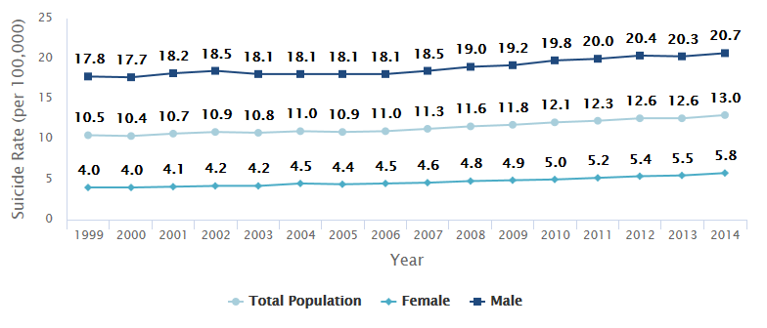
U.S. Suicide Rates Over Time*
* Age-adjusted. Curtin, S.C., Warner, M., & Hedegaard, H. (April 2016). Increase in suicide in the United States, 1999-2014. NCHS Data Brief No. 241. Access at: https://www.cdc.gov/nchs/products/databriefs/db241.htm

Slide 6
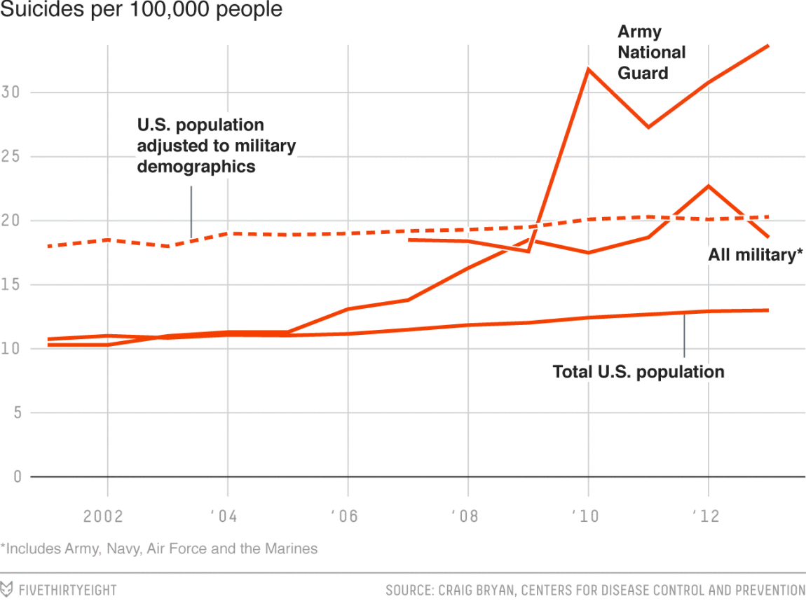
Military vs. Demographically-Adjusted Civilian Suicide Rate

Slide 7
What is going on?
Suicide rates have been rising in the U.S. throughout the 21st century…
especially among females and among veterans.
Why?
“Suicide is an important public health issue involving psychological, biological, and societal factors.”¹
1. Curtin, S.C., Warner, M., & Hedegaard, H. (April 2016). Increase in suicide in the United States, 1999-2014. NCHS Data Brief No. 241. Access at: https://www.cdc.gov/nchs/products/databriefs/db241.htm

Slide 8
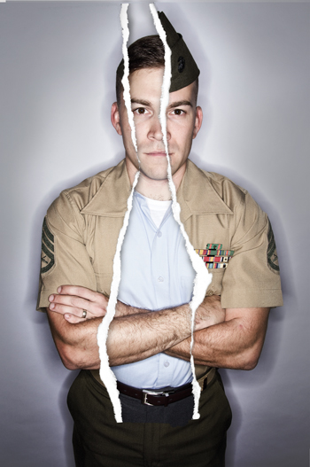
So why the increase in suicide rates?
Not entirely clear
…but...
sociocultural context clearly matters
…especially for…
persons faced with transition challenges.
Common transitions for Veterans/Service Members:
  Readjustment to civilian life
  Relationship/family changes
  Employment changes
  Identity transitions

Slide 9

What about Suicide Prevention Training for Chaplains?
Acknowledged as important by both VA^{1,2} and DoD.³
Army Chaplain & Chaplain Assistant Study⁴
  Perceived greater competence than civilian samples
  Roughly half reported that they could use more training
  High perceived mental health stigma, potentially preventing intervention
Mixed messages
  DoD/VA IMHS Study^{5,6}
  Reports from military chaplains
  But what is meant by “prevention?”
Memorandum of Understanding between the VA National Office of Suicide Prevention and the VA National Chaplain Center (August, 2016).
Kopacz, M.S., Nieuwsma, J.A., & Meador, K.G. (2017). A next step in suicide prevention. Psychiatric Services, 68, 422.
Department of Defense Task Force on the Prevention of Suicide by Members of the Armed Forces. (2010). The challenge and the promise: Strengthening the force, preventing suicide and saving lives: Final report of the Department of Defense Task Force on the Prevention of Suicide by Members of the Armed Forces. Washington, DC.
Ramchand, R., Ayer, L., Geyer, L., & Kofner, A. (2015). Army chaplains’ perceptions about identifying, intervening, and referring soldiers at risk of suicide. Spirituality in Clinical Practice, 2(1), 36–47.
Nieuwsma, J. A., Rhodes, Jeffrey E., Cantrell, W. C., Jackson, G. L., Lane, M. B., Milsten, G., … Meador, K. G. (2013). The intersection of chaplaincy and mental health care in VA and DoD: Expanded report on VA / DoD Integrated Mental Health Strategy, Strategic Action #23. Washington, DC: Department of Veterans Affairs and Department of Defense.
Kopacz, M. S., Nieuwsma, J. A., Jackson, G. L., Rhodes, J. E., Cantrell, W. C., Bates, M. J., & Meador, K. G. (2016). Chaplains’ Engagement with Suicidality among Their Service Users: Findings from the VA/DoD Integrated Mental Health Strategy. Suicide and Life-Threatening Behavior, 46(2), 206–212.

Slide 10
Prevention Continuum¹
Mitigating
occurrence
of risk factors
via promotion
of life enhancing practices
Primary
DoD/VA chaplains perceive training need²⁻⁴
Secondary
Intervening early in response to risk factors
Care/treatment of persons (and relations) in whom suicide-related behavior has occurred
Tertiary
DoD/VA chaplains perceive knowledge, awareness, training²⁻⁴
Caldwell, D. (2008). The suicide prevention continuum. Pimatisiwim, 6(2), 145-153.
Ramchand, R., Ayer, L., Geyer, L., & Kofner, A. (2015). Army chaplains’ perceptions about identifying, intervening, and referring soldiers at risk of suicide. Spirituality in Clinical Practice, 2(1), 36–47.
Nieuwsma, J. A., Rhodes, Jeffrey E., Cantrell, W. C., Jackson, G. L., Lane, M. B., Milsten, G., … Meador, K. G. (2013). The intersection of chaplaincy and mental health care in VA and DoD: Expanded report on VA / DoD Integrated Mental Health Strategy, Strategic Action #23. Washington, DC: Department of Veterans Affairs and Department of Defense.
Kopacz, M. S., Nieuwsma, J. A., Jackson, G. L., Rhodes, J. E., Cantrell, W. C., Bates, M. J., & Meador, K. G. (2016). Chaplains’ Engagement with Suicidality among Their Service Users: Findings from the VA/DoD Integrated Mental Health Strategy. Suicide and Life-Threatening Behavior, 46(2), 206–212.

Slide 11

Getting Upstream in Suicide Prevention:
Primary / Secondary / Tertiary Prevention
  Identity
  Meaning and purpose
  Religion / Spirituality
  Values
  Relationships and social connectivity
  Distress tolerance
  Effective problem-solving
  Facilitating access to care
  Anxiety
  Depression
  Substance use/abuse
  Psychiatric hospitalization
  Intersecting with existing programs & policy
  Assessing and responding to imminent risk
  Postvention care

Slide 12
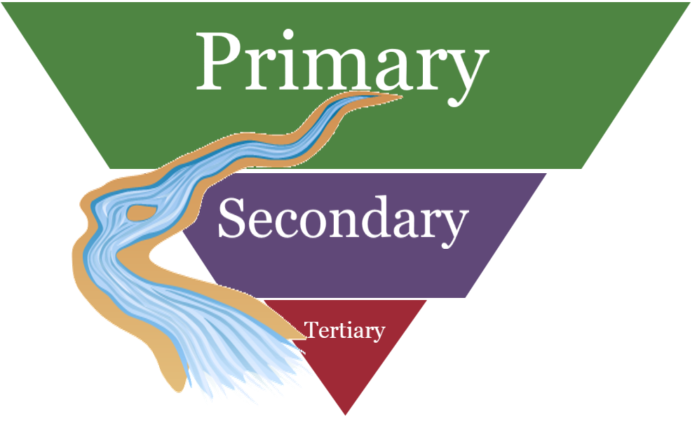
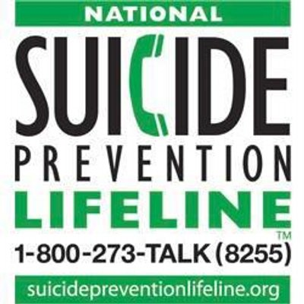
Downstream:
Tertiary Prevention
Examples:
  Operation S.A.V.E.
    Signs of suicidal thinking
    Ask questions
    Validate the person’s experience
    Encourage treatment and Expedite getting help
  Reducing access to lethal means
  Psychotherapy, pharmacotherapy, & other interventions
Resources:
  Operation S.A.V.E.:
    https://www.mentalhealth.va.gov/docs/suicide_prevention_community_edition-shortened_version.pdf
  Suicide Awareness Voices of Education (SAVE):
    https://save.org/
  VA Mental Health Suicide Prevention:
    https://www.mentalhealth.va.gov/suicide_prevention/
  National Suicide Prevention Lifeline:
    https://suicidepreventionlifeline.org/
  Crisis Line: 1-800-273-8255 (1-800-273-TALK)
    Press “1” for veterans.

Slide 13

Further Upstream:
Secondary Prevention
Numerous potential pathways:
Clergy/chaplain engagement:
  Direct care provision
  Care within the context of faith communities
  Collaboration with mental health care
Suicide
Substance Abuse
Thought Disorders
Social Problems
Health Problems
Affective Disorders
Anxiety Disorders
www.mirecc.va.gov/MIRECC/mentalhealthandchaplaincy/

Slide 14



Upstream:
Primary Prevention
Clergy & Chaplain Engagement
Promotion of healthy behaviors
Facilitating social & relational support
Religious / spiritual practices & resources

Slide 15
Experiential Avoidance &
Upstream* Suicide Prevention
*i.e., Primary / Secondary Prevention
Numerous problems contribute to suicide risk.
Experiential Avoidance:¹
Defined: The tendency to escape or avoid unwanted thoughts, emotions, memories, and sensations, even when doing so is futile or causes harm.²
Suicide
Substance Abuse
Thought Disorders
Social Problems
Health Problems
Affective Disorders
Anxiety Disorders
Might these problems share something in common?
Could there be a possible transdiagnostic process?
Luoma, J. B., & Villatte, J. L. (2012). Mindfulness in the Treatment of Suicidal Individuals. Cognitive and Behavioral Practice, 19(2), 265–276.
Hayes, S. C., Wilson, K. G., Gifford, E. V., Follette, V. M., & Strosahl, K. (1996). Experimental avoidance and behavioral disorders: a functional dimensional approach to diagnosis and treatment. Journal of Consulting and Clinical Psychology, 64(6), 1152–1168.

Slide 16
Experiential Avoidance &
Upstream* Suicide Prevention
*i.e., Primary / Secondary Prevention
A Transdiagnostic Process:
Experiential Avoidance¹
  A key construct and target within Acceptance and Commitment Therapy (ACT)
  Close overlap / association with concepts tied to suicidal behavior
  Suicide as most extreme expression
  Majority of suicide notes cite reason as escape from emotional pain²
  Mindfulness / ACT can reduce experiential avoidance³
Luoma, J. B., & Villatte, J. L. (2012). Mindfulness in the Treatment of Suicidal Individuals. Cognitive and Behavioral Practice, 19(2), 265–276.
Baumeister, R. F. (1990). Suicide as escape from self. Psychological Review, 97(1), 90–113.
Hayes, Steven C., Luoma, J. B., Bond, F. W., Masuda, A., & Lillis, J. (2006). Acceptance and commitment therapy: Model, processes and outcomes. Behaviour Research and Therapy, 44(1), 1–25.

Slide 17
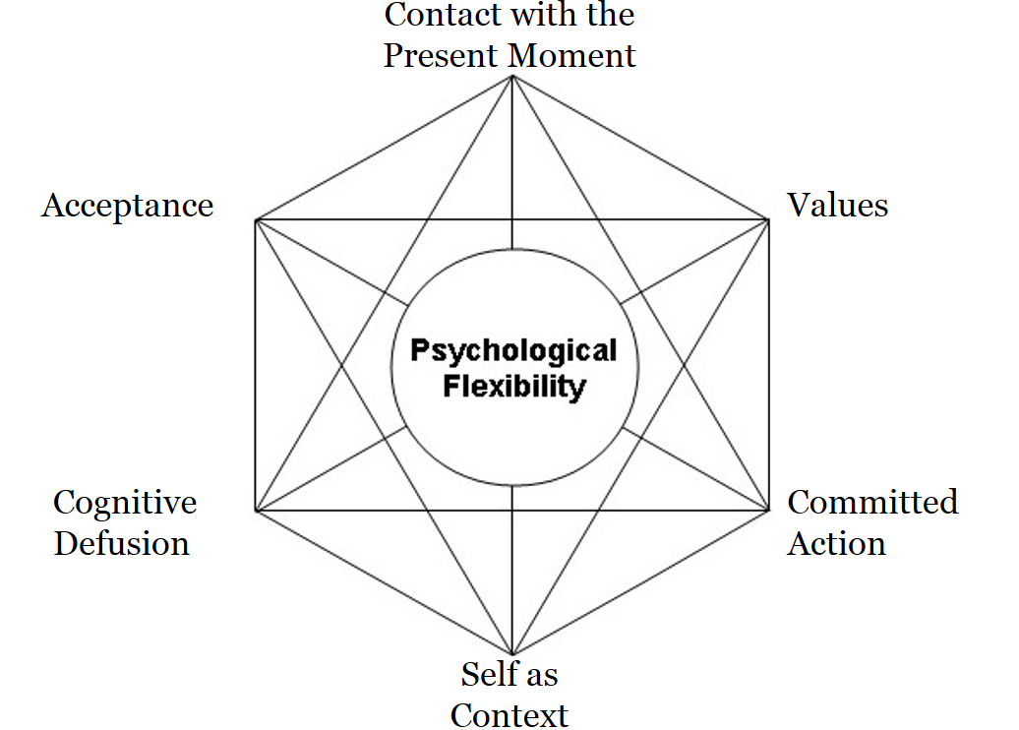
Experiential Avoidance &
Upstream* Suicide Prevention
*i.e., Primary / Secondary Prevention
Experiential avoidance & pastoral presence¹
  Individual-level willingness to be present
  Social/pastoral-level willingness to share presence
  Willing to be present (to distress)… for a reason (values)
…in order to…
1. Nieuwsma, J.A., Walser, R.D., & Hayes, S.C. (Eds.). (2016). ACT for clergy and pastoral counselors: Using acceptance and commitment therapy to bridge psychological and spiritual care. Oakland, CA: Context Press / New Harbinger Publications.

Slide 18
Chaplain Utilization of Evidence-based
Practices for Suicide Prevention
MHICS provides intensive training and case consultation in 3 evidence-based practices (EBP):
  Acceptance and Commitment Training (ACT)
  Problem Solving Therapy (PST)
  Motivational Interviewing (MI)

Slide 19
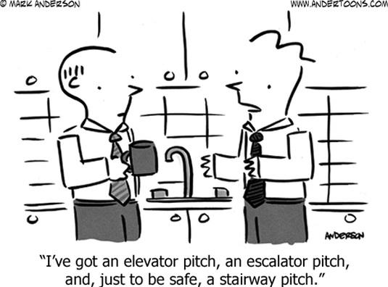
Getting Upstream:
Clergy/Mental Health Collaboration
It’s a two-way street, but you can only drive your car.
Developing an elevator pitch for mental health:
  Have a brief version.
  Translate it for the local dialect.
  Anticipate potential barriers.
  Tailor it for your particulars.
  Mention concrete offerings.
  Be ready with a relevant anecdote.

Slide 20
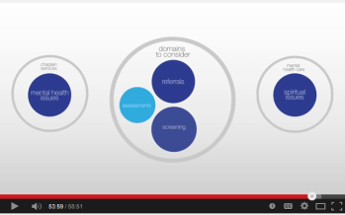

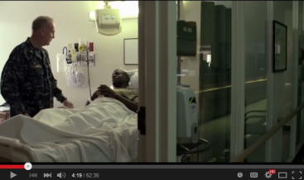


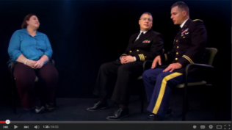
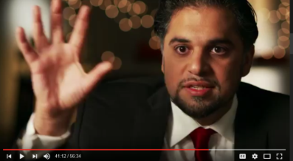
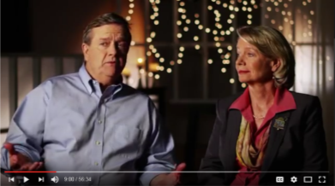

Resources: Online Video Products
Bridging Mental Health and Chaplaincy (≈ 1 hour each)
  “Why do it?”
  “Knowing Our Stories”
  “Opening a Dialogue”
Learning Collaborative (≈ 1 hour each)
  “Establishing Awareness”
  “Communicating and Coordinating Care”
  “Formalizing Systematic Processes”
Clergy & Faith Communities
  Clergy (≈ 1 hour each)
    “Signposts Toward Collaboration”
    “Abiding with Those Who Suffer”
  Faith Communities (≈ 20 minutes each)
    “Partners in Care”
    “Trauma”
    “Moral Injury”
    “Belonging”
Videos available on program website: www.mirecc.va.gov/MIRECC/mentalhealthandchaplaincy/

Slide 21
Suicide Prevention Simulation Training for Chaplains

Slide 22
Reason for this training
This simulated training helps prepare chaplains by providing the knowledge, skills, and abilities to provide effective crisis intervention when engaging with a crisis of lethality. This training was created to fill a gap in training and preparation of chaplains throughout the Veterans Health Administration. Chaplains currently participate in a TMS SAVE Refresher course once a year. This course does not require the chaplain to engage the curriculum and does not effectively prepare them for the following suicide prevention protocols used by clinical providers throughout the hospital system.

Slide 23
Learning objectives for trainees
Identify the warning signs of MH crisis – integrate knowledge to provide support and referral to SPC
Outline comprehension of the problem, steps of prevention, and interpret the importance of integrating knowledge/skills of crisis intervention to produce suicide prevention abilities
Demonstrate chaplain skills to provide crisis intervention to prevent Veteran from following through on suicidal ideations and plans

Slide 24
Format for Simulation Experience
Pre-assessment of knowledge, skills, and abilities as chaplains providing crisis response.
Didactic – supplemental to S.A.V.E. training
Includes: SP protocols necessary to ensure safety of Veteran
Mediation of crisis/psychological first aid/addressing lethality
Skills/knowledge/abilities necessary to make proper support and referrals

Slide 25
Hybrid Model of Crisis Intervention
Step 1: Define the problem – determining exactly what the problem is – use active listening, ask open-ended questions, and exhibit genuineness and positive regard
Ensure safety of the Veteran – use suicide risk assessment (ask about suicidal desire, suicidal capability, suicidal intent, buffers/connectedness) and ask about homicide risk – remove lethal means
Step 2: Provide support – accept the Veteran as an individual of value and communicate caring to them – talking with the Veteran about current state of life (taking care of basic needs)
Step 3: Examine alternatives – help the Veteran explore potential solutions to problems they are dealing with – internal coping strategies, situational supports, spiritual coping strategies and spiritual interventions, explore constructive thinking patterns (help the Veteran reframe the situation)
Step 4: Make plans – focus on concrete steps to restore control in the Veteran’s life, make sure steps are realistic
Step 5: Obtain commitment – write down the plan (safety plan) and follow-up with Veteran to ensure they have followed through with the plan

Slide 26
Simulation Scenarios
Scenarios using standardized patients (most common encounters):
Phone
in person
online (my Healthy Vet, text)

Slide 27
Debrief
In person debrief discussion with standardized patients
Offer feedback to other learners about what the chaplain saw, heard, or experienced as a result of the training
Post-assessment of knowledge, skills, and abilities as chaplains providing crisis response.

Slide 28
Integrating Suicide Prevention and Chaplaincy via Standardized Referral Protocols

Slide 29
VA’s integrated approach to Suicide Prevention

Slide 30
Rocky Mountain MIRECC
Providing care for Veterans at risk of suicide may feel like a daunting responsibility. Why worry alone?
The Rocky Mountain MIRECC offers free consultation for any provider (community as well as VA) who works with Veterans.
https://www.mirecc.va.gov/visn19/consult/index.asp

Slide 31
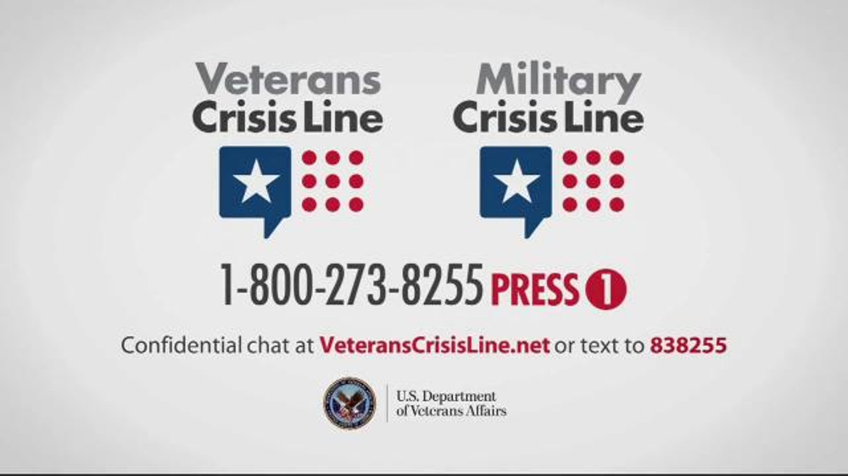
Vet/Military Crisis Line

Slide 32
Veterans Crisis Line
If you are a Service member or Veteran in crisis or you’re concerned about one, there are specially trained responders ready to help you, 24 hours a day, 7 days a week, 365 days a year.
The Veterans Crisis Line connects Service members and Veterans in crisis, as well as their family members and friends, with qualified, caring VA responders through a confidential toll-free hotline, online chat, or text-messaging service.

Slide 33
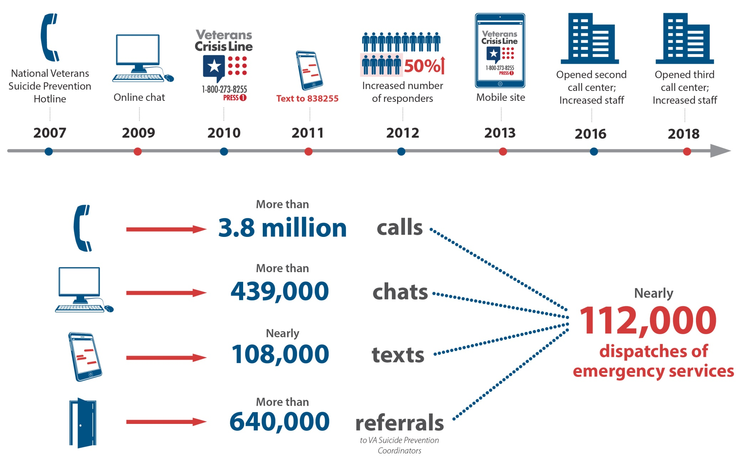
Veterans Crisis Line (stats inception-Jan 2019)
(as of January 2019)

Slide 34
Veterans Crisis Line
Dial 1-800-273-8255 and Press 1 to talk to someone.
Send a text message to 838255 to connect with a VA responder.
Start a confidential online chat session at VeteransCrisisLine.net/Chat.
Take a self-check quiz at VeteransCrisisLine.net/Quiz to learn whether stress and depression might be affecting you.
Find a VA facility near you.
Visit MilitaryCrisisLine.net if you are an active duty Service member, Guardsman, or Reservist.
Connect through chat, text, or TTY if you are deaf or hard of hearing.

Slide 35
The Spiritual Dimensions of Suicide Prevention:
A Model for Interdisciplinary Collaboration (Chaplain Service, Durham VA Health Care System)

Slide 36
Referral Protocol Implementation Timeline
Conversation Begins (Jan 2015)
Collaboration Grows (Feb-May 2015)
Literature Review (May 2015)
CPRS Consult Created (June 2015)
  Summary/Significant Data (April 2018)
National SP & Chaplaincy MOU (Aug 2016)
CPRS Consult “Stakeholder Survey” (Mar 2018)

Slide 37
Conversation Begins (late January 2015)
Multiple completed suicides
Bereaved Family members with complicated loss
Suicide Prevention Coordinator & Chief, Chaplain Service discuss Chaplain Service support for
  Suicide Prevention Team Staff Care
  Bereavement Care
  Suicide Prevention outreach efforts
Four Referrals from Suicide Prevention (Jan 2015)
  (3) Veterans with SI- Assessment & follow-up
  (1) Bereaved Family- Grief support & Memorial Service

Slide 38
Collaboration Grows (February-May 2015)
Consider Referral to Chaplain Service for:
Veterans with Completed Suicides (family care)
Veterans newly added as “High Risk”
Veterans experiencing Spiritual Crisis, especially:
  Guilt & forgiveness struggle
  Grief & lament for losses experienced
  Spiritual/Religious conflict or concern
  Feeling life is meaningless & without
  purpose (VCL calls…)
Need for a consistent,
streamlined referral process

Slide 39
Literature Review (May 2015)
Kopacz, Marek S. et al, “Understanding the Role of Chaplains in Veteran Suicide Prevention Efforts: A Discussion Paper” (SAGE Open, 2014)
Marek Kopacz, VISN 2 Center of Excellence for Suicide Prevention (Canandaigua, NY) and five co-authors (from 5 other VA sites)
“Spiritual Dimension of Suicide” and Spiritual Care Frames
  Loss of meaning/purpose (meaning making)
  Perceived spiritual abandonment (ministry of presence)
  PTSD and Trauma Recovery (spiritual grief/loss work)
  Suicidal Ideation (life review in context)
  Intrusive Thoughts (Mantras, meditation, prayer)

Slide 40
Consider your own context:
How many referrals per month do you receive from Mental Health for patients dealing with Suicidal Ideation?
  0-2
  3-4
  5-6
  7-8
  9 or more
How many referrals per month do you make to Mental Health for patients dealing with Suicidal Ideation?
  0-2
  3-4
  5-6
  7-8
  9 or more

Slide 41
Literature Review (May 2015) (continued…)
Kopacz, Marek S. and Michael J. Pollitt, “Delivering Chaplaincy Services to Veterans at Increased Risk of Suicide” (Journal of Health Care Chaplaincy, 2015)
Michael J. Pollitt, Director, VA National Chaplain Center (Hampton, Virginia)
“In terms of formal referral patterns, chaplains will usually see only 0-2 at-risk Veterans referred to them… most respondents will only refer 0-2 at-risk Veterans to other clinicians [per month].”
  DVAHCS Chaplain Service monthly avg: 9-10 at-risk Veterans
Only 26.27% of Chaplains surveyed report being “very satisfied” with interdisciplinary collaboration.
  DVAHCS Suicide Prevention/ Chaplain Service are proud of our collaboration!

Slide 42
Local “MOU” & CPRS Consult (June 2015)
Systemized referral process (“unofficial MOU”) between Suicide Prevention & Chaplain Service
Referral “indicators”
  each person newly added to Facility High Risk List
  any completed suicides
  those who request to speak with Chaplain
  “Positive Screen” for Spiritual Crisis, as described previously:
    Guilt & forgiveness struggle
    Grief & lament for losses experienced
    Spiritual/Religious conflict or concern
    Feeling life is meaningless & without purpose (VCL calls…)
“Chaplain-Suicide Prevention Team” Consult (6/4/15)

Slide 43
“Chaplain-Suicide Prevention Team” Consult
Since inception (June 5, 2015- Dec 2017)

Slide 44
“Chaplain-Suicide Prevention Team” Consult
Since inception (June 5, 2015- Dec 2017)
297 Consults Requested (288- Veteran; 9- Family)
  47- Inpatient (47- Veteran; 0- Family)
  250- Outpatient (241- Veteran; 9- Family)
297 Contacts Completed (288- Veteran; 9- Family)
223 Received Spiritual Care (216- Veteran; 7- Family)
147 Chaplain Service “Veteran Uniques”

Slide 45
National SP and Chaplain MOU (Aug 2016)¹
Goals of Collaboration:
  Increased dialogue between Suicide Prevention & Chaplains
  Access to care and care enhancement
  Increased awareness and integration of spirituality in clinical care, including the assessment and management of risk for suicide
Our local “unofficial MOU” was in place 15 months prior to the National Memorandum!
¹Memorandum of Understanding between the VA National Office of Suicide Prevention and the VA National Chaplain Center (August, 2016)

Slide 46
Stakeholder Survey (March 2018)
DVAHCS Suicide Prevention Team Members (n=5)
  (2) Suicide Prevention Case Managers (the primary referring providers for this consult,)
  (1) Suicide Prevention Coordinator (who started Suicide Prevention in Durham)
  (1) Suicide Prevention Coordinator (new to the role 2018, manages REACH VET)
  (1) Peer Support Specialist

Slide 47
Stakeholder Survey (March 2018)
The “Chaplain-Suicide Prevention Team Consult” protocol has:
Increased dialogue between facility Suicide Prevention Coordinators/Case Managers and Chaplains regarding identification of Veterans who may be elevated risk for suicide
  “strongly agree” (n=5, 100%)
Improved access to care and care enhancement for Veterans who may be elevated risk for suicide
  “strongly agree” (n=5, 100%)
Increased awareness and integration of spirituality in clinical care, including the assessment and management of risk for suicide
  “strongly agree” (n=5, 100%)

Slide 48
Awareness and Integration of Spirituality in Clinical Care
Reasons to refer to Chaplain pre/post Consult

Slide 49
Stakeholder Survey (March 2018)
  The team unanimously (n=5, 100%) “strongly agreed” to the statement: The “Chaplain-Suicide Prevention Team” Consult protocol has increased my satisfaction with interdisciplinary collaboration and dialogue between VHA chaplains and members of the Suicide Prevention Team
  Qualitative comments included:
    “Every Suicide Prevention Team should have a Chaplain,”
    “We couldn’t do it without you!”
    “Working fine, no changes needed at this time”
    “Continue to do the good work that you are doing”
    “Very satisfied, happy Veterans have chance to pursue chaplain feedback and collaboration”

Slide 50
Clarifying Role- Chaplain vs. SP Case Manager
Spiritual Assessment (vs. Suicide Safety Planning)
  Spiritual/Emotional needs underlying the presenting issue of suicidal ideation
Lament (vs. Protective Factors)
  i.e. “If I kill myself will I go to hell?”… “Sounds like you are in hell right now…”
  Feeding Spirit vs. Preventing Death
Recall: “Spiritual Dimension of Suicide” (Kopacz, 2014)
  Loss of meaning/purpose (meaning making)
  Perceived spiritual abandonment (ministry of presence)
  PTSD and Trauma Recovery (spiritual grief/loss work)
  Suicidal Ideation (life review in context)
  Intrusive Thoughts (Mantras, meditation, prayer)

Slide 51
FUTURE GOALS
Increase collaborative efforts between Mental Health and Chaplain Services using existing best practice models and expanding these efforts by:
  Integrating spiritual needs screening into routine mental health care.
  Enhancing mental health training provided to Chaplains.
  Using REACH VET models and Comprehensive Suicide Risk Evaluations as opportunities to develop more formalized referral processes from MH to Chaplain care

Slide 52

Getting Upstream in Suicide Prevention:
Primary / Secondary / Tertiary Prevention
  Identity
  Meaning and purpose
  Religion / Spirituality
  Values
  Relationships and social connectivity
  Distress tolerance
  Effective problem-solving
  Facilitating access to care
  Anxiety
  Depression
  Substance use/abuse
  Psychiatric hospitalization
  Intersecting with existing programs & policy
  Assessing and responding to imminent risk
  Postvention care
Jason Nieuwsma, PhD, Associate Director, VA MH&C

Slide 53
Crosswalk: AIM, Core Needs, Sacrament, Spiritual Dimensions
Spiritual-AIM- Needs (& Tasks) (Shields, Kestenbaum, Dunn, 2015) | “Core Needs” (Susan Lyon, ca. 1990) | Sacrament (per Susan Lyon, linked to Core Need) | Spiritual Dimensions (Paul Pruyser, 1976)
Meaning & Direction (Learn to Relate to Self, Then Others) | Meaning | Ordination | Vocation
 | Power | Confirmation | Providence
Self-Worth & Belonging to Community (Learn to Love Self) | Dignity | Baptism | Grace/ Gratefulness
 | Celebration | Eucharist | Awareness of the Holy
Reconciliation /to Love and Be Loved (Learn to Love Others) | Love | Marriage | Communion/ Community
 | Freedom | Confession/ Absolution | Repentance/ Repenting
 | Rest | Anointing/ Holy Unction | Faith

Slide 54
Getting Upstream in Suicide Prevention:
Primary / Secondary / Tertiary Prevention
Spiritual Needs & Tasks (AIM)
Meaning &
Direction
Self-Worth &
Belonging to Community
Reconciliation /
to Love and Be Loved
Underlying Issues
- Collaborate with Outpatient/CBOC MH (SUD, PTSD, TBI, Anxiety, Depression, IPV, MST, Moral Injury, Others?)
- Chaplain “Companions” during a Psychiatric Hospitalization
Presenting Issues
- Operation S.A.V.E.
- Crisis Line 1-800-273-TALK
Postvention care:
(Chapel Memorial Services, Family/Provider Grief Groups)

Slide 55
Bibliography
Caldwell, D. (2008). The suicide prevention continuum. Pimatisiwim, 6(2), 145-153.
Currier, J. M., Smith, P. N., & Kuhlman, S. (2015, September 21). Assessing the Unique Role of Religious Coping in Suicidal Behavior among U.S. Iraq and Afghanistan Veterans. Psychology of Religion and Spirituality.
Elbogen, E. B., Wagner, H. R., Kimbrel, N. A., Brancu, M., Naylor, J., Graziano, R., Crawford, E., & VA Mid-Atlantic MIRECC Workgroup (2017, June 19). Risk Factors for Concurrent Suicidal Ideation and Violent Impulses in Military Veterans. Psychological Assessment. Advance online publication.
Hayes, S. C., Wilson, K. G., Gifford, E. V., Follette, V. M., & Strosahl, K. (1996). Experimental avoidance and behavioral disorders: a functional dimensional approach to diagnosis and treatment. Journal of Consulting and Clinical Psychology, 64(6), 1152–1168.
Koenig, Harold G. “Association of Religious Involvement and Suicide” JAMA Psychiatry, August 2016, 73:8, 775-776.
Kopacz, M. S., Nieuwsma, J. A., Jackson, G. L., Rhodes, J. E., Cantrell, W. C., Bates, M. J., & Meador, K. G. (2016). Chaplains’ Engagement with Suicidality among Their Service Users: Findings from the VA/DoD Integrated Mental Health Strategy. Suicide and Life-Threatening Behavior, 46(2), 206–212.

Slide 56
Bibliography (continued…)
Kopacz, M. S., O’Reilly, L. M., Van Inwagen, C. C., Bleck-Doran, T. L., Smith, W. D., & Cornell, N. (2014). Understanding the Role of Chaplains in Veteran Suicide Prevention Efforts: A Discussion Paper. Sage Open, 4(4), 1-10. (pdf available on Blackboard)
Kopacz, M.S., Kane, C.P., Pigeon, W.R., & Nieuwsma, J.A. (2017). Chaplaincy Encounters Following a Suicide Attempt. Journal of Health Care Chaplaincy, 23, 167-173.
Kopacz, M.S., Nieuwsma, J.A., & Meador, K.G. (2017). A next step in suicide prevention. Psychiatric Services, 68, 422.
Kopacz, Marek S. and Michael J. Pollitt. “Delivering Chaplaincy Services to Veterans at Increased Risk of Suicide.” Journal of Health Care Chaplaincy, 2015, 21:1, 1-13.
Kopacz, Marek S. et al, “Understanding the Role of Chaplains in Veteran Suicide Prevention Efforts: A Discussion Paper.” SAGE Open, October 2014, 4:4.
Luoma, J. B., & Villatte, J. L. (2012). Mindfulness in the Treatment of Suicidal Individuals. Cognitive and Behavioral Practice, 19(2), 265–276.
Maltsberger, John T. ed. “In Conscience’s Talons: The Suicide of a Vietnam Veteran” Suicide and Life-Threatening Behavior, Winter 1996, 26.4., p. 424.
March, Margaret, Ryan Parker and John Oliver. “Using Simulation to Support Pastoral Care of Suicidal Veterans.” PlainViews, 2015, 12:11, 1-9.

Slide 57
Bibliography (continued…)
Memorandum of Understanding between the VA National Office of Suicide Prevention and the VA National Chaplain Center (August, 2016)
Nieuwsma, J. A., Rhodes, Jeffrey E., Cantrell, W. C., Jackson, G. L., Lane, M. B., Milsten, G., … Meador, K. G. (2013). The intersection of chaplaincy and mental health care in VA and DoD: Expanded report on VA / DoD Integrated Mental Health Strategy, Strategic Action #23. Washington, DC: Department of Veterans Affairs and Department of Defense.
Nieuwsma, J.A., Walser, R.D., & Hayes, S.C. (Eds.). (2016). ACT for clergy and pastoral counselors: Using acceptance and commitment therapy to bridge psychological and spiritual care. Oakland, CA: Context Press / New Harbinger Publications.
Norko, Michael A. et al. “Can Religion Protect Against Suicide?” The Journal of Nervous and Mental Disease, January 2017, 205:1, 9-14.
Parker, Ryan and John Oliver. “Spiritual Dimensions of Suicide Prevention: A Model for Interdisciplinary Collaboration.” VA Chaplaincy Best Practice. Accepted/Approved by VA National Chaplain Center (Hampton, Virginia), April 29, 2018.
Parker, Ryan. “Spiritual Dimensions of Suicide Prevention.” Spirit of Chaplaincy (National VA Chaplain Center, Hampton, VA,) May 2018, 9:1.

Slide 58
Bibliography (continued…)
Ramchand, R., Ayer, L., Geyer, L., & Kofner, A. (2015). Army chaplains’ perceptions about identifying, intervening, and referring soldiers at risk of suicide. Spirituality in Clinical Practice, 2(1), 36–47.
VanderWelle, Tyler J. “Association Between Religious Service Attendance and Lower Suicide Rates Among US Women.” JAMA Psychiatry, August 2016, 73:8, 845-851.
VHA Directive 1111: Spiritual and Pastoral Care in the Veterans Health Administration (Nov 22, 2016)

Slide 59
Questions?

