Slide 1
Perinatal Loss:
New Perspectives
Psychological
&
Theological

Slide 2
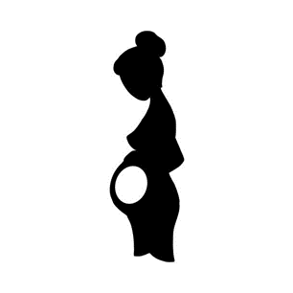
What is Miscarriage?
Clinical Definition
Legal Definition
Statistics

Slide 3
This identifies the categorization of the causes of pregnancy loss as presented by Thomas and van der Spuy and its attributional correlate. The attributional correlates are my addendum to the original table and are offered to establish a connection to the often unarticulated and internalized attributions made in terms of the etiology they offer.
Causes of Pregnancy Loss | Attributional Correlate
Genetic Abnormalities | Mother Father
Anatomic abnormalities | Mother
Antiphospholipid Antibody Syndrome | Mother
Endocrine Factors | Mother
Thrombophilias | Mother
Nutritional Factors | Mother & External factors
Infective Causes | Mother
Placental Problems | Mother

Slide 4
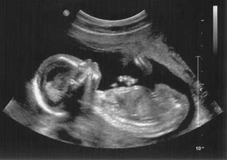
The Pregnant Mind
Dark Side of the Womb – Joan Raphael-Leff
Pregnancy as a unique relationship
Reproduction of mothering
Maternal Fetal bond
Technology

Slide 5
Psychological dimensions of loss
The reproductive story
Loss as a traumatic event
The Great Shift
Emotional responses

Slide 6
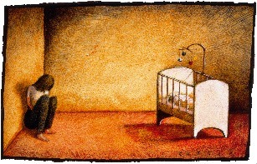
Maternal Self images
The ultimate Anti-Maternal self image
Motherhood vs. Monsterhood
Quotes

Slide 7
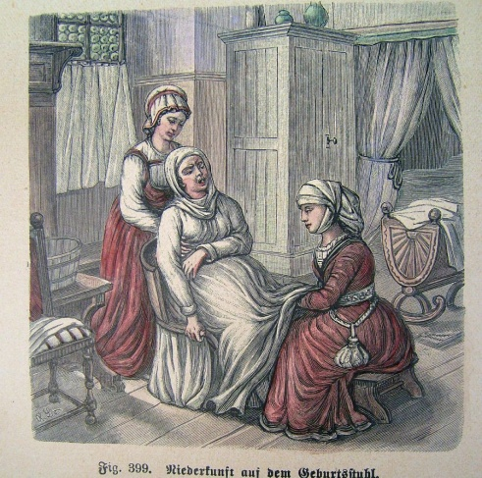
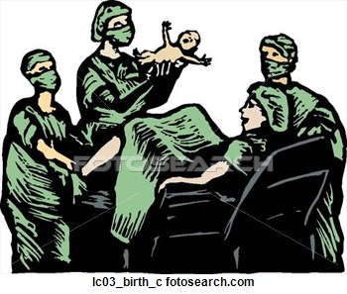
Historical Perspectives of Care
Clinical perceptions of miscarriage
Ethics of Justice vs Ethics of care
Outcomes
statistical outcomes
unspoken impact

Slide 8
Moral Injury
History
Definitions
MI & Ptsd
MI vs PTSD

Slide 9
Miscarriage as Moral Injury
Miscarrying Mom - Battlefield of Birthing
Body as Battlefield
Moral Injury as Outcome

Slide 10
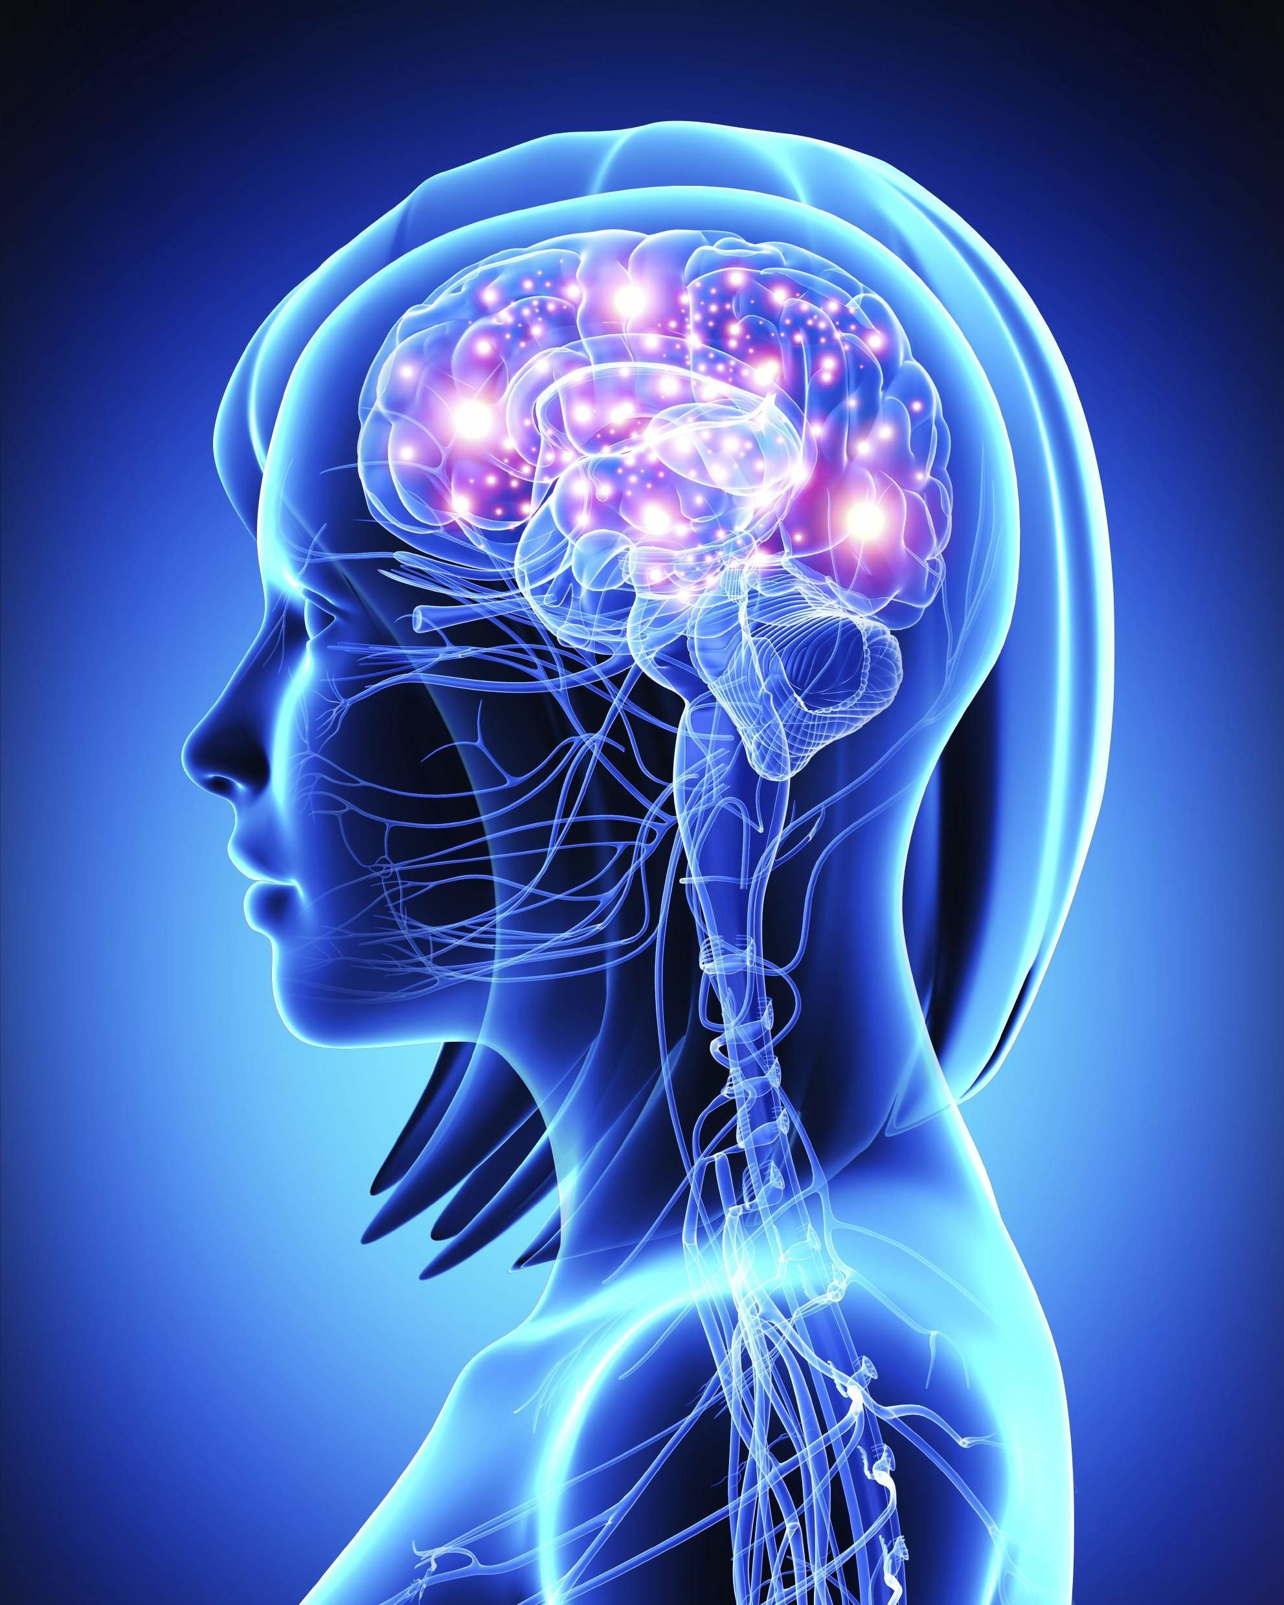
Feminine Psychology
Jean Baker Miller
Relational-Cultural Therapy - RCT
The box of inequality
Vicious cycle
Adrienne Rich
Rosemary Balsom

Slide 11
Theological Underpinnings in Culture
Reframing our thinking
Eve the first feminist
Mary – mother and activist
Jesus – Theology of Thirdness
reframing healing = return of personal agency
giving witness = space for surrender

Slide 12
Thirdness and We-ness
Jessica Benjamin
Thirdness vs. Subjugating Third
Pamela Cooper-White
We-ness (I-Thou –We)
The Adulterous woman
Limitations of Either or thinking

Slide 13
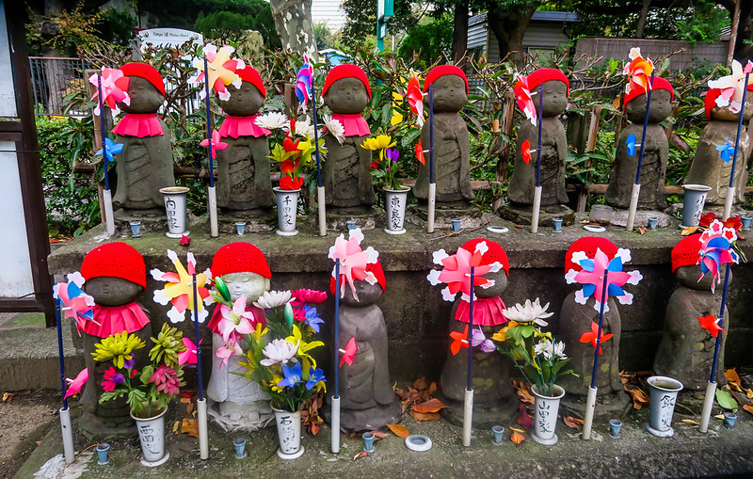
Jizo and Mizuko Kuyo
Jizo
protector of children
Mizuko Kuyo
ritual
Jizo Temple
space of Thirdness

Slide 14
Final Thoughts
Awareness of
unspoken and unacknowledged affects of loss
the need for witnessing
the need to acknowledge morally injurious dimension of this experience
affects on subsequent pregnancies & bonding with future children
long term affects
Chaplain as The Space of Thirdness
miscarriage as moral injury is a spiritual crisis
addressing immediate need precludes long term suffering

