Slide 1
Chaplains and EMR Assessments: How to Use the NCP to Develop Effective EMR Spiritual Assessment Documentation and Data Collection
Benjamin D. Rose MDiv, BCC
Alan B. Roof MDiv

Slide 2
Welcome to our journey

Slide 3
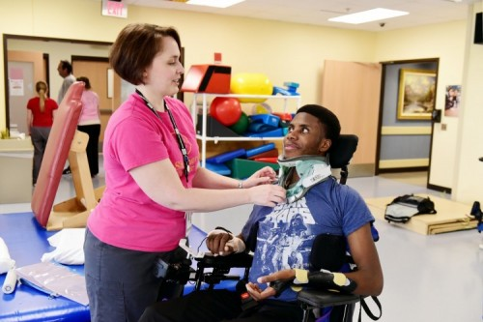
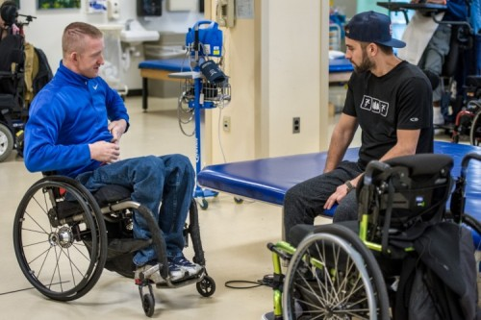
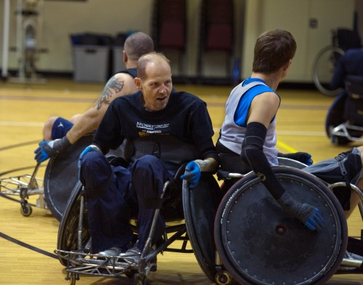
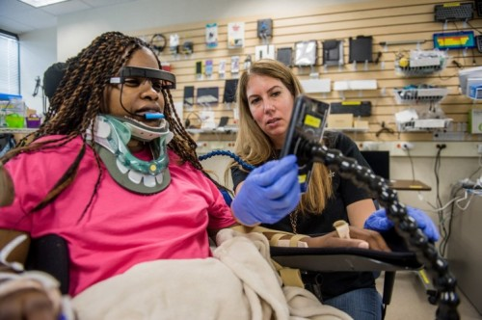
Our Setting
*All patients pictured have given written consent to Shepherd Center for use of their images.

Slide 4
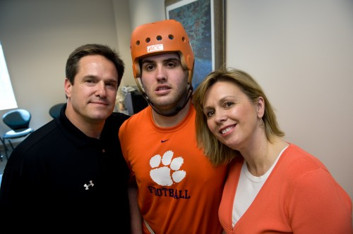
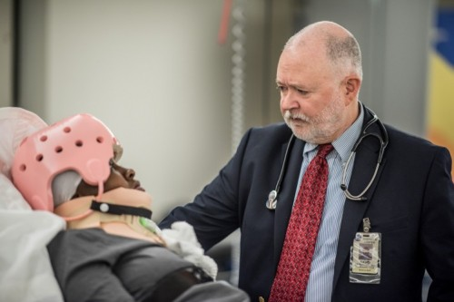
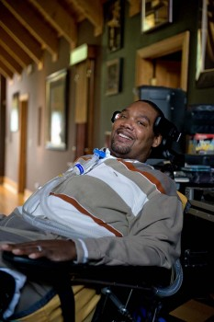
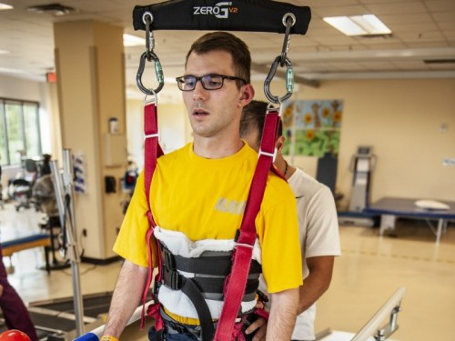
152-bed hospital
Annually we:
treat more than 900 inpatients
575 day program patients
more than 7,100 outpatients

Slide 5
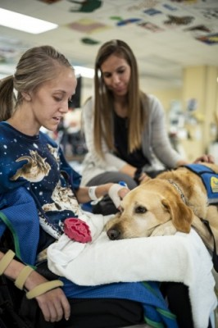
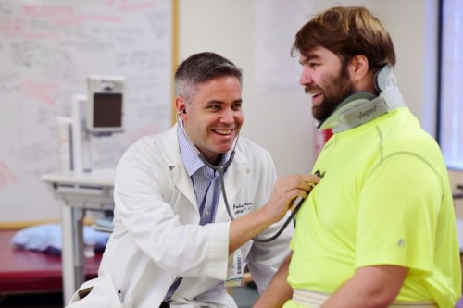
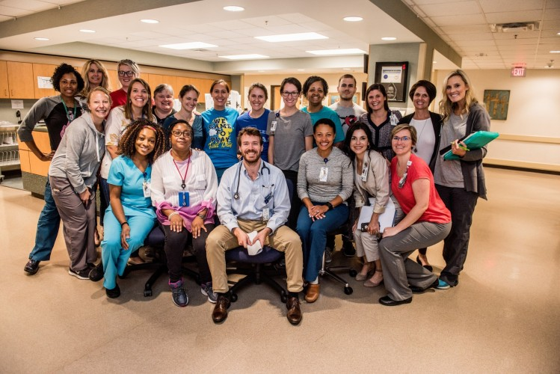
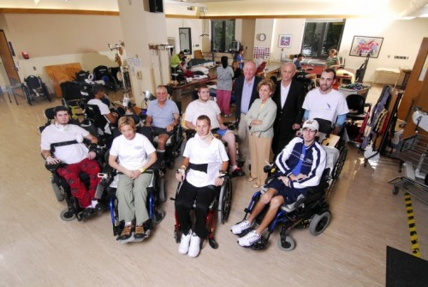

Slide 6
Goals
1) Identify the spiritual concerns/needs and definition of spirituality created by the NCP and demonstrate the development of a Spiritual Assessment Flowsheet within an EMR using this terminology.
2) Discuss ways to alter this format and content based on the healthcare setting and EMR (examples from our setting will be provided).
3) Demonstrate the opportunities within this model for research using preset fields within the EMR to generate reports.

Slide 7
Sharing our Adventure

Slide 8
JACHO – Spiritual Support Offered
CARF Requirement Met

Slide 9
“This is all I have to do for documentation?”

Slide 11
Spiritual Diagnosis (Primary) | Key Feature from History
Existential Concerns | Lack of Meaning Questions meaning about one’s own existence Concern about afterlife Questions the meaning of suffering Seeks spiritual assistance
Abandonment by God or others | Lack of love, loneliness Not being remembered No sense of relatedness
Anger at God or others | Displaces anger toward religious representatives or others Inability to forgive
Concerns about relationship with deity | Desires closeness to God, deepening relationship

Slide 12
Spiritual Diagnosis (Cont.) | Key Feature from History
Conflicted or challenged belief systems | Verbalizes inner conflicts or questions about beliefs of faith Conflicts between religious beliefs and recommended treatments Questions moral or ethical implications of therapeutic regimen Expresses concern with life /death or belief system
Despair/hopelessness | Hopelessness about future health, life Despair as absolute hopelessness No hope for value in life
Greif/loss | The feeling and process associated with the loss of a person, health, relationship
Guilt/Shame | Feeling that one has done something wrong or evil Feeling that one is bad or evil

Slide 13
Spiritual Diagnosis (Cont.) | Key Feature from History
Reconciliation | Need for forgiveness or reconciliation from self or others
Isolation | Separated from religious community or other community
Religious specific | Ritual needs Unable to perform usual religious practices
Religious/spiritual struggle | Loss of faith or meaning Religious or spiritual beliefs or community not helping with coping

Slide 14
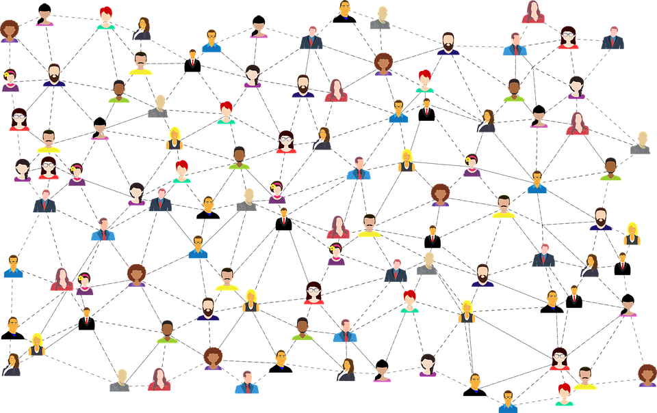
Building Relationships are Vital

Slide 16
Leveraging Connections

Slide 19
Gains from our first serious efforts
Expanded EMR Footprint
Refined use of NCP concepts
Develop language
Professionalized our work

Slide 22
Design and Relationships

Slide 23
Customization Based on setting
Concerns in our setting that differ from palliative care
Other assessment models and documentation

Slide 24
Standardize data collection
Common language
Format and use as other professions
Quantitative Data
Qualitative Data
Imagine research and
outcome data even if
you can’t pull it or
use it yet.
You need data collection
to play with data.

Slide 25
Takeaways from Our Journey

