Slide 1

#BlackHealthMatters
A Pastoral Care Approach for
African Americans Living with
Chronic Illnesses Rev. Danielle J. Buhuro, D.Min., BCC
ACPE Certified Educator & UCC Ordained Pastor

Slide 2
Intro: What is a Chronic Illness?
A Long-Term, Permanent Health Condition
  Cancer, Diabetes, Obesity, Heart Disease, Mental Illness, Drug and Alcohol Addictions & Violence (A new chronic illness phenomenon)
Causes:
  Tobacco/Alcohol Use, Poor Nutrition, Lack of Physical Activity, PTSD

Slide 3
HISTORIC HEALTHCARE OPPRESSION of African Americans in U.S.
The Mental and Physical Impact of African Enslavement (1619-1865)
Jim Crow (1865-1954)
  The Tuskegee Syphilis Study (1932-1972)
    What happened?
  The Immortal Life of Henrietta Lacks (1920-1951)
    What happened?
The Mental and Physical Impact of the Civil Rights Movement and Beyond (1950’s to the Present)

Slide 4
THE IMPACT of FOOD OPPRESSION
AFRICAN ENSLAVEMENT FOOD
FOOD DESSERTS
  What Are Food Desserts?

Slide 5
African Americans’ Distrust of Health Care Institutions
What History Tells Us
10 Evil Experiments Done on African Americans

Slide 6
In the Beginning….
Managing One’s Own Anxiety
  “Threats” in Pastoral Care
    Absence of a pastoral care “authority” produces anxiety/threats too
      External Threats = Forces beyond one’s control
      Internal Threats = Am I a “Good Enough” Chaplain?

Slide 7
In the Beginning cont…..
Be Vulnerable
  You don’t have to have all the “right” answers!
Facilitate Trust
  Provide safe, isolated space to grief
  Meet Human Needs (i.e. water, tissue, restroom, etc…)
  Make Eye Contact – Exhibit Open Body Language
  Demonstrate Nonjudgemental Presence
  Avoid “-isms” in conversation
  Create Space (Silence) to share story (optional)

Slide 8
A Pastoral Care Approach for Ministering to Persons with a Chronic Illness
Address Social Needs:
  ASSESS & CREATE CONNECTION:
    Who is your support team? Are you alone? Family? Friends? Religious Community? Social club? Fraternity? Sorority? Pets?

Slide 9
A Pastoral Care Approach for Ministering to Persons with a Chronic Illness cont.…
Address Emotional Needs:
  ASSESS & FACILITATE HOPE
    Are you experiencing guilt, shame, sadness or depression? Are you experiencing peacefulness, powerfulness, hopefulness? Do you need support, reassurance, affirmation/empowerment or a violation addressed?

Slide 10
A Pastoral Care Approach for Ministering to Persons with a Chronic Illness cont.…
Address Existential/Experiential Needs:
  ASSESS & FACILITATE NEW IDENTITY:
    What are your gifts, skills and talents? What do you do well? What are your hobbies? What do you like to do for fun? How can these gifts become your new identity or profession?

Slide 11
A Pastoral Care Approach for Ministering to Persons with a Chronic Illness cont.…
Address Religious Needs (ONLY after social, emotional, existential and experiential needs):
  ASSESS & FACILITATE RELIGIOUS RESOURCES:
    Koran? Torah? Bible? Prayer? Muslim Prayer Rugs? Catholic Rosaries? Communion? A visit from Jewish Rabbi, Muslim Imam, Catholic Priest or Protestant Pastor?

Slide 12
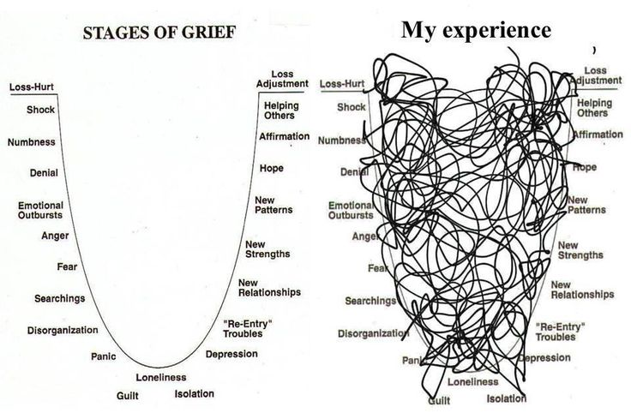
When death occurs….
What We Think Grief Is…. vs.
What Grief REALLY is!

Slide 13
When death occurs….
How to be Pastoral to Family
Address Social Needs:
  Who is the families’ community support? Who can the family lean on during this time? Can this person or people come to the hospital and be present with the family now?
Address Emotional & Existential Needs Via The Life Review Process:
  What was your loved one’s strengths? How would your loved one want to be remembered? What is your loved one’s legacy? What lesson do you take away from your loved one’s life? How can you incorporate his or her strengths? What’s your new mission/purpose? What are you inspired to do now?
Address Spiritual Needs:
  Do you have any religious, spiritual needs? Would you like a visit from a priest, imam, or elder? Rosary or prayer rug? Prayer? Meditation?

Slide 14
What can the church do to combat the “Invisible Fight” (Chronic Illness)?
Fight Drug and Alcohol Abuse:
  Create and facilitate drug and alcohol recovery programs in community with support of local political officials
Support Healthy Nutrition:
  Create healthy community “hotspots”, support community fruit and vegetable gardens and markets, resist supporting fast food restaurants.
Support Physical Activity:
  Create and facilitate exercise programs, partner with YMCA and local gyms

Slide 15
GANG VIOLENCE: A new chronic illness phenomenon
According to the National Gang Intelligence Center (NGIC), a gang is defined as a group of persons, primarily youth, who engage in criminal activity, primarily drug trafficking. There are three types of gangs: Prison Gangs, Motorcycle Gangs, and Street Gangs.
The oldest, first-recognized gangs formed in the 17th century and are primarily of:
  Irish descent (The Irish Mafia)
  Italian descent (The Cosa Nostra gang)
  Japanese descent (The Yakuza gang)
  The Aryan Brotherhood (racist Skinheads).
    History of Street Gangs in the United States (pdf)
  Videos
      History of Gangs - Part 1
      History of Gangs - Part 2

Slide 16
When victim of gang violence dies….
How to be Pastoral to Family
Address Social Needs:
  Who is the families’ community support? Who can the family lean on during this time? Can this person or people come to the hospital and be present with the family now?
Address Emotional & Existential Needs Via The Life Review Process:
  What was your loved one’s strengths? How would your loved one want to be remembered? What is your loved one’s legacy? What lesson do you take away from your loved one’s life? How can you incorporate his or her strengths? What’s your new mission/purpose? What are you inspired to do now?
Address Spiritual Needs:
  Do you have any religious, spiritual needs? Would you like a visit from a priest, imam, or elder? Rosary or prayer rug? Prayer? Meditation?

Slide 17
When victim of gang violence dies….
How to be Pastoral to Family cont….
Address Self Care Needs
  Professional Counseling (Visit a professional, licensed therapist)
  Exercise (Yoga, Swimming, Walking, Running, etc.)
  Travel
  Join a Social Service Organization/Volunteer
  Adopt a Pet
  Gain a Hobby (Journal, Sew, Knit, etc.)
  Cry (Let the emotions out!)
  Prayer/Meditation

Slide 18
When the victim Survives….
Connection is KEY! Methods to Connect:
Understanding Why Some Persons of Color Join Gangs
  Psychological Effects
    African Enslavement (1619 – 1865)
    Segregation (1865 – 1954)
  Sociological Effects
    2015 Survey on Average Family Income based on Ethnicity
    Impact of Unemployment and Poverty on Race
    Mass Incarceration (1954 – present)

Slide 19
When the victim Survives….
Methods to Connect cont….
Understanding Why All Persons Join Gangs
  Culture of Violence
    Movies
    Music
    Never-ending War
    Video Games
    Police Brutality & Black Lives Matter Movement
    Religion

Slide 20

A Pastoral Care Approach to
Gang Violence
Step #1: Provide EMPATHY!
  Empathy = to “connect with”; not Sympathy = to “feel sorry for”
  We demonstrate empathy through Listening
    Listening is a “Holy Art”
    (Cari Jackson)
    Clergy/Chaplains/Pastors = Representatives of God
    Thus, when clergy/chaplains/pastors take time to listen, the speaker feels as if God has heard them.

Slide 21
A Pastoral Care Approach to
Gang Violence cont….
Step #2: Provide EDUCATION!
  Empathize with feelings of Alienation
    Cite stories from person’s cultural history of oppressed persons who experienced feelings of alienation
    Cite stories from religious sacred texts of oppressed persons who experienced feelings of alienation

Slide 22
A Pastoral Care Approach to
Gang Violence cont….
Step #2: Provide EDUCATION cont….
  Facilitate Accountability
    Pivotal Question: Who is accountable to whom and for what?
      Being responsible to others
      Being responsible for oneself
      Sharing responsibilities with others
        Highlight the person’s community of support who love the person and depend on the person for stability
    Highlight the importance of Self-Differentiation (Family Systems Theory)

Slide 23
A Pastoral Care Approach to
Gang Violence cont….
Step #3: Provide EMPOWERMENT!
  What Do I Do Next?
    What Do I Do Next? (Video)
  Invite person to reflect on their gifts, skills and talents
  Invite person to write or journal on their hopes and dreams –life aspirations and goals
  Brainstorm methods to accomplish aspirations and goals
  Affirm person’s gifts, skills and talents

Slide 24
BASIC PASTORAL CARE DO’s & DON’TS:
      Don’t talk so much
      Don’t transfer or project meanings and feelings
      Reiterate that the Divine is “with them” in this current situation
      Invite persons to reflect on former experiences that they “survived and passed”
      Help them draw connections from former situation to new situation (the same way they survived and passed before they can survive and pass again)
      Help them understand and recognize their human agency in current situation

Slide 25
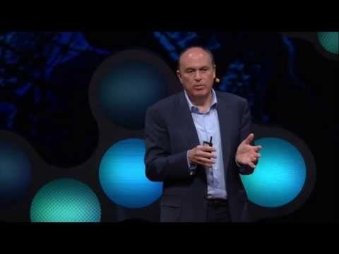
“Pastoring” the Family’s Church Pastor
Help the church pastor to:
Resist clichés
Avoid inappropriate theological statements
Allow family to express emotions
Create an Anti-Gang Violence Prevention Program at Church
Build partnerships with community organizations
Work with CeaseFire
Working with CeaseFire
What if we treat violence like a
contagious disease?

Slide 26
How Chaplains Can Practice
Good Self Care in this ministry….
Physical Self Care
  Quilting, Knitting, Crocheting
  Journaling/Writing in a Diary
  Eating a Healthy, Delicious Meal
  People Watching/Meeting Someone New
  Walking through a Park/Observing Nature
  Adopting/Playing with a Pet Animal

Slide 27
Practicing Good Self Care cont….
More types of physical self care
  Taking a Warm Bath/Shower
  Meditation/Yoga
  Listening to Peaceful Music
  Traveling
  Taking time off from work from time to time
  Watching a Peaceful, Violence-free Movie
  Coloring, Drawing, Arts
  Attending a Spa

Slide 28
Practicing Good Self Care cont….
Emotional Self Care – Avoid the following:
  All or nothing thinking
  Overgeneralization
  Mental Filter
  Disqualifying the positive:
  Jumping to conclusion
  Magnification or Minimization
  Emotional reasoning
  “Should” and “Must” statements
  Labeling and mislabeling
  Personalization

Slide 29
Practicing Good Self Care cont….
Spiritual Self Care
  Prayer
  Meditate
  Fast
  Read sacred texts
  Attend spiritual services
  More Self Care Tips

Slide 30

Buy The Book!
To purchase the book, feel free to contact Danielle Buhuro at:
careforgangs@gmail.com
For more information, log onto:
www.careforgangs.com
Follow the book on social media:
Facebook: @CareForGangs
Twitter: @CareForGangs

