Slide 1
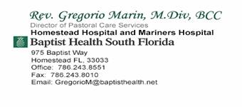
Care for the Hispanic-Latino Patient: A Culturally Competent Approach
Notes:
Let’s begin by taking a look at the “view from the inside” and what we found during our discovery phase…

Slide 2
Learning Objectives Upon successful completion of this activity, participants will be able to:
Identify the population who comprise the group known as the Hispanic/Latino Patient and develop an insight to their cultural values.
Recognize the specific healthcare priorities, attitudes, beliefs and practices of Latin Americans and act on this knowledge.
Deliver patient care in a culturally sensitive manner to encourage safe medical treatment and proper follow-up care.

Slide 3
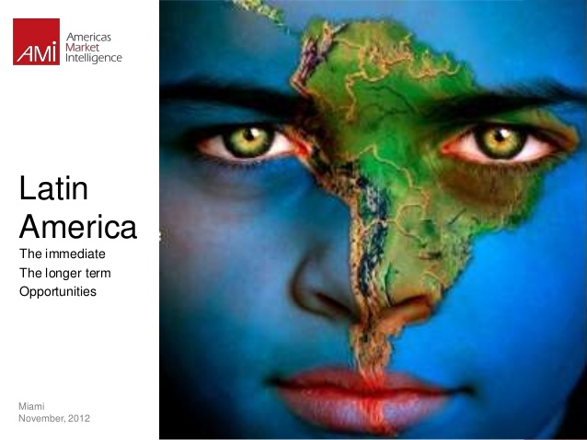

Slide 4
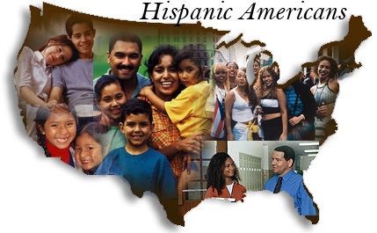
Hispanic vs. Latino
HISPANIC LATINO
Hispanic refers to language Geography - Latin America
Ancestry – Spanish-Speaking

Slide 5
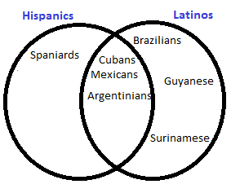
Hispanic vs. Latino
Portuguese
English
DUTCH
The Latino National Survey (2006):
35% preferred the term “Hispanic,”
13.4% preferred the term “Latino.”
32% of respondents said either term was acceptable, and 18.1% indicated they did not care (Fraga et al., 2006).
Notes:
The Latino National Survey (2006) found that 35% of respondents preferred the term “Hispanic,” whereas 13.4% preferred the term “Latino.” More than 32% of respondents said either term was acceptable, and 18.1% indicated they did not care (Fraga et al., 2006).

Slide 6
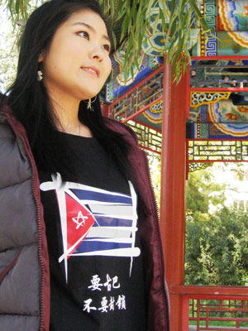
IMPERFECT TERMS:
Both Hispanic and Latino
EVOKE EUROPEAN HERITAGE AT THE EXPENSE OF:
NATIVE AMERICAN
AFRICAN
ASIAN
OTHER Heritages
NOT Represented by These Terms
Edwin David Aponte, Santo!: Varieties of Latina/o Spirituality. Orbis Books , 2012

Slide 7
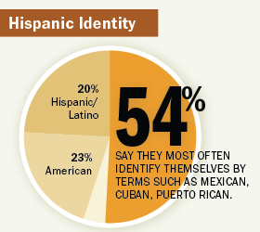
MIRIAM JORDAN, ‘HISPANICS’ Like Clout, Not the Label. WALL STREET JOURNAL, April 4, 2012.

Slide 8
Population
55 million
The Hispanic population of the United States as of July 1, 2014
Making people of Latinos origin the nation's largest ethnic or racial minority.
Latinos constituted 17 percent of the nation's total population
US CENSUS BUREAU: Hispanic Heritage Month 2015 September 14, 2015 Release Number: CB15-FF.18 www.census.gov/newsroom/facts-for-features/2015/cb15-ff18.html

Slide 9
Population
1.15 million
Number of Latinos added to the nation's population between July 1, 2013, and July 1, 2014.
Close to half people added to the nation's population during this period.
US CENSUS BUREAU: Hispanic Heritage Month 2015 September 14, 2015 Release Number: CB15-FF.18 www.census.gov/newsroom/facts-for-features/2015/cb15-ff18.html

Slide 10
National Origin/Heritage/Background - 2013
64%
The percentage of those of Latino origin in the United States who were of Mexican background
9.5 percent were of Puerto Rican
3.7 percent Cuban
3.7 percent Salvadoran
3.3 percent Dominican
2.4 percent Guatemalan
Remainder: other Central American, South American or other Hispanic or Latino origin.
US CENSUS BUREAU: Hispanic Heritage Month 2015 September 14, 2015 Release Number: CB15-FF.18 www.census.gov/newsroom/facts-for-features/2015/cb15-ff18.html

Slide 11
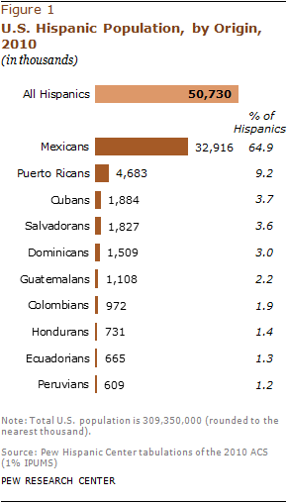

Slide 12
States and Counties - 2014
8 states have 1 million or more Latino residents
Arizona
California
Colorado
Florida
Illinois
New Jersey
New York
Texas.
US CENSUS BUREAU: Hispanic Heritage Month 2015 September 14, 2015 Release Number: CB15-FF.18 www.census.gov/newsroom/facts-for-features/2015/cb15-ff18.html

Slide 13
States and Counties - 2014
55% of US Latino population lives in California, Florida and Texas
15 million Latinos live in California.
The largest Hispanic population of any state.
US CENSUS BUREAU: Hispanic Heritage Month 2015 September 14, 2015 Release Number: CB15-FF.18 www.census.gov/newsroom/facts-for-features/2015/cb15-ff18.html

Slide 14
Spanish Language
38.4 million
The number of U.S. residents 5 and older who spoke Spanish at home in 2013.
120 percent increase since 1990
13.0 percent of U.S. residents 5 and older. More than half (58 percent) of these Spanish speakers spoke English very well.
73.3%
Percentage of Hispanics 5 and older who spoke Spanish at home in 2013.

Slide 15
MIAMI-DADE

Slide 17
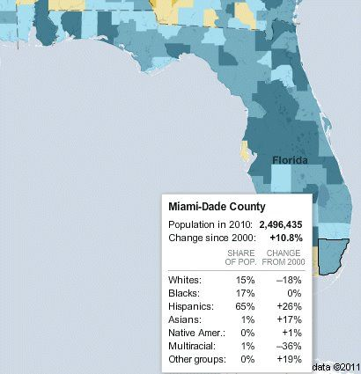

Slide 18
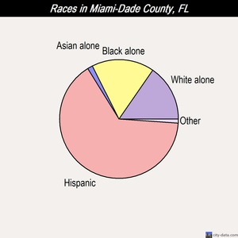

Slide 19
Miami-Dade County, Florida Religious Traditions, 2010
372175 4440 544449 71458 1503913
Notes:
Total Christian 921064
29 "other" denominations are included in the Religious Congregations & Membership Study 2010.
Association of Messianic Congregations, Baha’i, Buddhism, Church of Christ, Scientist, Church of Jesus Christ of Latter-day Saints, The Community of Christ, Judaism, Hindu, Jain, Jehovah's Witnesses, Muslim, National Spiritualist Association of Churches, New Apostolic Church of North America, National Organization of the, Shinto, Sikh, Swedenborgian Church, Tao, Messianic Jewish, Unitarian Universalist , Unity Churches, Association of, Zoroastrian
The unclaimed population - not adherents of any of the 236 groups included in the Religious Congregations & Membership Study, 2010 - not an indicator of irreligion or atheism, as it also includes adherents of groups not included in these data.
Religious Congregations & Membership Study, 2010 THE ASSOCIATION OF RELIGION DATA ARCHIVES.

Slide 20
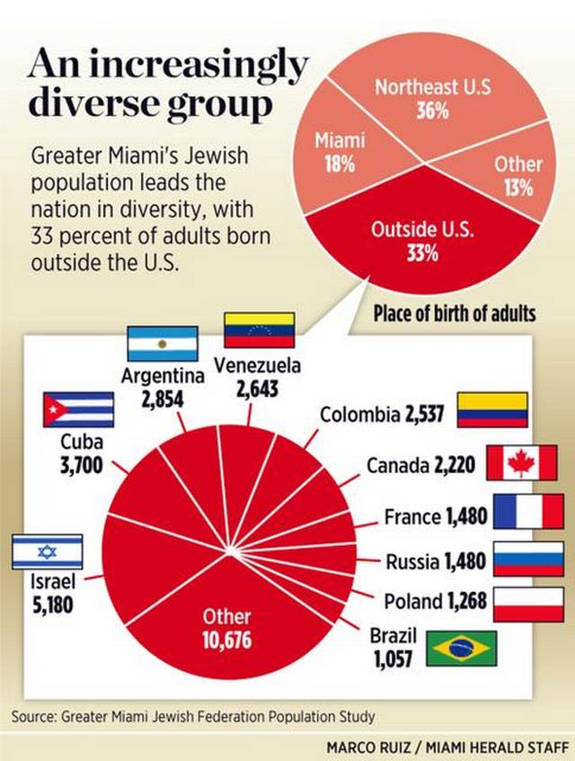
Notes:
NY and Miami: Two Largest Jewish Communities in the USA

Slide 21
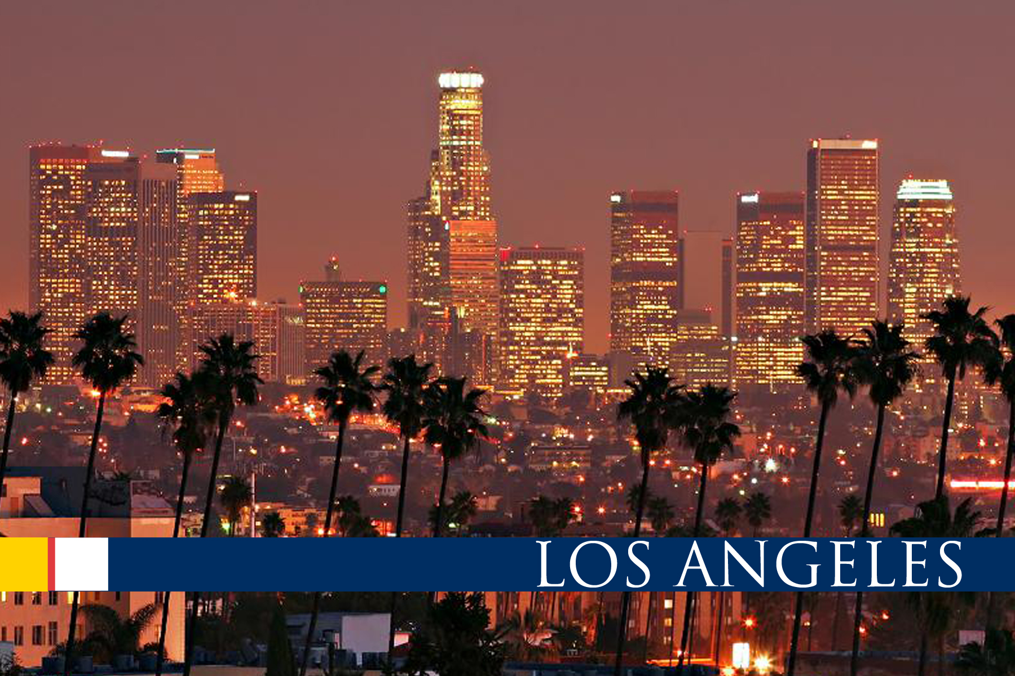

Slide 22
Notes:
HISPANIC OR LATINO Total population9,818,605100.0Hispanic or Latino (of any race)4,687,88947.7Mexican3,510,67735.8Puerto Rican44,6090.5Cuban41,3500.4Other Hispanic or Latino [2]1,091,25311.1Not Hispanic or Latino5,130,71652.3

Slide 23
Los Angeles County, California Religious Traditions, 2010
Notes:
Congregational adherents include all full members, their children, and others who regularly attend services. The 2010 reports contain incomplete counts of congregations and adherents belonging to the eight largest historically African-American denominations. These denominations are not included in the 2000 reports and are largely missing from the 1990 and 1980 reports.
http://www.thearda.com/rcms2010/r/c/06/rcms2010_06037_county_name_2010.asp
Unclaimed Population
Explanation:
The unclaimed population are those that are not adherents of any of the 236 groups included in the Religious Congregations & Membership Study, 2010. This number should not be used as an indicator of irreligion or atheism, as it also includes adherents of groups not included in these data.

Slide 24
Some of the major areas of difference within groups include:
Educational level,
English language proficiency,
Financial resources,
Adherence to folk customs and beliefs,
Geographic location,
Health status,
Racial/Ethnic Identity,
and Preferred language.

Slide 25
Latino/Hispanic Cultural Group - NOT homogeneous
BUT many beliefs, practices, and institutions in common.

Slide 26
Culturally Appropriated Care
Range of culturally related health belief
Culture = worldview
Includes “experiences, expressions, symbols, materials, customs, behaviors, morals, values, attitudes, and beliefs created and communicated among individuals,” and past down from generation as cultural traditions.
(California Endowment, 2003).

Slide 27
So who are we?
LATINOS share a strong heritage that includes family and religion
Each subgroup of the Latino population has distinct cultural beliefs and customs

Slide 28
CULTURE
Within these groups there are characteristics which define:
The use of language,
The role of family,
Religion/spirituality,
The definitions of illness, and
The use of healing/treatment practices in health provision and seeking behaviors.

Slide 29
The use of language,
Spanish is the primary language of many Latinos. There are numerous dialects/variations, but little difficulty with understanding among those who have differences.
•

Slide 30
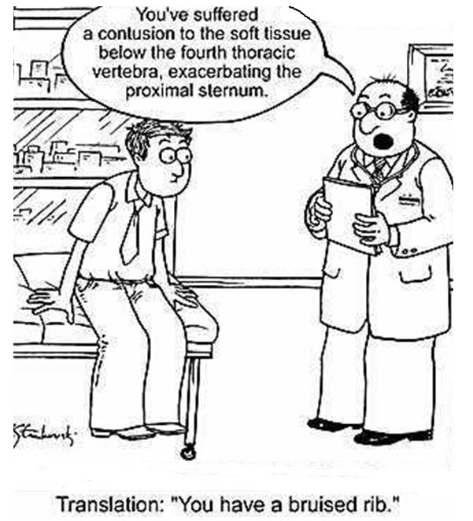
Notes:
You may not speak the same language even when you speak the same language

Slide 31
Why is it so hard to pronounce
Pérez?

Slide 32
The use of language,
Among the young, it is common to use a mix of Spanish and English.
Reading and writing are not common means of communication among those from lower socio-economic backgrounds.

Slide 34
There is an element of formality in Hispanic interactions, especially when older persons are involved:
Overfamiliarity is NOT appreciated in early relationships.
It is uncommon for Hispanics to be aggressive or assertive in health care interactions.
Direct eye contact is less.
Usually response is silence and noncompliance.

Slide 35
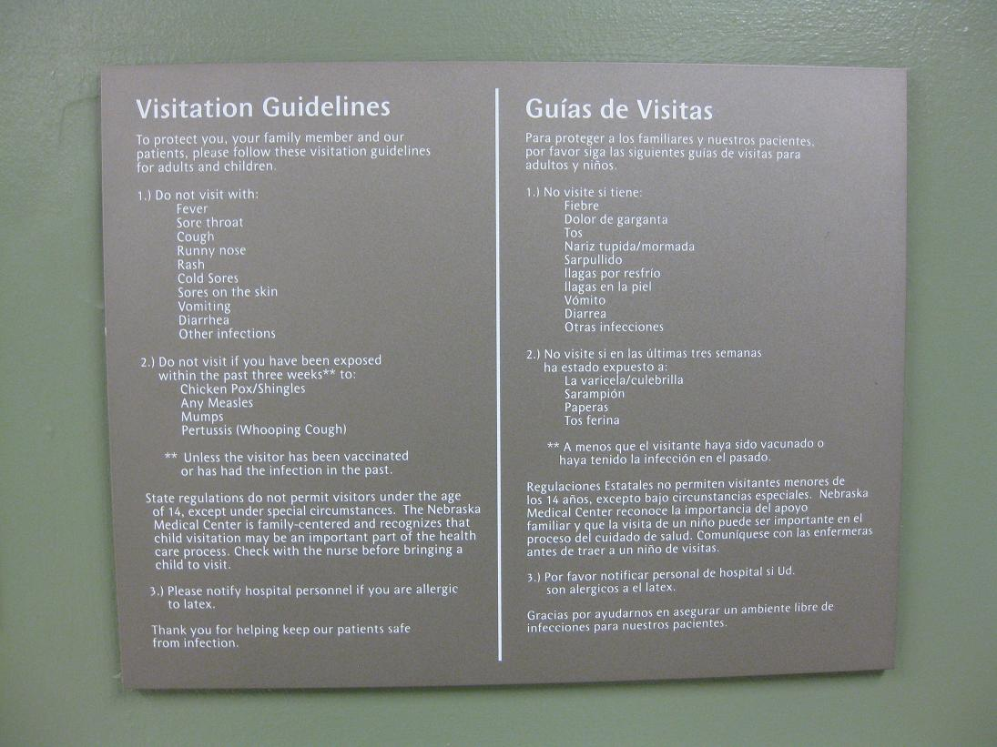
The Importance of Signs

Slide 36
Most Latinos, including those from traditional backgrounds, use cosmopolitan sources of health care (e.g., primary care physicians) as primary sources of health care.

Slide 37
Some Latino patients may prefer to use home remedies and may consult a folk healer, known as a curandero.

Slide 39
Common hierarchy of seeking relief from lay healers:
Home Remedies
Relatives / Neighbors (especially females)
Yerbatero (Herbalist)
Sobador (massage therapist)
Partera (midwife who may also treat children)
Curandero (lay healer that intervenes in multiple dimensions – physical / spiritual)
Doctor Naturalista – prescribe natural remedies without spiritual component.
Medico Chino

Slide 40
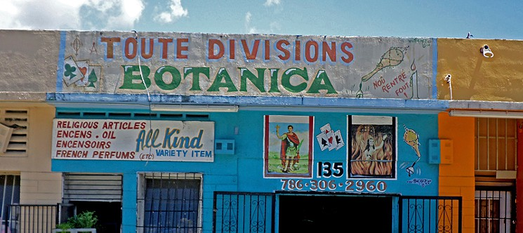
FOLK HEALERS

Slide 41
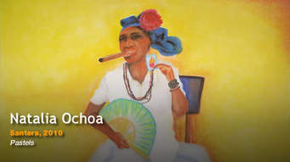
Afro – Catholic Folk Healers

Slide 42
Folk Medicine

Slide 43
Medications are shared with social networks.
Sick person simultaneously will be using:
Prayer
Folk and/or herbal medicine
Prescription Medication obtained from a friend
Prescription medications prescribed by a NP or MD.

Slide 44
Antibiotics
Antibiotics - easily obtained without a prescription
One study found -
Hispanic/Latino parents more likely to feel that antibiotics are a required treatment for their offspring as compared to non-Hispanic/Latino whites.
NY Study 2004 –
Hispanic/Latino area surveyed,
antibiotics were available without a prescription
in all of the grocery stores.

Slide 45
Regardless of the source of care, the patient (and family) are likely to include faith in God as a vital component of understanding of the problem and the cure

Slide 46
Unique belief and values shape their worldview
 | CULTURAL THEME | Description
 | Familismo | Importance of family at all levels: nuclear, extended, fictive kin (compadres). Needs of family take precedence over individual needs. Mutual reciprocity.
 | Personalismo | Display of mutual respect, trust building.
 | Jerarquismo | Respect for hierarchy.
 | Presentismo | Emphasis on present.
 | Espiritismo | Belief that good / evil spirits can affect well being and spirit of the dead person.
 | Fatalism | means that they have an external locus of control. God’s sovereignty and God’s providence may decrease personal responsibility and may lead them to become passive and to feel powerless.

Slide 47
The use of healing/treatment practices in health provision and seeking behaviors.
Remedies Everyone Should Know
Spanish Name | English Name | Uses | Efficacy | Safety
Ajo | Garlic | Hypertension, antibiotic, cough | + | +++
Azarcon/Greta | Lead/Mercury oxides | Empacho , teething | -- | ---
Eucalipto | Eucalyptus (Vicks Vapor Rub) | Asthma, bronchitis, TB | + respiratory 0 TB | +
Manzanilla | Chamomile | Nausea, flatus, colic, anxiety, eyewash | + except eye wash | ++ If not allergy
Oregano | Oregano | Expectorant, menstrual difficulties, worms | 0/+ except worms | +

Slide 48
Remedies Everyone Should Know
Spanish Name | English Name | Uses | Efficacy | Safety
Ruda | Rue | Antipasmodic, abortifacient, empacho, insect repellent | ??? | - Intern / extern
Saliva | Sage | Prevent hair loss, coryza, diabetes | ??? | --- Chronic use
Tilia | Linden flower | Sedative, hypertension, | + sedative ??? Others | -- chronic use
Yerba Buena | Spearmint | Dyspepsia, flatus, colic, susto | ++ | +
Zapila | Aloe Vera | External – cuts, burns Internal – purgative, immune stimulant | ++++ external +??? Internal | + ext - Int
Zapote Blanco | Sapodilla | Insomnia, hypertension, malaria | ??? | ???

Slide 49
Hispanics live longer.
Hispanics live longer.
Despite having a lower income than white Americans,
Hispanics live longer than whites.
Hispanics average life-expectancy:
75.1 years for men
82.6 years for women
White Americans - 74.8 years for men
80.1 years for women
(U. S Census Bureau, 2008a)

Slide 50
DIET
Rice & Bean prepared with lard.
Tortilla, arepa or bread with every meal.
In the USA fast foods are common.
Chicken soup (caldo de pollo / gallina) is frequently is given to persons who are ill

Slide 51
Pregnancy, Childbirth, and child- rearing
Pregnancy is viewed as natural, and there is tendency to seek prenatal care late in pregnancy or in some cases, not seeking care until delivery
The extended family and community exert a strong influence on health practices related to pregnancy and childbirth.

Slide 52
Pregnancy, Childbirth, and child- rearing
When going to clinic for prenatal be accompanied by their husbands; and more common for them to be accompanied by a sister, mother, or other female relative.
Female play a significantly supportive role throughout pregnancy and into the post natal period or la cuarentena.

Slide 53
Pregnancy, Childbirth, and child- rearing
Child-rearing is primarily the woman's responsibility in most families.
Hispanic homes are warm and protective toward the children.
Familism is a thread throughout Hispanic life, including in child-rearing. (Older children have significant responsibility for younger siblings or relatives).

Slide 55
Dying and Death Practice
The family is often significantly involved in caring for a family member who is dying.
Autopsies and organ donations are usually resisted, especially by Catholics, but also by others.
Public expression of grief is expected
Under some circumstances, especially among women.
Use of humor/social event - coping

Slide 56
Disease Prevention and Health Promotion
Neither prevention nor promotion are valued.
Higher prevalence of chronic illness, and seeking care late.
Much of this is contingent on levels of education
Economic access to care

Slide 57
IMPLICATION SUMMARY
Some Hispanics have UNIQUE traditional health beliefs and practices and these are practiced to varying degrees.
Some traditional practices are helpful some are harmful.
Is this faith based or fear based?
Notes:
Curative or Predatory?

Slide 58
IMPLICATION SUMMARY
Some are reluctant to share their beliefs with healthcare providers.
It is important to know about them and when possible assess health beliefs and practices (there are tools available).

Slide 59
Brief Assessment of Patient/Family Perception of Health Problems
What do you think caused your problem?
Do you have an explanation for why it started when it did?
What does your sickness do to you; how does it work?
How severe is your sickness? How long do you expect it to last?
What problems has your sickness caused you?
What do you fear about your sickness?
What kind of treatment do you think you should receive?
What are the most important results you hope to receive from this treatment?
developed by Tripp-Reimer, Brink, & Saunders (1984)

Slide 60
Cross-Cultural Interview Questions
What do you call the illness?
What do you think has caused the illness?
Why do you think the illness started when it did?
What problems do you think the illness causes? How does it work?
How severe is the illness? Will it have a long or short course?
What kind of treatment do you think is necessary? What are the most important results you hope to receive from this treatment?
What are the main problems the illness has caused you?
What do you fear most about the illness?
________________________________________
Kleinman A, Eisenberg L, Good B. Culture, illness and care: clinical lessons from anthropologic and cross-cultural research. Ann Intern Med. 1978; 88:251–8.

Slide 61
The Primacy of Relationships and Courtesy A brusque health care provider may:
Not learn of significant needs or problems
The patient will probably not return.
Communications and the relationship between patient and health care provider are key to providing quality care.
Trust and interpersonal comfort is a critical component of the relationship between the person who is ill and the healer

Slide 62
Communication & Language Issues
Early attention to building rapport will go a long way to facilitate communication.
Rapport begins through exchange of pleasantries or chit-chat before beginning the business of medical history-taking and physical examination.
Personalismo is an essential quality for providers to have when caring for this population.
Hispanics expect health care personnel to be warm and personal and express a strong need to be treated with dignity.

Slide 63
Questions

Slide 64
A CASE STUDY
INTRODUCTION
PHYSICAL DESCRIPTION
DEMOGRAPHIC INFORMATION
SYSTEM RELFECTIONS
MEDICAL HISTORY
ASSESSMENT SUMMARY
FAMILY SYSTEM
RELIGIOUS/SPIRITUAL SYSTEM
PASTORAL REFLECTION
ASSESSING PATIENT’S NEEDS
MEETING THE PATIENT’SNEEDS
Notes:
INTRODUCTION
PHYSICAL DESCRIPTION
DEMOGRAPHIC INFORMATION
SYSTEM RELFECTIONS
MEDICAL HISTORY
ASSESMET SUMMARY
FAMILY SYSTEM
RELIGIOUS/SPIRITUAL SYSTEM
PASTORAL REFLECTION
ASSESIG PATIENT’S NEEDS
B.MEETING THE PATIENT’S NEEDS

Slide 65
