Slide 1

A Compassionate Caregiving Model
Supported by Research and Practice
The Research
Amy Hegener, PhD Candidate
Researcher
Presented by Marc C. Kluender, PhD
Clinical Psychologist
Board Member, ShareTheCaregiving, Inc.

Slide 2
Caregiving Deeply Impacts The Life Of Everyone
There are only four kinds of people in this world:
1. Those who have been caregivers
  2. Those who are currently caregivers
  3. Those who will be caregivers
  4. Those who will need caregivers
- Former First Lady Rosalynn Carter
Notes:
The mission of sharethecaregiving, Inc. is to promote group caregiving as a proven option for meeting the needs of individuals who are seriously or chronically ill; individuals in rehabilitation; or the elderly.
Sharethecaregiving, Inc. will seek to inform and educate individuals, communities, clergy, corporations, and healthcare providers about Share The Care, a model that details how to create and operate a unique extended family-type support system that addresses the physical, social and emotional needs of individuals and provides needed support for the caregivers who make up this “created family.”

Slide 3
Who Are Family Caregivers?
National estimates: 65.7 million Americans over the age of 18 provide unpaid support to older people/adults with disabilities/special health needs children.
Market value of their activity far exceeds that spent on formal health care/nursing home care.
      Caregiving in the US,
      National Alliance of Caregivers, 2010
Notes:
The mission of sharethecaregiving, Inc. is to promote group caregiving as a proven option for meeting the needs of individuals who are seriously or chronically ill; individuals in rehabilitation; or the elderly.
Sharethecaregiving, Inc. will seek to inform and educate individuals, communities, clergy, corporations, and healthcare providers about Share The Care, a model that details how to create and operate a unique extended family-type support system that addresses the physical, social and emotional needs of individuals and provides needed support for the caregivers who make up this “created family.”

Slide 4
Risks to Family Caregivers
On-going strain exacts a toll, even for those who take pride in being able to give care.
43% of caregivers report unmet psychosocial needs, making functioning as a caregiver more difficult (Soothill et al., 2001).
Health problems (depression, chronic pain, stroke) are exacerbated (Brown & Brown 2014).
Older caregivers are at particular risk since their already vulnerable health and immune response systems are taxed (Navaie, Waliser et al. 2012).
Notes:
The mission of sharethecaregiving, Inc. is to promote group caregiving as a proven option for meeting the needs of individuals who are seriously or chronically ill; individuals in rehabilitation; or the elderly.
Sharethecaregiving, Inc. will seek to inform and educate individuals, communities, clergy, corporations, and healthcare providers about Share The Care, a model that details how to create and operate a unique extended family-type support system that addresses the physical, social and emotional needs of individuals and provides needed support for the caregivers who make up this “created family.”

Slide 5
Share The Care:
More Than a Support Group
“Society depends on family caregivers to provide care for their loved ones but does little to teach them how to do it and support them in this stressful work.”
Patient Safety and Quality: An Evidence-based Handbook for Nurses
Editor – R.G. Hughes
Share The Care approach does not result in just a support group but is also the basis for a powerful group system that …anticipates the inevitable hurdles this kind of group faces and provides an effective process for dealing with those issues.
www.sharethecare.org
Notes:
The mission of sharethecaregiving, Inc. is to promote group caregiving as a proven option for meeting the needs of individuals who are seriously or chronically ill; individuals in rehabilitation; or the elderly.
Sharethecaregiving, Inc. will seek to inform and educate individuals, communities, clergy, corporations, and healthcare providers about Share The Care, a model that details how to create and operate a unique extended family-type support system that addresses the physical, social and emotional needs of individuals and provides needed support for the caregivers who make up this “created family.”

Slide 6
RESEARCH OVERVIEW
Comprehensive descriptive evaluation of STC
• survey
• follow-up phone interview
Subjects include former STC groups
• caregivers
• care receivers
• individual group members
Subjects from
• United States
• Canada
• Australia
• Hong Kong
• UK

Slide 7
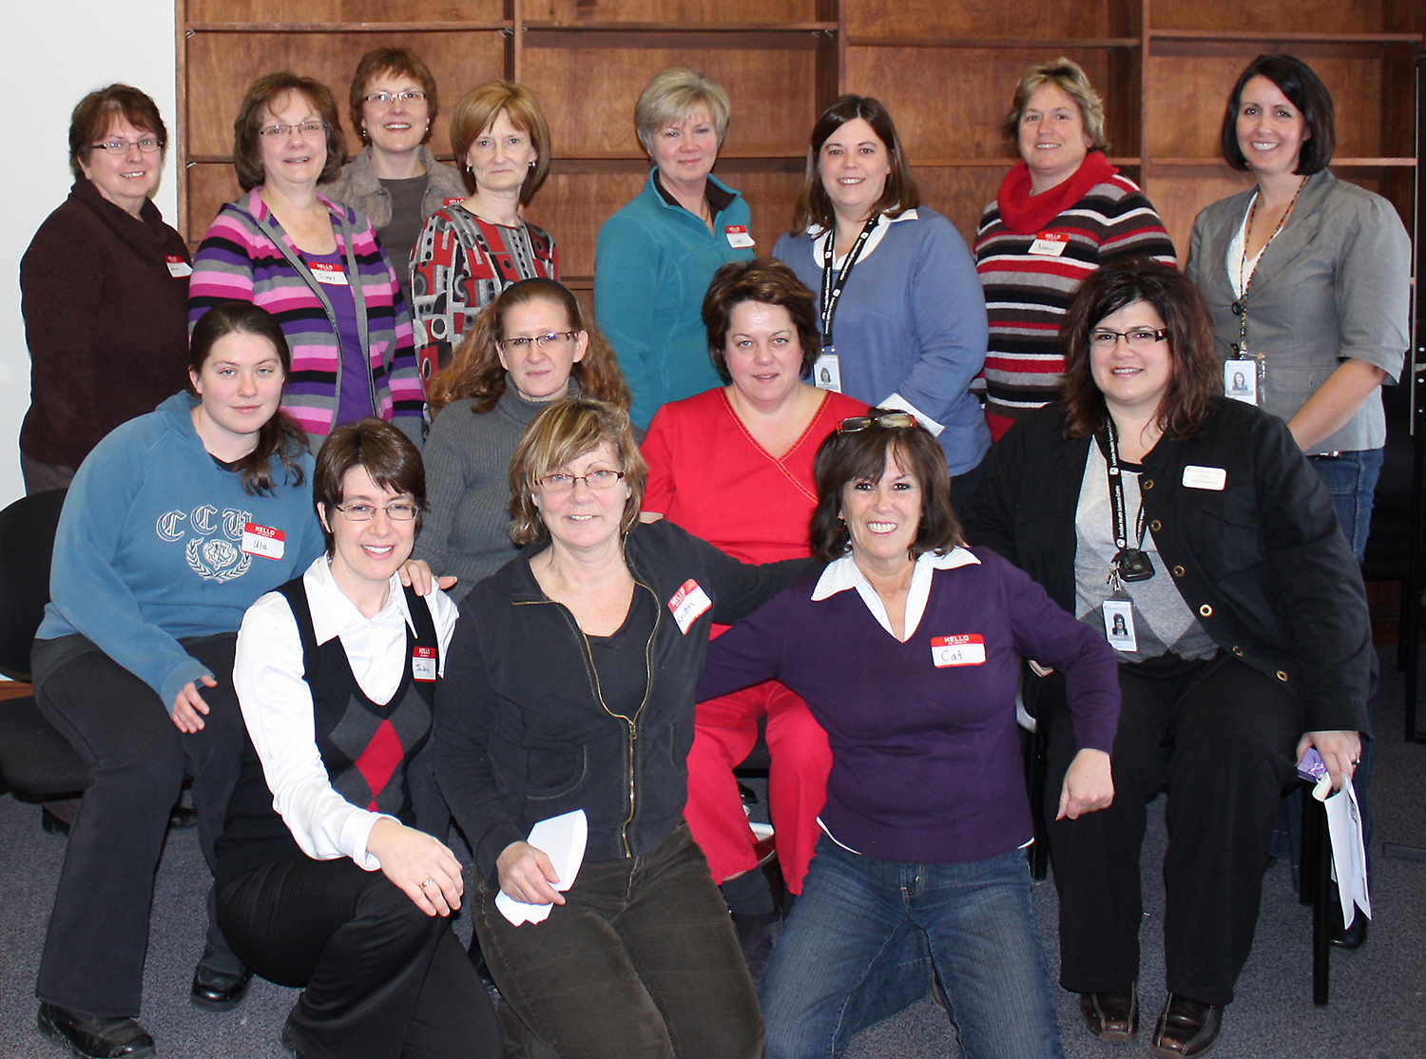
Research Purpose: To establish Share The Care™ as a best practice intervention that is supported and informed by evidence.

Slide 8
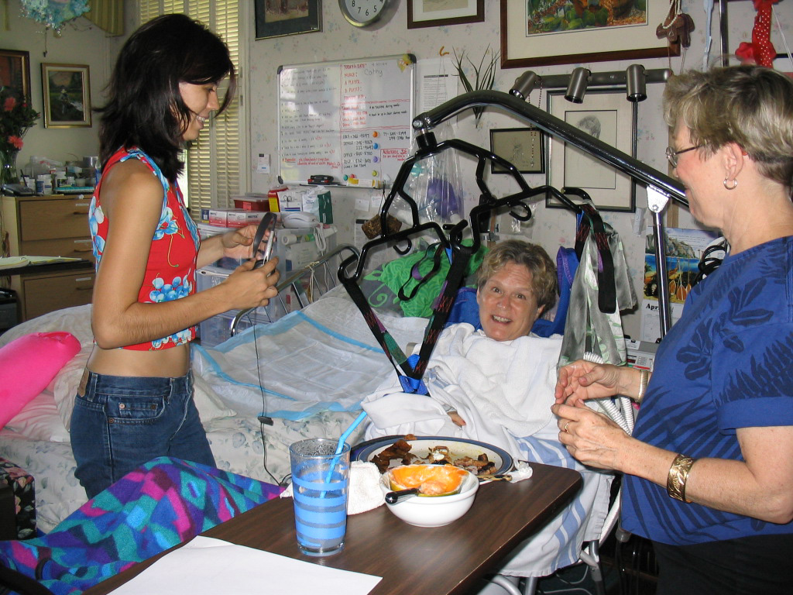
RESEARCH QUESTIONS:
• Does participation reduce
caregiver burden and burnout?
• Is there an association between
participation and improved
confidence in caregiving skills?
• Is there an association between
Share The Care’s unique structures
and processes and group members’
satisfaction?

Slide 9
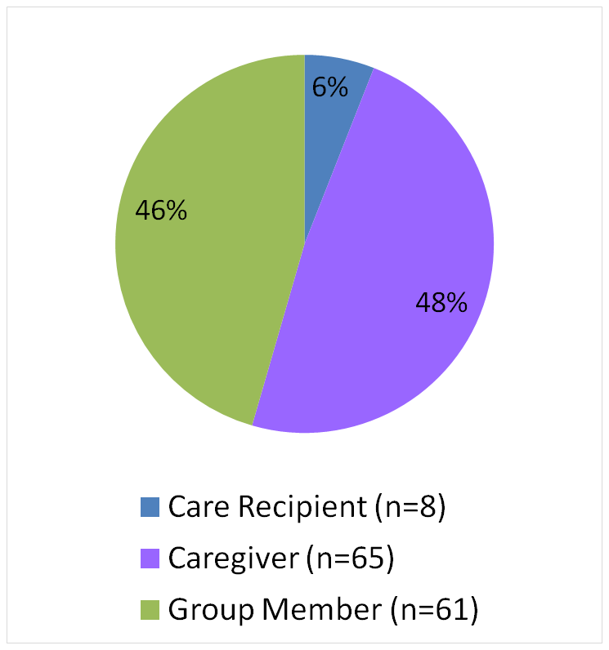
RESEARCH DESIGN:
No intention to demonstrate causation, but rather to explore impact program on the participants involved.
Mixed Methods:
Online Surveys (n= 134)
Structured Interviews (n=9)
Study limitations:
Retrospective
Sample lacked racial or economic diversity
Non-experimental design
Notes:
Three Separate Surveys - one for each stake holder
HOW MANY QUESTIONS?
SURVEY CONDUCTED IN 2014

Slide 10
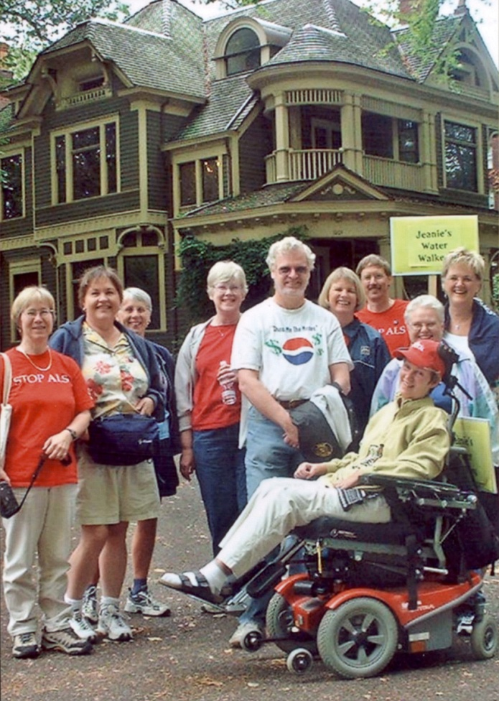
GROUP CHARACTERISTICS
  Three fourths (75%) providing assistance to an individual with a serious or terminal illness.
  Half (48%) lasted one year or longer.
  Three-fourths (76%) of group members contributed 1 to 6 hours per week.

Slide 11

Share The Care positively
associated with the
following outcomes:
Contributing to a reduced level
of burden among caregivers
Supporting a care receiver to stay at home
with the necessary supports

Slide 12
Share The Care positively
associated with:
Improving the well-being of
participants by focusing on
a distinct psychological
structure
4. Enhancing the caregiving skills of participants by preparing them for future caregiving situations

Slide 13
Share The Care : Broad Scale Replication
• Low Cost - decreasing the reliance on more costly systems
• Adaptable - demonstrating variability that can be applied across settings and cultures
• Sustainable - maintaining cohesiveness over the group’s life
Share The Care addresses community needs:
  1. Decreases caregiver burden and social isolation
  2. Prepares communities to meet the challenges of
  an aging society
  3. Improves end-of-life care

Slide 14
Research Finding
83% of caregivers reported a decreased
sense of burden which they attributed
to having others help them.
“The nicest thing about Share The Care is the idea that no one person should feel the burden, sorrow or pain to hold it all. It’s a really nice model for care taking.”
Group Leader of a Share The Care group
“I remember crying at the initial meeting. I was blown away
by the incredible support rallying around our family.
That gave me such a visceral experience of the the power
of being part of a community. It cracked my heart open
more than it had been before.”
Care Recipient of same Share The Care group
Notes:
The mission of sharethecaregiving, Inc. is to promote group caregiving as a proven option for meeting the needs of individuals who are seriously or chronically ill; individuals in rehabilitation; or the elderly.
Sharethecaregiving, Inc. will seek to inform and educate individuals, communities, clergy, corporations, and healthcare providers about Share The Care, a model that details how to create and operate a unique extended family-type support system that addresses the physical, social and emotional needs of individuals and provides needed support for the caregivers who make up this “created family.”

Slide 15
Share The Care Addresses Multiple Issues
Burden of social isolation
“ We sicken and die too much alone.
Society has sophisticated physical apparatus to keep
us alive as long as possible but not much to offer us
for dealing with the solitude, fear, guilt, fatigue and
other trials that accompany serious illness.
Sometimes we need to stop living so much alone.
This extraordinary book shows the way.”
Sukie Miller, PhD, Psychotherapist
From Forward of the book Share The Care
Notes:
The mission of sharethecaregiving, Inc. is to promote group caregiving as a proven option for meeting the needs of individuals who are seriously or chronically ill; individuals in rehabilitation; or the elderly.
Sharethecaregiving, Inc. will seek to inform and educate individuals, communities, clergy, corporations, and healthcare providers about Share The Care, a model that details how to create and operate a unique extended family-type support system that addresses the physical, social and emotional needs of individuals and provides needed support for the caregivers who make up this “created family.”

Slide 16
Challenges of an Aging Society
Research Findings:
Share The Care is an excellent use of community resources which enables people to remain in their homes for as long as possible. That is the human side of it.
The economic side of it reduces the cost and drain on the healthcare system.
It is critical that with an aging population those types of resources be enhanced as we go through the aging of the baby boomers. Share The Care is an extension of this. It uses community services effectively.
South West Ontario (Canada) Summative Evaluation:
Share The Care Campaign, March 30, 2011
Notes:
The mission of sharethecaregiving, Inc. is to promote group caregiving as a proven option for meeting the needs of individuals who are seriously or chronically ill; individuals in rehabilitation; or the elderly.
Sharethecaregiving, Inc. will seek to inform and educate individuals, communities, clergy, corporations, and healthcare providers about Share The Care, a model that details how to create and operate a unique extended family-type support system that addresses the physical, social and emotional needs of individuals and provides needed support for the caregivers who make up this “created family.”

Slide 17
End of Life Care
Caregiving strain is often worsened by caregiving demands in end-of-life care. Where caregivers do not have enough resources (knowledge, skills, social support), caregivers can be overwhelmed.
APA Initiative on Caregivers Study
Mental and Physical Health Effect of Family Caregiving, 2010
“Some people with caregiver groups will get better; others will not. But in some way there will be healing. Let there be room for spiritual, emotional and mental healing and acknowledge yourself having a part of it.”
Capossela and Warnock, Share The Care
“Unload your grief with others who can hold it without trying to fix it, so you can be more present for your loved one.”
STC Caregiver’s reflection on end-of-life care
Notes:
The mission of sharethecaregiving, Inc. is to promote group caregiving as a proven option for meeting the needs of individuals who are seriously or chronically ill; individuals in rehabilitation; or the elderly.
Sharethecaregiving, Inc. will seek to inform and educate individuals, communities, clergy, corporations, and healthcare providers about Share The Care, a model that details how to create and operate a unique extended family-type support system that addresses the physical, social and emotional needs of individuals and provides needed support for the caregivers who make up this “created family.”

Slide 18
CAREGIVER BURDEN AND BURNOUT
Caregivers had more time for themselves.
Decreased Burden
Acceptance of Challenge

Slide 19
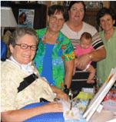
CAREGIVER BURDEN AND BURNOUT
Caregivers were better able
to balance caregiving with
other responsibilities.
“Without our group, it would have been nearly impossible for me to continue employment while taking care of my sibling.”
-STC Caregiver
Narrative Comment from Survey, 2014

Slide 20

IMPROVED CONFIDENCE IN CAREGIVING SKILLS
Group Members: Better Prepared to Meet
Future Caregiving Demands
“I had never imagined myself as a caregiver, but I now feel a lot more confident in myself being able to give care, such as moving someone, feeding, etc. It has assisted me in being more proactive and capable in looking after my young grandchildren.”
STC Group Member
2014 Survey

Slide 21
IMPROVED CONFIDENCE IN CAREGIVING SKILLS
The availability of a network eased anxiety re: tasks
Made a Difference
Increased Health Awareness

Slide 22
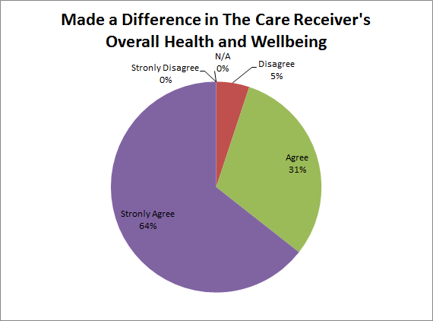
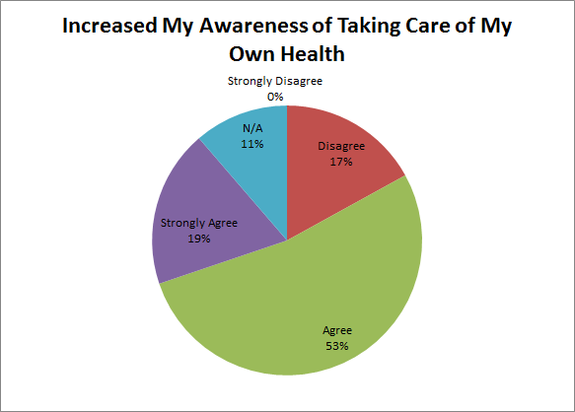
Group Members: Satisfied with both the helping experience and the care that was provided by the group.
Notes:
93 percent of caregivers report a decreased sense of burden because their friend or family member was receiving additional help.
73 percent of caregivers report an increased awareness of their own health.

Slide 23
UNIQUE PROGRAM STRUCTURE
Research Finding: A majority (92%) of group members reported the structure of STC enabled them to maintain flexibility and control over their assignments.
“Having the different experiences spread around so nobody got really burnt out made our connection with each other on the team and with our friend just kind of one of grace, one of beauty, instead of obligation.”
Share The Care Group Member 2014
Notes:
The mission of sharethecaregiving, Inc. is to promote group caregiving as a proven option for meeting the needs of individuals who are seriously or chronically ill; individuals in rehabilitation; or the elderly.
Sharethecaregiving, Inc. will seek to inform and educate individuals, communities, clergy, corporations, and healthcare providers about Share The Care, a model that details how to create and operate a unique extended family-type support system that addresses the physical, social and emotional needs of individuals and provides needed support for the caregivers who make up this “created family.”

Slide 24
STC Research: “A unique structure of shared group experience brings group member satisfaction.”
7 Guiding Principles
Sharing Responsibility is the Key to Not Burning Out.
It Won’t Work Unless Everyone Gains Something Personally.
Know Your Limits and Stick to Them.
There’s No One Right Way to Do It.
Anyone Who Wants to Help Should Be Encouraged.
Trust the Group; Support Each Other.
Keep Your Own Life in Good Working Order.
Notes:
The mission of sharethecaregiving, Inc. is to promote group caregiving as a proven option for meeting the needs of individuals who are seriously or chronically ill; individuals in rehabilitation; or the elderly.
Sharethecaregiving, Inc. will seek to inform and educate individuals, communities, clergy, corporations, and healthcare providers about Share The Care, a model that details how to create and operate a unique extended family-type support system that addresses the physical, social and emotional needs of individuals and provides needed support for the caregivers who make up this “created family.”

Slide 25
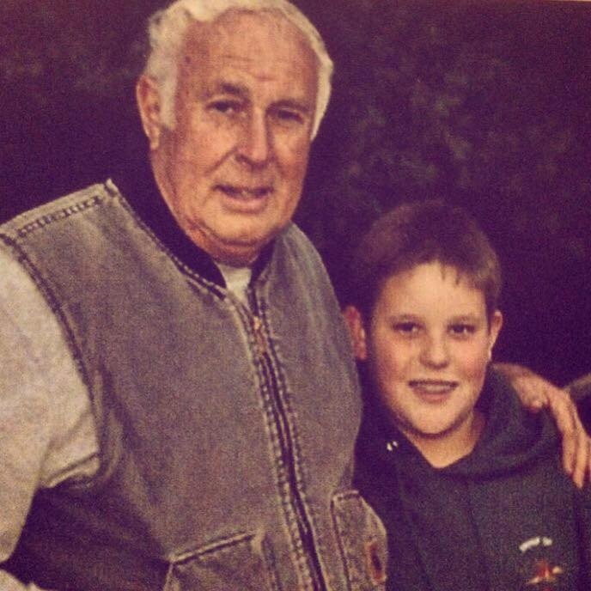
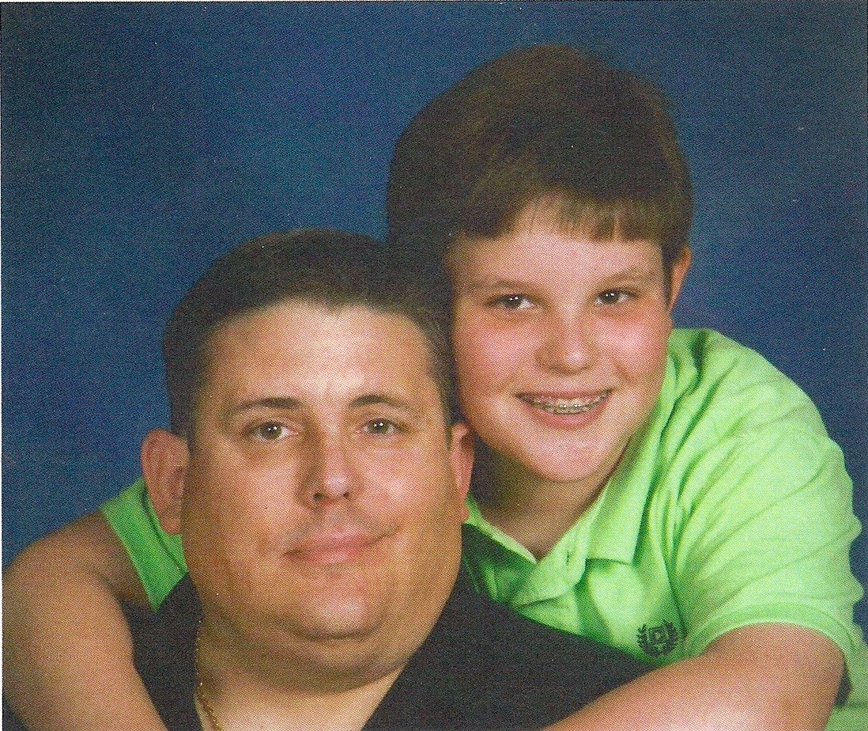
A Three Generational Story
47 Year Old Male with Kennedy’s disease
(a rare form of muscular dystrophy)
A Story of Share The Care caregiving over the last 2 years of his life

Slide 26
His father, main caregiver, narrates the story…
“.. came pretty much to the end of our rope as my son was diagnosed with MS and his wife left him. He lost his job and family. He was seriously depressed and felt hopeless.
My wife and I didn’t know what to do. You suggested Share The Care. It was a life saver for us. Sometimes you have to give up trying in order to open your eyes to new ways of dealing with stressful situations. That’s the way it was for us; we were too close to it.”

Slide 27
Principle: Sharing responsibility is the key to not burning out
“I had a ray of hope that there was something out there that might help us through this feeling of totally not being able to deal with this…
And the more I heard about Share The Care, I thought this is going to be a rather long process. But at the same time, I could see a “reality of help”.

Slide 28
Principle: Keep your own life in good working order
“Others in our Share The Care group were suffering themselves to a point that they started their own “mini” Share The Care group. Jim and his wife were part of a STC group when he became very ill. I know that Share The Care gave them ideas how to let people know what was happening to him and accept people helping him.
I think Share The Care helped a lot of people in our group and other situations that I don’t even know about. That’s the beauty of Share The Care. At its core, it creates this community of people.”

Slide 29
Principle: Trust the group and support each other
A Heavy Burden
“It’s tough to hear your son call in the middle of the night “Dad, I’m on the floor. I fell. I can’t get up. I can’t breathe.” Those were tough times.”
A Sudden Death
Almost a year later, he was driving his motorized wheelchair to join his 12 year-old son who was working with his grandad. They saw him coming, when he suddenly collapsed, fell forward from his wheelchair and died instantly.
Support Each Other
“Three friends of his came by the day he died. “They came by just to sit with us. These were big football players from his college days. They held my hand and I held theirs. We all cried together. That all came through Share The Care. It did.”

Slide 30
Caregiver Reflections on End-of-Life Care
“Death provides relief from the relentless strain of caregiving, but also represents a significant loss to the family and to the
primary caregiver…” (Schulz et.al.2003)
“…At the same time, now that he’s gone I miss that burden. He needed me and I needed him. We reconnected in a different way. We became more friends.
It was profound what happened, what the Share The Care community created. It’s easier to love people, to deeply care for people and accept where they are.
I learned to appreciate just the simple things of caring, a touch, a smile, a pat on the back; “I’ll say a prayer for you”. That’s what Share The Care brought into my life”
Caregiver a year after son’s death
Notes:
The mission of sharethecaregiving, Inc. is to promote group caregiving as a proven option for meeting the needs of individuals who are seriously or chronically ill; individuals in rehabilitation; or the elderly.
Sharethecaregiving, Inc. will seek to inform and educate individuals, communities, clergy, corporations, and healthcare providers about Share The Care, a model that details how to create and operate a unique extended family-type support system that addresses the physical, social and emotional needs of individuals and provides needed support for the caregivers who make up this “created family.”

Slide 31
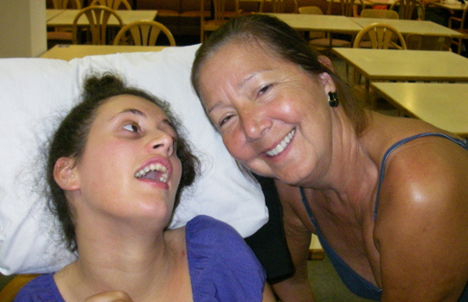
“It was the most rewarding experience of my life.
It proved that I could contribute so much without
feeling overwhelmed or overburdened. It taught me
to trust others, to know the real meaning of "team work".
Emotionally, being able to choose to help according
to my strengths and to "pass the buck" where I felt
I was weak was a Godsend!”
STC Group Member Narrative Comment from Survey, 2014

Slide 32
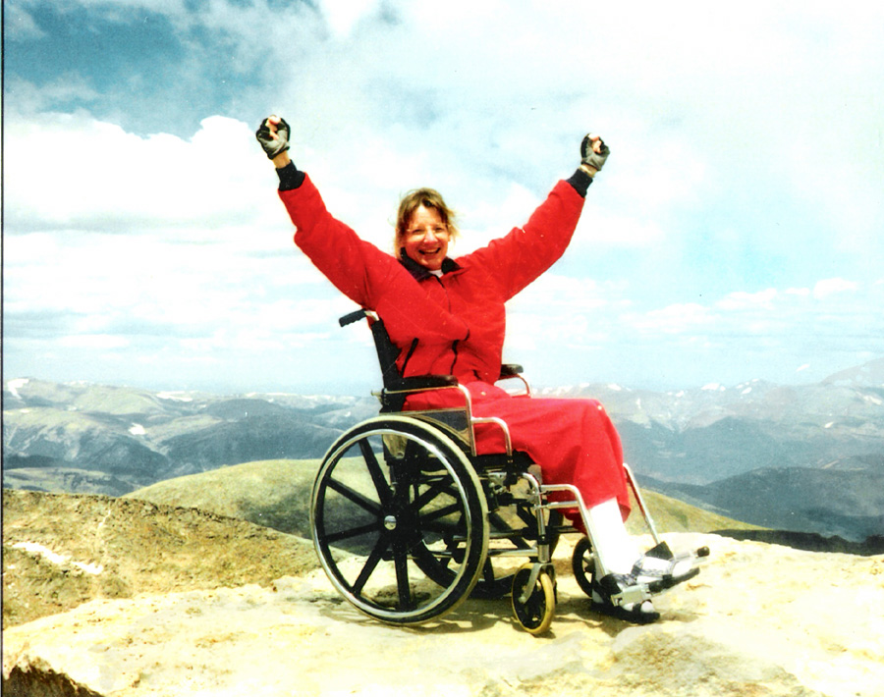

For Additional Information on:
The Share The Care™ Model: Swarnock@sharethecare.org
The Share The Care™ Research: amyksnyder78@gmail.com
Presenter: dr.marckluender@comcast.net
Share The Care Website: www.sharethecare.org

