Slide 1
A New National Survey of Hospital Directors: The Number, Roles and Functions of Hospital Chaplains
Rev. Eric Hall
President & CEO
Rev. George Handzo, BCC, CSSBB
Director, Health Services Research & Quality
Rev. Susan K. Wintz, BCC
Director, Professional & Community Education

Slide 2
Objectives
Understand the basic principles and process behind mounting and completing an online survey
Describe the basic demographics of health care chaplains in the U.S.
Leverage the results of the survey to mount growth strategies for chaplaincy in their own settings

Slide 3
Definitions
Chaplain
Spiritual Care
Chaplaincy Care
Pastoral Care
Assessment- Screening, History

Slide 4
Background
Early 2000’s, surveyed hospital chaplain directors and administrators on factors affecting provision of spiritual care
Still the only data of its kind but now about 15 yrs. old
Need updated data
By repeating could compare against original numbers

Slide 5
Process
Get a team
What questions do you want to answer?
Stakeholders/end users including field, marketing, product development
What is the field today?
How has the field changed?
What are you going to use the data for?
Draft questions
Readable layout
Beta test
Mailing lists
Data collection

Slide 6
Execution
Survey Monkey
Chose email vs. snail mail
Problems with unsolicited email- 3 month delay
Wound up with snail mail + in-house lists
More chaplaincy involved people- bias?
Data scrubbing because of write in
Lesson learned- do not use unsolicited email

Slide 7
Demographics
800 responses (2016) vs. 500 (2004)
All states and DC
Mostly general hospitals
Faith based- 30% (2016) vs. 22% (2004)
Faith based were 60% Catholic
Respondents who are chaplains- 50% (2016) vs. 40% (2004)

Slide 8
Demographics
Type of Area
Rural- 16.7 % (2016) vs. 44% (2004)
Suburban- 25.7 % (2016) vs. 25% (2004)
Urban- 45.4% (2016) vs. 30% (2004)
Type of Organization
For Profit- 13% (2016) vs. 12% (2004)
Not For Profit- 80% (2016) vs. 88% (2004)

Slide 9
Staffing
Hospitals that have a Chaplaincy Department- 61%
Professional Chaplains
71% (2016) vs. 60%(2004) have professional chaplains
How many? Median= 4
How many BCC? Median= 2 (50%)(2016) vs. 50%(2004)
How many FTE? Median= 3
How many outpatient FTE- Median- 1 (20%)
Unpaid Volunteer Chaplains
20% have unpaid volunteer chaplains
How many? Median= 7
How many FTE? Median= 2
How many BCC? Median= 1 (2%)
How many outpatient FTE? Median= 3

Slide 10
Staffing
Call Community Clergy As Needed- 80%
Chaplaincy Students
25% have students
How many? Median= 4
How many FTEs? Median= 4
How many FTEs in Outpatient? Median= 1 (2%)

Slide 11
Palliative Care
50% have palliative care teams- general hospitals were higher
Below other reported numbers
75% of teams have chaplains
Mean amount of chaplain time on the team – 50%

Slide 12
Documenting
90% of professional chaplains document
50% of volunteer chaplains document

Slide 13
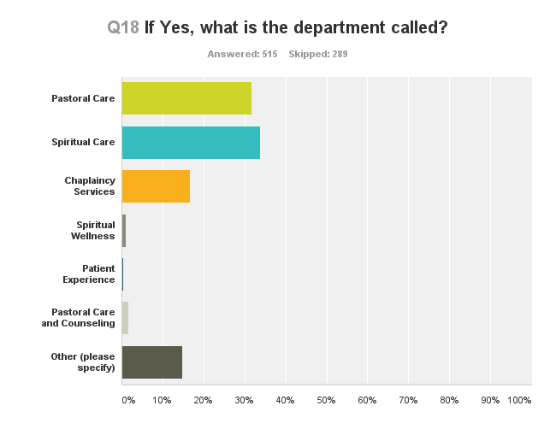
Do You Have a Chaplaincy Department?

Slide 14
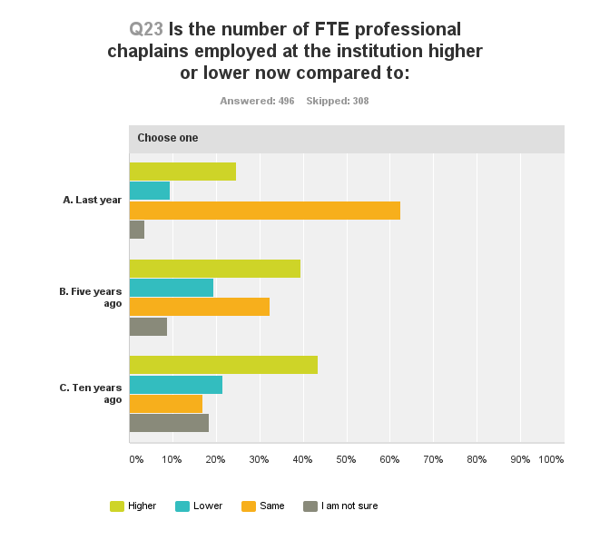

Slide 15
Drivers of Change
Downside
Budget
Upside
Perception that Chaplains Add Value
Greater Patient Demand for Spiritual Care

Slide 16
What is Important for Chaplains to Do?
Provide EOL Care- 9.46
Provide Emotional Support to Patients/Families- 9.28
Provide Emotional Support to Staff- 9.01
Pray with Patients/Families- 8.97
Help Patients/Families Dealing with Difficult Decisions- 8.82
Be the Point Person for Integrating Spirituality into the Care of Your Institution- 8.78

Slide 17
What is Important for Chaplains to Do?
Do Crisis Counseling and Debriefing for Staff- 8.70
Conduct and Document Spiritual Assessments- 8.69
Contribute to Improving Patient Satisfaction Scores-8.56
Be Part of the Palliative Care Team- 8.49
Serve as a Patient’s Advocate- 8.37
Provide Ethical Consultation- 8.37
Do Grief and Bereavement Counseling- 8.35
Be Part of Advance Care Planning Discussions- 7.98
Serve as Liaison to Local Clergy- 7.87

Slide 18
What is Important for Chaplains to Do?
Promote Patient Safety-7.81
Provide Religious Rituals-7.71**
Be a Liaison to the Community at Large-7.48
Contribute to Institutional Cost Savings- 7.18
Provide Education on Advance Directive to Patients and Families- 6.65
Provide Religious Services and Worship- 6.28**
Handle Requests for Organ and Tissue Donation- 4.53**

Slide 19
Differences Between Chaplains and Non-Chaplains
Ratings for chaplains and non-chaplains for each item were very close.
In virtually every case, the item ratings for non-chaplains were lower than those for chaplains
Only three were significantly different- Worship, Ritual & Organ Donation
Provision of religious services (worship & ritual) rated lower than most other activities. Same as last time.

Slide 20
Findings
Percentage that say they have chaplains is up in all regions of the country but 30% do not have professional chaplains.
Chaplains are assigned to Outpatient and Palliative Care but still a lot missing.
About twice as many hospitals have added chaplaincy jobs over the past 10 years as have cut them. This finding holds across all geographic regions.

Slide 21
Future Questions
Drill down on drivers of change
How do ranking of important tasks vary across variables like size and location of hospital?
What are the barriers keeping hospitals from having professional chaplains?
How do we overcome the barriers that cause chaplaincy positions to be cut?

Slide 22
Thank You

