Slide 1
Care for the Spirit
Can you hear me now?!!
An Introduction to PAIRS ESSENTIAL Workshop

Slide 2
Care for the Spirit : Can you hear me now?!!
A Brief History of the Formation of PAIRS
A Brief History of the Warrior to Soul Mate Program

Slide 3
Care for the Spirit : Can you hear me now?!!
Key Concepts:
Good Will
Empathy
Compassion
Bonding
Relationship Road Map

Slide 4
PAIN
Anger
Sadness
Hurt
Fear
PLEASURE
Happiness
Joy
Serenity
Love
Our Future
WB-16
Notes:
4

Slide 5
Relationship Road Map I The Logic of Emotion and Bonding
BIOLOGICALLY
BASED NEEDS Air – Food – Water – Shelter BONDING (Emotional Openness/Physical Closeness)
DIS-EASE DISTRESS DISTRUST
UNHAPPINESS
PAIN
DANGER
FEAR/ANGER
EASE EU-STRESS TRUST
HAPPINESS
PLEASURE
DESIRE
LOVE
SYMPTOMS OF UNHAPPINESS Illness, Fatigue Depression Rigidity of Personality Constriction, Isolation Closed, Guarded, Wary Anti-Social Behavior Range of Addictions: Drugs, Alcohol Food, Shopping, Work Gambling, Internet
SIGNS OF HAPPINESS Health, Energy Well Being Flexibility Creativity Open, Sharing Personal Responsibility Capacity for Intimacy
WB-17

Slide 6
The Language of Love “BONDING”
In the context of PAIRS, bonding represents the biologically-based human need for the combination of emotional openness and physical closeness with another person.
WB-9

Slide 7
Care for the Spirit : Can you hear me now?!!
Laying the Foundation “The Heart of Intimacy
Levels of Learning
Three Hopes – Three Fears
Stages of Relationships
Relationship Roadmap
Leveling/Congruent Style
Daily Temperature Reading
Talking Tips
The Love Bank

Slide 8
Stress Styles of Communication
The Placater or “People Pleaser”
The Blamer
The Computer
The Distracter
WB-18
Notes:
8
Copyright © PAIRS. All Rights Reserved. (877) 724-7748.
PAIRS SHM Training, University of Central Florida

Slide 9
Leveling Posture

Slide 10
Daily Temperature Reading with appreciation to Virginia Satir
Appreciations
New Information
Puzzles
Concerns with Recommendations
Wishes, Hopes, Dreams
WB-23

Slide 11
Care for the Spirit : Can you hear me now?!!
Session Two: Constructive Conflict
Emotional Stages of Development
Dirty Fighting
The Emotional Jug
Emptying the Emotional Jug
Fair Fight for Change

Slide 12
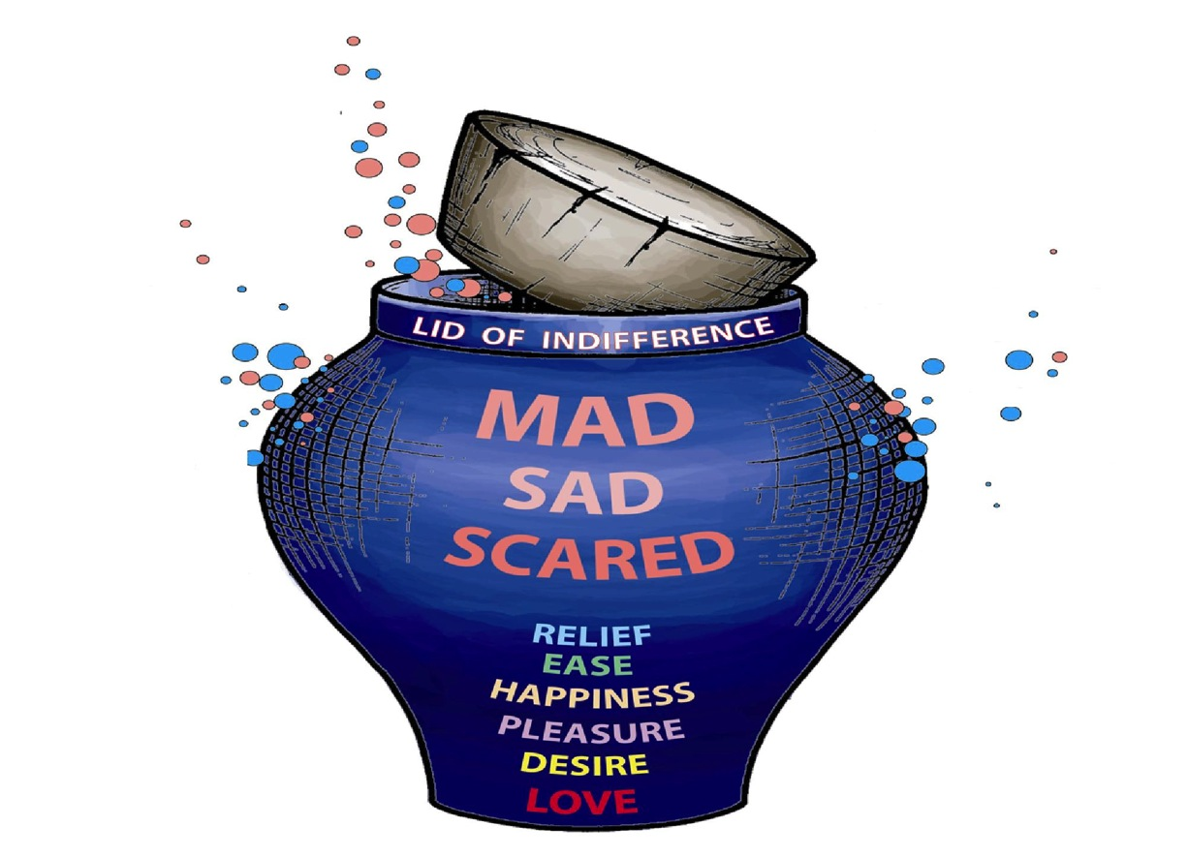
PAIRS Emotional Jug
- Blowing your Top
-Popping Your Cork
Leaks Through
DIRTY FIGHTING:
Sarcasm
Ridiculing
Threatening
Accusing
Labeling
Taunting
Laughing At
Leaks Through
DIRTY FIGHTING:
Assuming
Sneering
Contempt
Ignoring
Blaming
Stonewalling
WB-36

Slide 13
EMPTYING THE EMOTIONAL JUG
What are you MAD about? What else are you mad about?
If you were mad about anything else, what would it be? Thank You!
What are you SAD about? What else are you sad about?
If you were sad about anything else, what would it be? Thank You!
What are you SCARED about? What else are you scared about?
If you were scared about anything else, what would it be? Thank You!
What are you GLAD about? What else are you glad about?
Is there anything else that you are glad about? Thank You!
WB-37

Slide 14
Care for the Spirit : Can you hear me now?!!
Session Three: Emotional Literacy
Love Knots – Irrational Assumptions
Prowergram – Who Decides
Emotional Allergy Negative Infinity Loop
Confiding an Emotional Allergy
Transforming the Loop

Slide 15
Care for the Spirit : Can you hear me now?!!
Questions??

Slide 16
Chaplain Dick Millspaugh
Email: uni4peas@gmail.com
PAIRS Website: www.pairs.com

