Slide 1
A New Approach to Chaplain Deployment: The Hybrid Liaison Model

Slide 2
What Does it Mean to be a Jewish Hospital?
History: Alienation & Welcoming to All
Exodus 23:9 (Also Ex. 22:21) “Do not oppress a stranger; you know the feelings of a stranger, for you were strangers in the Land of Egypt.”
Values: Facilitation not Enforcement
Transcript of Knesset Member Yair Lapid's presentation at Kiryat Ono College, March 13, 2012
I’ll give you an example that I always use when talking about Haredi [ultra-orthodox]-secular relations in Israel, which is the Yom Kippur Law. Israel has the hametz Law, but still, all over Israel people eat hametz [bread products] on Passover and buy and sell leaven on Passover. And Israel has the Pork Law, but still, all over Israel people eat pork and buy and sell pork. And the only law that they keep scrupulously is the Yom Kippur Law. On Yom Kippur, not one secular Jew in Israel drives out of his driveway. And not one secular Jew in Israel would even dream of eating in public on Yom Kippur. Do you know why secular Jews keep the Yom Kippur Law so stringently? Because there is no such law. The Yom Kippur Law was never passed in Israel. It doesn’t exist.

Slide 3
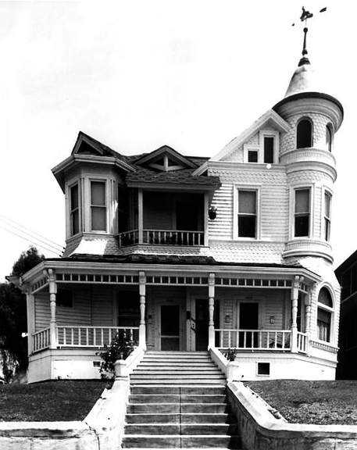
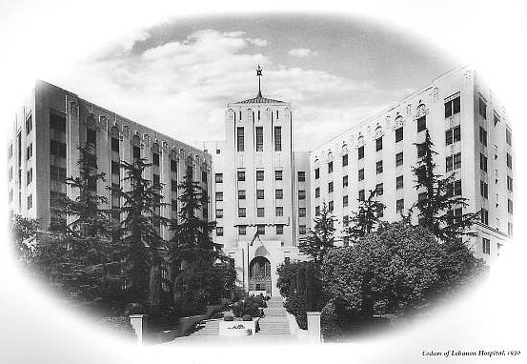
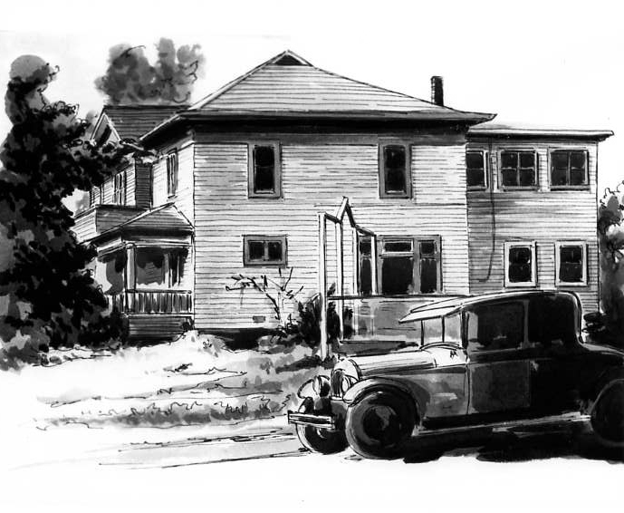
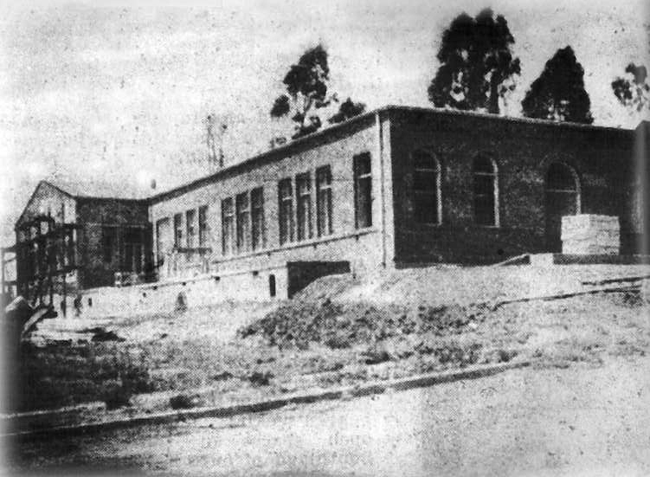
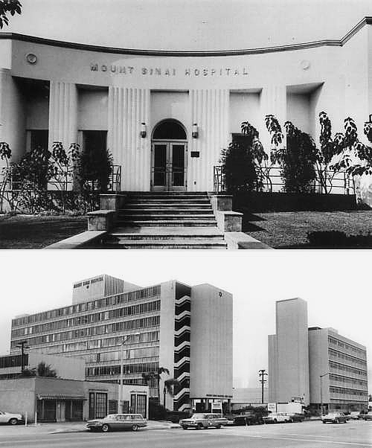
Spiritual Care History 1902-1961 and 1961-1976: The Volunteer Clergy Era
Kaspare Cohn Hospital/Cedars of Lebanon Hospital
Bikur Cholim Hospital/Mount Sinai Hospital

Slide 4
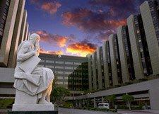
Spiritual Care History 1976-2012
Cedars-Sinai Medical Center
900 Beds
Cancer Center
Level 1 Trauma Center
Emergency Department
Spiritual Care Staffing
1976 Hired first chaplain (Catholic Priest)
1977 Hired second chaplain (Rabbi)
1977-1992 Two part-time assistant chaplains (Jewish)
Hired third chaplain 2000 (Christian Minister)
2011 Rabbi Levi Meier (z”l), Cedars-Sinai’s central, long-standing spiritual care leader passes away

Slide 5
Spiritual Care History 2012
Began national search for new rabbinic, spiritual care leader
Began Spiritual Care Assessment* – Purpose:
Ensure successful, evidence-based chaplaincy practice, including:
Meeting regulatory requirements
Maintaining the culture of Cedars-Sinai
Striving for excellence in achieving standards of practice
Improve patient and staff experiences
Facilitate further program planning and evaluation
Gain a broad-based perspective of spiritual care needs from Cedars-Sinai staff and physicians
* Consulting services provided by Michele Prince, formerly with Kalsman Institute on Judaism and Health at the Hebrew Union College – Jewish Institute of Religion

Slide 6
Timeline and Milestones
 | FEB | MAR | APR
Administration
Taskforce and Team Interviews | I | E
Taskforce Meetings | N | X | I
Chaplain Staffing, Structure, Support, Duties | T | T | N
Current Chaplaincy Usage and Coverage | E | E | T
Data and Documentation | R | R | E
Legal/Regulatory Requirements | N | N | G
External Hospital Data and Benchmark Collection | A | A | R
Referral Process and Response | L | L | A
Chaplaincy Religious Philosophies |  |  | T
Chaplaincy Student Training | F | F | I
Scholarship and Academic Values | O | O | O
Data Collection Complete | C | C | N
Visioning | U | U
Report Due | S | S
Implementation Proposal and Revisions

Slide 7
Spiritual Care Assessment Task Force
Task Force Composition – 22 leaders and front-line professionals representing 19 departments across the medical center
Evaluative Responsibilities
Provide insight, anecdotes, and data
Share history of experiences and observations
Act as a sounding board for initial findings and recommendations
Help ensure the cultural and professional diversity of opinion and thought throughout this process
Implementation Responsibilities
Help identify and navigate potential challenges during assessment and implementation
Help shift Cedars-Sinai’s culture to increase awareness of spiritual needs and care
Boost academic and scholarly thinking and efforts
Aid in the implementation of recommendations

Slide 8
Timeline and Milestones
 | FEB | MAR | APR
Administration
Taskforce and Team Interviews | I | E
Taskforce Meetings | N | X | I
Chaplain Staffing, Structure, Support, Duties | T | T | N
Current Chaplaincy Usage and Coverage | E | E | T
Data and Documentation | R | R | E
Legal/Regulatory Requirements | N | N | G
External Hospital Data and Benchmark Collection | A | A | R
Referral Process and Response | L | L | A
Chaplaincy Religious Philosophies |  |  | T
Chaplaincy Student Training | F | F | I
Scholarship and Academic Values | O | O | O
Data Collection Complete | C | C | N
Visioning | U | U
Report Due | S | S
Implementation Proposal and Revisions

Slide 9
Quantitative Data: Inpatient Census, Percentage by Faith
Data based on total inpatient census at Cedars-Sinai, Jan-Dec 2010

Slide 10
Quantitative Data – Opportunity/Picker Score
Emotional Support “Top Box” for Cedars-Sinai with five indicators most likely to impact “emotional support” scores:
Ease of finding someone to talk to
Confidence/trust in Doctors
Confidence/trust in Nurses
Doctor discussed anxieties/fears
Nurse discussed anxieties/fears
Primary Influence
Interview; Picker Summary Report August 20, 2010.
Notes:
When we did internal interviews and dialogues, we asked how spiritual care could help impact emotional support ratings – this is what we came up with. Numerous people indicated that the absence of “emotional support” was palpable on floors.

Slide 11
Qualitative Data – Interviews/Group Meetings Findings
Strong desire for increased Spiritual Care services including preliminary work:
Staff training
Increased quantity/meeting with more people
One-to-one counseling with patients, families, staff
Those who are aware of chaplains appreciate their work and want more spiritual care staff
Staff don’t use chaplains or referrals maximally
Difficult history acknowledged
National and regional competitive review indicated top hospitals show leadership in provision of Spiritual Care
Notes:
NOTES:
National competitive review indicated top hospitals also show leadership in chaplaincy services
THROUGH LARGE AND STRONG DEPARTMENTS
Implementation planning will include Cedars-Sinai’s unique religious, ethnic, and cultural considerations
HISTORIC AND CURRENT CONSIDERATIONS
STRONG COMMUNITY PRESENCE DESIRED
JEWISH DENOMINATIONAL CONSIDERATIONS

Slide 12
Timeline and Milestones
 | FEB | MAR | APR
Administration
Taskforce and Team Interviews | I | E
Taskforce Meetings | N | X | I
Chaplain Staffing, Structure, Support, Duties | T | T | N
Current Chaplaincy Usage and Coverage | E | E | T
Data and Documentation | R | R | E
Legal/Regulatory Requirements | N | N | G
External Hospital Data and Benchmark Collection | A | A | R
Referral Process and Response | L | L | A
Chaplaincy Religious Philosophies |  |  | T
Chaplaincy Student Training | F | F | I
Scholarship and Academic Values | O | O | O
Data Collection Complete | C | C | N
Visioning | U | U
Report Due | S | S
Implementation Proposal and Revisions

Slide 13
External Benchmarking – National
US News & World Report – Top 10 Hospitals (2010)
Medical Center Name | Chaplain-to-Bed Ratios
Mayo Clinic | 1:49
Ronald Reagan UCLA Medical Center (WW) | 1:58
Brigham and Women's Hospital | 1:63
Johns Hopkins | 1:83
Barnes Jewish Hospital | 1:88
Cleveland Clinic | 1:108
MA General | 1:113
Duke University Medical Center | 1:116
Hospital at the University of Pennsylvania, Phil. | 1:174
UCSF | 1:200
NY Presbyterian | 1:208
Cedars-Sinai | 1:274
Spiritual Care Assessment Report – Interviews Conducted Feb-Apr 2010.
Notes:
DOES NOT INCLUDE RESIDENTS, INTERNS – EXPLAIN CPE

Slide 14
External Benchmarking – Local
Los Angeles Medical Centers/Hospitals (2010)
Hospital Name | Chaplain-to-Bed Ratios
St. John’s | 1:48
UCLA Medical Center – Ronald Reagan Westwood | 1:58
USC County Hospital | 1:60
St. Joseph's (Providence – Burbank) | 1:62
Children's Hospital Los Angeles | 1:64
City of Hope | 1:88
USC University/Norris Hospital | 1:100
UCLA Medical Center – Santa Monica | 1:147
Cedars-Sinai | 1:274
Kaiser Hospital of Los Angeles | 1:307
Spiritual Care Assessment Report – Interviews Conducted Feb-Apr 2010.

Slide 15
Timeline and Milestones
 | FEB | MAR | APR
Administration
Taskforce and Team Interviews | I | E
Taskforce Meetings | N | X | I
Chaplain Staffing, Structure, Support, Duties | T | T | N
Current Chaplaincy Usage and Coverage | E | E | T
Data and Documentation | R | R | E
Legal/Regulatory Requirements | N | N | G
External Hospital Data and Benchmark Collection | A | A | R
Referral Process and Response | L | L | A
Chaplaincy Religious Philosophies |  |  | T
Chaplaincy Student Training | F | F | I
Scholarship and Academic Values | O | O | O
Data Collection Complete | C | C | N
Visioning | U | U
Report Due | S | S
Implementation Proposal and Revisions

Slide 16
Implementation Proposal
Hybrid Liaison Model
Personnel/Physical Space
Prioritize Units and Needs
Increase Awareness and Education
Documentation and Charting
Student Training Program in Clinical Pastoral Education (CPE)
Culture Shift: An Evolution
Aspirational Visioning
Notes:
Process/Weaknesses and Challenges
Plan – Value – Change within 12-18 months
OVERALL GOAL: Meeting Emotional and Spiritual Needs of patients, loved ones, families, and staff

Slide 17
External Benchmarking – National
US News & World Report – Top 10 Hospitals (2010)
Medical Center Name | Chaplain-to-Bed Ratios
Mayo Clinic | 1:49
Ronald Reagan UCLA Medical Center (WW) | 1:58
Brigham and Women's Hospital | 1:63
Johns Hopkins | 1:83
Cedars-Sinai | 1:87
Barnes Jewish Hospital | 1:88
Cleveland Clinic | 1:108
MA General | 1:113
Duke University Medical Center | 1:116
Hospital at the Univ. of Pennsylvania, Phil. | 1:174
UCSF | 1:200
NY Presbyterian | 1:208
Post-hiring
Spiritual Care Assessment Report – Interviews Conducted Feb-Apr 2010.
Notes:
All Academic Medical Centers have strong spiritual care offerings – most with CPE programs
ADD NEW RATIO WITH NEW HIRES? – OLD WAS 3.5 TO 958=1:274, NEW IS 11 TO 958=1:87

Slide 18
External Benchmarking – Local
Los Angeles Medical Centers/Hospitals (2010)
Hospital Name | Chaplain-to-Bed Ratios
St. Johns | 1:48
UCLA Medical Center – Ronald Reagan Westwood | 1:58
USC County Hospital | 1:60
St. Joseph's (Providence – Burbank) | 1:62
Children's Hospital Los Angeles | 1:64
Cedars-Sinai | 1:87
City of Hope | 1:88
USC University/Norris Hospital | 1:100
UCLA Medical Center - Santa Monica | 1:147
Kaiser Hospital of Los Angeles | 1:307
Post-hiring
Spiritual Care Assessment Report – Interviews Conducted Feb-Apr 2010.

Slide 19
Number of Referrals per Month (During 1st Full Year of Implementation)

Slide 20
Interfaith vs. Multifaith
No Religion is an Island
Confrontation

Slide 21
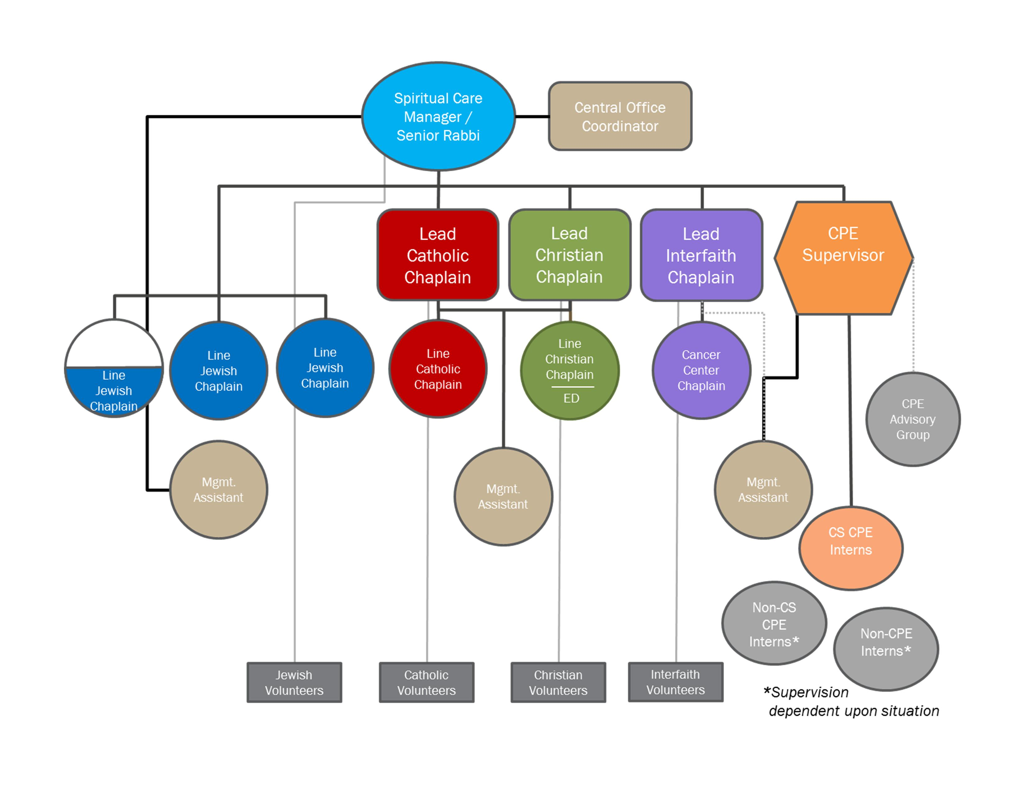
Spiritual Care Dept.
Organizational Chart

Slide 22
Referral Workflow
Staff Chaplains
Social Workers
Other
Patients
Physicians
Central Office Coordinator
CPE Students, Interns
Families
Matching
Religion
Language
Culture
Gender
Diagnosis
Other factors
Nurses
Volunteers
Notes:
Size of ovals is relative to how many referrals we receive from each source type.

Slide 23
Decision-making for CPE Interns On Assigned Unit: Should I visit this patient?
START
Did you receive a referral for this patient?
Report to Central Office Coordinator
YES
NO
NO
Check pt’s chart to see if any other chaplain is following.
Don’t visit
YES
NO

Slide 24
Decision-making for CPE Interns On Assigned Unit: Should I visit this patient?
NO
Visit and Assess: Are there faith-specific spiritual needs?
Report to Central Office Coordinator
YES
NO
Continue to follow if necessary or requested.
REPEAT PROCESS AS NEEDED

Slide 25
Typical student workflow (example uses Jewish student)
Clock in for the day
Attend interdisciplinary Progression of Care Rounds (POCR)
Receive referrals from team members (SW, RN, MD, Other)
Check email for referrals: Could be anywhere in the hospital.
Relay referrals to Central Office Coordinator for dispatch
Review charts for patients on assigned unit

Slide 26
Typical student workflow (example uses Jewish student)
Visit referrals from:
Central Office Coordinator
POCR
IN THIS ORDER
Jewish Patients
No/Other Religion Patients
Christian/Catholic Patients
Self-initiate visits with non-referred patients*
on assigned unit
*Patients who are not currently being followed by other chaplains

Slide 27
CPE Training using the Hybrid Liaison Model
Challenges
Time spent learning protocol & procedures
Faith-specific focus
Benefits
Teamwork
Faith-specific sensitivity
Strong multifaith responsibility
Patient-Centered Spiritual Care
Spiritual Screening & Assessment

