Slide 1
Using Systems Redesign to Integrate Chaplaincy with Mental Health Services
Jason A. Nieuwsma, PhD;^{1,2} William C. Cantrell, MDiv, BCC;^{1,3} &
Keith G. Meador, MD, ThM, MPH^{1,4}
1. Mental Health and Chaplaincy, Department of Veterans Affairs
2. Duke University Medical Center
3. U.S. Navy Chaplain Corps
4. Vanderbilt University
Notes:
Using Systems Redesign to Integrate Chaplaincy with Mental Health Services
Presentation Details:
2016 Health Care Chaplaincy Conference – San Diego, CA. April 11-13.
90-minute presentation: 3:50-5:20 on Tuesday, April 12.
Keith & Jason presenting.
Group discussion: 10 min
Learning Objectives:
Describe how systems redesign principles can be used to integrate mental health and chaplain services.
Identify six specific areas for improving the integration of spiritual and mental health care.
Develop an individualized approach for systematically integrating chaplaincy with mental health care.
Presenters:
Jason A. Nieuwsma, PhD (CV attached)
William C. Cantrell, MDiv, BCC (CV attached)
Keith G. Meador, MD, ThM, MPH (CV attached)
Abstract:
This workshop will review findings and present actionable recommendations derived from a yearlong VA/DoD “learning collaborative” focused on the integration of mental health and chaplain services. The learning collaborative utilized systems redesign principles (e.g., flow mapping, plan-do-study-act cycles) to improve the integration of mental health and chaplain services at 14 participating VA and DoD facilities across the country. Each facility was represented by a team that championed the integration, which was composed of a chaplain, mental health professional, and systems redesign coach. Over the course of three different action periods, teams implemented practice improvements in the following six domains: screening, referrals, assessment, documentation and communication, role clarification, and cross-disciplinary training. Teams implemented improvements in domains that were individually identified as needing improvement, and they carefully tracked metrics in their selected area of improvement. For example, a number of teams identified a gap in mental health professionals being able to screen for spiritual problems and make appropriate referrals to chaplains. These teams developed individually relevant screening instruments and practices, systematically implemented these practices in appropriate clinics, and monitored across time the number of screenings conducted and referrals generated (numerous sites went from a baseline of zero to generating multiple weekly referrals). These and other findings will be reviewed as part of the workshop, with an emphasis on principles that attendees can utilize.
The workshop presenters include a chaplain, psychologist, and psychiatrist who collaborate in leading the VA’s Mental Health and Chaplaincy program. Since 2009, this multidisciplinary team has led national efforts across VA and the military aimed at better integrating mental health and chaplain care services, as evidenced by selected publications below. The workshop will include both didactic and interactive elements, building on abbreviated key exercises that were used as part of the VA/DoD mental health and chaplaincy learning collaborative.
References:
Bulling, D., DeKraai, M.B., Abdel Monem, T., Nieuwsma, J.A., Cantrell, W., Ethridge, K., & Meador, K.G. (2014). Confidentiality and mental health/chaplain collaboration. Military Psychology, 25, 557-567.
Fitchett, G., Nieuwsma, J.A., Bates, M.J., Rhodes, J.E., & Meador, K.G. (2014). Evidence-based chaplaincy care: Attitudes and practices in diverse healthcare chaplain samples. Journal of Health Care Chaplaincy, 20, 144-160.
Kopacz, M.S., Nieuwsma, J.A., Jackson, G.L., Rhodes, J.E., Cantrell, W.C., Bates, M.J., & Meador, K.G. (in press). Chaplains’ engagement with suicidality among their service users: Findings from the VA/DoD Integrated Mental Health Strategy. Suicide and Life-Threatening Behavior.
Meador, K. G., & Koenig, H. G. (2000). Spirituality and religion in psychiatric practice: Parameters and implications. Psychiatric Annals, 30(8), 549–555.
Nieuwsma, J.A., Jackson, G.L., DeKraai, M.B., Bulling, D.J., Cantrell, W.C., Rhodes, J.E., Bates, M.J., Ethridge, K., Lane, M.E., Tenhula, W.N., Batten, S.J., & Meador, K.G. (2014). Collaborating across the Departments of Veterans Affairs and Defense to integrate mental health and chaplaincy services. Journal of General Internal Medicine, 29, S885-S894.
Nieuwsma, J.A., Rhodes, J.E., Jackson, G.L., Cantrell, W.C., Lane, M.B., Bates, M.B., DeKraai, M.B., Bulling, D.J., Ethridge, K., Drescher, K.D., Fitchett, G., Tenhula, W.N., Milstein, G., Bray, R.M., & Meador, K.G. (2013). Chaplaincy and mental health in the Department of Veterans Affairs and Department of Defense. Journal of Health Care Chaplaincy, 19, 3-21.
Zullig, L.L., Jackson, G.L., Provenzale, D., Griffin, J.M., Phelan, S., Nieuwsma, J.A., & van Ryn, M. (2014). Utilization of hospital-based chaplain services among newly diagnosed Veterans Affairs colorectal cancer patients. Journal of Religion and Health, 53, 498-510.

Slide 2
Learning Objectives
Describe how systems redesign principles can be used to integrate mental health and chaplain services.
Identify six specific areas for improving the integration of spiritual and mental health care.
Develop an individualized approach for systematically integrating chaplaincy with mental health care.

Slide 3
Presentation Outline
Background and Rationale
Mental Health and Chaplaincy Learning Collaborative
Methodology
Findings
Recommendations and Conclusions

Slide 4
Background & Rationale

Slide 5
Why Integrate Mental Health and Chaplain Services?
People who are suffering turn to clergy and/chaplains.^{1,2}
Spirituality and mental health are related in meaningful ways, with particularities for service members and veterans.^{3,4}
Integration between mental health and chaplaincy is suboptimal, and much remains to be done.
Wang, P. S., Berglund, P. A., & Kessler, R. C. (2003). Patterns and Correlates of Contacting Clergy for Mental Disorders in the United States. Health Services Research, 38(2), 647–673.
Nieuwsma, J.A., Fortune-Greeley, A.K., Jackson, G.L., Meador, K.G., Beckham, J.C., & Elbogen, E.B. (2014). Pastoral care use among post-9/11 veterans who screen positive for mental health problems. Psychological Services, 11, 300-308.
Fontana, A., & Rosenheck, R. (2004). Trauma, change in strength of religious faith, and mental health service use among veterans treated for PTSD. Journal of Nervous and Mental Disease, 192(9), 579–584.
Iversen AC, van Staden L, Hughes JH, Browne T, Greenberg N, Hotopf M, Fear NT, et al. Helpseeking and receipt of treatment among UK service personnel. British Journal of Psychiatry. 2010; 197:149–155.
Notes:
Matt: National Comorbidity Study: people seeking help for mental health care problems are more likely to turn to clergy than a psychiatrist.
Psychiatrist (17/140=12%); Other MH specialist (43/140=31%) (including psychologists, mental health counselors, social workers other than in a social services agency, or providers in outpatient mental health or alcohol or drug clinics); Non-psychiatrist MD (23/140=16%) (including general practitioners, family physicians, and physician specialists such as cardiologists or gynecologists); Clergy (24/140=17%) (including ministers, priests, or rabbis); tx provided by clergy is typically lower intensity (i.e., fewer sessions) than that of other providers; majority see only clergy and no other provider; effect more pronounced in the South (Bible Belt); Alternative (26=18%) (including spiritualists, herbalists, natural therapists, faith healers, or self-help groups); hence, this group contains many “spiritual care providers;” Human services (8/140=6%) (including counselors or social workers specifically in a social service agency or department).
Note that this is people seeking mental health care services, not people suffering from mental illness or who could benefit from some form of mental health care. If it were the latter, the percentages for PCPs and clergy become larger.
Post 9/11 people turned to clergy and pastoral counselors.
Notion that people don’t come to us asking for to fix their “mental health problem” vs. “spiritual problem,” but come “suffering.”
Familiar
Financial reasons
Stigma
Shared worldview: there is a disconnect between pts and mental health care providers. Health care providers in general are less religious than the populations they serve; mental health care providers are significantly less religious than average health care provider (and, ironically, spirituality is much more salient in regard to mental health than in regard to dental health; mental health care providers and clergy are both in the business of telling people how to live)
First responders: funeral arrangements, marital conflicts, personal crises
Organic
Many of these similarities for clergy also translate for chaplains.
Chaplains are frontline providers for Veterans and Service members with mental health needs.
Majority of issues presented to military chaplains are mental health related.
Chaplains provide a safety net for service members reluctant to seek mental health care due to stigma.
Traditional chaplain training has not equipped them to optimally respond to mental health related issues.
Most mental health providers and chaplains are receptive and willing to work toward integration of services for optimal care of service members.

Slide 6
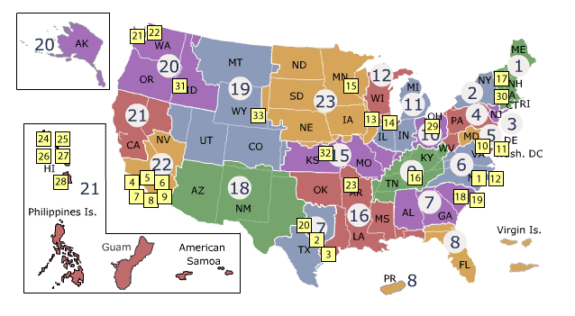
Recent History of Mental Health and Chaplaincy Integration across VA and DoD
Survey
(N = 2,163)
Site Visits
(N = 33 sites)
Task Group
(N = 38)
IMHS
(2010-2013)
VA/DoD Integrated Mental Health Strategy (IMHS) Final Report: http://www.mirecc.va.gov/mentalhealthandchaplaincy/Docs_and_Images/Expanded%20IMHS%20SA23%20Mental%20Health%20and%20Chaplaincy%20Report.pdf
MHICS
(N = 40)
Learning Collaborative
(N = 14 sites)
Broad Education
JIF
(2013-present)
DoD/VA Joint Incentive Fund (JIF) Final Report:
http://www.mirecc.va.gov/mentalhealthandchaplaincy/Docs_and_Images/Chaplains_MH_JIF_Final_Report.pdf

Slide 7
IMHS Methods
Quantitative: VA/DoD Chaplain Survey
Assessed chaplain practices with respect to spiritual and mental health care
M = 42 minutes to complete
Response rates: 75% in VA (n = 440 / 585); 60% in DoD (n = 1,723 / 2,879)
Qualitative: VA/DoD Site Visit Interviews
Facilities: 17 VA; 15 DoD; 1 Joint
Providers: 201 mental health; 195 chaplains
Task Group (n = 38)
Employer: 17 VA; 14 DoD; 7 external
Professions: chaplaincy; psychology; psychiatry; social work; epidemiology; other
Nieuwsma, J.A., Jackson, G.L., DeKraai, M.B., Bulling, D.J., Cantrell, W.C., Rhodes, J.E., Bates, M.J., Ethridge, K., Lane, M.E., Tenhula, W.N., Batten, S.J., & Meador, K.G. (2014). Collaborating across the Departments of Veterans Affairs and Defense to integrate mental health and chaplaincy services. Journal of General Internal Medicine, 29, S885-S894.

Slide 8
IMHS Chaplain Survey Perceived Understanding & Valuing
Nieuwsma, J. A., Rhodes, J. E., Cantrell, W. C., Jackson, G. L., Lane, M. B., DeKraai, M. B., Bulling, D. J., Fitchett, G., Milstein, G., Bray, R. M., Ethridge, K., Drescher, K. D., Bates, M. J., & Meador, K. G. (2013). The intersection of chaplaincy and mental health care in VA and DoD: Expanded report on VA / DoD Integrated Mental Health Strategy, Strategic Action #23. Washington, DC: Department of Veterans Affairs and Department of Defense.

Slide 9
IMHS Chaplain Survey: Routes to Care
 | VA n (%) | DoD n (%) | p
Veterans/SMs come to me on their own without referral. | 295 (68%) | 1,511 (89%) | <.001
I go to Veterans/SMs without them being referred to me. | 372 (85%) | 1,080 (64%) | <.001
Veterans/SMs are referred to me by other professionals / their commanding officers. | 268 (62%) | 627 (37%) | <.001
Veterans/SMs are referred to me by their fellow Veterans/SMs. | 154 (36%) | 803 (47%) | <.001
Veterans/SMs are referred to me by non-Veteran/SM family or friends. | 75 (17%) | 266 (16%) | .731
Nieuwsma, J. A., Rhodes, J. E., Cantrell, W. C., Jackson, G. L., Lane, M. B., DeKraai, M. B., Bulling, D. J., Fitchett, G., Milstein, G., Bray, R. M., Ethridge, K., Drescher, K. D., Bates, M. J., & Meador, K. G. (2013). The intersection of chaplaincy and mental health care in VA and DoD: Expanded report on VA / DoD Integrated Mental Health Strategy, Strategic Action #23. Washington, DC: Department of Veterans Affairs and Department of Defense.
Notes:
Stress informal routes to care (top two, though different order, are both informal…chaplain or pt initiative).
SM = Service member. Percentages are of chaplains who reported that they come into contact with Veterans or Service members "Frequently" or "Almost always" in the manners listed. (Scale was: Never, Rarely, Sometimes, Frequently, Almost Always.) VA chaplains were asked about "Veterans" and "professionals." DoD chaplains were asked about "Service members" and "commanding officers." Missing data for the above variables ranged from 4 (1%) to 9 (2%) cases out of the total VA sample (n = 440), and 26 (2%) to 41 (2%) cases out of the total DoD sample (n = 1,723). Percentages in the table are based out of the total number of those that responded to each item.

Slide 10
IMHS Chaplain Survey: Referrals
Chaplains making referrals to mental health
VA: 43% reported rarely (less than monthly or never)
DOD: 37% reported rarely
Chaplains receiving referrals from mental health
VA: 36% reported rarely
DOD: 74% reported rarely
Nieuwsma, J. A., Rhodes, J. E., Cantrell, W. C., Jackson, G. L., Lane, M. B., DeKraai, M. B., Bulling, D. J., Fitchett, G., Milstein, G., Bray, R. M., Ethridge, K., Drescher, K. D., Bates, M. J., & Meador, K. G. (2013). The intersection of chaplaincy and mental health care in VA and DoD: Expanded report on VA / DoD Integrated Mental Health Strategy, Strategic Action #23. Washington, DC: Department of Veterans Affairs and Department of Defense.
Notes:
(Scale was: Never, Less than monthly, Monthly, Weekly, Daily or almost daily.) Make point about different potential ways to interpret this and how these differences embody some of the issues that will come up in this learning collaborative (e.g., can chaplains even place a “consult” or referral).

Slide 11
IMHS Site Visit Findings: Common Themes from Interviews
Most common themes* to arise from interviews with DoD chaplains and mental health professionals:
Mental health should have general awareness of chaplain practices.
Professional relationships encourage cross-disciplinary referral and integration.
Chaplains currently don’t have or should have a general awareness of mental health.
Chaplains would benefit from training in mental health evidence-based practices.
* Themes were systematically identified using a grounded theory approach following completion of interviews with 396 chaplains & mental health professionals in DoD & VA. Of the 122 themes ultimately coded for, these were among the most common.
Nieuwsma, J.A., Jackson, G.L., DeKraai, M.B., Bulling, D.J., Cantrell, W.C., Rhodes, J.E., Bates, M.J., Ethridge, K., Lane, M.E., Tenhula, W.N., Batten, S.J., & Meador, K.G. (2014). Collaborating across the Departments of Veterans Affairs and Defense to integrate mental health and chaplaincy services. Journal of General Internal Medicine, 29, S885-S894.

Slide 12
IMHS Task Group Input: Barriers & Solutions
Barriers
1. Lack of cross-training
2. Professional roles blur
3. Different desired outcomes
4. Discomfort with respective specialties
5. Resources
6. Chaplaincy subsumed by medical model
7. Proselytizing
8. Lack relationships
9. Cultural differences (confidentiality)
10. Lack of community collaboration
11. Chaplaincy resistance of evidence-based
12. Lack of common value system
Solutions
Cross-training of Chap/MH Embrace integrated roles Standardize processes across entire systems Change from bottom up Prevent proselytizing and communicate that not goal of chaplaincy Gain permission from pt to share information Involve other healthcare providers Involve chaplains in identifying expectations and measures
Nieuwsma, J.A., Rhodes, J.E., Jackson, G.L., Cantrell, W.C., Lane, M.B., Bates, M.B., DeKraai, M.B., Bulling, D.J., Ethridge, K., Drescher, K.D., Fitchett, G., Tenhula, W.N., Milstein, G., Bray, R.M., & Meador, K.G. (2013). Chaplaincy and mental health in the Department of Veterans Affairs and Department of Defense. Journal of Health Care Chaplaincy, 19, 3-21.

Slide 13
Mental Health and Chaplaincy Learning Collaborative
Methods

Slide 14
Using the Learning Collaborative Process to Integrate Mental Health and Chaplaincy: Systems Redesign Rationale
Learning collaboratives have been used in healthcare since the mid-1990’s to encourage improvement in care processes
Based on concepts of lean management – engineering and management principle aimed at getting from current care processes to desired future care processes
Used to clarify to process of caring for patients (e.g., how to screen and refer appropriate patients between clinical services)
Utilizes local teams of clinical and administrative stakeholders who understand how things are done at their own treatment facilities
Notes:
What is “quality improvement?”
Lean
Six Sigma
TQM
VA-TAMMICS
…numerous others
All share in common the aim of taking a systematic approach to:
understanding current practices & identifying areas for improvement
developing improvements
testing out improvements
refining improvements

Slide 15
Learning Collaborative: Rationale and Process
Notes:
HK: Do we need to define home team? Will the speaker note that Learning Sessions (at least 2 for DoD) were in person?

Slide 16
Mental Health and Chaplaincy Learning Collaborative Goals
Establish chaplains as collaborators within models of integrated mental health care.
Improve reliability, efficiency, and usefulness of care processes by sharing information about strong practices across sites.
Increase timely, reliable, bidirectional access to chaplain and mental health services for Veterans and Service members with PTSD and mental health problems.
Establish participating facilities as resources for other sites seeking to better integrate mental health and chaplain services.
Contribute to the optimization of health system performance as delineated by VA Triple Aims and DOD Quadruple Aims.
Notes:
Enhance quality of MH care and incorporate dimensions of spirituality that have been lacking.
Increase cross-disciplinary understanding and communication.
Consider what are “credible” outcomes? And can some of them be “weaker” for certain aims?
Educating chaplains about broader vision of “community health,” and chaplain’s role in taking initiative to make linkages in that, etc. (benefits of stigma reduction, connectedness in communities).
Other goals:
Establish integrated care practices between mental health and chaplaincy
Improve reliability, efficiency, and usefulness of care processes
Increase timely, reliable, bidirectional access to chaplain and MH services
Successful integration will contribute to the optimization of health system performance as delineated by VA Triple Aims and DOD Quadruple Aims

Slide 17
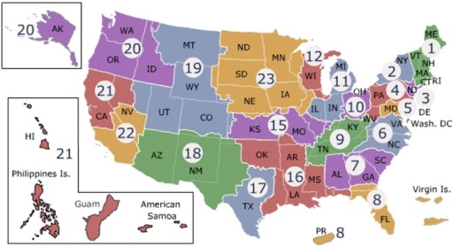
Mental Health and Chaplaincy Learning Collaborative Site Locations
V1
V2
V4
V5
D6
D4
D2
D3
V3
D1
V6
D5, D7
V7
Participating VA Facilities:
V1 = Cheyenne VA Medical Center, Cheyenne Vet Center, Cheyenne, WY & Ft. Collins Vet Center, Ft. Collins, CO
V2 = Louis Stokes Cleveland VA Medical Center, Cleveland, OH
V3 = VA North Texas Health Care System, Dallas, TX
V4 = Richard L. Roudebush VA Medical Center, Indianapolis, IN
V5 = VA Pittsburgh Health Care System, Pittsburgh, PA
V6 = South Texas Veterans’ Health Care SystemSan Antonio, TX
V7 = James A. Haley Veterans’ Hospital, Tampa, FL
Participating DoD Facilities:
D1 = Naval Hospital, Pensacola, FL
D2 = Naval Hospital, Camp Lejeune, NC
D3 = Naval Medical Center, San Diego, CA
D4 = Army Ft. Belvoir Community Hospital, Ft. Belvoir, VA
D5 = Army Southern Regional Medical Command, San Antonio, TX
D6 = Army Pacific Region Medical Center, Tripler, Honolulu, HI
D7 = Air Force Joint Base, San Antonio, TX
Notes:
Seven VA and seven DoD teams were selected for participation in the collaborative. VA teams were invited to participate in the collaborative based on preexisting knowledge of facilities and personnel from the IMHS site visits, recommendations from VA National Chaplain Center leadership, and geographic diversity. DoD teams were selected in close coordination with appropriate leadership in the domains of mental health and chaplaincy in the three branches of the military. Figure 2 displays the names and locations of participating VA and DoD facilities. Teams consisted of:
Core team from facility (required to participate in all activities):
Mental health provider champion (traveled to learning sessions)
Chaplain champion (traveled to learning sessions)
Non-clinical team member (did not travel)
Support staff members identified and provided by learning collaborative leadership:
Team level coach (a process improvement expert)
Integration of mental health and chaplaincy coach captain

Slide 18
Site selection
December 2013 –
February 2014*
Action Period #3
October 30, 2014 – February 13, 2015*
Sustain &
Spread
Learning Session #3
October 28-29, 2014
Pre-work
March 10 – April 7, 2014*
Action Period #2
July 24 – October 27, 2014
Learning Session #1
April 8-9, 2014*
Learning Session #2
July 22-23, 2014
Action Period #1
April 10 – July 21, 2014*
*DoD teams were delayed in joining the collaborative and therefore had later dates of participation for aspects of the collaborative.

Slide 19
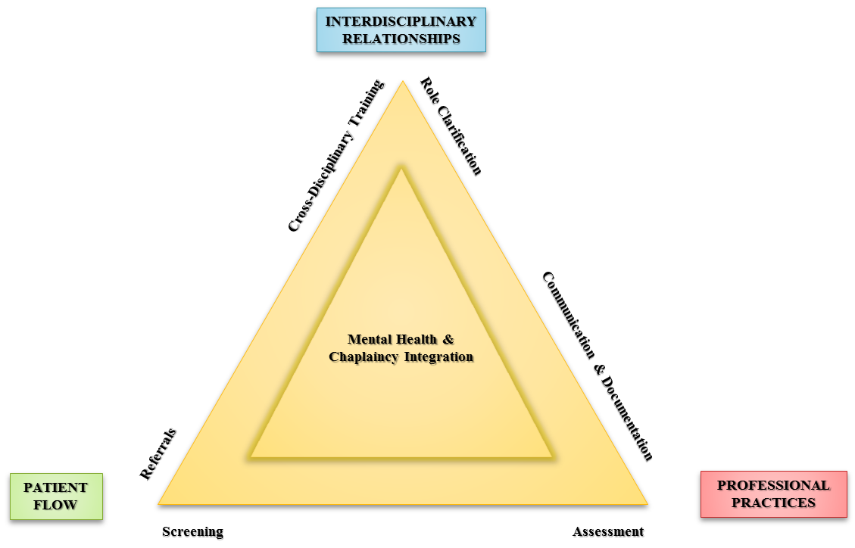
Learning Collaborative Model
Learning Session #3
Learning Session #1
Learning Session #2

Slide 20
Learning Session #1 Aims: Patient Flow
Screening:
Evaluate current practices for screening patients for spiritual and mental health issues, with the intention of strengthening existing practices and/or implementing new research-informed screening practices where none exist.
Referrals:
Strengthen and/or develop clearly articulated processes for referring patients between disciplines, including processes to contact the other discipline, communicate the core issue, articulate a basic care plan, and close the loop.
Notes:
Screening - Evaluate current practices for screening patients for spiritual and mental health issues, with the intention of strengthening existing practices and/or implementing new research-informed screening practices where none exist.
Referrals - Strengthen and/or develop clearly articulated processes for referring patients between disciplines, including processes to contact the other discipline, communicate the core issue, articulate a basic care plan, and conduct follow up.
Assessment - Develop, improve, and/or ensure standardized use of multidimensional spiritual and mental health assessments that can contribute to making effective referrals and to providing relevant healthcare information to the other discipline.
Communication and Documentation - Establish regular communication practices, ideally as part of recurring integrated care team meetings, and document care and consults in a useful manner to the other discipline (at facilities where chaplain documentation of care is expected).
Cross-Disciplinary Training - Champion cross-disciplinary training opportunities, at a minimum to inform colleagues about the aims of and rationale for this learning collaborative.
Role Clarification - Develop a better understanding of chaplain and mental health provider roles, culminating in the development of formal documentation of how mental health and chaplain services collaborate (e.g., care coordination agreement).

Slide 21
Learning Session #2 Aims: Professional Practices
Assessment:
Develop, improve, and / or ensure standardized use of multidimensional spiritual and mental health assessments that can contribute to making effective referrals and to providing relevant healthcare information to the other discipline.
Communication & Documentation:
Establish regular communication practices, ideally as part of recurring integrated care team meetings, and document care and consults in a useful manner to the other discipline (at facilities where chaplain documentation of care is expected).

Slide 22
Learning Session #3 Aims: Interdisciplinary Relationships
Cross-Disciplinary Training:
Champion cross-disciplinary training opportunities, at a minimum to inform colleagues about the aims of and rationale for this learning collaborative.
Role Clarification:
Develop a better understanding of chaplain and mental health provider roles, culminating in the development of formal documentation of how mental health and chaplain services collaborate (e.g., care coordination agreement).

Slide 23
Mental Health and Chaplaincy Learning Collaborative
Findings
Nieuwsma J.A., King H.A., Cantrell W.C., Jackson G.L., Bates M.J., Rhodes J.E., Wright L., Bidassie B., White B., Davis R.C., Ethridge K., Roddenberry V., O’Mara S., Gatewood S., Irvine R.J., Meador K.G. (2015). Improving patient-centered care via integration of chaplains with mental health care: Department of Veterans Affairs (VA) / Department of Defense (DoD) Joint Incentive Fund project final report. Durham, NC: Department of Veterans Affairs Mental Health and Chaplaincy Program.

Slide 24
Mental Health and Chaplaincy Learning Collaborative: Team Focus Areas
PDSA = Plan, Do, Study, Act Cycle
Last reporting period was 4/1/2015.

Slide 25
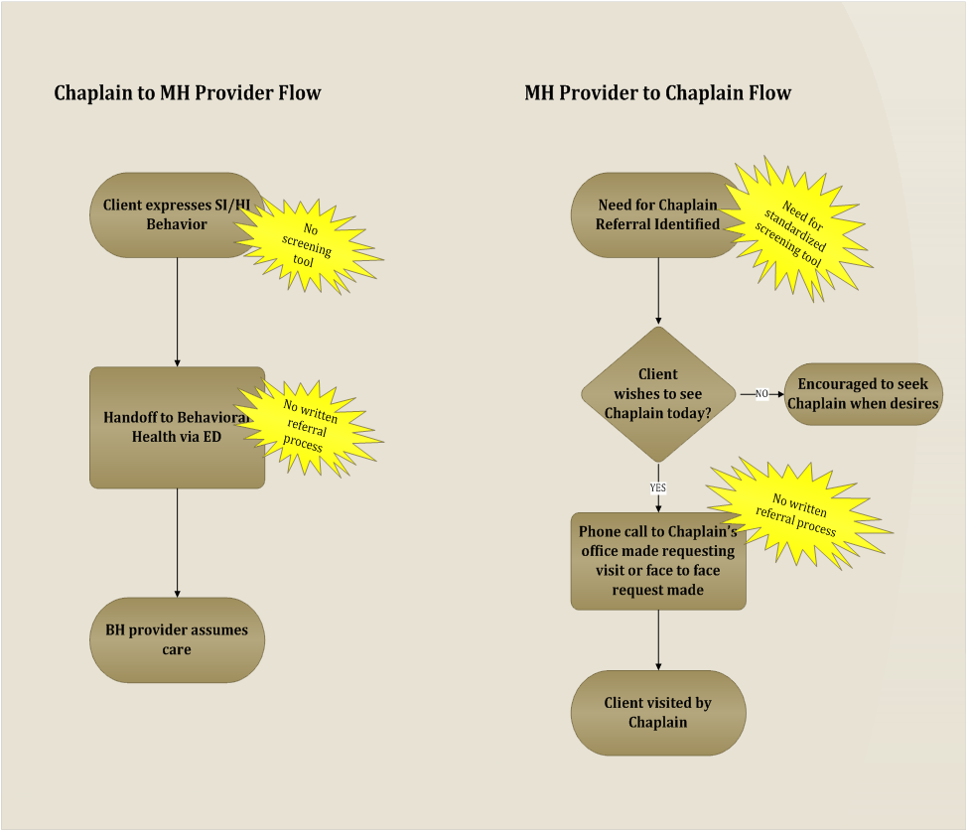
Sample Flow Mapping at One DoD Site

Slide 26
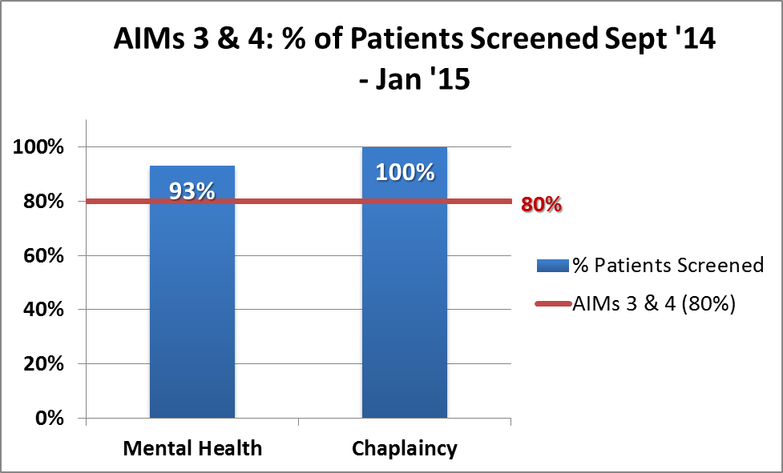
Sample Screening Percentage Achieved at One DoD Site
The relevant aims for this team were: Aim # 3 – Establish a formal screening process for active duty from mental health to chaplaincy that screens at least 80% of patients who present. Aim #4 – Establish a formal screening process from chaplaincy to mental health that screens at least 80% of patients who present.

Slide 27
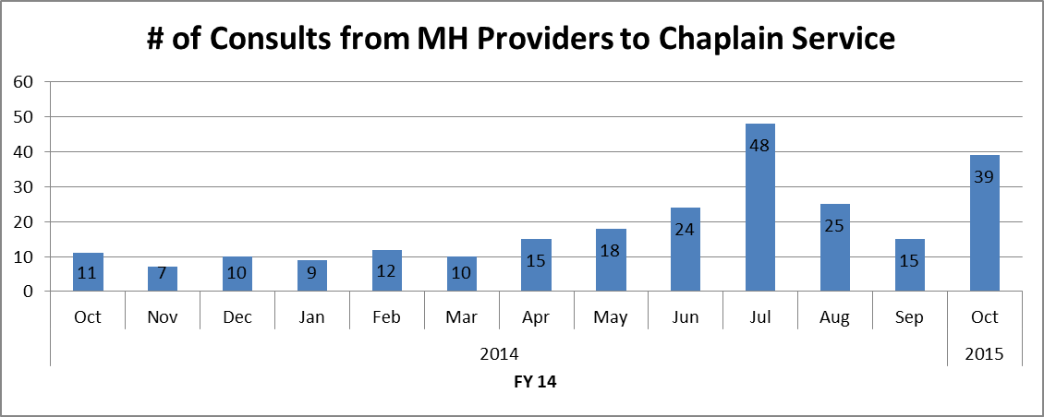
Sample Consults from MH to CH at One VA Site
Chaplain provided in-service to mental health providers in June, after which consults significantly increased.

Slide 28
Sample Screening Results at One VA Site

Slide 29
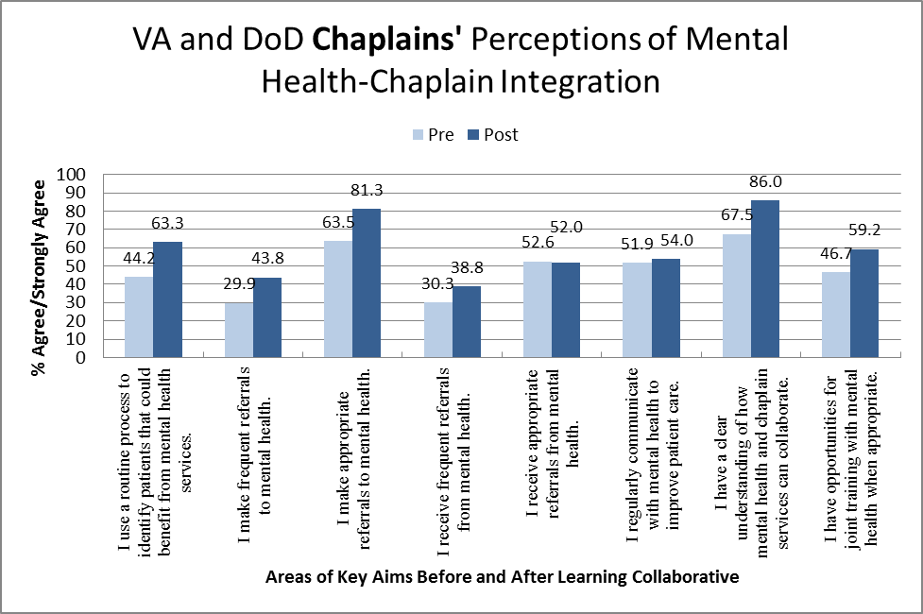
Learning Collaborative Key Results: Chaplain Perceptions

Slide 30
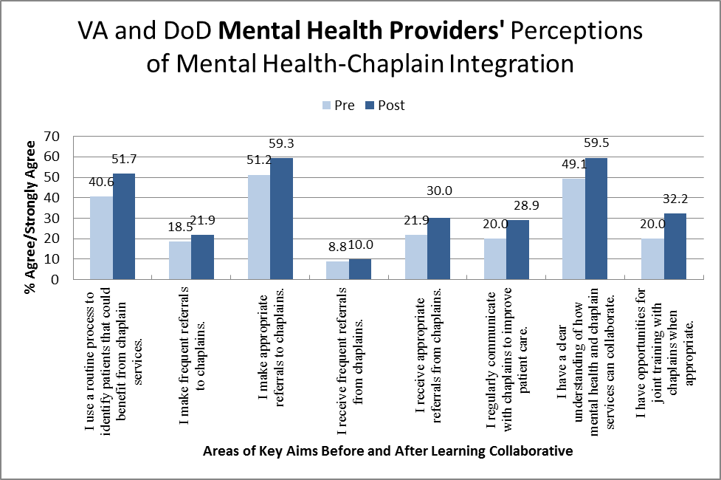
Learning Collaborative Key Results: Mental Health Perceptions

Slide 31
Change Effort Accomplishments
Zero agreements were in place before the collaborative; by the end, agreements were completed or in progress for 6 of 7 VA teams and 7 of 7 DoD teams.
All teams provided/planned for educating mental health about chaplaincy and/or spirituality, and vice versa (i.e., MH→CH).
All hospital-based teams implemented specific screening questions to be used in mental health clinics to assess potential need for referral to chaplaincy.
New specific process for mental health to make referral to chaplaincy were developed at 12 of 13 hospital-based team sites.
New implementation of chaplains’ screening for mental health issues was completed at 4 of 7 DoD teams and no VA teams (appropriate due to setting characteristics).
New process for chaplains to refer to mental health developed and implemented at 3 of 7 DoD sites and 1 of 6 VA sites.

Slide 32
Qualitative Interview Findings
VA and DoD teams reported aspects of the collaborative-coaching strategy that worked well, including:
Enhancing local focus on mental health-chaplaincy integration
Utilization of in-person learning sessions to share experiences
Utilization of team-specific improvement coaches / facilitators to guide the process
DoD teams desired or identified:
Earlier help understanding specific collaborative objectives
Greater initial clarity concerning the roles of improvement coaches (also reported by VA)
Need to translate improvement and VA language into DoD nomenclature
Difficulty with an initial “virtual” learning session
DoD teams reported that coaches and collaborative leadership effectively facilitated this process over time.
In contrast to DoD teams’ desire for more structure, VA teams reported a desire for a less structured collaborative model.
Notes:
Qualitative Interviews. Feedback from the first round of qualitative interviews was used to identify issues potentially in need of addressing and to develop actionable and constructive improvements to the learning collaborative process. For example, traveling team members expressed a desire for more time dedicated for team sharing, which was reflected accordingly in the agenda for the third learning session. For the follow-up interviews, individual interview data and notes based on recording transcripts were organized in matrices to address aspects of collaborative operations and processes, such as degree of team flexibility. Individual qualitative data were aggregated to identify patterns across facilities by collaborative operations / processes and organization (VA, DoD). The following themes emerged.
VA and DoD teams reported aspects of the collaborative-coaching strategy that worked well, including:
Enhancing local focus on mental health-chaplaincy integration
Utilization of in-person learning sessions to share experiences
Utilization of team-specific improvement coaches / facilitators to guide the process
DoD teams desired or identified:
Earlier help understanding specific collaborative objectives
Greater initial clarity concerning the roles of improvement coaches (also reported by VA)
Need to translate improvement and VA language into DoD nomenclature
Difficulty with an initial “virtual” learning session
DoD teams reported that coaches and collaborative leadership effectively facilitated this process over time.
In contrast to DoD teams’ desire for more structure, VA teams reported a desire for a less structured collaborative model.
DoD and VA teams reported that the implementation strategy (learning collaborative with coaching / facilitation) worked well for enhancing collaboration across healthcare professions. However, DoD arguably has a greater level of command and control and a wider variety of missions than the VA healthcare system. When working across organizations with different levels of centralized control to conduct collaboratives, there appears to be a need to balance flexibility with standardization. Organizational context, culture, and structure may be important to consider when selecting and designing appropriate implementation strategies.

Slide 33
Recommendations
and Conclusions

Slide 34
Learning Resources: Team Experiences
Videos available on program website:
www.mirecc.va.gov/MIRECC/mentalhealthandchaplaincy/
Or Goggle “Mental Health and Chaplaincy”
Click on this to access learning collaborative videos
Click on this to access other videos
Notes:
1. https://www.youtube.com/watch?v=4rPU11Bj2gg&index=1&list=PLUvYCtRcDiavj9dn908N-LmxXxn3xWqrX
2. https://www.youtube.com/watch?v=iD71SVA1sdA&list=PLUvYCtRcDiavj9dn908N-LmxXxn3xWqrX&index=2
3. https://www.youtube.com/watch?v=zORJ95z5lvM&list=PLUvYCtRcDiavj9dn908N-LmxXxn3xWqrX&index=3

Slide 35
Recommendations
Map and understand the current process for screening / referring / communicating about patients between disciplines.
Enhance awareness of roles.
Develop a service agreement.

Slide 36
Recommendation #1: Map the Current Process
Description:
Identify and write down the who, what, where, when and how
Mental health and chaplaincy identify, refer, and communicate concerning patients that may benefit from receiving care from each service
Process map/description should be submitted to ____.
Update and submit every two years.
Supporting findings from JIF project
All participating facilities successfully mapped current processes and utilized information to improve processes of care
All facilities were able to implement quality improvement processes based on understanding of current state.

Slide 37
Recommendation #2: Enhance Awareness of Roles
Description:
On a recurring basis that is appropriate based on characteristics of the setting, chaplains and mental health professionals provide education to one another about what their disciplines do and can offer to patients.
Educational materials were made available by Mental Health and Chaplaincy (see website for select materials) to assist in this process.
Supporting findings from JIF project
Teams at all participating facilities conducted education activities between chaplaincy and mental health.
Both chaplains and mental health providers evidenced facility-level improvements in understanding how to collaborate with the other discipline (i.e., changes implemented by teams spread to the larger facility).

Slide 38
Recommendation #3: Develop a Service Agreement
Description:
For MH&C collaborative, service agreements were 1-2 page documents generally signed by heads of mental health services and chaplain services to address topics including:
Identifying spiritual needs among patients in mental health settings (and vice versa).
Facilitating access to chaplain services for newly enrolled patients in mental health (and vice versa).
Ensuring multidisciplinary awareness between mental health and chaplain services.
Supporting findings from JIF project:
Teams at 13 of the 14 participating sites were able to complete a service agreement.
See next slide for example.

Slide 39
Service Agreement Example
Mental Health and Chaplaincy Integration Service Agreement
Purpose
To facilitate the provision of patient-centered, holistic care to active members newly enrolled in Mental Health (MH) through the availability of pastoral care which is, where possible, integrated into the patient’s MH treatment milieu.
To facilitate improved identification of need/desire for and access to pastoral care for active duty members engaged in MH treatment.
To improve the multidisciplinary understanding of and fluency with care provided by collaborating disciplines.
Implementation
MH Service
Promote and foster understanding of pastoral care’s complimentary potential among staff.
Provide, as needed, staff education in service of the above.
Welcome and integrate chaplains to MH clinics and teams as allowed by chaplain staffing (or other) restraints.
Where possible, integrate into team assessments screening of potential need for (and the service member’s interest in) pastoral care.
Chaplain Services
As allowed by staffing, chaplains will be integrated into MH clinics and will serve as a part of an interdisciplinary team in consultative capacity.
Chaplains will assist MH service in providing education and training to staff regarding the nature and value of pastoral care for interested active duty members and the manner in which it can be integrated into MH treatment.
Chaplains will work to maintain contact and, after release is signed by member, include the member’s Command Chaplain as part of the Chaplaincy team. However, this will be done only if member explicitly asks for their Command Chaplain to be included and a release has been signed noting what information is to be disclosed.
Referrals
Active duty members will, as possible, be screened for need for and interest in pastoral care.
Active duty members who endorse a desire to obtain pastoral care will be referred to Chaplain Services via an email consult request and a signed release of information.
Active duty members received via consult will be scheduled and seen by Chaplain Services, with feedback to the team or clinic being provided as appropriate to patient’s concern over confidentiality within the team and by the need to integrate care in service of the service member’s recovery goals.
This service agreement will be reviewed annually by MH and Chaplain Services.
Initiated: [date] Last Reviewed: [date]
_______________________________ ___________________________
[name] [name]
Department Head, Mental Health Command Chaplain

Slide 40
Conclusions
Because in many locations there is a substantial gap between mental health and chaplain services, improvement efforts in many places may need to focus first on establishing basic building blocks before moving on to making improvements in other domains.
Global recommendations for integrating mental health and chaplain services must be able to accommodate variations in the local characteristics and capacities of different facilities and providers.
Patients (including service members and veterans) commonly endorse having mental and spiritual problems when asked, and continued efforts are merited with respect to further developing and refining approaches to screening, referrals, and treatment.
Notes:
Mental Health and Chaplaincy Integration Lessons Learned
Because in many locations there is a substantial gap between mental health and chaplain services, improvement efforts in many places may need to focus first on establishing basic building blocks before moving on to making improvements in other domains. Surveys of mental health professionals at participating learning collaborative sites indicated that a large proportion of mental health professionals knew very little about the services that chaplains could offer. Hence, a critical foundational piece is to provide mental health professionals with such information about chaplaincy – both in general and in contextually-specific ways (i.e., what do chaplains do in general and what can chaplains provide in the context of specific facilities and clinics). This educational process then inherently informs other domains where improvements need to be made. For instance, mental health professionals who implemented screening procedures to identify spiritual problems were most effective in conducting screenings and making meaningful referrals to services when they understood precisely the function of chaplain services to which they were referring a patient.
Global recommendations for integrating mental health and chaplain services must be able to accommodate variations in the local characteristics and capacities of different facilities and providers. There are marked variations between different VA and military facilities. Patient populations, provider capacities, and sufficiency of staffing are among some of the more important characteristics that drive if and how different quality improvement efforts can be successful. For instance, facilities with a limited number of chaplains might be able to offer spirituality groups but may not be able to offer as much in the way of individual spiritual counseling time to patients. Processes for screening and referring patients to chaplains must be structured according to this reality. Of additional note, a handful of participating learning collaborative sites also had chaplains who were participating in MHICS, either as members of the learning collaborative team or as staff chaplains at the facility. These sites generally appeared to be more successful in integrating care services, which per participant report was in large part due to the enhanced capacities of those chaplains going through the year-long intensive MHICS training.
Service members and Veterans commonly endorse having mental and spiritual problems when asked, and continued efforts are merited with respect to further developing and refining approaches to screening, referrals, and treatment. In general, when mental health professionals began systematically asking about religious and spiritual issues and tracking patients’ responses, teams discovered that a substantial proportion of patients indicated having such problems. At the same time, there was also fairly wide variation between sites in the proportion of patients who endorsed suffering from spiritual problems as well as the proportion of patients who subsequently indicated interest in seeing a chaplain. It is likely that patient characteristics, provider characteristics, and characteristics of the screening question influenced this variation. The intention of conducting quality improvement efforts in a learning collaborative is to meaningfully and iteratively enhance “on the ground” care processes, not to conduct a controlled research study. Conducting such real world improvements across an array of sites provides rich information for potential follow-up in more controlled research settings. Lessons learned from the collaborative can and are being used to inform future controlled research studies on topics ranging from tool development to treatment protocols.

Slide 41
Questions?

Slide 42
Contact Information
Keith G. Meador, MD, ThM, MPH
Director, Mental Health & Chaplaincy, VHA
keith.meador@vanderbilt.edu
Jason Nieuwsma, PhD
Associate Director, Mental Health & Chaplaincy, VHA
jason.nieuwsma@duke.edu
Bill Cantrell, MDiv, BCC
Associate Director for Chaplaincy, Mental Health & Chaplaincy, VHA
william.cantrell@va.gov
Mental Health & Chaplaincy – General Inquiries:
mh-c@va.gov

