Slide 1
Chaplain Documentation in the Electronic Health Record: Current Practice/New Horizons
Matthew Sakumoto, MD & M. Jeanne Wirpsa, MA, BCC
Research Partners:
Rebecca Johnson phd, George Handzo MDiv BCC
Linda Emanuel MD PhD, Abel Kho MD MS, Lara Boyken BA

Slide 2
Disclosures
The authors/presenters have no relevant financial or nonfinancial relationships to disclose

Slide 3
Objectives
Examine findings of a mixed method research study of chaplain documentation in the electronic health record for an acute care hospital intensive care unit
Gain insight into the role of a chaplain on a research team and resources necessary for research using the electronic health record as a data base
Explore implications of this research for best practices in documentation for healthcare chaplains

Slide 4
Outline
Research Team & Methodology
Research Project – Results and Analysis
Larger Questions for our Profession

Slide 5
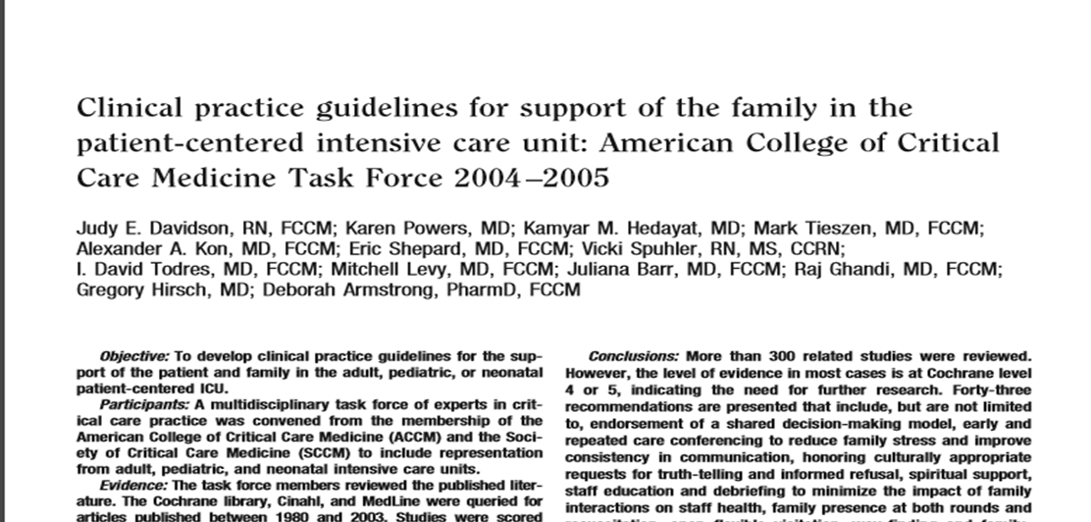
Background
ICU Care: Clinical Guidelines
Emotional
Cultural/religious
Shared decision making
Impact of Spiritual Care in the ICU – Balboni, Osborn, et al
Essential to Whole Person Care
Impacts length of stay & patient/family satisfaction
Quality of life, choice of aggressive/life-prolonging interventions, etc.

Slide 6
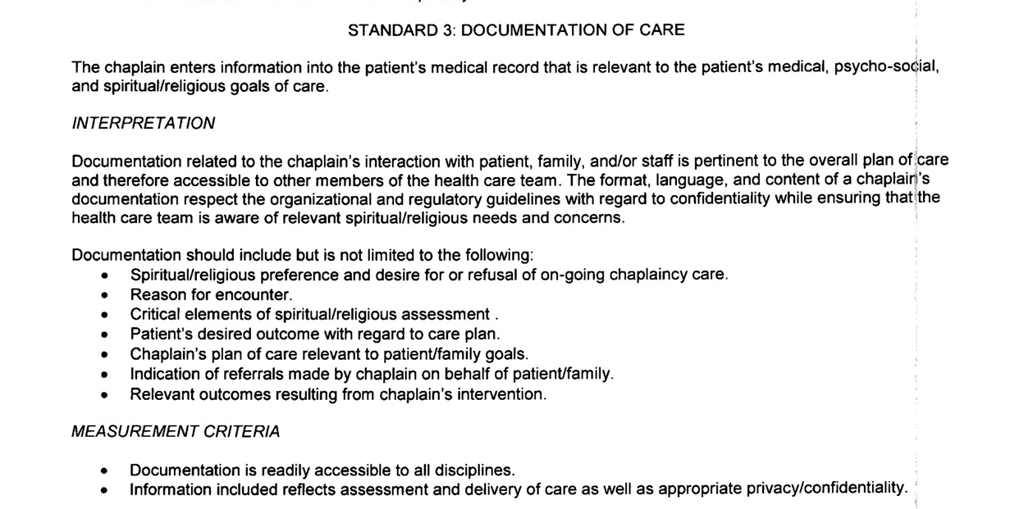
Background
Chaplain Role in Patient-Centered Care/Research on Documentation
Standards
Peery & Roberts; Goldstein - Handbook; Wendy Cadge; Goldstein et al, Chaplain Access; McCurdy, Chaplains, Confidentiality and Charting.

Slide 7
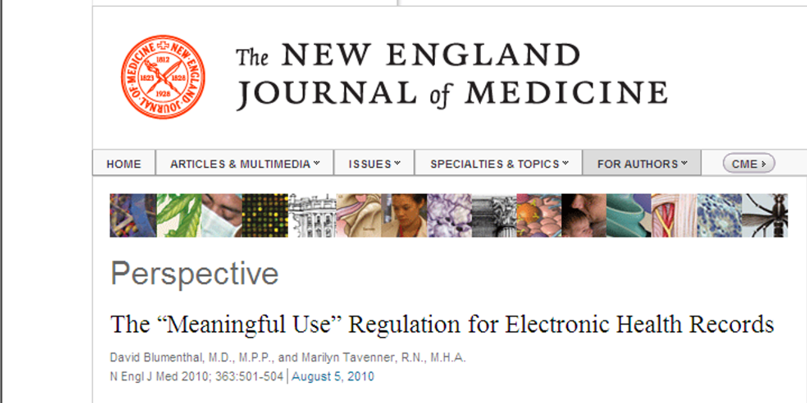
Background
Electronic Health (Medical) Record: Emerging/Changing Technology

Slide 8
RESEARCH PROCESS & TEAM
Notes:
IRB Approval for NMH Patient Electronic Records – restricted access implications
Areas of Expertise: Interdisciplinary
EMR/DATA/Informatics – Drs Kho & Sakumoto
Qualitative Research – Drs Johnson, Emanuel, G Handzo
Chaplaincy/Spiritual Care – J Wirpsa, G Handzo
Research Assistant – L. Boyken
High Profile Research Team Team on the Ground
Process of focusing research project & publications
Chaplain’s Contributions: Taking our Place at the Table
Outcomes: Poster, Informatics and Chaplaincy Conference, Publication, QI NMH Chaplaincy Documentation
Don’t always have to get published for research to make a difference. Ultimate goal – impact the care we provide patients.

Slide 9
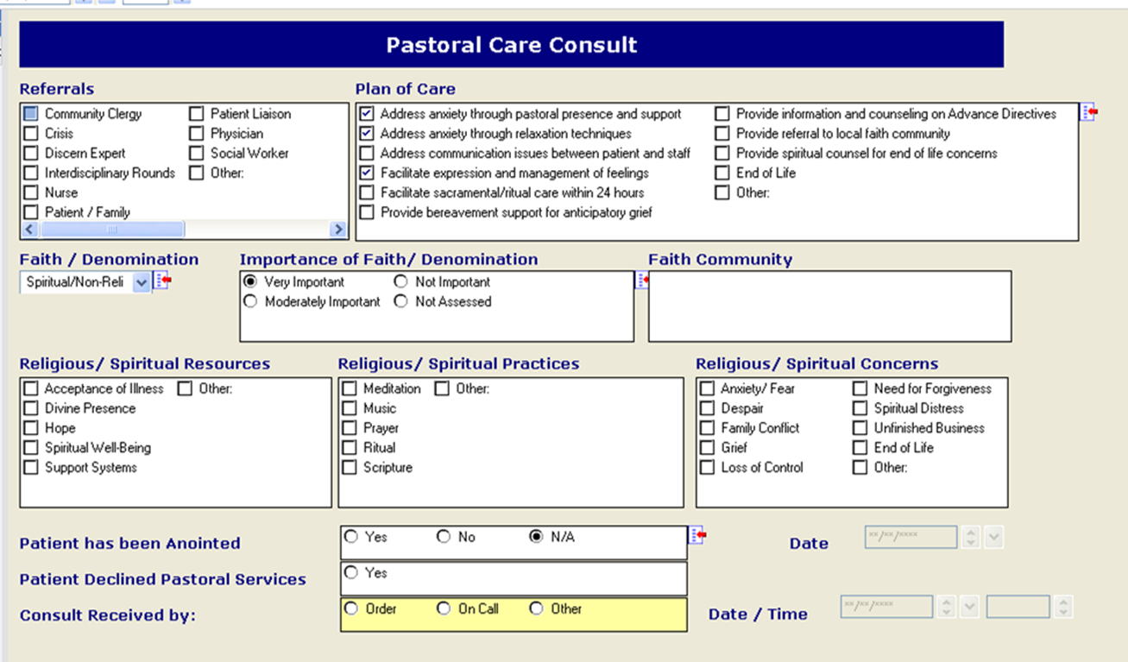
Research method: mixed quantitative & qualitative
Electronic Health Record: Cerner Power Chart
Structured Template + Free text
Single Site: NSICU
Integrated Chaplain Team
Notes:
Setting: Academic tertiary medical center with a Pastoral Care department and chaplaincy training program. The Neuroscience-Spine ICU (NSICU) has an integrated chaplain service.
EMR Template: Power Chart (Cerner) template with both structured elements and an unstructured narrative note.
Data Extraction: We extracted Pastoral Care notes using a text-string search from our Enterprise Data Warehouse (EDW), and restricted our analysis to only experienced healthcare chaplains.
Descriptive Review: A manual review for themes in free text fields for 426 notes were compared to frequencies of corresponding structured data fields.Scope limited to NSICU to understand content and limit “noise”
+Additional Section for Narrative Note documentation

Slide 10
Electronic health record: Method of Extraction
EDW Phrase Search
(n = 31,791)
Remove inexperienced Chaplains, Priests
(n = 356)
Location: Only NSICU
(n = 1,128)
Author: Only “Experienced” Chaplain (n = 772)
Patient deduplication
(n = 281)
Last note for NSICU patients
(n = 491)

Slide 11
Quantitative research: challenges of using the EHR
Data Management Warehouse – duplication of records, last entry, dates, patient encounter vs. patient id, location of patient at time of visits
No standardized template across systems for chaplain documentation – single site restriction vs. comparison of charting practices
Order of entries affects frequency of checking boxes?
Can’t assume all chaplains have same definition for boxes
Even if choose to measure restricted data of patient religious denomination vis a vis chaplain visits or length of stay – manual entry for first data, relative unreliability

Slide 12
Qualitative approach
Note:
Sample does not include narrative notes made by interns or Catholic priests as these chaplains are not fully integrated into the NISCU team or have ritual specific roles
Content analysis of over 400 free text narrative notes made by six chaplains
Chaplains in receipt of free-text narrative note orientation
Notes made for patients in Neuro-spine intensive care unit (NSICU)
Chaplains fully integrated in intensive care setting

Slide 13
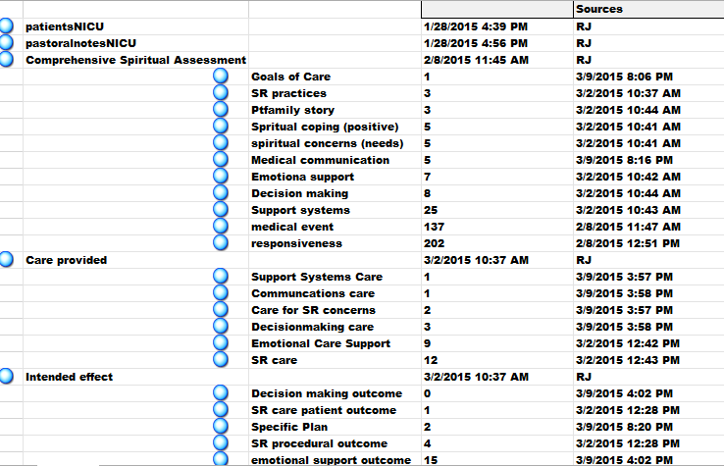
Content Analysis
- Initial coding
- Thematic coding
Axial Coding
Code book (domains and examples)
Wife does not describe herself as religious or spiritual but her Israeli upbringing has inculcated a strong sense of Jewish people
Husband decided to proceed as planned and ended life support
Chaplain acknowledged conflict and affirmed Mrs. X’s sense of authority about her role in relation to husband, Mrs. X seemed self-assured after conversation.
Notes:
The study team undertook three coding processes to reach consensus on the core domains and themes that should be in their code book
Initial coding allowed us to look at the verbs, nouns and phrases chaplains frequenty used
Thematic coding enabled us to begin the process of identify core themes evident in the notes
Axial coding enabled us to explore for overarching concepts – to investigate for evidence of professional concepts such as assessment, intervention and outcome.
Notes could be coded multiple times – as shown here

Slide 14
Coding discussions
Axial Coding:
What to code as a professional practice outcome as opposed to an intervention
Thematic coding:
Is it important to note differences between chaplain notation styles ?
Thematic coding:
How to code for
non-specifically sourced emotional phenomena
Example:
Chaplain provided empathy and active listening = intervention
Patient reported feeling a great sense of relief and increased peace as a result of this intervention today = outcome
Example: Chaplain A likes to report patient wishes verbatim. Chaplain B prefers third person report.
Example: She was grateful for the time to vent
Notes:
Coding narrative notes is not easy! The team had many discussions about where items should be coded to – the three big discussions we had as a tream concered how (and whether) to cide for non-specifically sourced emotional phenomena – (one member of the team was strongly opposed to this) whether to code for and report differences in chaplains style – if we’re aiming for a norm does difference matter? ; what to code as an outcme as opposed to an intervention

Slide 15
Qualitative coding team, Inter-rater reliability and conflict resolution process
CALL IN
Coding Team
(on site)
Chaplain
5th year medical student
Qualitative researcher
Full research team
(on and off site)
2 MDs (EDW warehouse & Spiritual Research)
2 Chaplains
Notes:
All initial coding was completed by a small coding team who met regularly on site at NU. Results were shared by telephone conference calls with a multidisciplinary research team to validate item assignment and domain definition
To achieve inter rater reliability members of the small research team read the collated free text notes several times marking up possible spritiual categories, subcategories , codes and subcodes. One researcher used Nvivo (see previous slide) the others coded the same subsets by hand. Once categories were agreed the experienced qualitative researcher compiled a complete representative record in Nvivo.

Slide 16
Mixed method research Strengths & weaknesses
Generalizability
400+ free texts – saturation for qualitative research
Generalizations not recommended
Transferability
Single-site as templates not compare across institutions
Limited quantitative usefulness; need larger numbers for meaningful results
Descriptive Analysis - Linguistic and Thematic
Raises important questions for our profession to consider
Point to areas of possible future research – role of chaplains in medical decision making

Slide 17
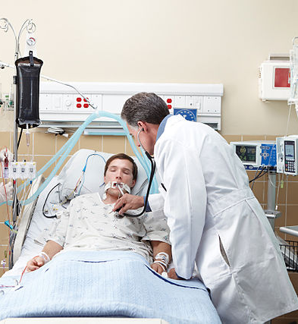
Quantitative Results Patient demographics from NSICU sample
Patient Characteristics | Total n=491
Mean Age, years ± std | 60.6 | ± 17
Female Gender, n (%) | 266 | (54%)
Religious Affiliation
Catholic | 167 (34%)
Protestant | 109 (20%)
Other | 50 (10%)
None | 14 (3%)
Not Recorded | 151 (21%)
"Clinicians in Intensive Care Unit" by Calleamanecer - Own work. commons.wikimedia.org/Clinicians_in_Intensive_Care_Unit.jpg

Slide 18
Overall Utilization Tracking
Many structured data options are used <5% of the time in this setting

Slide 19
Referrals are most often initiated by Patient or Family
Referral Source | Total n=435
Patient/Family | 215 | 49%
Interdisciplinary Rounds | 70 | 16%
Nurse | 52 | 12%
Discern Expert⁺ | 48 | 11%
Other* | 83 | 19%
+Discern Expert = electronically-generated referral from admitting nurse spiritual screen
*Referral Other (n):
DNR order (29)
Follow up (29)
Other Chaplains (15)
Trauma/Code (3)
Other (7)
Notes:
Add box around important items
<5%: Physician, Social Worker, Crisis, Community Clergy

Slide 20
Spiritual Assessment Trends
Resources | n=278
Support Systems | 92%
Hope | 23%
Divine Presence | 18%
Spiritual WellBeing | 19%
Accept Illness | 9%
Practices | n=156
Prayer | 75%
Ritual | 37%
Scripture | 13%
Music/Meditation | 10%
Concerns | n=228
Anxiety/Fear | 81%
Loss of Control | 36%
Grief | 21%
End Of Life | 12%
Notes:
<5%: Family Conflict, Despair, Unfinished Business, Spiritual Distress, Need Forgiveness

Slide 21
Plan of Care often addresses emotional needs, ritual & ACP/GOC needs
Plan of Care | n= | 444
Address anxiety through pastoral presence |  | 69%
Facilitate expression and management of feelings |  | 32%
Facilitate Sacraments within 24 hours |  | 29%
Provide information and counseling on Advance directives |  | 26%
End of Life |  | 8%
Other* |  | 16%
Notes:
Other: *Plan of Care – Other: Assessment of DNR decision making (49), Pastoral support (5), Provide spiritual materials or services such as deliver bible or communion or anointing (4), Pre-operative visit (2), Other (10)
<5%: Provide bereavement support for anticipatory grief, Address communication issues between patient and staff, Provide spiritual counsel for end of life concerns, Address anxiety through relaxation, Referral to local faith community

Slide 22
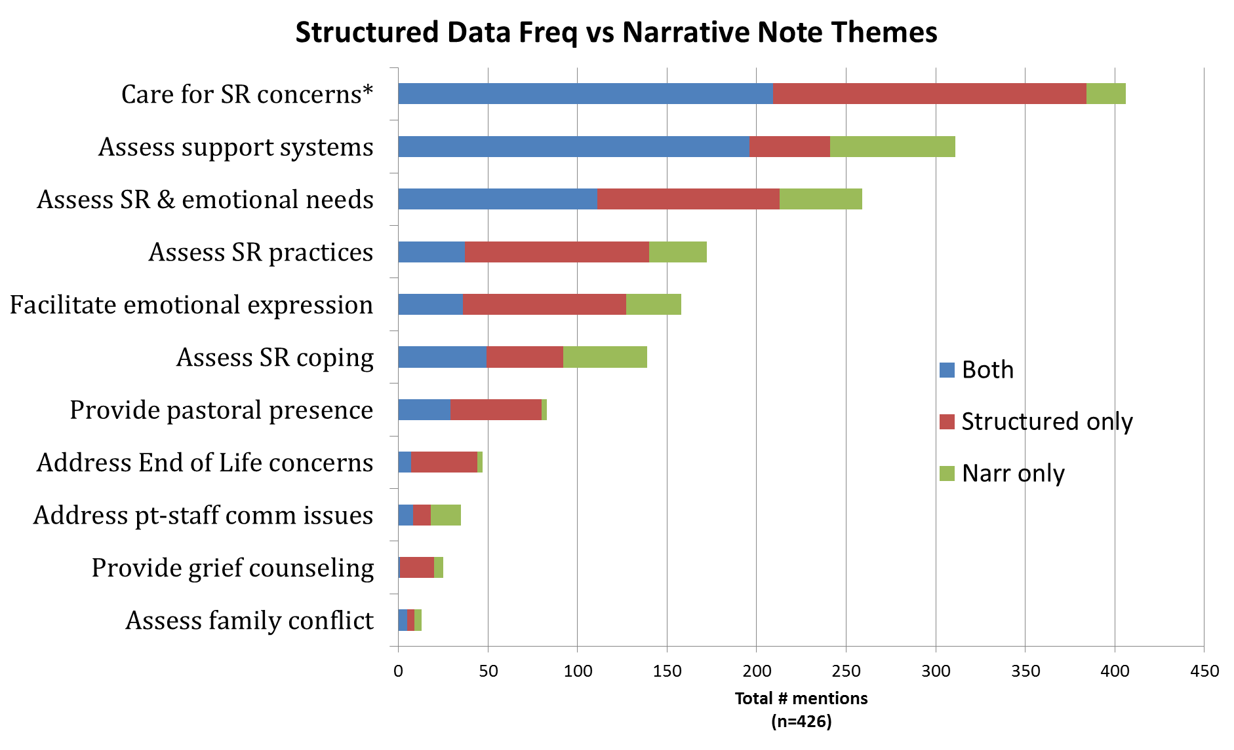
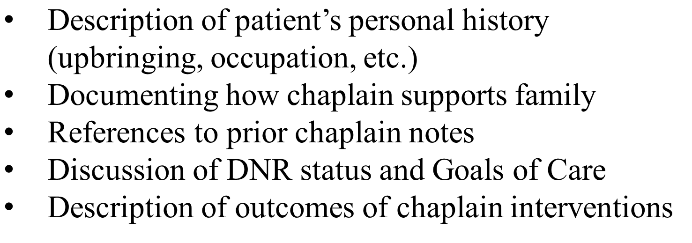
Comparing Structured Data with Narrative Notes
Additional themes identified in narrative text include:

Slide 23
Qualitative analysis: Free text/narrative notes

Slide 24
Linguistic & Content analysis: Spiritual/Religious
Authoritative when connected to medical care plan for a particular patient
Substantive & detailed documentation of spiritual concerns & resources
Catholic last rites needed before withdrawal of life support.
Although pt. is a Muslim, family does not identify any special rituals or care of body at time of death.
Patient expresses feelings of guilt: being punished b/c did not listen to his parents who were Holocaust survivors.
Patient struggling with loss of hope. Some spiritual doubts raised as prayers not seemingly answered.

Slide 25
Linguistic & Content analysis: Emotional Resources & Needs
Primary emotions: Anxiety, Grief, Feeling Overwhelmed, Anger
Emotions prompted by a range of factors – medical event, family, faith, etc.
Colloquial use of terms vs. clinical measurement definition
Patient, accompanied by spouse, expressed a mixture of gratitude and anxiety. Patient grateful for successful surgery, but remains anxious about recovery and managing when she gets home. Patients also especially grateful for the ways spouse has been supporting her and walking with her. Patient was able to identify the ways she is coping and taking things one step at a time.

Slide 26
Linguistic & Content analysis: Medical Decision Making & Communication
Decision Making | Medical Decision Making | Capacity, decision makers, treatment preferences, conflict in family about goals of care | Facilitate conversation about decision maker Clarify values that impact decision making | Advance directives completed Values/beliefs integrated into goals of care
 | Medical Communication | Communication issues (system and interpersonal) | Inform patient/family about palliative care | Possess needed knowledge, relationships
Specificity and Role Clarity: DNR order, proxy decision maker status
Verbatim report of patient’s wishes or summary of patient values
Prevalence of reports of patient responsiveness as relates to capacity for decision making (NSICU)
X states: ‘We have done enough, we should stop this.’ Y states patient would not want to be like this, describes patient as very active and that X would want to be able to go out with friends and be independent even if should could not resume working.
Notes:
Assessment of patient/family wishes, treatment preferences, impact of religions beliefs on end-of-life decisions, family conflict around goals of care, communication with the medical team, and whether patient possesses relevant advance directive documentation.

Slide 27
Linguistic and content analysis: Patient story
Who is this Patient as a Person?
Narrative of life events as background to current coping and choices
Impact of Illness on Who Person Is
Culturally Specific behaviors or beliefs
Relationships/Roles and Community
Notes:
Return to this later – implications for unique role of chaplains on medical team and in charting/template design

Slide 28
Process categories: assessment
Overview of the whole patient within a care setting
Descriptive & Substantive
No standardized assessment model observable in documentation
Patient states he does not have enough ‘spirituality’ to cope with surgery and possibility of not walking since he is a ‘physical’ person.
Daughter struggling with timing of dying process, as she does not want to see her mother suffer any more and it is difficult to sit by and not be able to do anything.

Slide 29
Process categories: interventions
Congruence with verbs: affirmed, acknowledged, validated, normalized, explored, clarified, reassured
Substantive vs. “pastoral presence”
Records of spiritual care interventions highest as in other studies – prayer, rituals, blessing, scripture, spiritual counsel
Intervention + outcome
Mrs. L seemed more quiet and peaceful after prayer.
Notes:
Handbook and Massey internventions

Slide 30
Process categories: outcomes – Patient centered
1. Patient-reported outcomes
2. Chaplain’s observations or interpretation of impact of care on patient/family
3. Process outcome:
What patient or family accomplished a result of chaplain visit
Patient reported feeling a great sense of relief and increased peace as a result of visit today.
Chaplain acknowledged conflict and affirmed Ms. X’s sense of authority about her role. Ms. X seemed self-assured after the conversation.
Daughter able to express her anger at ‘being robbed.’
Notes:
Fewest, not surprising given state of our profession. Patient centered – not about what we did but how did care impact patient/family. Return later – very different than Massey.

Slide 31
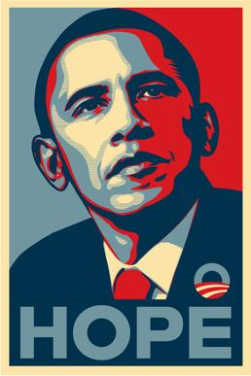
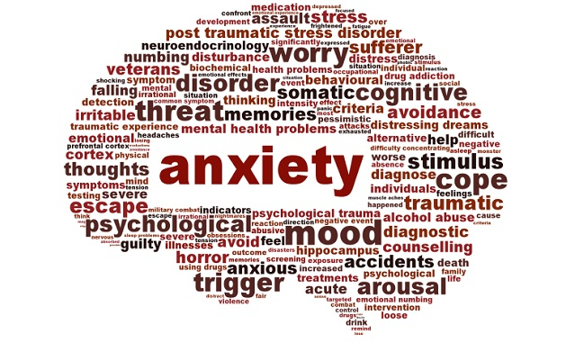
Implications/questions for our profession Intra & Inter-professional Consensus on Terms?
To promote understanding of chaplain role & S/R dimension of care
To facilitate interdisciplinary communication
To measure impact of our care
Notes:
Move toward normative language for interventions Massey etc. Examples – religiously sourced hope, colloquial and third use.

Slide 32
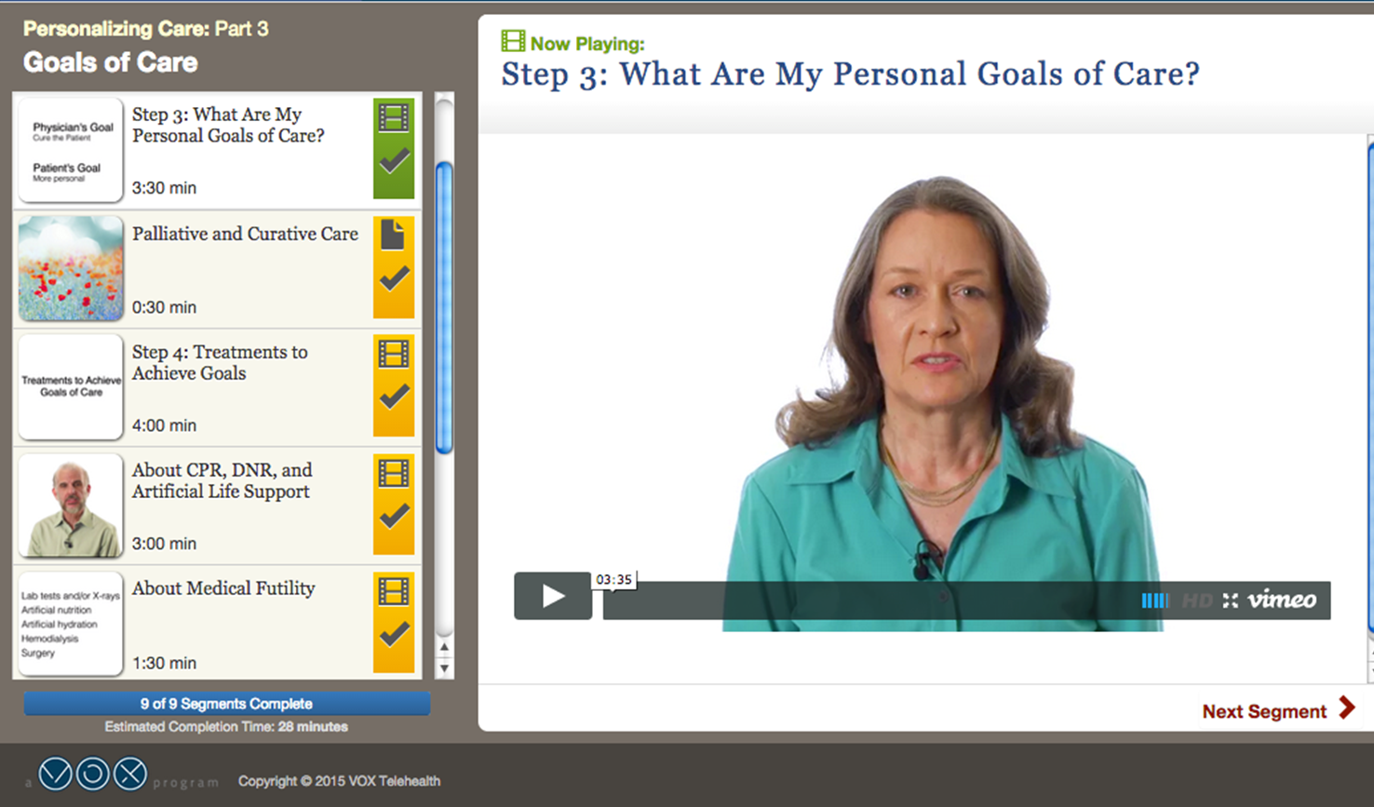
Implications/questions for our profession what is Chaplain Role in Medical Decision Making?
Religious beliefs and values not integrated into care plans
How do verbatim statements – “we should stop this” - contribute to goal of personalized care?
Assessing for Capacity – Chaplain role?
Shared Goals of Care Note?
Notes:
Balboni recent study- 7 % of the time in family meetings when patient/families bring up s/r physicians attend to it

Slide 33
Implications/questions for our profession what kind of outcome language?
PATIENT-CENTERED
Patient-reported
Any report of the status of a patient’s health condition that comes directly from the patient, without interpretation of the patient’s response by a clinician or anyone else. Measurable in absolute terms or as a change from a previous measure.
2. Chaplain Observed/Interpreted
Evidence-based medicine + therapeutic/interpretive role of chaplain
3. Process outcome
What patient/family accomplished a result of chaplain visit
or
Notes:
“outcomes are simply the observable result of our care.. . Concerned with the objective. Receiving the patient’s narrative thread – seeing, hearing, listening are examples of the empathetic turn – the belief in chaplaincy terms that it is important to try to imagine what it’s like to be in the patient shoes. To gain an experiential understanding of what is behind the emotional response.” VandeCreek and Lucas.

Slide 34
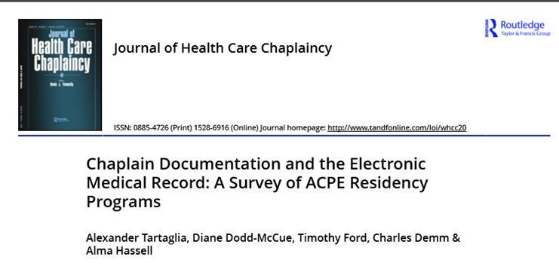
Implications/questions for our profession: what are benefits of check boxes?
Students vs. Professional Chaplains
Education via Drop Boxes/Pre-populated Entries
Reactions
Chaplains - “Helps me focus my thoughts and be more purposeful in my actions”
Clinicians - “Able to reference chaplain Plan of Care for managing patient’s anxiety”
Normative language for Professional Chaplains
Structured data utilization focus on “actionable analytics” such as referral patterns and faith-specific resources
Notes:
If use checkboxes – education essential to be sure all chaplains meaning the same thing. Example “non-denominational” or end of life
See recent JHCC article ACPE – Tartaglia et al

Slide 35
Electronic medical record re-design: recommendations from other disciplines
EHR developers need to optimize the systems to facilitate longitudinal care delivery as well as care that involves teams of clinicians and patients that are managed over time.
We are in danger of repeating history by over-structuring the clinical record and overloading it with extraneous data.
Wherever possible, EHR systems should not require users to check a box or otherwise indicate that an observation or an action has been taken if the data documented in the patient record already substantiates the action(s).
Clinicians must learn to leverage the enormous and growing capabilities of EHR technology without diminishing or devaluing the importance of narrative entries.
Notes:
Helpful to look at what our colleagues are recommending as they rethink use of EMR/EHR technology for clinical documentation.

Slide 36
Electronic medical record re-design: recommendations from other disciplines
Pre-populated entries or Narrative Notes?
“Physicians desire nursing documentation with greater clarity and additional information. Physicians indicate checklists alone…are insufficient for effective nurse/physician collaboration. Narrative nursing summaries are invaluable references that guide medical treatment decisions. Physicians see detailed assessments and well-described interventions of nurses as critical to their ability to effectively practice medicine.”
Green, Shayla D; Thomas, Joan D. Pediatric Nursing 34.3 (May/Jun 2008): 225-7, 240.
Notes:
Physicians desire nursing documentation with greater clarity and additional information. Physicians indicate checklists alone for patient assessment and intervention data are insufficient for effective nurse/physician collaboration. Narrative nursing summaries are invaluable references that guide medical treatment decisions. Physicians see detailed assessments and well-described interventions of nurses’ as critical to their ability to effectively practice medicine.
Green, Shayla D; Thomas, Joan D. Pediatric Nursing34.3 (May/Jun 2008): 225-7, 240.
Davidson et al., 2007 Interdisciplinary Collaboration and the Electronic Medical Record

Slide 37
Implications/questions for our profession re-Design of the Electronic medical record
Pre-populated entries or Narrative Notes?
Narrative Medicine: Better medical outcomes when attend to narratives
Chaplain’s role: preserve personhood vs. “cases”
Will our colleagues read all those details?
Structured Narrative Notes?
Notes:
Free-text notes document evidence of factors which matter to the person being cared for, fall beyond the scope of quantitative spiritual assessment/check boxes

Slide 38
Chaplain Care Intervention Flowsheet
Encounter: Patient & Spouse/Significant Other
Reason for Visit: Other: Poor Diagnosis
Referral From: Nurse
Clergy Visit Preference: Hospital Chaplain
Length of Visit: 45 minutes
Requires Follow-Up: Yes
Spiritual Care Plan: Routine Follow Up
Patient Affect at time of visit: Open to Chaplain Visit, Abrupt
Patient Spiritual Assessment: Angry, Conflict (external), Grief (anticipatory), Guilt
Patient Chaplain Intervention: Advocate, Empathetic listening, Exploration, Grief support, Reframing
Spouse/Significant Other Affect at time of visit: Expressive, Open to Chaplain Visit, Tearful
Spouse/Significant Other Spiritual Assessment: Anxious, Conflict (external), Fear, Grief (anticipatory), Sad,
Spouse/Significant Other Chaplain Intervention: Affirm, Advocate, Clarify feelings, Exploration, Grief support, Reassurance, Reframing, Other: Prayer Shawl & Carenotes
Outcome Care Plan
Spiritual Interventions:
Encourage verbalization of feelings/concerns/expectations
Be sensitive to patient’s spiritual/emotional needs
Communicate referral to chaplain care as appropriate
Note: Spiritual Care referral from RN after diagnosis. Chaplain familiar with family and provided support to both patient and spouse.
EPIC DROP DOWN
BOXES
Chaplain
Documentation
Notes:
Example from charting submitted for certification – with permission- What does this tell other members of the IDT?

Slide 39
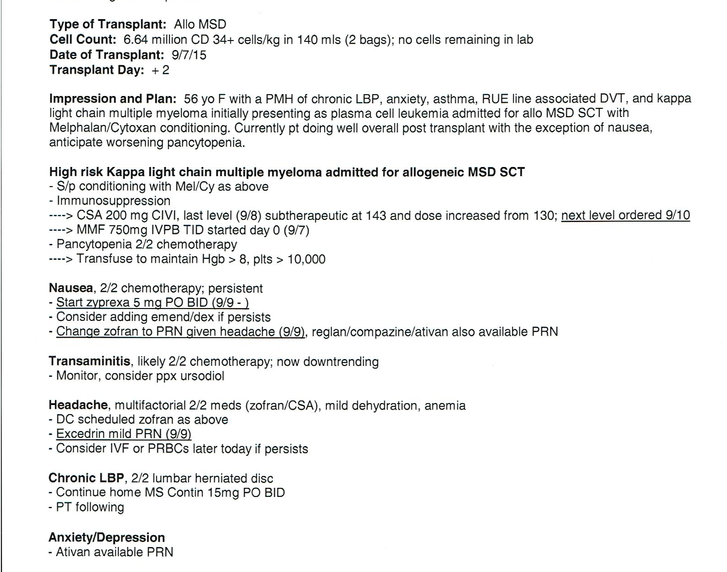
Narrative note documentation
Structure = Predictable
Physician Structure of Note
Notes:
Requires teaching and language; impact of research on our practice as a department

Slide 40
narrative note: five-part model
Notes:
Outcome for our Department – Structured Narrative Note rather than just one blob – show pre and post documentation styles. Still – what chaplain does structure rather than organized to convey significant info to other members of team. See next note

Slide 41
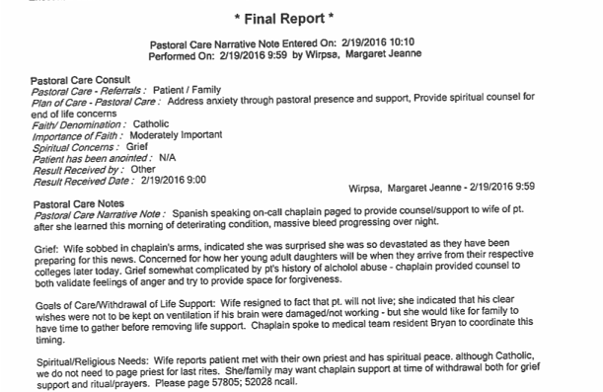
narrative note: thematic

Slide 42
New horizons Questions & Discussion
How does charting preserve & promote our unique contribution to patient/family-centered care?
To what extent should we adopt language recognized and shared by other members of medical team? (e.g. definition of outcomes, terms such as hope, anxiety)
How can we effectively use narrative notes to communicate the patient’s story, context, and specific values, wishes impacting care?
Notes:
3 large questions to offer up for discussion – you may have others.

Slide 44
references
Association of Professional Chaplains. (2010). Standards of Practice for Chaplains in Acute Care. Retrieved from http://www.professionalchaplains.org/files/professional_standards/standards_of_practice/standards_practice_professional_chaplains_acute_care.pdf
Balboni, T. A., Paulk, M. E., Balboni, M. J., Phelps, A. C., Loggers, E. T., Wright, A. A., . . . Prigerson, H. G. (2010). Provision of spiritual care to patients with advanced cancer: associations with medical care and quality of life near death. J Clin Oncol, 28(3), 445-452. doi:10.1200/jco.2009.24.8005
Bay, P. S., Beckman, D., Trippi, J., Gunderman, R., & Terry, C. (2008). The effect of pastoral care services on anxiety, depression, hope, religious coping, and religious problem solving styles: A randomized controlled study. Journal of religion and health, 47(1), 57-69.
Bazeley, P., & Jackson, K. (2013). Qualitative data analysis with NVivo: Sage Publications Limited.
Bjelland, I., Dahl, A. A., Haug, T. T., & Neckelmann, D. (2002). The validity of the Hospital Anxiety and Depression Scale. An updated literature review. J Psychosom Res, 52(2), 69-77.
Borneman, T., Ferrell, B., & Puchalski, C. M. (2010). Evaluation of the FICA Tool for Spiritual Assessment. J Pain Symptom Manage, 40(2), 163-173. doi:10.1016/j.jpainsymman.2009.12.019
Bosslet, G. T., Pope, T. M., Rubenfeld, G. D., Lo, B., Truog, R. D., Rushton, C. H., . . . White, D. B. (2015). An Official ATS/AACN/ACCP/ESICM/SCCM Policy Statement: Responding to Requests for Potentially Inappropriate Treatments in Intensive Care Units. Am J Respir Crit Care Med, 191(11), 1318-1330. doi:10.1164/rccm.201505-0924ST
Blumenthal, D & Tavenner, M (2010). The “Meaningful Use” Regulation for the EHR. New England Journal of Medicine 363, 501-504.
Brashler, R. (2012). Patient Narratives and the EMR – Are the Compatible? NMH Ethics Grand Rounds Presentation.

Slide 45
Burkhart, L. (2009). Capturing and measuring spiritual care. NACC: Vision Online http://www.nacc.org/vision/July-aug-2009/ru.aspInformatics.
Cadge, W. (2009). A Profession in Process. Chaplaincy Today, 25(2), 26-27.
Cadge, W., Calle, K., & Dillinger, J. (2011). What do chaplains contribute to large academic hospitals? The perspectives of pediatric physicians and chaplains. J Relig Health, 50(2), 300-312.. doi:10.1007/s10943-011-9474-8.
Curtis, J., & White, D. (2008). Practical guidance for evidence-based ICU family conferences. Chest, 134(4), 835-843. doi:10.1378/chest.08-0235
Davidson, J. E., Powers, K., Hedayat, K. M., Tieszen, M., Kon, A. A., Shepard, E., . . . Armstrong, D. (2007). Clinical practice guidelines for support of the family in the patient-centered intensive care unit: American College of Critical Care Medicine Task Force 2004-2005. Crit Care Med, 35(2), 605-622. doi:10.1097/01.ccm.0000254067.14607.eb
Derrickson, P. E. (1995). Screening patients for pastoral care: A preliminary report. The Caregiver Journal, 11(2), 14-18.
Donovan, D. (2012). Assessments. In S. Roberts (Ed.), Professional Spiritual & Pastoral Care: A Practical Clergy and Chaplain’s Handbook (pp. 42-60). Woodstock, VT: Skylight Paths Publishing.
Ferrell, B. R. (2005). Overview of the domains of variables relevant to end-of-life care. J Palliat Med, 8 Suppl 1, S22-29. doi:10.1089/jpm.2005.8.s-22
Fitchett, G. (1993). Assessing spiritual needs : a guide for caregivers. Minneapolis: Augsburg Fortress.
Food and Drug Administration. (2009). Guidance for industry patient-reported outcome measures: use in medical product development to support labeling claims. Fed Regist, 74(235), 65132-65133.

Slide 46
Gaeeni, M., Farahani, M. A., Mohammadi, N., & Seyedfatemi, N. (2014). Sources of hope: Perception of Iranian family members of patients in the Intensive Care Unit. Iranian journal of nursing and midwifery research, 19(6), 635.
Goldstein, H. R. (2012). Chaplains and Charting. In D. Donovan & S. Roberts (Eds.), Professional spiritual and pastoral care: A practical clergy and chaplain's handbook (pp. 81-91). Woodstock, VT: Skylight Paths Publishing.
Goldstein, H. R., Marin, D., & Umpierre, M. (2011). Chaplains and access to medical records. J Health Care Chaplain, 17(3-4), 162-168. doi:10.1080/08854726.2011.616172
Green, Shayla D; Thomas, Joan D. (2008) Pediatric Nursing 34.3 (May/Jun 2008): 225-7, 240.
Handzo, G. F., Cobb, M., Holmes, C., Kelly, E., & Sinclair, S. (2014). Outcomes for professional health care chaplaincy: an international call to action. J Health Care Chaplain, 20(2), 43-53. doi:10.1080/08854726.2014.902713
Herth, K. (1992). Abbreviated instrument to measure hope: development and psychometric evaluation. J Adv Nurs, 17(10), 1251-1259.
Hsieh, H. F., & Shannon, S. E. (2005). Three approaches to qualitative content analysis. Qual Health Res, 15(9), 1277-1288. doi:10.1177/1049732305276687
Idler, E., Binney, Z., Grant, G., Perkins, M., & Quest, T. (2015). Practical Matters and Ultimate Concerns,“Doing” and “Being”: A Diary Study of the Chaplain's Role in the Care of the Seriously Ill in an Urban Acute Care Hospital (S710). Journal of Pain and Symptom Management, 2(49), 412.
Kestenbaum, A., James, J., Morgan, S., Shields, M., Hocker, W., Rabow, M., & Dunn, L. (2015). Taking Your place at the table: An autoethnographic study of chaplains’ participation on an interdisciplinary research team. BMS Palliative Care 14:20. doi10.1186/s 12904-015-0006-2

Slide 47
Kuhn, T., Basch, P., Barr, M., Yackel, T.. (2015). Clinical Documentation in the 21st Century: Executive Summary of a Policy Position Paper from the American College of Physicians. Annals of Internal Medicine, 162(4), 301-303. doi:10.7326/M14-2128
Kushinka, S. (2010) Clinical Documentation: EHR Deployment Techniques. California HealthCare Foundation Issue Brief
LaRocca-Pitts, M. (2010). "Protocol-based referrals: A method for selecting patients in the electronic age." Chaplaincy Today 26(2): 26-33.
Lin, C. T., et al. (2013). "Health Care Provider Satisfaction With a New Electronic Progress Note Format: SOAP vs APSO Format." Jama Internal Medicine 173(2): 160-162
Massey, K., Barnes, M. J., Villines, D., Goldstein, J. D., Pierson, A. L., Scherer, C., . . . Summerfelt, W. T. (2015). What do I do? Developing a taxonomy of chaplaincy activities and interventions for spiritual care in intensive care unit palliative care. BMC Palliat Care, 14, 10. doi:10.1186/s12904-015-0008-0
Nolan, S. (2011). Spiritual Care at the End of Life: The Chaplain as a'hopeful Presence': Jessica Kingsley Publishers.
Olver, I. N. (2012). Evolving definitions of hope in oncology. Current opinion in supportive and palliative care, 6(2), 236-241.
Osborn, T. R., Curtis, J. R., Nielsen, E. L., Back, A. L., Shannon, S. E., & Engelberg, R. A. (2012). Identifying elements of ICU care that families report as important but unsatisfactory: decision-making, control, and ICU atmosphere. Chest, 142(5), 1185-1192. doi:10.1378/chest.11-327
Peery, B., & Roberts, S. (2012). Outcome oriented chaplaincy: Intentional caring. In D. Donovan & S. Roberts (Eds.), Professional spiritual and pastoral care: A practical clergy and chaplain's handbook (pp. 342-361). Woodstock, VT: Skylight Paths Publishing.

Slide 48
Piccinelli, C., Clerici, C., Veneroni, L., Ferrari, A., & Proserpio, T. (2015). Hope in severe disease: a review of the literature on the construct and the tools for assessing hope in the psycho-oncologic setting. Tumori, 0.
Puchalski, C. M. (2010). Formal and informal spiritual assessment. Asian Pac J Cancer Prev, 11 Suppl 1, 51-57.
Puchalski, C. M., Vitillo, R., Hull, S. K., & Reller, N. (2014). Improving the spiritual dimension of whole person care: reaching national and international consensus. J Palliat Med, 17(6), 642-656. doi:10.1089/jpm.2014.9427
Rawdin, B., Evans, C., & Rabow, M. W. (2013). The relationships among hope, pain, psychological distress, and spiritual well-being in oncology outpatients. Journal of palliative medicine, 16(2), 167-172.
Roberts, S. (2012). Professional spiritual and pastoral care: A practical clergy and chaplain's handbook. Woodstock, VT: Skylight Paths Publishing.
Snowden, A., Telfer, I., Kelly, E., Burniss, S., & Mowat, H. (2013). The construction of the Lothian PROM. Scottish Journal of Healthcare Chaplaincy, 16(1), 3-16.
Tartaglia, A., Dodd-McCue, D., Ford, T., Demm, C., & Hassell, A. (2016). Chaplain Documentation and the Electronic Medical Record: A Survey of ACPE Residency Programs. Journal of Health Care Chaplaincy,
VandeCreek, L., & Lucas, A. M. (2014). The discipline for pastoral care giving: Foundations for outcome oriented chaplaincy: Routledge.
World Health Organization. (2015). People-centred and integrated health services: an overview of the evidence: interim report. Retrieved from http://www.who.int/servicedeliverysafety/areas/people-centered-care/en/

