Slide 1
A Chaplain Led Support Group
The story of Care for the Caregiver Group…
Sage Olnick, MDiv, RN
Madeline Leong, MD

Slide 2
Financial Disclosures/Unapproved Use
We have no financial relationships with a commercial entity that is relevant to the content of this presentation.
We will not reference unlabeled or unapproved uses of drugs or other products.

Slide 3
OBJECTIVES
By the conclusion of this talk, you will be able to:
Define palliative care and its benefits
Recall the literature behind clinician support groups
Understand the history and format of a chaplain-led support group
Notes:
In this talk, I will be comparing some benefits of palliative care to interventions we commonly use e think (and sometimes or often are beneficial that we use routinely).

Slide 4
Outline
Part 1: What is Palliative Care?
Part 2: Preventing Burnout: A Review of the Literature
Part 3: A Chaplain-Led Support Group

Slide 5
What is Palliative Care?
Notes:
Better QOL and mood
Reduced use of life sustaining treatment near death
Earlier hospice referrals
Care more consistent with patient preference
Improved bereavement outcomes for family
Improved survival
Patients want the truth about their prognoses

Slide 6
What is Palliative Care?
Serious illness
Symptom relief
Improve QOL
Any age/stage
With curative therapies
Notes:
specialized medical care for people with serious illnesses, focused on providing patients with relief from the symptoms, pain, and stress of a serious illness—whatever the diagnosis. The goal is to improve quality of life for both the patient and the family. Palliative care is provided by a team of doctors, nurses, and other specialists who work together with a patient's other doctors to provide an extra layer of support. It is appropriate at any age and at any stage in a serious illness and can be provided along with curative treatment.”

Slide 7
PRIMARY PC
Integration - daily practice
Basic
Pain, symptom management
Discussions

Slide 8
SECONDARY PC
Refractory symptoms
Conflict resolution
Addressing near futility

Slide 9
PC vs HOSPICE
PALLIATIVE CARE | HOSPICE
Can be seen earlier in disease course with life limiting illness | Terminal diagnosis - 6 months or less to live
Improve QOL | Improve QOL; reduce suffering
Symptom management with curative therapies | Comfort measure are the focus
Any insurance | Medicare benefit; any insurance
Inpatient (hospital, SNF and outpatient models (home, clinic) | Mostly home based but can do SNF or inpatient hospice
Notes:
There are some key differences between palliative care and hospice. PC include:…

Slide 10
BENEFITS
American Cancer Society Cancer Action Network
Notes:
Better QOL and mood
Reduced use of life sustaining treatment near death
Earlier hospice referrals
Care more consistent with patient preference
Improved bereavement outcomes for family
Improved survival

Slide 11
BENEFITS
American Cancer Society Cancer Action Network
Notes:
emotional/spiritual support
information/communication
care at time of death
access to services in community

Slide 12
BENEFITS
Support
Information / Communication
Access
Symptoms
Survival
Cost
Hope
Casarett et al., J Am Geriatr Soc 2008; 56:593-99. Temel et al, NEJM 2010; 363; 8:733-742. Higginson et al, Lancet 2014; 2:979-987
Notes:
Emotional/spiritual support
Information/communication
Care at time of death
Access to services in community
Better symptom management
Many live longer
Cost savings in multiple studies
Higginson- 53 to breathlessness support service and 52 to usual care- COPD, ILD, cancer, chronic heart failure, and motor neuron disease. 6 weeks- interview- QOL and function. 16% higher QOL and function; less depression, lower SOB at exertion. Survival for

Slide 13
Preventing Burnout: A Review of the Literature
Madeline Leong, MD
Assistant Professor, Palliative Care
Johns Hopkins School of Medicine
mkunsbe1@jhmi.edu

Slide 14
Outline
Introduction
Definition of terms
Three papers
Interdisciplinary moral distress survey
A doctors’ support group
Balint groups
Conclusion
Disclosures: none

Slide 15
The Problem
Moral distress
Compassion fatigue
Burnout
Primary traumatic stress

Slide 16
The Problem
Moral distress
Compassion fatigue
Burnout
Primary traumatic stress

Slide 17
Moral Distress
Moral distress: “when one knows the right thing to do, but institutional constraints make it nearly impossible to pursue the right course of action”
Notes:
http://www.medscape.com/viewarticle/562718_2

Slide 18
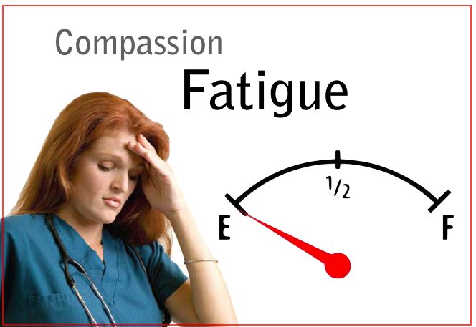

Slide 19
Compassion Fatigue
“The emotional residue or strain of exposure to working with those suffering from the consequences of traumatic events.”
Differs from, but can co-exist with burnout
Notes:
http://www.stress.org/military/for-practitionersleaders/compassion-fatigue/

Slide 20
Burnout
“Cumulative process marked by emotional exhaustion and withdrawal associated with increased workload and institutional stress, NOT trauma-related”
Notes:
http://www.stress.org/military/for-practitionersleaders/compassion-fatigue/

Slide 21
Burnout (II)
“. . . defined as a ‘progressive loss of idealism, energy, and purpose experienced by people in the helping professions as a result of the conditions of their work.’ It is further defined by 3 key characteristics: physical and emotional exhaustion, cynicism, and inefficacy.”
“In clinicians working with seriously ill cancer patients, the rates of all 3 characteristics of burnout are high with up to 69% of oncologists experiencing emotional exhaustion, 10% to 25% of oncologists experiencing depersonalization which is a form of cynicism, and 33% to 50% of oncologists and palliative care physicians reporting inefficacy.”
Sanchez-Reilly S, Morrison LJ, Carey E, Bernacki R, O'Neill L, Kapo J, Periyakoil VS, Thomas Jde L. Caring for oneself to care for others: physicians and their self-care. J Support Oncol. 2013 Jun;11(2):75-81. PubMed PMID: 23967495; PubMed Central PMCID: PMC3974630.

Slide 22
Primary Traumatic Stress
“Primary stressors are those inherent in the extreme event, such as what was immediately experienced or witnessed”
Notes:
http://www.stress.org/military/for-practitionersleaders/compassion-fatigue/

Slide 23
THREE PAPERS

Slide 24
First Paper: Moral Distress
Allen R, Judkins-Cohn T, deVelasco R, Forges E, Lee R, Clark L, Procunier M. Moral distress among healthcare professionals at a health system. JONAS Healthc Law Ethics Regul. 2013 Jul-Sep;15(3):111-8; quiz 119-20.

Slide 25
Moral Distress
Moral Distress Scale-Revised
21 questions
Likert scale (0 to 4)
A “composite score” or “actual moral distress” is calculated; range 0-336
Validated
A cross-sectional, descriptive, comparative survey
523 adult and pediatric physicians
1794 adult and pediatric nurses, SWs/CMs, and RTs
12-16% response rate

Slide 26
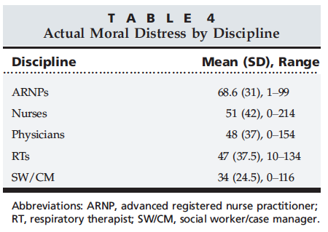
Notes:
Out of 336 → this is 64% (high); range was 10-20%

Slide 27
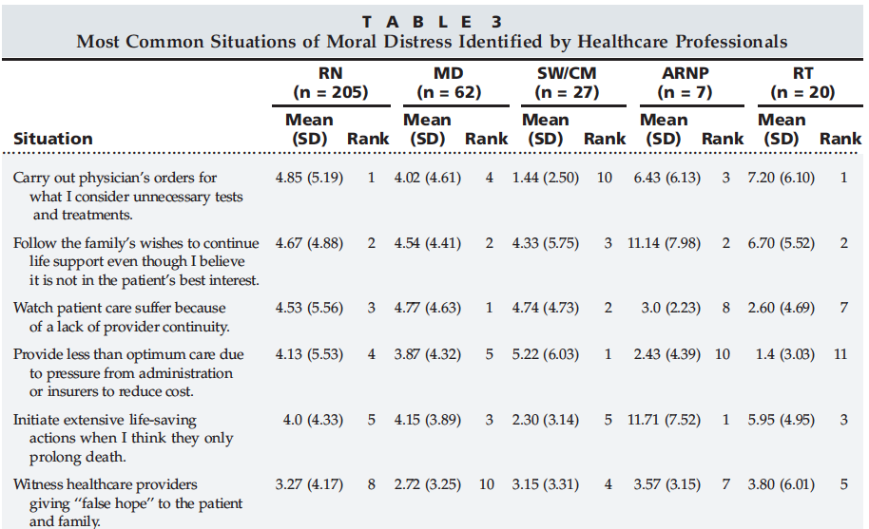

Slide 28
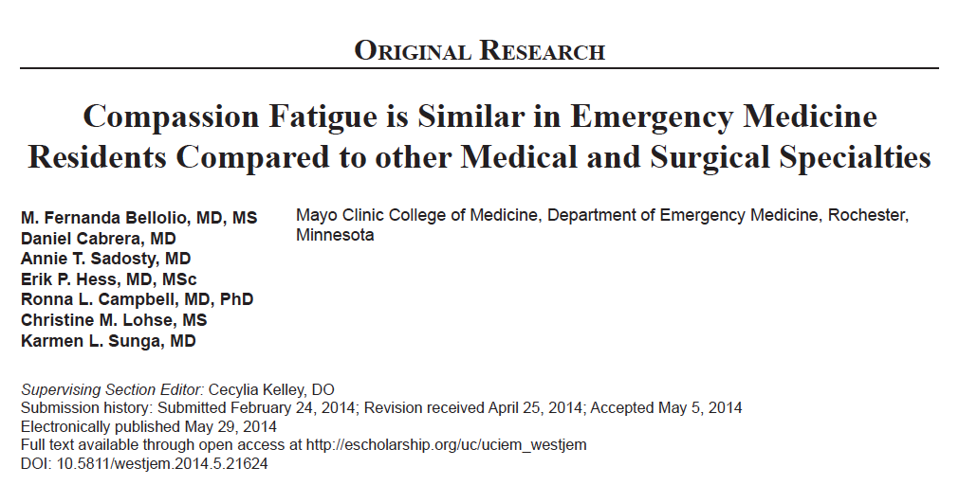
Other supporting studies …

Slide 29
Compassion Fatigue
“Conclusion: CF scores in EM residents are similar to residents in other surgical and medical specialties. Residents working primarily night shifts and those working more than 80 hours per week appear to be at high risk of developing compassion fatigue. Residents with children are more likely to experience secondary traumatic stress.”

Slide 30
It’s universal …
“This recent study by Orton et al found that 46% of UK GPs reported emotional exhaustion, 42% reported depersonalisation, and 34% reported low levels of personal accomplishment.”
Dale S, Olds J. Maintaining professionalism in the face of burnout. Br J Gen Pract. 2012 Nov;62(604):605-7. doi: 10.3399/bjgp12X658449. PubMed PMID: 23211174; PubMed Central PMCID: PMC3481511.

Slide 31
… and important
“Physician suicide is an important public health problem as the rate of suicide is higher among physicians than the general population. . . . Inadequate treatment [of mental illness] and increased problems related to job stress may be potentially-modifiable risk factors to reduce suicidal death among physicians.”
1: Gold KJ, Sen A, Schwenk TL. Details on suicide among US physicians: data from the National Violent Death Reporting System. Gen Hosp Psychiatry. 2013 Jan-Feb;35(1):45-9. doi: 10.1016/j.genhosppsych.2012.08.005. Epub 2012 Nov 2. PubMed PMID: 23123101; PubMed Central PMCID: PMC3549025.

Slide 32
Second Paper: Support Group
Feld J, Heyse-Moore L. An evaluation of a support group for junior doctors working in palliative medicine. Am J Hosp Palliat Care. 2006 Aug-Sep;23(4):287-96. PubMed PMID: 17060292.

Slide 33
Feld et al.
Intervention: Support group
Met for 1 hr every 3rd week
Doctors only (palliative care)
Facilitator: SW (a “trained counselor”)
No agenda or structure
Evaluation: Questionnaire
Sent to 37 “junior doctors” who worked at hospice
68% response rate
Not validated

Slide 34
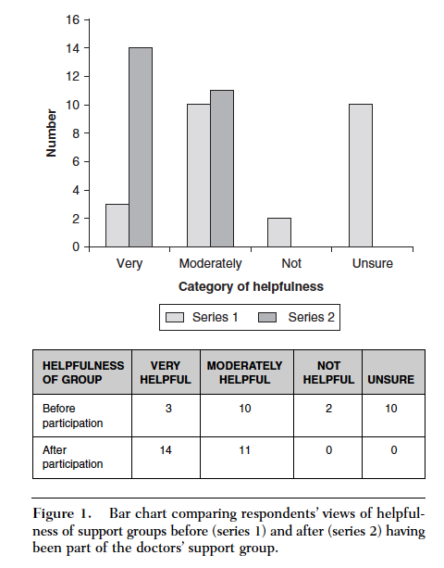

Slide 35
Third Paper: Balint Groups
Ghetti C, Chang J, Gosman G. Burnout, psychological skills, and empathy: balint training in obstetrics and gynecology residents. J Grad Med Educ. 2009 Dec;1(2):231-5. doi: 10.4300/JGME-D-09-00049.1. PubMed PMID: 21975984; PubMed Central PMCID: PMC2931236.

Slide 36
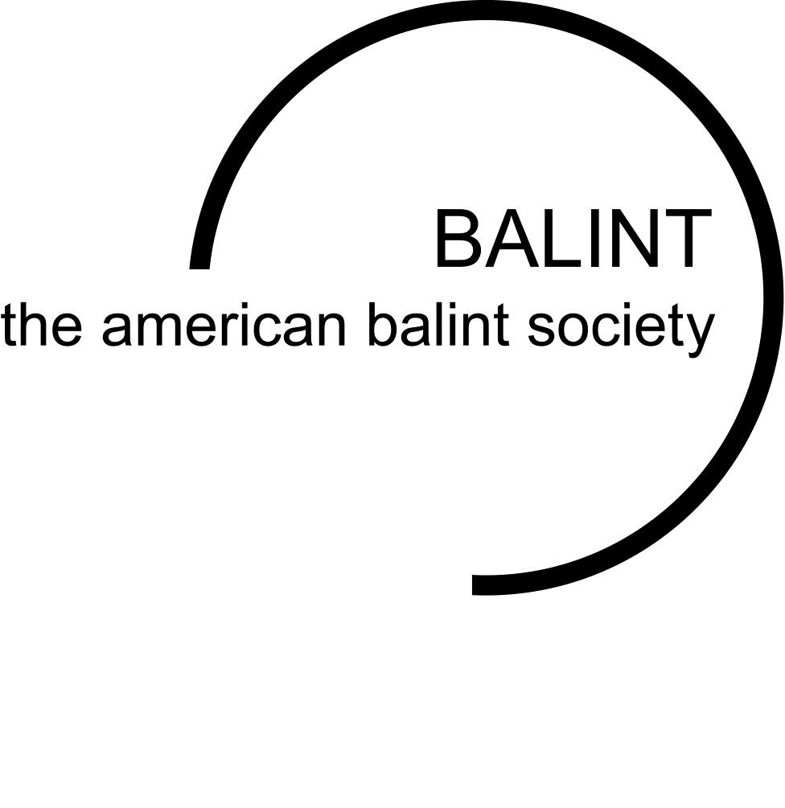
What is “Balint”?
“A Balint group is a group of physicians or other clinicians who meet regularly and present clinical cases in order to better understand the clinician-patient relationship.”
Notes:
http://americanbalintsociety.org/

Slide 37
Balint Groups
Format: Case presentations only
Two leaders (e.g., physician and psychologist)
Leaders go through credentialing process
No other structure

Slide 38
Ghetti et al. (I)
Prospective educational study
36 OB-GYN residents received “Balint training”
Methods
“The Psychological Medicine Inventory, the Maslach Burnout Inventory, and the Jefferson Scale of Physician Empathy were administered prior to initiating training and at 12 Months”

Slide 39
Ghetti et al. (II)
Results
17 residents
At baseline, 70% reported high burnout scores
“Burnout and empathy remained unchanged at 12 months. Psychological medicine skills improved at 12 months.”
Conclusion
“Interest and confidence in handling psychological aspects of patient care improved at 12 months after the introduction of Balint training.”

Slide 40
Ghetti et al. (III)
Why is this a negative study?
Do we need more than just “case presentations”?

Slide 41
“It is possible to change the conversation from burnout to wellness, and the time for that change is now.”

Slide 42
A Chaplain Led Support Group
The story of Care for the Caregiver Group…

Slide 43
Origin of the group…..
Two physicians noticed that there was a need to provide emotional support to those in the Palliative Care Fellowship program
Dr Rab approached Chaplain Resident Sage and Dr Madeline to start some sort of reflection group
Dr Rab, the four fellows and Sage gathered for an hour – there was venting, some laughter, and a few tears
The outcome of the first session was positive and the group decided to meet on a regular basis
The group GREW!

Slide 44
From Burnout to Wellness
System-Centered Theory Approach
Yvonne Agazarian’s Hypotheses and Observations
Role Goal Context
Process of developing the group’s identity
Three core principles: (1) trust and confidentiality, (2) an interdisciplinary approach, and (3) a clearly defined structure.

Slide 45
Why the Chaplain?
If we define spirituality as the process of finding meaning, purpose and connection to something greater then oneself, then spirituality is present in all people. In order to offer exceptional care to patients and their families, we need to also care for ourselves.
The chaplain is positioned to have both a professional and often personal relationship with members of the team.
The chaplain has an awareness of the experiences of members of the team as she is caring for the same patients. This dual relationship with providers gives the chaplain insight into topics and concepts to explore in group to decrease the risk for moral distress and burnout.

Slide 46
Spiritual Assessment
Palliative Care Team as a System
Parallel Process: Goal of Palliative Care and Goal of Group
Paul Galchutt’s Spiritual Assessment Model Applied

Slide 47
Spiritual Assessment
Story
Palliative Care Provider at JHH Experience
Suffering
Burdens
Spirit
Connection between burdens and providers wellbeing
Sense-Making
Process of finding meaning and purpose

Slide 48
Support Group as a Spiritual Intervention
Attend to the needs of the group as a whole and individual members
Utilize different group theories to facilitate healthy and effective group dynamics
Focus on aspects of self-care that promote healthy boundaries and professionalism
Re-infuse the humanity back into the role of being a caregiver
Create a safe space that fosters support, sharing and meaning-making

Slide 49
Outcomes…
Words from Joe
Words from Rab
Words from Madeline
Increase in attendance
Incorporation of CFC into the Fellow’s Program

