Slide 1
COPING AFTER SUICIDE™
JOANNE L. HARPEL, MPHIL, JD, PRESIDENT
joanneharpel@icloud.com
www.linkedin.com/in/joannelelewerharpel

Slide 2
A PATIENT JUST TOLD ME THEY “WANT TO END IT ALL” . . . NOW WHAT?
JOANNE L. HARPEL, MPHIL, JD
PRESIDENT, COPING AFTER SUICIDE, LLC
PRESIDENT AND CEO, RETHINK THE CONVERSATION
joanneharpel@icloud.com
917.584.1200
©2016 Joanne L. Harpel. All rights reserved.

Slide 3
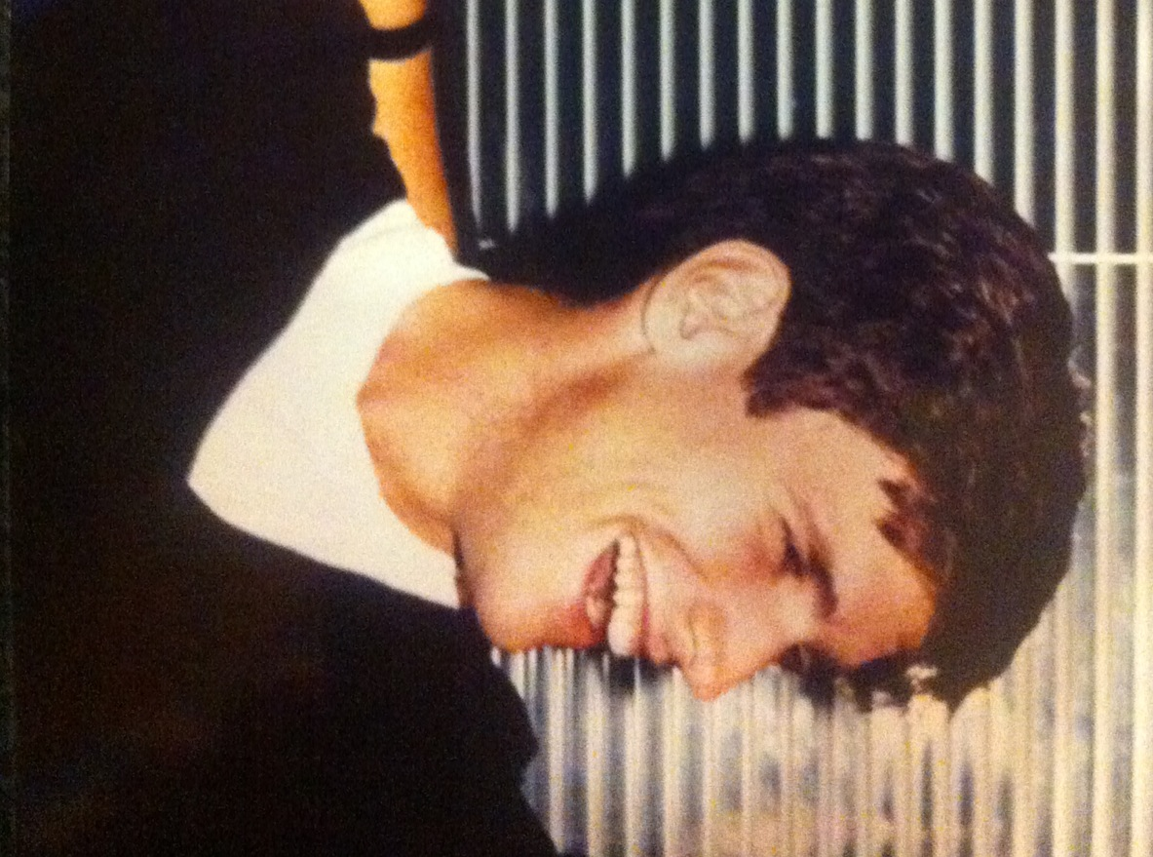

Slide 4
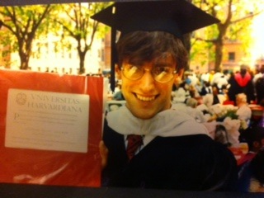

Slide 6
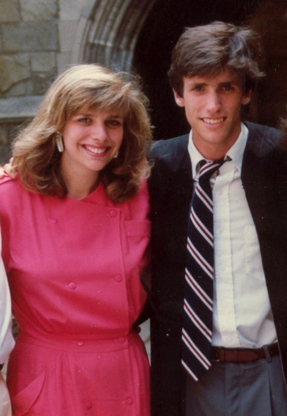

Slide 7
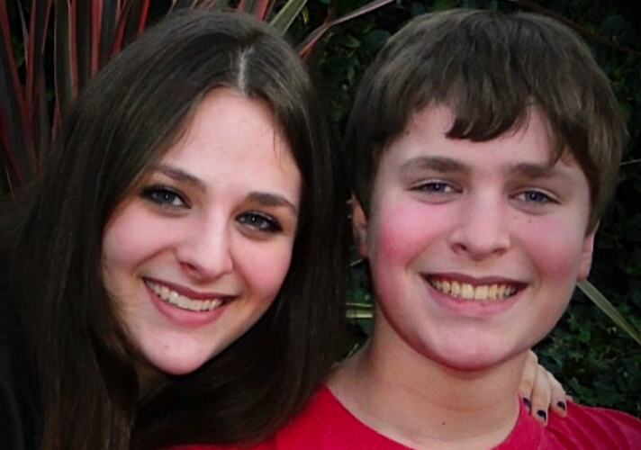

Slide 8
SUICIDE PREVENTION 101
Our goals today
Handouts
Five Great Books on Understanding Suicide
If You’re Worried About Someone
Mayo Clinic article on What to Do if Someone is Suicidal
“Gatekeeper” Trainings
ASIST (www.livingworks.net)
QPR (www.qprinstitute.com)

Slide 9
THE LANGUAGE OF SUICIDE
“Committed suicide”
died by suicide
killed him/herself
took his/her own life
“Successful” “Unsuccessful” “Failed” suicide attempt
Fatal/nonfatal
What’s a “survivor”
survivor of suicide loss
survivor of suicide attempt

Slide 10
WHY??
90%
Depression, bipolar disorder, schizophrenia, substance abuse
Recognized?
excruciating psychological pain and desperate hopelessness
not always obvious
Diagnosed?
correctly? by whom?
Treated?
adequately?
Serious mental illness can be fatal
Overwhelming majority DON’T kill themselves
Necessary but not sufficient

Slide 11
OUR ASSUMPTIVE WORLD
Human need to make sense of things
Create a narrative
Assumptions
life wants to live
I knew him
my love matters
my help helps
Suicide hugely confronting

Slide 12
I NEVER SAW IT COMING

Slide 13
It’s Not an “Epidemic”
Vast majority who [lose their jobs/get divorced/are bullied] DON’T kill themselves
Complicated – but not wholly inexplicable

Slide 14
RISK FACTORS
Serious underlying mental health condition
Access to lethal means
History (childhood trauma, previous attempts)
Exposure (finding the body, media coverage)
Physical health (pain)
Environmental (loss of relationship, death, academic or professional failures, arrest, “bullycide”)
linear cause and effect?
oversimplification risks normalization
Suicide isn’t a “normal” reaction even to extremely stressful events

Slide 15
WARNING SIGNS
IS PATH WARM? (Adapted from American Association of Suicidology)
Ideation
Substance abuse
Purposelessness
Anxiety
Trapped
Hopelessness
Withdrawal
Anger
Recklessness
Mood changes

Slide 16
IMMINENT RISK
Are they communicating it?
Talking/writing about death, dying or suicide (if not typical for them)
Talking of/threatening to hurt or kill themselves
Do they have a plan?
Do they have the means?
Seeking access to firearms, pills, or other means

Slide 17
WHAT’S MY ROLE?
What it is
unique vantage point
confidante
link in the chain
Don’t panic
Show you care (non-judgmental)
What it Isn’t
boundaries – it’s not all up to you
you’re not a clinician (and don’t need to be)
Suicide is scary

Slide 18
WHAT SHOULD I DO?
Trust your gut
Ask direct questions
Remove lethal means
Alone isn’t good – for them or for you
Know and follow your institution’s protocol
at a minimum, tell the attending
National Suicide Prevention Lifeline 1-800-273-TALK
put it into your contacts now
www.suicidepreventionlifeline.org
doesn’t supercede protocol
Crisis Text Line 741 741

Slide 19
TRANSPARENCY AND TRUST
Difficult spot
confidentiality
Be transparent
explain that you’re taking what they said seriously
clearly you’re in pain
disclose what you now need to do
acknowledge the difficulty
E xplain that your job includes helping keep them safe
They may (likely will) recant
doesn’t change things

Slide 20
YOUR OWN BELIEFS
Suicide makes us uncomfortable
We all carry our own feelings/beliefs
be conscious of yours
family or personal history
Character flaw?
Sign of weakness or cowardice?
Taking the easy way out?
Irresponsible?
Selfish? Heroic?
The Sheriff and the Train
“Psychache”

Slide 21
YOUR OWN FAITH TRADITION
Stigma
rooted in religious tradition (e.g., cemetery)
protective effect
yet misses the mark re: help-seeking and supporting survivors
What is your understanding of your own faith tradition’s current view about suicide?
The Jesuit seminary student
Is it complementary or in conflict with your own personal view?
How would you answer, “will I go to hell?”
Be careful about “with God now” “in a better place”
risk of contagion

Slide 22
WHAT DO I SAY TO THE FAMILY
Are we now at risk?
Part of family health history
What should we tell the kids/neighbors

Slide 23
IS SUICIDE BEREAVEMENT DIFFERENT?
Quantitatively?
Qualitatively?

Slide 24
UNIVERSAL THEMES
Why?
Who?
guilt, blame, responsibility
round robin, including God and me
Shame and stigma
Rejection and abandonment
How could they do this [to me]?
Weren’t they thinking about the pain they’d leave behind?
Anger
Relief (shh)

Slide 25
COMPASSION FATIGUE AND BURNOUT
You matter, too
Signs of burnout
Self-care

Slide 26
YOUR TURN

Slide 27
COPING AFTER SUICIDE™
JOANNE L. HARPEL, MPHIL, JD, PRESIDENT
joanneharpel@icloud.com
www.linkedin.com/in/joannelelewerharpel

