Slide 1
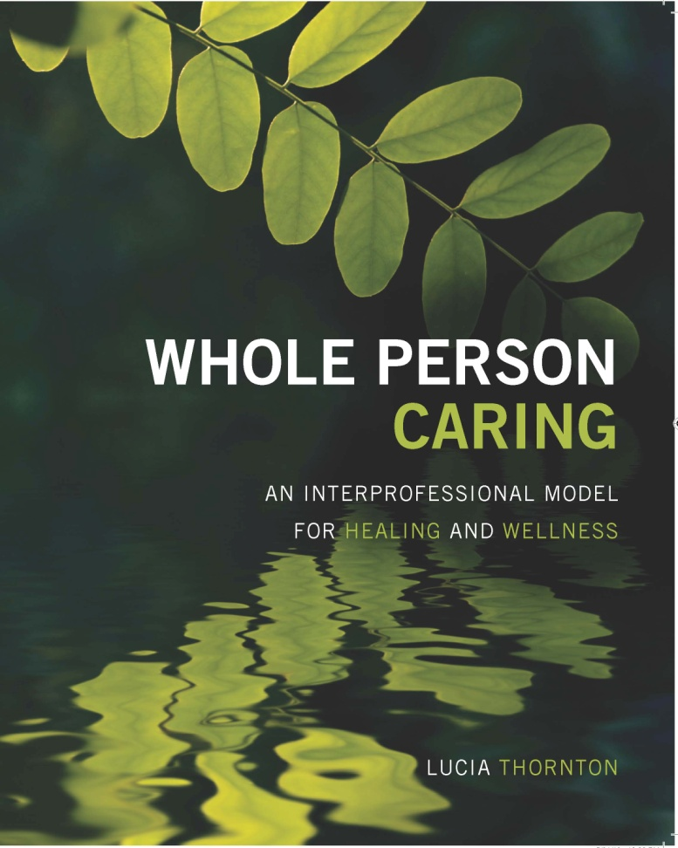
Disclosure Information
Author of: Whole Person Caring An Interprofessional Model for
Healing and Wellness
Member of the Board of Directors:
Integrative Health Policy Consortium
Academy of Integrative Health and Medicine

Slide 2
Whole-Person Caring:
Where Healing Happens

Slide 3
Creating Our Intention

Slide 4
Development of the Model of Whole Person Caring

Slide 6
Key Elements of Model
Holistic & Integrative Perspective
Interdisciplinary & Interprofessional
Focus on Healing & Wellness
Acknowledges Our Spiritual and Energetic Nature

Slide 7
Interprofessional Model
Creates a Common Vision
Aligns People around Shared Values
Provides a Common Ground for Practice
Creates Synergy
Facilitates Individual and Cultural Transformation

Slide 8
Results of Implementing The Model of Whole Person Caring

Slide 9
Increase in Patient Satisfaction
Patient satisfaction increased from low 80th percentile to 94th percentile on units where implemented.

Slide 10
Considerable
Cost Savings
Over $1.6 million dollars saved as a result of decreased nursing turnover in one year on the implementation units.

Slide 11
Integration of Organizational Values
Significant increase in integration of organizational values in employees participating in WPC programs:
excellence
honesty
respect
service

Slide 12
National, State, and Local Recognition
Norman Cousins Award
Excellence in Healthcare Leadership
Award
Innovation in the Workplace Award

Slide 13
Models of Care Define:
Who We Are
What We Do
How We Do It

Slide 14
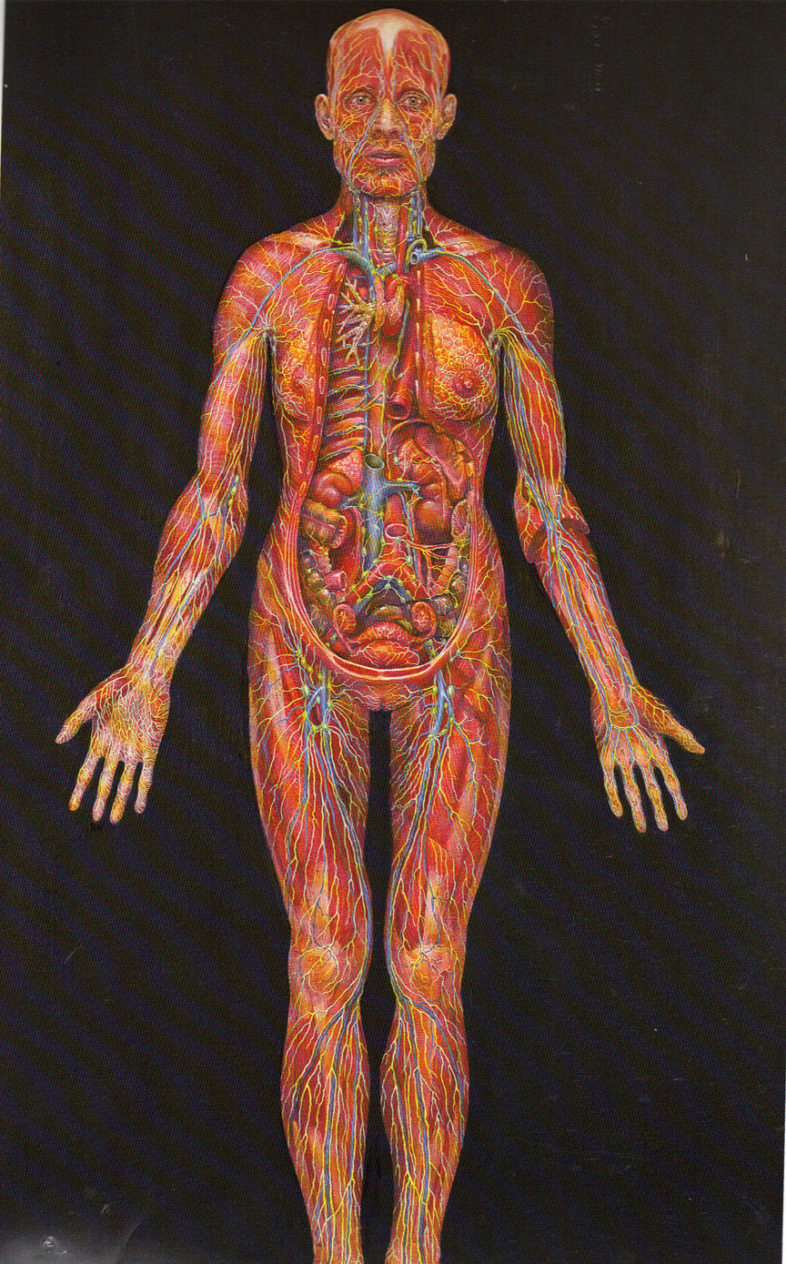
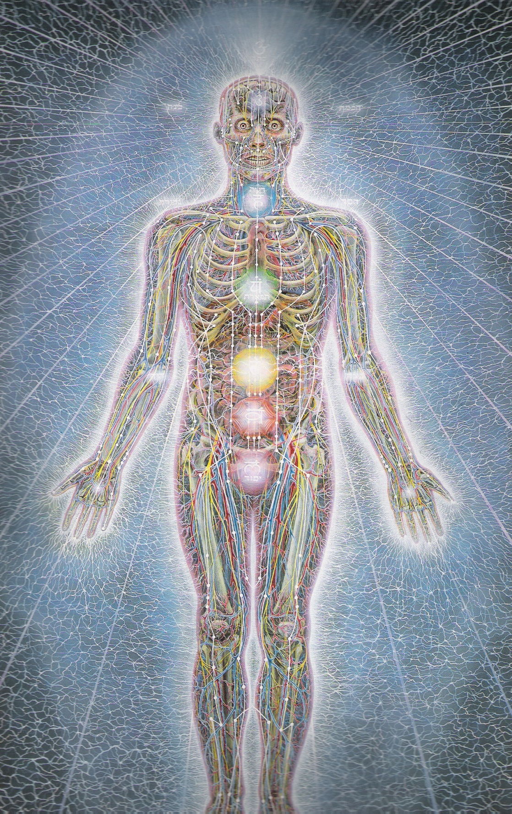
Who Are We?
Alex Gray, 1990 Sacred Mirrors
Alex Gray, 1990 Sacred Mirrors

Slide 15
Current Biomedical Paradigm
(origins in 17th Century)
People are perceived as an amalgamation of molecules and atoms that interact in a predictable fashion based on laws of mathematics, chemistry, and physics.

Slide 16
Moving Toward a Paradigm Where Healing Happens. . .
Re-Defining Who We Are

Slide 17
Concepts Derived From Nurse Theorists & Modern Physics
Florence Nightingale
Martha Rogers
Jean Watson

Slide 18
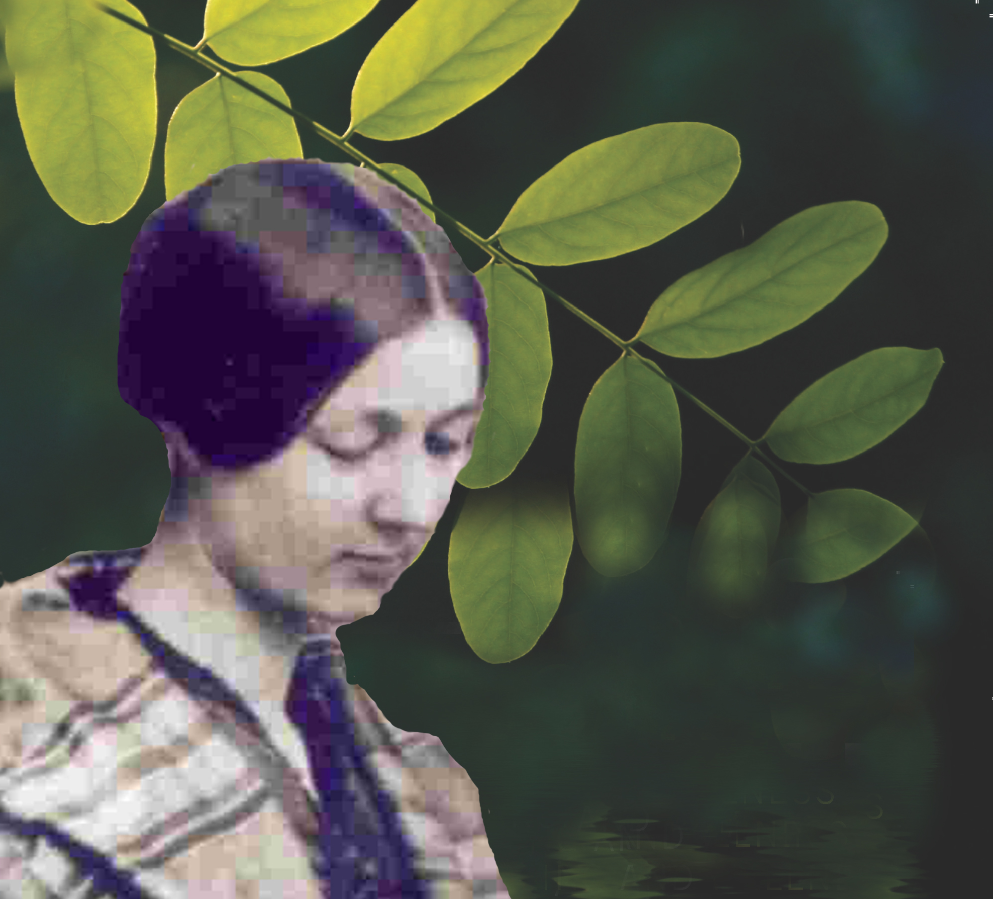
Florence Nightingale
We are. . .
“ Reflections of the Divine. With physical, metaphysical, and intellectual attributes.”

Slide 19
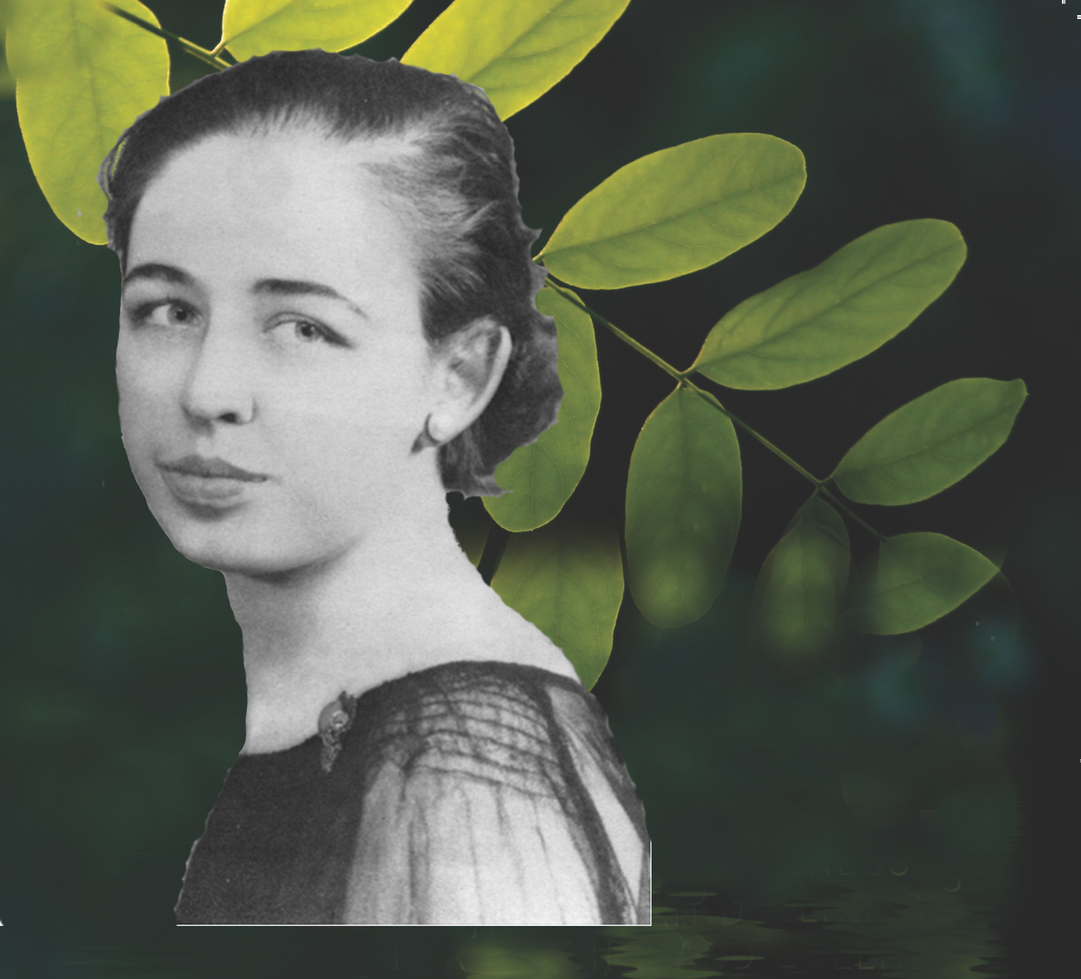
Martha Rogers
We are . . .
“Irreducible, indivisible, pandimensional energy fields that are infinite in nature and inseparable from the environment.”

Slide 20
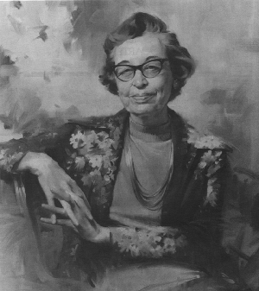
Lucia: “When I have looked at your theory I see it could cross over into all fields”
Martha: “No . . . none of these other fields deal with the whole people now. Psychology deals with the piece, something we call mind; Physics deals with the physical world; and these deal with the physiological pathology and so on. Astronomers study the cosmos . .
Nursing is the only field that does or has ever has dealt with unitary human beings as indivisible energy fields.
This is neither good nor bad, it is not an either or. When we talk about a science, the thing that identifies a science is that which is being studied, the phenomenon.

Slide 21
Nursing is the only field that does or has ever has dealt with unitary human beings as indivisible pandimensional energy fields.
Martha Rogers
But, I think she’s changed
her mind ! ! !

Slide 22
Basic Physics
All matter is composed of atoms
Atoms are composed of 99.99999% empty space.
All 6 billion people on earth could fit inside a single apple if all the empty space was removed ! ! !

Slide 23
Modern Physics
What occupies this space?
A dynamic energy (Higgs field) fills all of space and gives
particles mass
We are 99.9999% dynamic energy!

Slide 24
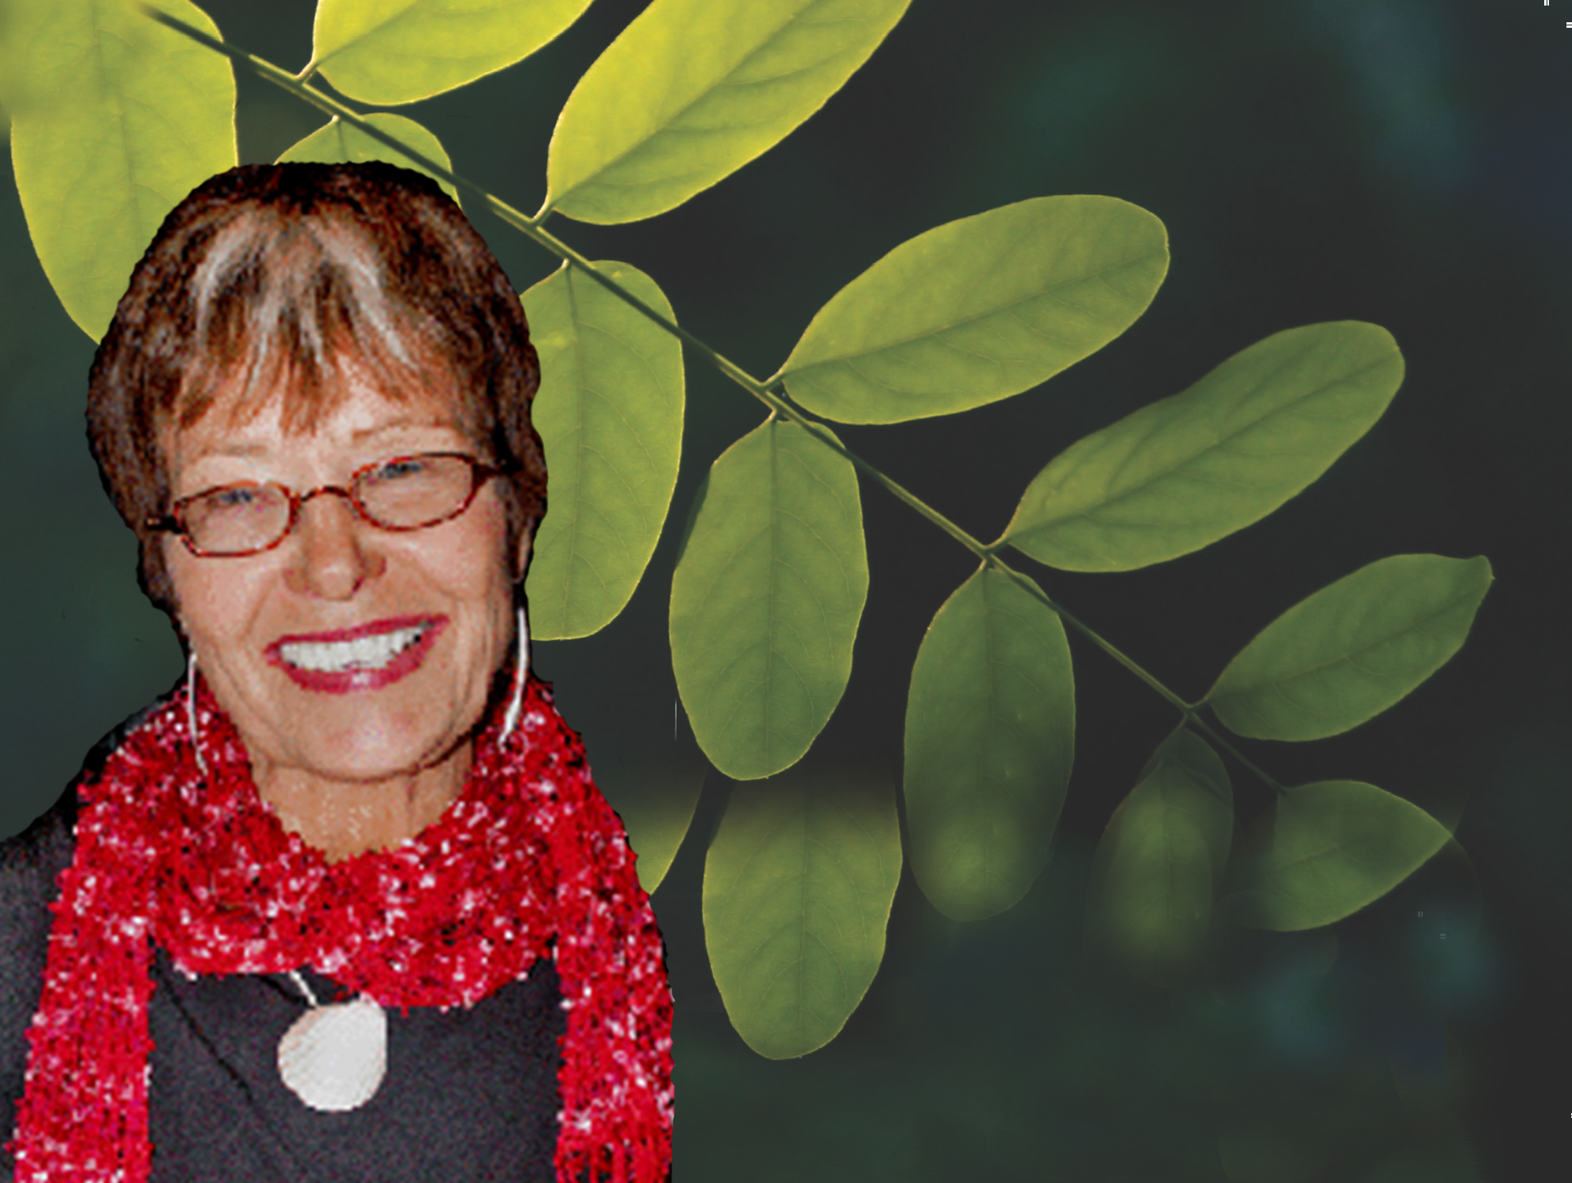
Jean Watson
“We are Sacred Beings.
We must regard ourselves and others with deepest respect, dignity, mystery and awe.”

Slide 25
Who Are We?
Reflections of the Divine
Infinite Fields of Energy
Sacred Beings

Slide 26
Person
An energy field that is open, infinite and spiritual in essence and in continual mutual process with the environment.
Each person has unique physical, mental, emotional, and social/relational manifestations of pattern that are interrelated, inseparable and continually evolving.

Slide 27
Concept of Whole Person

Slide 28
Concept of Whole Person
Self
Emotional
Social/
Mental
Physical
Relational
Spiritual
Energy Field
(Field of Love)

Slide 29
Spiritual
The spiritual dimension is a unifying force that integrates the physical, mental, emotional, and social/relational aspects of being.
The spiritual dimension is the essence of self and also transcends the self. It is our closest, most direct experience of the universal life force.

Slide 30
Key Concepts of Whole-Person Caring
Infinite and Sacred Nature of Being
Self-Compassion, Self-Care , and Self-Healing
Optimal Wellness
Therapeutic Partnering
Transformational Leadership
Caring as Sacred Practice

Slide 31
Infinite and Sacred Nature of Being
Everything in nature is a holy temple . . . An altar for serving the Divine.
Hildegard of Bingen

Slide 32
Pandimensionality
A non-linear domain without spatial or temporal attributes.

Slide 33
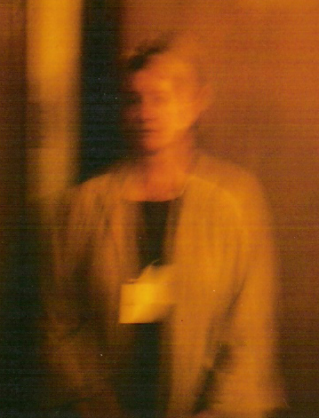
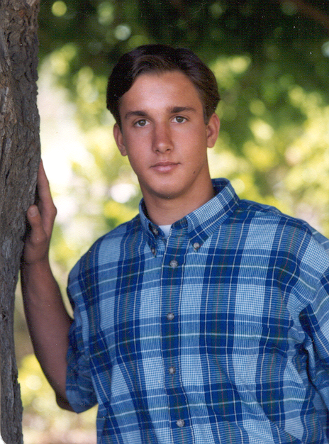
Our Infinite Nature

Slide 34
Self- Compassion, Self-Care & Self-Healing

Slide 35
Self- Compassion
The moment you see how important it is to love yourself, you will stop making others suffer.
Thich Nhat Hahn

Slide 36
Components of Self- Compassion
*Self-kindness versus self-judgment
*Mindfulness versus over-identification
*A sense of common humanity versus isolation

Slide 37
Self- Care & Self-Healing
We must learn to treat ourselves with love and respect before we are able to treat others that way.
Jean Watson

Slide 38
Self- Care & Self-Healing
Foundational for Personal and Organizational Transformation
Primary in Establishing a Caring
and Healing Culture

Slide 39
Optimal Wellness
The process of Optimal Wellness is one in which each aspect of our being becomes attuned and aligned to our Essence/Spiritual Self.
As our spiritual/energetic Essence infuses the patterns of our life, we recognize and develop to our full potential (Self-Realization).

Slide 40
Concept of Whole Person

Slide 41
Concept of Whole Person
Self
Emotional
Social/
Mental
Physical
Relational
Spiritual
Energy Field
(Field of Love)

Slide 42
Concept of Whole Person
Acceptance of Self & Others
Ability to Give & Receive Love
Appreciation for Basic Pleasures
Expressing Ones Own Truths
Empathy & Compassion
Self
Emotional
Mental
Emotional
Social/
Physical
Relational
Spiritual
Energy Field
(Field of Love)

Slide 43
Concept of Whole Person
Optimal Dietary Intake
Optimal Elimination
Optimal Rest & Sleep
Optimal Movement & Exercise
Optimal Breathing
Self
Emotional
Mental
Emotional
Social/
Physical
Physical
Relational
Spiritual
Energy Field
(Field of Love)

Slide 44
Concept of Whole Person
Deep Interpersonal Relationships
Relationships Promoting Growth
Wholesome & Loving Relationships
Meaningful & Purposeful Work
Deep Respect for All
Knowing Love as Essence of Self & Others
Self
Emotional
Mental
Emotional
Social/
Social/
Physical
Relational
Physical
Relational
Spiritual
Energy Field
(Field of Love)

Slide 45
Concept of Whole Person
Perceiving Reality With Clarity
Self-Awareness
Problem Solving Orientation
Positive Thoughts & Attitude
High Degree of Imagination & Creativitiy
Sense of Humor
Self-Realization
Self
Emotional
Mental
Emotional
Social/
Mental
Social/
Physical
Relational
Physical
Relational
Spiritual
Energy Field
(Field of Love)

Slide 46
Therapeutic Partnering
True compassion only occurs among equals.
The Dalai Lama

Slide 47
Therapeutic Partnering
A relationship whose common mission and purpose is to promote healing and wellness and is characterized by mutual power, respect, compassion, trust, and clear communication.
Thornton, 2013

Slide 48
Relationship Between Professionals
Traditional Therapeutic Partnership
Hierarchical among and within professions
Perceived “power” based on profession, level of education and position in the organization
Competition and divisive energy prominent
Inequitable, physician centered relationships
Professions work together as partners in service
Concept of “power” obsolete, replaced by concept of “service”
Mutual support and synergistic energy dominant
Equitable , patient centered relationships

Slide 49
Relationship Between
Client & Health Provider
Traditional Therapeutic Partnership
The provider has power and authority
Client expected to comply with plan of care and is a passive participant in care.
Client depends on the provider for health care directives.
Provider and patient are partners with equal power.
Client and provider mutually determine the plan of care - patient is an active participant in care.
Client empowered to take control and encouraged to initiate health-promoting behaviors.

Slide 50
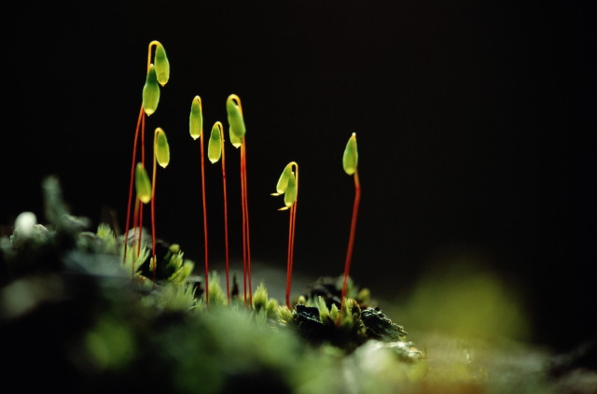
Transformational Leadership
Transformational Leadership
One must not always think so much about what one should do, but rather what one should be.
Our works do not ennoble us; but we must ennoble our works.
Meister Eckhart
Process of deep inner growth, change, and development.

Slide 51
Transformational Leadership
Healing Environment
Emotional
Emotional
Mental
Mental
Relational
Relational
Physical
Physical
Social/
Social/
Organization
Empathetic
Empowering
Caring
Modeling
Shared Governance
Values Driven
Clarity
Awareness
Vision
Vital
Flowing
Flexible
Concepts of Whole-Person Caring
Energy Field
(Field of Love)

Slide 52
Caring as Sacred Practice
We cannot do great things We can only do small things with great love .
Mother Theresa

Slide 53
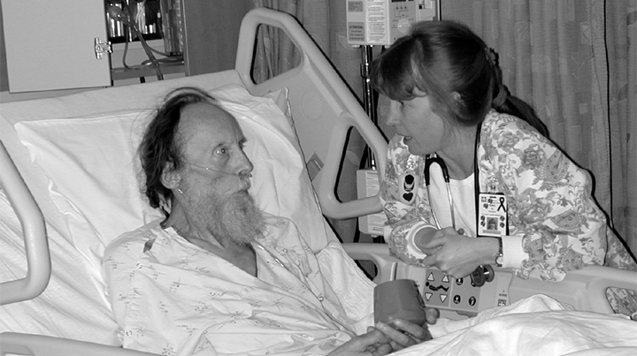
Creating Sacred Space through Our Presence
You ARE the Healing Environment !

Slide 54
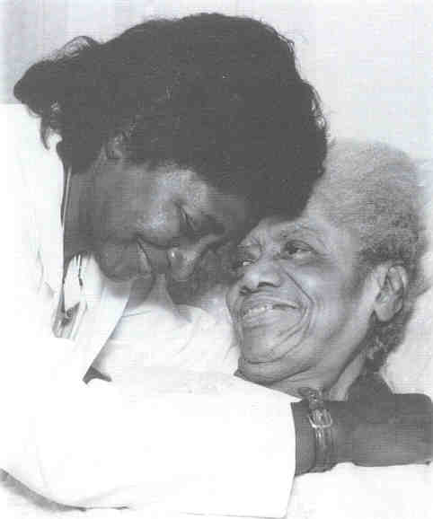
Your vision will become clear only when you can look inside your own heart. .
. . Who looks outside dreams, who looks inside awakes. Carl Jung

Slide 55
Resources

Slide 56
Resources
Curriculum guide & articles download for free at : www. luciathornton.com
Turn-key 2 day program for students, nurses & organizations to create optimal health and well-being.
Correspond at: lucia@luciathornton.com

Slide 57
The Integrative Health Policy Consortium (IHPC)
Eliminating Barriers to Health
www. ihpc.org

Slide 58
IHPC Initiatives
Supporting your rights to covered integrative holistic care
www. ihpc.org
www.covermycare.org

Slide 59
The ACADEMY of INTEGRATVE HEALTH & MEDICINE
Creating a Global Community of Health Professionals
United in Healing
United in Health
United in Caring
Stand With US!
www.aihm.org
Conference Oct.30- Nov. 3 San Diego, CA

Slide 60
We Have . . .
A New Vision !

Slide 61
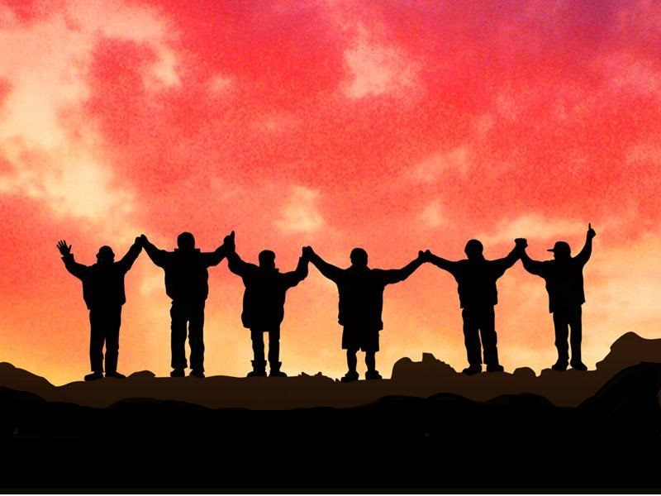
Together . . .
We Will Bring Health and Healing into this World !!!

Slide 62
Thank You!

