Slide 1
The Importance of Community Engagement by Hospital Based Chaplains: Why Do it? How to Do it?
Deborah B. Marin, MD, Director
Rev. Dr. Zorina Costello, Community Liaison
Vansh Sharma, MD, Director of Research

Slide 2
The Mount Sinai Health System
7 Hospitals
37,000 employees
177,000 admissions per year
2,600,00 outpatient visits per year

Slide 3
Center for Spirituality and Health
Clinical Services
Education
Research
Community Engagement

Slide 4
Driving Principles
Use evidence based models
Data
Document methods
Measure performance
Review outcomes

Slide 5
Agenda
The role of Faith and Community Based Organizations (FBOs & CBOs) in health promotion
Process used to engage faith based organizations
Results
Population health implications

Slide 6
The Important Role of FBOs in Health Promotion
Of the religiously affiliated, 60% attend church at least monthly
Churches serve both their congregants as well as the community
Clergy can have a profound impact on their congregants
http://www.pewforum.org/2015
Lumpkins et al. J Rel Health.2013;52(4)1093-1107)

Slide 7
Changes in the Health Care Model
Increasing recognition that health promotion cannot be confined to the medical setting
Increasing efforts to provide health services in the community setting
Value based purchasing

Slide 8
Examples of FBOs in Health Promotion
Health ministries
Health fairs
Health screens
Blood pressure
Cholesterol
Cancer
HIV
Hepatitis C
On site education
Invited lectures
Sermons
Written material
Delivery of evidence based disease management programs

Slide 9
Hospital Relationships with FBOs
Services provided:
Health fairs
Lectures
Health screens
Research
Challenges
Episodic
Lack of continuity
May not be culturally competent
Outreach vs. engagement

Slide 10
Who Drives Hospital Relationships?
Community Relations Department
Social work
Health educators
Public affairs
Auxiliary Boards
Researchers
Challenges:
Lack of coordination
What can be the role of health care chaplains?

Slide 11
Why Chaplains?
Chaplains understand the importance of different faiths and religions regarding:
Lifestyle
Attitude toward illness
Medical decision making
Chaplains understand the nuances of the culture of congregations

Slide 12
Outreach vs Engagement with FBOs
Model should be relevant and meaningful to the faith based organization
Community engaged projects are co-created
Continual work to improve the design of locally relevant methods and attitudes towards research
Commitment to co-learning
Promote equity, sustainability, accountability
The complexity of a church community must be considered in providing a framework for intervening at multiple levels of influence on health behaviors and practices
Church based health promotion considers that faith based organizations can become essential partners
www.community.vcu.edu; Campbell, Hudson, Resnicow et. al. Annual Review of Public Health 2007.28:213-34.

Slide 13
Faith-Based Engagement
Recognition of the importance of FBOs in health promotion*
Partnering with FBOs in envisioning the nurturing of the presence of religious, spiritual, faithful imagination in relationships to effect transformation in health outcomes by seeking the-Leading Causes of Life (LCL**).
* http://www.cdc.gov/minorityhealth/resources/Faith.html
**Gunderson, G.R., and Cochrane, James, R. (2012). Religion and the Health of the Public:
Shifting the Paradigm, New York: Palgrave MacMillan.

Slide 14
Stage 1 Engaging the Community

Slide 15
Trust Building: Engagement Process
Monthly community clergy faith based breakfasts
Forums to provide an opportunity for interreligious dialogue and discussion of health concerns
Events are in small groups, provide a safe space, give leaders a platform to explore health topics and access to experts in health education

Slide 16
Alternating Topics
Learning about health and spiritual topics occurs in an environment of a shared social construct –
Respect of faith and a search for meaning
Opportunity to exchange stories among chaplains and other clergy
Appreciate value of the Narrative Process

Slide 17
Data
87 FBOs and CBOs have attended breakfast lectures
Topics include
Health prevention
Disease management
Access to care
Use of scriptures to work with the sick

Slide 18
Asset Mapping ( 31 FBOs)
Health Education Programs
Diabetes classes-4
Nutrition classes-1
Screening programs
Blood Pressure – 3
Blood Sugar - 3
Weight – 4
HIV – 1

Slide 19
Asset Survey Needs
Common Health Problems
Diabetes - 13
Hypertension – 12
Obesity – 8
Stroke – 3
HIV – 1
Requested topics
Access to Physicians – 8
Health Education – 14
Health Screening – 6
Community Liaison – 6

Slide 20
Stage 2 Role of a healthcare chaplain as the community liaison
Rev. Dr. Zorina Costello

Slide 21
Multi-Faith Initiative on Community And Health M.I.C.A.H. project
Health Education for Congregations
Wellness Events tailored to each FBO needs
Pathway to access to health care
Opportunities for programs on prevention and early detection
Collaboration with Mount Sinai and other community partners

Slide 22
Engagement Process
Continue Clergy Breakfasts
Build relationships within the hospital
Establish an Advisory Committee
Implement multifaceted engagement
Attending worship services
Meeting one to one with leaders
Responding to requests
Learning about individual differences and similarities of congregations

Slide 23
Work Within Mount Sinai
Collaboration with Community Relations
Engaging providers with resources to provide health education, screening and prevention
Discussing potential improvement in access to care
Inclusion of pre-existing Population Health programs with data that support measurable outcomes

Slide 24
Preliminary Work with Community
Reviewed the establishment of the M.I.C.A.H. project
Opened up a dialogue about health disparities
Observed which congregational leaders self-selected by asking for more information and programs
Collaboration and co-creation of tailored health education programs by utilizing MSHS resources
Responding to requests while setting realistic goals

Slide 25
Importance of Religious Health Ministries
These ministries may be formal or informal
May have clergy or non-clergy assigned as leaders
Leaders may have professional health industry experience or feel that God is calling them to be helpers
Pastor, Imam, Rabbi, Minister, Monk, Cleric
Ministries may already address Cancer, HIV/AIDS, Youth, Elder Care, Mental/Behavioral Health, Political Advocacy, Social Action etc.

Slide 26
Conducting a Survey of Topics
Based on input from Advisory Committee, a survey was developed
Survey asked for leaders to rank order topics of importance to their congregants
Survey also asked about preference of educational format

Slide 27
Surveys
Topics
Healthy life style
Cancer risk and prevention
Navigating access to health care
Mental illness
Visiting the sick
Educational programs
Health screening
HIV/AIDS
Other
Communication Preference
Group meeting
Newsletter
Social media
Augmenting a sermon
Other

Slide 28
Survey Results (N=14)

Slide 29
Other Requests (no particular order)
Educating Caregivers
Depression
Asthma
Living wills
Cost for funerals
Senior Homes
Prostate
Diabetes
Alzheimer’s Disease
Parenting
Child Development
Family Care
(Childhood obesity, Learning disabilities, Adolescents)

Slide 30
Presentation Format

Slide 31
Involve representative from Congregation?

Slide 32
Developing and Maintaining Relationships
One-to-one meetings with leaders
Attendance at services
Serving as liaison for requests

Slide 33
Community Activities
Type of Activity | Number of Participants | Number of Occasions
Blood Pressure | 49 | 2
Breast cancer screen | 85 | 3
Colon cancer screen | 111 | 5
Diabetes | 145 | 4
Educ. Materials | 14 | 2
Flu Vaccines | 19 | 1
Health Education Panel | 118 | 3
Health Fair | 226 | 6
Hep C Screen | 66 | 4
HIV Screen | 46 | 4
MICAH Overview | 5536 | 56
Stroke Prevention | 18 | 2

Slide 34
Potential Impact on Population Health
The Center is recognized as a valuable partner of the Mount Sinai DSRIP program
(Delivery System Reform Incentive Payment)

Slide 35
What is DSRIP?
DSRIP = Delivery System Reform Incentive Payment.
One of various outputs of Governor Andrew Cuomo’s Medicaid Redesign team efforts to transform the NYS Medicaid program
An effort between the New York State Department of Health (NYSDOH) and the Federal government to improve the health of the Medicaid population and the uninsured.
A performance-based program; not a traditional grant. Must hit performance goals before payment is made.

Slide 36
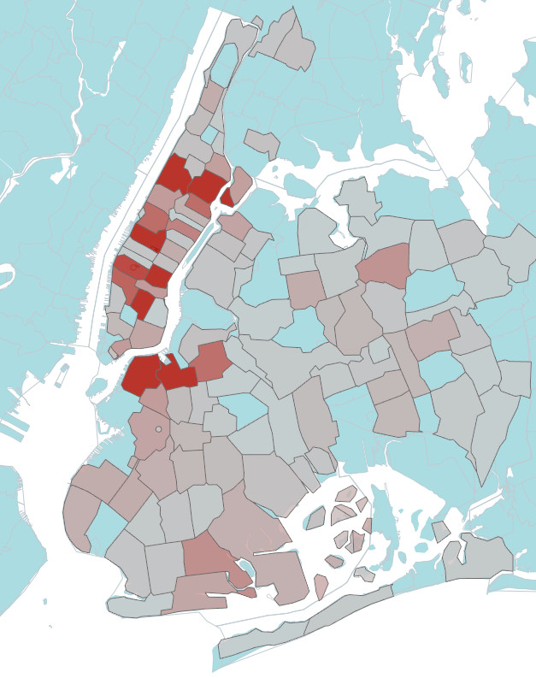
Mount Sinai Performing Provider System
MSPPS initiative serves all 7 hospitals within the Mount Sinai Health System in 4 counties
56 Health Centers Clinics
58 Care Management Providers
Over 600 Mental Health & Substance Abuse Providers
78 SNF/Rehab Facilities
11 Hospice Programs
53 Community Based Organizations
Recently added 3 Faith Based Organizations
Provider density by zip codes
Notes:
Attributed not Contracted Lives
Provider density – the darker the red the more providers, grey is less

Slide 37
Goals of the Program
Provide incentives to healthcare providers to build infrastructure and programs to improve population health
Expand access, allowing patients to receive care at the right place and at the right time to maintain their health
Reduce avoidable hospital admissions by 25% by DY 5
Shift the payment system “from volume to “value”
Fee for Service vs. Value-based payments
80-90% of Medicaid MCO payments are VBP by the year 2020
35% of the payments by fully capitated MCO’s should be risk-based¹
1. Medicaid Institute “Navigating the New York State Value-Based Payment Roadmap

Slide 38
Partnerships with Community Organizations (CBO/FBO)
Community-level partnerships are key to making DSRIP work
Need to look beyond traditional medical system model
Community-level organizations are important in keeping people healthy
CBO/FBOs are the way to reach into communities and reach people who are not engaged, or not well engaged in the medical care system

Slide 39
Stage 3 Next Steps

Slide 40
Improve Access to Care
Develop navigation
services
Develop a Resource Guide
Develop a Call Center for referrals
Potential to train navigators from within the congregations
Include Congregations in the Community Resource Guide as Assets
Help train congregations to access the call center resources

Slide 41
Lessons Learned
Advisory Committee process takes time to develop and to build consensus
Congregational timeframes/calendars have a life of their own which poses challenges in matching providers to needs
A large percentage of time is devoted to building and sustaining relationships
Hospital resources may not always be co-located in a data base or easy to access
Access to care and navigational services may have different pathways
Engagement project may evoke a historical narrative from the community
Congregations like being affiliated with the hospital and enjoy the opportunity to learn about healthcare
Congregational leadership enjoy a safe space to discuss spiritual questions and interfaith dialogue

Slide 42
Future Goals
Developing more relationships
Measuring health outcomes of programs
?Placement of additional health promotion programs that can be sustained within the FBOs and CBOs

Slide 43
Questions / Comments

