Slide 1
Quality Improvement: Hospice Chaplaincy Philosophy and Clinical Documentation Strategies
Ensuring Best Practice in Hospice Chaplaincy

Slide 2
Introduction
Toward Excellence in Spiritual Care: How it all started
Recognition of the problem
CMS FY 2011 Top Ten Hospice Survey Deficiencies
Compliance Recommendations
3. Medicare hospice CoP: §418.56(c) Standard: Content of the plan of care.
The hospice must develop an individualized written plan of care for each patient. The plan of care must reflect patient and family goals and interventions based on the problems identified in the initial, comprehensive, and updated comprehensive assessments. The plan of care must include all services necessary for the palliation and management of the terminal illness and related conditions.
Interpretive Guidelines L-Tag: L545

Slide 3
Introduction
Recognition of the problem
CMS FY 2011 Top Ten Hospice Survey Deficiencies
Compliance Recommendations
Our Plan of Care resources included:
21 Spiritual Concerns
7 Goals
7 Interventions
It was virtually impossible to provide an individualized POC
There was no philosophy to guide the development of a POC

Slide 4
Introduction
Embrace a plan to develop a philosophy, algorithm, and template.
PDSA, or Plan-Do-Study-Act, is an iterative, four-stage problem-solving model used for improving a process or carrying out change.
In applying PDSA, ask yourself three questions:
What are we trying to accomplish?
How will we know that a change is an improvement?
What changes can we make that will result in an improvement?

Slide 5
Outcome Oriented Chaplaincy
Forms the superstructure to our spiritual care philosophy
The principles on which OOC is based include:
Accountability
Best Practice
Collaboration
How OOC shapes our spiritual care assessment model
Spiritual Concern
Goals/Expected Outcomes
Interventions

Slide 6
The Documentation Template
The Documentation Template captures the important information required to paint the picture of patient care:
Patient Information—The Chaplain will identify the patient in the following manner: The patient presented as a ___ year old, Euro/Hispanic/African American male/female who was in her/his chair/bed/etc. during visit.
Purpose of the visit—The Chaplain can state that this was an initial assessment visit, a routine visit to deepen the spiritual care relationship, or state that this was an On Call visit, or a Return visit due to an emergency or whatever description that fits the circumstance of the visit.

Slide 7
The Documentation Template
Observations—Chaplains do not assess, they observe. Such verbiage must be in the Clinical Note (i.e. Chaplain observed the patient was using the wall to aid in ambulation).
Pain level/scale—The Chaplain is required to identify pain levels based upon the VAS scale, or PainAD, or FLACC scale.
Safety issues
Decline—The acrostic, MAC, guides the Chaplain (and other disciplines, as well) to observe decline in the patient. The Initial Spiritual Care Assessment serves as a baseline in the Chaplain’s observations. In each subsequent visit the Chaplain will use the MAC to highlight his or her observations of the patient’s decline.

Slide 8
The Documentation Template
M—Mobility: How does the patient ambulate? Wheelchair, walker, cane, holding onto the wall, needs assistance? When observing decline, note any difference in the manner the patient ambulates from your prior visit.
A—Activities of Daily Living: The patient and/or family member(s) may assist you with this observation. Areas of ADL’s to observe include: eating, sleeping, bathing, incontinence, transferring, toileting. Helpful questions include: How much is patient eating? What amount compared to last visit? Has food been pureed? How is appetite? How is patient sleeping? All night? Partial night? Napping for long stretches during the day? Up at night, sleeping during the day? How many hours of sleep, day or night? Is patient bathing him/herself? Assistance needed? If so, contact Nurse to meet this need.
C—Communication: Is there any difference in the manner in which the patient speaks? Is the patient short of breath compared to your last visit? Is the patient struggling to remember words, gets mixed up, repeats the same phrase, has troubled making sense? (All compared to your last visit with patient)

Slide 9
The Documentation Template
Plan of Care
Spiritual concern(s)—Refer to the Algorithm for the list of Spiritual Concerns.
Goals/Expected Outcomes—The Goals/Expected Outcomes are identified by the patient as to what he/she would like to accomplish in dealing with the Spiritual Concern(s) during their hospice journey with the Chaplain. Refer to the Algorithm for the potential Goals/Expected Outcomes.
Intervention(s)
A. What interventions did you use to address the spiritual concern(s)?—The Chaplains have 21 possible Interventions from which to choose. (See Algorithm)
B. What evidence can you give that this helped the
patient?

Slide 10
The Documentation Template
Response of the patient/family
Collaboration—With whom did the Chaplain collaborate regarding this patient and what was the substance of said collaboration?
Subsequent visit—This section should be brief and summed up in one sentence.

Slide 11
Template for Spiritual Care Documentation
Patient information
Purpose of the visit
Observations
Pain level/scale
Safety issues
MAC
Plan of Care
Spiritual concern(s)
Goals and Expected
Intervention(s)
Response of the patient/family
Collaboration
Subsequent visit

Slide 12
Resources
Aquino, A., Ballard, K., Dakin, D.H., Irish, T., Meyer, B., & Nebel, S. (2013). Standards of Practice for Professional Chaplains in Hospice and Palliative Care. In Standards of Practice. Retrieved from www.professionalchaplains.org/content.asp?pl=198&sl=200&contentid=200#hospice
Advocate Health Care. (2014). Chaplaincy Taxonomy User’s Guide. Downers Grove, Illinois: Kevin Massey.
National Hospice and Palliative Care Organization. (2011). CMS FY 2011 Top Ten Hospice Survey Deficiencies Compliance Recommendations. Alexandria, Virginia
Otis-Green, S. (2014) Quality Improvement . In Gary E. Myers and Stephen Roberts (Eds.). Handbook: An Invitation to Chaplaincy Research: Entering the Process (96-107). New York, NY: Healthcare Chaplaincy Network.
PDSA: Plan-Do-Study-Act http://www.health.state.mn.us/divs/opi/qi/toolbox/pdsa.html
Peery, Rev. Brent. (2012). Outcome Oriented Chaplaincy: Intentional Caring. In Stephen B. Roberts (Ed.), Professional Spiritual and Pastoral Care: A Practical Clergy and Chaplain's Handbook (pp. 342-361). Woodstock, VT: SkyLight Paths Publishing.
Weiss, S., & Groda, J. (presenters). (2011). From 2011 MHPCO Annual Conference: Spiritual Care Assessment: Measurable Goals and Outcomes.
Wittenberg-Lyles, E., Demiris, G., Parker-Oliver, D., Washington, K., Burt, S., & Shaunfield, S. (2012). Stress Variances Among Informal Hospice Caregivers. Qualitative Health Research, XX(X), 1-12. doi: 10.1177/1049732312448543

Slide 13
Spiritual Care Algorithms
Written and Developed by Rich Behers, DMin., BCC, CFHPC Spiritual Care Program Manager
Intellectual Property of Cornerstone Hospice & Palliative Care, Inc. No portion of the Algorithms may be used without permission.

Slide 14
Alienation
Goals/Expected Outcomes
Experiences loving and supportive relationships
Actively/intentionally forgives self, family, friends, institutions, God
Interventions
Facilitate open expression of feelings
Use open-ended questions to elicit feelings
Establishes/re-establishes connection with clergyperson, family, friends
Releases guilt
Overcomes shame
Family member(s) reconciles with patient/other family members
Listen to patient’s story/life review
Offer reassurance
Assess faith community support
Facilitate positive relationship with clergyperson(s)/family members/institutions/others
Provide empathetic, pastoral presence
Provide reflective listening regarding important life events

Slide 15
Anxiety/Fear
Goals/Expected Outcomes
Expresses peace about the afterlife
Expresses spiritual/ emotional congruence regarding illness and faith
Interventions
Facilitate open expres-sion
of feelings
Finds illness as enabling, not disabling
Resolves anger toward God
Feels closeness with God/The Divine/Transcendent One
Experiences peace through provision of religious rituals
Listen to patient’s story/life review
Offer reassur-ance
Enquire about patient’s spiritual beliefs, values, and practices
Provide empathetic, pastoral presence
Provide reflective listening regarding important life events
Establishes/ re-establishes relationship with faith community
Establishes/ re-establishes connection with clergyperson, family, friends
Accepts the limitations of humanity, medical care, and/or themselves
Knows mortality to be inevitable, yet redeeming
Evaluate religious needs
Facilitate positive relationship with clergyperson(s)/family members/institutions/others
Identify and support patient’s source of spiritual strength
Provide Sacred/ Scriptural readings
Provide prayer/ spoken blessing as requested
Facilitate positive relationship with clergyperson(s)/family members/institutions/ others

Slide 16
Depressed Mood
Goals/Expected Outcomes
Finds fulfill-ment in the meaning of one’s life
Identifies the meaning of suffering
Interventions
Facilitate open expres-sion
of feelings
Use open-ended questions to elicit feelings
Expresses spiritual/ emotional congruence regarding illness and faith
Finds illness as enabling, not disabling
Resolves anger toward God
Takes time to meditate or communicate with God/The Divine/Transcendent One
Listen to patient’s story/life review
Offer reassur-ance
Assist in finding the Divine in the midst of suffering
Identify conflict with clergyperson(s)/family members/institutions/ others
Provide empathetic, pastoral presence
Actively/intentionally forgives self, family, friends, institutions, God
Feels closeness with God/The Divine/Transcendent One
Releases guilt
Over-comes shame
Facilitate faith expression without the involvement of faith community
Identify and support patient’s source of spiritual strength
Provide Sacred/ Scriptural readings
Accepts the limitations of humanity, medical care, and/or themselves

Slide 17
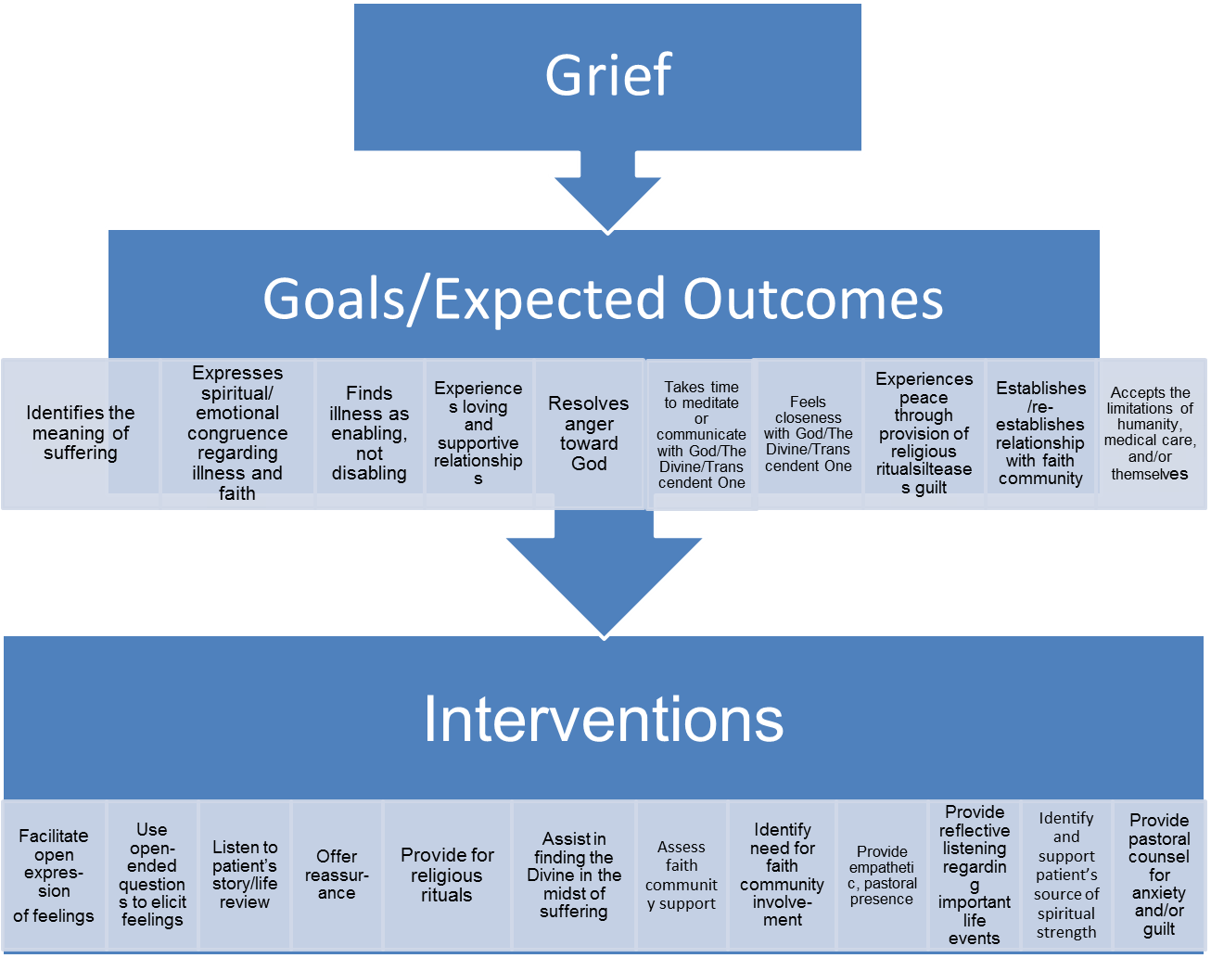

Slide 18
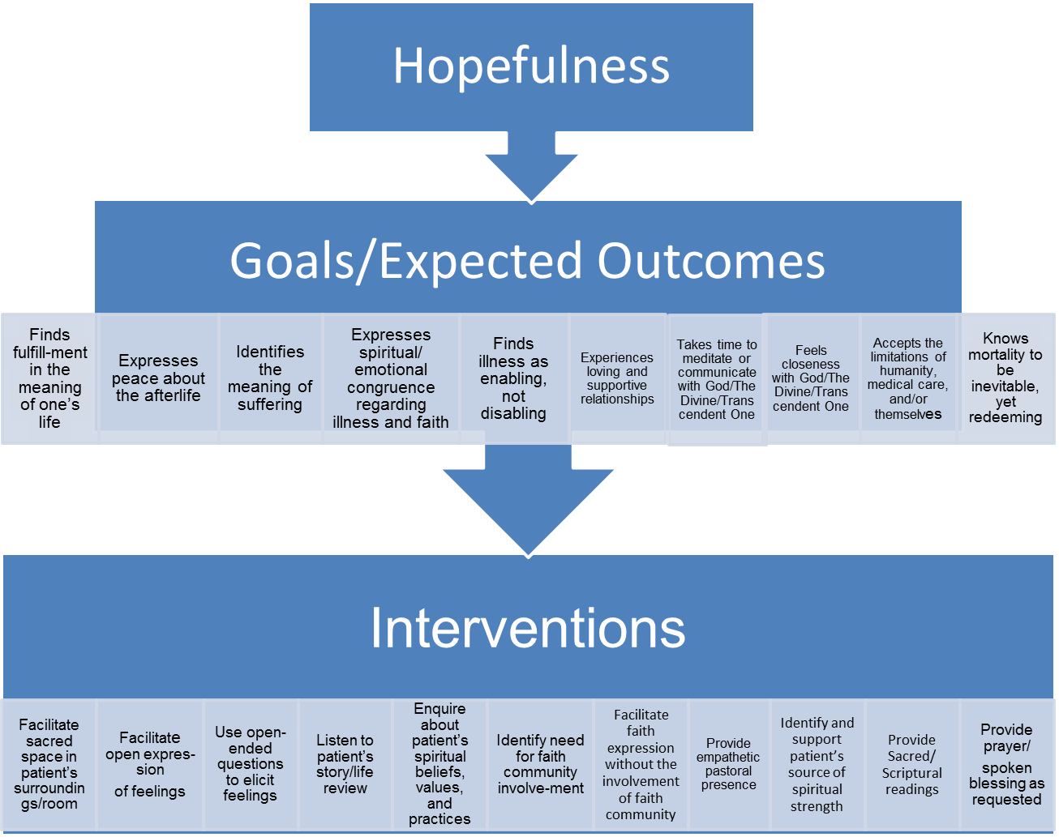

Slide 19
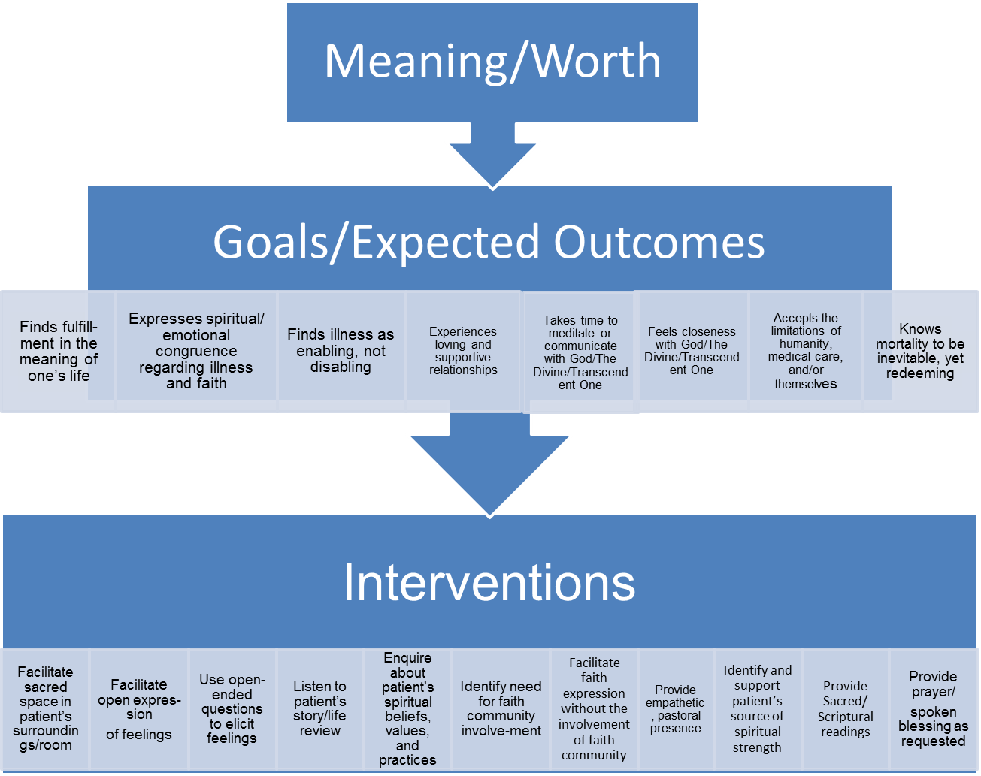

Slide 20
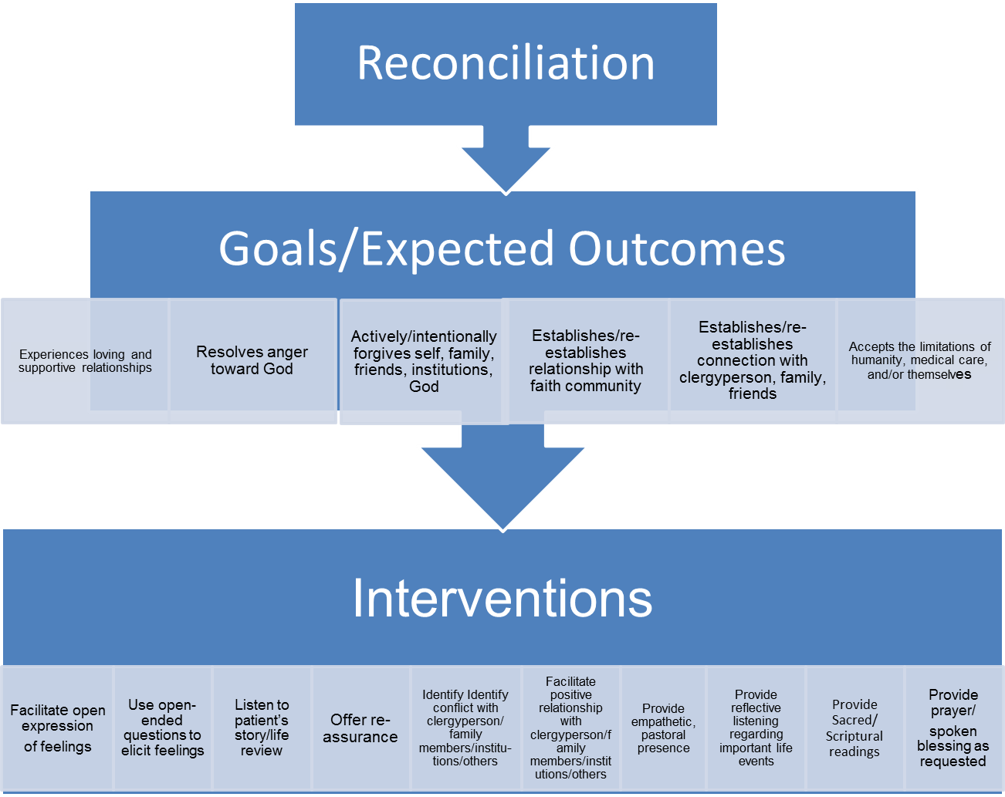

Slide 21
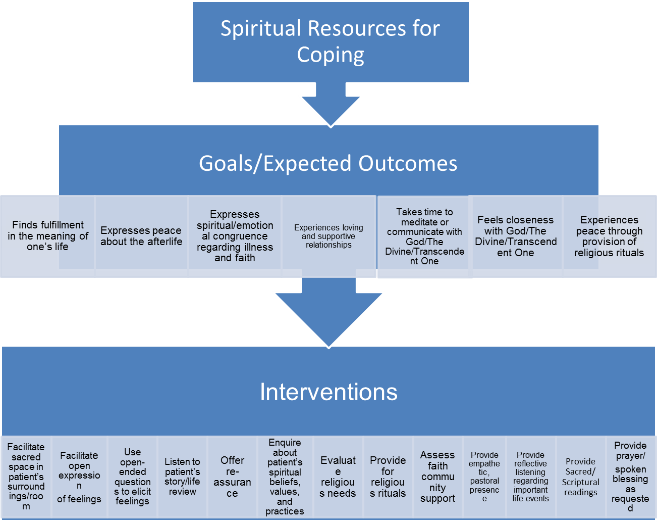

Slide 22
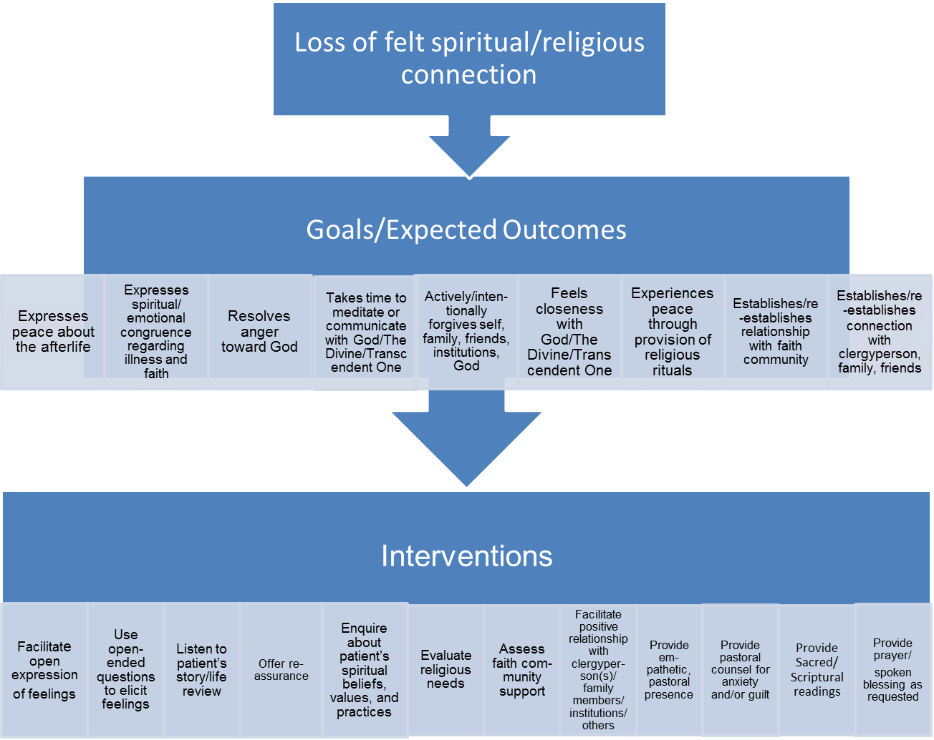

Slide 23
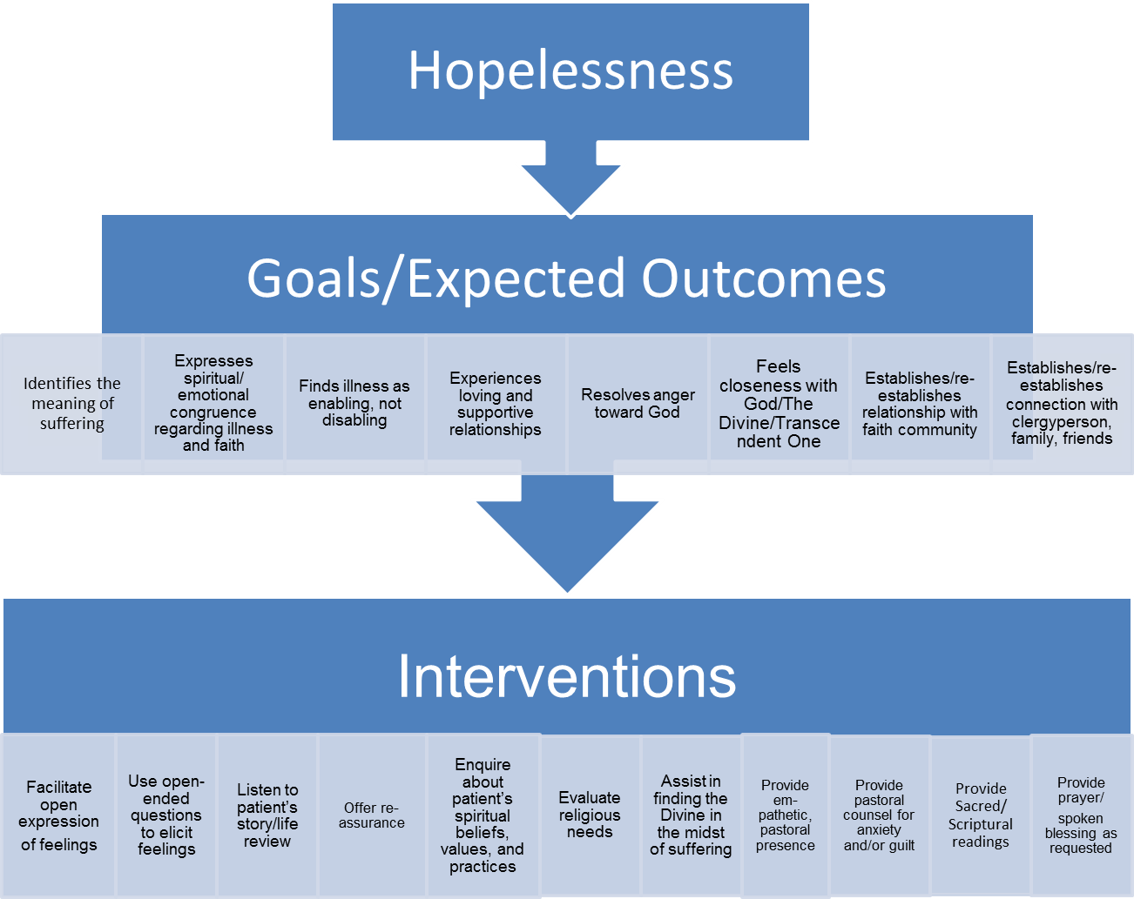

Slide 24
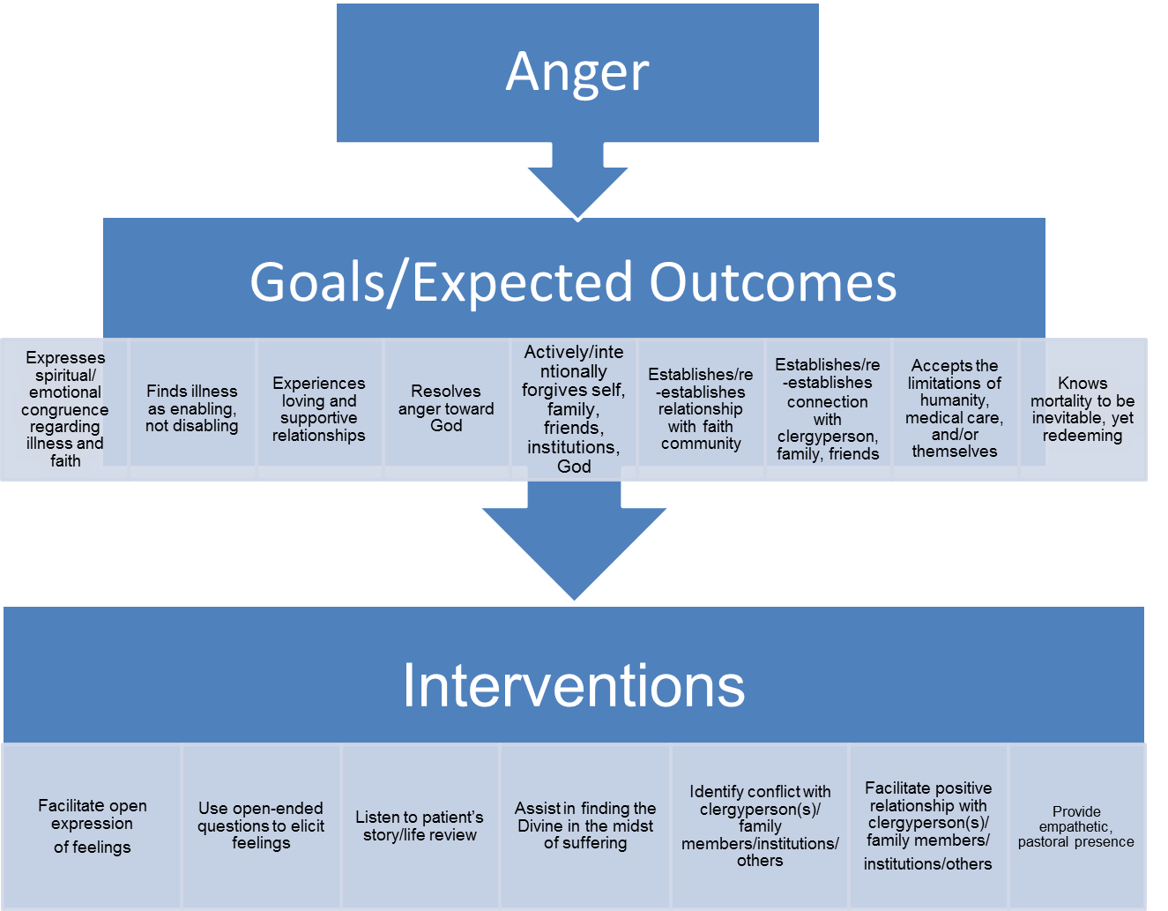

Slide 25
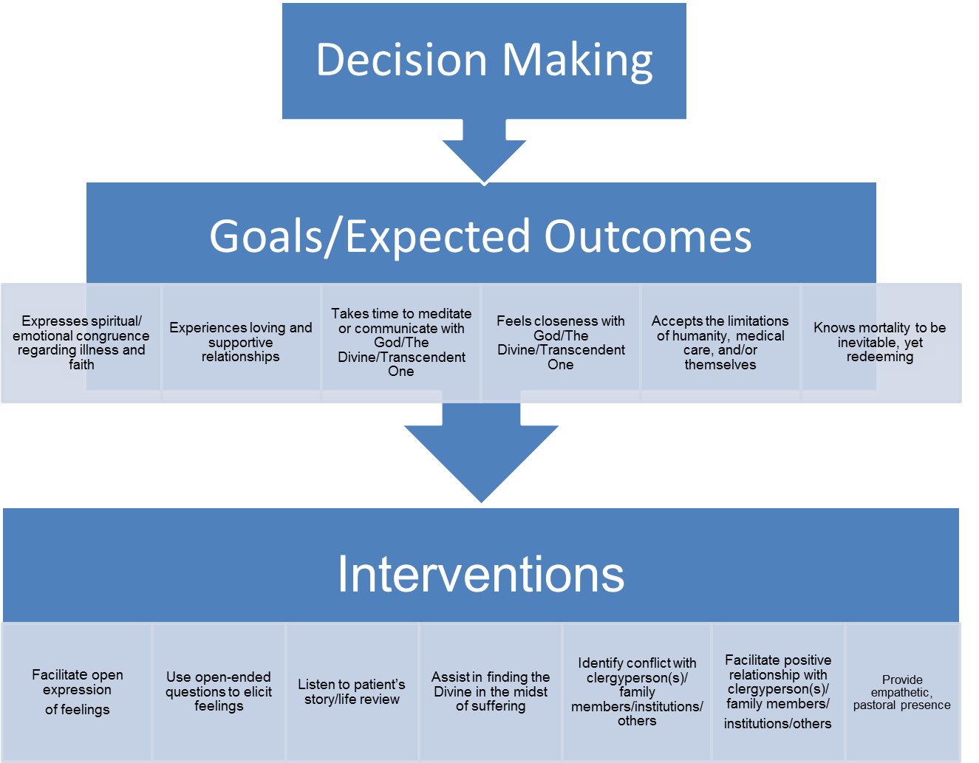

Slide 26
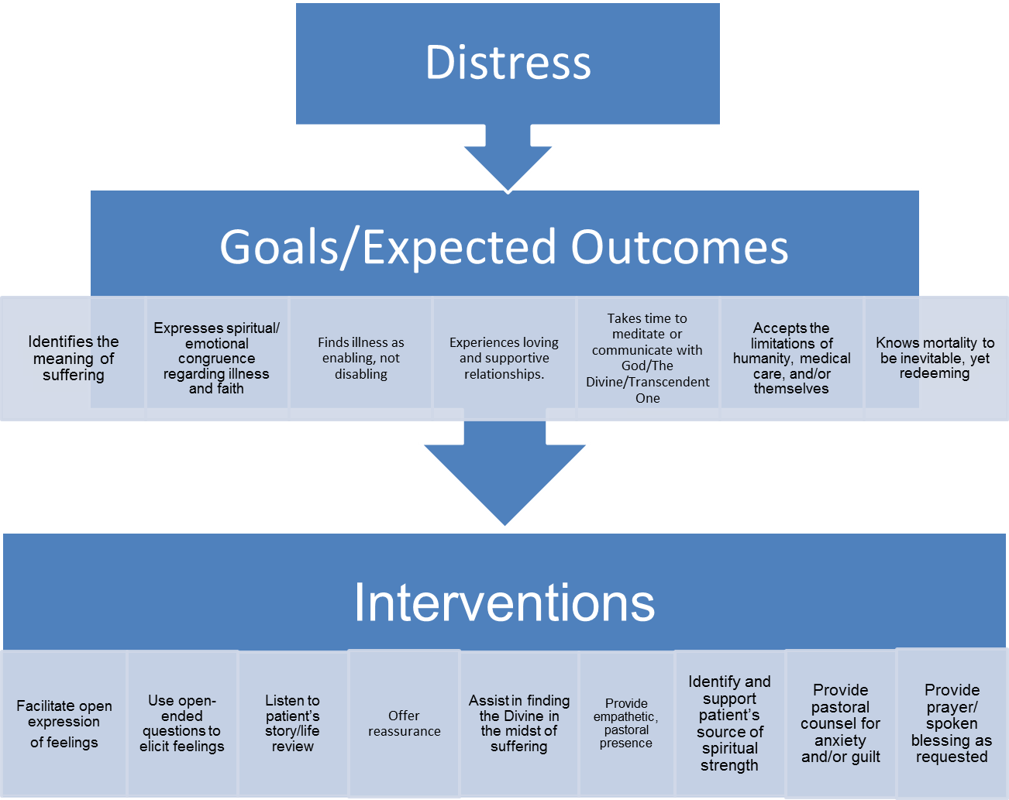

Slide 27
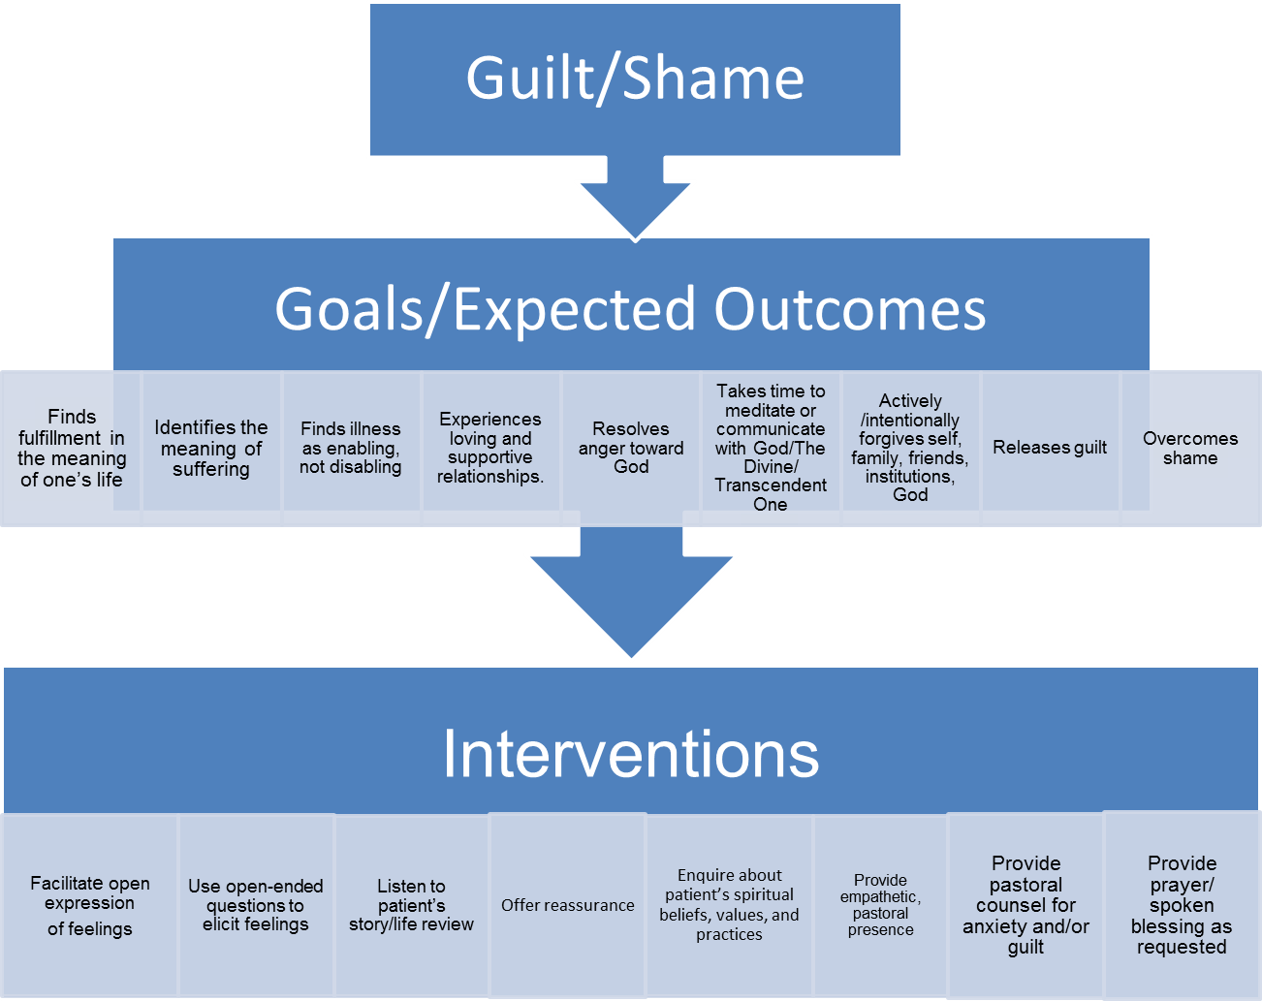

Slide 28
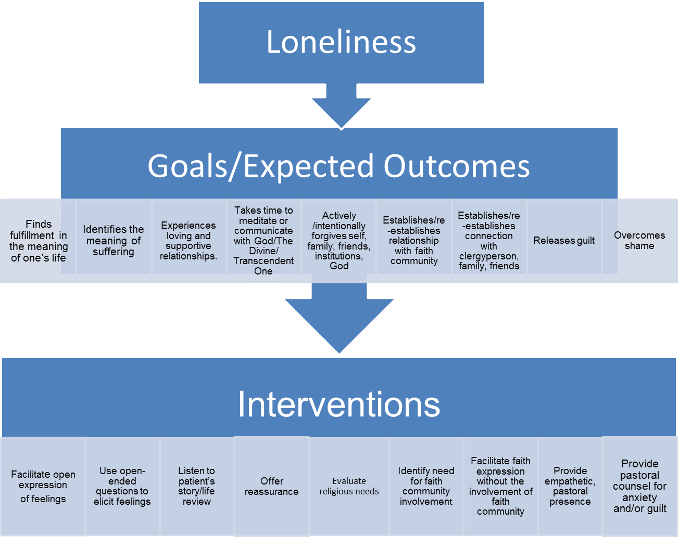

Slide 29
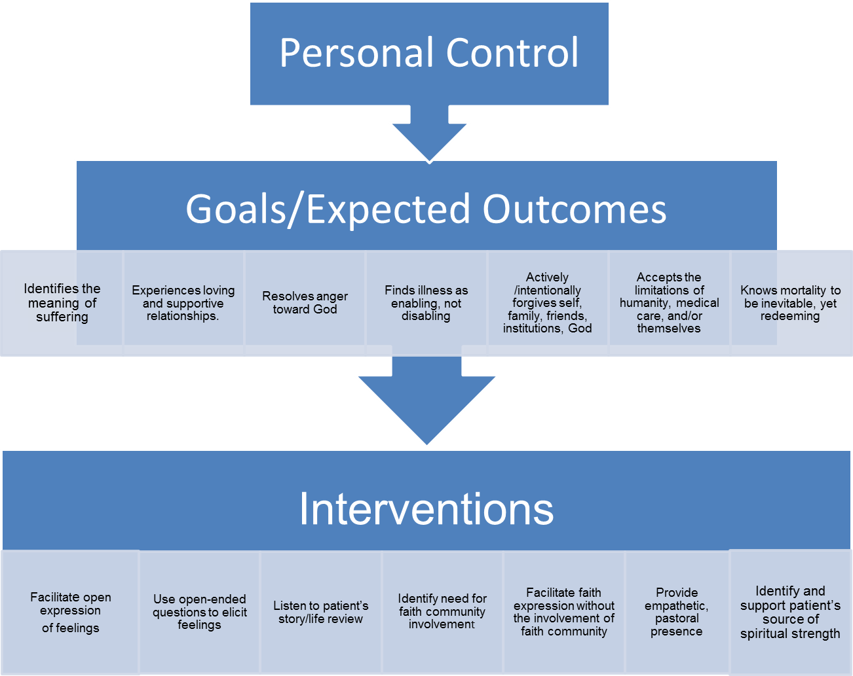

Slide 30
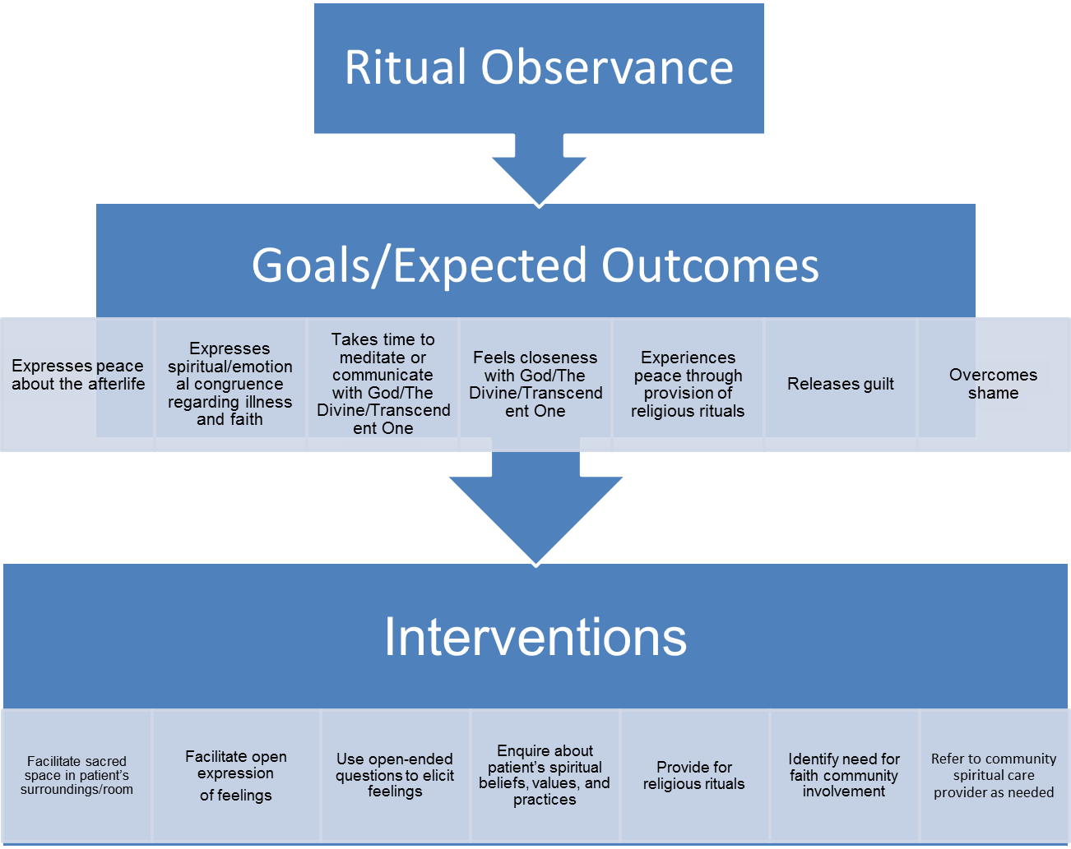

Slide 31
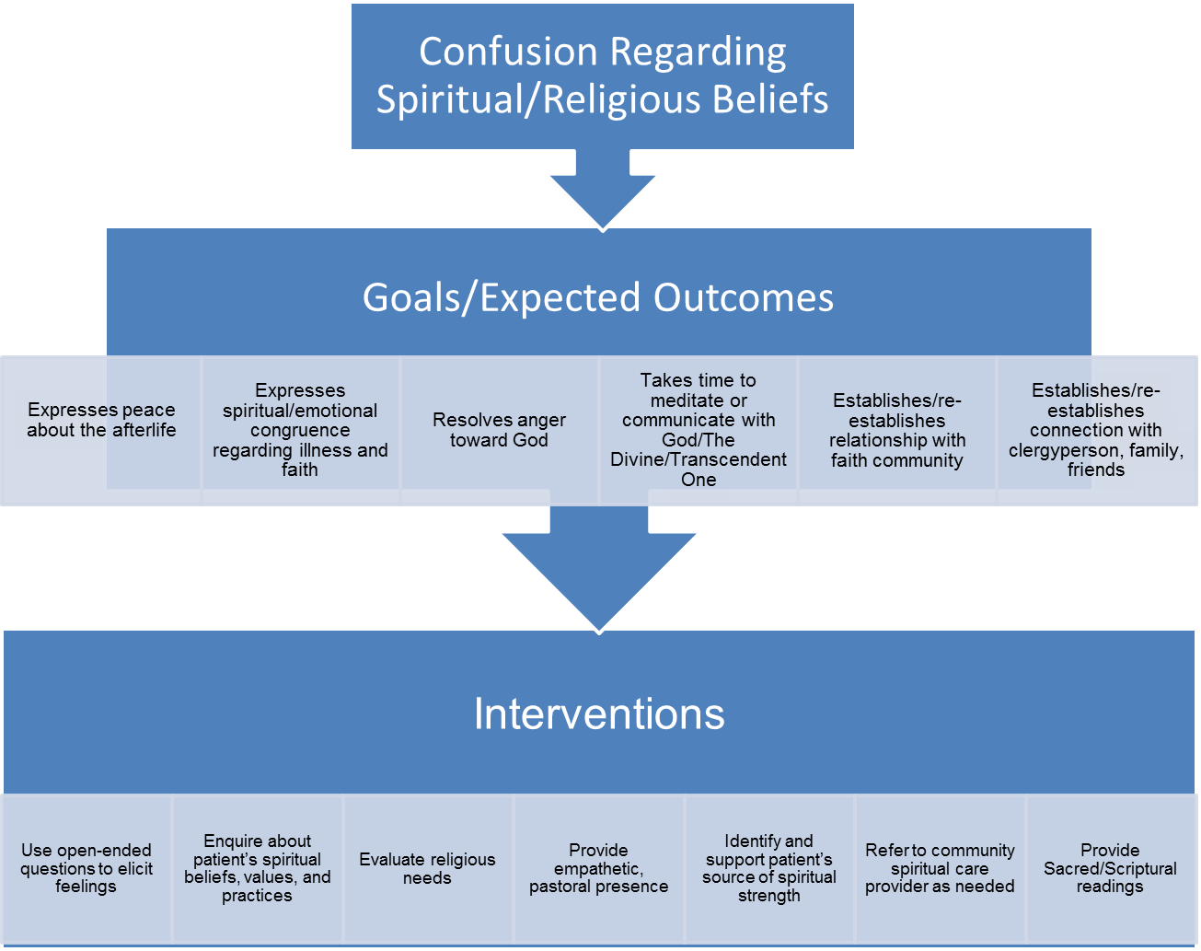

Slide 32
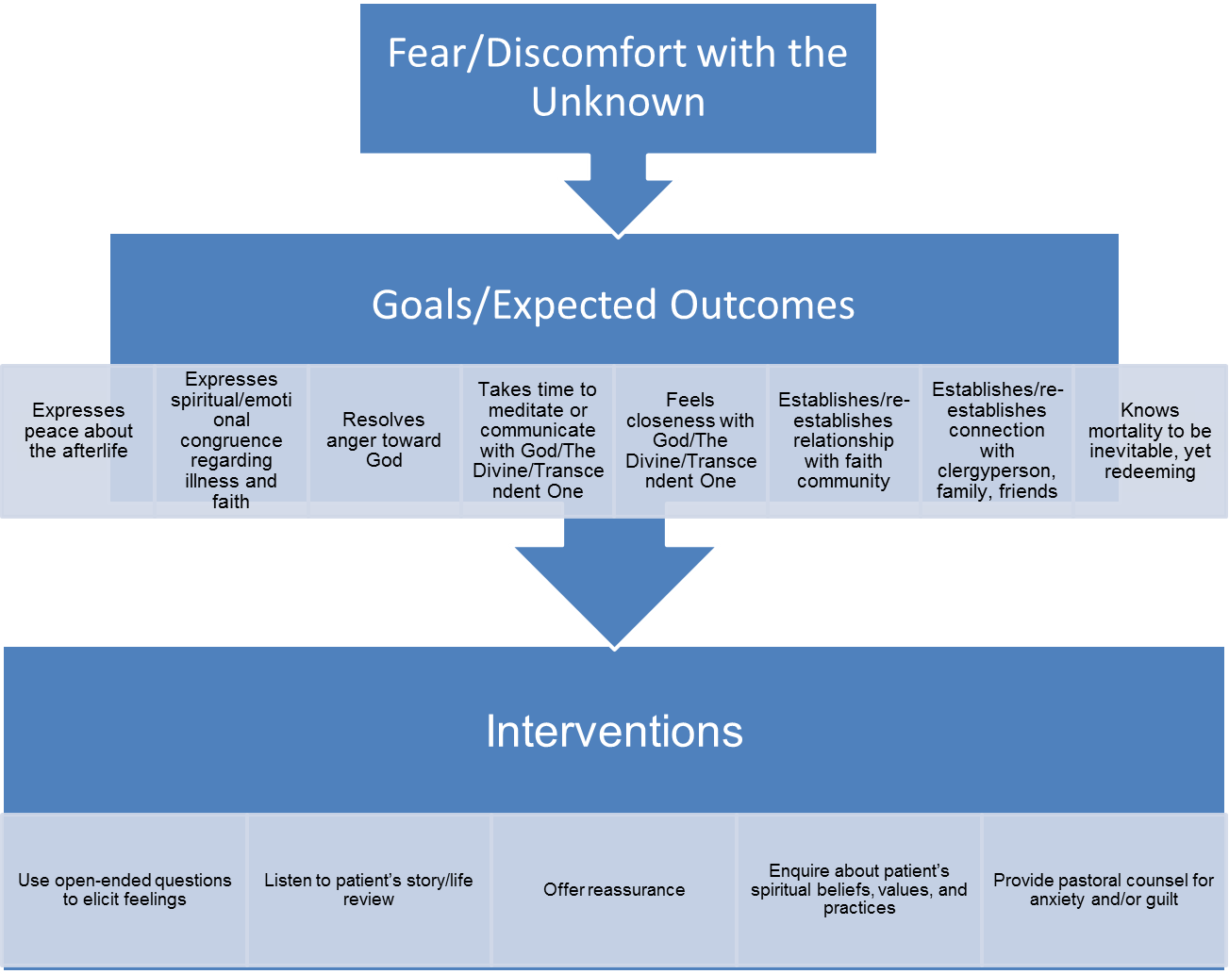

Slide 34
